Slide 1
Externalities and Public Goods
ECON 380

Slide 2
Market Equilibrium
The market supply and demand are determined by agents’ private marginal costs and benefits.
  Private Marginal Cost represents the supply curve.
  Private Marginal Benefit represents the demand curve.
At the equilibrium,
  Supply = Demand, so
  Private Marginal Cost = Private Marginal Benefit
When private marginal costs and benefits match social marginal costs and benefits, markets are efficient.

Slide 3
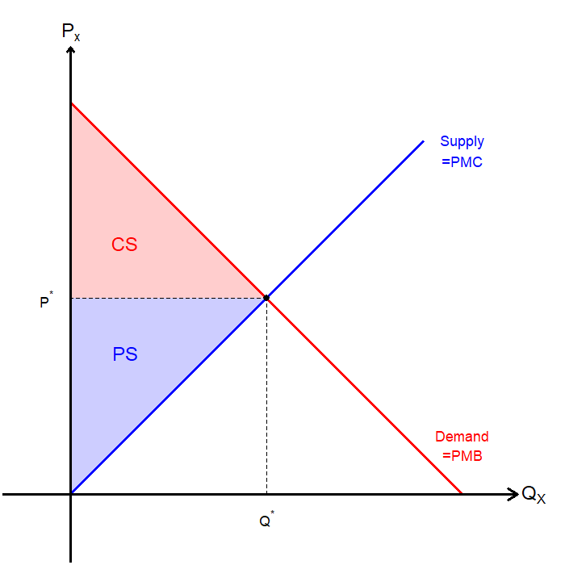
Market Equilibrium
Consumer surplus (CS) is the difference between the price and consumers’ max willingness to pay.
Producer surplus (PS) is the difference between the price and producers’ min willingness to accept.
Total surplus is the sum of CS and PS.

Slide 4
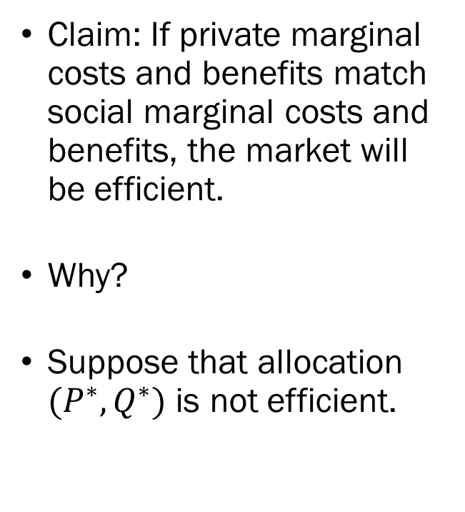
Market Equilibrium
Claim: If private marginal costs and benefits match social marginal costs and benefits, the market will be efficient.
Why?
Suppose that allocation $(P^{∗},Q^{∗})$ is not efficient.

Slide 5
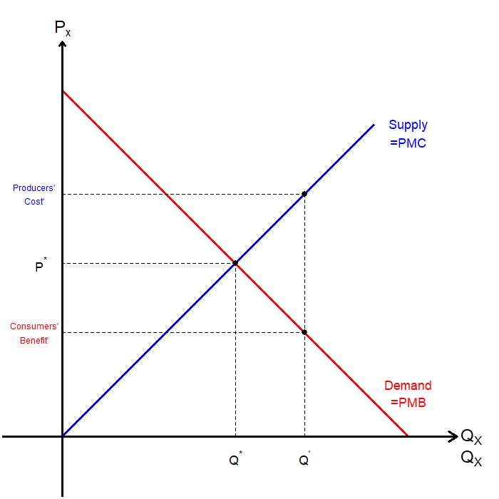
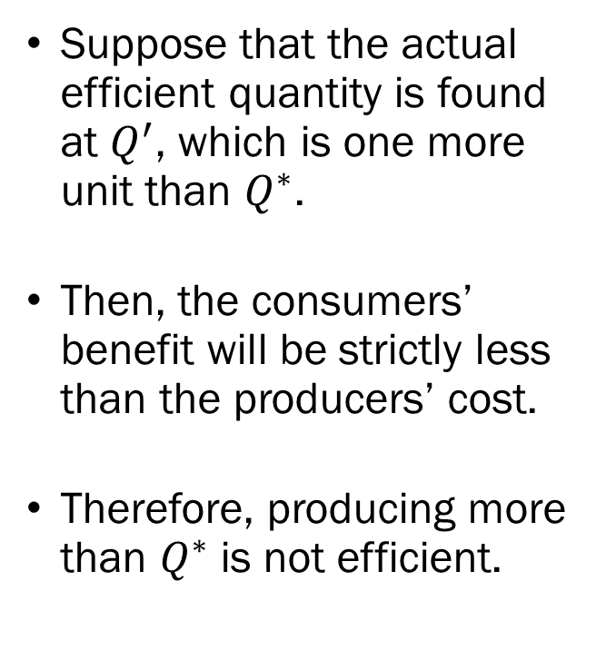
Market Equilibrium
Suppose that the actual efficient quantity is found at $Q^{′}$, which is one more unit than $Q^{∗}$.
Then, the consumers’ benefit will be strictly less than the producers’ cost.
Therefore, producing more than $Q^{∗}$ is not efficient.

Slide 6
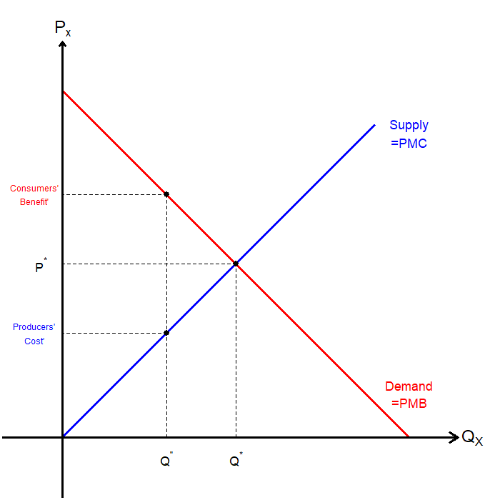
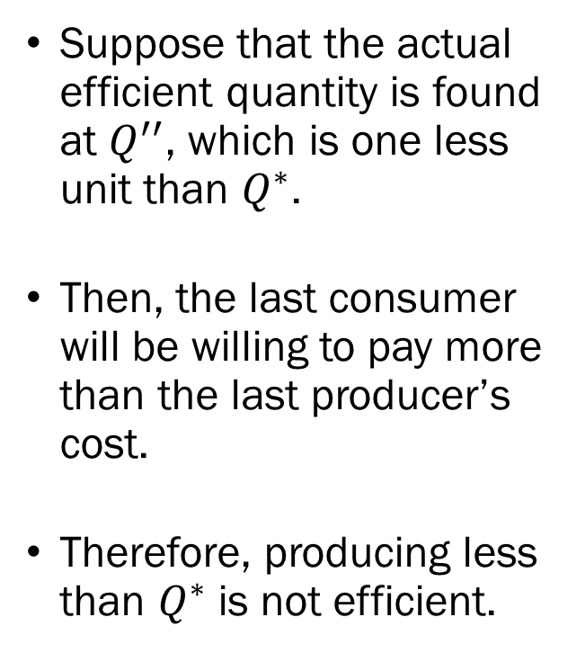
Market Equilibrium
Suppose that the actual efficient quantity is found at $Q^{′′}$, which is one less unit than $Q^{∗}$.
Then, the last consumer will be willing to pay more than the last producer’s cost.
Therefore, producing less than $Q^{∗}$ is not efficient.

Slide 7
Externalities
In the presence of externalities, the private costs and benefits no longer align with social costs and benefits.
Externalities are problematic, since there is no market for externalities, and thus are not priced.
Markets are efficient when prices accurately reflect the true value of goods and services.
Externalities drive a wedge between the private benefits and costs and social benefits and costs.

Slide 8
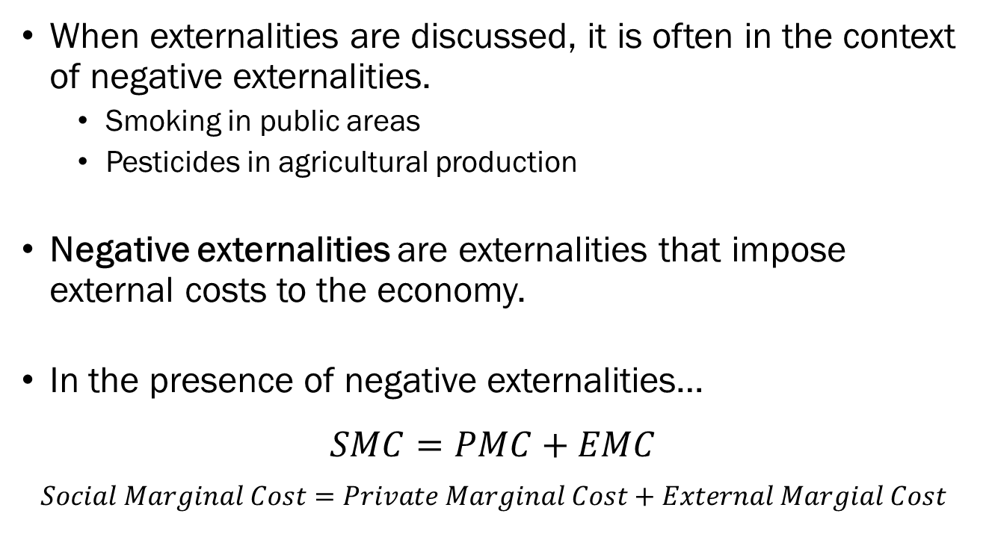
Negative Externalities
When externalities are discussed, it is often in the context of negative externalities.
  Smoking in public areas
  Pesticides in agricultural production
Negative externalities are externalities that impose external costs to the economy.
In the presence of negative externalities…
$$SMC=PMC+EMC$$
$$Social Marginal Cost=Private Marginal Cost+External Margial Cost$$

Slide 9
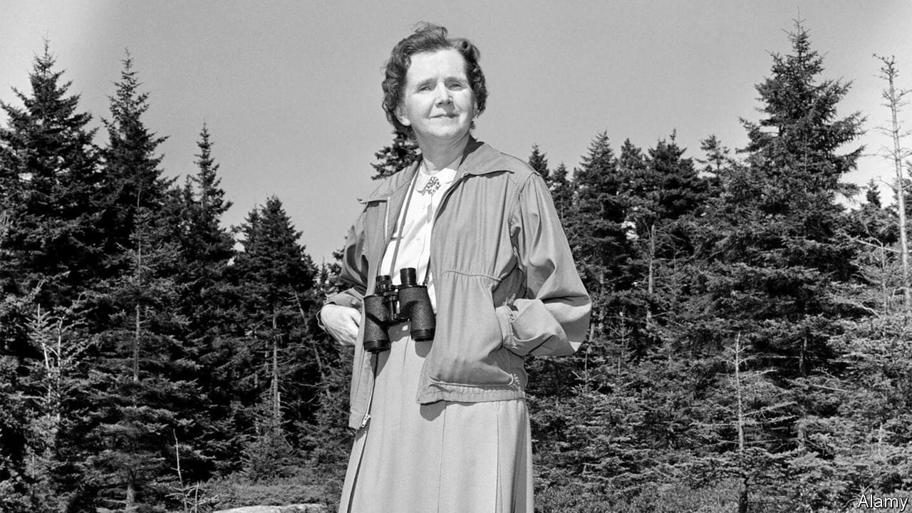
Rachel L. Carson

Slide 10

Negative Externalities

Slide 11
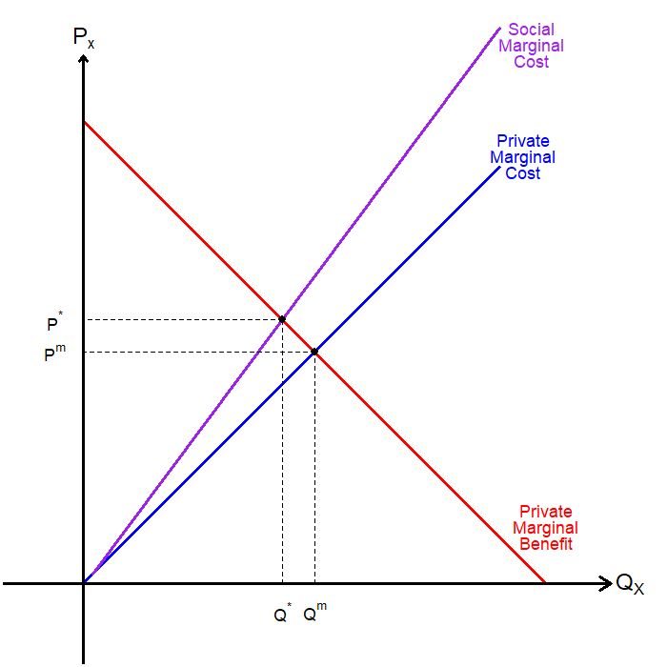
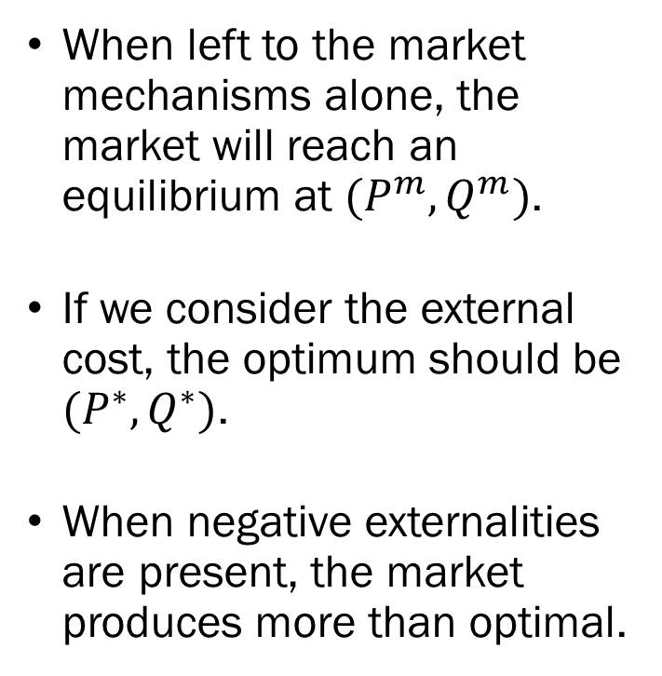
Negative Externalities
When left to the market mechanisms alone, the market will reach an equilibrium at $(P^{m},Q^{m})$.
If we consider the external cost, the optimum should be $(P^{∗},Q^{∗})$.
When negative externalities are present, the market produces more than optimal.

Slide 12
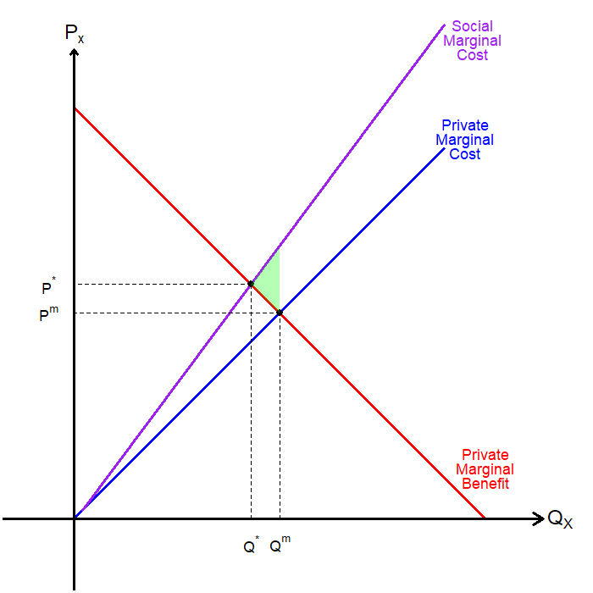
Negative Externalities
We find that the market will generate deadweight loss.
The difference between the consumers’ willingness to pay and the social cost.
Private agents do not consider external costs.
Societal loss occurs due to the unregulated externality.

Slide 13
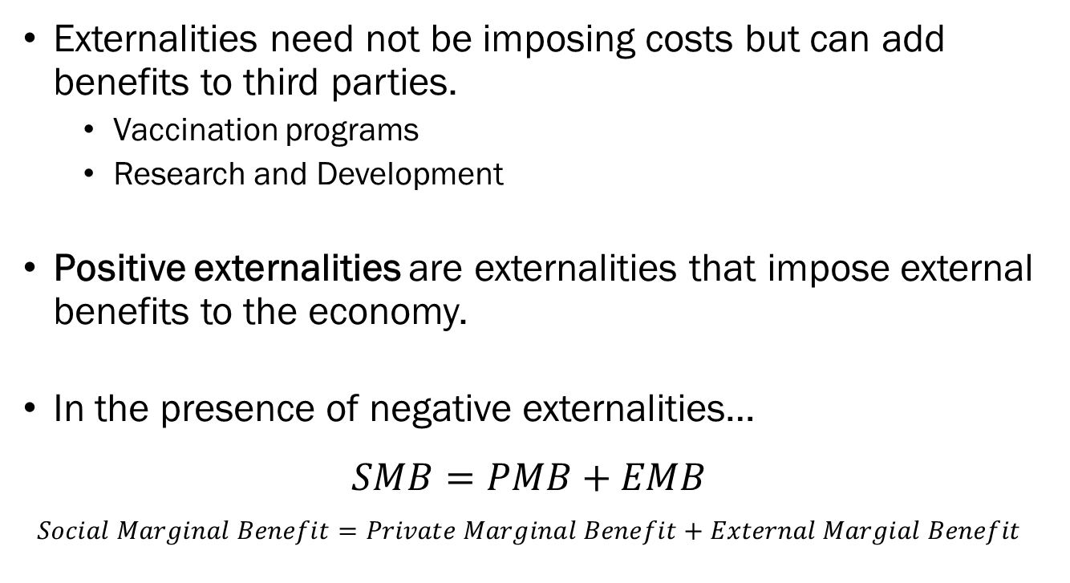
Positive Externalities
Externalities need not be imposing costs but can add benefits to third parties.
  Vaccination programs
  Research and Development
Positive externalities are externalities that impose external benefits to the economy.
In the presence of negative externalities…
$$SMB=PMB+EMB$$
$$Social Marginal Benefit=Private Marginal Benefit+External Margial Benefit$$

Slide 14

SARS-CoV-2

Slide 15

Positive Externalities

Slide 16
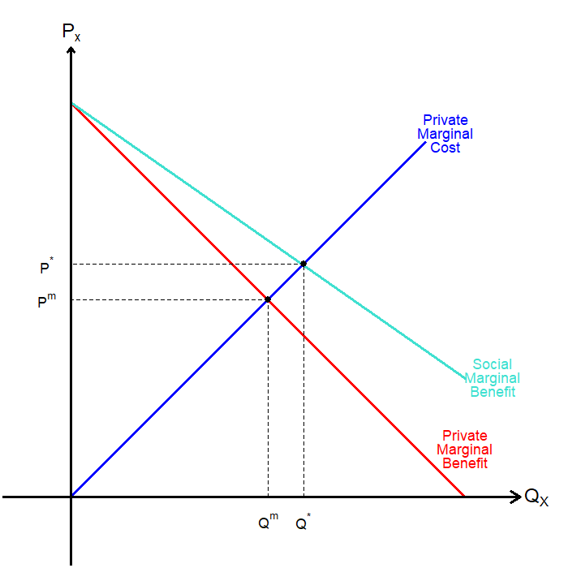
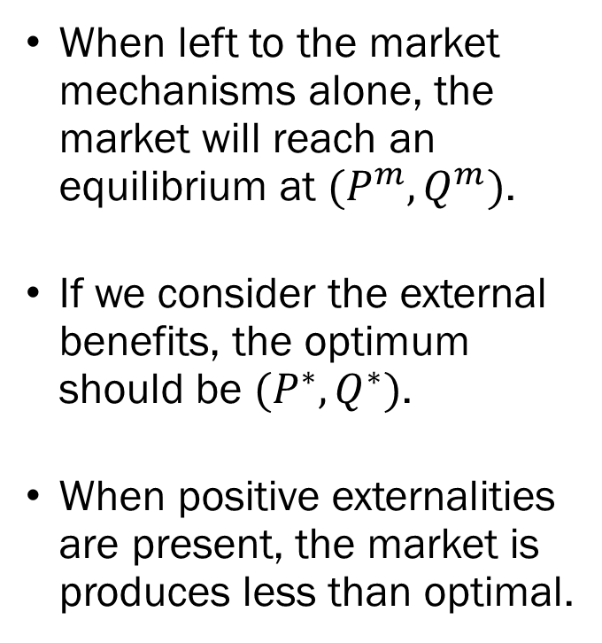
Positive Externalities
When left to the market mechanisms alone, the market will reach an equilibrium at $(P^{m},Q^{m})$.
If we consider the external benefits, the optimum should be $(P^{∗},Q^{∗})$.
When positive externalities are present, the market is produces less than optimal.

Slide 17
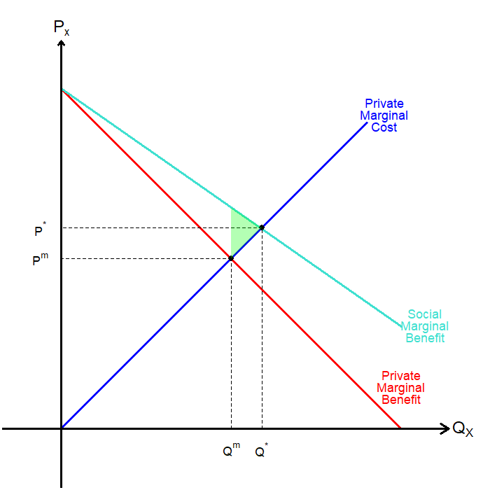
Positive Externalities
We find that the market will generate deadweight loss.
The difference between the societal marginal benefit and the social cost.
Private agents do not consider external benefits.
Societal loss occurs due to the unregulated externality.

Slide 18
Public Goods
In some cases, goods or services that are associated with large positive externalities are Public goods.
Public goods are characterized by non-excludability and non-rivalry in consumption (environmental quality?).
This leads to the free-rider problem, which is a market failure that occurs when some agents who benefit from some good / service under-pays for said good / service.
Recall that goods with positive externalities are under-supplied if left to the market.

Slide 19

Public Goods

Slide 20
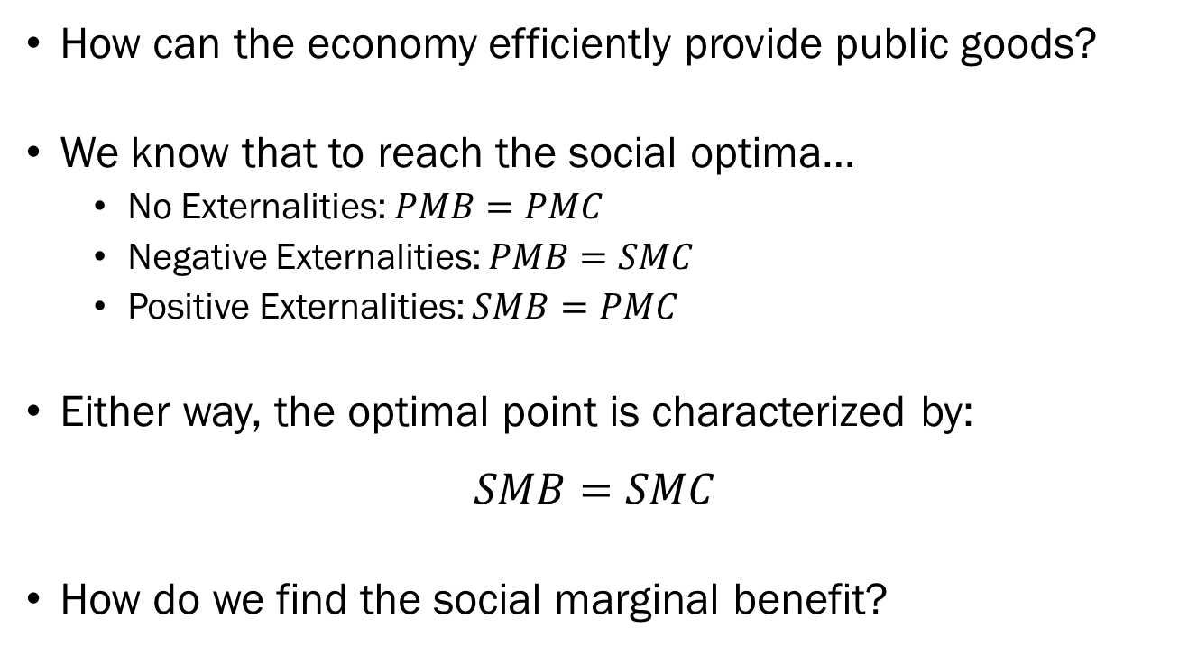
Provision of Public Goods
How can the economy efficiently provide public goods?
We know that to reach the social optima…
  No Externalities: $PMB=PMC$
  Negative Externalities: $PMB=SMC$
  Positive Externalities: $SMB=PMC$
Either way, the optimal point is characterized by:
$$SMB=SMC$$
How do we find the social marginal benefit?

Slide 21
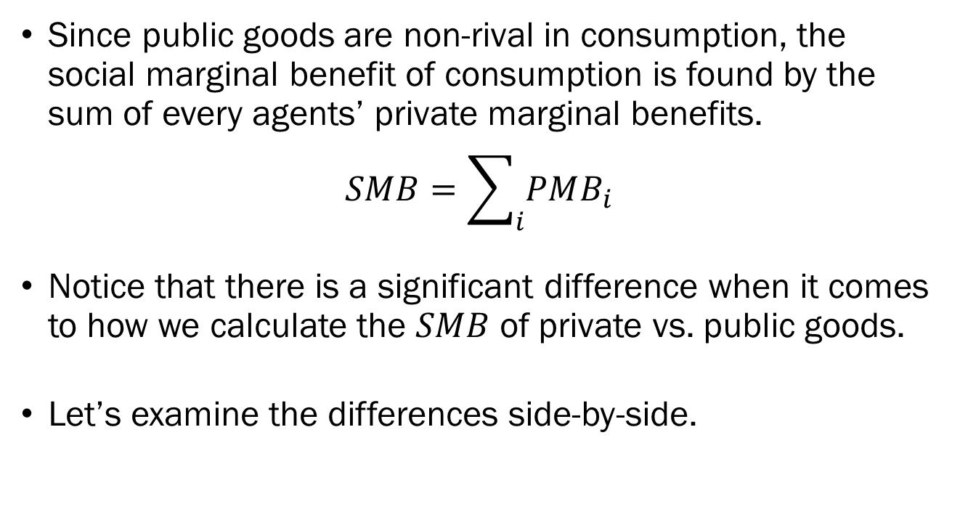
Provision of Public Goods
Since public goods are non-rival in consumption, the social marginal benefit of consumption is found by the sum of every agents’ private marginal benefits.
$$SMB=\sum_{i}{PMB_{i}}$$
Notice that there is a significant difference when it comes to how we calculate the $SMB$ of private vs. public goods.
Let’s examine the differences side-by-side.

Slide 22
Provision of Public Goods
Private Goods
Public Goods
Only one person can consume one unit.
At each price, what is the quantity demanded?
At each price, we must add up individuals’ quantity demanded.
Add demand curves horizontally.
Multiple people can consume one unit.
At each quantity, what is the total marginal benefit?
At each quantity, we must add up individuals’ PMBs.
Add demand curves vertically.

Slide 23
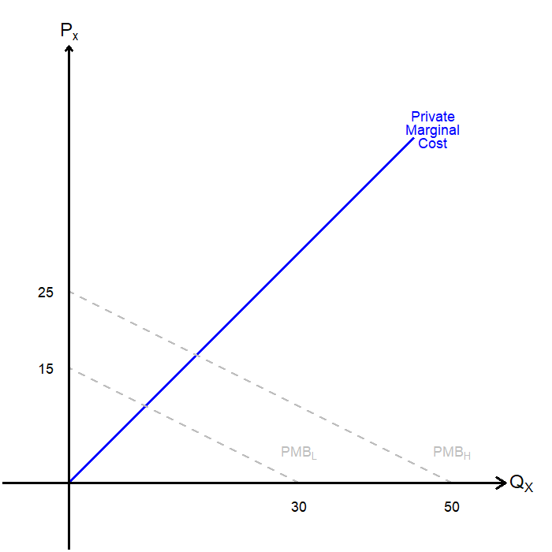
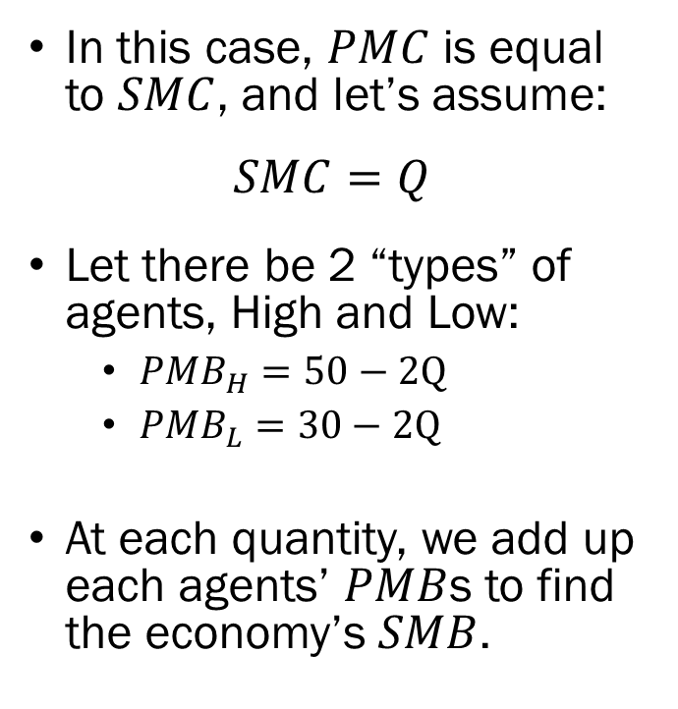
Provision of Public Goods
In this case, $PMC$ is equal to $SMC$, and let’s assume:
$$SMC=Q$$
Let there be 2 “types” of agents, High and Low:
  $PMB_{H}=50−2Q$
  $PMB_{L}=30−2Q$
At each quantity, we add up each agents’ $PMB$s to find the economy’s $SMB$.

Slide 24
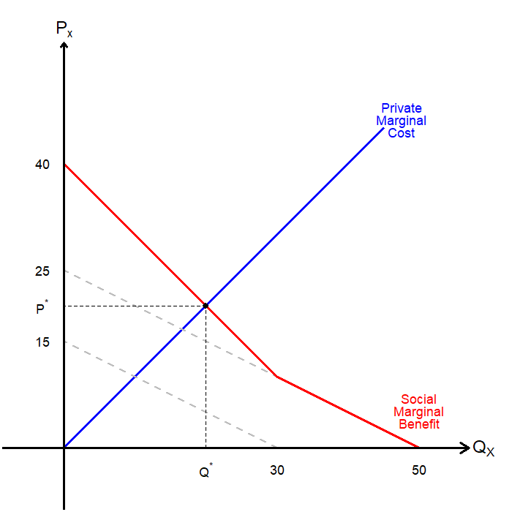
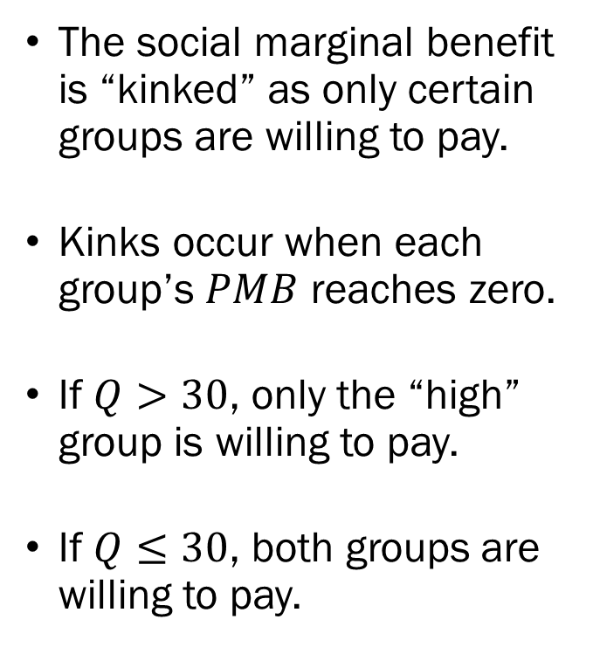
Provision of Public Goods
The social marginal benefit is “kinked” as only certain groups are willing to pay.
Kinks occur when each group’s $PMB$ reaches zero.
If $Q>30$, only the “high” group is willing to pay.
If $Q≤30$, both groups are willing to pay.

Slide 25
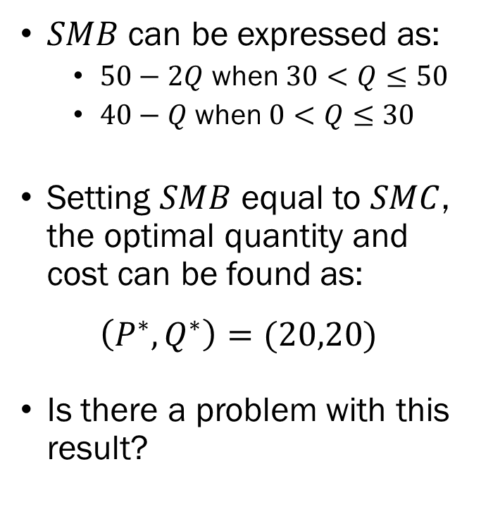
Provision of Public Goods
$SMB$ can be expressed as:
  $50−2Q$ when $30<Q≤50$
  $40−Q$ when $0<Q≤30$
Setting $SMB$ equal to $SMC$, the optimal quantity and cost can be found as:
$$\left(P^{∗},Q^{∗}\right)=(20,20)$$
Is there a problem with this result?

Slide 26
Provision of Public Goods
Neither party is willing to purchase the socially optimal quantity on their own.
The marginal cost of provision is also 20, which is greater than any individual group’s maximum willingness to pay.
The social planner (government) must provide the good.
Then how does the social planner finance the cost of providing the public good?

Slide 27
Provision of Public Goods
Lindahl, Vickrey-Clarke-Groves
  Each group pays equivalent to their private marginal benefit.
  Requires the social planner to have complete information on each agents’ utility functions. (highly unlikely)
Assurance contracts
  Each agent commits to spend a certain amount, conditional on the total funding being sufficient to provide said good.
  If total funding falls short, the commitment is refunded.
Lotteries

