Slide 1
Producer Theory:
Production Technology
ECON 300

Slide 2
Production
We covered consumer theory in three large “parts.”
  Examined the consumer’s budget constraint.
  Model the consumer’s preferences.
  Combined the two parts to find the utility maximizing consumer’s choice.
The producer’s theory also consists of three large “parts.”
  Model the producer’s production technology.
  Account for costs of production.
  Determine the optimal mix of inputs for production.
We start by talking about production technology.

Slide 3
Production
Suppose that we want to become producers of Monmouth College branded pencils.
Ignoring production costs for a moment, what are some questions we need to answer?
What are the required inputs?
How do we combine these inputs to create output?
How much of each input do we need?

Slide 4
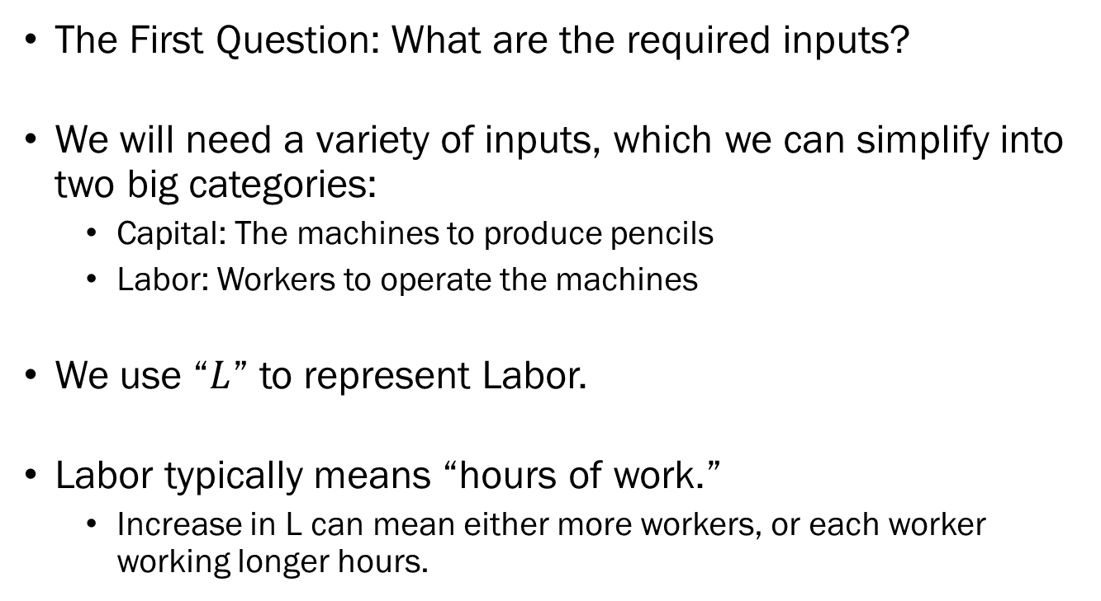
Factors of Production
The First Question: What are the required inputs?
We will need a variety of inputs, which we can simplify into two big categories:
  Capital: The machines to produce pencils
  Labor: Workers to operate the machines
We use “$L$” to represent Labor.
Labor typically means “hours of work.”
  Increase in L can mean either more workers, or each worker working longer hours.

Slide 5

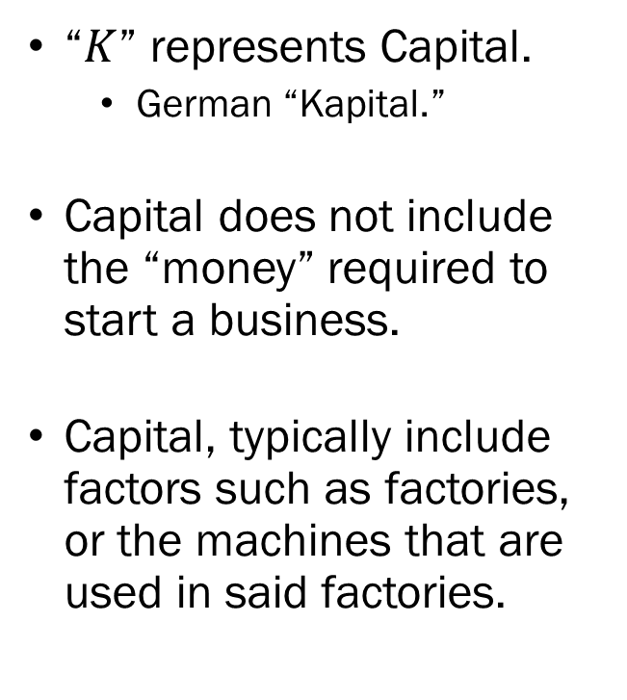
Factors of Production
“$K$” represents Capital.
  German “Kapital.”
Capital does not include the “money” required to start a business.
Capital, typically include factors such as factories, or the machines that are used in said factories.

Slide 6
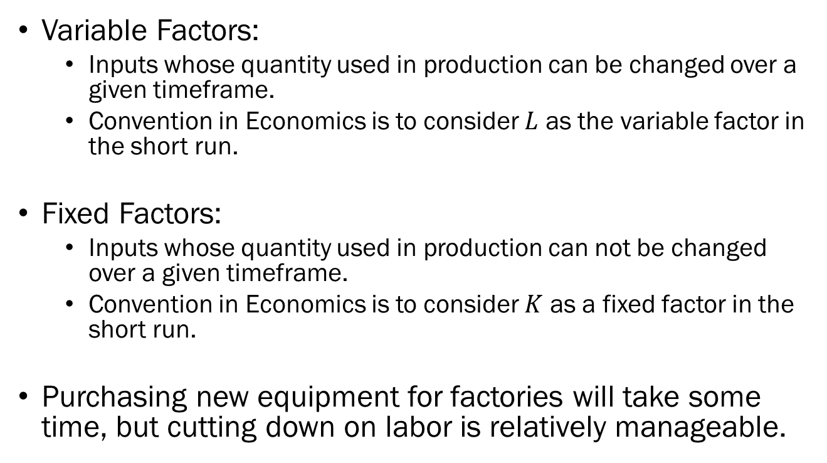
Variable vs. Fixed Factors
Variable Factors:
  Inputs whose quantity used in production can be changed over a given timeframe.
  Convention in Economics is to consider $L$ as the variable factor in the short run.
Fixed Factors:
  Inputs whose quantity used in production can not be changed over a given timeframe.
  Convention in Economics is to consider $K$ as a fixed factor in the short run.
Purchasing new equipment for factories will take some time, but cutting down on labor is relatively manageable.

Slide 7
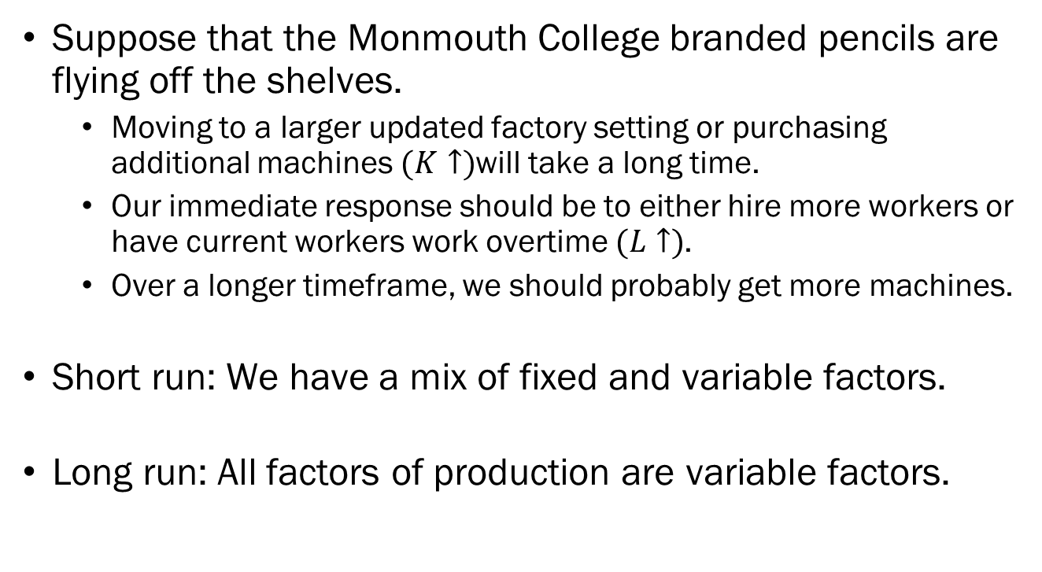
Short vs. Long Run
Suppose that the Monmouth College branded pencils are flying off the shelves.
  Moving to a larger updated factory setting or purchasing additional machines $(K↑)$will take a long time.
  Our immediate response should be to either hire more workers or have current workers work overtime $(L↑)$.
  Over a longer timeframe, we should probably get more machines.
Short run: We have a mix of fixed and variable factors.
Long run: All factors of production are variable factors.

Slide 8
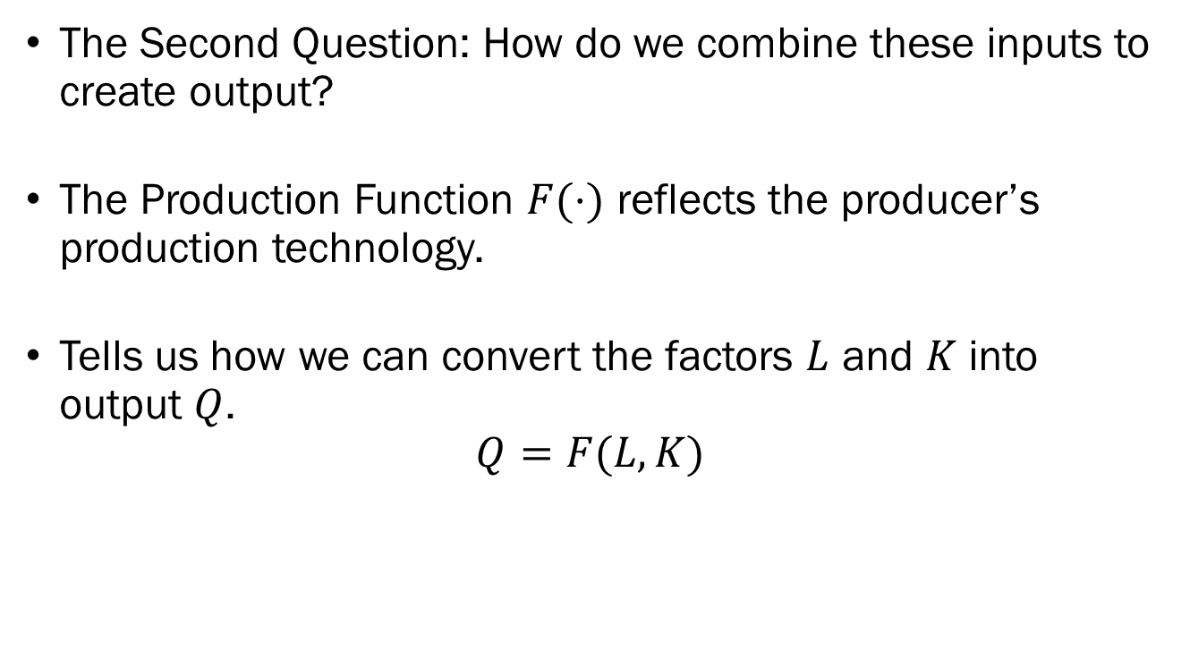
Production Function
The Second Question: How do we combine these inputs to create output?
The Production Function $F(⋅)$ reflects the producer’s production technology.
Tells us how we can convert the factors $L$ and $K$ into output $Q$.
$$Q=F(L,K)$$

Slide 9
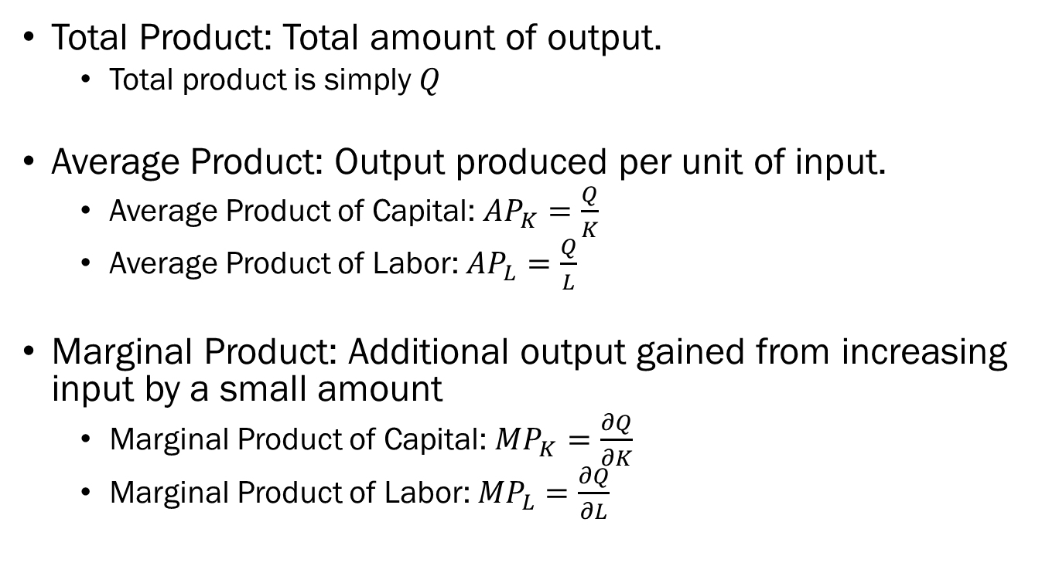
Production Function
Total Product: Total amount of output.
  Total product is simply $Q$
Average Product: Output produced per unit of input.
  Average Product of Capital: $AP_{K}=\frac{Q}{K}$
  Average Product of Labor: ${AP}_{L}=\frac{Q}{L}$
Marginal Product: Additional output gained from increasing input by a small amount
  Marginal Product of Capital: $MP_{K}=\frac{∂Q}{∂K}$
  Marginal Product of Labor: ${MP}_{L}=\frac{∂Q}{∂L}$

Slide 10
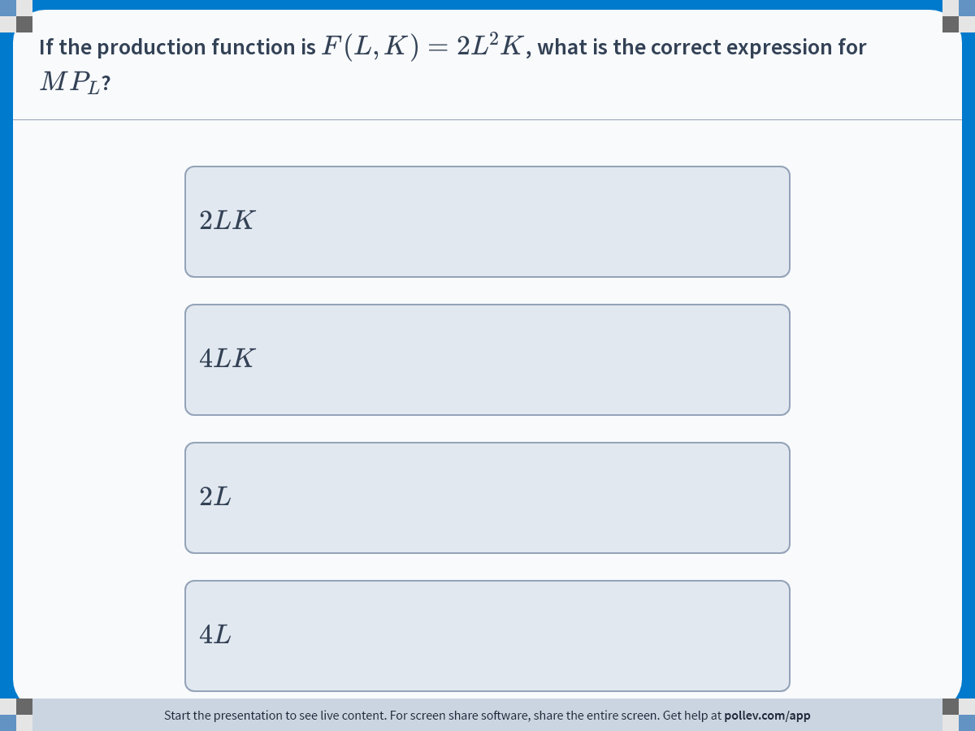
Notes:
Poll Title: Do not modify the notes in this section to avoid tampering with the Poll Everywhere activity.
More info at polleverywhere.com/support
If the production function is $$F(L,K)=2L^2K$$, what is the correct expression for $$MP_L$$?
https://www.polleverywhere.com/multiple_choice_polls/9mjs5QteI5GkBSftzPQ3d?display_state=instructions&activity_state=opened&state=opened&flow=Engagement&onscreen=persist

Slide 11
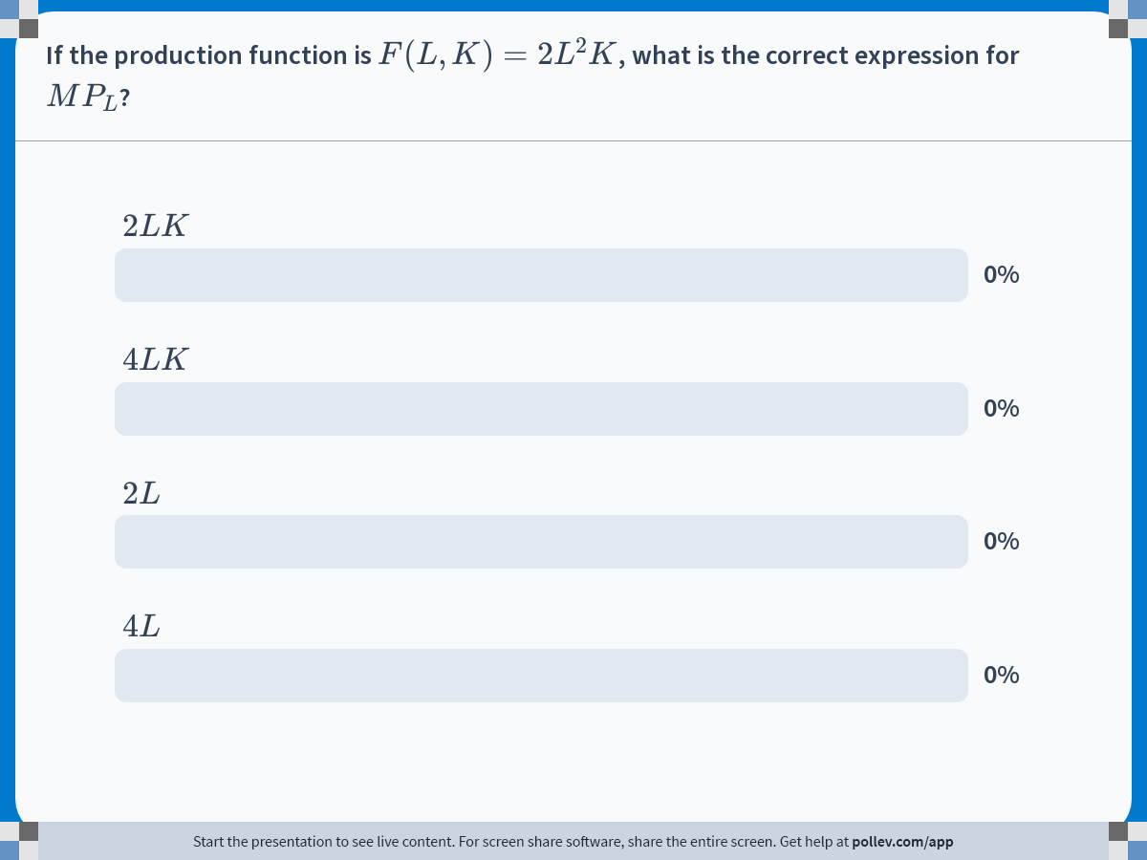
Notes:
Poll Title: Do not modify the notes in this section to avoid tampering with the Poll Everywhere activity.
More info at polleverywhere.com/support
If the production function is $$F(L,K)=2L^2K$$, what is the correct expression for $$MP_L$$?
https://www.polleverywhere.com/multiple_choice_polls/9mjs5QteI5GkBSftzPQ3d?display_state=chart&activity_state=closed&state=closed&flow=Engagement&onscreen=persist

Slide 12
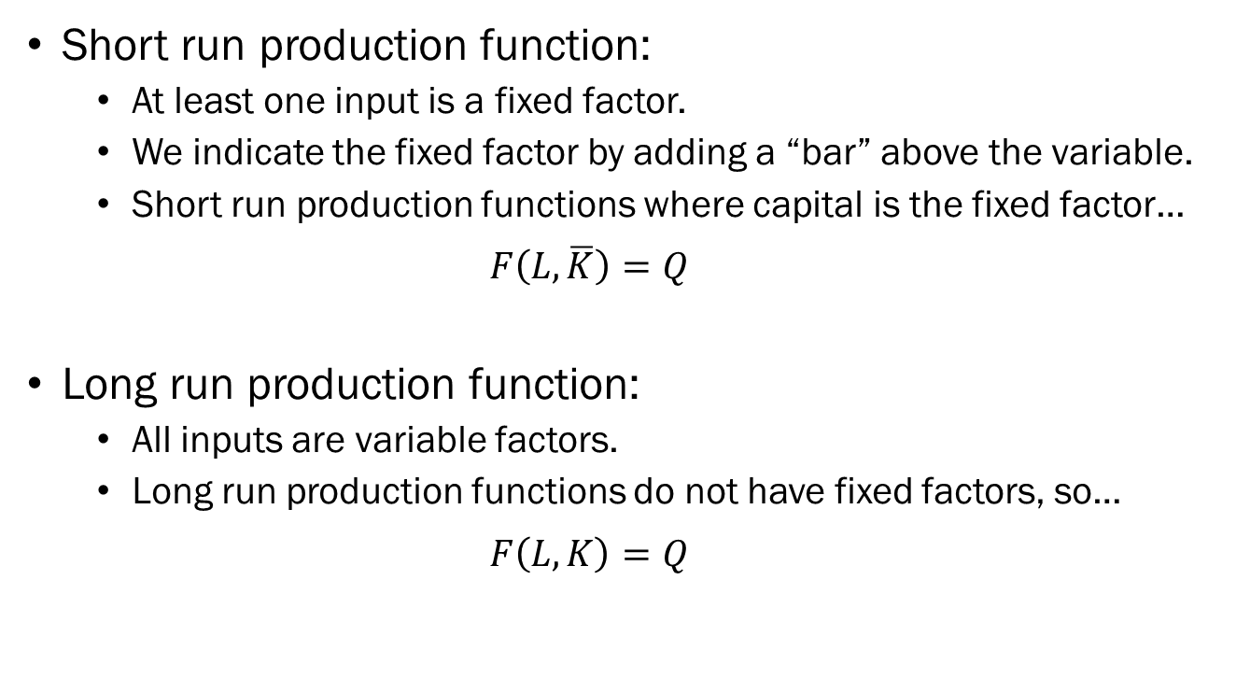
Production Function
Short run production function:
  At least one input is a fixed factor.
  We indicate the fixed factor by adding a “bar” above the variable.
  Short run production functions where capital is the fixed factor…
  $$F\left(L,\overline{K}\right)=Q$$
Long run production function:
  All inputs are variable factors.
  Long run production functions do not have fixed factors, so…
  $$F\left(L,K\right)=Q$$

Slide 13

Total Product, Average Product, and Marginal Product
Suppose we are in a Zombie apocalypse scenario.
Your task is to determine whether to accept or deny new survivors to join your group.
Since you have a self-sustaining farm, you only care about how much ammunition the applicant will bring with them.
$TP$: Total Rounds of Ammunition in the Group.
$AP$: Average Rounds of Ammunition per Individual.
$MP$: The Amount of Ammunition a newcomer supplies.

Slide 14
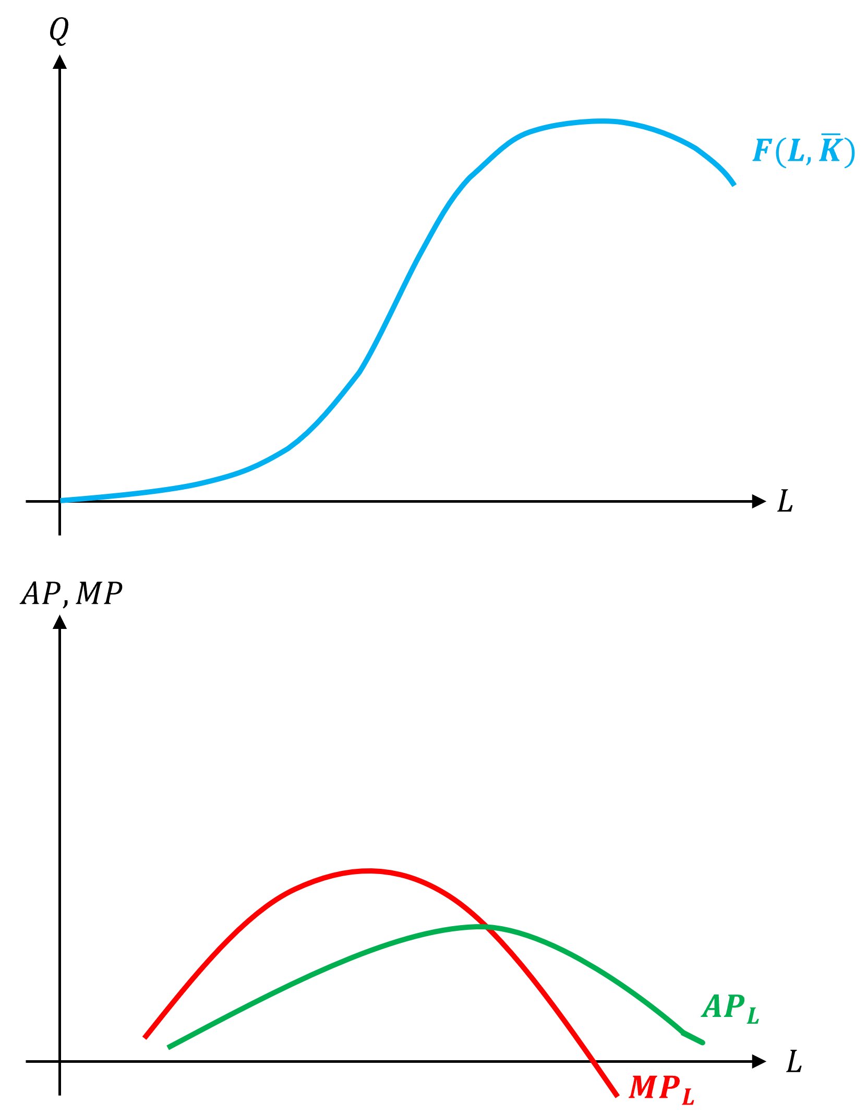
Total Product, Average Product, and Marginal Product
Assume that we are in the short run, and capital is fixed at some level.
Total product is plotted on top, and below it the average and marginal products.
Observe the relationship between these three concepts.

Slide 15
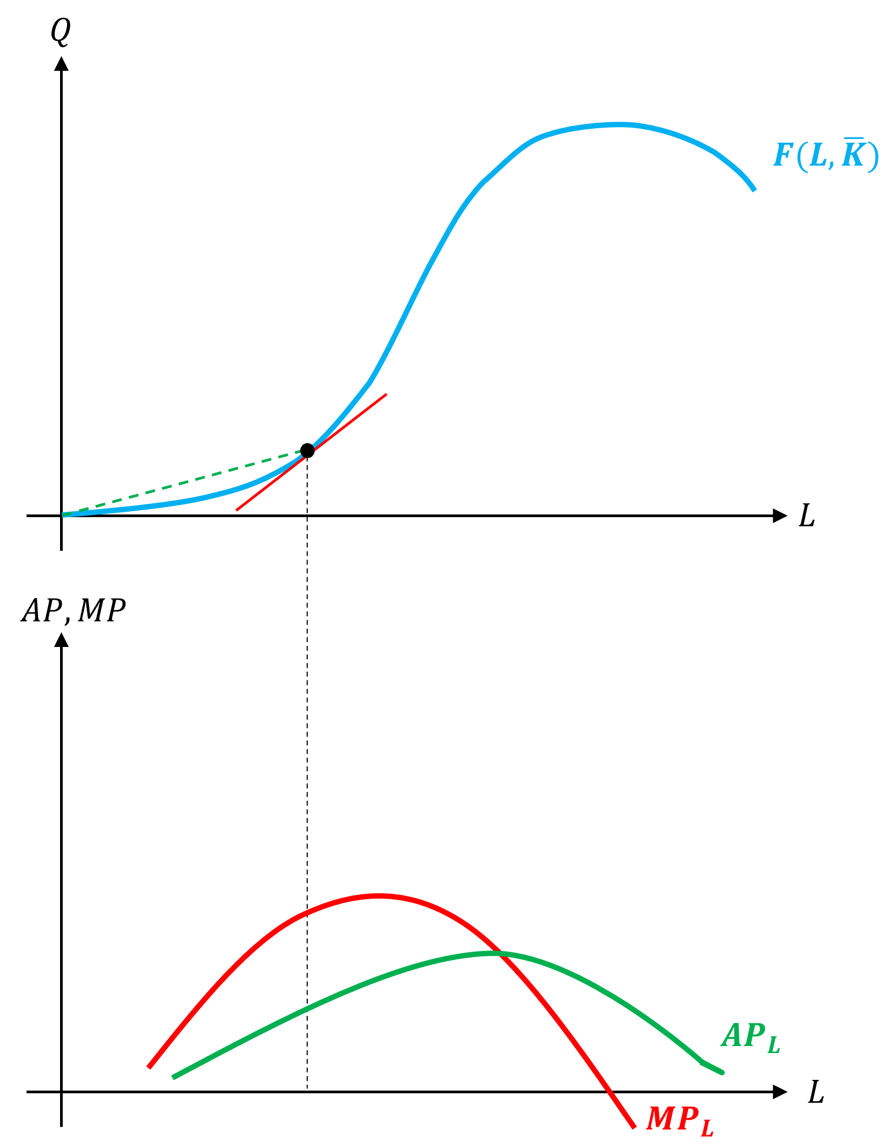
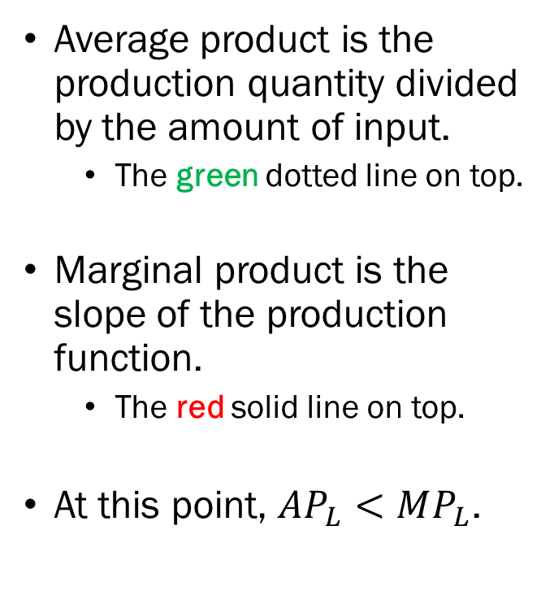
Total Product, Average Product, and Marginal Product
Average product is the production quantity divided by the amount of input.
  The green dotted line on top.
Marginal product is the slope of the production function.
  The red solid line on top.
At this point, $AP_{L}<MP_{L}$.

Slide 16
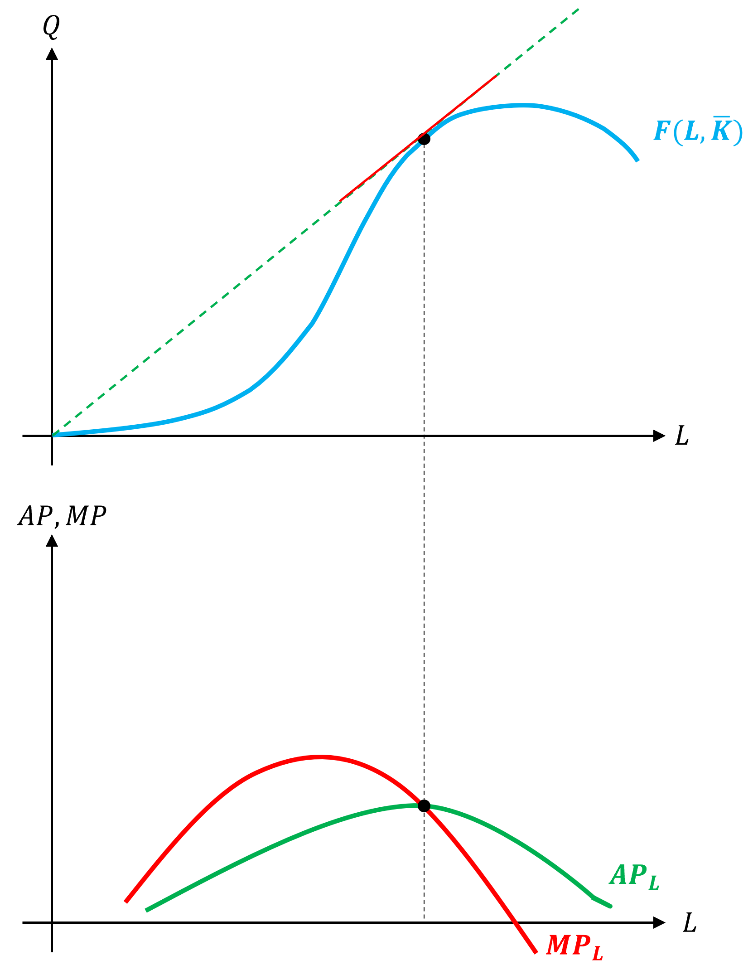
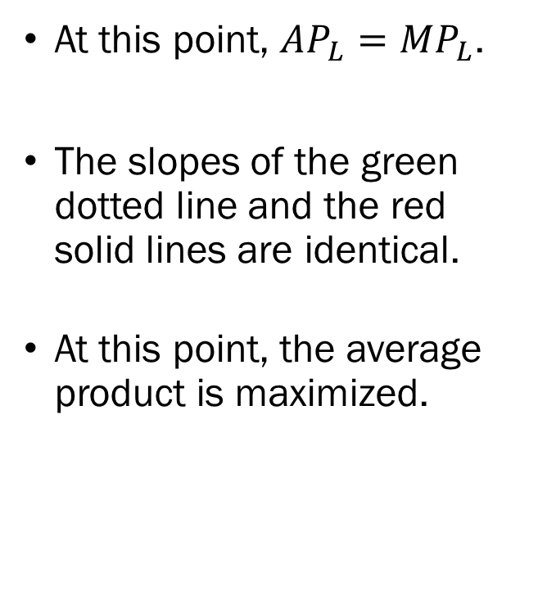
Total Product, Average Product, and Marginal Product
At this point, $AP_{L}=MP_{L}$.
The slopes of the green dotted line and the red solid lines are identical.
At this point, the average product is maximized.

Slide 17
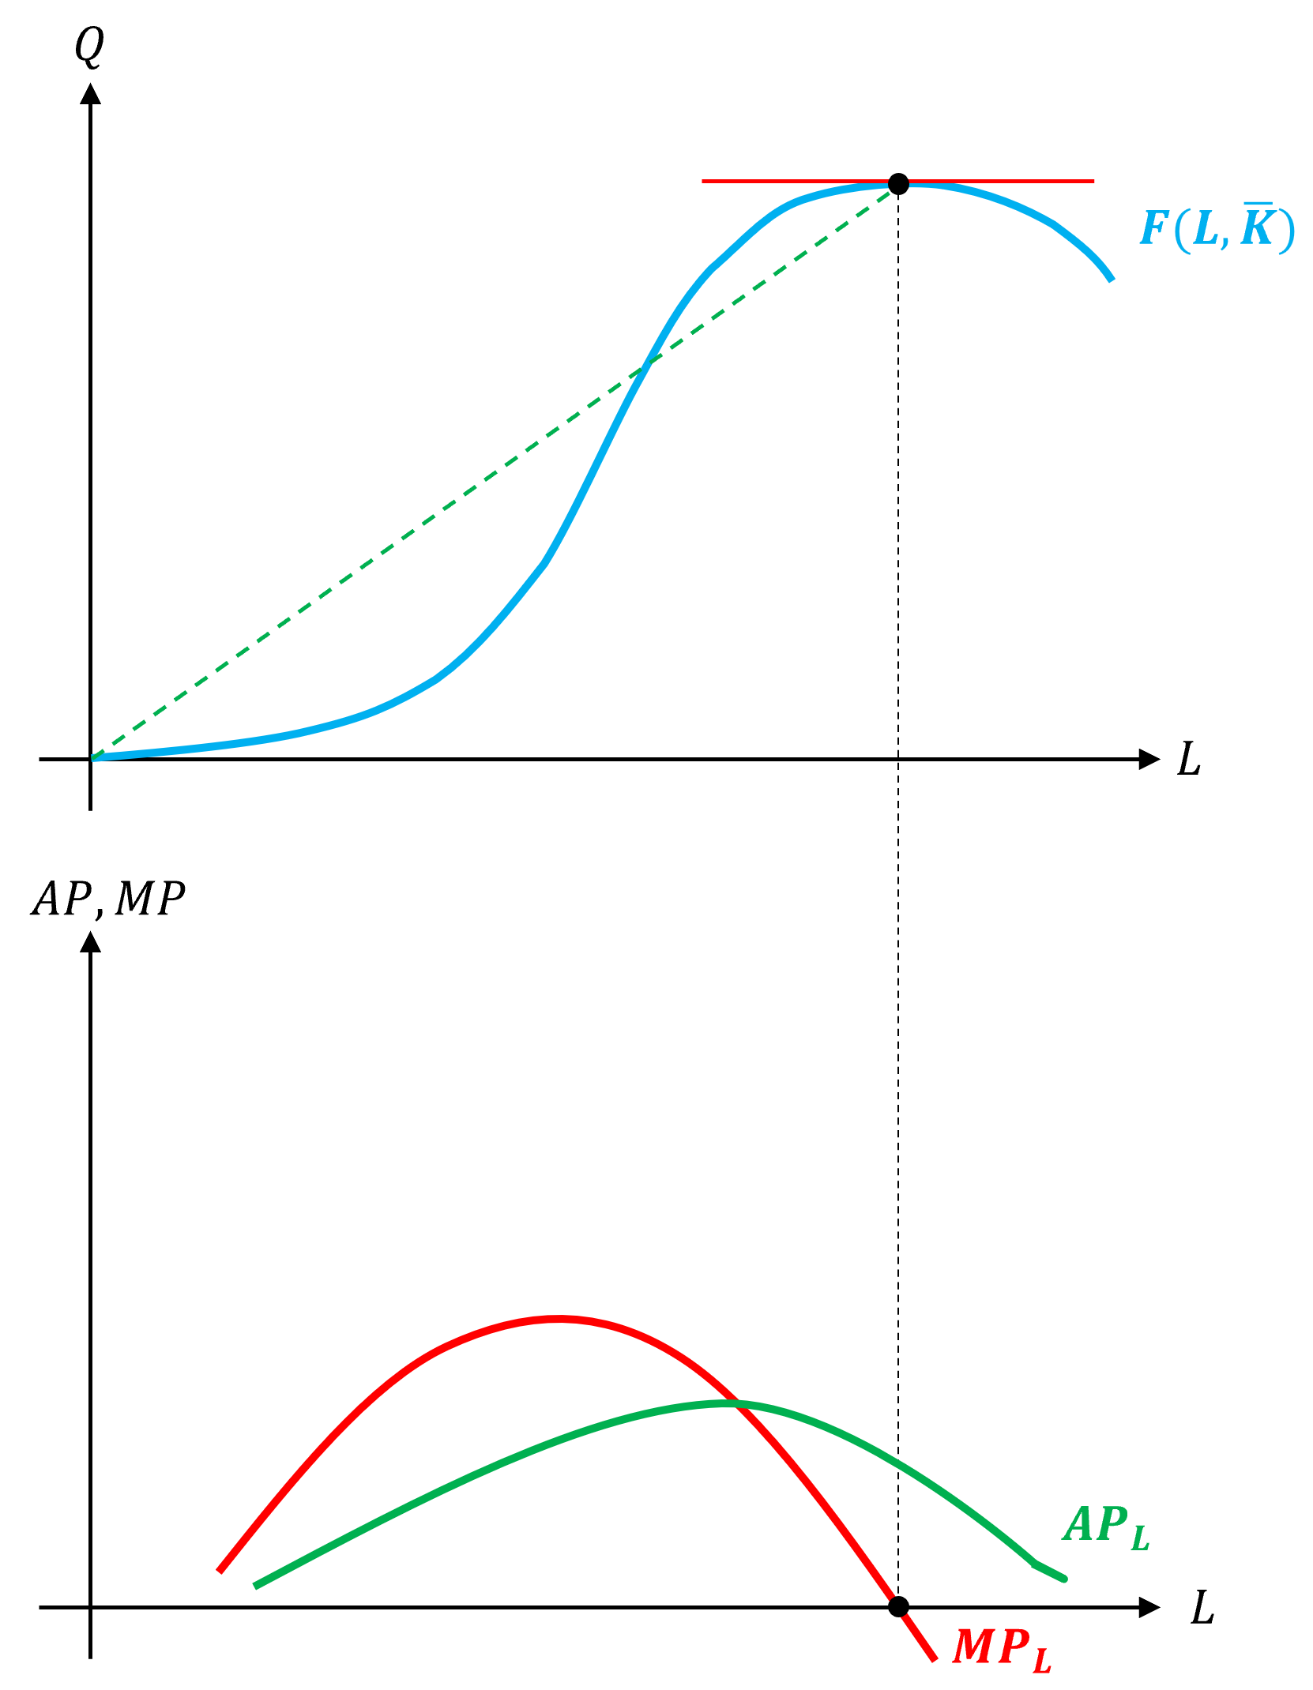
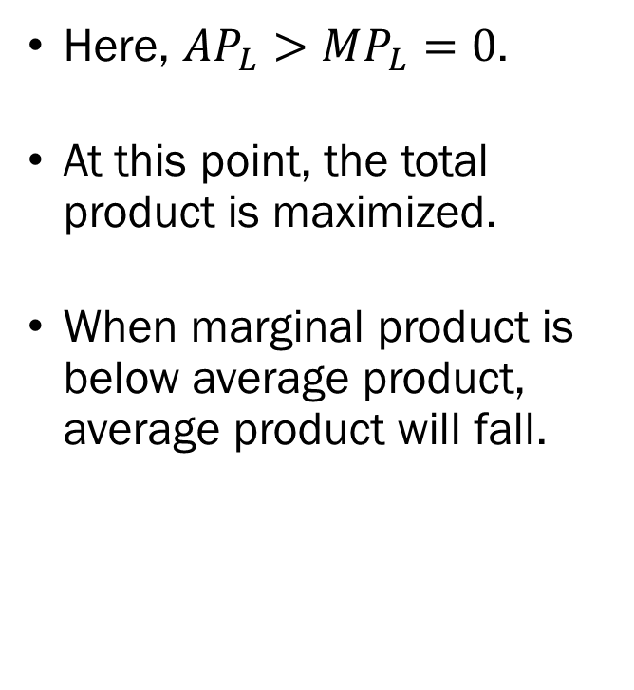
Total Product, Average Product, and Marginal Product
Here, $AP_{L}>MP_{L}=0$.
At this point, the total product is maximized.
When marginal product is below average product, average product will fall.

Slide 18
Isoquant
The Third Question: How much of each input do we need?
The answer will depend on a few elements:
  The Production Technology
  The Cost of Each Input
  The Target Level of Output
Given some target level of output, which combinations of inputs will allow us to reach the target?
Which of these combinations will result in the lowest cost of production?

Slide 19
Isoquant
The question we are asking here should remind you of…
  Given some target level of output, which combinations of inputs will allow us to reach the target?
  Given some target utility level, what are the bundles that will give our consumer that much utility?
This concept is analogous to the consumers’ indifference curves.
For producers, this object is called the “isoquant.”
  Iso- : Same, Equal (e.g., Isosceles, Isotope)
  Quant: Quantity

Slide 20
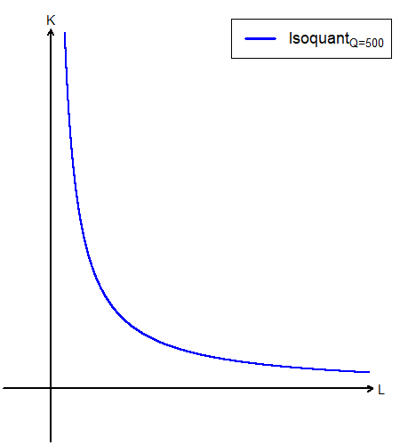
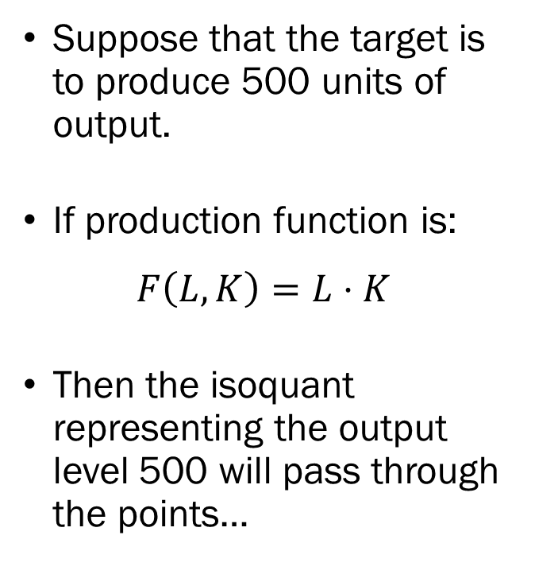
Isoquant
Suppose that the target is to produce 500 units of output.
If production function is:
$$F\left(L,K\right)=L⋅K$$
Then the isoquant representing the output level 500 will pass through the points…

Slide 21

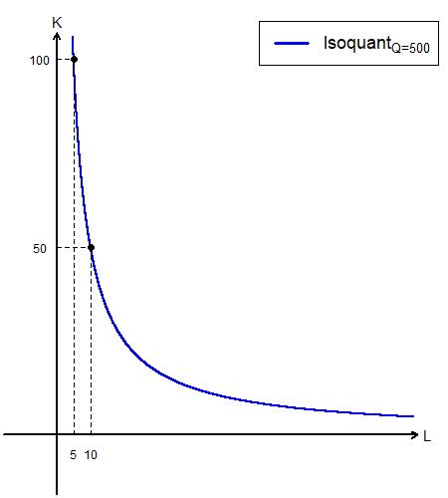
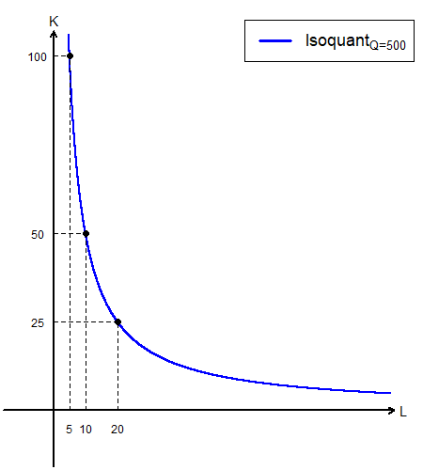
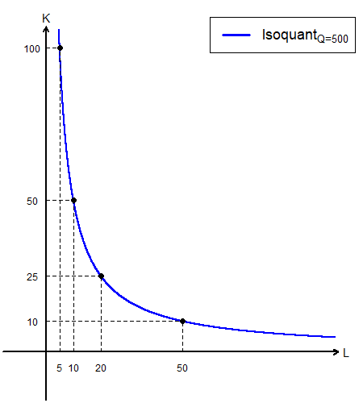
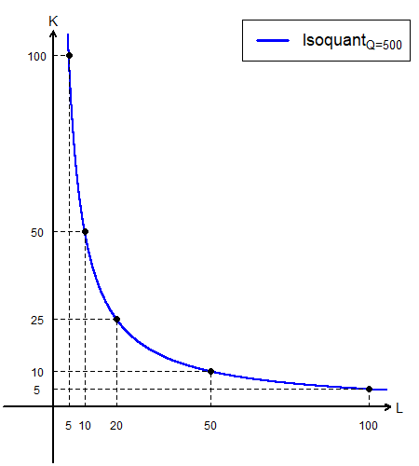
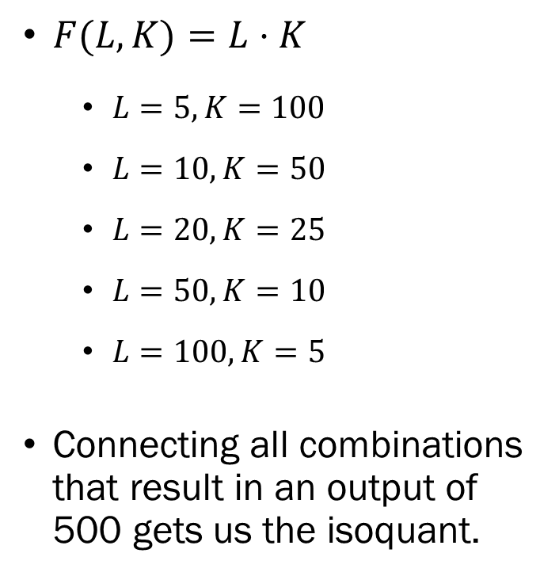
Isoquant
$F(L,K)=L⋅K$
  $L=5, K=100$
  $L=10,K=50$
  $L=20,K=25$
  $L=50,K=10$
  $L=100,K=5$
Connecting all combinations that result in an output of 500 gets us the isoquant.

Slide 22
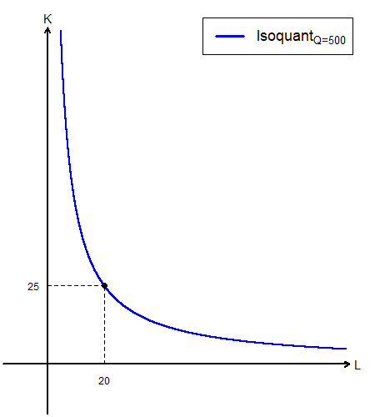
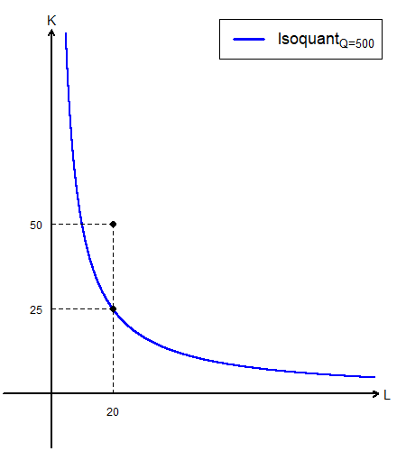
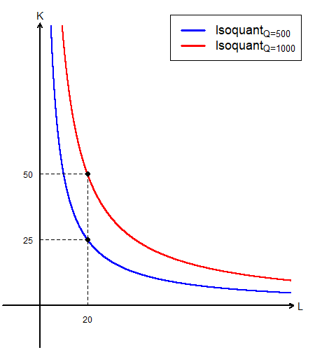
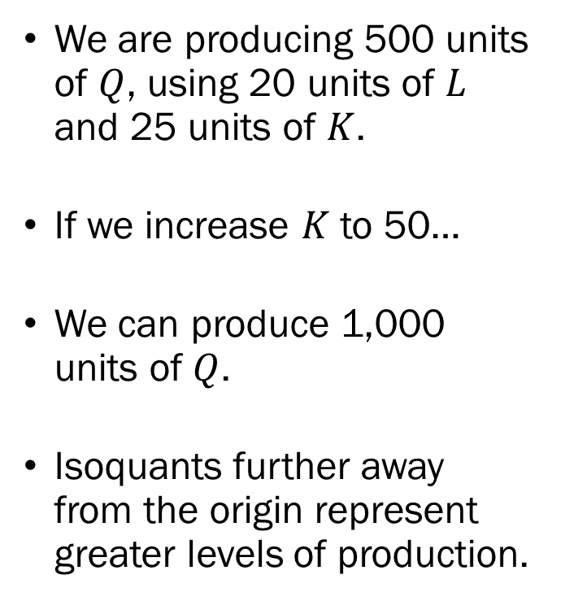
Isoquant
We are producing 500 units of $Q$, using 20 units of $L$ and 25 units of $K$.
If we increase $K$ to 50…
We can produce 1,000 units of $Q$.
Isoquants further away from the origin represent greater levels of production.

Slide 23
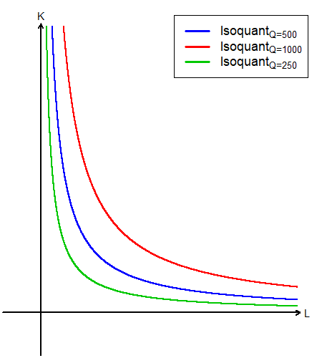
Isoquant
Isoquants are very similar to indifference curves.
Indifference curves tell us which combinations of goods result in the same level of utility.
Isoquants tell us which combinations of inputs result in the same level of output.

Slide 24
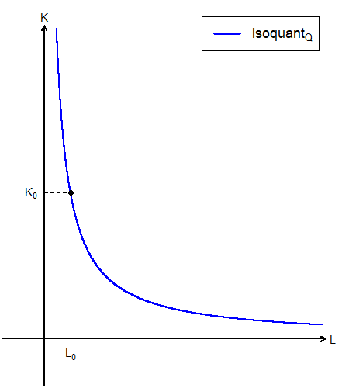
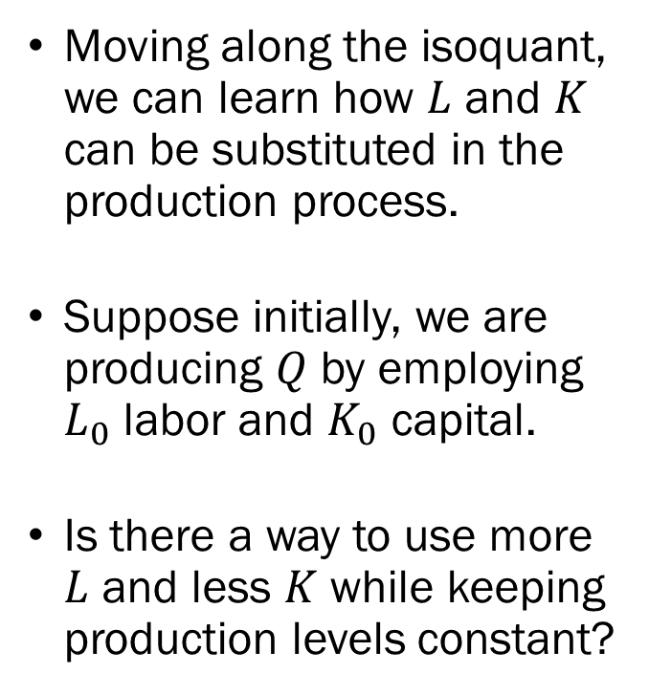
Isoquant
Moving along the isoquant, we can learn how $L$ and $K$ can be substituted in the production process.
Suppose initially, we are producing $Q$ by employing $L_{0}$ labor and $K_{0}$ capital.
Is there a way to use more $L$ and less $K$ while keeping production levels constant?

Slide 25
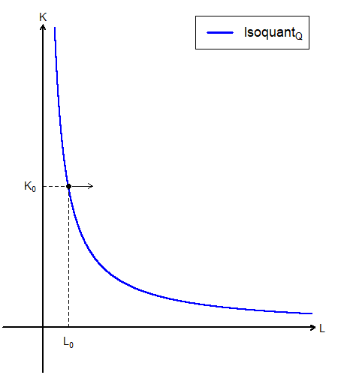
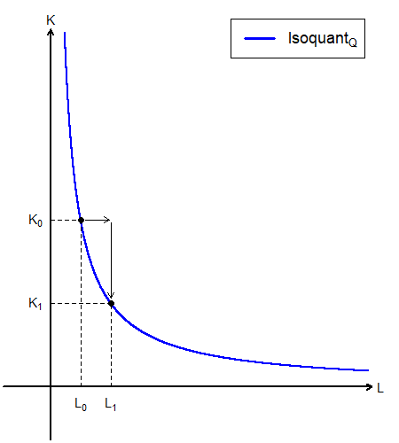
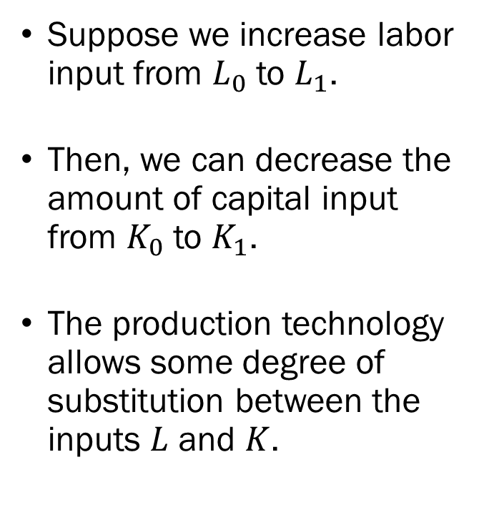
Isoquant
Suppose we increase labor input from $L_{0}$ to $L_{1}$.
Then, we can decrease the amount of capital input from $K_{0}$ to $K_{1}$.
The production technology allows some degree of substitution between the inputs $L$ and $K$.

Slide 26
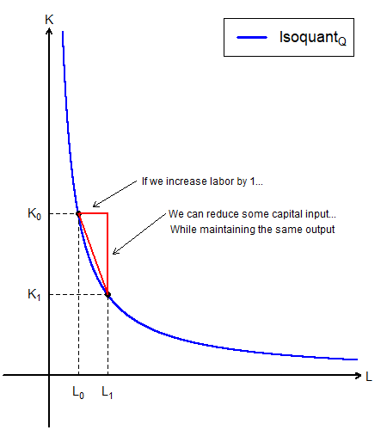
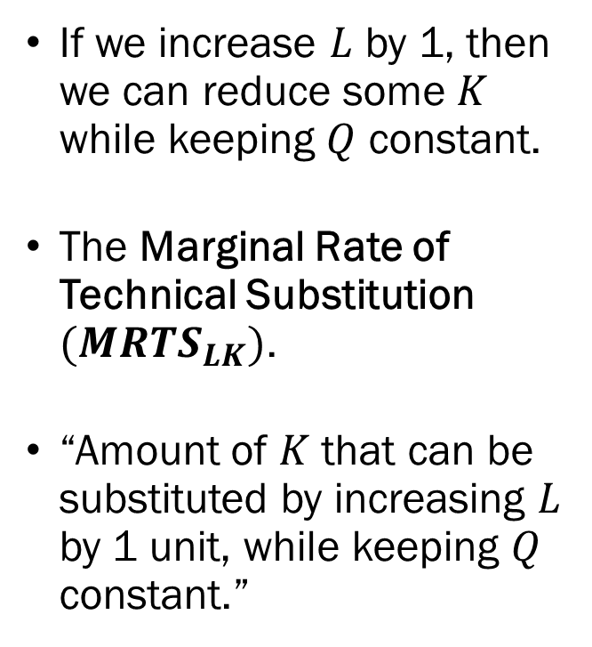
Marginal Rate of Technical Substitution
If we increase $L$ by 1, then we can reduce some $K$ while keeping $Q$ constant.
The Marginal Rate of Technical Substitution $(MRTS_{LK})$.
“Amount of $K$ that can be substituted by increasing $L$ by 1 unit, while keeping $Q$ constant.”

Slide 27
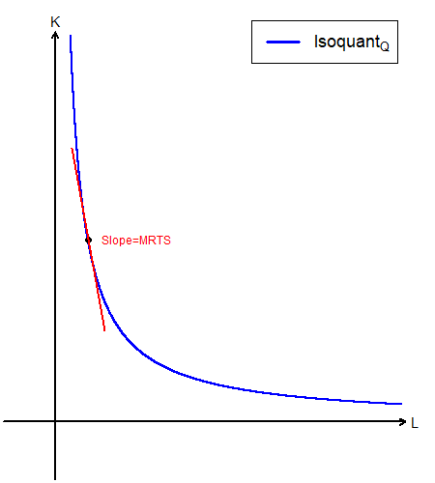
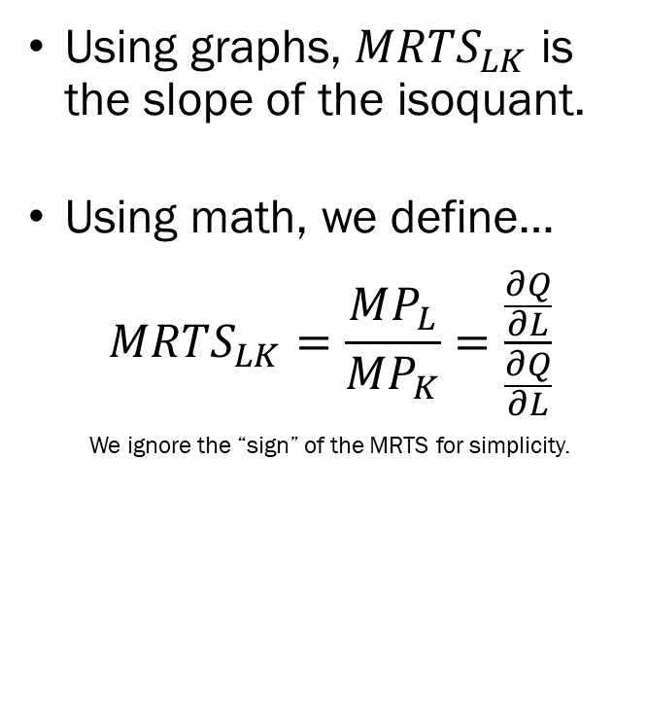
Marginal Rate of Technical Substitution
Using graphs, $MRTS_{LK}$ is the slope of the isoquant.
Using math, we define…
$$MRTS_{LK}=\frac{MP_{L}}{MP_{K}}=\frac{\frac{∂Q}{∂L}}{\frac{∂Q}{∂L}}$$
We ignore the “sign” of the MRTS for simplicity.

Slide 28
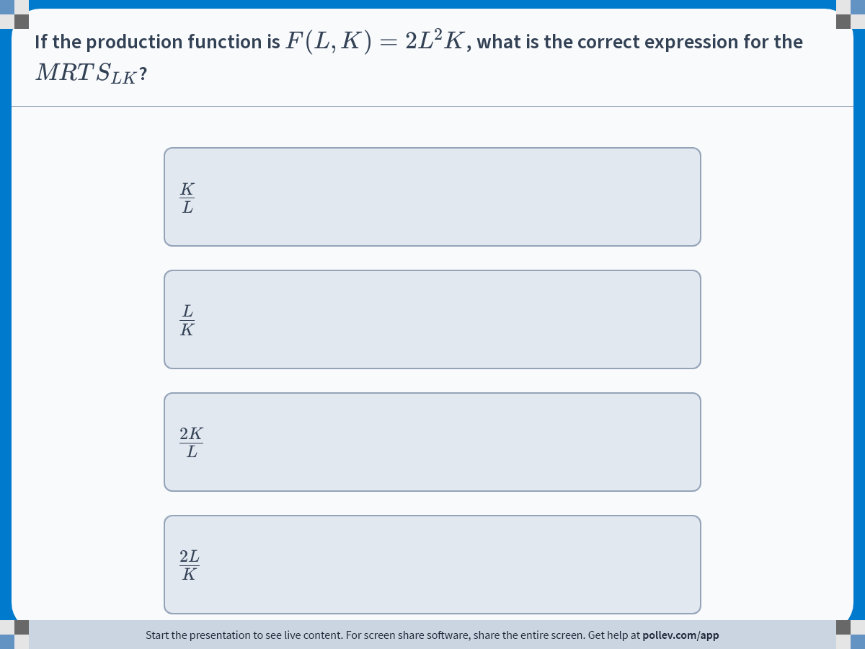
Notes:
Poll Title: Do not modify the notes in this section to avoid tampering with the Poll Everywhere activity.
More info at polleverywhere.com/support
If the production function is $$F(L,K)=2L^2K$$, what is the correct expression for the $$MRTS_{LK}$$?
https://www.polleverywhere.com/multiple_choice_polls/H0vwbWof0kAOzInRUZ2ft?display_state=instructions&activity_state=opened&state=opened&flow=Engagement&onscreen=persist

Slide 29
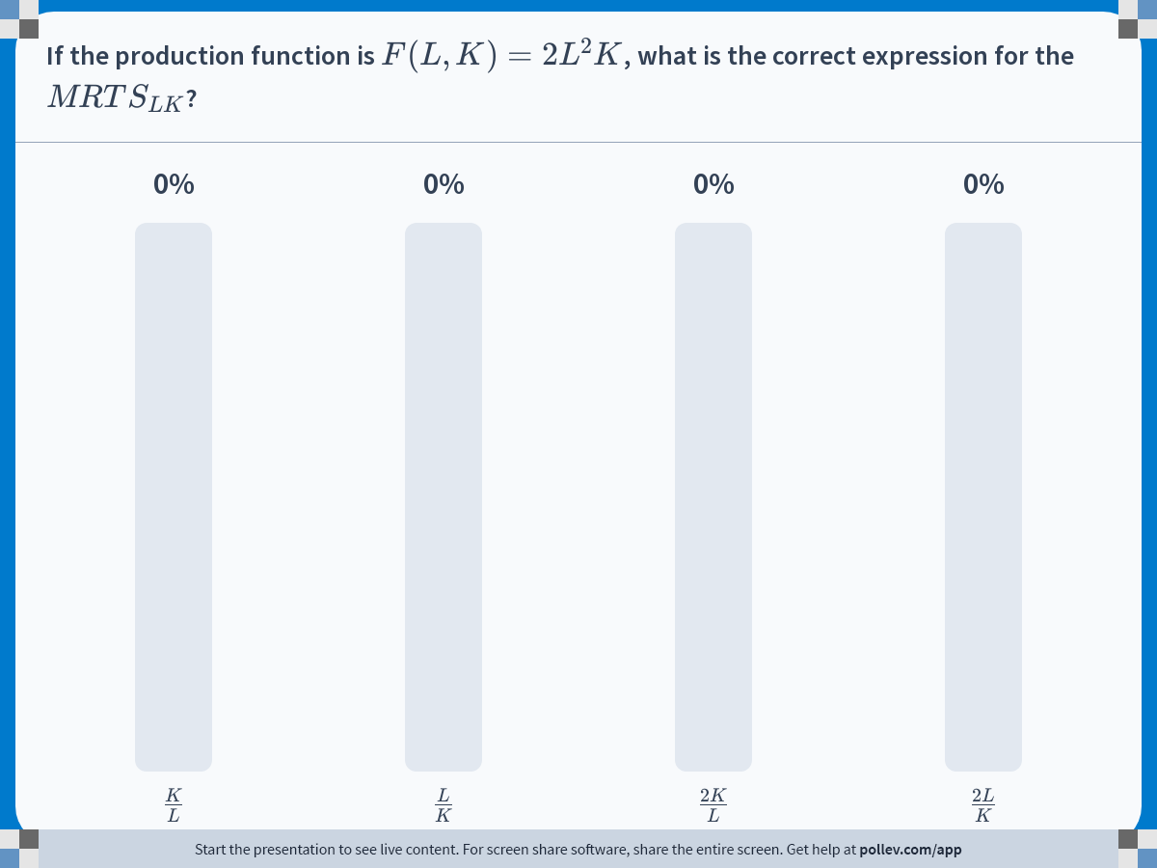
Notes:
Poll Title: Do not modify the notes in this section to avoid tampering with the Poll Everywhere activity.
More info at polleverywhere.com/support
If the production function is $$F(L,K)=2L^2K$$, what is the correct expression for the $$MRTS_{LK}$$?
https://www.polleverywhere.com/multiple_choice_polls/H0vwbWof0kAOzInRUZ2ft?display_state=chart&activity_state=closed&state=closed&flow=Engagement&onscreen=persist

Slide 30
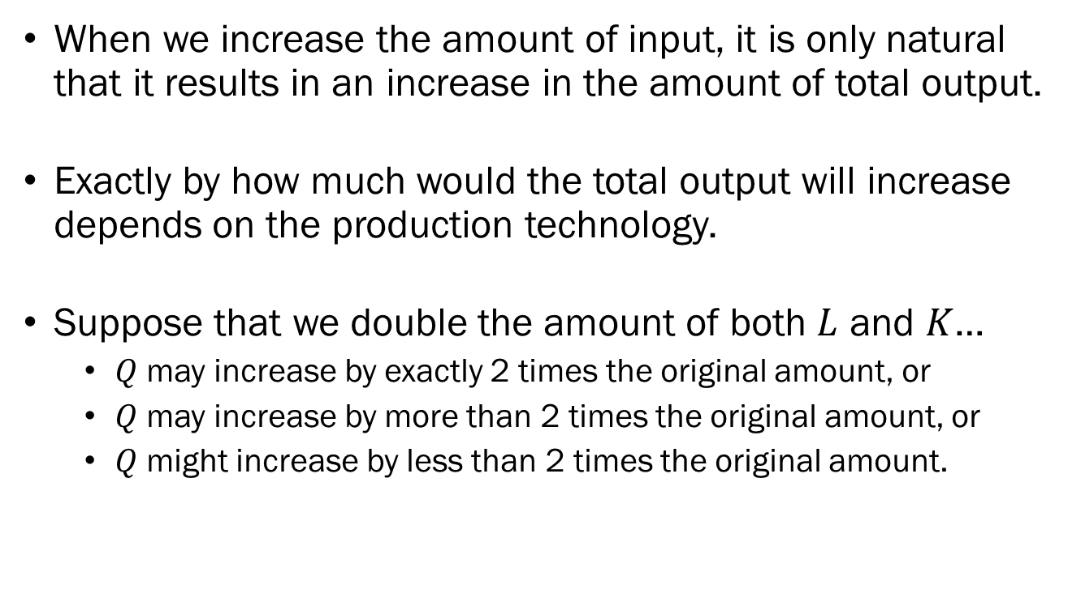
Returns to Scale
When we increase the amount of input, it is only natural that it results in an increase in the amount of total output.
Exactly by how much would the total output will increase depends on the production technology.
Suppose that we double the amount of both $L$ and $K$…
  $Q$ may increase by exactly 2 times the original amount, or
  $Q$ may increase by more than 2 times the original amount, or
  $Q$ might increase by less than 2 times the original amount.

Slide 31
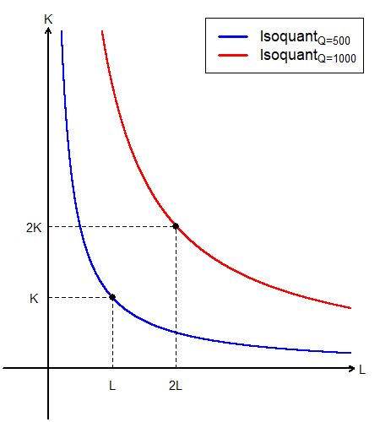
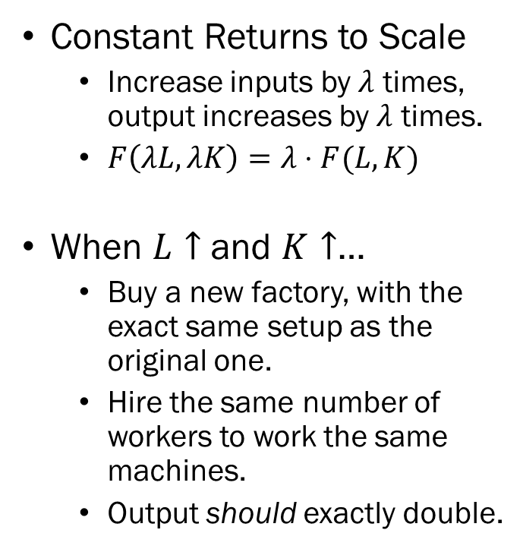
Returns to Scale
Constant Returns to Scale
  Increase inputs by $λ$ times, output increases by $λ$ times.
  $F\left(λL,λK\right)=λ⋅F(L,K)$
When $L↑$ and $K↑$…
  Buy a new factory, with the exact same setup as the original one.
  Hire the same number of workers to work the same machines.
  Output should exactly double.

Slide 32

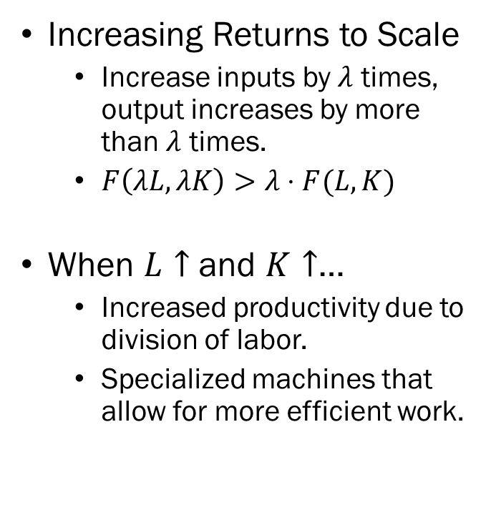
Returns to Scale
Increasing Returns to Scale
  Increase inputs by $λ$ times, output increases by more than $λ$ times.
  $F\left(λL,λK\right)>λ⋅F(L,K)$
When $L↑$ and $K↑$…
  Increased productivity due to division of labor.
  Specialized machines that allow for more efficient work.

Slide 33

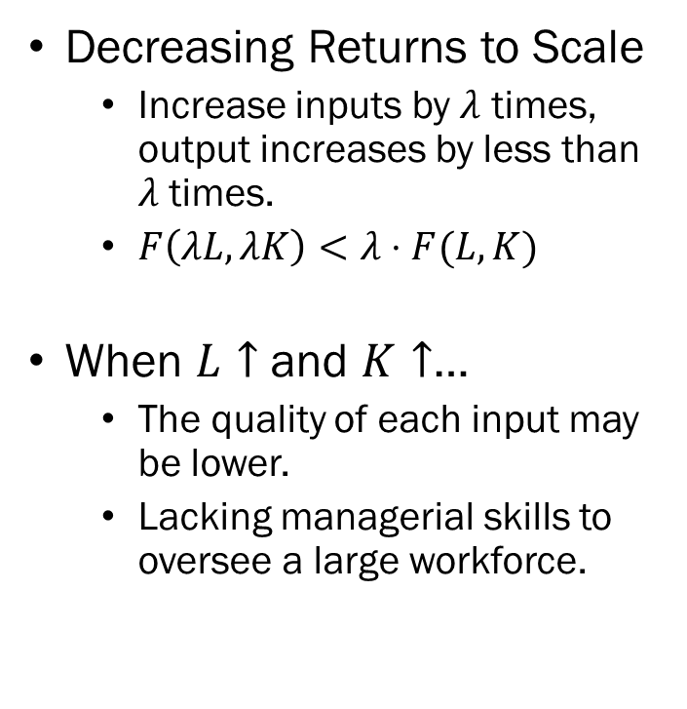
Returns to Scale
Decreasing Returns to Scale
  Increase inputs by $λ$ times, output increases by less than $λ$ times.
  $F\left(λL,λK\right)<λ⋅F(L,K)$
When $L↑$ and $K↑$…
  The quality of each input may be lower.
  Lacking managerial skills to oversee a large workforce.

Slide 34
Technical Progress
Output may increase as a reaction to increased inputs, but it may also increase due to the improvement of the production technology itself.
When output increases in absence of an increase of inputs in production, we say that there was Technical Progress.
Technical progress is the evolution of the production function itself.

Slide 35
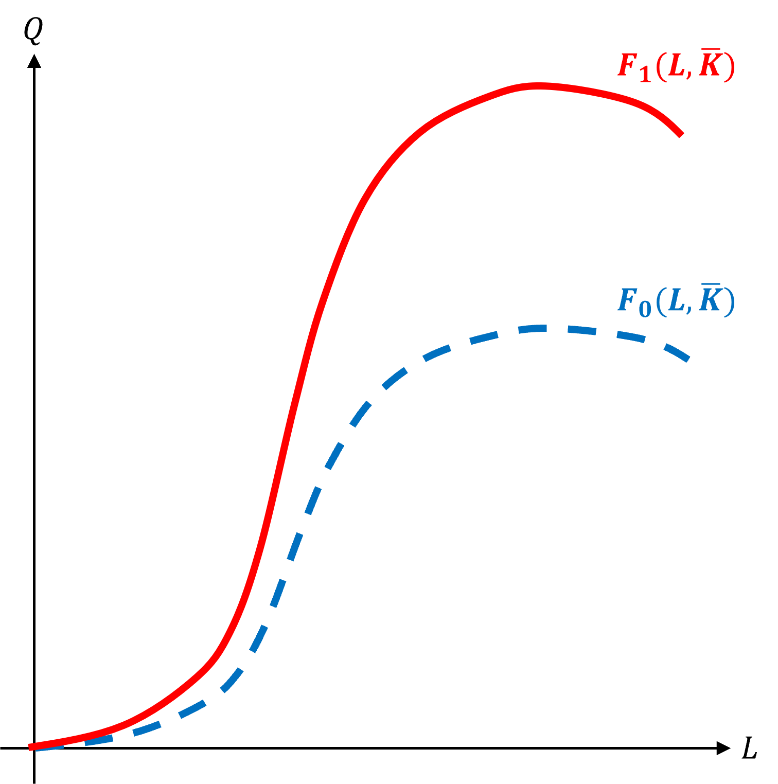
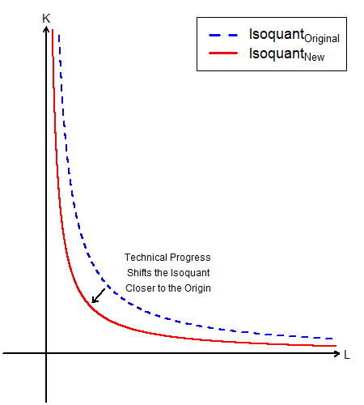
Technical Progress
Short Run Production
Long Run Production

Slide 36
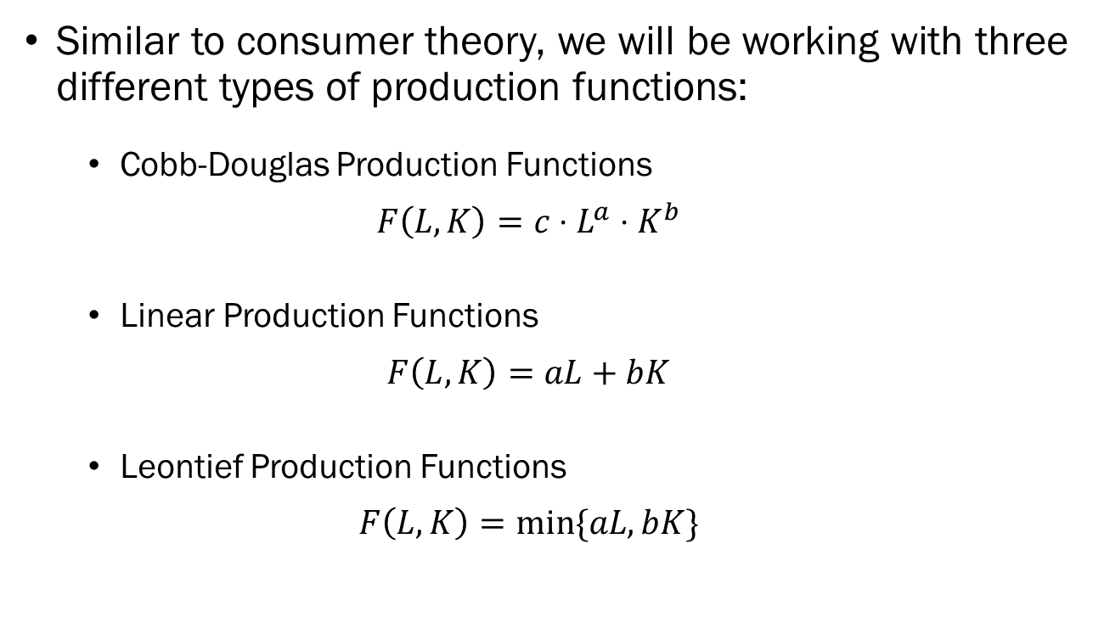
Three Types of Production Functions
Similar to consumer theory, we will be working with three different types of production functions:
  Cobb-Douglas Production Functions
  $$F\left(L,K\right)=c⋅L^{a}⋅K^{b}$$
  Linear Production Functions
  $$F\left(L,K\right)=aL+bK$$
  Leontief Production Functions
  $$F\left(L,K\right)=min⁡\{aL,bK\}$$

