Slide 1
INTERMEDIATE MICROECONOMIC THEORY
Chapter 20: Profit Maximization

Slide 2
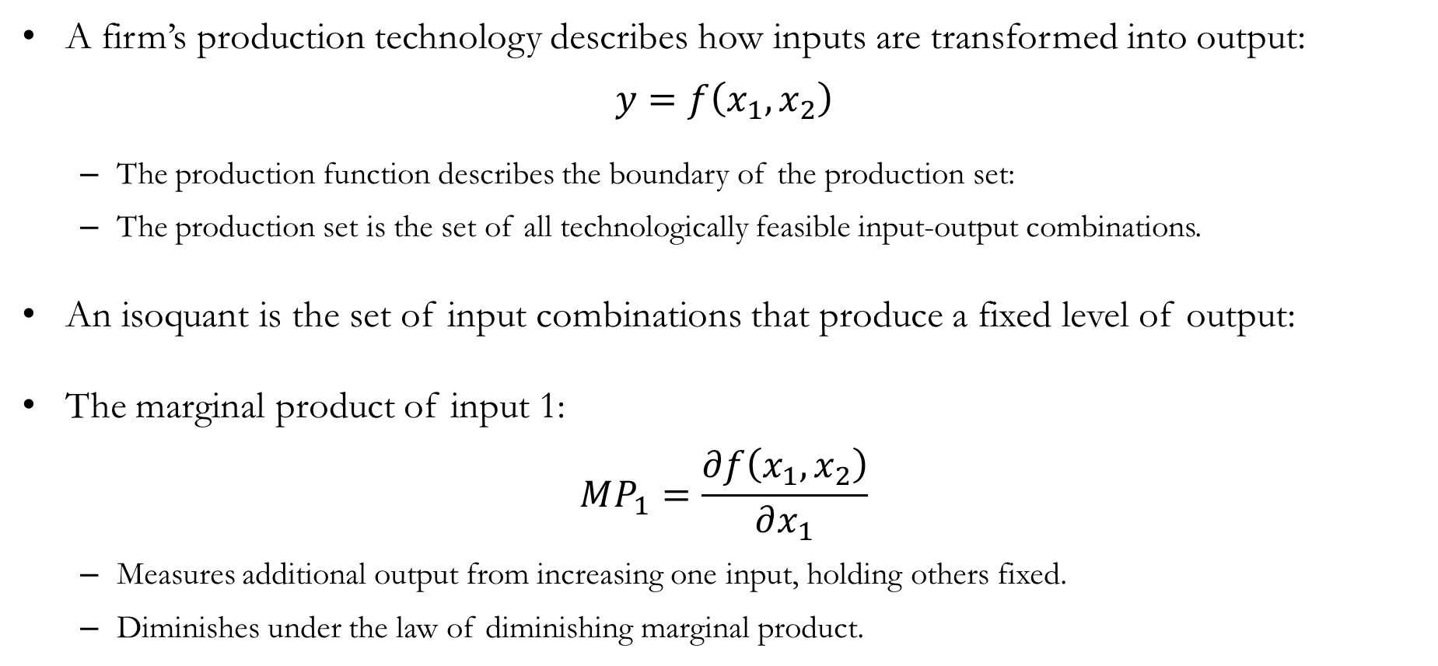
Recap: Technology
A firm’s production technology describes how inputs are transformed into output:
$$y=f\left(x_{1},x_{2}\right)$$
The production function describes the boundary of the production set:
The production set is the set of all technologically feasible input-output combinations.
An isoquant is the set of input combinations that produce a fixed level of output:
The marginal product of input 1:
$$MP_{1}=\frac{∂f\left(x_{1},x_{2}\right)}{∂x_{1}}$$
Measures additional output from increasing one input, holding others fixed.
Diminishes under the law of diminishing marginal product.

Slide 3
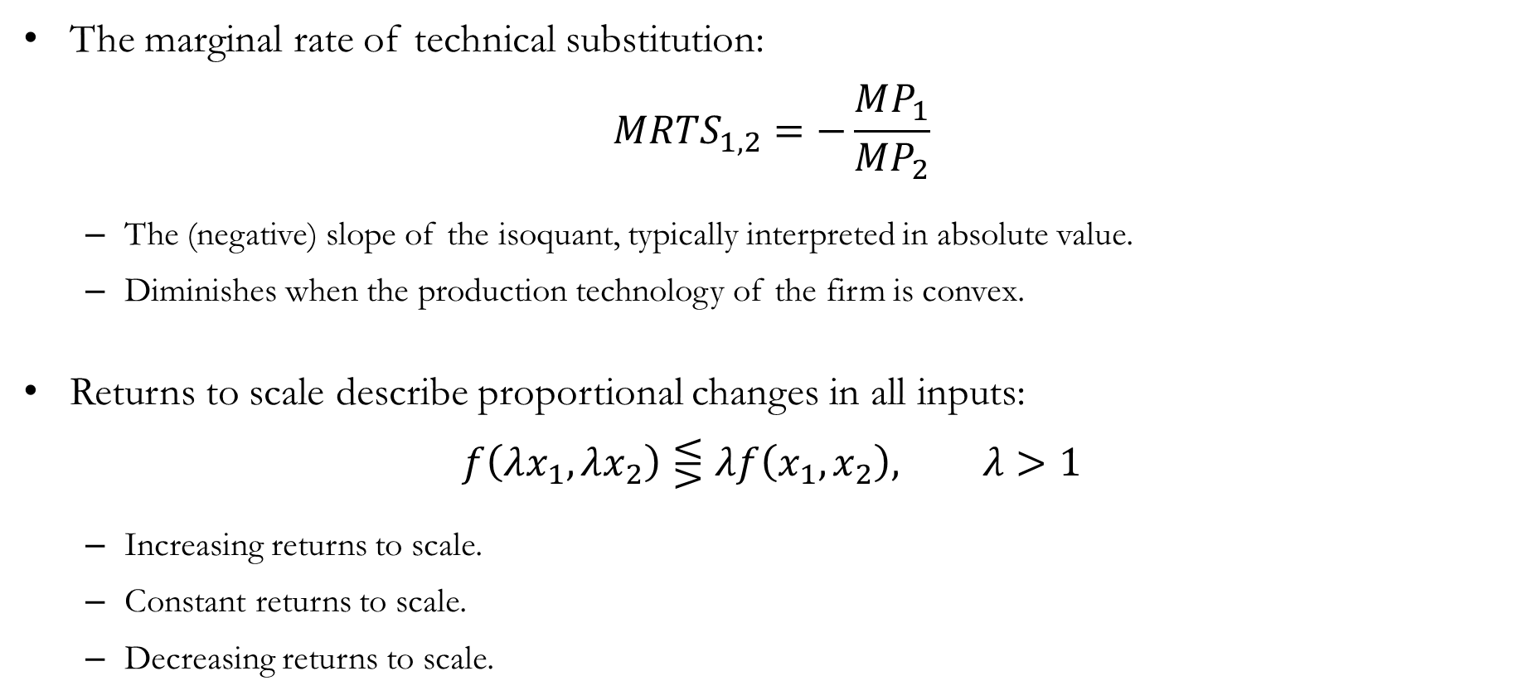
Recap: Technology
The marginal rate of technical substitution:
$$MRTS_{1,2}=−\frac{MP_{1}}{MP_{2}}$$
The (negative) slope of the isoquant, typically interpreted in absolute value.
Diminishes when the production technology of the firm is convex.
Returns to scale describe proportional changes in all inputs:
$$f\left(λx_{1},λx_{2}\right)⋚λf\left(x_{1},x_{2}\right), λ>1$$
Increasing returns to scale.
Constant returns to scale.
Decreasing returns to scale.

Slide 4
Profit Maximization
in the Short Run

Slide 5
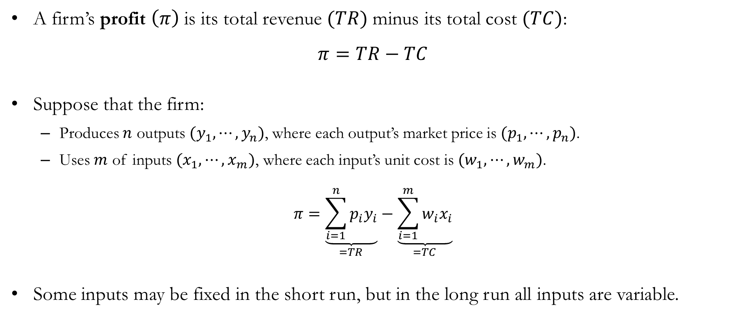
Profit
A firm’s profit $\left(π\right)$ is its total revenue $(TR)$minus its total cost $(TC)$:
$$π=TR−TC$$
Suppose that the firm:
Produces $n$ outputs $(y_{1},⋯,y_{n})$, where each output’s market price is $(p_{1},⋯,p_{n})$.
Uses $m$ of inputs $(x_{1},⋯,x_{m})$, where each input’s unit cost is $(w_{1},⋯,w_{m})$.
$$π=\underset{=TR}{\underbrace{\sum_{i=1}^{n}{p_{i}y_{i}}}}−\underset{=TC}{\underbrace{\sum_{i=1}^{m}{w_{i}x_{i}}}}$$
Some inputs may be fixed in the short run, but in the long run all inputs are variable.

Slide 6
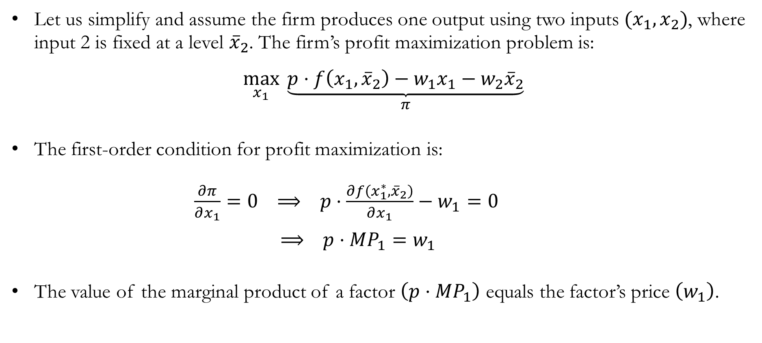
Short Run Profit Maximization
Let us simplify and assume the firm produces one output using two inputs $(x_{1},x_{2})$, where input 2 is fixed at a level ${\overline{x}}_{2}$. The firm’s profit maximization problem is:
$$\max_{x_{1}}{ \underset{π}{\underbrace{p⋅f\left(x_{1},{\overline{x}}_{2}\right)−w_{1}x_{1}−w_{2}{\overline{x}}_{2}}}}$$
The first-order condition for profit maximization is:
$\frac{∂π}{∂x_{1}}=0 ⟹ p⋅\frac{∂f\left(x_{1}^{∗},{\overline{x}}_{2}\right)}{∂x_{1}}−w_{1}=0$
$⟹ p⋅MP_{1}=w_{1}$
The value of the marginal product of a factor $\left(p⋅MP_{1}\right)$ equals the factor’s price $\left(w_{1}\right)$.

Slide 7
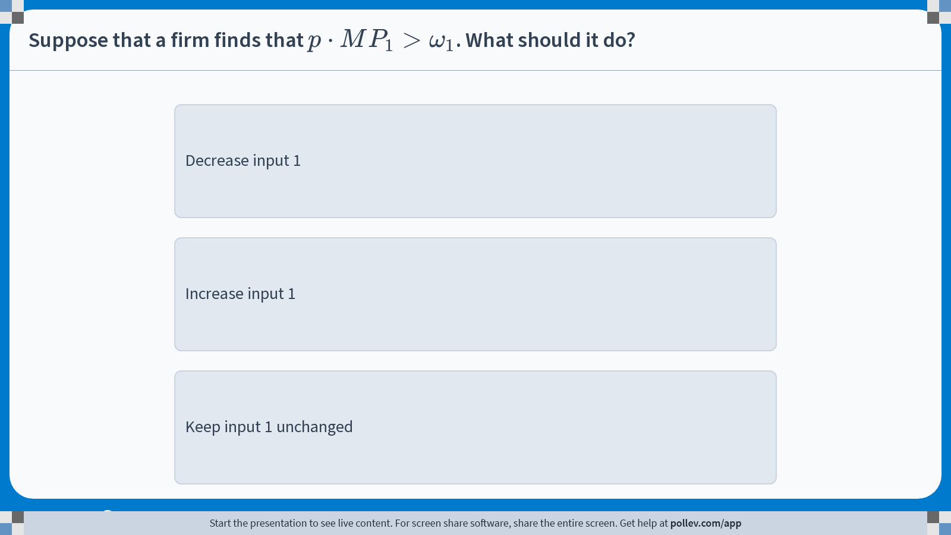
Poll Everywhere multiple choice poll instructions screen Activity Title: Suppose that a firm finds that $$p\\cdot MP_1>\\omega_1$$. What should it do? Slide 7
Notes:
Do not modify the notes in this section to avoid tampering with the Poll Everywhere activity. More info at polleverywhere.com/support Suppose that a firm finds that $$p\\cdot MP_1>\\omega_1$$. What should it do? https://www.polleverywhere.com/multiple_choice_polls/PwtpXd9rzEYypJRPzNNuf?display_state=instructions&activity_state=opened&state=opened&flow=Engagement&onscreen=persist

Slide 8
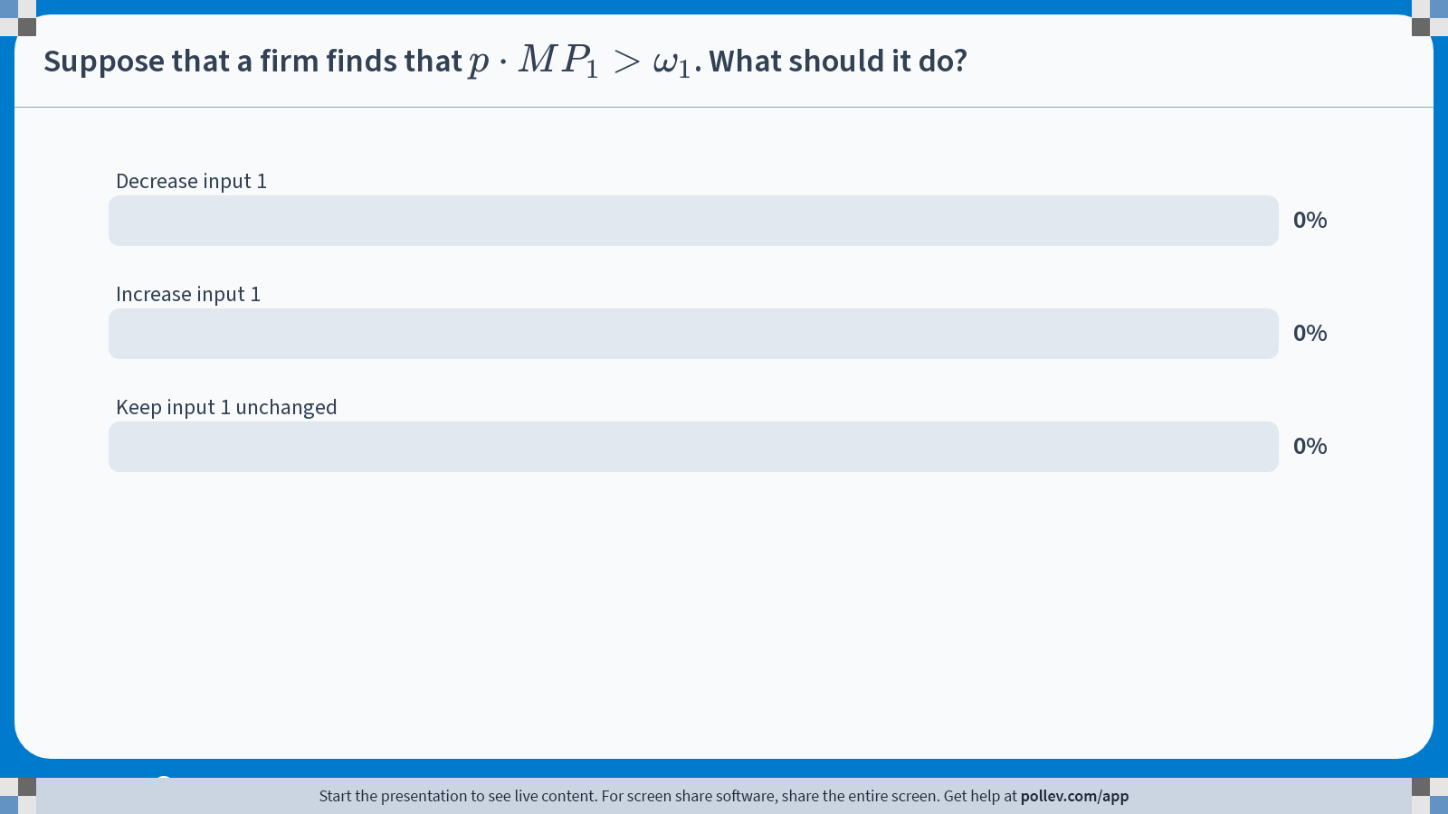
Poll Everywhere multiple choice poll chart screen Activity Title: Suppose that a firm finds that $$p\\cdot MP_1>\\omega_1$$. What should it do? Slide 9
Notes:
Do not modify the notes in this section to avoid tampering with the Poll Everywhere activity. More info at polleverywhere.com/support Suppose that a firm finds that $$p\\cdot MP_1>\\omega_1$$. What should it do? https://www.polleverywhere.com/multiple_choice_polls/PwtpXd9rzEYypJRPzNNuf?display_state=chart&activity_state=closed&state=closed&flow=Engagement&onscreen=persist

Slide 9
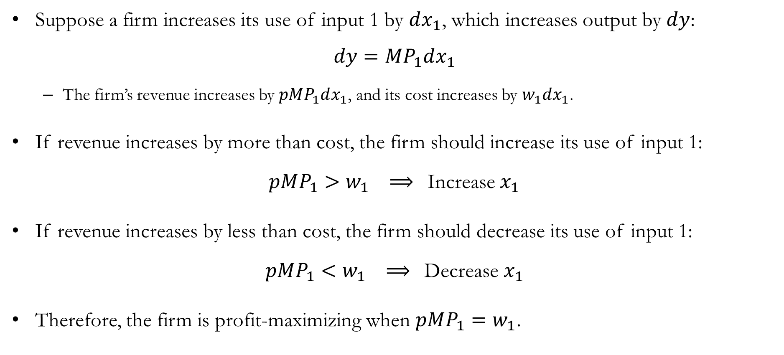
Why $p⋅MP_{1}=ω_{1}$?
Suppose a firm increases its use of input 1 by $dx_{1}$, which increases output by $dy$:
$$dy=MP_{1}dx_{1}$$
The firm’s revenue increases by $pMP_{1}dx_{1}$, and its cost increases by $w_{1}dx_{1}$.
If revenue increases by more than cost, the firm should increase its use of input 1:
$pMP_{1}>w_{1} ⟹$Increase $x_{1}$
If revenue increases by less than cost, the firm should decrease its use of input 1:
$pMP_{1}<w_{1} ⟹$Decrease $x_{1}$
Therefore, the firm is profit-maximizing when $pMP_{1}=w_{1}$.

Slide 10
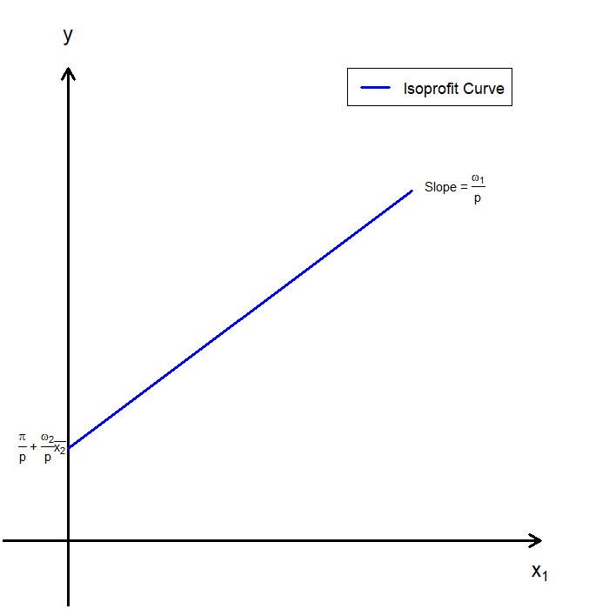
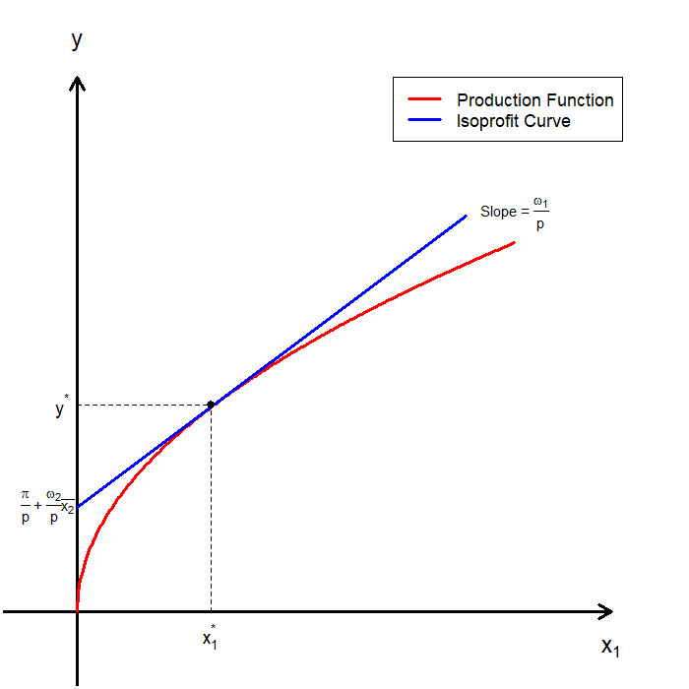
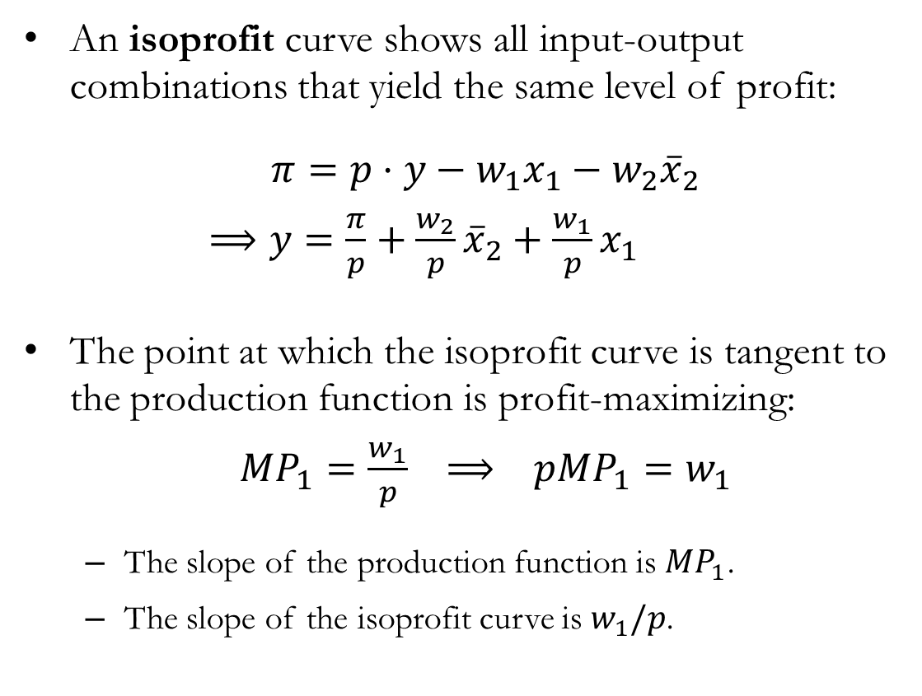
Short Run Profit Maximization: Isoprofit Curves
An isoprofit curve shows all input-output combinations that yield the same level of profit:
$π=p⋅y−w_{1}x_{1}−w_{2}{\overline{x}}_{2}$
$⟹y=\frac{π}{p}+\frac{w_{2}}{p}{\overline{x}}_{2}+\frac{w_{1}}{p}x_{1}$
The point at which the isoprofit curve is tangent to the production function is profit-maximizing:
$MP_{1}=\frac{w_{1}}{p} ⟹ pMP_{1}=w_{1}$
The slope of the production function is $MP_{1}$.
The slope of the isoprofit curve is $w_{1}/p$.

Slide 11
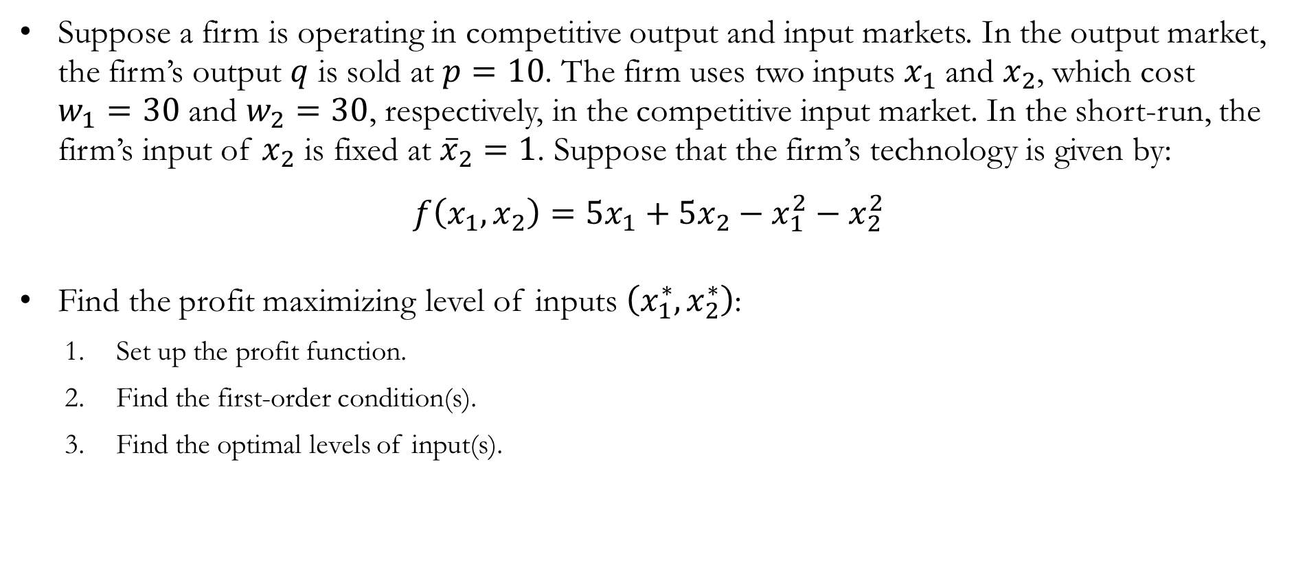
Numerical Example: Profit Maximization
Suppose a firm is operating in competitive output and input markets. In the output market, the firm’s output $q$ is sold at $p=10$. The firm uses two inputs $x_{1}$ and $x_{2}$, which cost $w_{1}=30$ and $w_{2}=30$, respectively, in the competitive input market. In the short-run, the firm’s input of $x_{2}$ is fixed at ${\overline{x}}_{2}=1$. Suppose that the firm’s technology is given by:
$$f\left(x_{1},x_{2}\right)=5x_{1}+5x_{2}−x_{1}^{2}−x_{2}^{2}$$
Find the profit maximizing level of inputs $\left(x_{1}^{∗},x_{2}^{∗}\right)$:
Set up the profit function.
Find the first-order condition(s).
Find the optimal levels of input(s).

Slide 12

Numerical Example: Profit Maximization
Set up the profit function:
$π=p⋅f\left(x_{1},{\overline{x}}_{2}\right)−w_{1}x_{1}−w_{2}x_{2}$
$⟹ π=10\left(5x_{1}+5−x_{1}^{2}−1^{2}\right)−30x_{1}−30$
Find the first-order condition (FOC):
$\frac{∂π}{∂x_{1}}=0 ⟹ 10\left(5−2x_{1}\right)−30=0$
$⟹ 50−20x_{1}−30=0$
$⟹ x_{1}^{∗}=1$
The short-run profit maximizing inputs are $x_{1}^{∗}=1$ and ${\overline{x}}_{2}=1$.

Slide 13
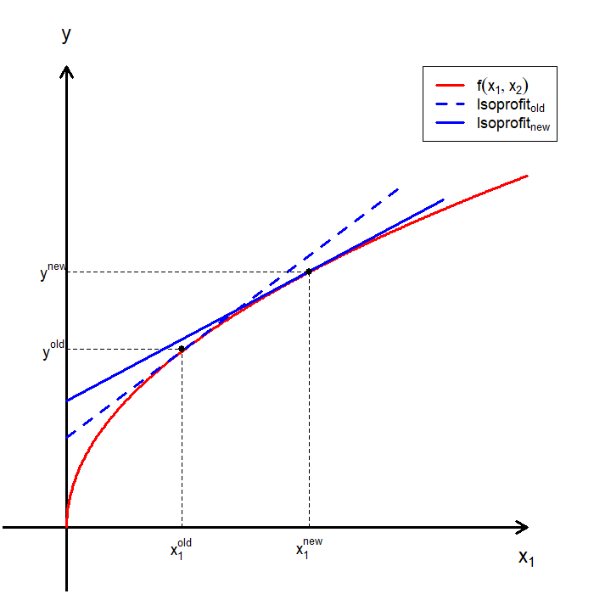
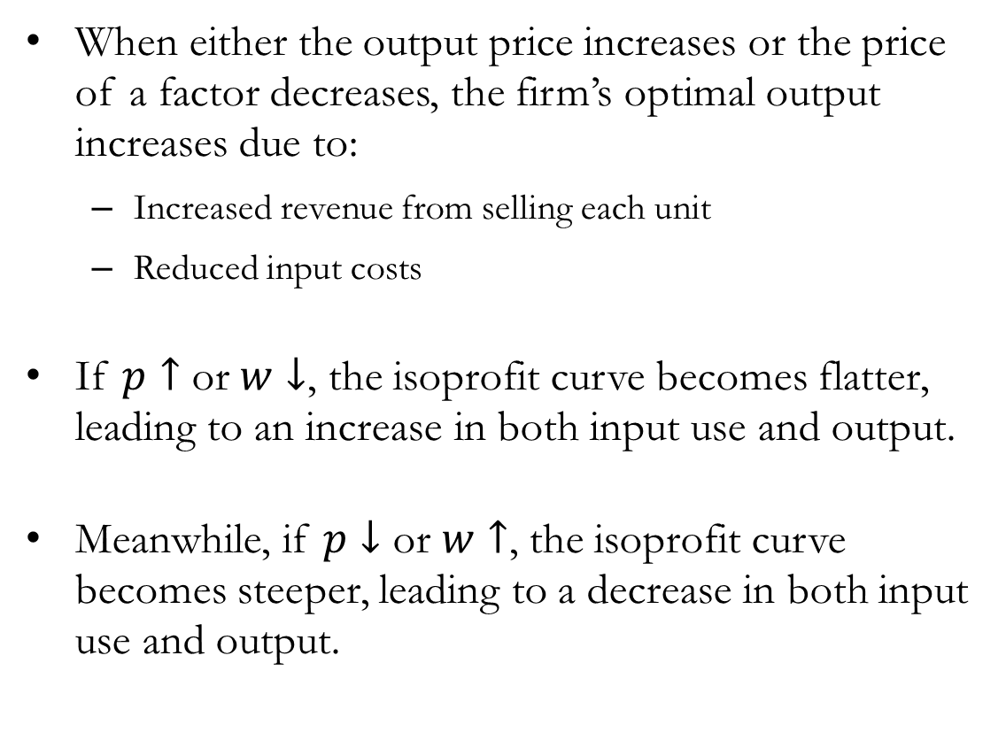
Comparative Statics: Changes in $p$ and $ω$
When either the output price increases or the price of a factor decreases, the firm’s optimal output increases due to:
Increased revenue from selling each unit
Reduced input costs
If $p↑$ or $w↓$, the isoprofit curve becomes flatter, leading to an increase in both input use and output.
Meanwhile, if $p↓$ or $w↑$, the isoprofit curve becomes steeper, leading to a decrease in both input use and output.

Slide 14
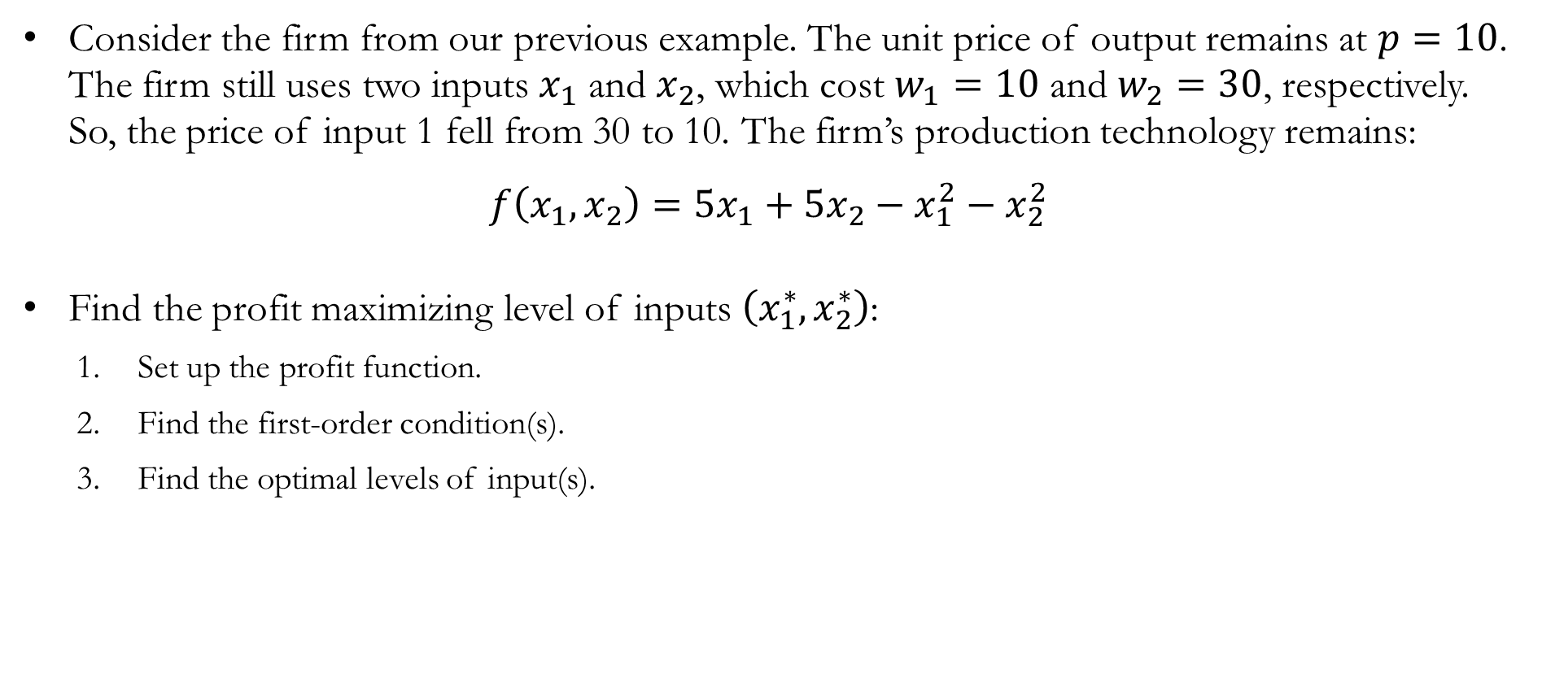
Numerical Example: Short Run Profit Maximization
Consider the firm from our previous example. The unit price of output remains at $p=10$. The firm still uses two inputs $x_{1}$ and $x_{2}$, which cost $w_{1}=10$ and $w_{2}=30$, respectively. So, the price of input 1 fell from 30 to 10. The firm’s production technology remains:
$$f\left(x_{1},x_{2}\right)=5x_{1}+5x_{2}−x_{1}^{2}−x_{2}^{2}$$
Find the profit maximizing level of inputs $\left(x_{1}^{∗},x_{2}^{∗}\right)$:
Set up the profit function.
Find the first-order condition(s).
Find the optimal levels of input(s).

Slide 15

Numerical Example: Short Run Profit Maximization
Set up the profit function:
$π=p⋅f\left(x_{1},{\overline{x}}_{2}\right)−w_{1}x_{1}−w_{2}x_{2}$
$⟹ π=10\left(5x_{1}+5−x_{1}^{2}−1^{2}\right)−10x_{1}−30$
Find the first-order condition (FOC):
$\frac{∂π}{∂x_{1}}=0 ⟹ 10\left(5−2x_{1}\right)−10=0$
$⟹ 50−20x_{1}−10=0$
$⟹ x_{1}^{∗}=2$
The short-run profit maximizing inputs are $x_{1}^{∗}=2$ and ${\overline{x}}_{2}=1$.

Slide 16
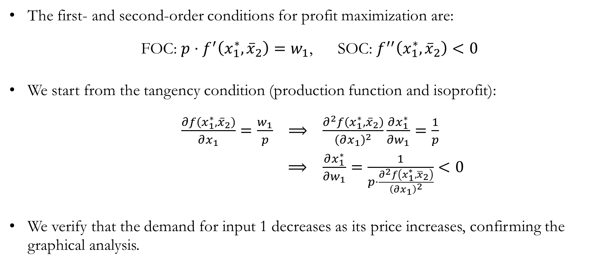
Comparative Statics: Changes in $p$ and $ω$
The first- and second-order conditions for profit maximization are:
FOC: $p⋅f^{′}\left(x_{1}^{∗},{\overline{x}}_{2}\right)=w_{1}$, SOC: $f^{′′}\left(x_{1}^{∗},{\overline{x}}_{2}\right)<0$
We start from the tangency condition (production function and isoprofit):
$\frac{∂f\left(x_{1}^{∗},{\overline{x}}_{2}\right)}{∂x_{1}}=\frac{w_{1}}{p} ⟹ \frac{∂^{2}f\left(x_{1}^{∗},{\overline{x}}_{2}\right)}{{\left(∂x_{1}\right)}^{2}}\frac{∂x_{1}^{∗}}{∂w_{1}}=\frac{1}{p}$
$⟹ \frac{∂x_{1}^{∗}}{∂w_{1}}=\frac{1}{p⋅\frac{∂^{2}f\left(x_{1}^{∗},{\overline{x}}_{2}\right)}{{\left(∂x_{1}\right)}^{2}}}<0$
We verify that the demand for input 1 decreases as its price increases, confirming the graphical analysis.

Slide 17
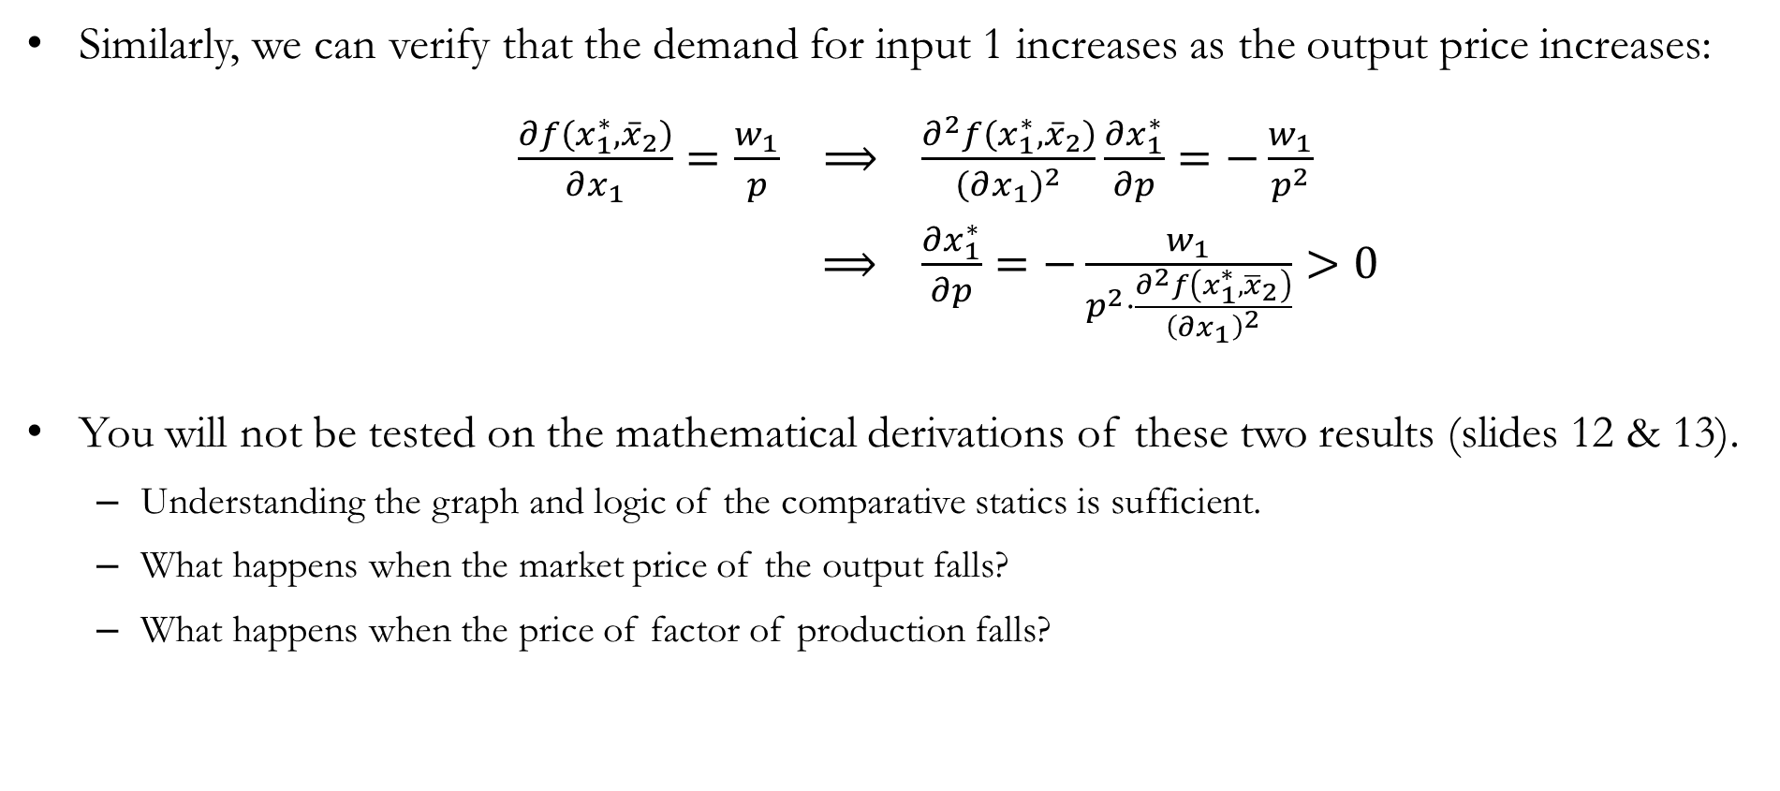
Comparative Statics: Changes in $p$ and $ω$
Similarly, we can verify that the demand for input 1 increases as the output price increases:
$\frac{∂f\left(x_{1}^{∗},{\overline{x}}_{2}\right)}{∂x_{1}}=\frac{w_{1}}{p} ⟹ \frac{∂^{2}f\left(x_{1}^{∗},{\overline{x}}_{2}\right)}{{\left(∂x_{1}\right)}^{2}}\frac{∂x_{1}^{∗}}{∂p}=−\frac{w_{1}}{p^{2}}$
$⟹ \frac{∂x_{1}^{∗}}{∂p}=−\frac{w_{1}}{p^{2}⋅\frac{∂^{2}f\left(x_{1}^{∗},{\overline{x}}_{2}\right)}{{\left(∂x_{1}\right)}^{2}}}>0$
You will not be tested on the mathematical derivations of these two results (slides 12 & 13).
Understanding the graph and logic of the comparative statics is sufficient.
What happens when the market price of the output falls?
What happens when the price of factor of production falls?

Slide 18
Profit Maximization
in the Long Run

Slide 19
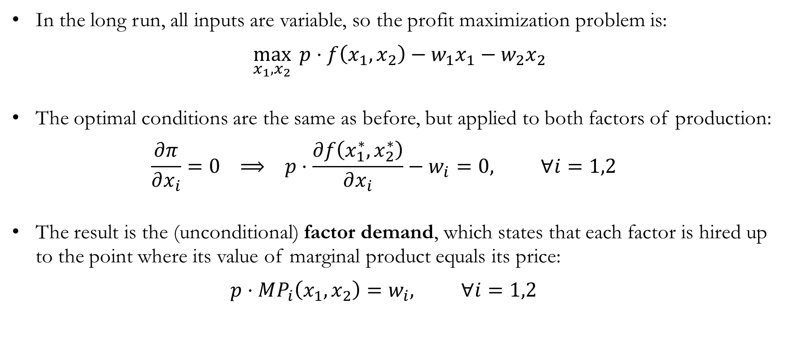
Long Run Profit Maximization
In the long run, all inputs are variable, so the profit maximization problem is:
$$\max_{x_{1},x_{2}}{ p⋅f\left(x_{1},x_{2}\right)−w_{1}x_{1}−w_{2}x_{2}}$$
The optimal conditions are the same as before, but applied to both factors of production:
$$\frac{∂π}{∂x_{i}}=0 ⟹ p⋅\frac{∂f\left(x_{1}^{∗},x_{2}^{∗}\right)}{∂x_{i}}−w_{i}=0, ∀i=1,2$$
The result is the (unconditional) factor demand, which states that each factor is hired up to the point where its value of marginal product equals its price:
$$p⋅MP_{i}\left(x_{1},x_{2}\right)=w_{i}, ∀i=1,2$$

Slide 20
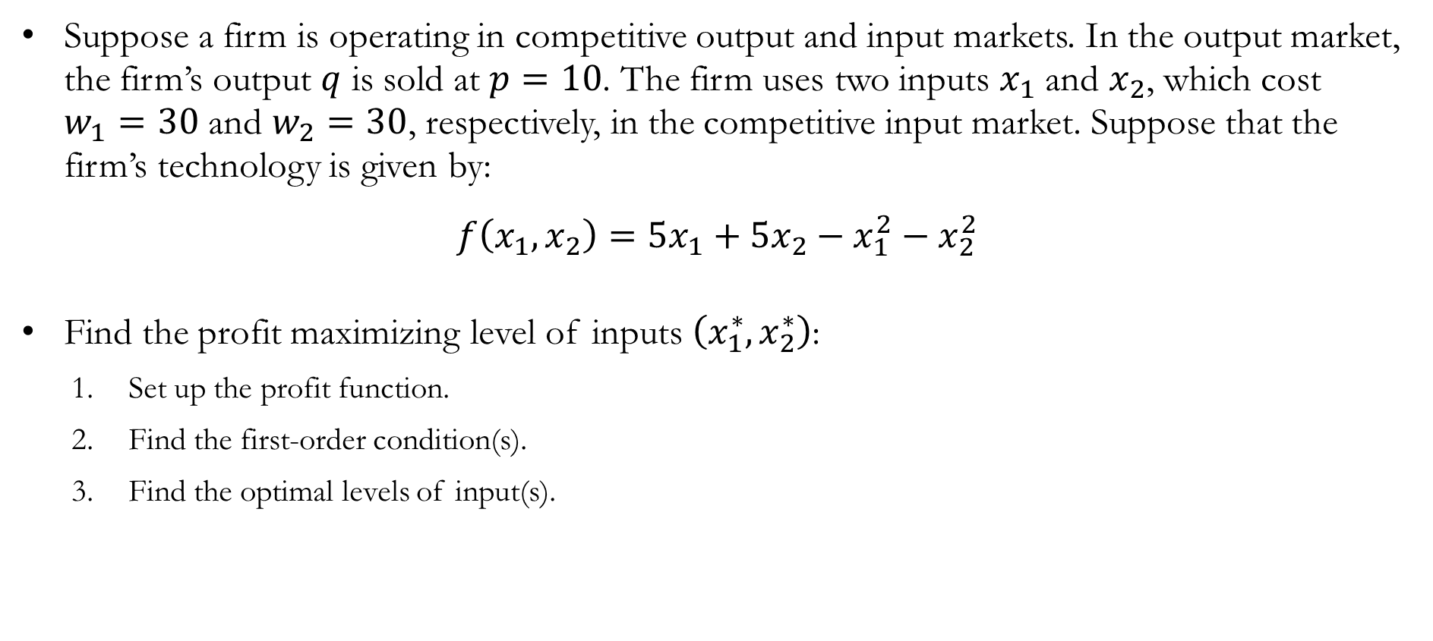
Numerical Example: Long Run Profit Maximization
Suppose a firm is operating in competitive output and input markets. In the output market, the firm’s output $q$ is sold at $p=10$. The firm uses two inputs $x_{1}$ and $x_{2}$, which cost $w_{1}=30$ and $w_{2}=30$, respectively, in the competitive input market. Suppose that the firm’s technology is given by:
$$f\left(x_{1},x_{2}\right)=5x_{1}+5x_{2}−x_{1}^{2}−x_{2}^{2}$$
Find the profit maximizing level of inputs $\left(x_{1}^{∗},x_{2}^{∗}\right)$:
Set up the profit function.
Find the first-order condition(s).
Find the optimal levels of input(s).

Slide 21

Numerical Example: Profit Maximization
Set up the profit function:
$π=p⋅f\left(x_{1},{\overline{x}}_{2}\right)−w_{1}x_{1}−w_{2}x_{2}$
$⟹ π=10\left(5x_{1}+5x_{2}−x_{1}^{2}−{x_{2}}^{2}\right)−30x_{1}−30x_{2}$
Find the first-order conditions (FOCs):
$\frac{∂π}{∂x_{1}}=0 ⟹ 10\left(5−2x_{1}\right)−30=0$
$\frac{∂π}{∂x_{2}}=0 ⟹ 10\left(5−2x_{2}\right)−30=0$
The long-run profit maximizing inputs are $x_{1}^{∗}=1$ and $x_{2}^{∗}=1$.

Slide 22
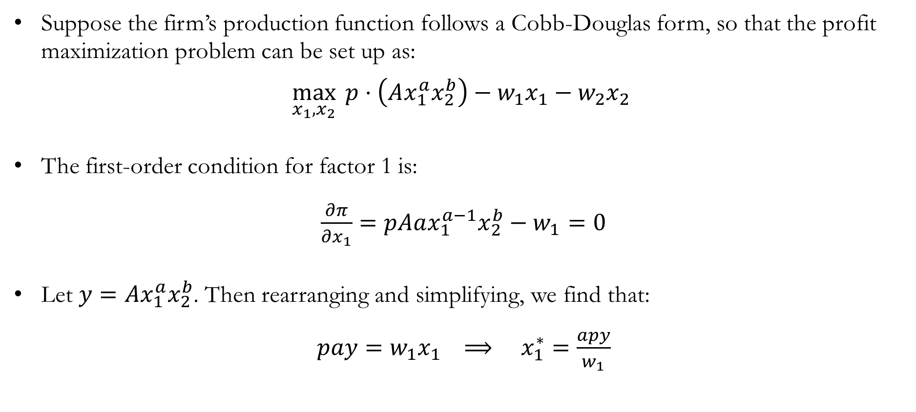
Detour: Profit Maximization
Suppose the firm’s production function follows a Cobb-Douglas form, so that the profit maximization problem can be set up as:
$$\max_{x_{1},x_{2}}{ p⋅\left(Ax_{1}^{a}x_{2}^{b}\right)−w_{1}x_{1}−w_{2}x_{2}}$$
The first-order condition for factor 1 is:
$\frac{∂π}{∂x_{1}}=pAax_{1}^{a−1}x_{2}^{b}−w_{1}=0$
Let $y=Ax_{1}^{a}x_{2}^{b}$. Then rearranging and simplifying, we find that:
$pay=w_{1}x_{1} ⟹ x_{1}^{∗}=\frac{apy}{w_{1}}$

Slide 23
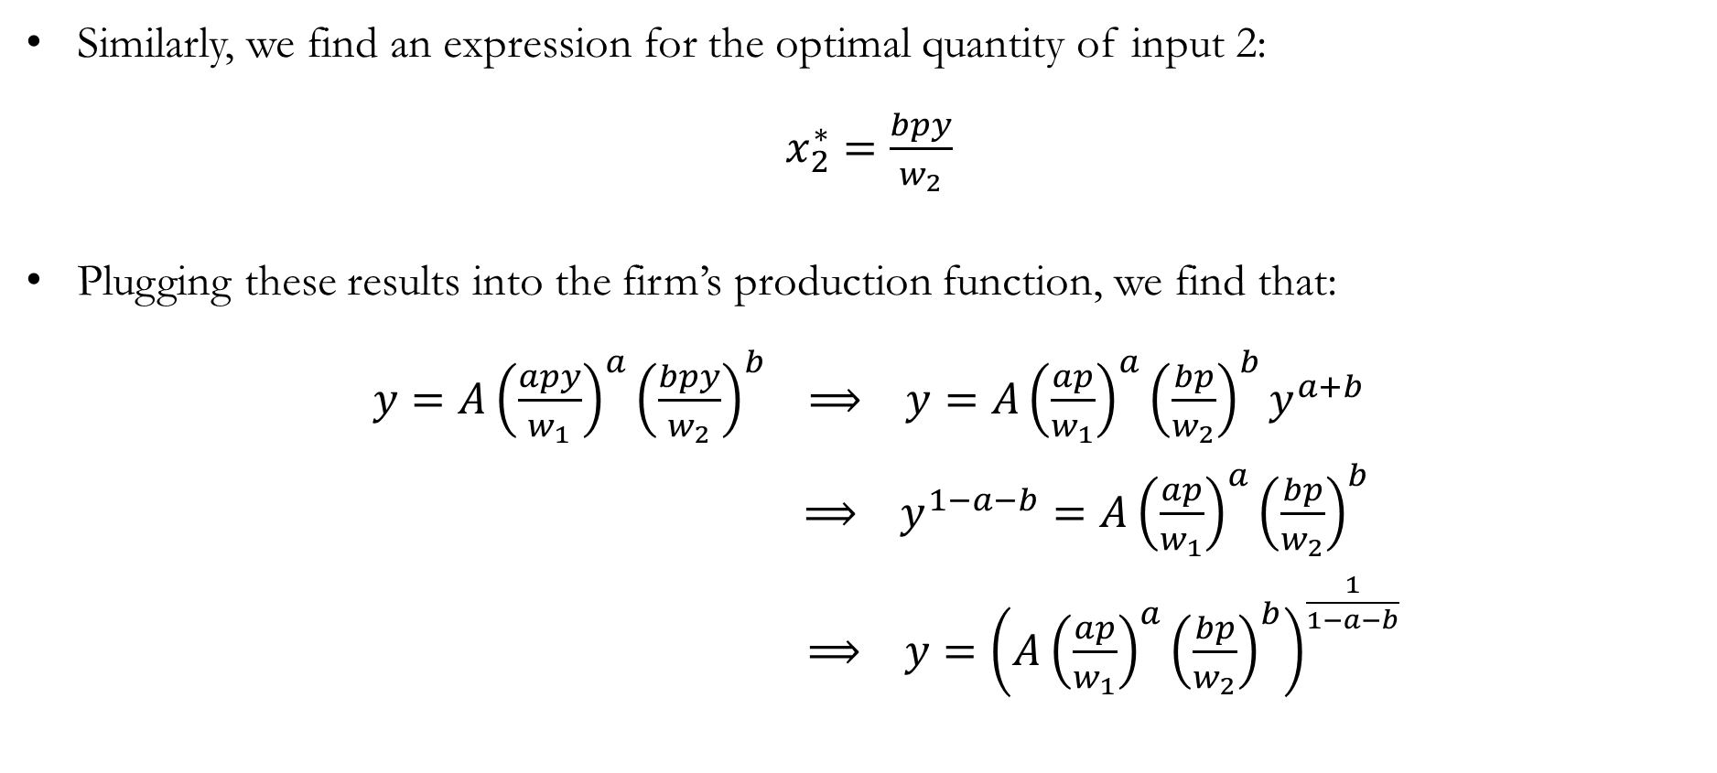
Detour : Profit Maximization
Similarly, we find an expression for the optimal quantity of input 2:
$x_{2}^{∗}=\frac{bpy}{w_{2}}$
Plugging these results into the firm’s production function, we find that:
$y=A{\left(\frac{apy}{w_{1}}\right)}^{a}{\left(\frac{bpy}{w_{2}}\right)}^{b} ⟹ y=A{\left(\frac{ap}{w_{1}}\right)}^{a}{\left(\frac{bp}{w_{2}}\right)}^{b}y^{a+b}$
$⟹ y^{1−a−b}=A{\left(\frac{ap}{w_{1}}\right)}^{a}{\left(\frac{bp}{w_{2}}\right)}^{b}$
$⟹ y={\left(A{\left(\frac{ap}{w_{1}}\right)}^{a}{\left(\frac{bp}{w_{2}}\right)}^{b}\right)}^{\frac{1}{1−a−b}}$

Slide 24

Detour : Profit Maximization
This is the expression for the firm’s supply function:
${y=\left(A{\left(\frac{ap}{w_{1}}\right)}^{a}{\left(\frac{bp}{w_{2}}\right)}^{b}\right)}^{\frac{1}{1−a−b}}$
When $p$ increases, output also increases.
When either factor price increases, output decreases.
Note that this requires that $a+b<1$.

Slide 25
Recap & Preview

Slide 26
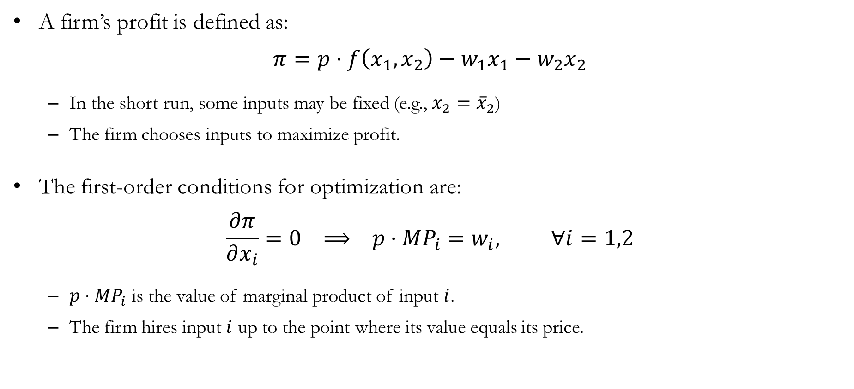
Recap: Profit Maximization
A firm’s profit is defined as:
$$π=p⋅f\left(x_{1},x_{2}\right)−w_{1}x_{1}−w_{2}x_{2}$$
In the short run, some inputs may be fixed (e.g., $x_{2}={\overline{x}}_{2}$)
The firm chooses inputs to maximize profit.
The first-order conditions for optimization are:
$$\frac{∂π}{∂x_{i}}=0 ⟹ p⋅MP_{i}=w_{i}, ∀i=1,2$$
$p⋅MP_{i}$ is the value of marginal product of input $i$.
The firm hires input $i$ up to the point where its value equals its price.

Slide 27
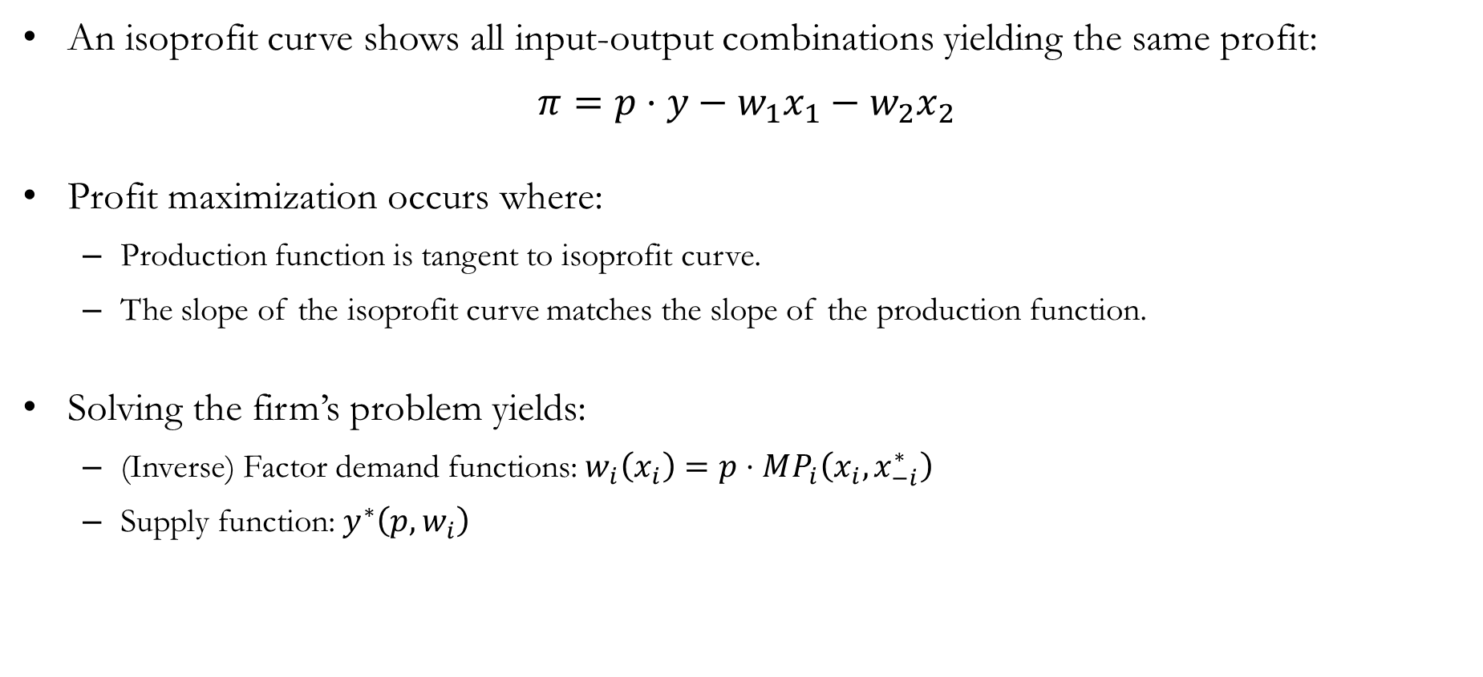
Recap: Profit Maximization
An isoprofit curve shows all input-output combinations yielding the same profit:
$$π=p⋅y−w_{1}x_{1}−w_{2}x_{2}$$
Profit maximization occurs where:
Production function is tangent to isoprofit curve.
The slope of the isoprofit curve matches the slope of the production function.
Solving the firm’s problem yields:
(Inverse) Factor demand functions: $w_{i}\left(x_{i}\right)=p⋅MP_{i}\left(x_{i},x_{−i}^{∗}\right)$
Supply function: $y^{∗}\left(p,w_{i}\right)$

Slide 28
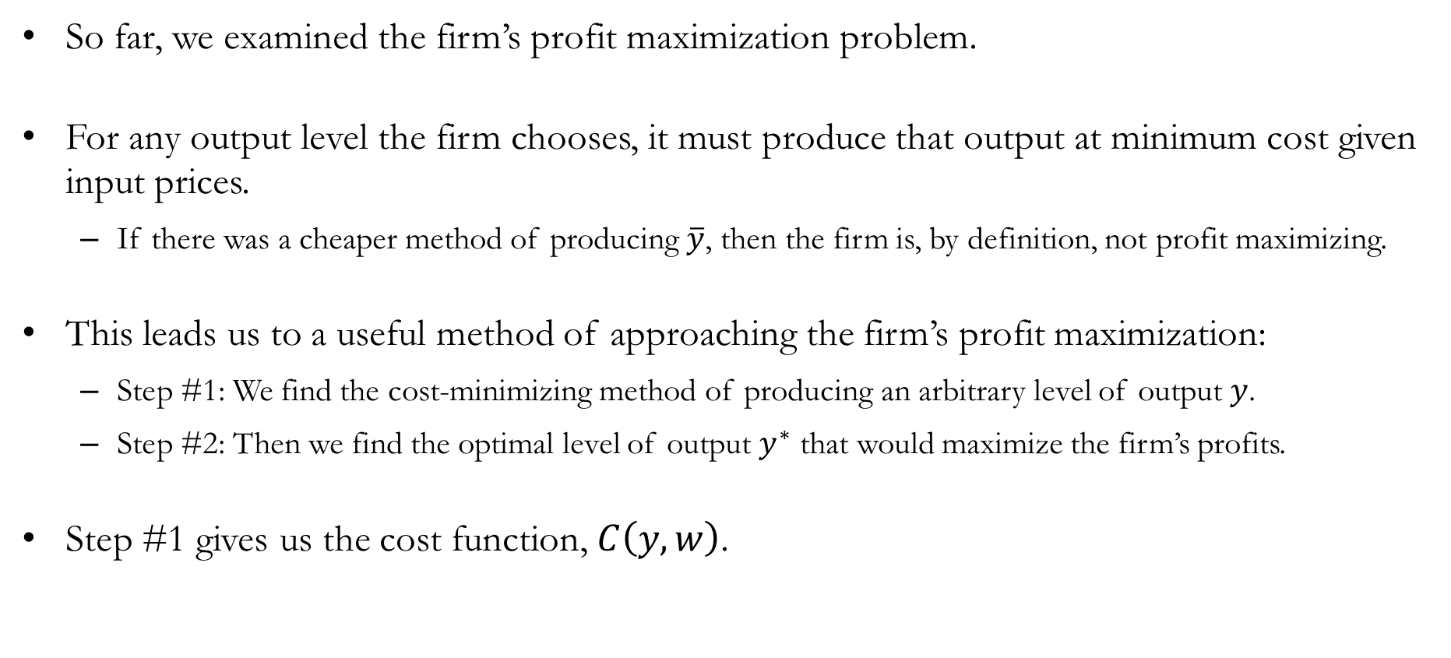
Preview: Cost Minimization
So far, we examined the firm’s profit maximization problem.
For any output level the firm chooses, it must produce that output at minimum cost given input prices.
If there was a cheaper method of producing $\overline{y}$, then the firm is, by definition, not profit maximizing.
This leads us to a useful method of approaching the firm’s profit maximization:
Step #1: We find the cost-minimizing method of producing an arbitrary level of output $y$.
Step #2: Then we find the optimal level of output $y^{∗}$ that would maximize the firm’s profits.
Step #1 gives us the cost function, $C\left(y,w\right)$.

