Slide 1
INTERMEDIATE MICROECONOMIC THEORY
Chapter 21: Cost Minimization

Slide 2
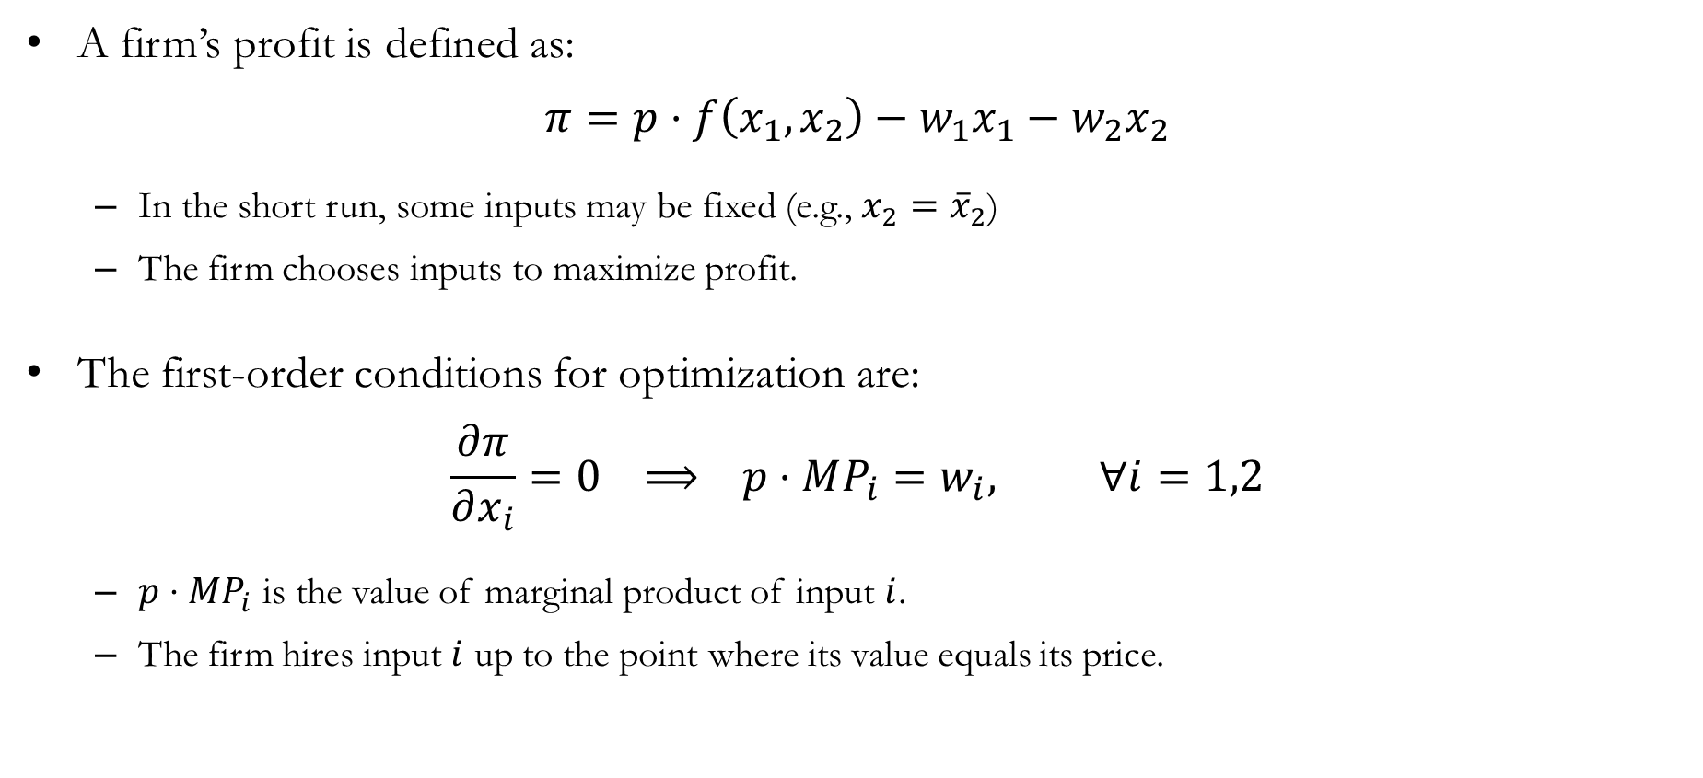
Recap: Profit Maximization
A firm’s profit is defined as:
$$π=p⋅f\left(x_{1},x_{2}\right)−w_{1}x_{1}−w_{2}x_{2}$$
In the short run, some inputs may be fixed (e.g., $x_{2}={\overline{x}}_{2}$)
The firm chooses inputs to maximize profit.
The first-order conditions for optimization are:
$$\frac{∂π}{∂x_{i}}=0 ⟹ p⋅MP_{i}=w_{i}, ∀i=1,2$$
$p⋅MP_{i}$ is the value of marginal product of input $i$.
The firm hires input $i$ up to the point where its value equals its price.

Slide 3
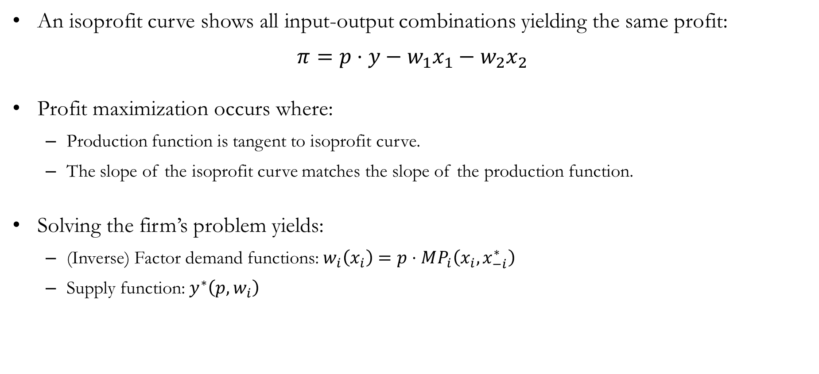
Recap: Profit Maximization
An isoprofit curve shows all input-output combinations yielding the same profit:
$$π=p⋅y−w_{1}x_{1}−w_{2}x_{2}$$
Profit maximization occurs where:
Production function is tangent to isoprofit curve.
The slope of the isoprofit curve matches the slope of the production function.
Solving the firm’s problem yields:
(Inverse) Factor demand functions: $w_{i}\left(x_{i}\right)=p⋅MP_{i}\left(x_{i},x_{−i}^{∗}\right)$
Supply function: $y^{∗}\left(p,w_{i}\right)$

Slide 4
The Cost Minimization Problem

Slide 5
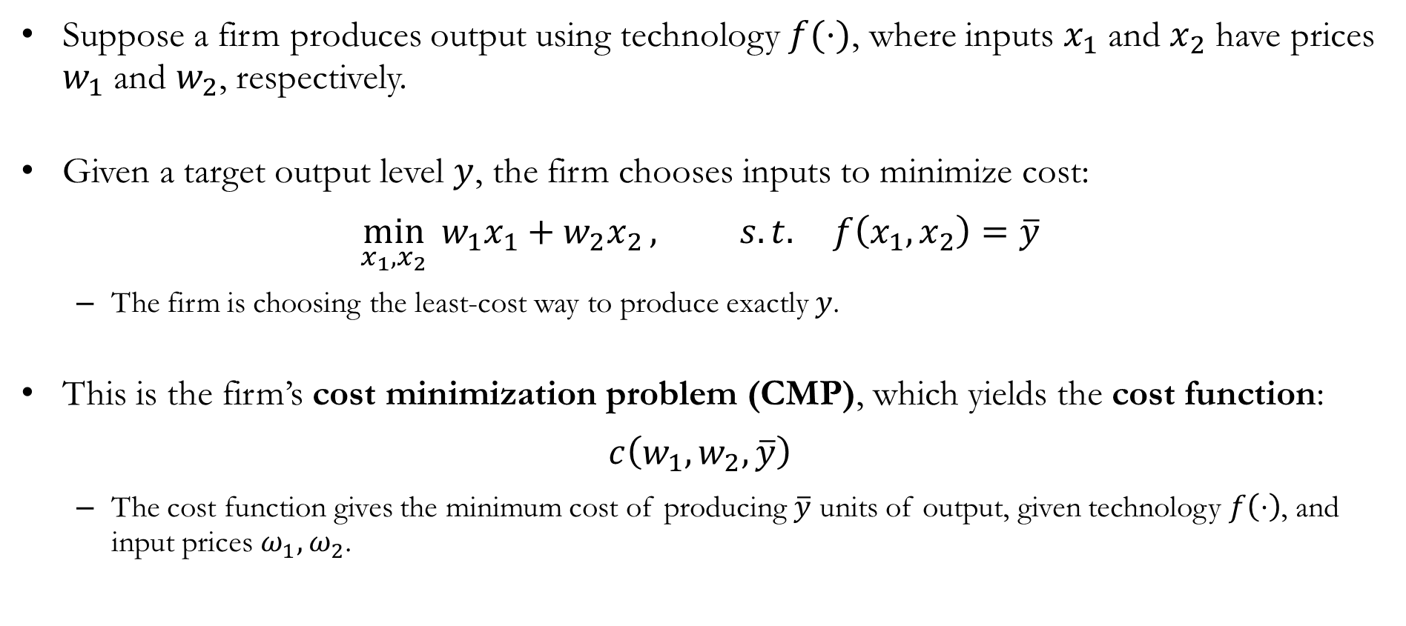
The Cost Minimization Problem
Suppose a firm produces output using technology $f(⋅)$, where inputs $x_{1}$ and $x_{2}$ have prices $w_{1}$ and $w_{2}$, respectively.
Given a target output level $y$, the firm chooses inputs to minimize cost:
$$\min_{x_{1},x_{2}}{{ w}_{1}x_{1}+w_{2}x_{2}}, s.t. f\left(x_{1},x_{2}\right)=\overline{y}$$
The firm is choosing the least-cost way to produce exactly $y$.
This is the firm’s cost minimization problem (CMP), which yields the cost function:
$$c\left(w_{1},w_{2},\overline{y}\right)$$
The cost function gives the minimum cost of producing $\overline{y}$ units of output, given technology $f\left(⋅\right)$, and input prices $ω_{1},ω_{2}$.

Slide 6
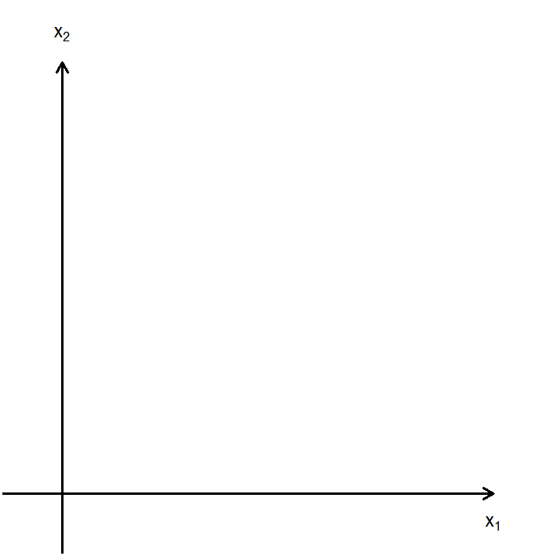
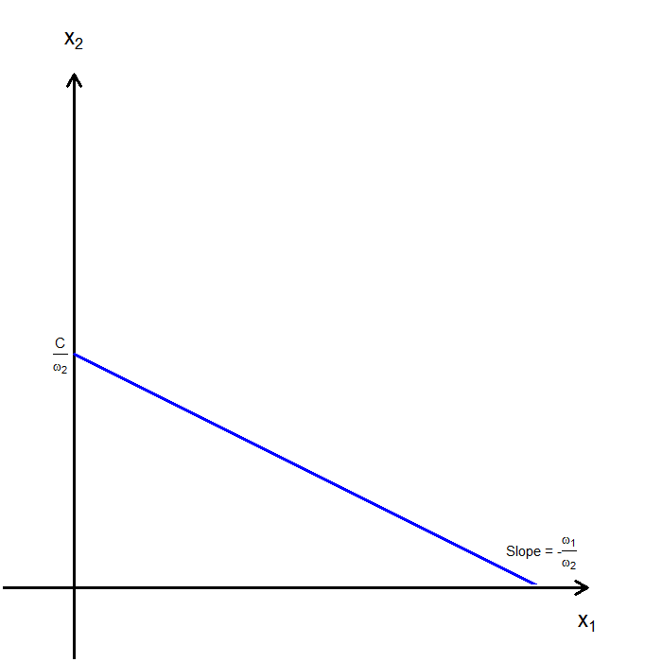
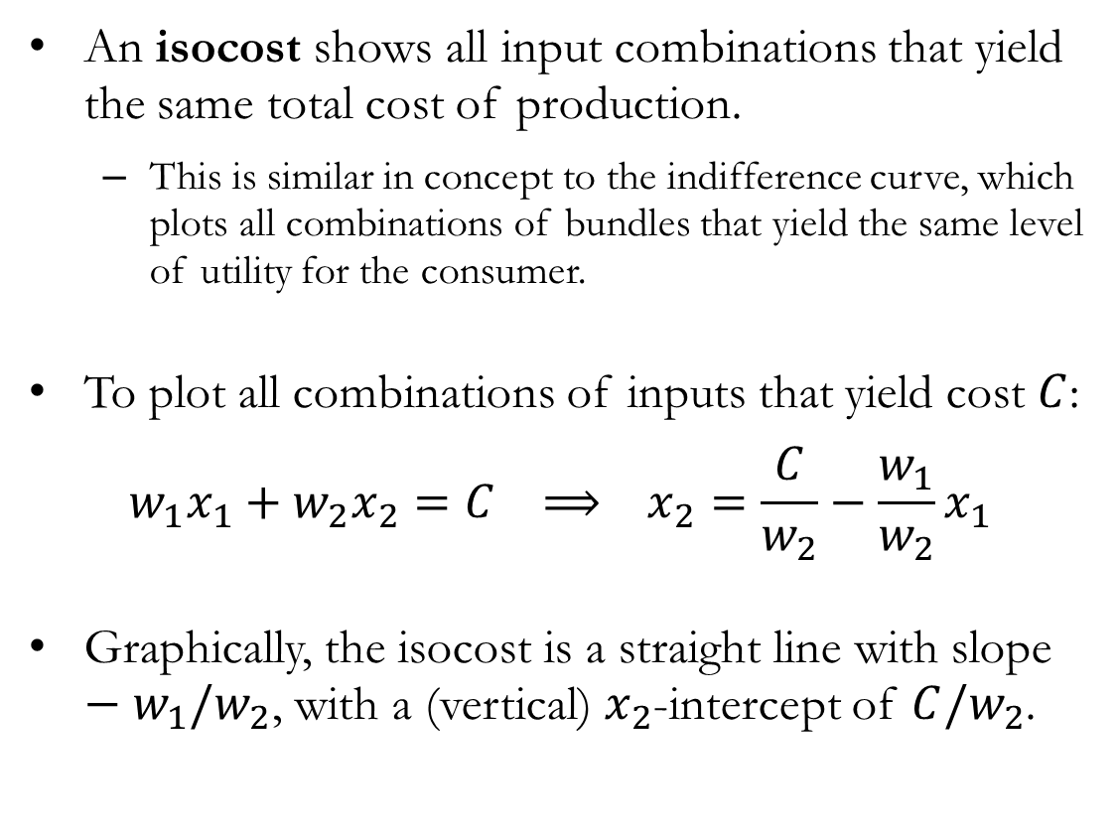
Isocost: The Objective
An isocost shows all input combinations that yield the same total cost of production.
This is similar in concept to the indifference curve, which plots all combinations of bundles that yield the same level of utility for the consumer.
To plot all combinations of inputs that yield cost $C$:
$$w_{1}x_{1}+w_{2}x_{2}=C ⟹ x_{2}=\frac{C}{w_{2}}−\frac{w_{1}}{w_{2}}x_{1}$$
Graphically, the isocost is a straight line with slope $−w_{1}/w_{2}$, with a (vertical) $x_{2}$-intercept of $C/w_{2}$.

Slide 7
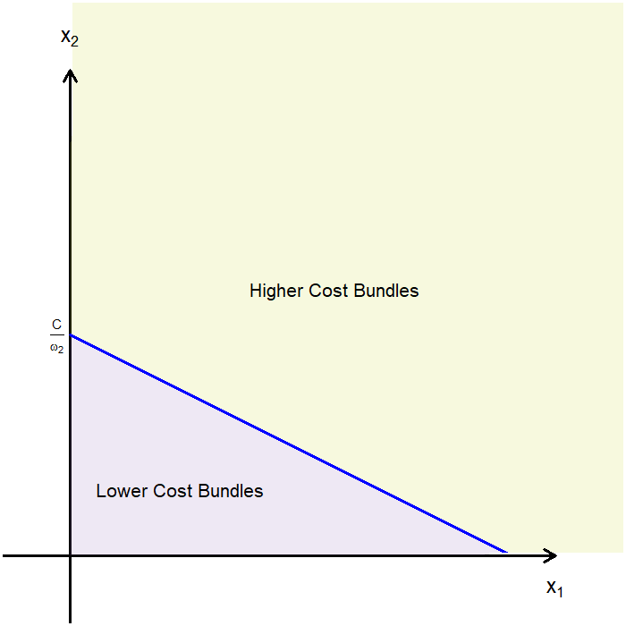
Isocost: The Objective
An isocost effectively divides the input plane into two regions.
The area below a given isocost consists of all input bundles that are cheaper than any bundle on the isocost.
The area above a given isocost consists of all input bundles that are more expensive than any bundle on the isocost.
Similar to how the isoquant divides the input space into two regions.
Also similar to how an indifference curve divides the consumption set into two regions.
Also similar to how the budget line divides the consumption set into two regions.

Slide 8
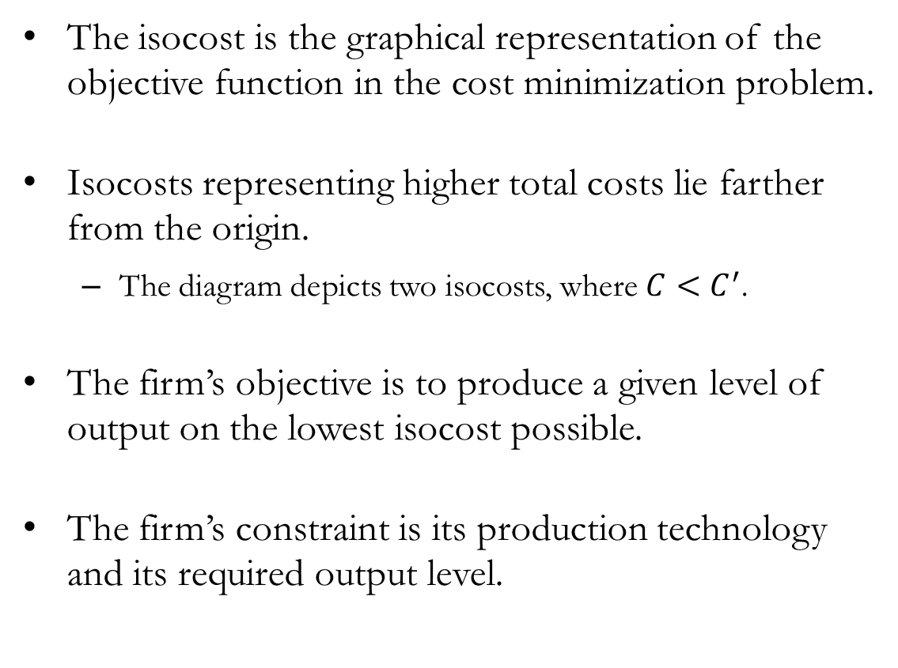
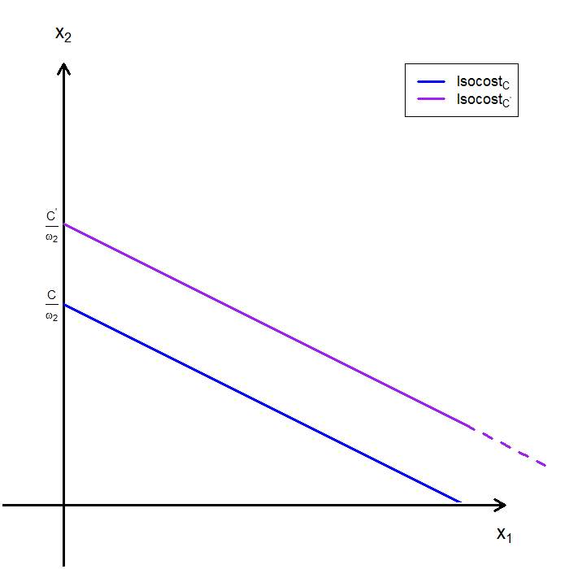
Isocost: The Objective
The isocost is the graphical representation of the objective function in the cost minimization problem.
Isocosts representing higher total costs lie farther from the origin.
The diagram depicts two isocosts, where $C<C^{′}$.
The firm’s objective is to produce a given level of output on the lowest isocost possible.
The firm’s constraint is its production technology and its required output level.

Slide 9
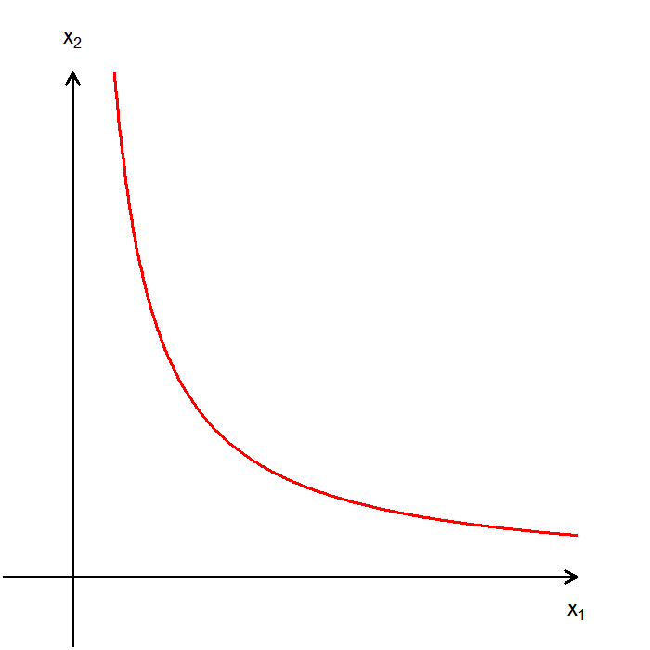
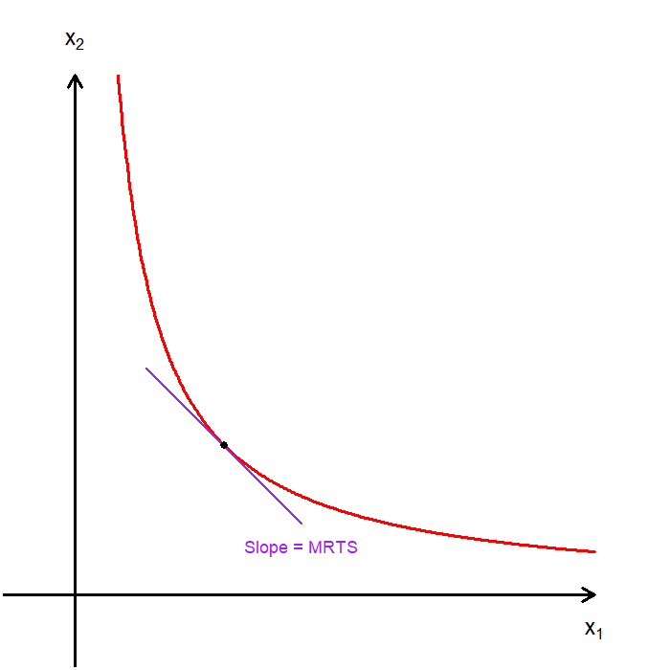
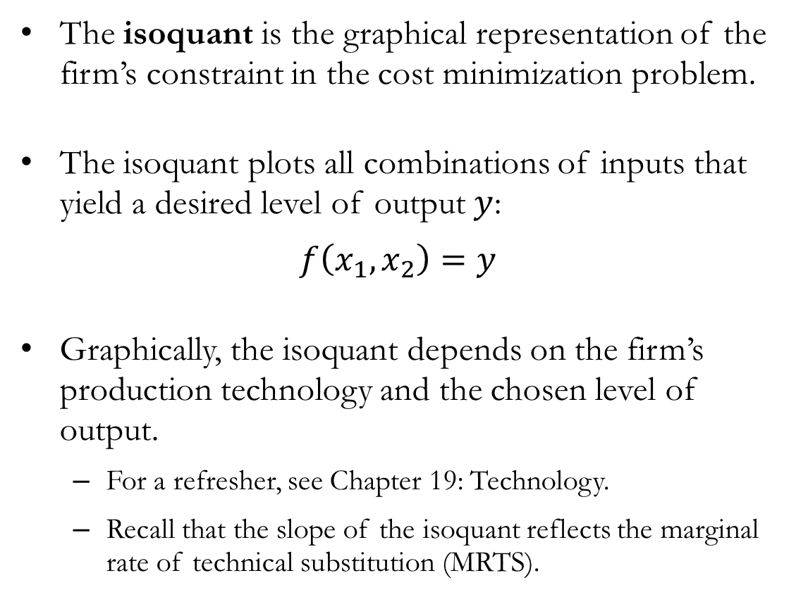
Isoquant: The Constraint
The isoquant is the graphical representation of the firm’s constraint in the cost minimization problem.
The isoquant plots all combinations of inputs that yield a desired level of output $y$:
$$f\left(x_{1},x_{2}\right)=y$$
Graphically, the isoquant depends on the firm’s production technology and the chosen level of output.
For a refresher, see Chapter 19: Technology.
Recall that the slope of the isoquant reflects the marginal rate of technical substitution (MRTS).

Slide 10
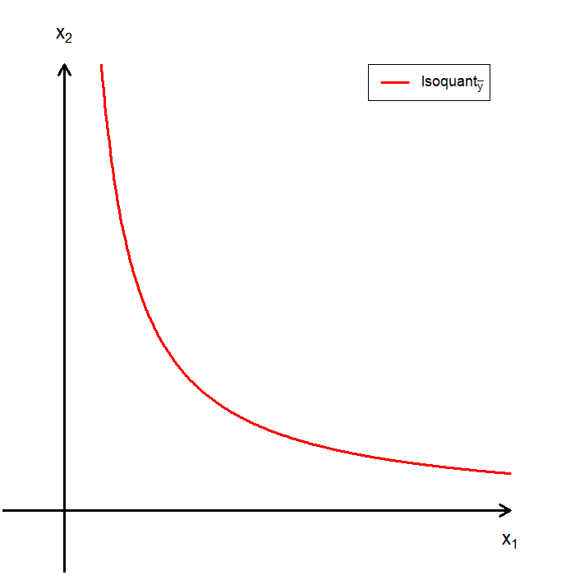
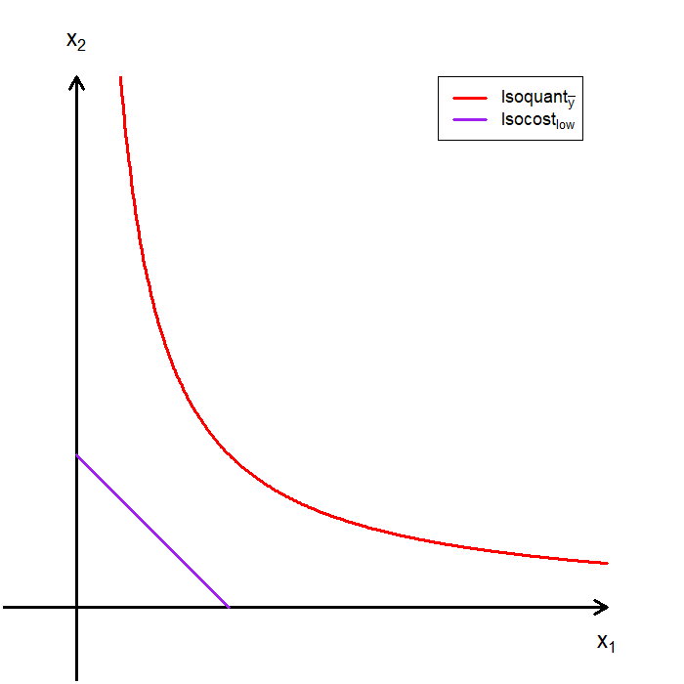
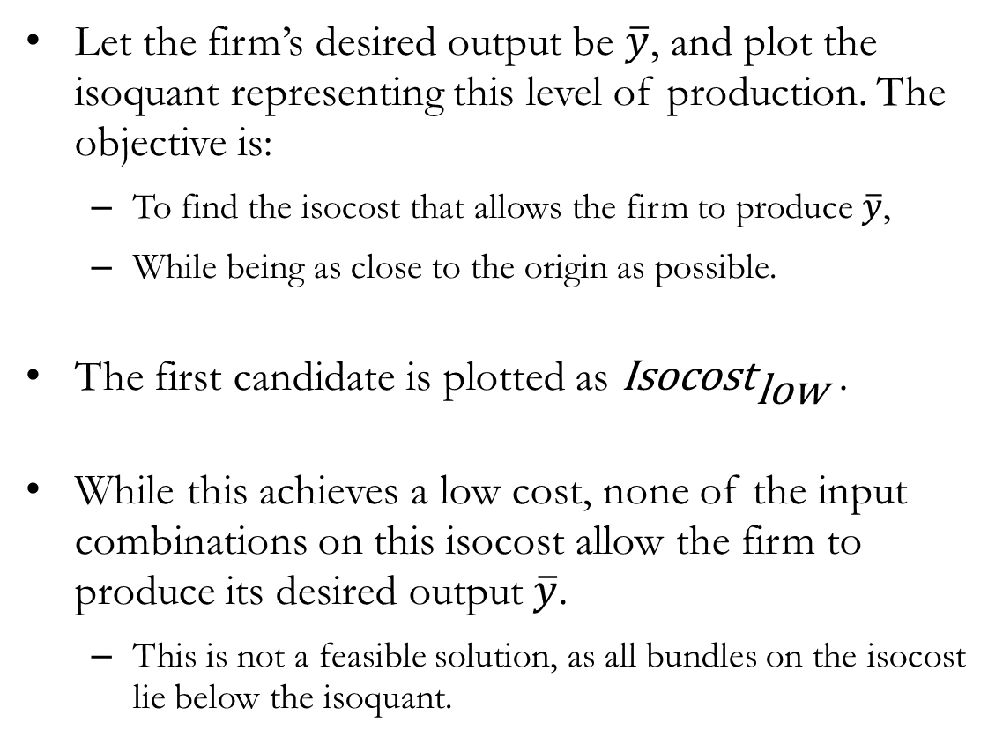
CMP Visualized: Candidate #1
Let the firm’s desired output be $\overline{y}$, and plot the isoquant representing this level of production. The objective is:
To find the isocost that allows the firm to produce $\overline{y}$,
While being as close to the origin as possible.
The first candidate is plotted as ${\text{Isocost}}_{\text{low}}$ .
While this achieves a low cost, none of the input combinations on this isocost allow the firm to produce its desired output $\overline{y}$.
This is not a feasible solution, as all bundles on the isocost lie below the isoquant.

Slide 11
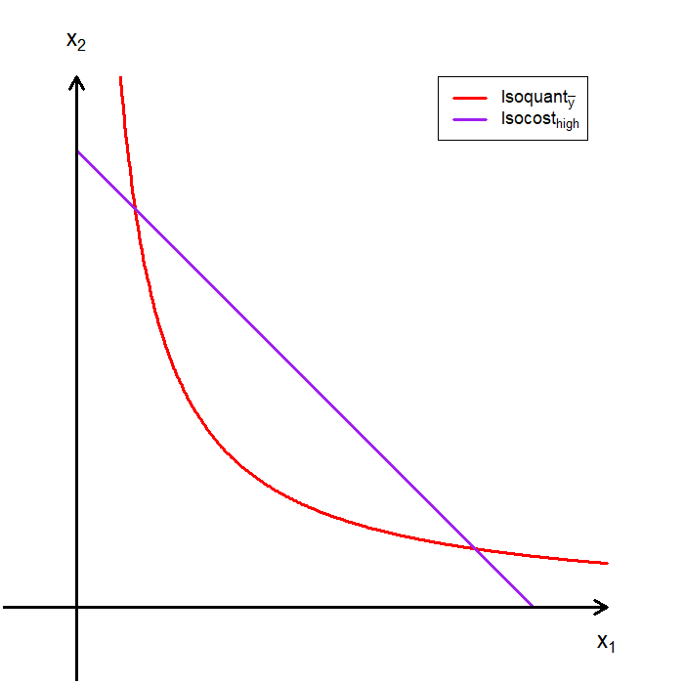
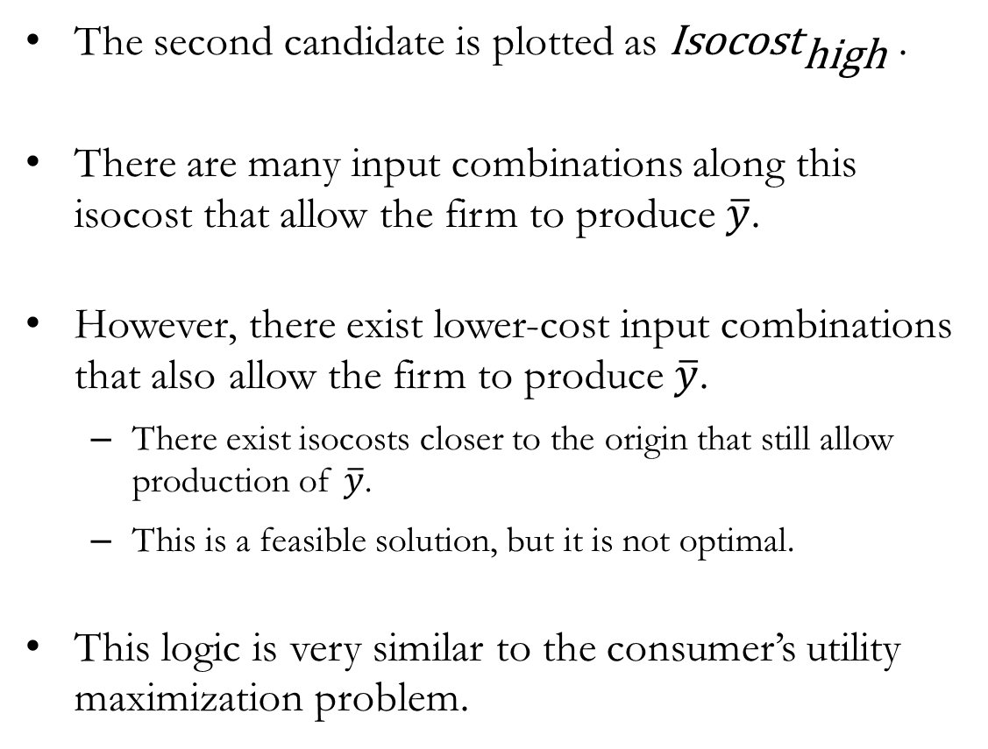
CMP Visualized: Candidate #2
The second candidate is plotted as ${\text{Isocost}}_{\text{high}}$ .
There are many input combinations along this isocost that allow the firm to produce $\overline{y}$.
However, there exist lower-cost input combinations that also allow the firm to produce $\overline{y}$.
There exist isocosts closer to the origin that still allow production of $\overline{y}$.
This is a feasible solution, but it is not optimal.
This logic is very similar to the consumer’s utility maximization problem.

Slide 12
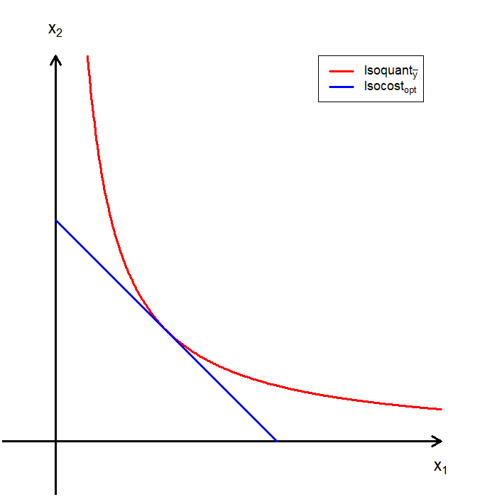
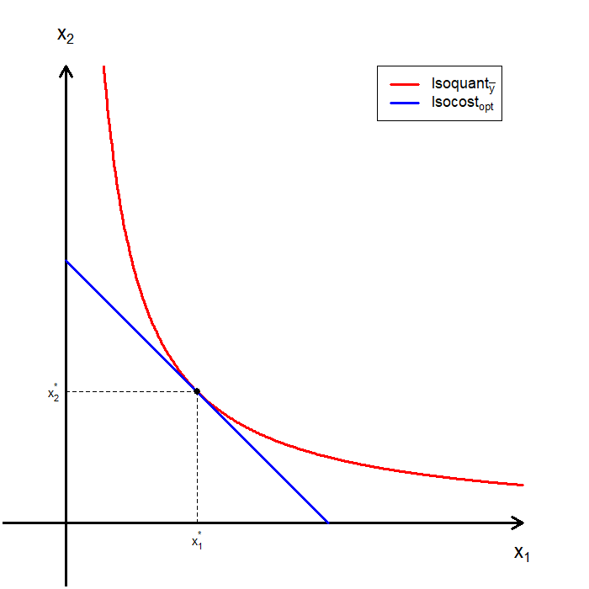
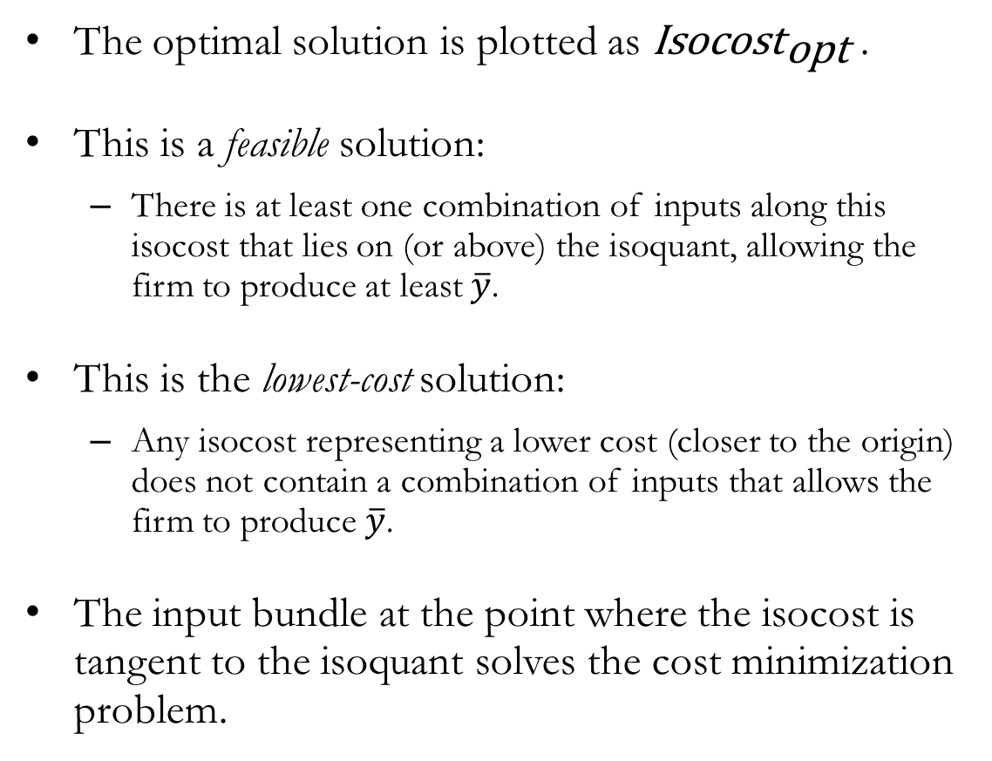
CMP Visualized: Candidate #3
The optimal solution is plotted as ${\text{Isocost}}_{\text{opt}}$ .
This is a feasible solution:
There is at least one combination of inputs along this isocost that lies on (or above) the isoquant, allowing the firm to produce at least $\overline{y}$.
This is the lowest-cost solution:
Any isocost representing a lower cost (closer to the origin) does not contain a combination of inputs that allows the firm to produce $\overline{y}$.
The input bundle at the point where the isocost is tangent to the isoquant solves the cost minimization problem.

Slide 13
The Cost Minimization Problem:
The Mathematics

Slide 14
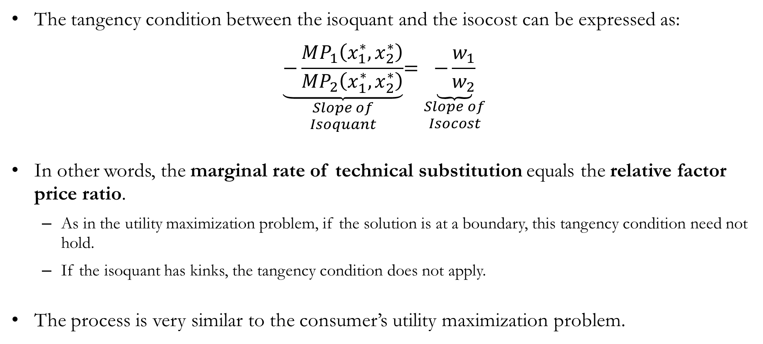
CMP: Graphs to Math
The tangency condition between the isoquant and the isocost can be expressed as:
$$\underset{\begin{aligned}Slope of \\ Isoquant\end{aligned}}{\underbrace{−\frac{MP_{1}\left(x_{1}^{∗},x_{2}^{∗}\right)}{MP_{2}\left(x_{1}^{∗},x_{2}^{∗}\right)}}}=\underset{\begin{aligned}Slope of \\ Isocost\end{aligned}}{\underbrace{−\frac{w_{1}}{w_{2}}}}$$
In other words, the marginal rate of technical substitution equals the relative factor price ratio.
As in the utility maximization problem, if the solution is at a boundary, this tangency condition need not hold.
If the isoquant has kinks, the tangency condition does not apply.
The process is very similar to the consumer’s utility maximization problem.

Slide 15
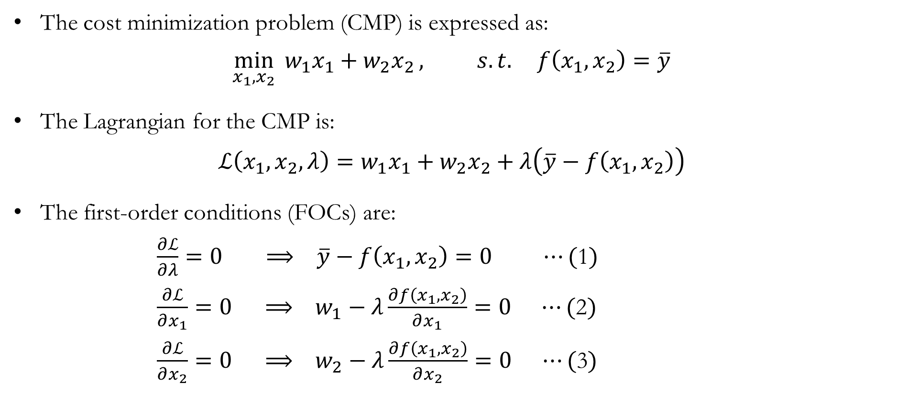
CMP: The Lagrangian
The cost minimization problem (CMP) is expressed as:
$$\min_{x_{1},x_{2}}{{ w}_{1}x_{1}+w_{2}x_{2}}, s.t. f\left(x_{1},x_{2}\right)=\overline{y}$$
The Lagrangian for the CMP is:
$$ℒ\left(x_{1},x_{2},λ\right)=w_{1}x_{1}+w_{2}x_{2}+λ\left(\overline{y}−f\left(x_{1},x_{2}\right)\right)$$
The first-order conditions (FOCs) are:
$\frac{∂ℒ}{∂λ}=0 ⟹ \overline{y}−f\left(x_{1},x_{2}\right)=0 ⋯(\text{1})$
$\frac{∂ℒ}{∂x_{1}}=0 ⟹ w_{1}−λ\frac{∂f\left(x_{1},x_{2}\right)}{∂x_{1}}=0 ⋯(\text{2})$
$\frac{∂ℒ}{∂x_{2}}=0 ⟹ w_{2}−λ\frac{∂f\left(x_{1},x_{2}\right)}{∂x_{2}}=0 ⋯(\text{3})$

Slide 16
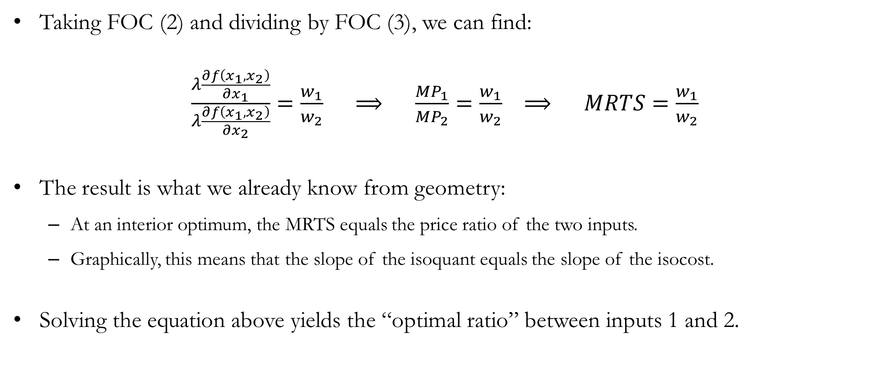
CMP: Tangency Condition
Taking FOC (2) and dividing by FOC (3), we can find:
$\frac{λ\frac{∂f\left(x_{1},x_{2}\right)}{∂x_{1}}}{λ\frac{∂f\left(x_{1},x_{2}\right)}{∂x_{2}}}=\frac{w_{1}}{w_{2}} ⟹ \frac{MP_{1}}{MP_{2}}=\frac{w_{1}}{w_{2}} ⟹ MRTS=\frac{w_{1}}{w_{2}}$
The result is what we already know from geometry:
At an interior optimum, the MRTS equals the price ratio of the two inputs.
Graphically, this means that the slope of the isoquant equals the slope of the isocost.
Solving the equation above yields the “optimal ratio” between inputs 1 and 2.

Slide 17
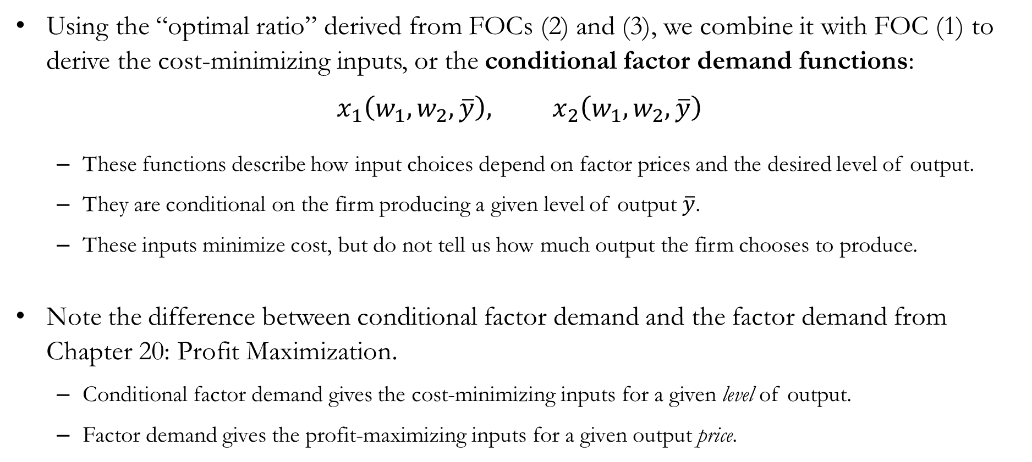
CMP: The Conditional Factor Demand
Using the “optimal ratio” derived from FOCs (2) and (3), we combine it with FOC (1) to derive the cost-minimizing inputs, or the conditional factor demand functions:
$$x_{1}\left(w_{1},w_{2},\overline{y}\right), x_{2}\left(w_{1},w_{2},\overline{y}\right)$$
These functions describe how input choices depend on factor prices and the desired level of output.
They are conditional on the firm producing a given level of output $\overline{y}$.
These inputs minimize cost, but do not tell us how much output the firm chooses to produce.
Note the difference between conditional factor demand and the factor demand from Chapter 20: Profit Maximization.
Conditional factor demand gives the cost-minimizing inputs for a given level of output.
Factor demand gives the profit-maximizing inputs for a given output price.

Slide 18

CMP: The Cost Function
The cost function of the firm is then defined as:
$$c\left(w_{1},w_{2},\overline{y}\right)=w_{1}⋅x_{1}\left(w_{1},w_{2},\overline{y}\right)+w_{2}⋅x_{2}\left(w_{1},w_{2},\overline{y}\right)$$
The cost function describes the lowest cost of producing a given level of output $\overline{y}$, and it depends on:
Input prices $\left(w_{1}, w_{2}\right)$.
Desired level of output $\overline{y}$.
The firm’s production technology $f(⋅)$.

Slide 19
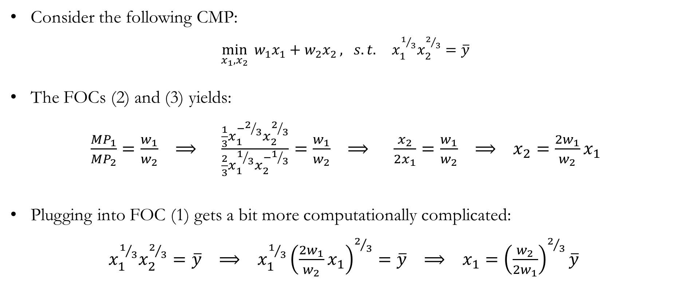
Numerical Example: Cost Minimization
Consider the following CMP:
$\min_{x_{1},x_{2}}{{ w}_{1}x_{1}+w_{2}x_{2}}, s.t. x_{1}^{1/3}x_{2}^{2/3}=\overline{y}$
The FOCs (2) and (3) yields:
$\frac{MP_{1}}{MP_{2}}=\frac{w_{1}}{w_{2}} ⟹ \frac{\frac{1}{3}x_{1}^{−2/3}x_{2}^{2/3}}{\frac{2}{3}x_{1}^{1/3}x_{2}^{−1/3}}=\frac{w_{1}}{w_{2}} ⟹ \frac{x_{2}}{2x_{1}}=\frac{w_{1}}{w_{2}} ⟹ x_{2}=\frac{{2w}_{1}}{w_{2}}x_{1}$
Plugging into FOC (1) gets a bit more computationally complicated:
$x_{1}^{1/3}x_{2}^{2/3}=\overline{y} ⟹ x_{1}^{1/3}{\left(\frac{{2w}_{1}}{w_{2}}x_{1}\right)}^{2/3}=\overline{y} ⟹ x_{1}={\left(\frac{w_{2}}{{2w}_{1}}\right)}^{2/3}\overline{y}$

Slide 20

Numerical Example: Cost Minimization
The optimal ratio tells us:
$x_{2}=\frac{{2w}_{1}}{w_{2}}x_{1} ⟹ x_{2}=\frac{{2w}_{1}}{w_{2}}\left({\left(\frac{w_{2}}{{2w}_{1}}\right)}^{2/3}\overline{y}\right) ⟹ x_{2}={\left(\frac{{2w}_{1}}{w_{2}}\right)}^{1/3}\overline{y}$
The cost function is then:
$c\left(w_{1},w_{2},\overline{y}\right)=w_{1}{\left(\frac{w_{2}}{{2w}_{1}}\right)}^{2/3}\overline{y}+w_{2}{\left(\frac{{2w}_{1}}{w_{2}}\right)}^{1/3}\overline{y}$
$⟹ c\left(w_{1},w_{2},\overline{y}\right)=\frac{3}{2^{2/3}}w_{1}^{1/3}w_{2}^{2/3}\overline{y}$

Slide 21
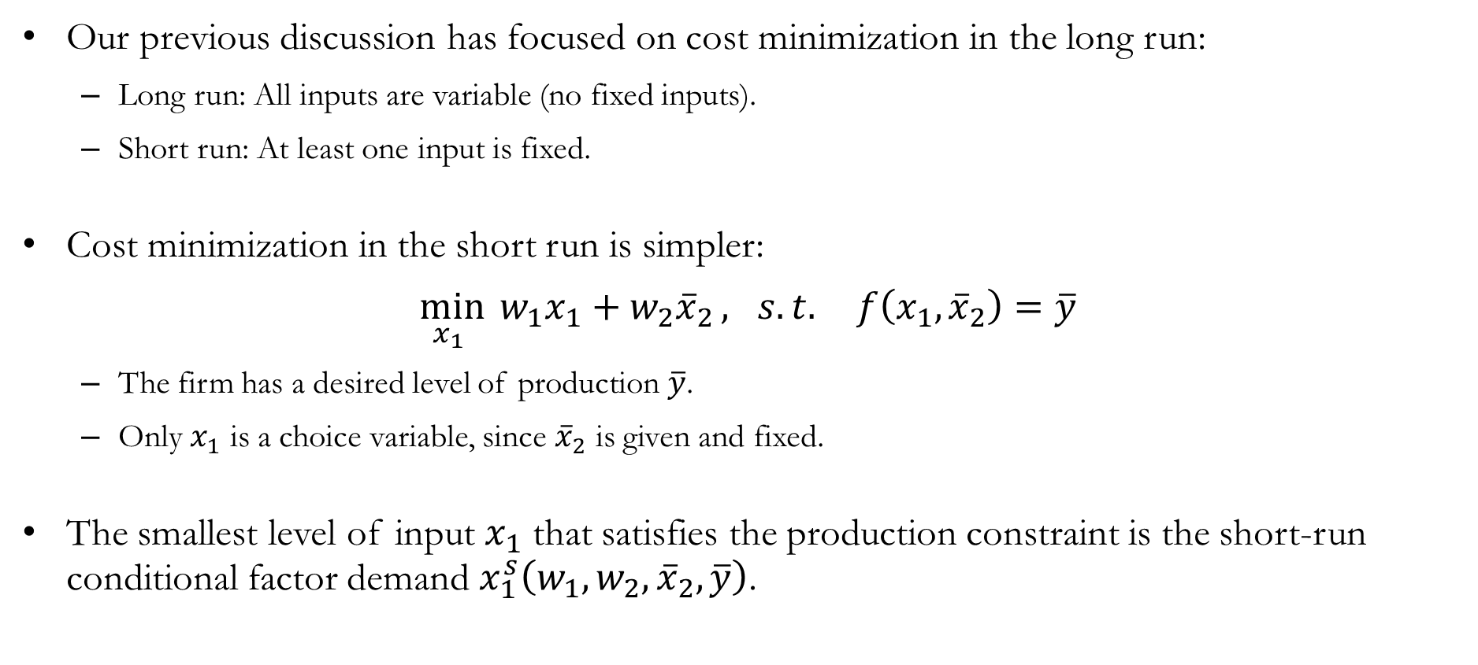
CMP in the Short Run
Our previous discussion has focused on cost minimization in the long run:
Long run: All inputs are variable (no fixed inputs).
Short run: At least one input is fixed.
Cost minimization in the short run is simpler:
$\min_{x_{1} }{{ w}_{1}x_{1}+w_{2}{\overline{x}}_{2}}, s.t. f\left(x_{1},{\overline{x}}_{2}\right)=\overline{y}$
The firm has a desired level of production $\overline{y}$.
Only $x_{1}$ is a choice variable, since ${\overline{x}}_{2}$ is given and fixed.
The smallest level of input $x_{1}$ that satisfies the production constraint is the short-run conditional factor demand $x_{1}^{s}\left(w_{1},w_{2},{\overline{x}}_{2},\overline{y}\right)$.

Slide 22
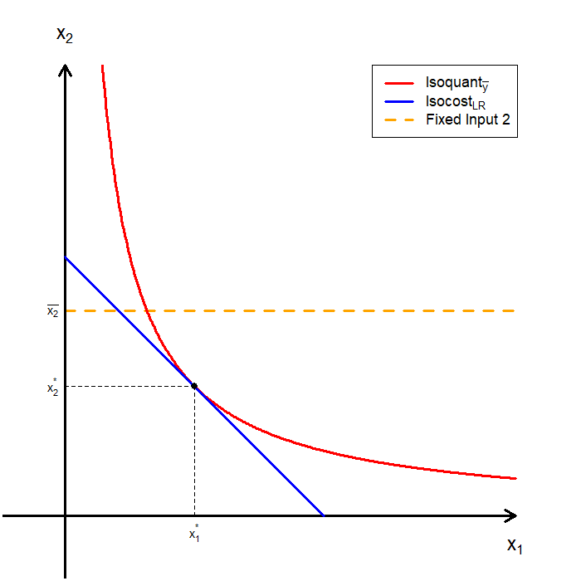
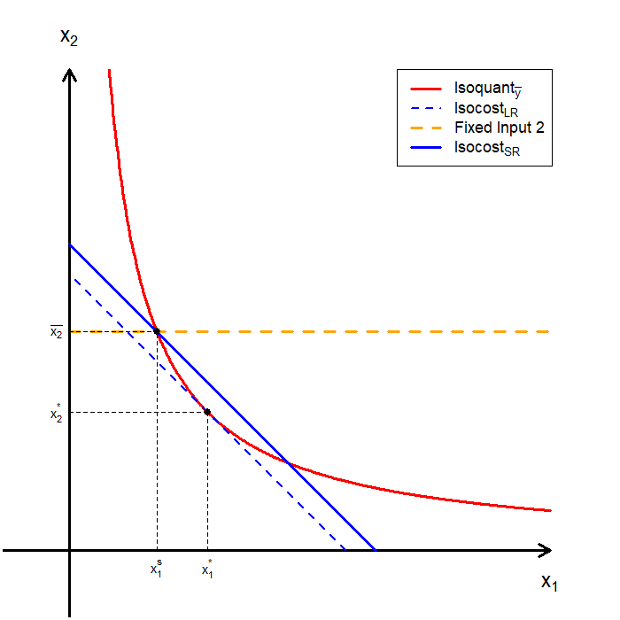
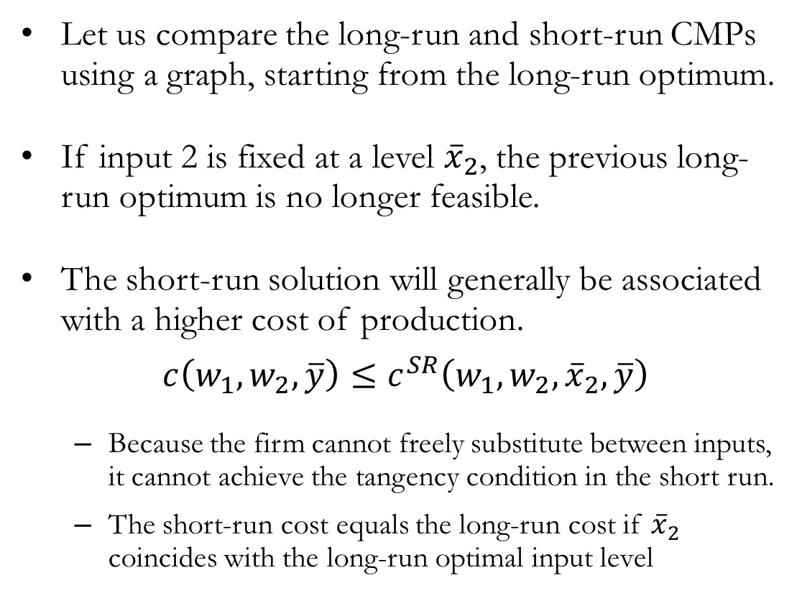
CMP in the Short Run Visualized
Let us compare the long-run and short-run CMPs using a graph, starting from the long-run optimum.
If input 2 is fixed at a level ${\overline{x}}_{2}$, the previous long-run optimum is no longer feasible.
The short-run solution will generally be associated with a higher cost of production.
$$c\left(w_{1},w_{2},\overline{y}\right)≤c^{SR}\left(w_{1},w_{2},{\overline{x}}_{2},\overline{y}\right)$$
Because the firm cannot freely substitute between inputs, it cannot achieve the tangency condition in the short run.
The short-run cost equals the long-run cost if ${\overline{x}}_{2}$ coincides with the long-run optimal input level

Slide 23

Numerical Example: Short Run Cost Minimization
Consider the following CMP:
$\min_{x_{1} }{{ w}_{1}x_{1}+w_{2}{\overline{x}}_{2}}, s.t. x_{1}^{1/3}{\overline{x}}_{2}^{2/3}=\overline{y}$
The production constraint solely dictates the conditional factor demand of input 1:
$$x_{1}^{1/3}{\overline{x}}_{2}^{2/3}=\overline{y} ⟹ x_{1}^{1/3}=\frac{\overline{y}}{{\overline{x}}_{2}^{2/3}} ⟹ x_{1}=\frac{{\overline{y}}^{3}}{{\overline{x}}_{2}^{2}}$$
The short run cost function is then:
$$c^{SR}(w_{1},w_{2},{\overline{x}}_{2},\overline{y})=w_{1}\frac{{\overline{y}}^{3}}{{\overline{x}}_{2}^{2}}+w_{2}{\overline{x}}_{2}$$

Slide 24
Recap & Preview

Slide 25
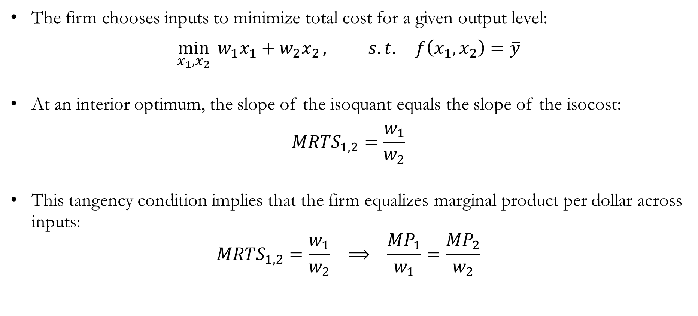
Recap: Cost Minimization
The firm chooses inputs to minimize total cost for a given output level:
$$\min_{x_{1},x_{2}}{{ w}_{1}x_{1}+w_{2}x_{2}}, s.t. f\left(x_{1},x_{2}\right)=\overline{y}$$
At an interior optimum, the slope of the isoquant equals the slope of the isocost:
$$MRTS_{1,2}=\frac{w_{1}}{w_{2}}$$
This tangency condition implies that the firm equalizes marginal product per dollar across inputs:
$$MRTS_{1,2}=\frac{w_{1}}{w_{2}} ⟹ \frac{MP_{1}}{w_{1}}=\frac{MP_{2}}{w_{2}}$$

Slide 26
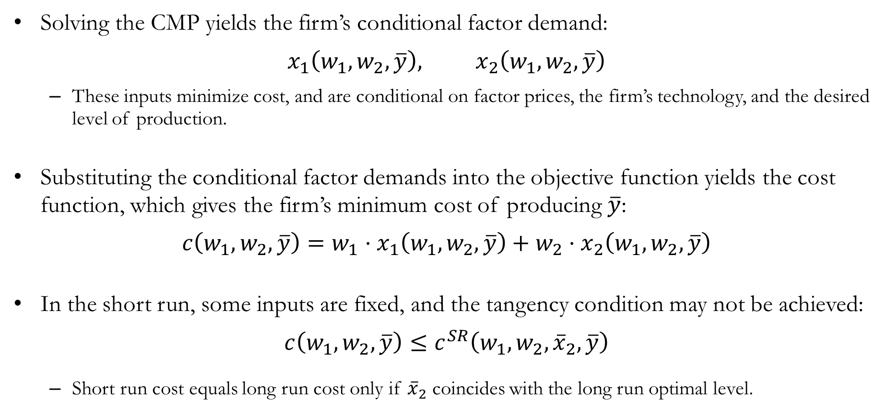
Recap: Cost Minimization
Solving the CMP yields the firm’s conditional factor demand:
$$x_{1}\left(w_{1},w_{2},\overline{y}\right), x_{2}\left(w_{1},w_{2},\overline{y}\right)$$
These inputs minimize cost, and are conditional on factor prices, the firm’s technology, and the desired level of production.
Substituting the conditional factor demands into the objective function yields the cost function, which gives the firm’s minimum cost of producing $\overline{y}$:
$$c\left(w_{1},w_{2},\overline{y}\right)=w_{1}⋅x_{1}\left(w_{1},w_{2},\overline{y}\right)+w_{2}⋅x_{2}\left(w_{1},w_{2},\overline{y}\right)$$
In the short run, some inputs are fixed, and the tangency condition may not be achieved:
$$c\left(w_{1},w_{2},\overline{y}\right)≤c^{SR}\left(w_{1},w_{2},{\overline{x}}_{2},\overline{y}\right)$$
Short run cost equals long run cost only if ${\overline{x}}_{2}$ coincides with the long run optimal level.

Slide 27
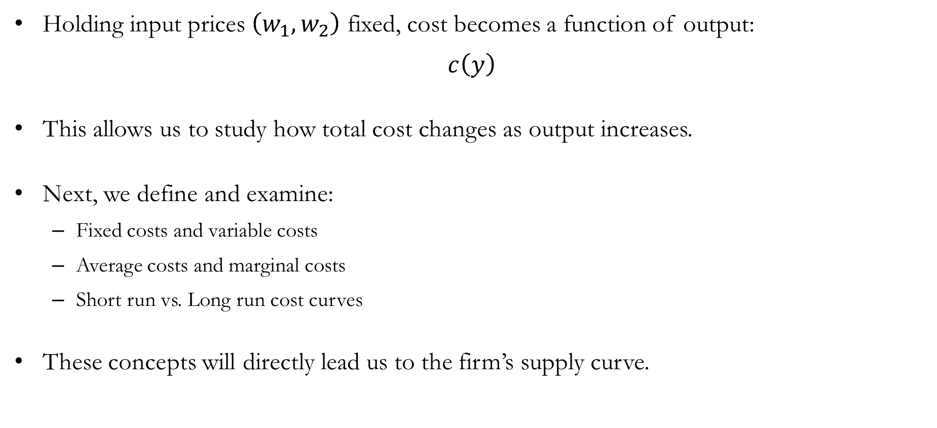
Preview: Cost Curves
Holding input prices $\left(w_{1},w_{2}\right)$ fixed, cost becomes a function of output:
$$c\left(y\right)$$
This allows us to study how total cost changes as output increases.
Next, we define and examine:
Fixed costs and variable costs
Average costs and marginal costs
Short run vs. Long run cost curves
These concepts will directly lead us to the firm’s supply curve.

