Slide 1
INTERMEDIATE MICROECONOMIC THEORY
Chapter 22: Cost Curves

Slide 2
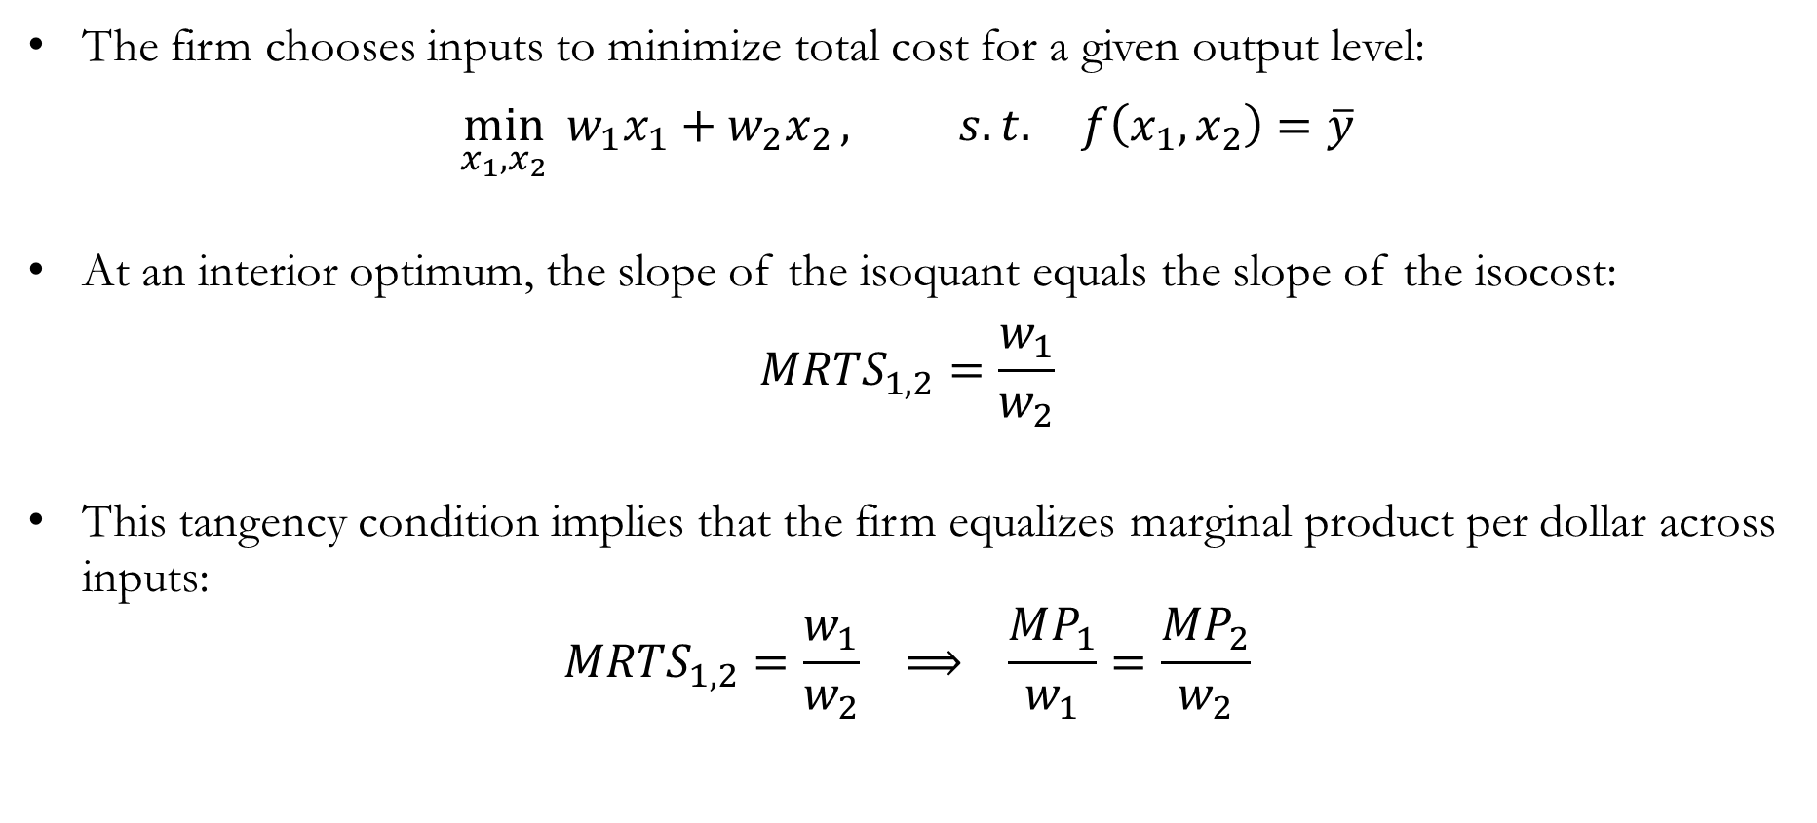
Recap: Cost Minimization
The firm chooses inputs to minimize total cost for a given output level:
$$\min_{x_{1},x_{2}}{{ w}_{1}x_{1}+w_{2}x_{2}}, s.t. f\left(x_{1},x_{2}\right)=\overline{y}$$
At an interior optimum, the slope of the isoquant equals the slope of the isocost:
$$MRTS_{1,2}=\frac{w_{1}}{w_{2}}$$
This tangency condition implies that the firm equalizes marginal product per dollar across inputs:
$$MRTS_{1,2}=\frac{w_{1}}{w_{2}} ⟹ \frac{MP_{1}}{w_{1}}=\frac{MP_{2}}{w_{2}}$$

Slide 3
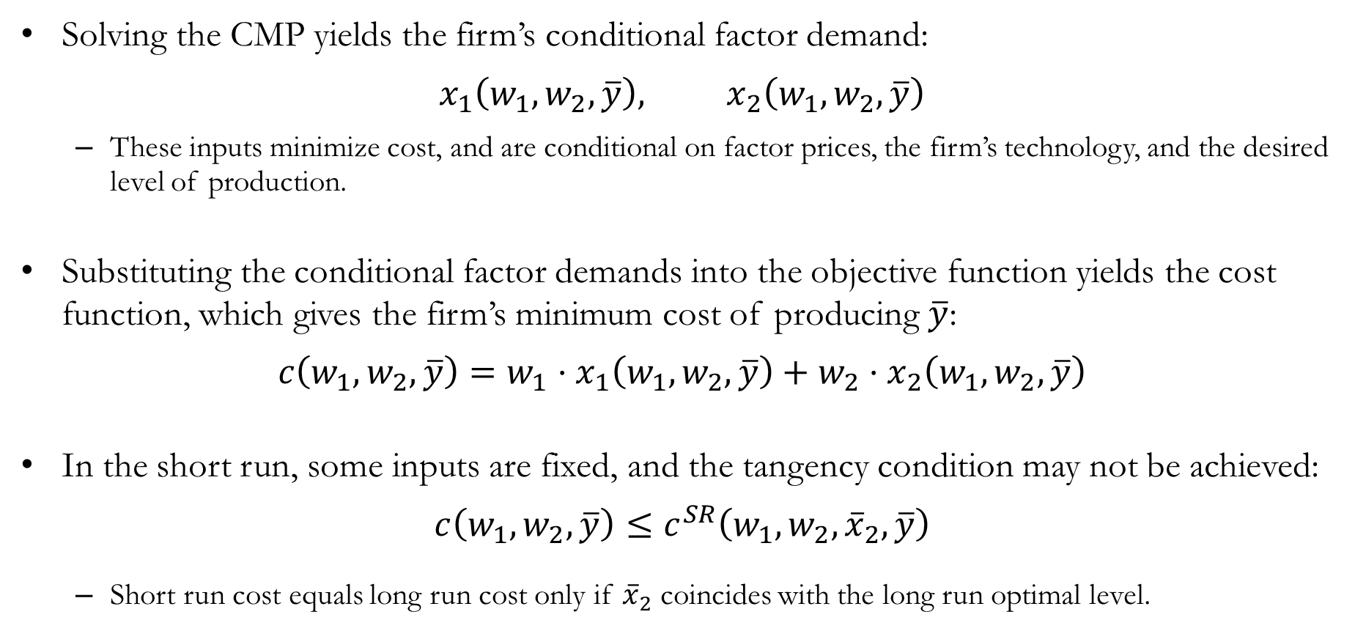
Recap: Cost Minimization
Solving the CMP yields the firm’s conditional factor demand:
$$x_{1}\left(w_{1},w_{2},\overline{y}\right), x_{2}\left(w_{1},w_{2},\overline{y}\right)$$
These inputs minimize cost, and are conditional on factor prices, the firm’s technology, and the desired level of production.
Substituting the conditional factor demands into the objective function yields the cost function, which gives the firm’s minimum cost of producing $\overline{y}$:
$$c\left(w_{1},w_{2},\overline{y}\right)=w_{1}⋅x_{1}\left(w_{1},w_{2},\overline{y}\right)+w_{2}⋅x_{2}\left(w_{1},w_{2},\overline{y}\right)$$
In the short run, some inputs are fixed, and the tangency condition may not be achieved:
$$c\left(w_{1},w_{2},\overline{y}\right)≤c^{SR}\left(w_{1},w_{2},{\overline{x}}_{2},\overline{y}\right)$$
Short run cost equals long run cost only if ${\overline{x}}_{2}$ coincides with the long run optimal level.

Slide 4
Various Types of Costs

Slide 5
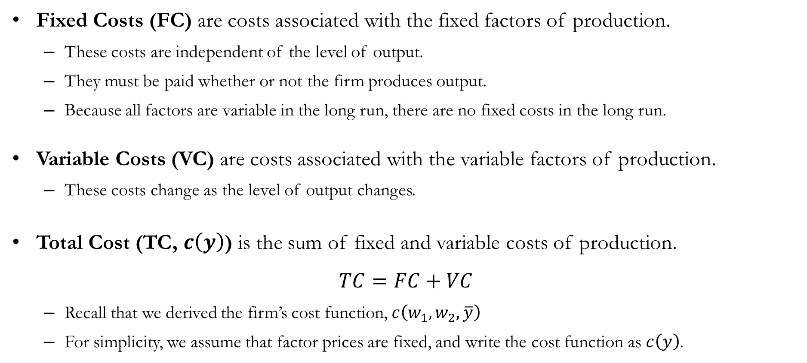
Fixed, Variable, and Total Costs
Fixed Costs (FC) are costs associated with the fixed factors of production.
These costs are independent of the level of output.
They must be paid whether or not the firm produces output.
Because all factors are variable in the long run, there are no fixed costs in the long run.
Variable Costs (VC) are costs associated with the variable factors of production.
These costs change as the level of output changes.
Total Cost (TC, $c\left(y\right)$) is the sum of fixed and variable costs of production.
$$TC=FC+VC$$
Recall that we derived the firm’s cost function, $c\left(w_{1},w_{2},\overline{y}\right)$
For simplicity, we assume that factor prices are fixed, and write the cost function as $c\left(y\right)$.

Slide 6
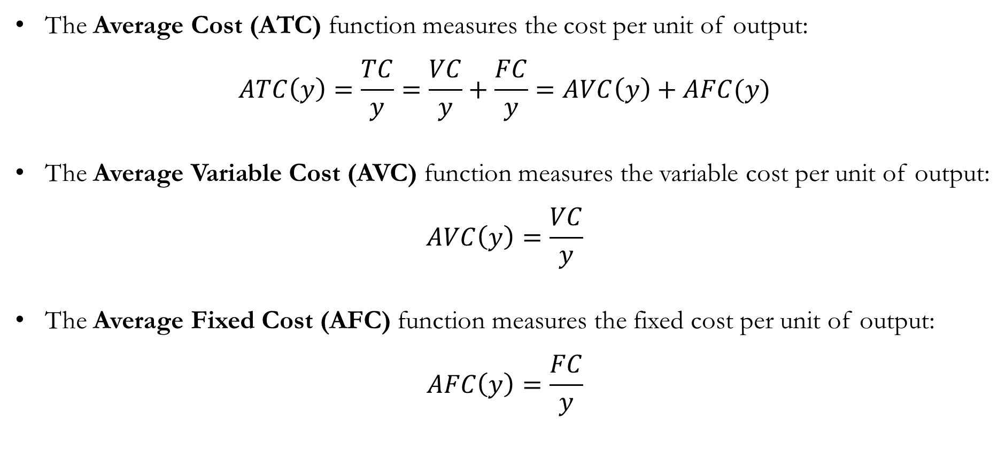
Average Costs
The Average Cost (ATC) function measures the cost per unit of output:
$$ATC\left(y\right)=\frac{TC}{y}=\frac{VC}{y}+\frac{FC}{y}=AVC\left(y\right)+AFC(y)$$
The Average Variable Cost (AVC) function measures the variable cost per unit of output:
$$AVC\left(y\right)=\frac{VC}{y}$$
The Average Fixed Cost (AFC) function measures the fixed cost per unit of output:
$$AFC\left(y\right)=\frac{FC}{y}$$

Slide 7
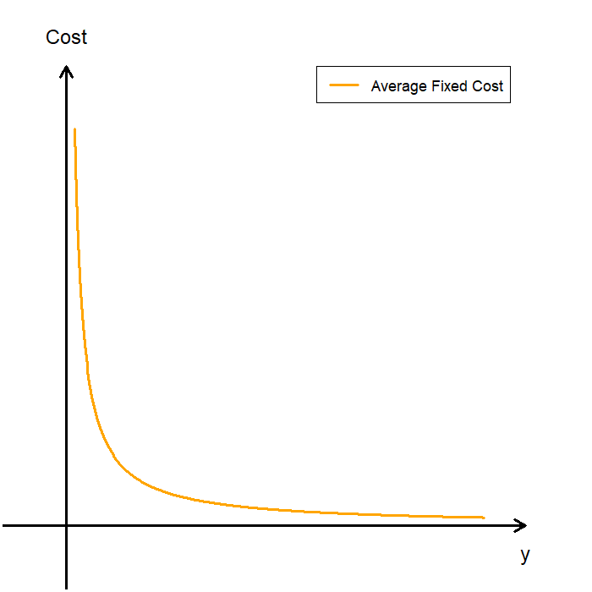
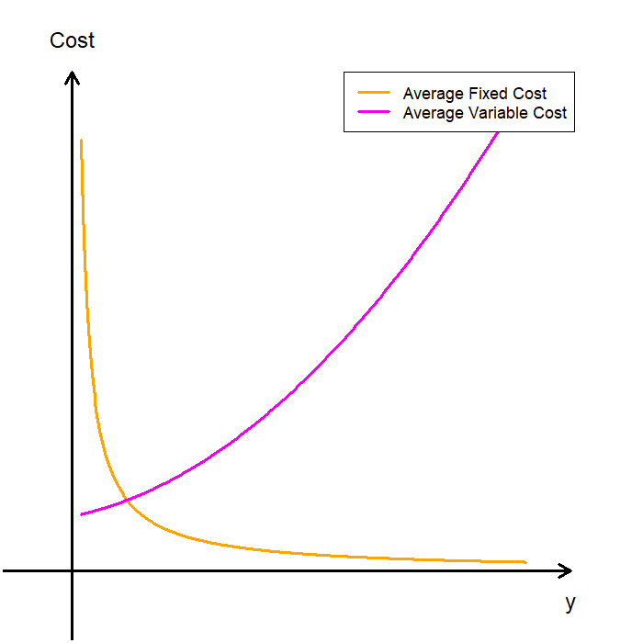
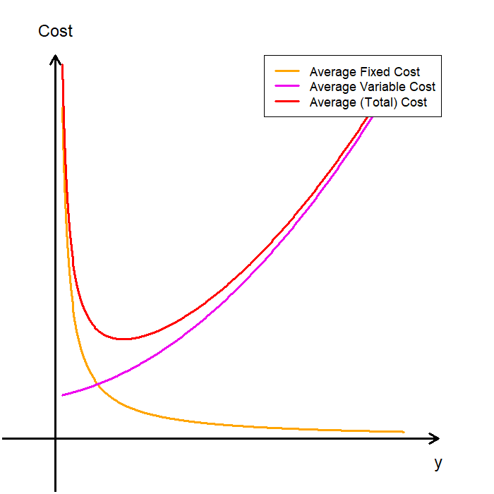
The Average Cost Curves Visualized
AFC declines as output increases, because fixed costs are spread over more units of output.
AVC typically slopes upward, due to diminishing marginal product of factors.
ATC is the sum of AFC and AVC, and is typically U-shaped.
When the firm produces low levels of output, ATC falls due to the rapid decline in AFC.
As the firm increases output, AFC becomes very small, and ATC approaches AVC.
Since AFC>0, ATC always lies above AVC.

Slide 8
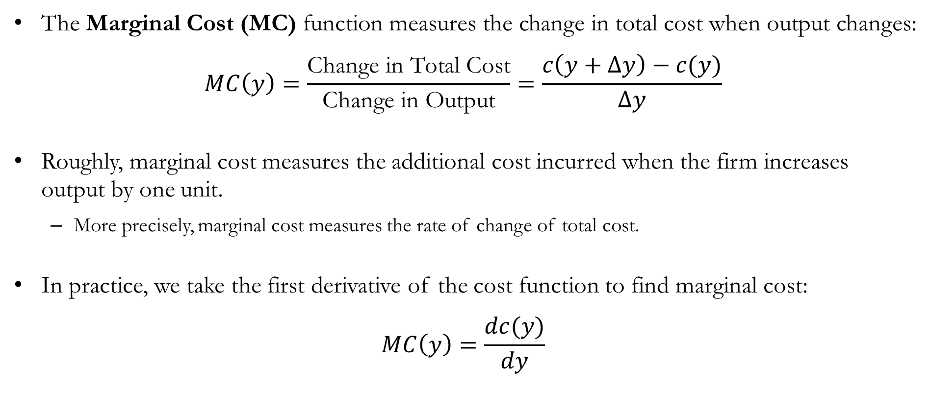
Marginal Cost
The Marginal Cost (MC) function measures the change in total cost when output changes:
$$MC\left(y\right)=\frac{\text{Change} \text{in} \text{Total} \text{Cost}}{\text{Change} \text{in} \text{Output}}=\frac{c\left(y+Δy\right)−c(y)}{Δy}$$
Roughly, marginal cost measures the additional cost incurred when the firm increases output by one unit.
More precisely, marginal cost measures the rate of change of total cost.
In practice, we take the first derivative of the cost function to find marginal cost:
$$MC\left(y\right)=\frac{dc(y)}{dy}$$

Slide 9
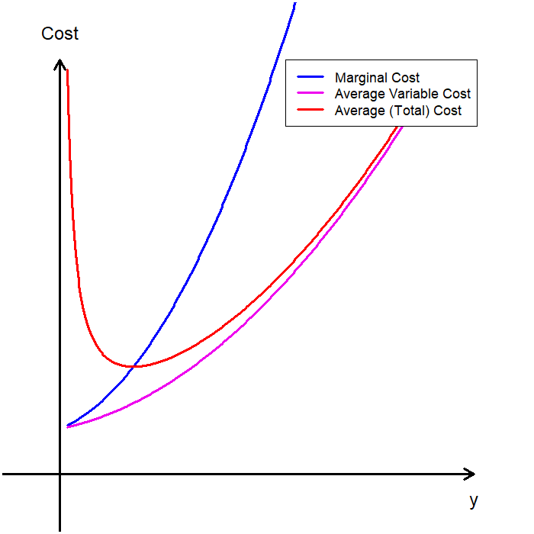
The Marginal Cost Curve Visualized
Claim: The MC curve passes through the minimum of both the AVC and ATC curves.
When MC < AC, ATC is decreasing.
When MC > AC, ATC is increasing.
Therefore, MC = ATC at the minimum of the ATC curve.
This relationship between marginal and average values appears in many contexts:
When term GPA is below CGPA, your CGPA falls.
When term GPA is above CGPA, your CGPA rises.
Therefore, your CGPA stops changing when your term GPA equals your CGPA.

Slide 10

Numerical Example: TC, FC, VC, AC, and MC
Suppose a firm has the following total cost function:
$$c\left(y\right)=5y^{2}−3y+150$$
Compute the following:
Fixed Cost
Variable Cost
Average Total Cost
Average Fixed Cost
Average Variable Cost
Marginal Cost

Slide 11
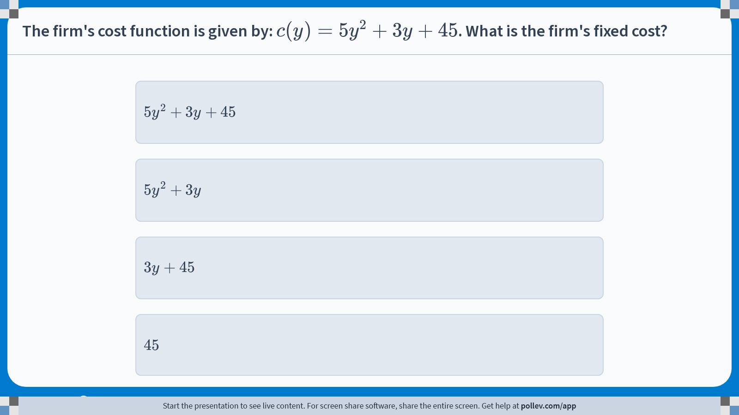
Poll Everywhere multiple choice poll instructions screen Activity Title: The firm's cost function is given by: $$c(y)=5y^2+3y+45$$. What is the firm's fixed cost? Slide 11
Notes:
Do not modify the notes in this section to avoid tampering with the Poll Everywhere activity. More info at polleverywhere.com/support The firm's cost function is given by: $$c(y)=5y^2+3y+45$$. What is the firm's fixed cost? https://www.polleverywhere.com/multiple_choice_polls/8cqPUwP3XYjrTHDBqlqp0?display_state=instructions&activity_state=opened&state=opened&flow=Engagement&onscreen=persist

Slide 12
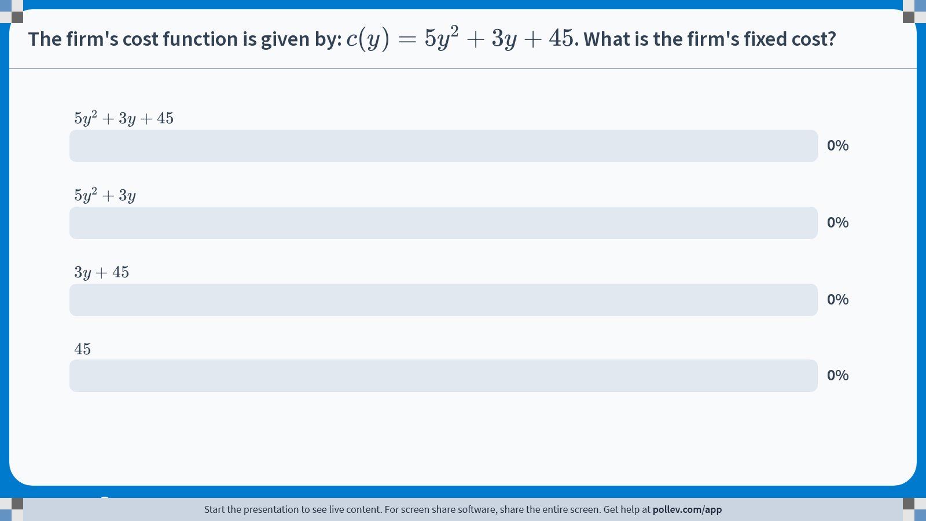
Poll Everywhere multiple choice poll chart screen Activity Title: The firm's cost function is given by: $$c(y)=5y^2+3y+45$$. What is the firm's fixed cost? Slide 13
Notes:
Do not modify the notes in this section to avoid tampering with the Poll Everywhere activity. More info at polleverywhere.com/support The firm's cost function is given by: $$c(y)=5y^2+3y+45$$. What is the firm's fixed cost? https://www.polleverywhere.com/multiple_choice_polls/8cqPUwP3XYjrTHDBqlqp0?display_state=chart&activity_state=closed&state=closed&flow=Engagement&onscreen=persist

Slide 13

Numerical Example: TC, FC, VC, AC, and MC
Suppose a firm has the following total cost function:
$$c\left(y\right)=5y^{2}+3y+45$$
Fixed Cost (FC):
The fixed cost is the cost that the firm incurs when production is zero.
$$FC=45$$
Variable Cost (VC):
The variable cost is the cost that varies with the firm’s production quantity.
$$VC=5y^{2}+3y$$

Slide 14

Numerical Example: TC, FC, VC, AC, and MC
Suppose a firm has the following total cost function:
$$c\left(y\right)=5y^{2}+3y+45$$
Average Total Cost (ATC):
ATC is the total cost divided by the quantity of output.
$$ATC=\frac{c\left(y\right)}{y}=5y+3+\frac{45}{y}$$
Average Fixed Cost (AFC):
AFC is the fixed cost divided by the quantity of output.
$$AFC=\frac{FC}{y}=\frac{45}{y}$$

Slide 15

Numerical Example: TC, FC, VC, AC, and MC
Suppose a firm has the following total cost function:
$$c\left(y\right)=5y^{2}+3y+45$$
Average Variable Cost (AVC):
AVC is the variable cost divided by the quantity of output.
$$AVC=\frac{VC}{y}=5y+3$$
Here, we can verify that ATC is the sum of AFC and AVC:
$$ATC=\underset{=AVC}{\underbrace{5y+3}}+\underset{=AFC}{\underbrace{\frac{45}{y}}}$$

Slide 16
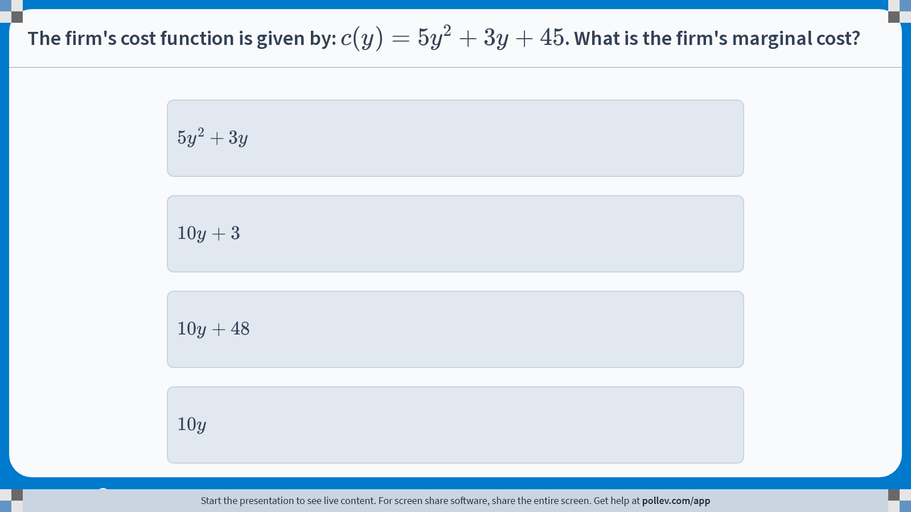
Poll Everywhere multiple choice poll instructions screen Activity Title: The firm's cost function is given by: $$c(y)=5y^2+3y+45$$. What is the firm's marginal cost? Slide 16
Notes:
Do not modify the notes in this section to avoid tampering with the Poll Everywhere activity. More info at polleverywhere.com/support The firm's cost function is given by: $$c(y)=5y^2+3y+45$$. What is the firm's marginal cost? https://www.polleverywhere.com/multiple_choice_polls/FG9Kn95KEVYprapMqOU15?display_state=instructions&activity_state=opened&state=opened&flow=Engagement&onscreen=persist

Slide 17
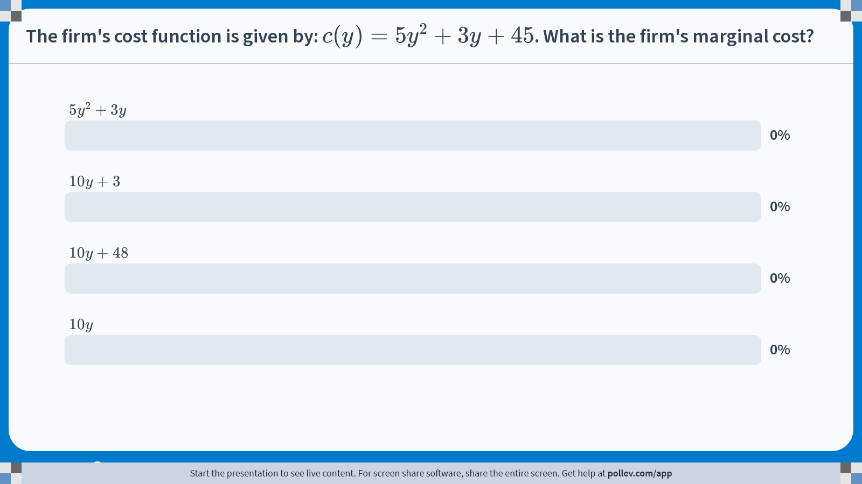
Poll Everywhere multiple choice poll chart screen Activity Title: The firm's cost function is given by: $$c(y)=5y^2+3y+45$$. What is the firm's marginal cost? Slide 18
Notes:
Do not modify the notes in this section to avoid tampering with the Poll Everywhere activity. More info at polleverywhere.com/support The firm's cost function is given by: $$c(y)=5y^2+3y+45$$. What is the firm's marginal cost? https://www.polleverywhere.com/multiple_choice_polls/FG9Kn95KEVYprapMqOU15?display_state=chart&activity_state=closed&state=closed&flow=Engagement&onscreen=persist

Slide 18
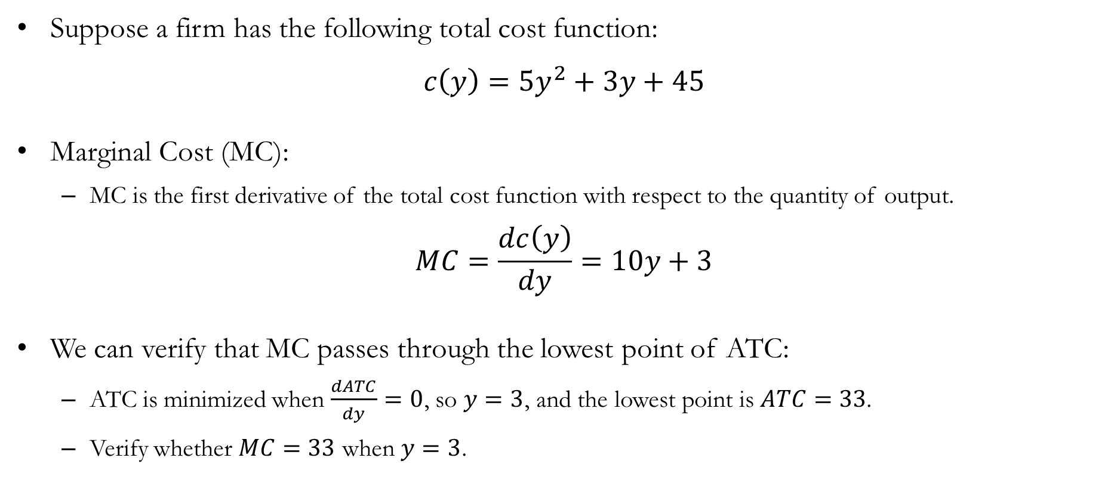
Numerical Example: TC, FC, VC, AC, and MC
Suppose a firm has the following total cost function:
$$c\left(y\right)=5y^{2}+3y+45$$
Marginal Cost (MC):
MC is the first derivative of the total cost function with respect to the quantity of output.
$$MC=\frac{dc\left(y\right)}{dy}=10y+3$$
We can verify that MC passes through the lowest point of ATC:
ATC is minimized when $\frac{dATC}{dy}=0$, so $y=3$, and the lowest point is $ATC=33$.
Verify whether $MC=33$ when $y=3$.

Slide 19
Long Run Costs

Slide 20
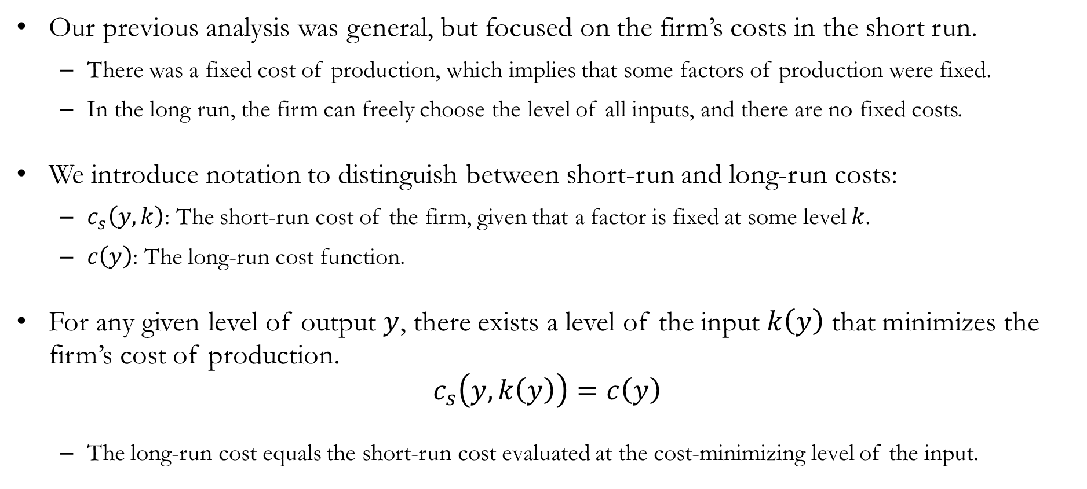
Long Run Setup
Our previous analysis was general, but focused on the firm’s costs in the short run.
There was a fixed cost of production, which implies that some factors of production were fixed.
In the long run, the firm can freely choose the level of all inputs, and there are no fixed costs.
We introduce notation to distinguish between short-run and long-run costs:
$c_{s}\left(y,k\right)$: The short-run cost of the firm, given that a factor is fixed at some level $k$.
$c\left(y\right)$: The long-run cost function.
For any given level of output $y$, there exists a level of the input $k\left(y\right)$ that minimizes the firm’s cost of production.
$$c_{s}\left(y,k\left(y\right)\right)=c\left(y\right)$$
The long-run cost equals the short-run cost evaluated at the cost-minimizing level of the input.

Slide 21
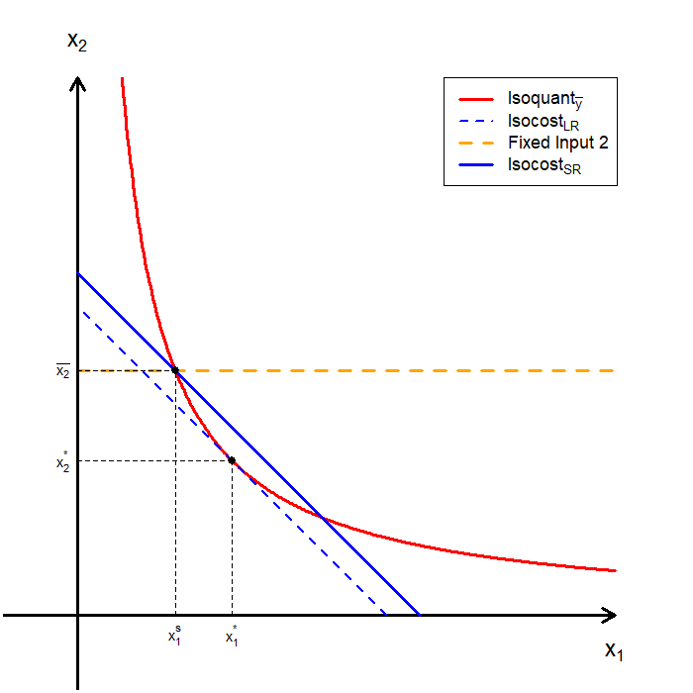
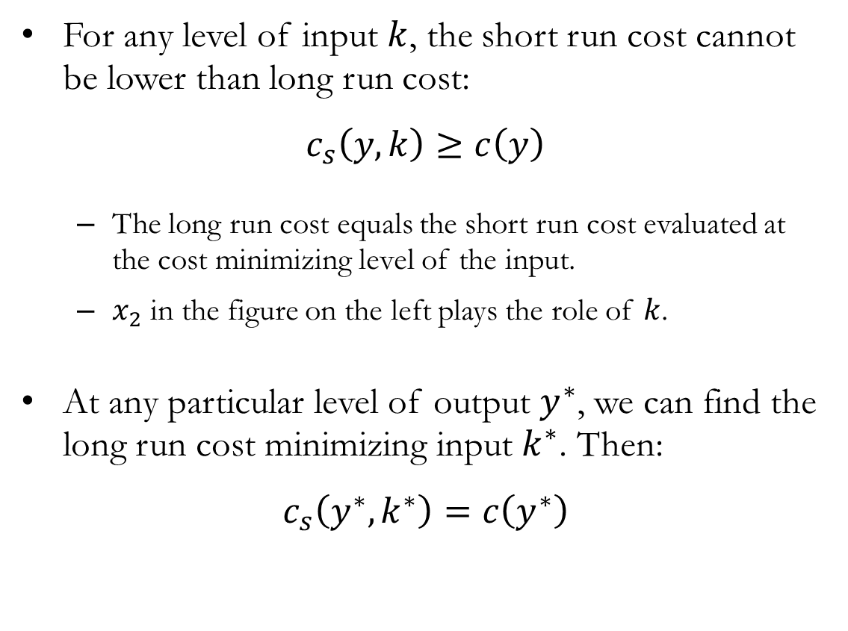
The Long Run and Short Run
For any level of input $k$, the short run cost cannot be lower than long run cost:
$$c_{s}\left(y,k\right)≥c\left(y\right)$$
The long run cost equals the short run cost evaluated at the cost minimizing level of the input.
$x_{2}$ in the figure on the left plays the role of $k$.
At any particular level of output $y^{∗}$, we can find the long run cost minimizing input $k^{∗}$. Then:
$$c_{s}\left(y^{∗},k^{∗}\right)=c\left(y^{∗}\right)$$

Slide 22
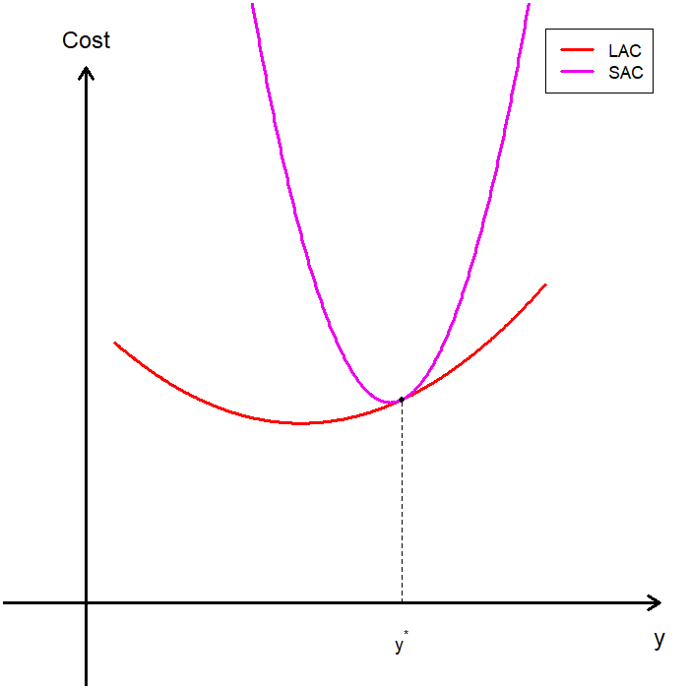
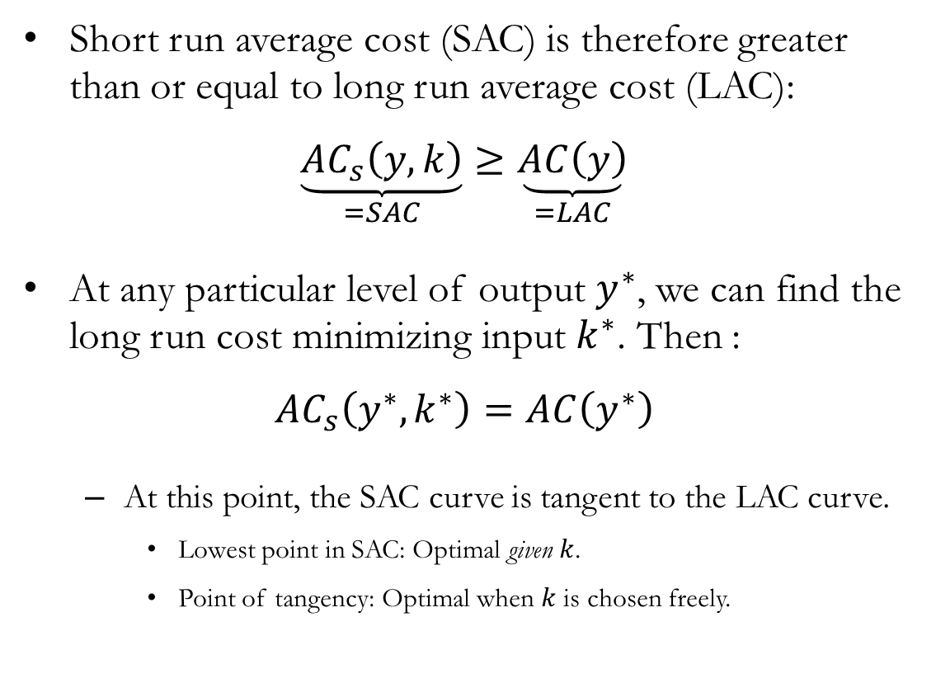
The Long Run and Short Run: Average Costs
Short run average cost (SAC) is therefore greater than or equal to long run average cost (LAC):
$$\underset{=SAC}{\underbrace{{AC}_{s}\left(y,k\right)}}≥\underset{=LAC}{\underbrace{AC\left(y\right)}}$$
At any particular level of output $y^{∗}$, we can find the long run cost minimizing input $k^{∗}$. Then :
$${AC}_{s}\left(y^{∗},k^{∗}\right)=AC\left(y^{∗}\right)$$
At this point, the SAC curve is tangent to the LAC curve.
Lowest point in SAC: Optimal given $k$.
Point of tangency: Optimal when $k$ is chosen freely.

Slide 23
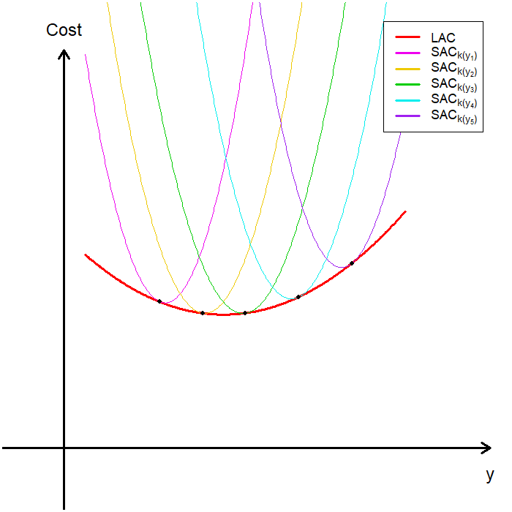
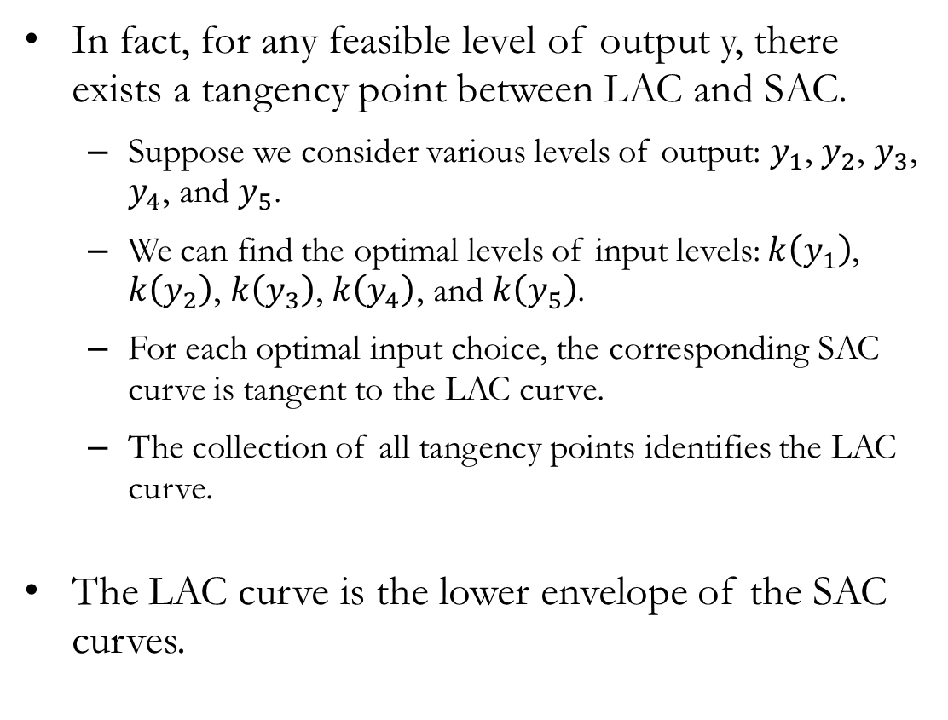
The Long Run and Short Run: The Envelope
In fact, for any feasible level of output y, there exists a tangency point between LAC and SAC.
Suppose we consider various levels of output: $y_{1}$, $y_{2}$, $y_{3}$, $y_{4}$, and $y_{5}$.
We can find the optimal levels of input levels: $k\left(y_{1}\right)$, $k\left(y_{2}\right)$, $k\left(y_{3}\right)$, $k\left(y_{4}\right)$, and $k\left(y_{5}\right)$.
For each optimal input choice, the corresponding SAC curve is tangent to the LAC curve.
The collection of all tangency points identifies the LAC curve.
The LAC curve is the lower envelope of the SAC curves.

Slide 24
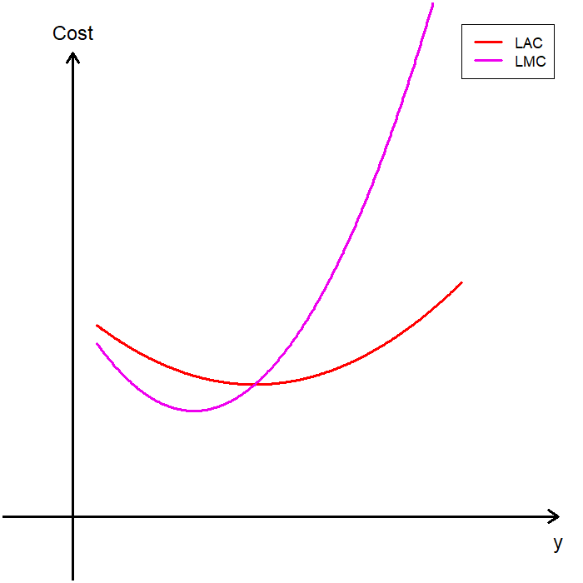
Long Run Marginal Cost
Now we examine the relationship between long run marginal cost (LMC) and short run marginal cost (SMC).
Long run marginal cost (LMC):
All inputs are adjustable.
The firm re-optimizes all inputs at each output level.
Reflects optimal production when input choices are fully flexible.
The LMC curve intersects the LAC curve at the minimum of the LAC curve.

Slide 25
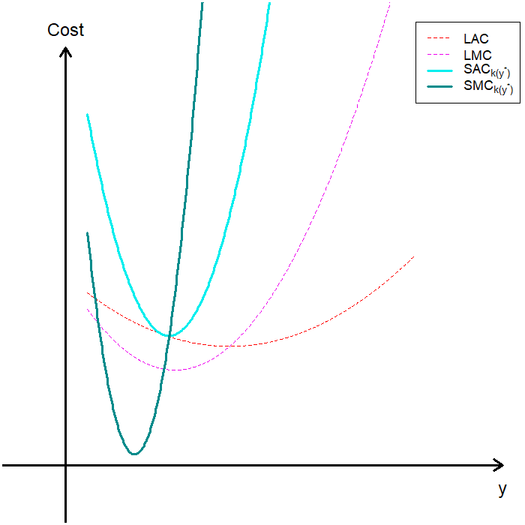
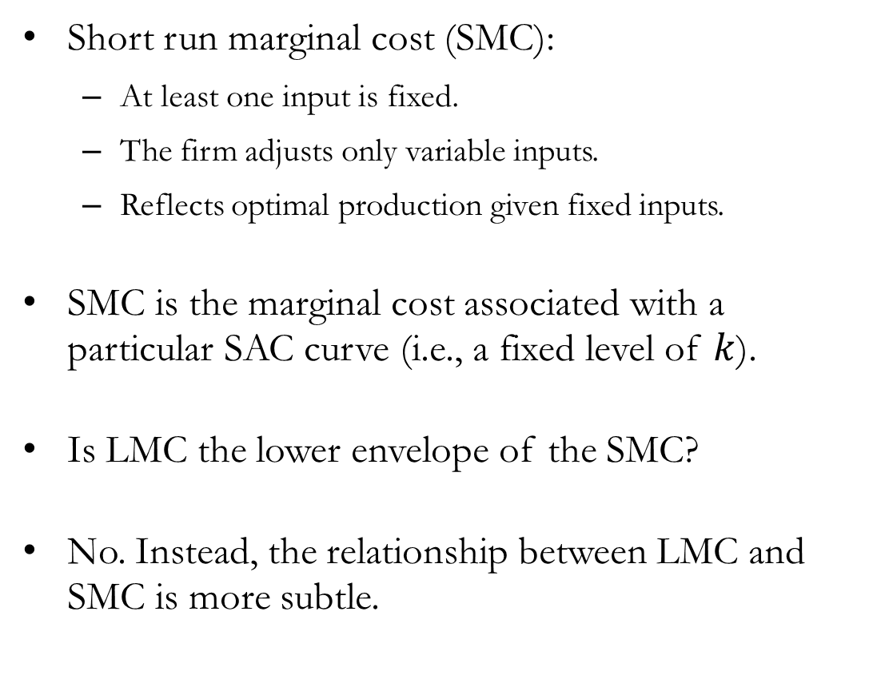
Short Run Marginal Cost
Short run marginal cost (SMC):
At least one input is fixed.
The firm adjusts only variable inputs.
Reflects optimal production given fixed inputs.
SMC is the marginal cost associated with a particular SAC curve (i.e., a fixed level of $k$).
Is LMC the lower envelope of the SMC?
No. Instead, the relationship between LMC and SMC is more subtle.

Slide 26
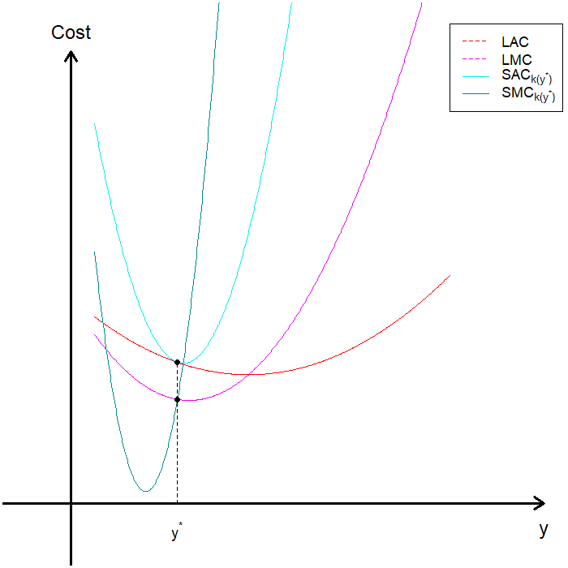
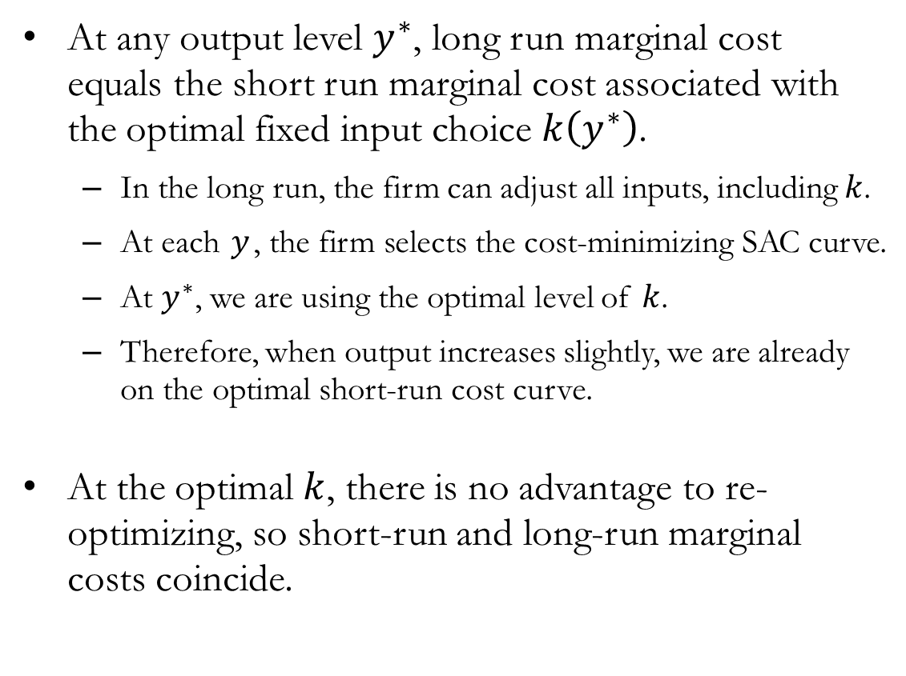
Long Run and Short Run Marginal Cost
At any output level $y^{∗}$, long run marginal cost equals the short run marginal cost associated with the optimal fixed input choice $k\left(y^{∗}\right)$.
In the long run, the firm can adjust all inputs, including $k$.
At each $y$, the firm selects the cost-minimizing SAC curve.
At $y^{∗}$, we are using the optimal level of $k$.
Therefore, when output increases slightly, we are already on the optimal short-run cost curve.
At the optimal $k$, there is no advantage to re-optimizing, so short-run and long-run marginal costs coincide.

Slide 27
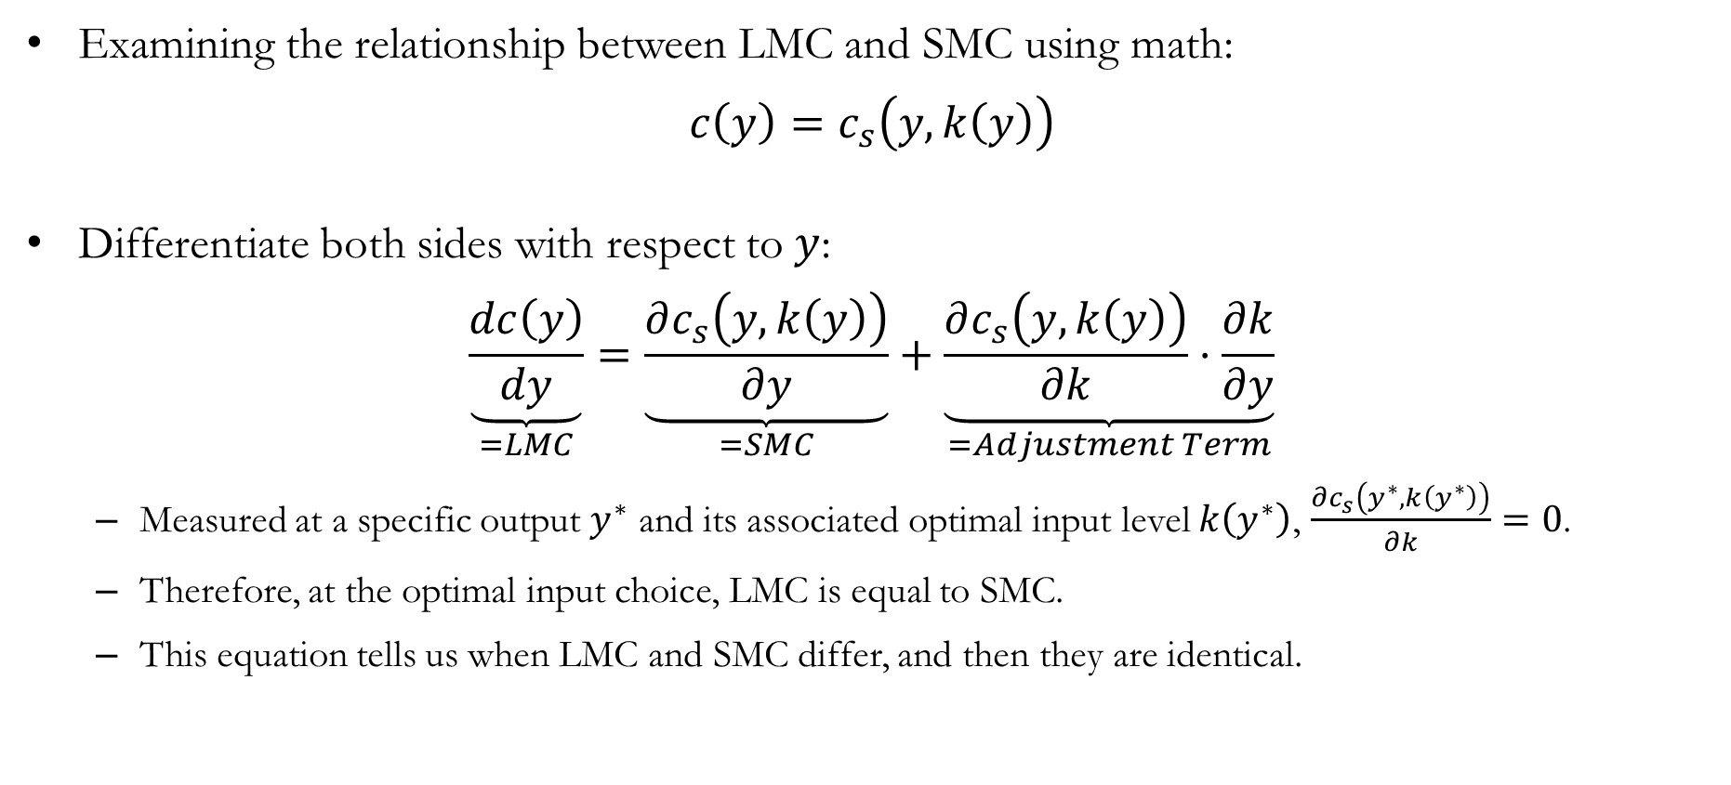
Detour: The Mathematics of LMC & SMC
Examining the relationship between LMC and SMC using math:
$$c\left(y\right)=c_{s}\left(y,k\left(y\right)\right)$$
Differentiate both sides with respect to $y$:
$$\underset{=LMC}{\underbrace{\frac{dc\left(y\right)}{dy}}}=\underset{=SMC}{\underbrace{\frac{∂c_{s}\left(y,k\left(y\right)\right)}{∂y}}}+\underset{=Adjustment Term}{\underbrace{\frac{∂c_{s}\left(y,k\left(y\right)\right)}{∂k}⋅\frac{∂k}{∂y}}}$$
Measured at a specific output $y^{∗}$ and its associated optimal input level $k\left(y^{∗}\right)$, $\frac{∂c_{s}\left(y^{∗},k\left(y^{∗}\right)\right)}{∂k}=0$.
Therefore, at the optimal input choice, LMC is equal to SMC.
This equation tells us when LMC and SMC differ, and then they are identical.

Slide 28
Recap & Preview

Slide 29
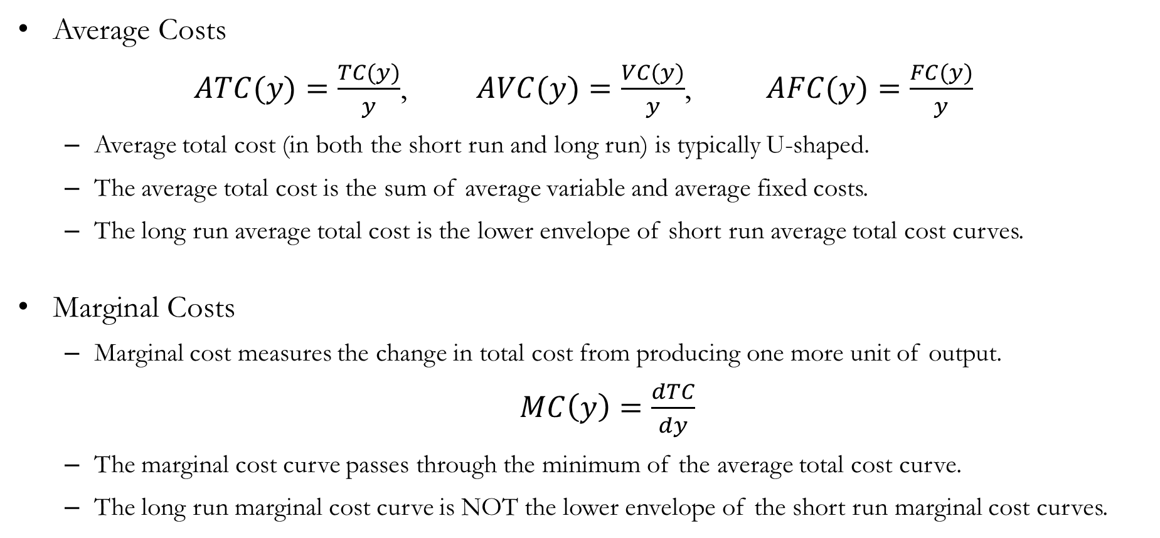
Recap: Cost Curves
Average Costs
$ATC(y)=\frac{TC(y)}{y}$, $AVC(y)=\frac{VC(y)}{y}$, $AFC(y)=\frac{FC(y)}{y}$
Average total cost (in both the short run and long run) is typically U-shaped.
The average total cost is the sum of average variable and average fixed costs.
The long run average total cost is the lower envelope of short run average total cost curves.
Marginal Costs
Marginal cost measures the change in total cost from producing one more unit of output.
$MC\left(y\right)=\frac{dTC}{dy}$
The marginal cost curve passes through the minimum of the average total cost curve.
The long run marginal cost curve is NOT the lower envelope of the short run marginal cost curves.

Slide 30
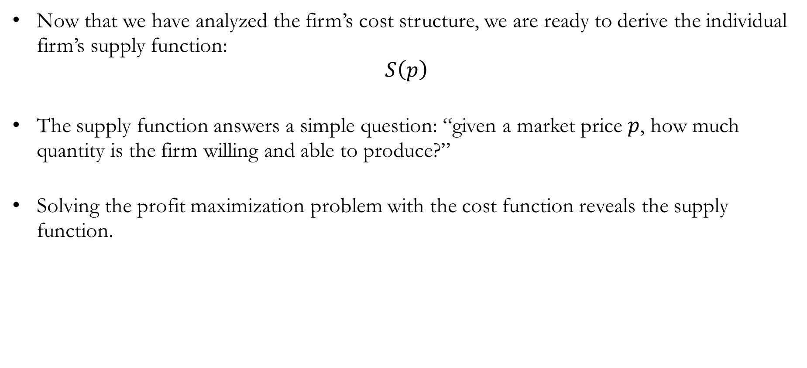
Preview: Firm Supply
Now that we have analyzed the firm’s cost structure, we are ready to derive the individual firm’s supply function:
$$S\left(p\right)$$
The supply function answers a simple question: “given a market price $p$, how much quantity is the firm willing and able to produce?”
Solving the profit maximization problem with the cost function reveals the supply function.

