Slide 1
INTERMEDIATE MICROECONOMIC THEORY
Chapter 32: Exchange

Slide 2
Preview: General Equilibrium
So far, we have studied individual optimization, where consumers maximize utility and firms maximize profits in isolation.
We consider one consumer and one firm in isolation.
This leads to a partial equilibrium.
In reality, individuals interact with one another, and markets are interconnected:
People trade with each other, and outcomes depend on these interactions.
This leads to a general equilibrium.
Then, we must ask: “How do individual decisions translate into societal welfare?”
Are outcomes efficient and/or fair?
Can markets achieve desirable outcomes on its own?

Slide 3
The Edgeworth Box
and Pareto Optimality

Slide 4
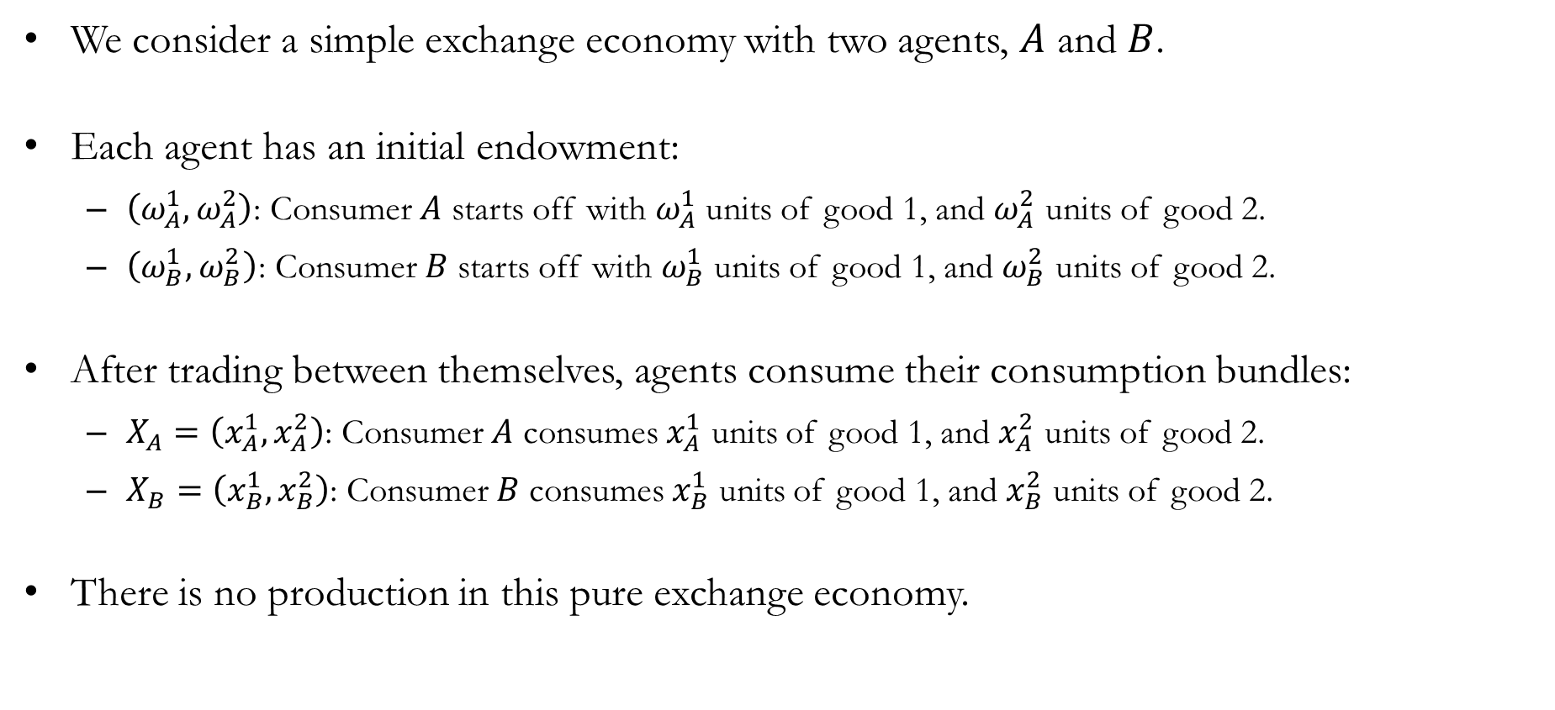
A Model of Pure Exchange: Notations
We consider a simple exchange economy with two agents, $A$ and $B$.
Each agent has an initial endowment:
$\left(ω_{A}^{1}, ω_{A}^{2}\right)$: Consumer $A$ starts off with $ω_{A}^{1}$ units of good 1, and $ω_{A}^{2}$ units of good 2.
$\left(ω_{B}^{1}, ω_{B}^{2}\right)$: Consumer $B$ starts off with $ω_{B}^{1}$ units of good 1, and $ω_{B}^{2}$ units of good 2.
After trading between themselves, agents consume their consumption bundles:
$X_{A}=\left(x_{A}^{1}, x_{A}^{2}\right)$: Consumer $A$ consumes $x_{A}^{1}$ units of good 1, and $x_{A}^{2}$ units of good 2.
$X_{B}=\left(x_{B}^{1}, x_{B}^{2}\right)$: Consumer $B$ consumes $x_{B}^{1}$ units of good 1, and $x_{B}^{2}$ units of good 2.
There is no production in this pure exchange economy.

Slide 5
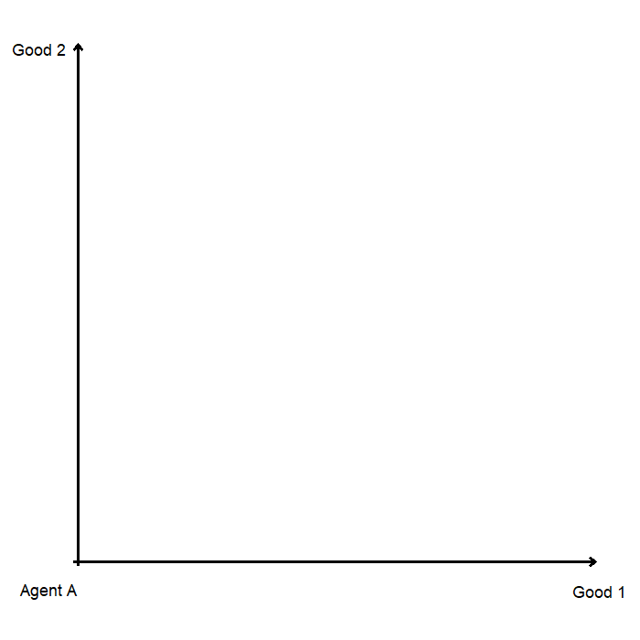
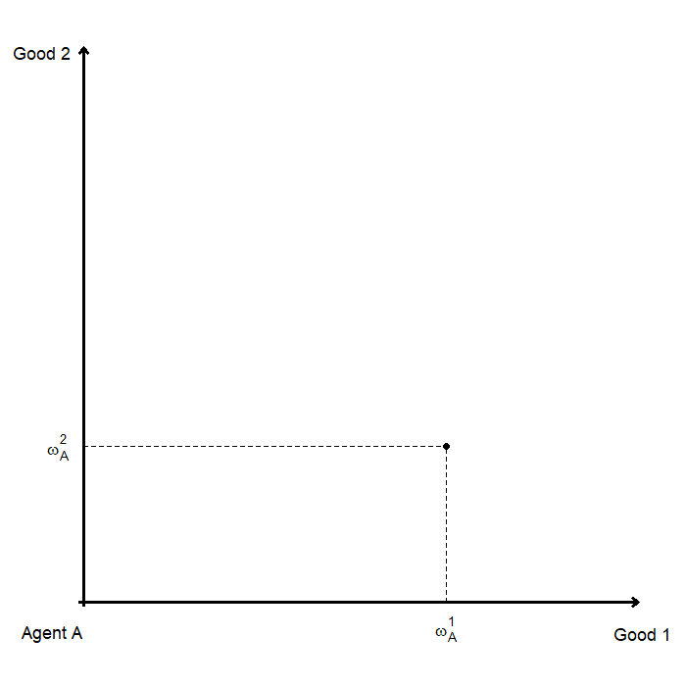
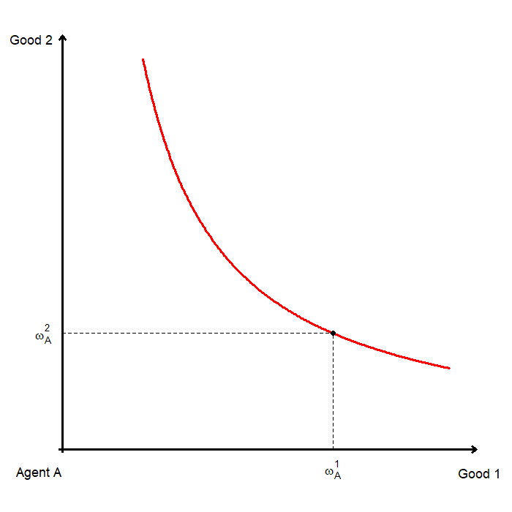
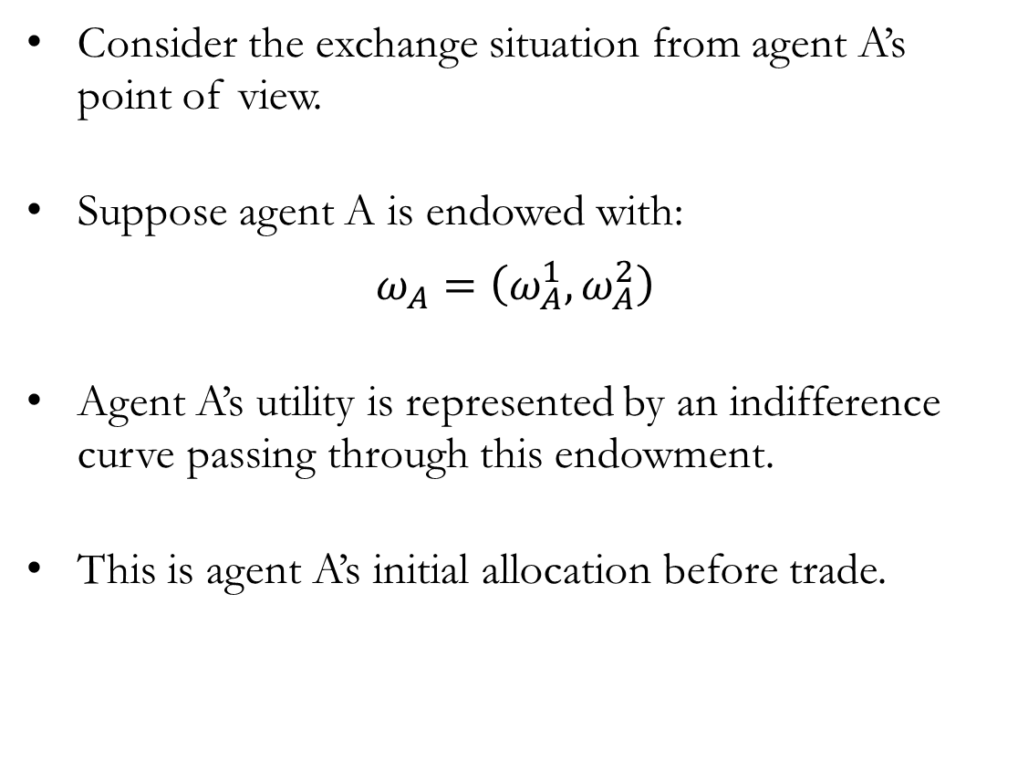
Agent A’s Point of View
Consider the exchange situation from agent A’s point of view.
Suppose agent A is endowed with:
$$ω_{A}=\left(ω_{A}^{1}, ω_{A}^{2}\right)$$
Agent A’s utility is represented by an indifference curve passing through this endowment.
This is agent A’s initial allocation before trade.

Slide 6
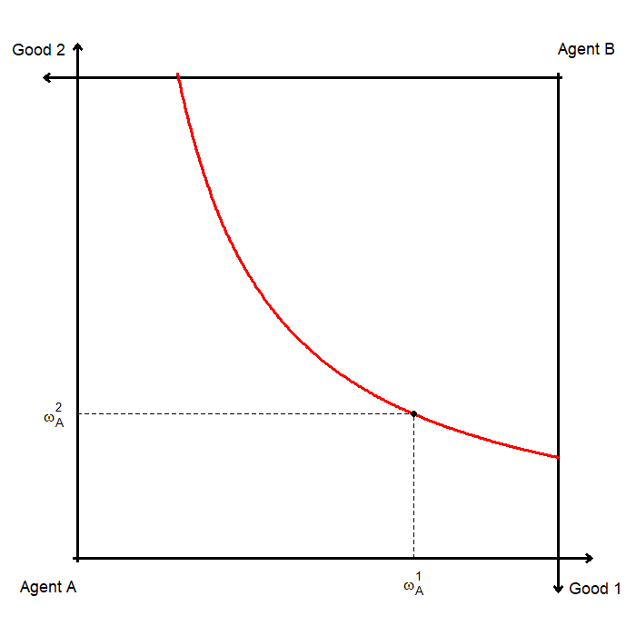
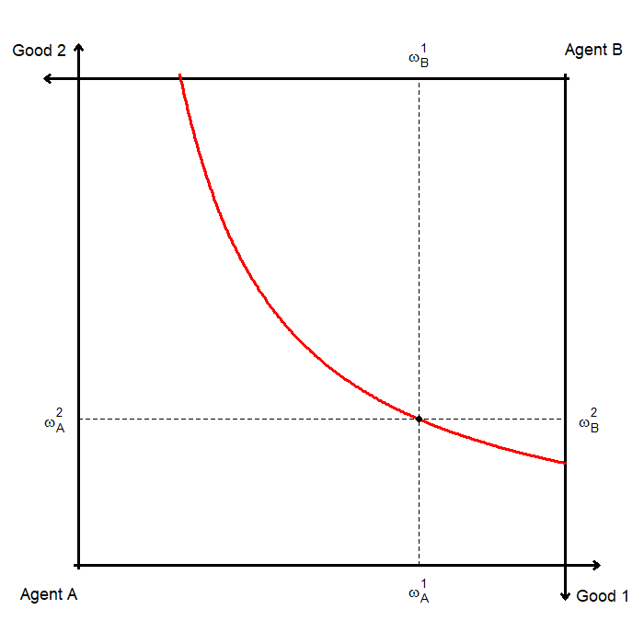
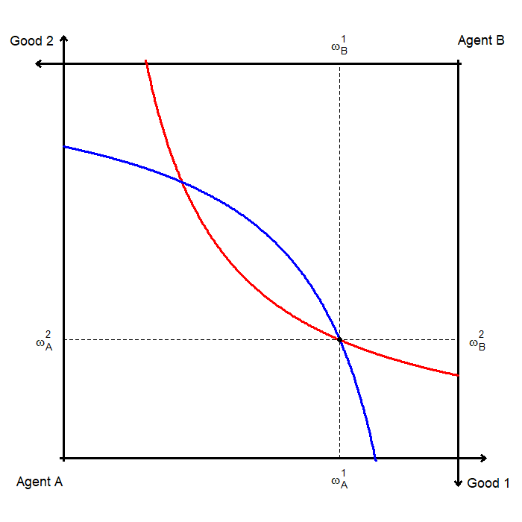
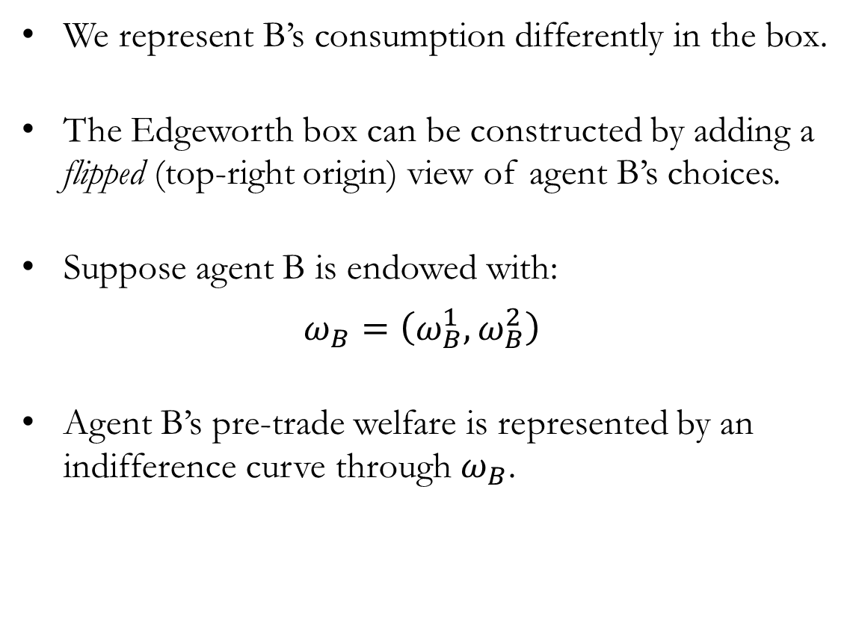
Adding Agent B’s Point of View
We represent B’s consumption differently in the box.
The Edgeworth box can be constructed by adding a flipped (top-right origin) view of agent B’s choices.
Suppose agent B is endowed with:
$$ω_{B}=\left(ω_{B}^{1}, ω_{B}^{2}\right)$$
Agent B’s pre-trade welfare is represented by an indifference curve through $ω_{B}$.

Slide 7
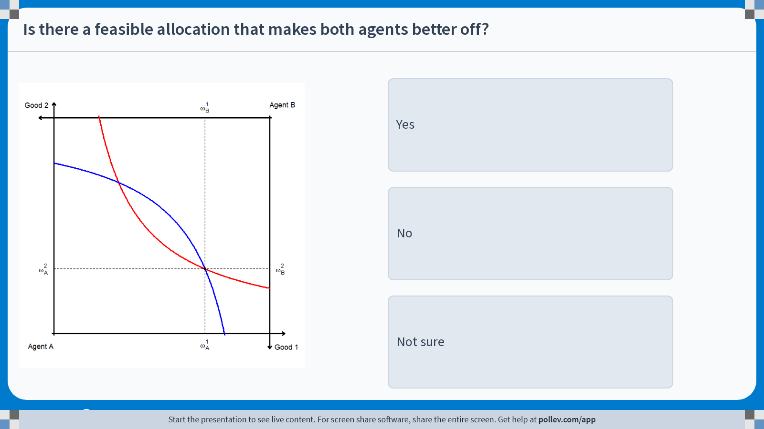
Poll Everywhere multiple choice poll instructions screen Activity Title: Is there a feasible allocation that makes both agents better off? Slide 7
Notes:
Do not modify the notes in this section to avoid tampering with the Poll Everywhere activity. More info at polleverywhere.com/support Is there a feasible allocation that makes both agents better off? https://www.polleverywhere.com/multiple_choice_polls/GLyqWxQeOqoZNPnJ1wMiN?display_state=instructions&activity_state=opened&state=opened&flow=Engagement&onscreen=persist

Slide 8
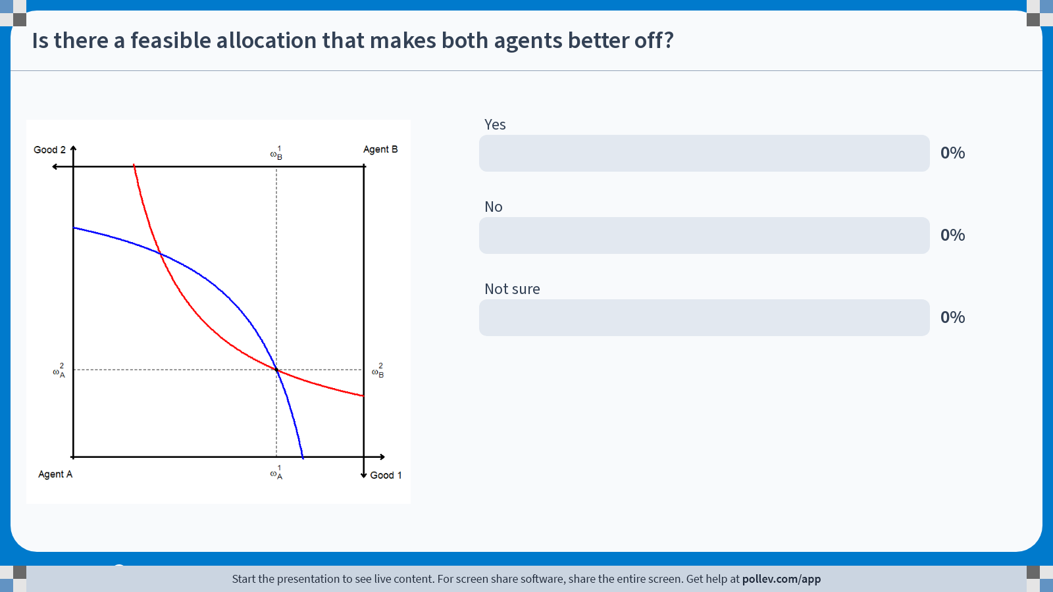
Poll Everywhere multiple choice poll chart screen Activity Title: Is there a feasible allocation that makes both agents better off? Slide 9
Notes:
Do not modify the notes in this section to avoid tampering with the Poll Everywhere activity. More info at polleverywhere.com/support Is there a feasible allocation that makes both agents better off? https://www.polleverywhere.com/multiple_choice_polls/GLyqWxQeOqoZNPnJ1wMiN?display_state=chart&activity_state=closed&state=closed&flow=Engagement&onscreen=persist

Slide 9
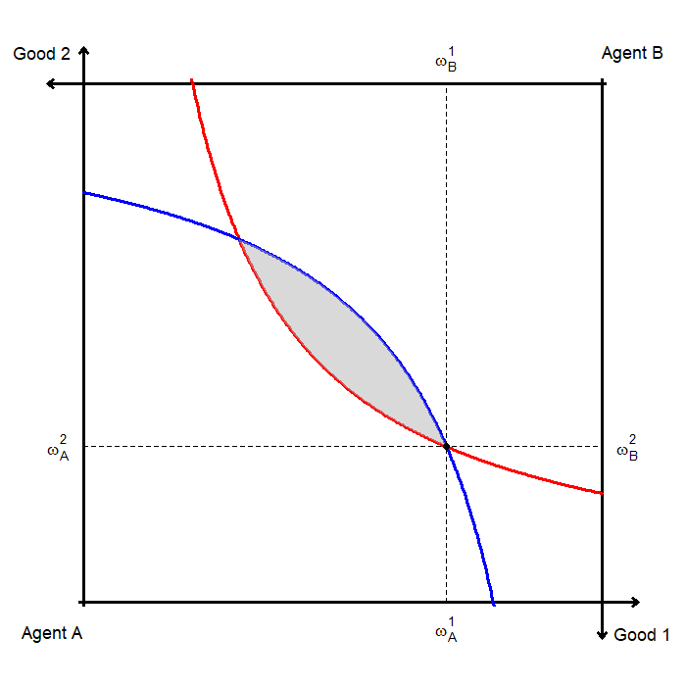
Potential for Welfare Gains
Agents A and B can improve their welfare by trading away from their initial endowment.
Consider any consumption bundle in the shaded region between the two agents’ indifference curves.
It improves agent A’s welfare (above A’s indifference curve).
It improves agent B’s welfare (above B’s flipped indifference curve).
This is the set of mutually beneficial trades.
In fact, any bundle in this region is a Pareto improvement.

Slide 10
Pareto Optimality / Improvements
Pareto improvements are changes in allocation where:
At least one agent is better off
No agent is worse off
In the Edgeworth box, any bundle in the shaded region is a Pareto improvement over the initial endowment.
An allocation is Pareto optimal if there are no further Pareto improvements available.
So where in the Edgeworth box do we end up?

Slide 11
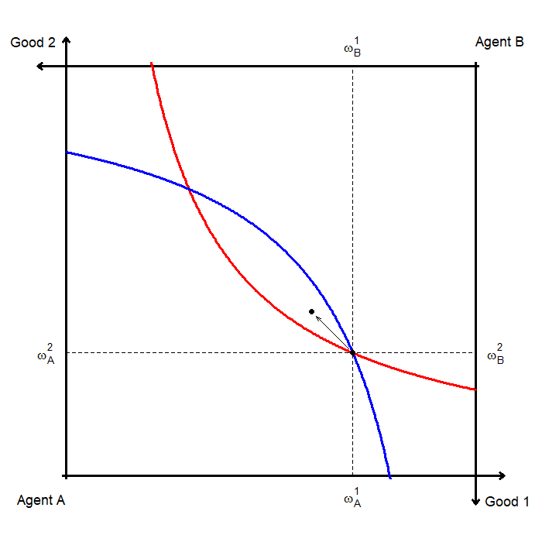
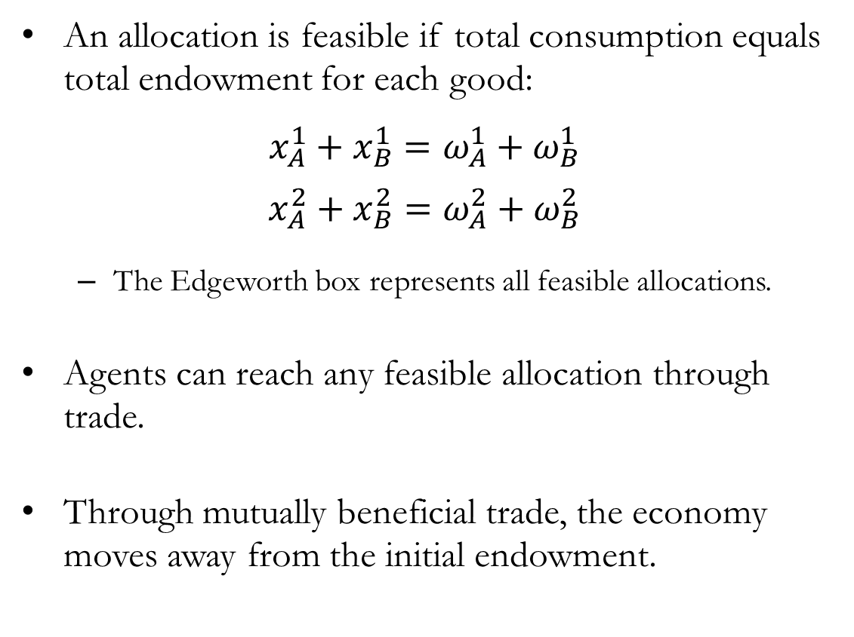
Feasible Allocations and Trade
An allocation is feasible if total consumption equals total endowment for each good:
$$x_{A}^{1}+x_{B}^{1}=ω_{A}^{1}+ω_{B}^{1}$$
$$x_{A}^{2}+x_{B}^{2}=ω_{A}^{2}+ω_{B}^{2}$$
The Edgeworth box represents all feasible allocations.
Agents can reach any feasible allocation through trade.
Through mutually beneficial trade, the economy moves away from the initial endowment.

Slide 12
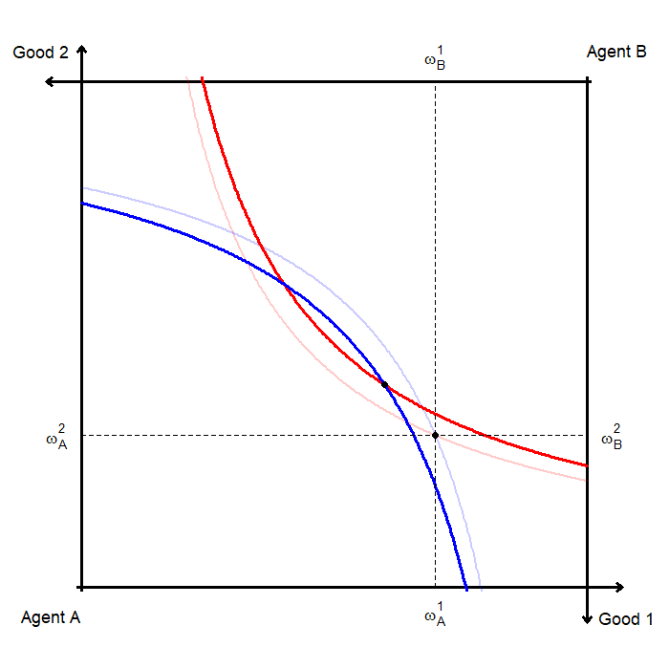
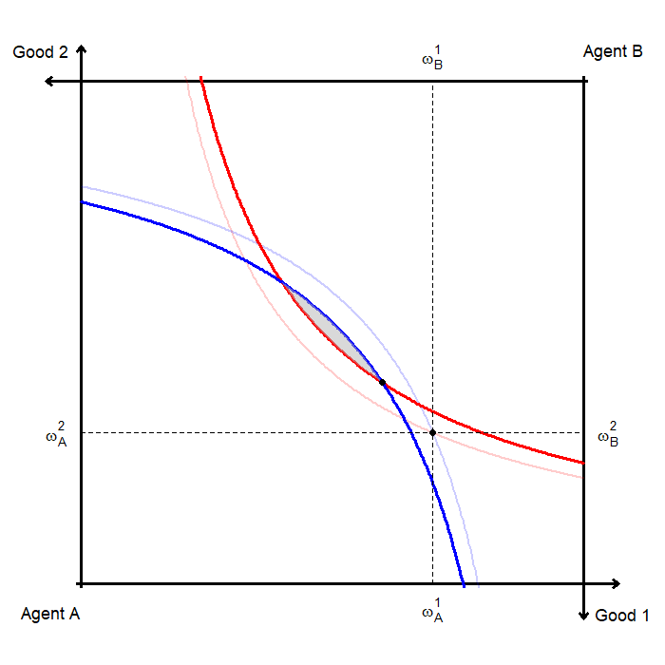
Trade and Pareto Improvements
The allocation after the first round of trade is a Pareto improvement over the initial endowment.
However, additional Pareto improvements are still possible.
Any bundle in the shaded region between the updated indifference curves is a Pareto improvement.
This process continues until no further Pareto improvements are possible.
How do we characterize a Pareto optimal allocation in this setting?

Slide 13
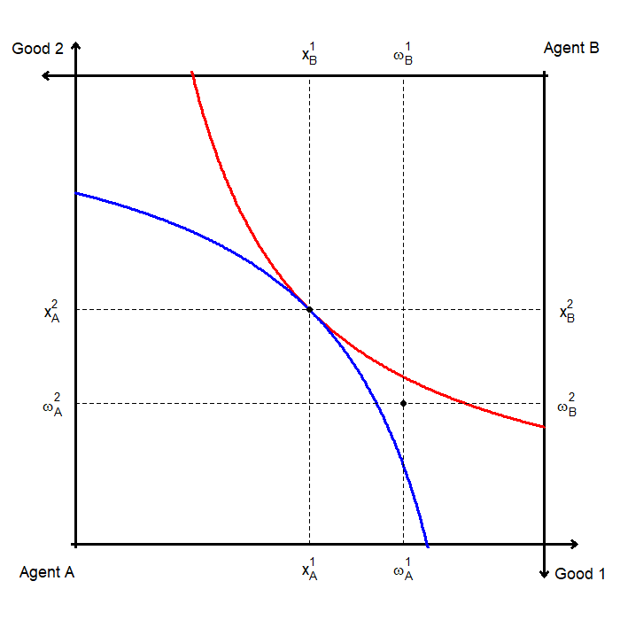
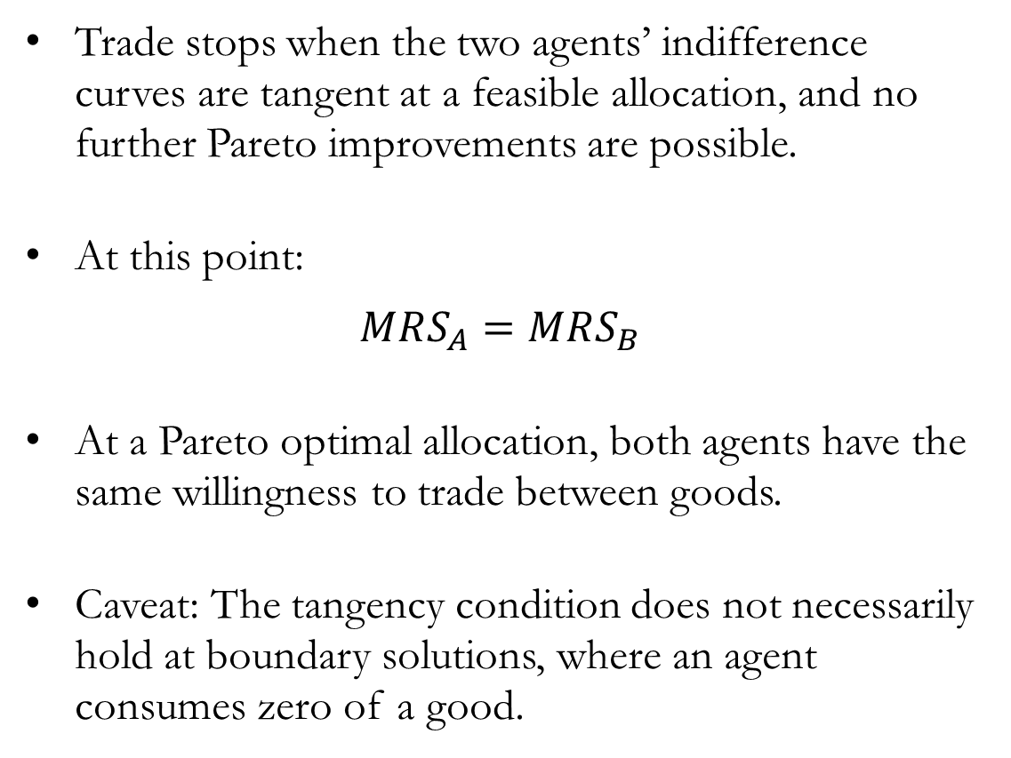
A Pareto Optimal Allocation
Trade stops when the two agents’ indifference curves are tangent at a feasible allocation, and no further Pareto improvements are possible.
At this point:
$$MRS_{A}=MRS_{B}$$
At a Pareto optimal allocation, both agents have the same willingness to trade between goods.
Caveat: The tangency condition does not necessarily hold at boundary solutions, where an agent consumes zero of a good.

Slide 14
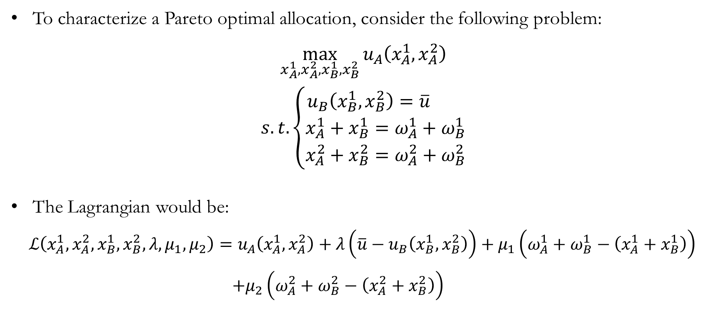
Pareto Optimality: The Setup
To characterize a Pareto optimal allocation, consider the following problem:
$$\max_{x_{A}^{1},x_{A}^{2},x_{B}^{1},x_{B}^{2}}{u_{A}\left(x_{A}^{1},x_{A}^{2}\right)}$$
$$s.t. \left\{\begin{aligned}u_{B}\left(x_{B}^{1},x_{B}^{2}\right)=\overline{u} \\ x_{A}^{1}+x_{B}^{1}=ω_{A}^{1}+ω_{B}^{1} \\ x_{A}^{2}+x_{B}^{2}=ω_{A}^{2}+ω_{B}^{2}\end{aligned}\right.$$
The Lagrangian would be:
$ℒ\left(x_{A}^{1},x_{A}^{2},x_{B}^{1},x_{B}^{2},λ,μ_{1},μ_{2}\right)=u_{A}\left(x_{A}^{1},x_{A}^{2}\right)+λ\left(\overline{u}−u_{B}\left(x_{B}^{1},x_{B}^{2}\right)\right)+μ_{1}\left(ω_{A}^{1}+ω_{B}^{1}−\left(x_{A}^{1}+x_{B}^{1}\right)\right)$
$+μ_{2}\left(ω_{A}^{2}+ω_{B}^{2}−\left(x_{A}^{2}+x_{B}^{2}\right)\right)$

Slide 15

Pareto Optimality: The FOCs
The first-order conditions with respect to each choice variable are:
$\frac{∂ℒ}{∂x_{A}^{1}}=0 ⟹ \frac{∂u_{A}}{∂x_{A}^{1}}−μ_{1}=0 ⋯(\text{1})$
$\frac{∂ℒ}{∂x_{A}^{2}}=0 ⟹ \frac{∂u_{A}}{∂x_{A}^{2}}−μ_{2}=0 ⋯(\text{2})$
$\frac{∂ℒ}{∂x_{B}^{1}}=0 ⟹ −λ\frac{∂u_{B}}{∂x_{B}^{1}}−μ_{1}=0 ⋯(\text{3})$
$\frac{∂ℒ}{∂x_{B}^{2}}=0 ⟹ −λ\frac{∂u_{B}}{∂x_{B}^{2}}−μ_{2}=0 ⋯(\text{4})$

Slide 16
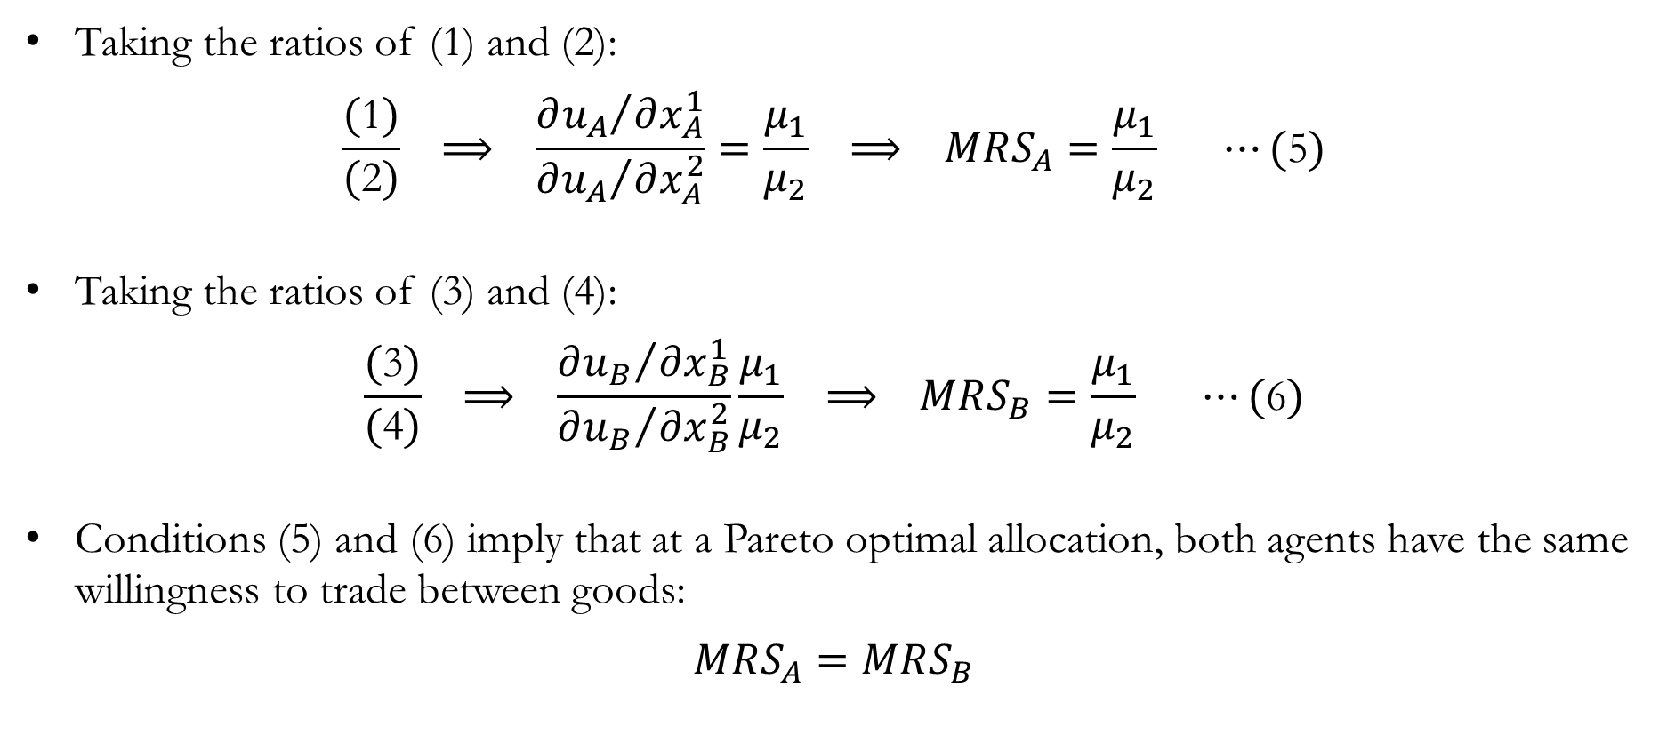
Pareto Optimality: The Tangency Condition
Taking the ratios of (1) and (2):
$$\frac{(\text{1})}{(\text{2})} ⟹ \frac{{∂u_{A}}/{∂x_{A}^{1}}}{{∂u_{A}}/{∂x_{A}^{2}}}=\frac{μ_{1}}{μ_{2}} ⟹ MRS_{A}=\frac{μ_{1}}{μ_{2}} ⋯(\text{5})$$
Taking the ratios of (3) and (4):
$$\frac{(\text{3})}{(\text{4})} ⟹ \frac{{∂u_{B}}/{∂x_{B}^{1}}}{{∂u_{B}}/{∂x_{B}^{2}}}\frac{μ_{1}}{μ_{2}} ⟹ MRS_{B}=\frac{μ_{1}}{μ_{2}} ⋯(\text{6})$$
Conditions (5) and (6) imply that at a Pareto optimal allocation, both agents have the same willingness to trade between goods:
$$MRS_{A}=MRS_{B}$$

Slide 17
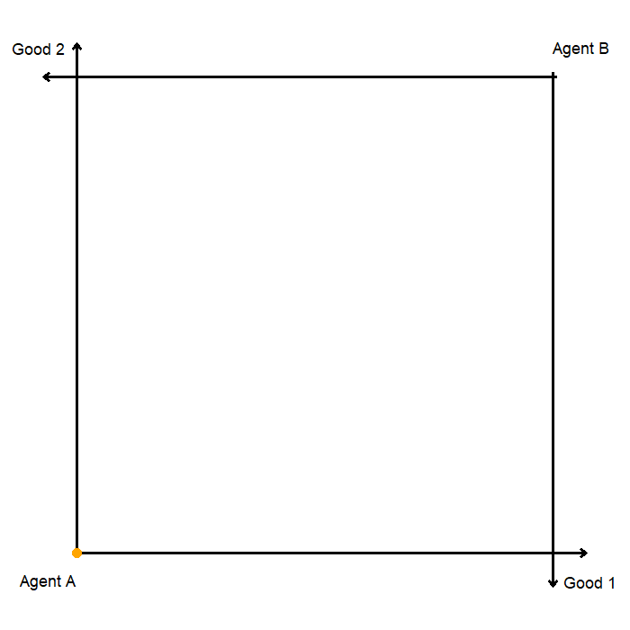
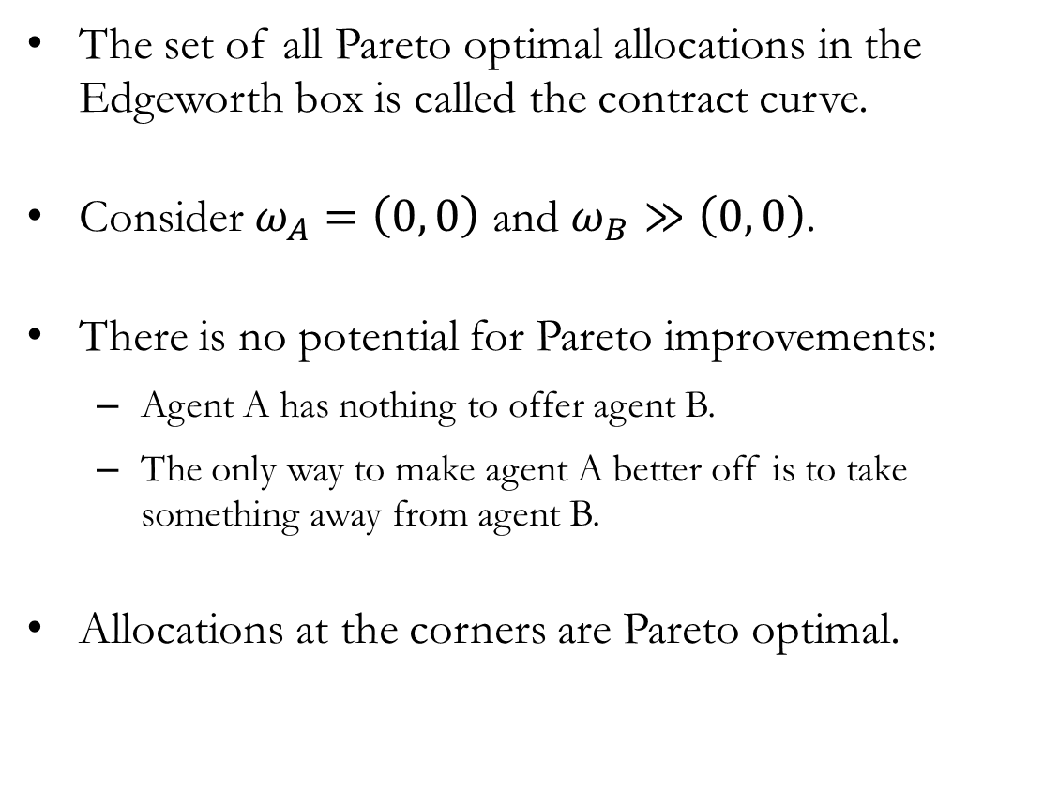
The Contract Curve: The Edges
The set of all Pareto optimal allocations in the Edgeworth box is called the contract curve.
Consider $ω_{A}=\left(0, 0\right)$ and $ω_{B}≫\left(0, 0\right)$.
There is no potential for Pareto improvements:
Agent A has nothing to offer agent B.
The only way to make agent A better off is to take something away from agent B.
Allocations at the corners are Pareto optimal.

Slide 18
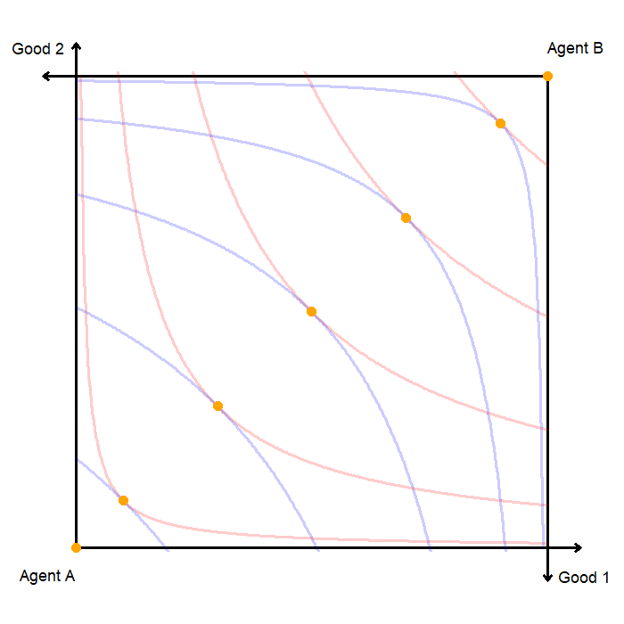
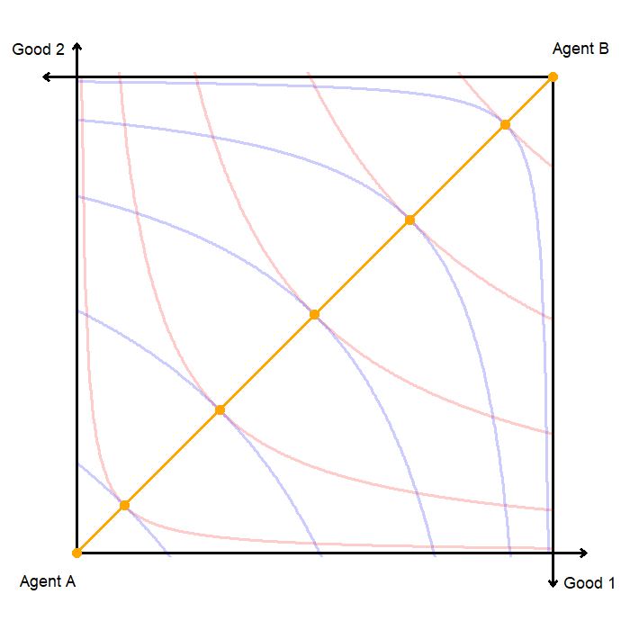
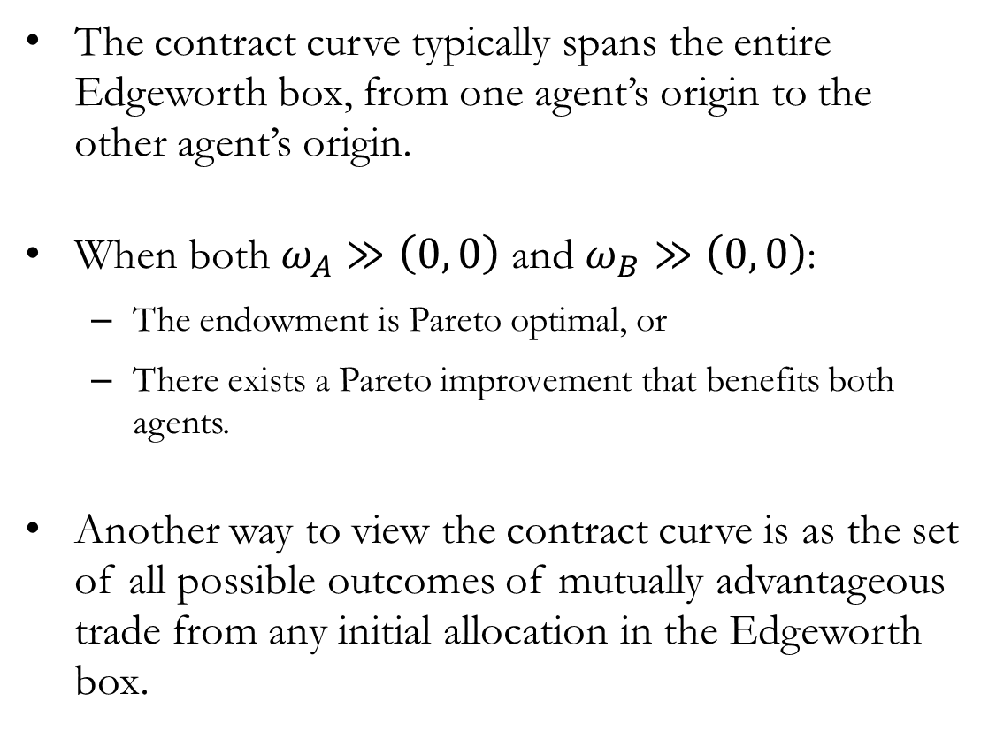
The Contract Curve: The Interior
The contract curve typically spans the entire Edgeworth box, from one agent’s origin to the other agent’s origin.
When both $ω_{A}≫\left(0, 0\right)$ and $ω_{B}≫\left(0, 0\right)$:
The endowment is Pareto optimal, or
There exists a Pareto improvement that benefits both agents.
Another way to view the contract curve is as the set of all possible outcomes of mutually advantageous trade from any initial allocation in the Edgeworth box.

Slide 19
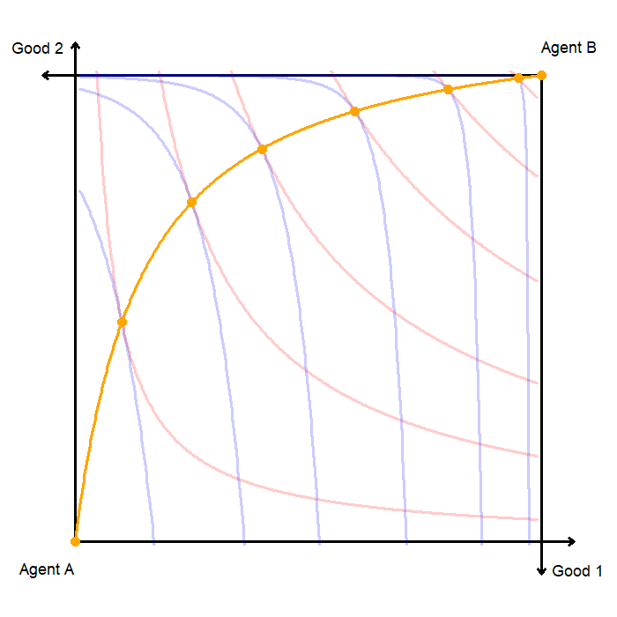
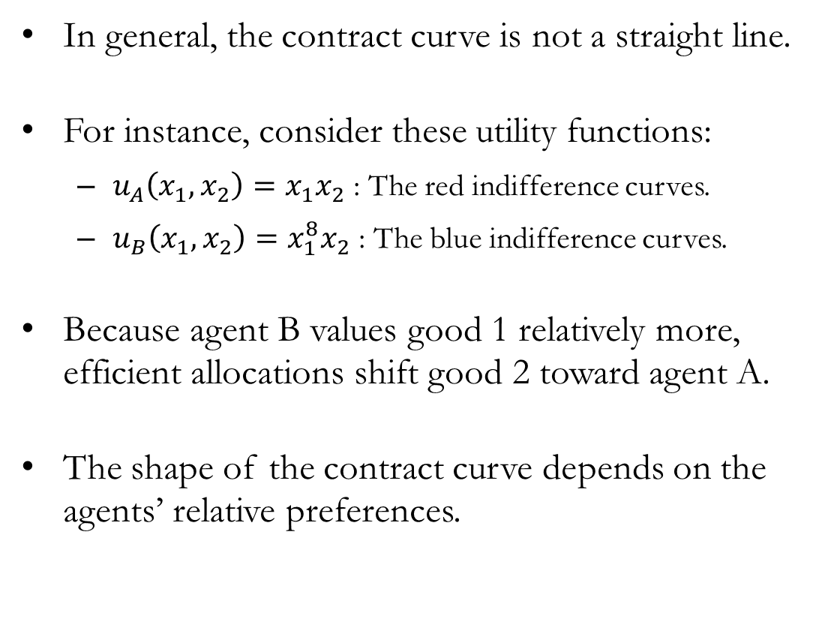
The Contract Curve: The Shape
In general, the contract curve is not a straight line.
For instance, consider these utility functions:
$u_{A}\left(x_{1},x_{2}\right)=x_{1}x_{2}$ : The red indifference curves.
$u_{B}\left(x_{1},x_{2}\right)=x_{1}^{8}x_{2}$ : The blue indifference curves.
Because agent B values good 1 relatively more, efficient allocations shift good 2 toward agent A.
The shape of the contract curve depends on the agents’ relative preferences.

Slide 20
Market Trade
to Walrasian Equilibria

Slide 21
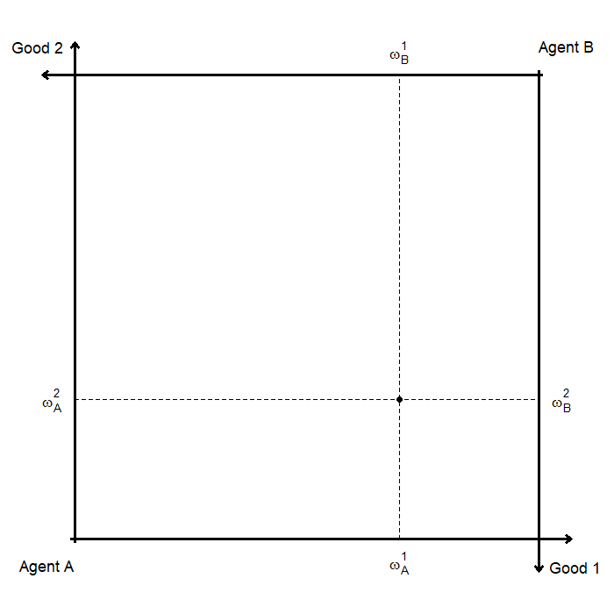
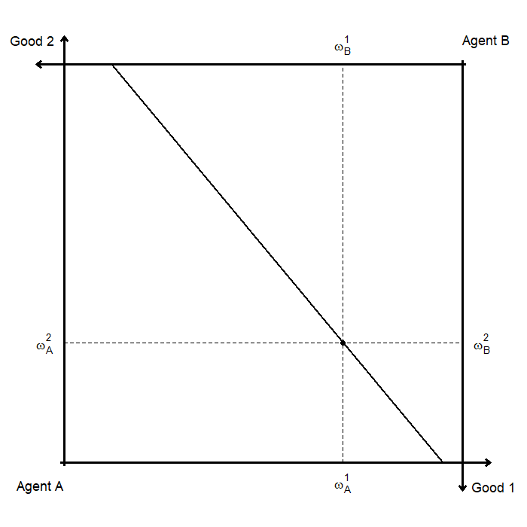
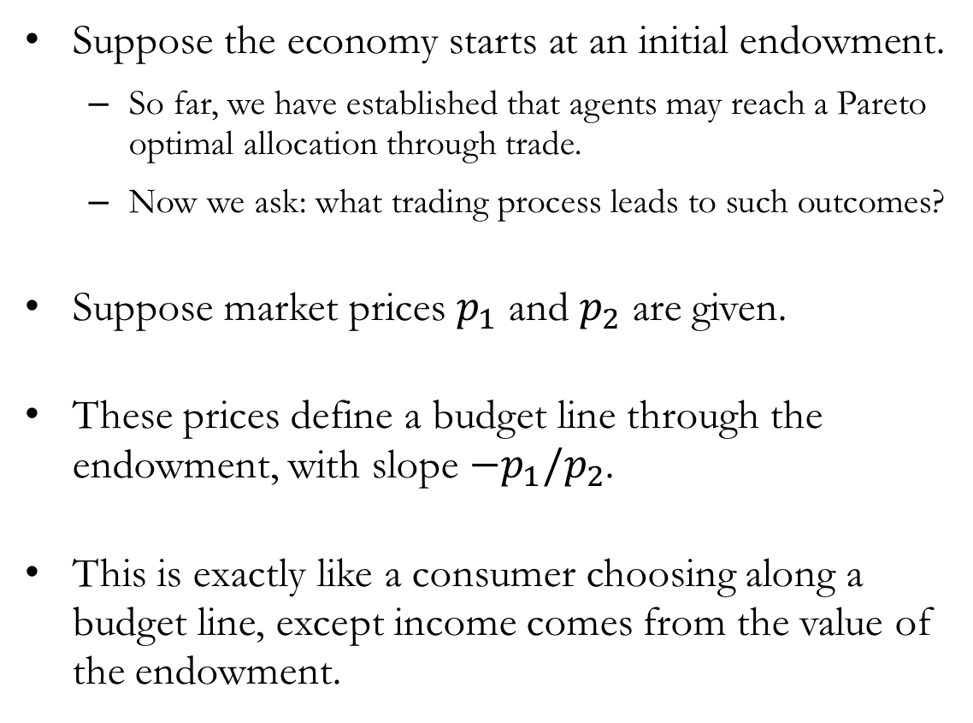
Market Prices
Suppose the economy starts at an initial endowment.
So far, we have established that agents may reach a Pareto optimal allocation through trade.
Now we ask: what trading process leads to such outcomes?
Suppose market prices $p_{1}$ and $p_{2}$ are given.
These prices define a budget line through the endowment, with slope $−p_{1}/p_{2}$.
This is exactly like a consumer choosing along a budget line, except income comes from the value of the endowment.

Slide 22
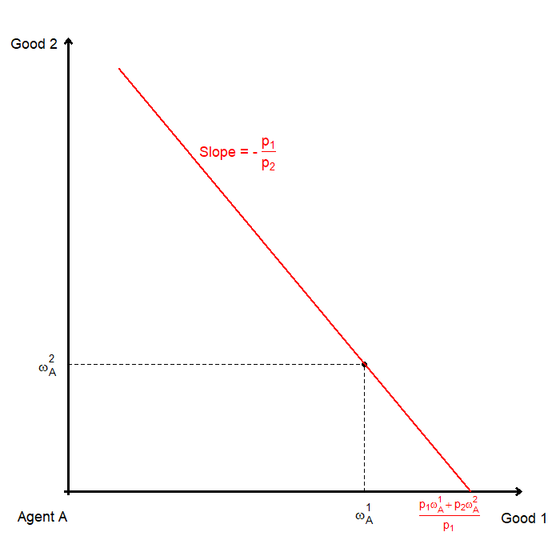
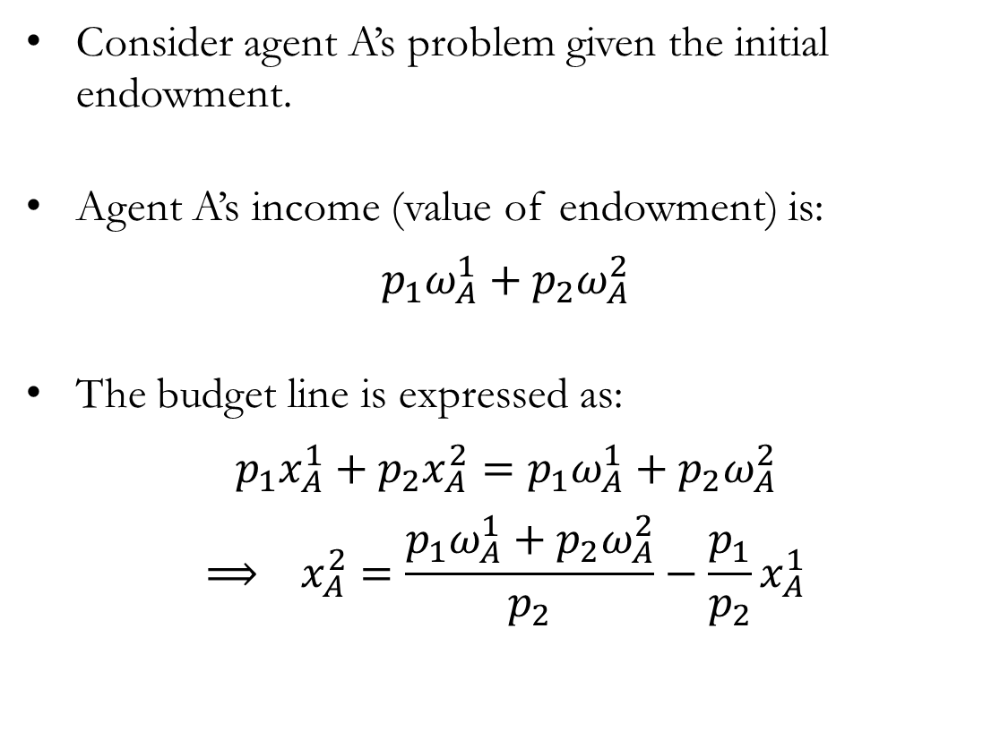
Endowments: The Budget Constraint
Consider agent A’s problem given the initial endowment.
Agent A’s income (value of endowment) is:
$$p_{1}ω_{A}^{1}+p_{2}ω_{A}^{2}$$
The budget line is expressed as:
$$p_{1}x_{A}^{1}+p_{2}x_{A}^{2}=p_{1}ω_{A}^{1}+p_{2}ω_{A}^{2}$$
$$⟹ x_{A}^{2}=\frac{p_{1}ω_{A}^{1}+p_{2}ω_{A}^{2}}{p_{2}}−\frac{p_{1}}{p_{2}}x_{A}^{1}$$

Slide 23
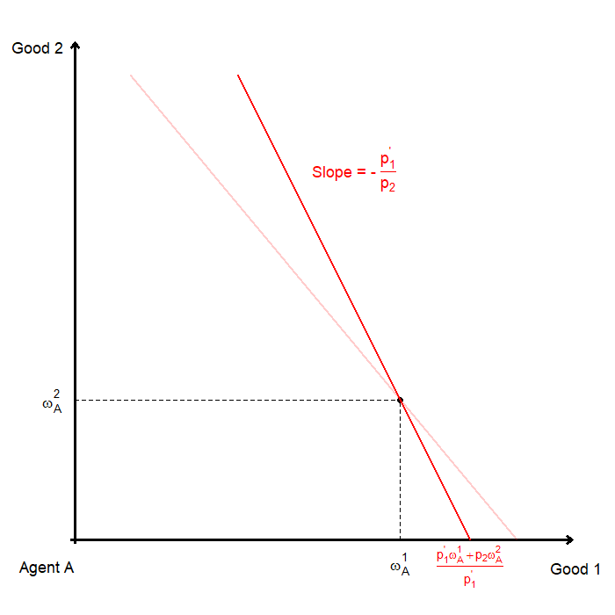
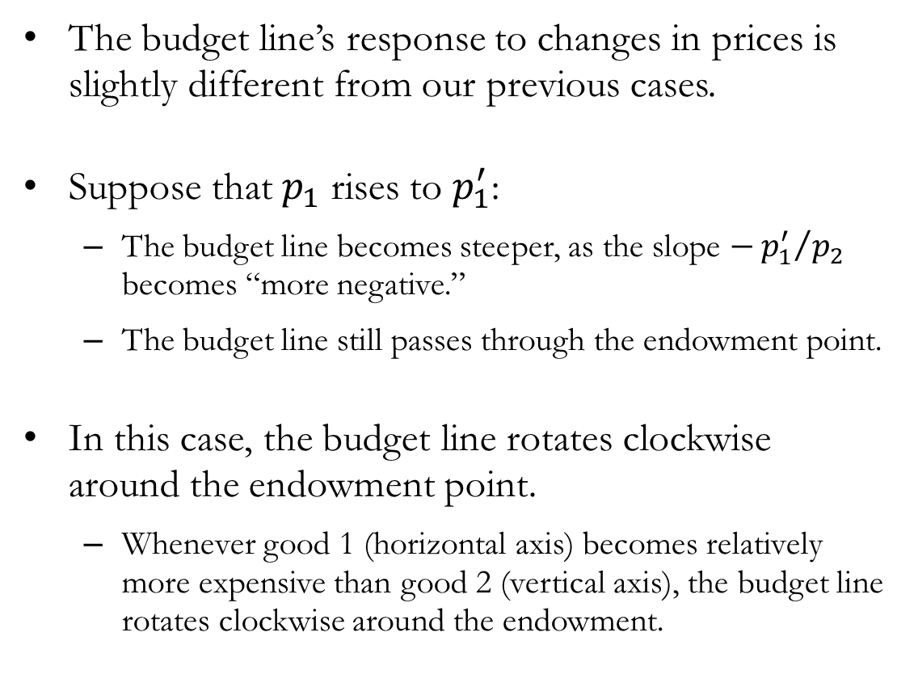
Endowments: Change in Price(s)
The budget line’s response to changes in prices is slightly different from our previous cases.
Suppose that $p_{1}$ rises to $p_{1}^{′}$:
The budget line becomes steeper, as the slope $−{p_{1}^{′}}/{p_{2}}$ becomes “more negative.”
The budget line still passes through the endowment point.
In this case, the budget line rotates clockwise around the endowment point.
Whenever good 1 (horizontal axis) becomes relatively more expensive than good 2 (vertical axis), the budget line rotates clockwise around the endowment.

Slide 24
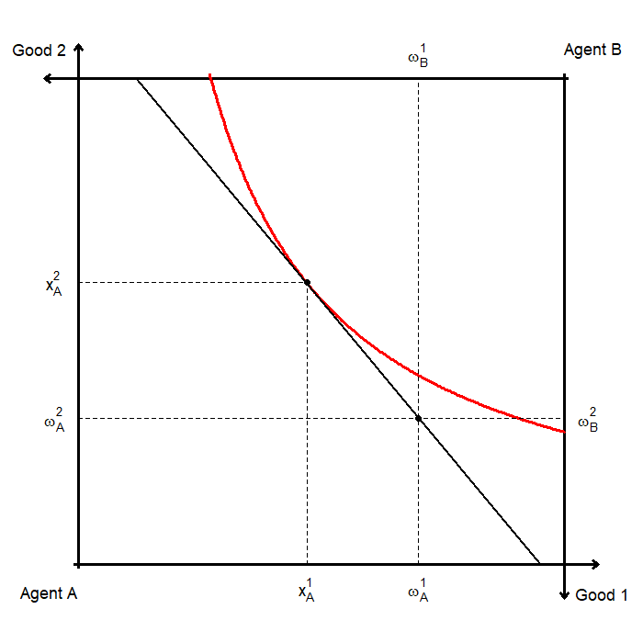
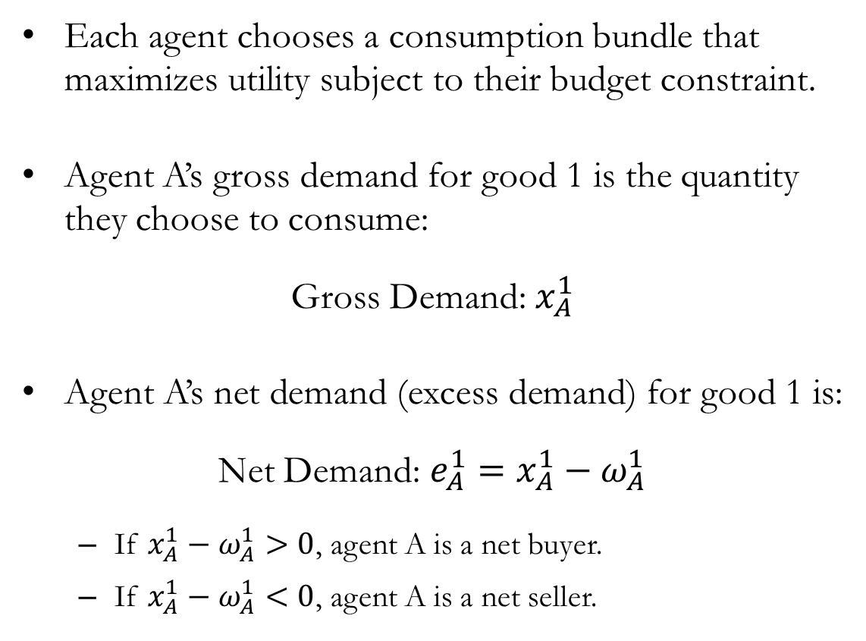
Trade: Net and Gross Demands
Each agent chooses a consumption bundle that maximizes utility subject to their budget constraint.
Agent A’s gross demand for good 1 is the quantity they choose to consume:
Gross Demand: $x_{A}^{1}$
Agent A’s net demand (excess demand) for good 1 is:
Net Demand: $e_{A}^{1}=x_{A}^{1}−ω_{A}^{1}$
If $x_{A}^{1}−ω_{A}^{1}>0$, agent A is a net buyer.
If $x_{A}^{1}−ω_{A}^{1}<0$, agent A is a net seller.

Slide 25
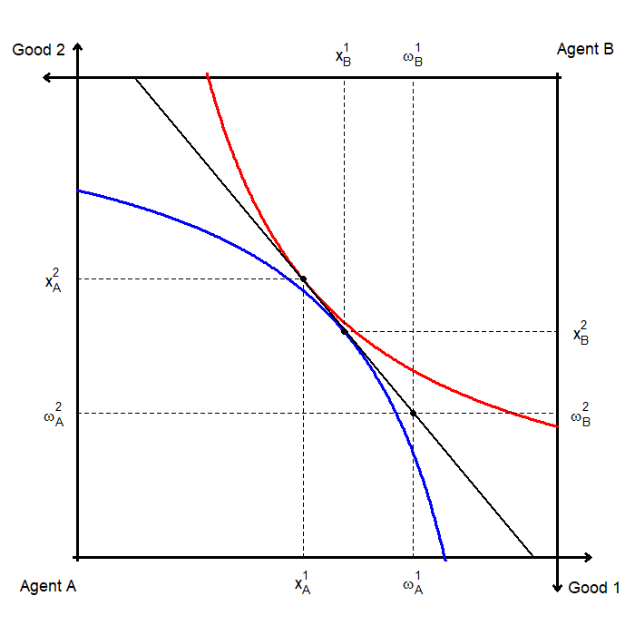
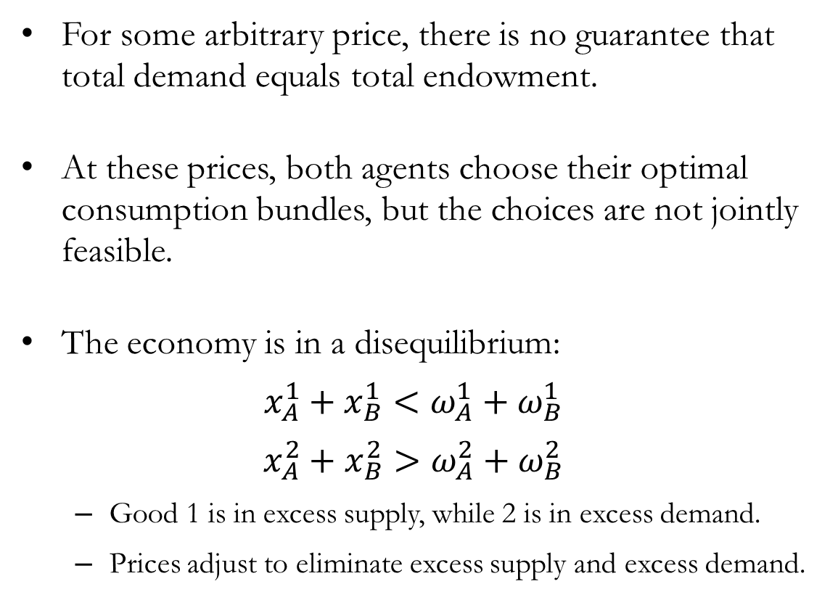
Trade: Disequilibrium
For some arbitrary price, there is no guarantee that total demand equals total endowment.
At these prices, both agents choose their optimal consumption bundles, but the choices are not jointly feasible.
The economy is in a disequilibrium:
$$x_{A}^{1}+x_{B}^{1}<ω_{A}^{1}+ω_{B}^{1}$$
$$x_{A}^{2}+x_{B}^{2}>ω_{A}^{2}+ω_{B}^{2}$$
Good 1 is in excess supply, while 2 is in excess demand.
Prices adjust to eliminate excess supply and excess demand.

Slide 26
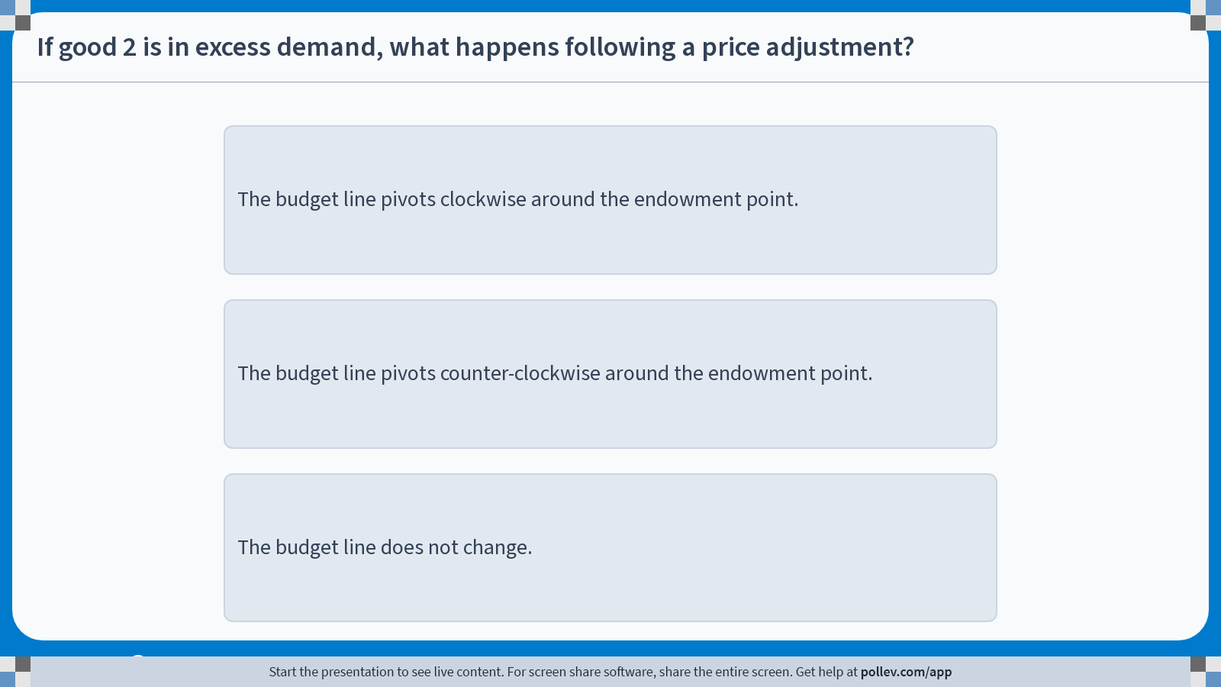
Poll Everywhere multiple choice poll instructions screen Activity Title: If good 2 is in excess demand, what happens following a price adjustment? Slide 24
Notes:
Do not modify the notes in this section to avoid tampering with the Poll Everywhere activity. More info at polleverywhere.com/support If good 2 is in excess demand, what happens following a price adjustment? https://www.polleverywhere.com/multiple_choice_polls/i241XpNWIAAE7BdPca6Ub?display_state=instructions&activity_state=opened&state=opened&flow=Engagement&onscreen=persist

Slide 27
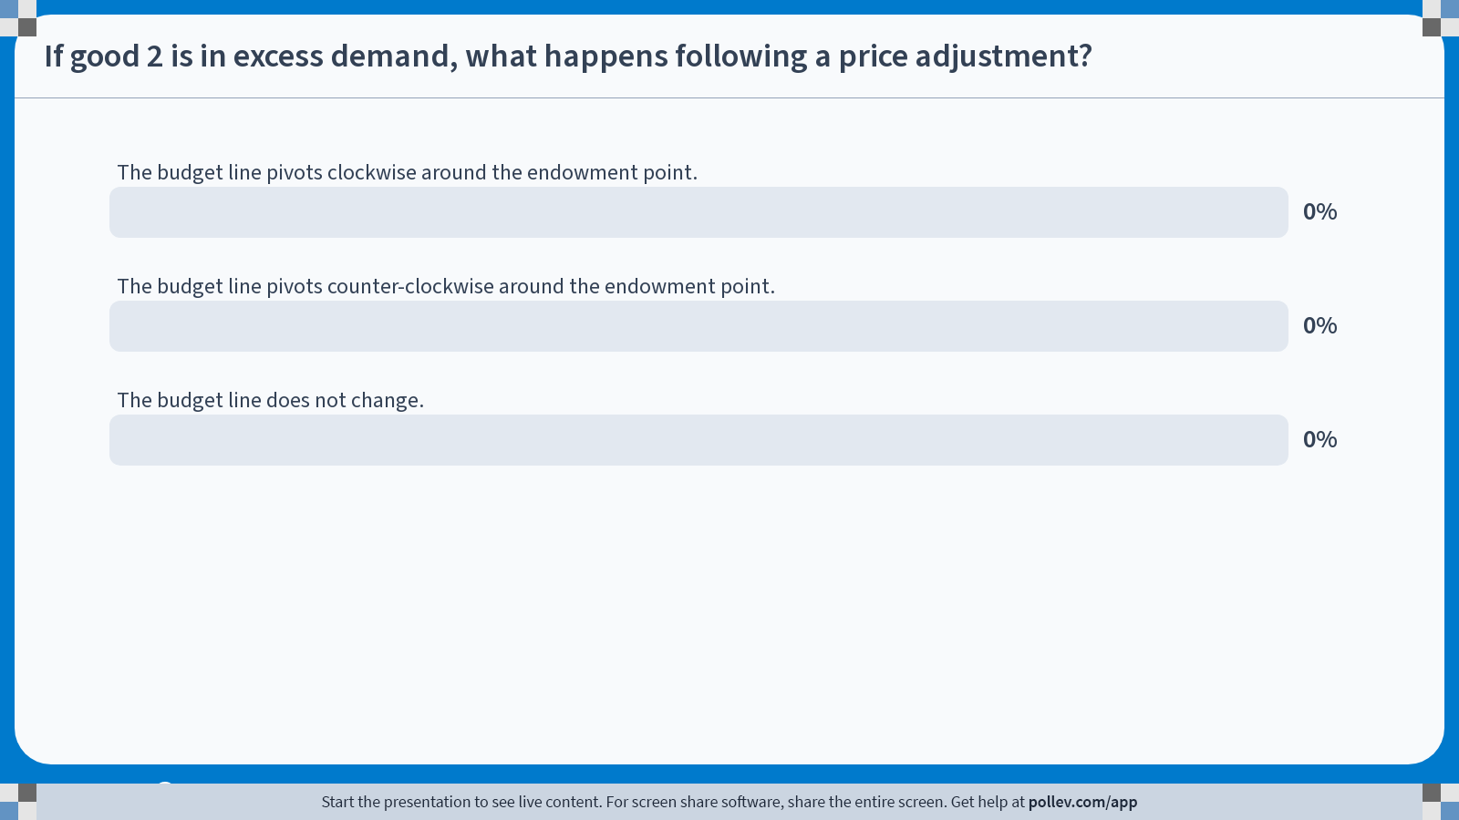
Poll Everywhere multiple choice poll chart screen Activity Title: If good 2 is in excess demand, what happens following a price adjustment? Slide 26
Notes:
Do not modify the notes in this section to avoid tampering with the Poll Everywhere activity. More info at polleverywhere.com/support If good 2 is in excess demand, what happens following a price adjustment? https://www.polleverywhere.com/multiple_choice_polls/i241XpNWIAAE7BdPca6Ub?display_state=chart&activity_state=closed&state=closed&flow=Engagement&onscreen=persist

Slide 28
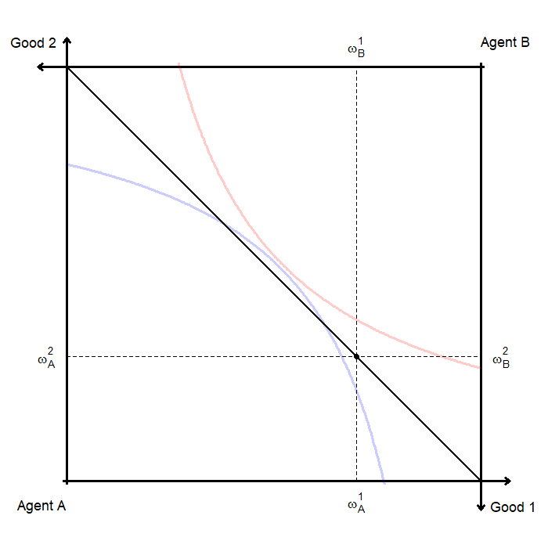
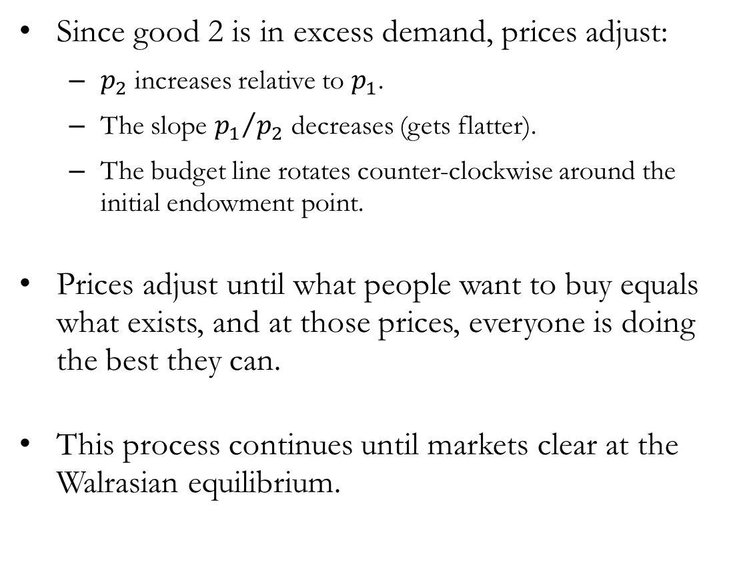
Trade: Price Adjustments
Since good 2 is in excess demand, prices adjust:
$p_{2}$ increases relative to $p_{1}$.
The slope ${p_{1}}/{p_{2}}$ decreases (gets flatter).
The budget line rotates counter-clockwise around the initial endowment point.
Prices adjust until what people want to buy equals what exists, and at those prices, everyone is doing the best they can.
This process continues until markets clear at the Walrasian equilibrium.

Slide 29
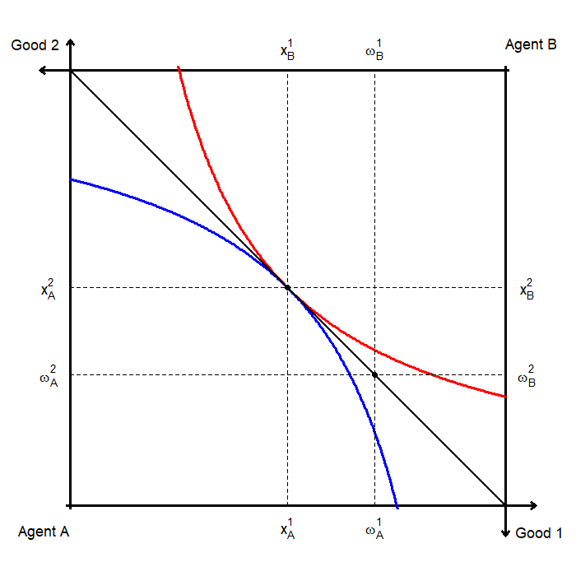
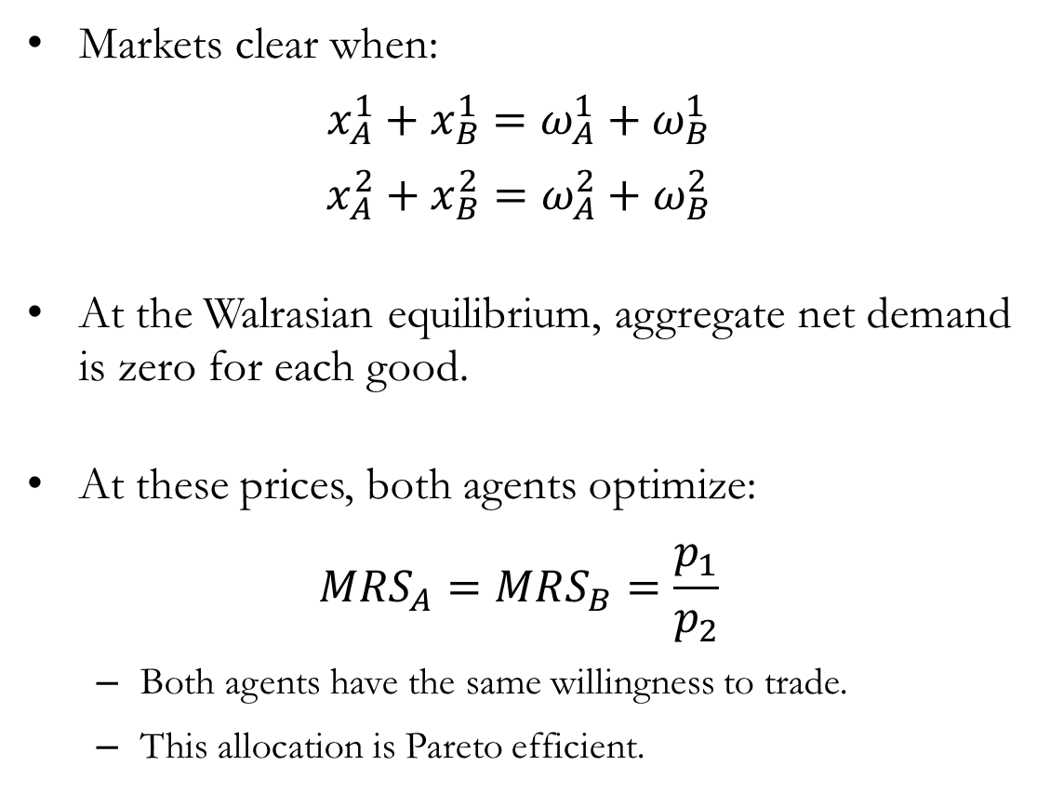
Trade: Market Clearing and Walrasian Equilibrium
Markets clear when:
$$x_{A}^{1}+x_{B}^{1}=ω_{A}^{1}+ω_{B}^{1}$$
$$x_{A}^{2}+x_{B}^{2}=ω_{A}^{2}+ω_{B}^{2}$$
At the Walrasian equilibrium, aggregate net demand is zero for each good.
At these prices, both agents optimize:
$$MRS_{A}=MRS_{B}=\frac{p_{1}}{p_{2}}$$
Both agents have the same willingness to trade.
This allocation is Pareto efficient.

Slide 30
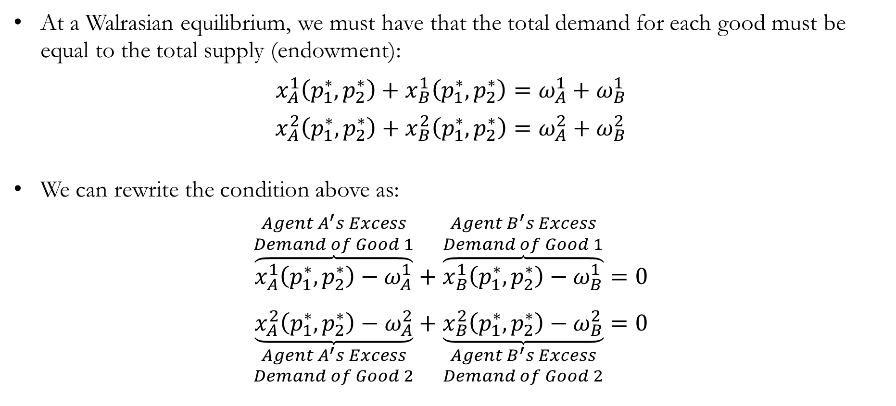
Walras’s Law: The Algebra
At a Walrasian equilibrium, we must have that the total demand for each good must be equal to the total supply (endowment):
$$x_{A}^{1}\left(p_{1}^{∗},p_{2}^{∗}\right)+x_{B}^{1}\left(p_{1}^{∗},p_{2}^{∗}\right)=ω_{A}^{1}+ω_{B}^{1}$$
$$x_{A}^{2}\left(p_{1}^{∗},p_{2}^{∗}\right)+x_{B}^{2}\left(p_{1}^{∗},p_{2}^{∗}\right)=ω_{A}^{2}+ω_{B}^{2}$$
We can rewrite the condition above as:
$$\overset{\begin{aligned}Agent A^{′}s Excess \\ Demand of Good 1\end{aligned}}{\overbrace{x_{A}^{1}\left(p_{1}^{∗},p_{2}^{∗}\right)−ω_{A}^{1}}}+\overset{\begin{aligned}Agent B^{′}s Excess \\ Demand of Good 1\end{aligned}}{\overbrace{x_{B}^{1}\left(p_{1}^{∗},p_{2}^{∗}\right)−ω_{B}^{1}}}=0$$
$$\underset{\begin{aligned}Agent A^{′}s Excess \\ Demand of Good 2\end{aligned}}{\underbrace{x_{A}^{2}\left(p_{1}^{∗},p_{2}^{∗}\right)−ω_{A}^{2}}}+\underset{\begin{aligned}Agent B^{′}s Excess \\ Demand of Good 2\end{aligned}}{\underbrace{x_{B}^{2}\left(p_{1}^{∗},p_{2}^{∗}\right)−ω_{B}^{2}}}=0$$

Slide 31
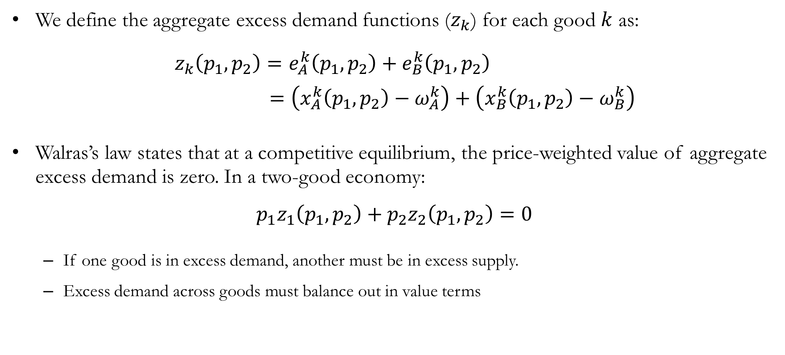
Walras’s Law
We define the aggregate excess demand functions ($z_{k}$) for each good $k$ as:
$z_{k}\left(p_{1},p_{2}\right)=e_{A}^{k}\left(p_{1},p_{2}\right)+e_{B}^{k}\left(p_{1},p_{2}\right)$
$=\left(x_{A}^{k}\left(p_{1},p_{2}\right)−ω_{A}^{k}\right)+\left(x_{B}^{k}\left(p_{1},p_{2}\right)−ω_{B}^{k}\right)$
Walras’s law states that at a competitive equilibrium, the price-weighted value of aggregate excess demand is zero. In a two-good economy:
$$p_{1}z_{1}\left(p_{1},p_{2}\right)+p_{2}z_{2}\left(p_{1},p_{2}\right)=0$$
If one good is in excess demand, another must be in excess supply.
Excess demand across goods must balance out in value terms

Slide 32
The Fundamental Theorem(s)
of Welfare Economics

Slide 33
Equilibrium and Efficiency
Graphically, we can see that the competitive equilibrium is Pareto optimal.
Consider agent A’s point of view starting from a competitive equilibrium:
There are allocations that increase agent A’s utility (above their indifference curve).
However, every such allocation necessarily lowers agent B’s utility, since it moves them below their indifference curve.
Therefore, no Pareto improvements are possible at the competitive equilibrium.

Slide 34
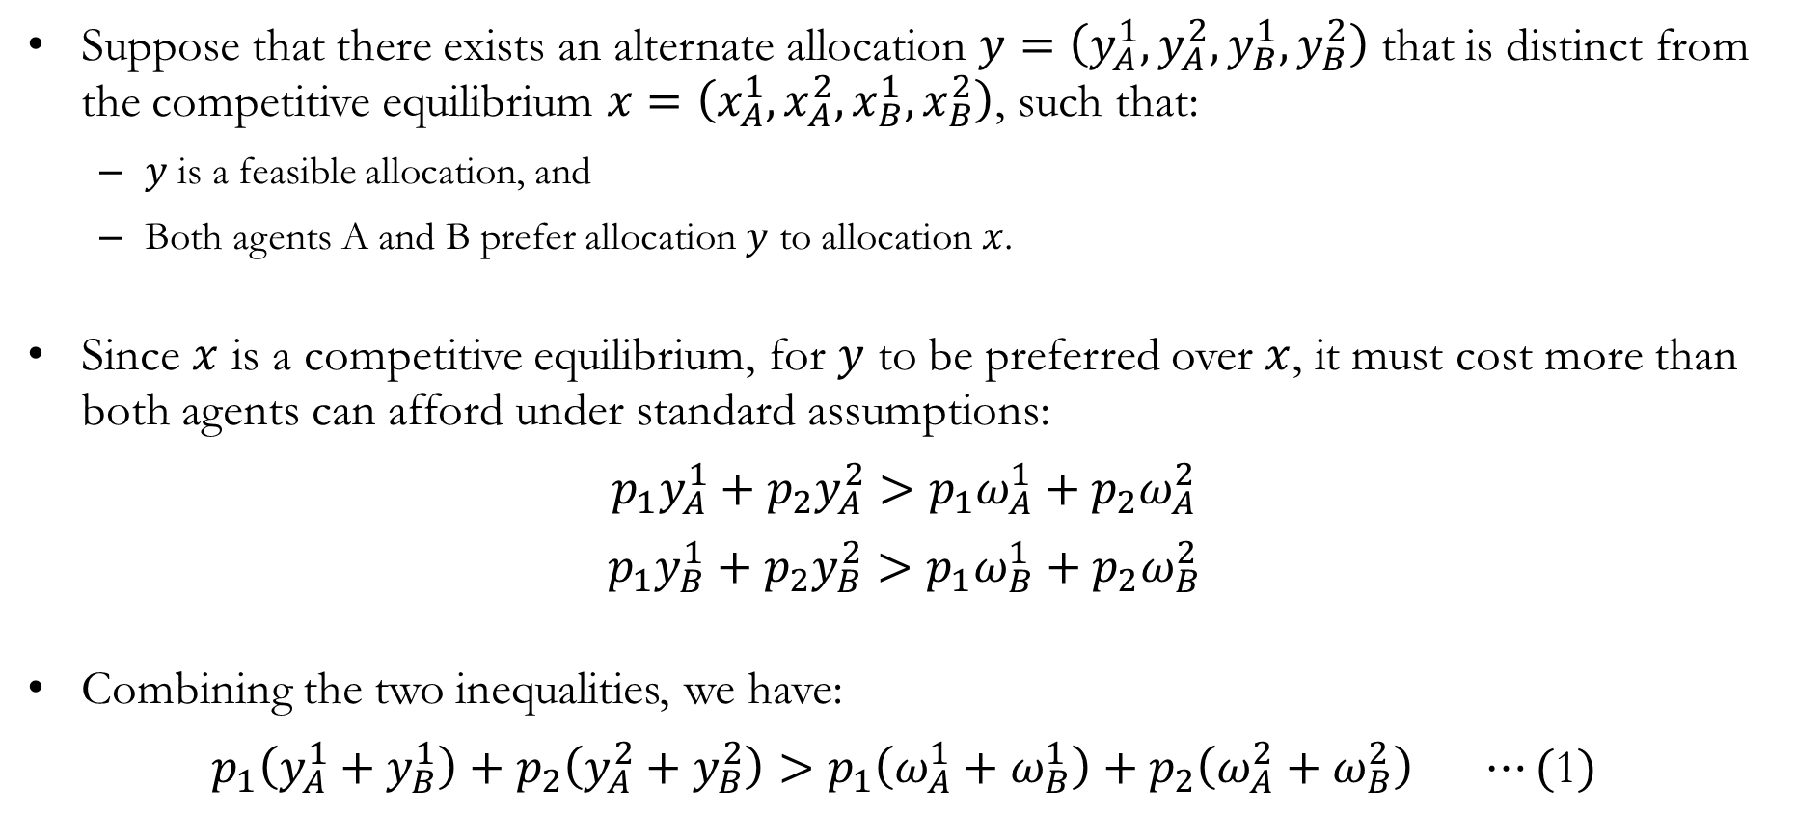
Equilibrium and Efficiency: The Math
Suppose that there exists an alternate allocation $y=\left(y_{A}^{1},y_{A}^{2},y_{B}^{1},y_{B}^{2}\right)$ that is distinct from the competitive equilibrium $x=\left(x_{A}^{1},x_{A}^{2},x_{B}^{1},x_{B}^{2}\right)$, such that:
$y$ is a feasible allocation, and
Both agents A and B prefer allocation $y$ to allocation $x$.
Since $x$ is a competitive equilibrium, for $y$ to be preferred over $x$, it must cost more than both agents can afford under standard assumptions:
$$p_{1}y_{A}^{1}+p_{2}y_{A}^{2}>p_{1}ω_{A}^{1}+p_{2}ω_{A}^{2}$$
$$p_{1}y_{B}^{1}+p_{2}y_{B}^{2}>p_{1}ω_{B}^{1}+p_{2}ω_{B}^{2}$$
Combining the two inequalities, we have:
$$p_{1}\left(y_{A}^{1}+y_{B}^{1}\right)+p_{2}\left(y_{A}^{2}+y_{B}^{2}\right)>p_{1}\left(ω_{A}^{1}+ω_{B}^{1}\right)+p_{2}\left(ω_{A}^{2}+ω_{B}^{2}\right) ⋯(\text{1})$$

Slide 35
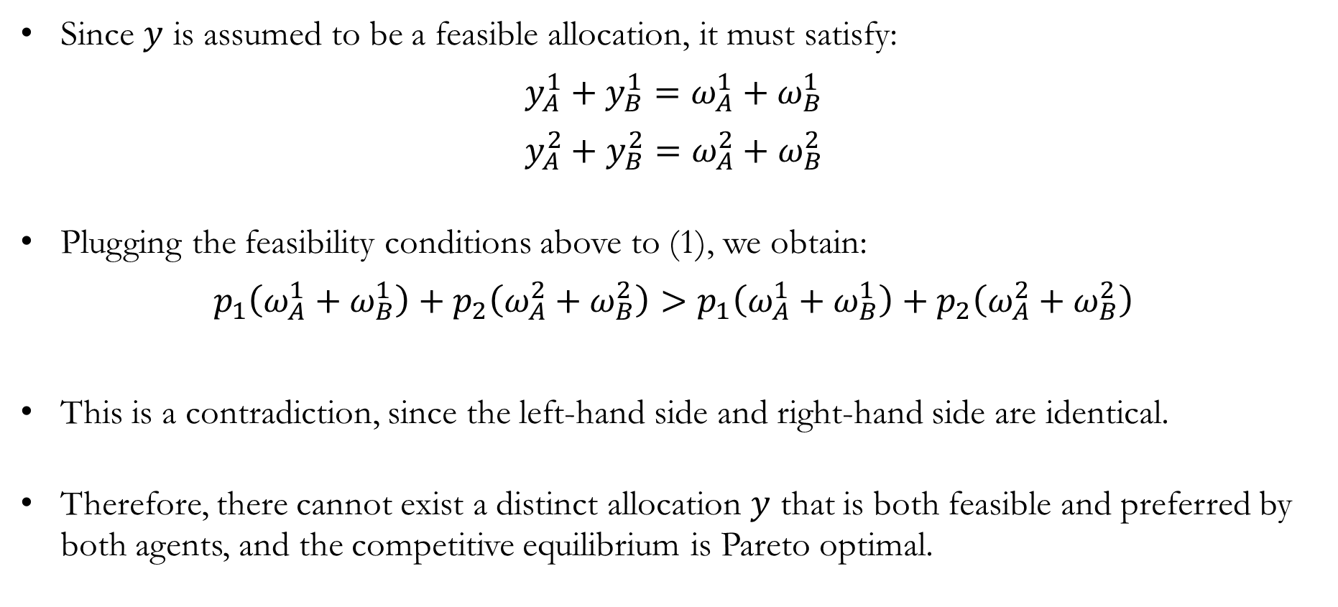
Equilibrium and Efficiency: The Math
Since $y$ is assumed to be a feasible allocation, it must satisfy:
$$y_{A}^{1}+y_{B}^{1}=ω_{A}^{1}+ω_{B}^{1}$$
$$y_{A}^{2}+y_{B}^{2}=ω_{A}^{2}+ω_{B}^{2}$$
Plugging the feasibility conditions above to (1), we obtain:
$$p_{1}\left(ω_{A}^{1}+ω_{B}^{1}\right)+p_{2}\left(ω_{A}^{2}+ω_{B}^{2}\right)>p_{1}\left(ω_{A}^{1}+ω_{B}^{1}\right)+p_{2}\left(ω_{A}^{2}+ω_{B}^{2}\right)$$
This is a contradiction, since the left-hand side and right-hand side are identical.
Therefore, there cannot exist a distinct allocation $y$ that is both feasible and preferred by both agents, and the competitive equilibrium is Pareto optimal.

Slide 36
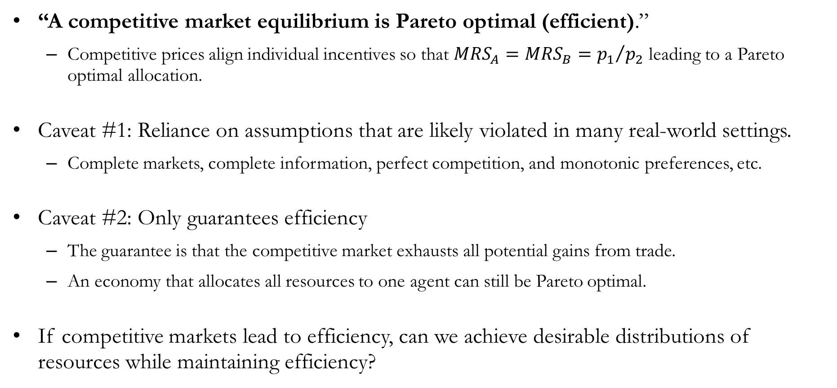
The First Fundamental Theorem of Welfare Econ.
“A competitive market equilibrium is Pareto optimal (efficient).”
Competitive prices align individual incentives so that $MRS_{A}=MRS_{B}={p_{1}}/{p_{2}}$ leading to a Pareto optimal allocation.
Caveat #1: Reliance on assumptions that are likely violated in many real-world settings.
Complete markets, complete information, perfect competition, and monotonic preferences, etc.
Caveat #2: Only guarantees efficiency
The guarantee is that the competitive market exhausts all potential gains from trade.
An economy that allocates all resources to one agent can still be Pareto optimal.
If competitive markets lead to efficiency, can we achieve desirable distributions of resources while maintaining efficiency?

Slide 37
The Second Fundamental Theorem of Welfare Econ.
“For any Pareto optimal allocation, there exists a set of prices and an assignment of endowments such that it can be supported as a competitive equilibrium.”
Translated: “If one can identify a desirable allocation, we can redistribute endowments and find prices so that the market leads to that allocation.”
Caveat #1: Reliance on even stronger assumptions than the first fundamental theorem.
Convex preferences are required
The key idea is that markets are not just efficient, but they are flexible enough to implement any efficient outcome, if we redistribute resources appropriately.

Slide 38
The Existence of an Equilibrium
Under standard assumptions, a competitive equilibrium exists.
Together with the two fundamental theorems:
A competitive market equilibrium exists.
Competitive market equilibria are efficient, and
Markets can implement any efficient allocation (with redistribution).
Markets are powerful:
They exist, they are efficient, and they are flexible enough to achieve any efficient outcome.
But only under very strong and often unrealistic assumptions.
This is why economists like markets, but this is also why economists worry about when these assumptions fail.

Slide 39
Recap & Preview

Slide 40
Recap: Exchange
We moved from individual optimization to interaction between agents, toward a model of general equilibrium.
In a pure exchange economy:
Two agents, two goods, and fixed total resources.
The Edgeworth box represents all feasible allocations.
The initial endowment determines the starting point.
Trade leads to Pareto improvements:
Agents move toward mutually beneficial allocations.
Process stops at Pareto optimal allocations.
The set of all Pareto optimal allocations is the contract curve.

Slide 41
Recap: Exchange
Competitive markets provide a mechanism for trade:
Prices guide decisions, and agents solve utility maximization problems subject to budget constraints.
First Fundamental Theorem:
Competitive market equilibria are Pareto optimal.
Second Fundamental Theorem:
Any Pareto optimal allocation can be supported as a competitive equilibrium.
With appropriate redistribution of endowments.
Markets are powerful and efficient mechanisms:
But they do not determine fairness, and rely on strong assumptions for these results.

Slide 42
Preview: Production
So far, we have studied general equilibrium in a pure exchange economy.
Now, we introduce production:
Goods can be transformed using technology.
Firms (agents) decide what to produce and how.
We now ask: “How do production decisions interact with consumer preferences?”
In a general equilibrium with production:
Consumers maximize utility.
Firms maximize profit.
Prices coordinate both sides of the economy.

