Slide 1
INTERMEDIATE MICROECONOMIC THEORY
Chapter 33: Production

Slide 2
Preview: General Equilibrium with Production
So far, we have studied general equilibrium in a pure exchange economy.
Now, we introduce production:
Goods can be transformed using technology.
Firms (agents) decide what to produce and how.
We now ask: “How do production decisions interact with consumer preferences?”
In a general equilibrium with production:
Consumers maximize utility.
Firms maximize profit.
Prices coordinate both sides of the economy.

Slide 3
The Robinson Crusoe Economy

Slide 4
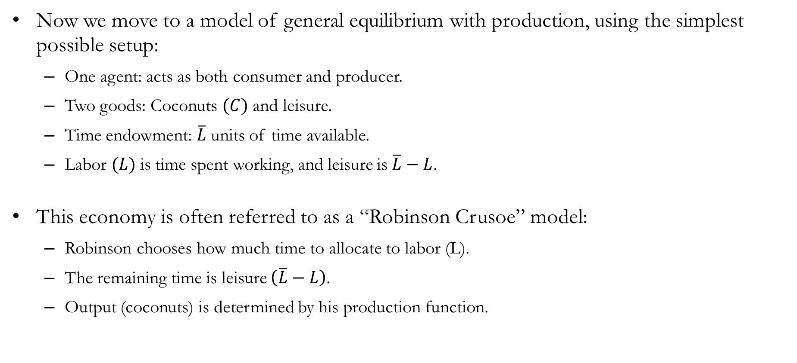
A Model of Production: Settings
Now we move to a model of general equilibrium with production, using the simplest possible setup:
One agent: acts as both consumer and producer.
Two goods: Coconuts $(C)$ and leisure.
Time endowment: $\overline{L}$ units of time available.
Labor $(L)$ is time spent working, and leisure is $\overline{L}−L$.
This economy is often referred to as a “Robinson Crusoe” model:
Robinson chooses how much time to allocate to labor (L).
The remaining time is leisure $\left(\overline{L}−L\right)$.
Output (coconuts) is determined by his production function.

Slide 5
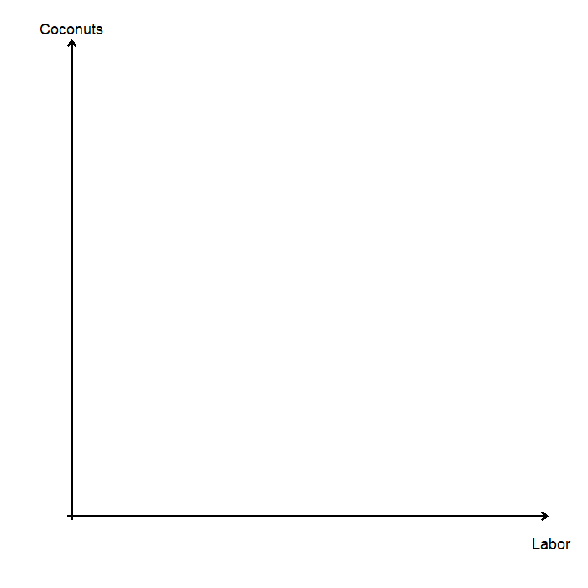
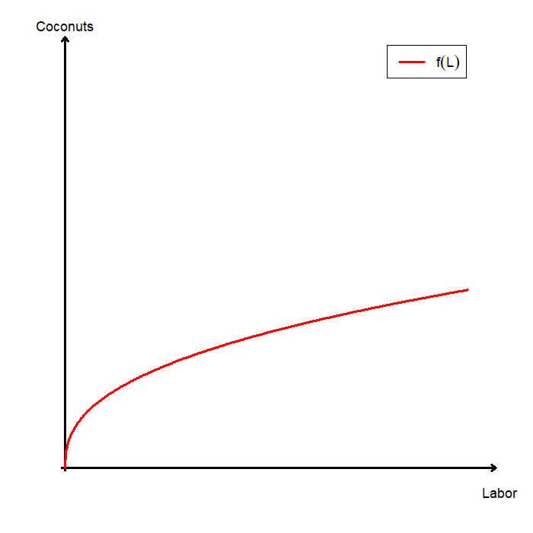
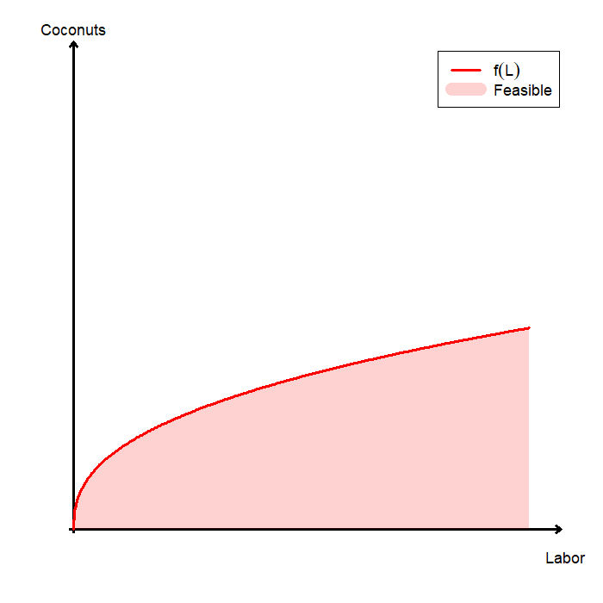
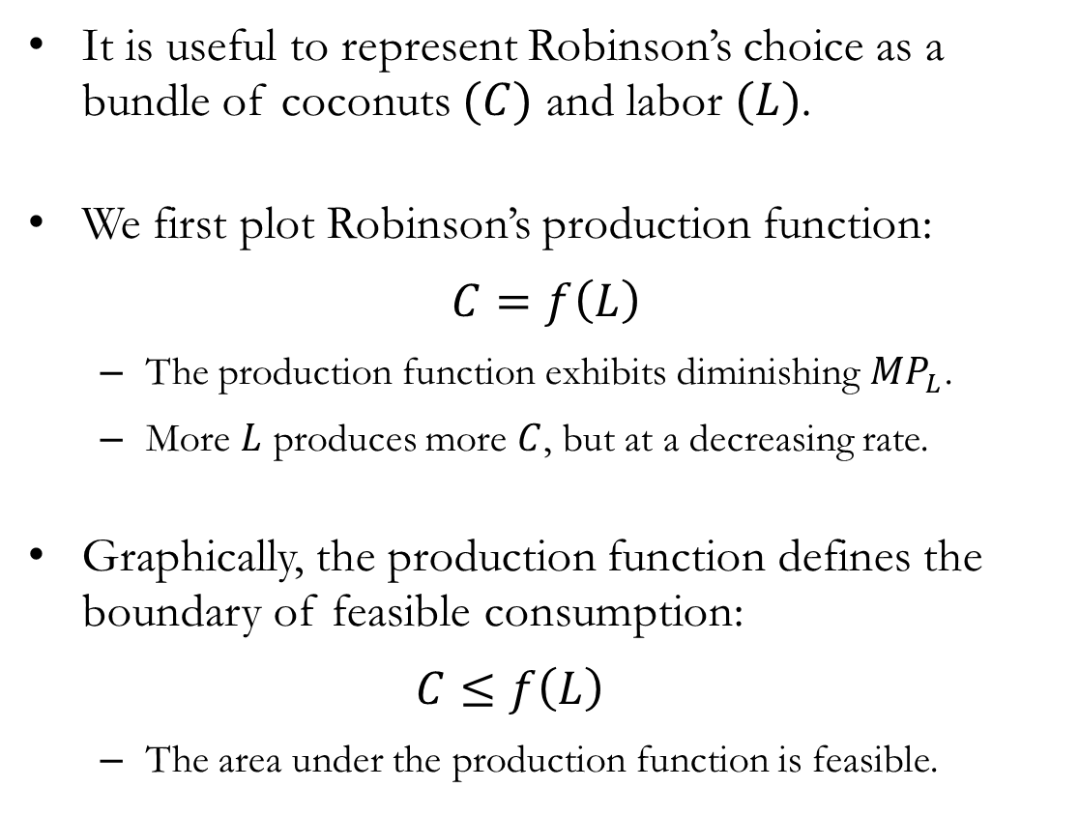
Robinson’s Problem: Production
It is useful to represent Robinson’s choice as a bundle of coconuts $(C)$ and labor $(L)$.
We first plot Robinson’s production function:
$$C=f\left(L\right)$$
The production function exhibits diminishing $MP_{L}$.
More $L$ produces more $C$, but at a decreasing rate.
Graphically, the production function defines the boundary of feasible consumption:
$$C≤f\left(L\right)$$
The area under the production function is feasible.

Slide 6
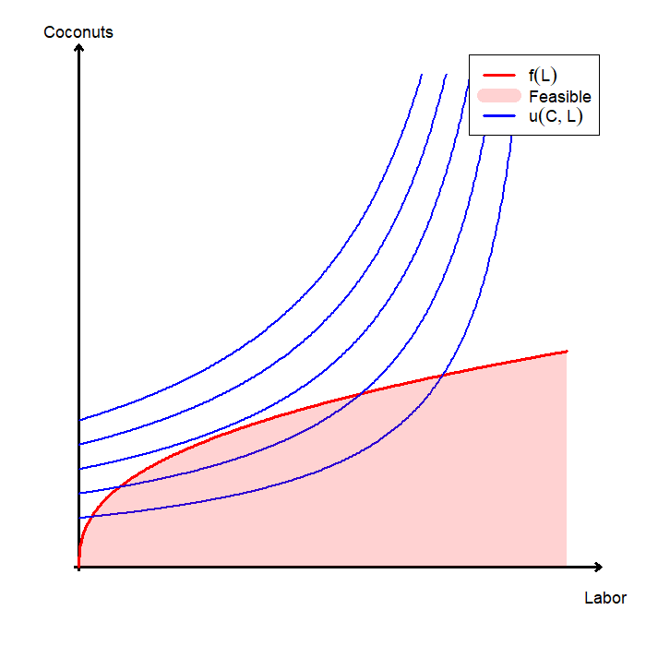
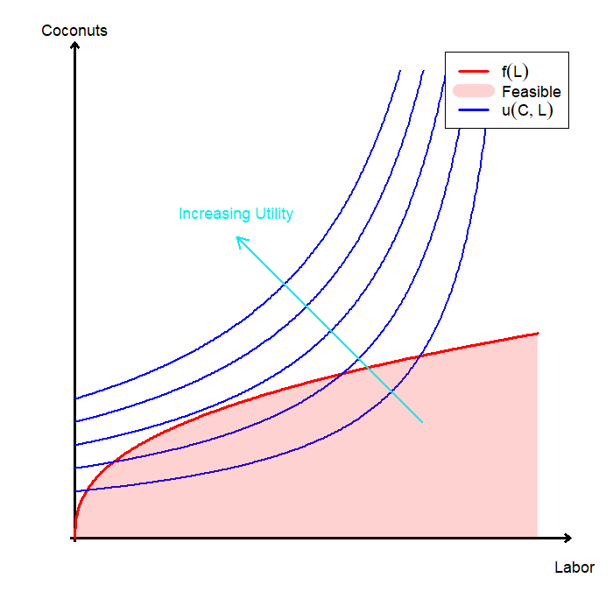
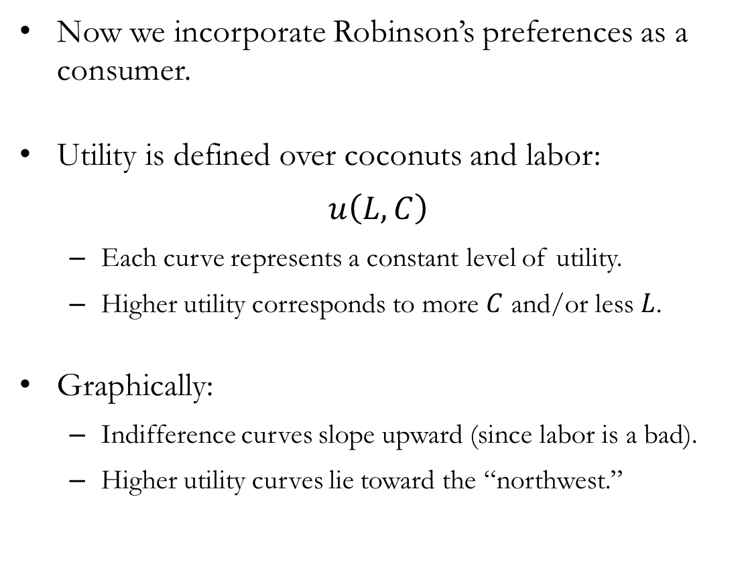
Robinson’s Problem: Production & Consumption
Now we incorporate Robinson’s preferences as a consumer.
Utility is defined over coconuts and labor:
$$u\left(L,C\right)$$
Each curve represents a constant level of utility.
Higher utility corresponds to more $C$ and/or less $L$.
Graphically:
Indifference curves slope upward (since labor is a bad).
Higher utility curves lie toward the “northwest.”

Slide 7
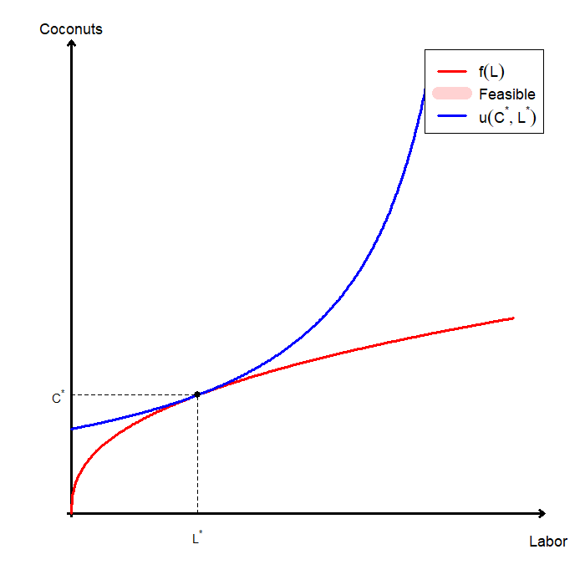
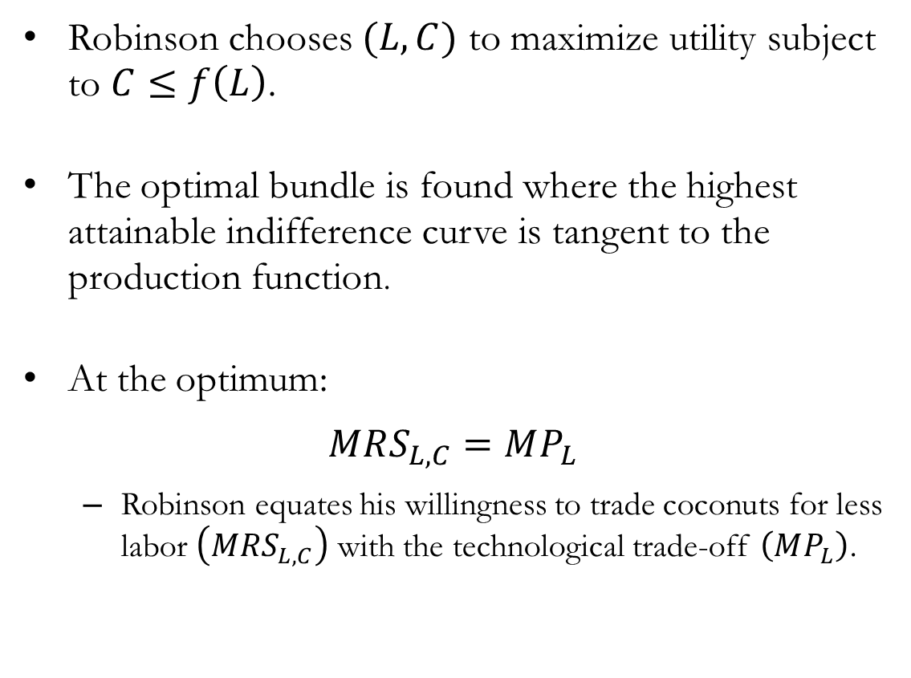
Robinson’s Problem: Optimal Choice
Robinson chooses $(L,C)$ to maximize utility subject to $C≤f\left(L\right)$.
The optimal bundle is found where the highest attainable indifference curve is tangent to the production function.
At the optimum:
$$MRS_{L,C}=MP_{L}$$
Robinson equates his willingness to trade coconuts for less labor $\left(MRS_{L,C}\right)$ with the technological trade-off $\left(MP_{L}\right)$.

Slide 8
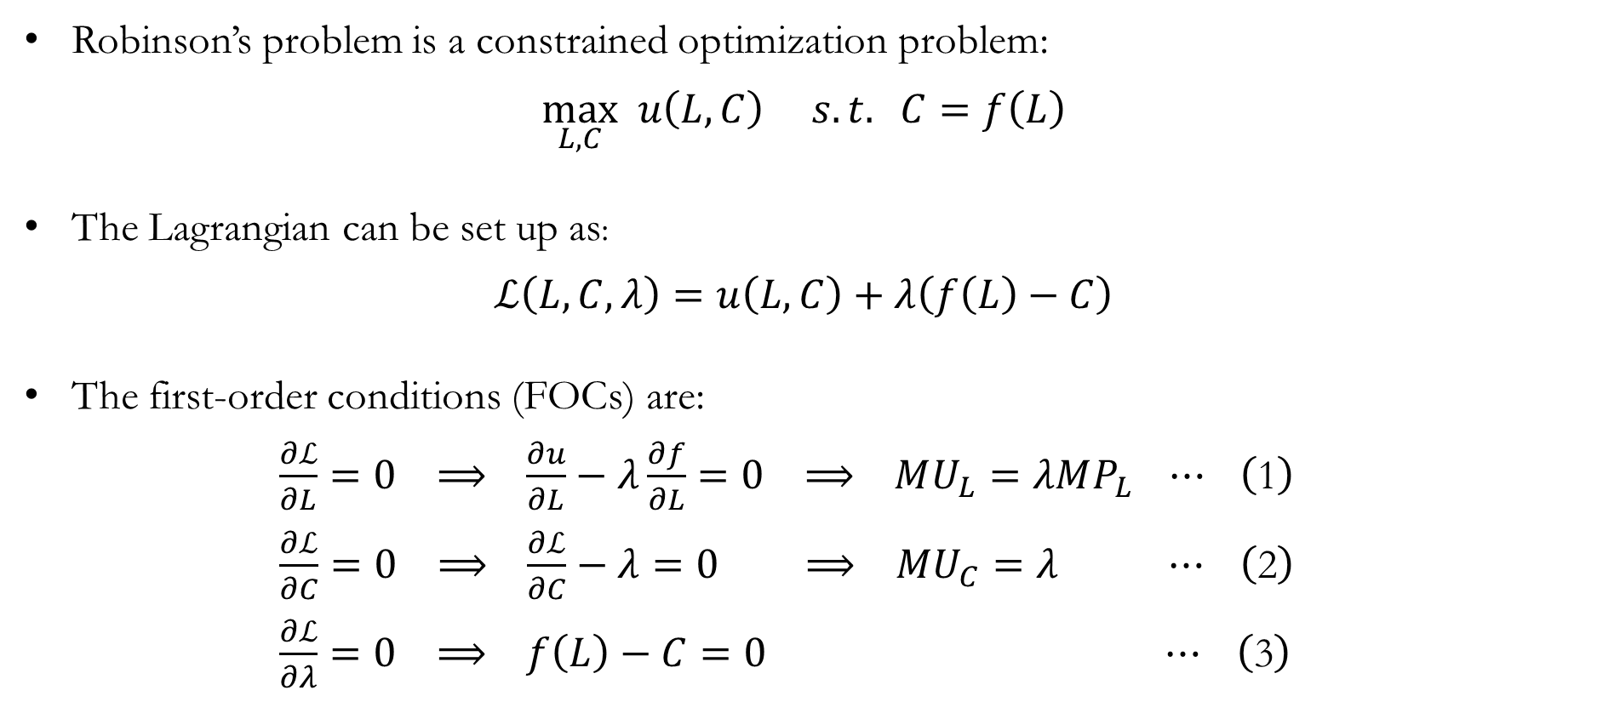
Robinson’s Problem: The Mathematics
Robinson’s problem is a constrained optimization problem:
$$\max_{L,C} u\left(L,C\right) s.t. C=f\left(L\right)$$
The Lagrangian can be set up as:
$$ℒ\left(L,C,λ\right)=u\left(L,C\right)+λ\left(f\left(L\right)−C\right)$$
The first-order conditions (FOCs) are:
$\frac{∂ℒ}{∂L}=0 ⟹ \frac{∂u}{∂L}−λ\frac{∂f}{∂L}=0 ⟹ MU_{L}=λMP_{L} ⋯ \left(\text{1}\right)$
$\frac{∂ℒ}{∂C}=0 ⟹ \frac{∂ℒ}{∂C}−λ=0 ⟹ MU_{C}=λ ⋯ \left(\text{2}\right)$
$\frac{∂ℒ}{∂λ}=0 ⟹ f\left(L\right)−C=0 ⋯ \left(\text{3}\right)$

Slide 9

Robinson’s Problem: The Mathematics
Taking the ratio of FOCs (1) and (2):
$$\frac{MU_{L}}{MU_{C}}=MP_{L}$$
FOC (3) enforces the feasibility constraint:
$$f\left(L\right)−C=0$$
We can use mathematics to verify the conclusion we have drawn analyzing graphs, that Robinson’s marginal rate of substitution equals the marginal product of labor.

Slide 10
Robinson Crusoe and Friday

Slide 11
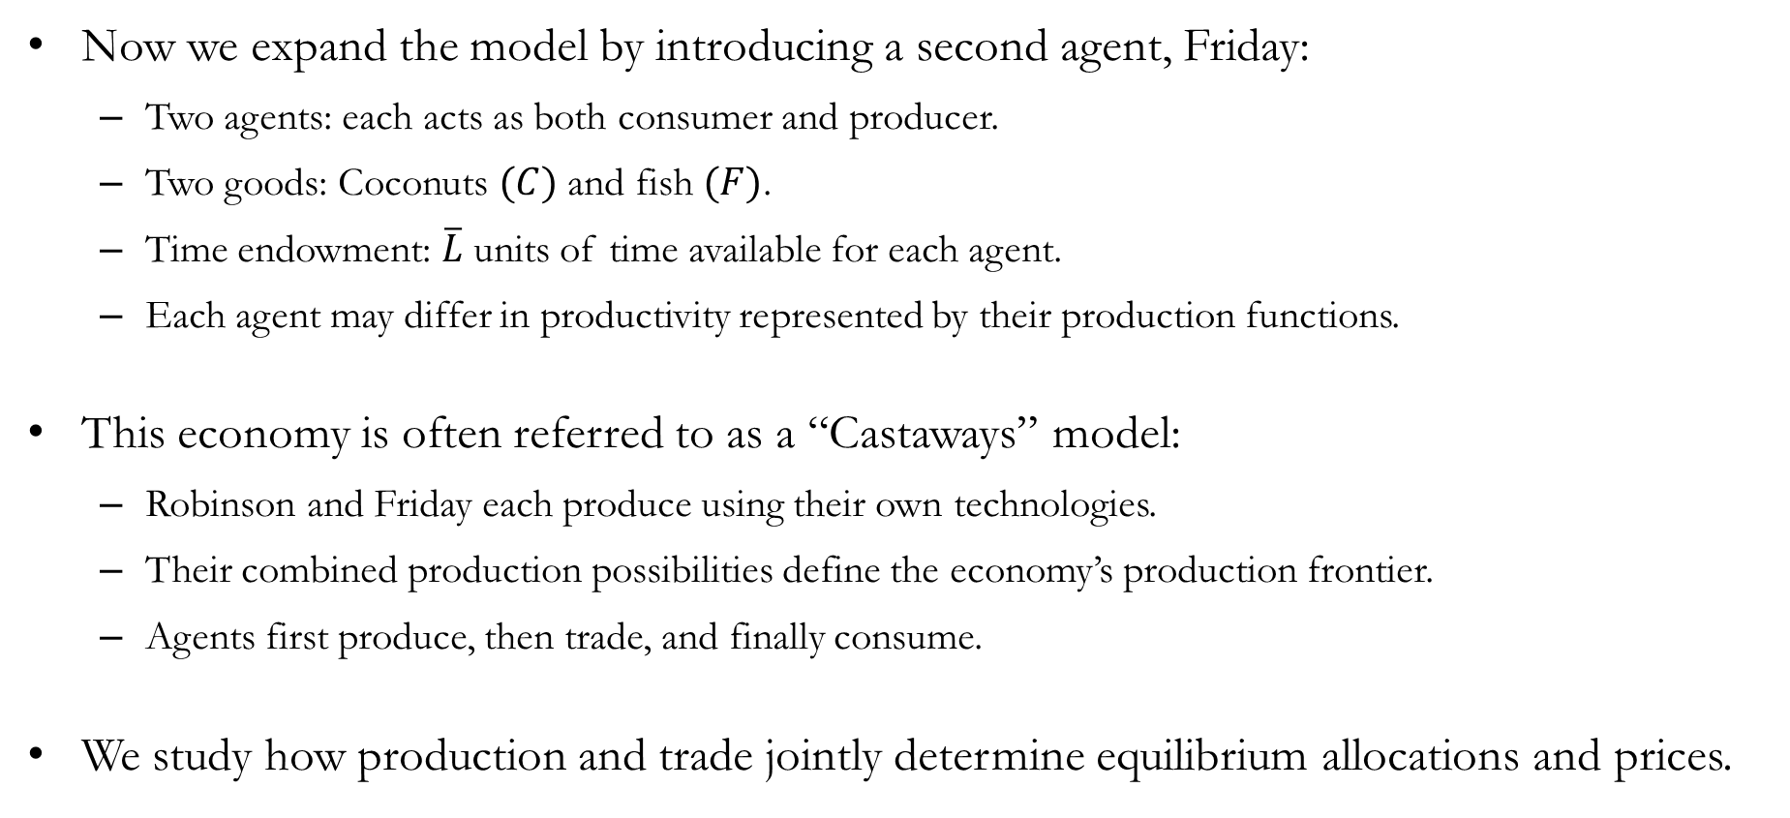
An Expanded Model of Production: Settings
Now we expand the model by introducing a second agent, Friday:
Two agents: each acts as both consumer and producer.
Two goods: Coconuts $(C)$ and fish $(F)$.
Time endowment: $\overline{L}$ units of time available for each agent.
Each agent may differ in productivity represented by their production functions.
This economy is often referred to as a “Castaways” model:
Robinson and Friday each produce using their own technologies.
Their combined production possibilities define the economy’s production frontier.
Agents first produce, then trade, and finally consume.
We study how production and trade jointly determine equilibrium allocations and prices.

Slide 12
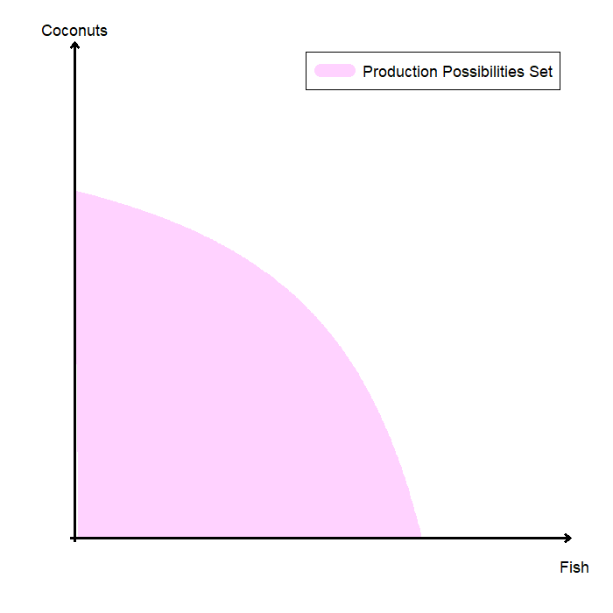
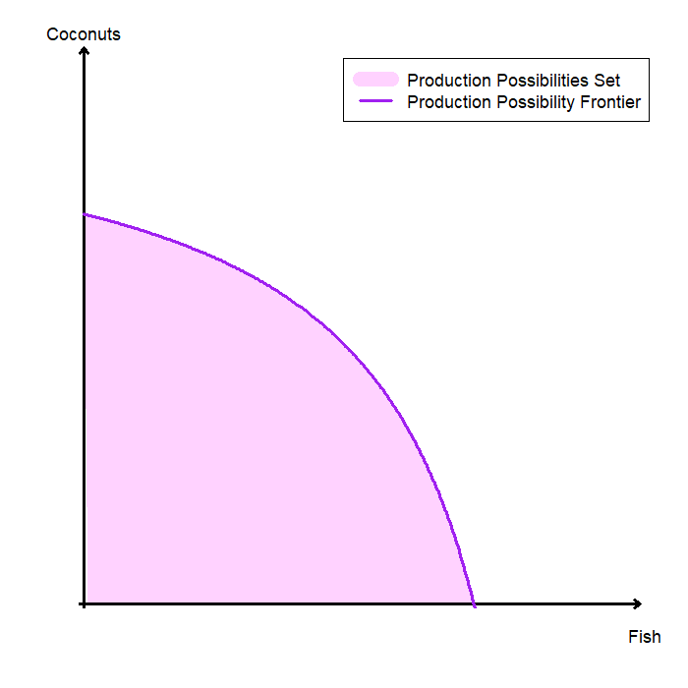
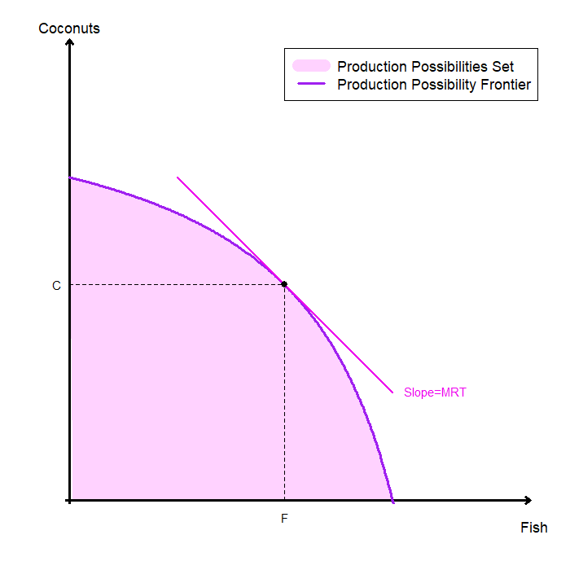
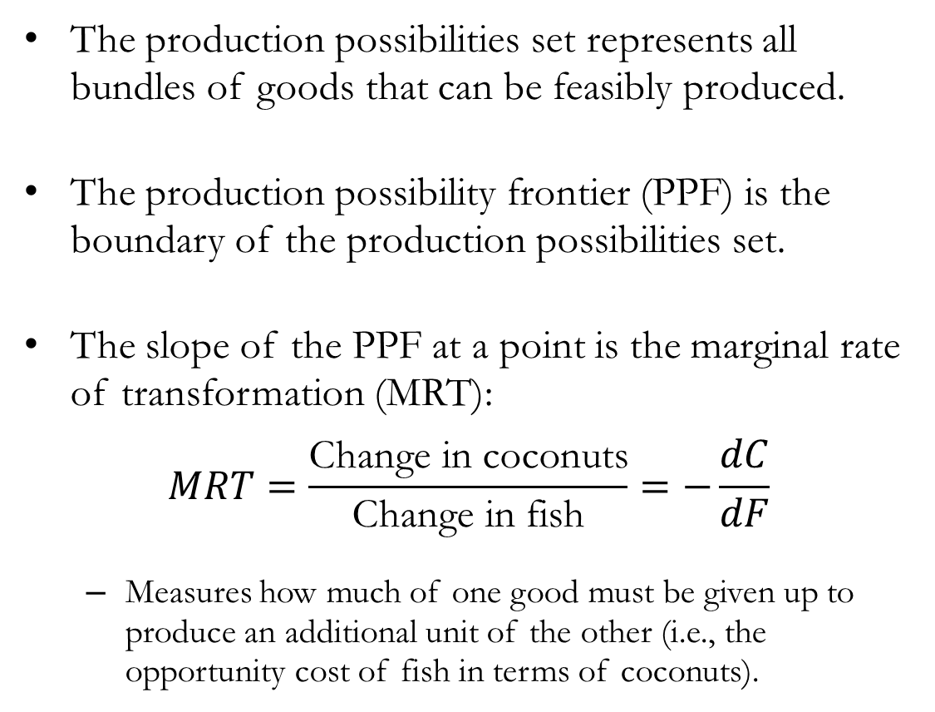
Production Possibilities
The production possibilities set represents all bundles of goods that can be feasibly produced.
The production possibility frontier (PPF) is the boundary of the production possibilities set.
The slope of the PPF at a point is the marginal rate of transformation (MRT):
$$MRT=\frac{\text{Change} \text{in} \text{coconuts}}{\text{Change} \text{in} \text{fish}}=−\frac{dC}{dF}$$
Measures how much of one good must be given up to produce an additional unit of the other (i.e., the opportunity cost of fish in terms of coconuts).

Slide 13
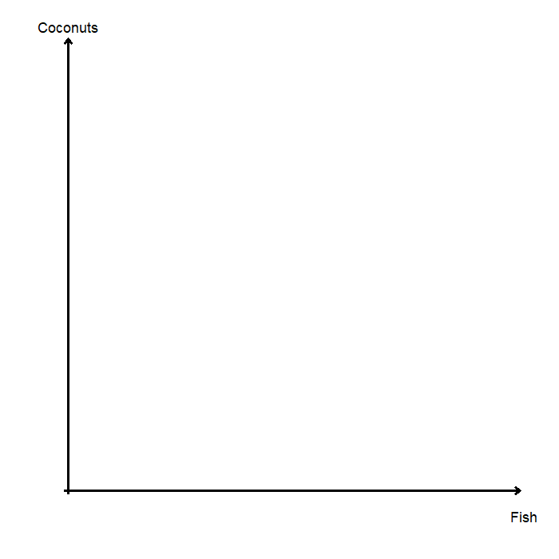
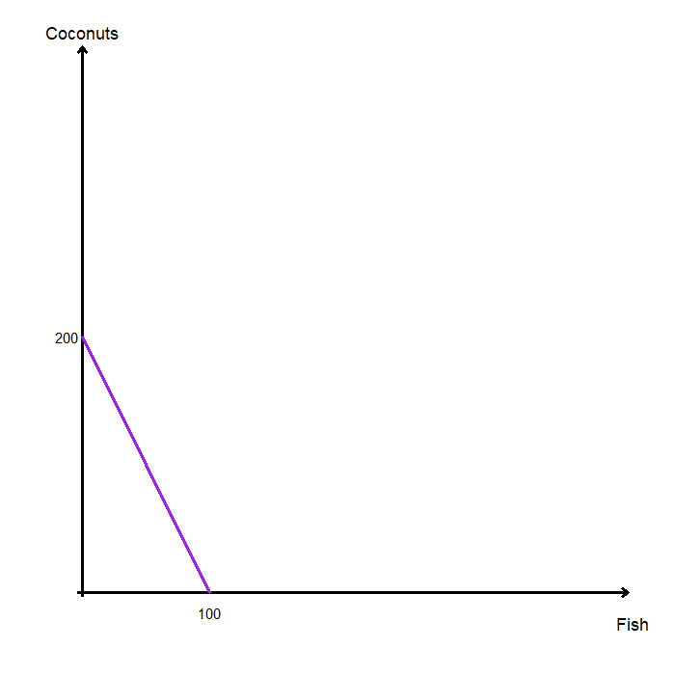
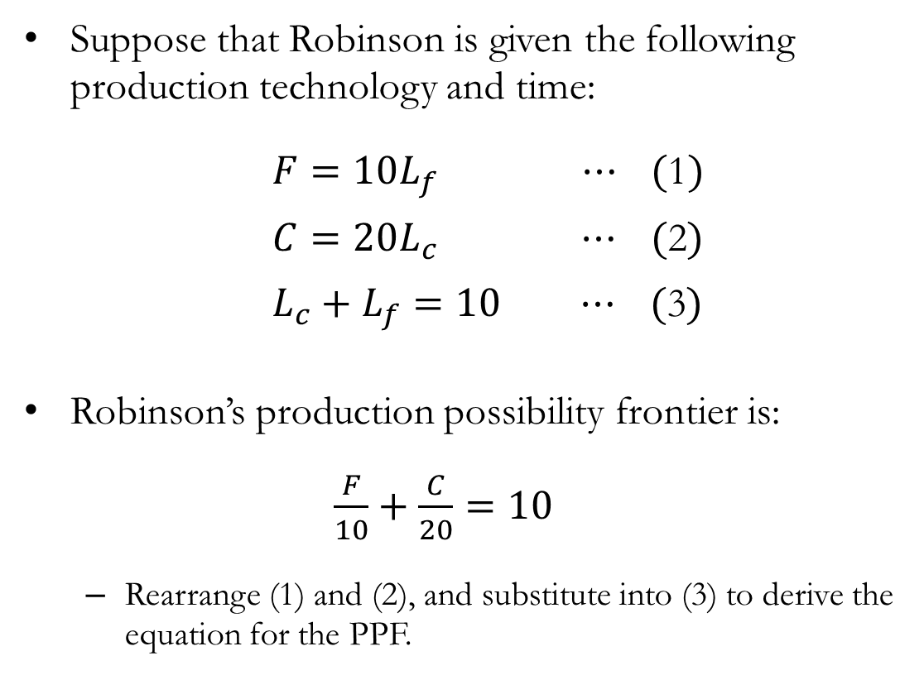
Production Possibilities: Robinson
Suppose that Robinson is given the following production technology and time:
$F=10L_{f} ⋯ (\text{1})$
$C=20L_{c} ⋯ (\text{2})$
$L_{c}+L_{f}=10 ⋯ (\text{3})$
Robinson’s production possibility frontier is:
$\frac{F}{10}+\frac{C}{20}=10$
Rearrange (1) and (2), and substitute into (3) to derive the equation for the PPF.

Slide 14
Production Possibilities: Robinson
The slope of Robinson’s PPF is constant at -2, so his MRT is also constant at 2.
To produce one more unit of fish, Robinson must give up 2 coconuts.
Robinson’s opportunity cost of fish is 2 coconuts.
Conversely, his opportunity cost of a coconut is 0.5 fish.
Robinson’s PPF is linear because his opportunity cost is constant.
In general, the PPF is bowed outward (as shown in slide 12), reflecting increasing opportunity cost.

Slide 15
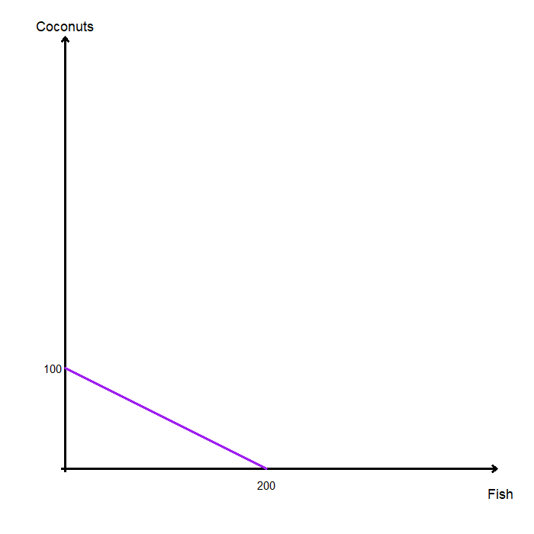
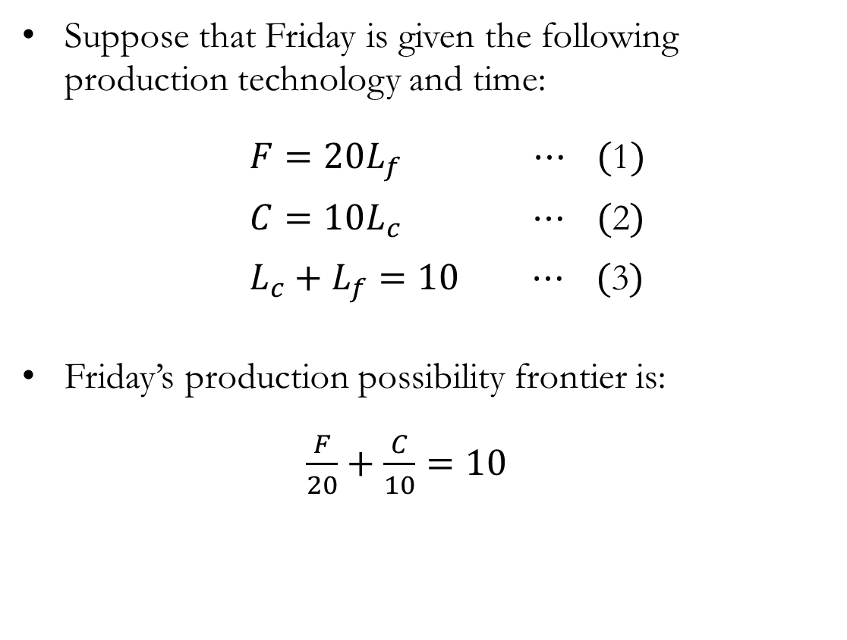
Production Possibilities: Friday
Suppose that Friday is given the following production technology and time:
$F=20L_{f} ⋯ (\text{1})$
$C=10L_{c} ⋯ (\text{2})$
$L_{c}+L_{f}=10 ⋯ (\text{3})$
Friday’s production possibility frontier is:
$\frac{F}{20}+\frac{C}{10}=10$

Slide 16
Production Possibilities: Friday
The slope of Friday’s PPF is constant at -0.5, so his MRT is also constant at 0.5.
To produce one more unit of fish, Friday must give up 0.5 coconuts.
Friday’s opportunity cost of fish is 0.5 coconuts.
Conversely, his opportunity cost of a coconut is 2 fish.
Since opportunity costs differ, Robinson and Friday have different comparative advantages.

Slide 17
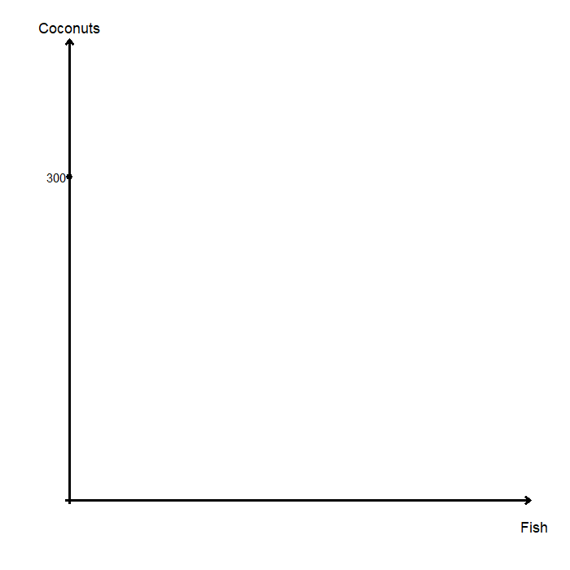
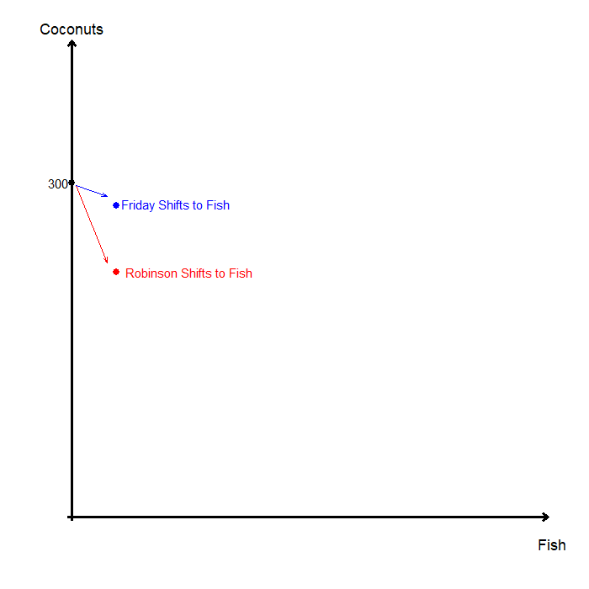
Joint Production Possibilities
The joint production possibilities set combines the production capabilities of both agents.
If Robinson and Friday both specialize in coconuts:
Robinson produces 200, Friday produces 100.
Total production is 300 coconuts.
To begin producing fish, production should shift toward the agent with the lower opportunity cost:
Robinson’s opportunity cost of fish is 2 coconuts.
Friday’s opportunity cost of fish is 0.5 coconuts.
Therefore, Friday should specialize in fish production first.

Slide 18
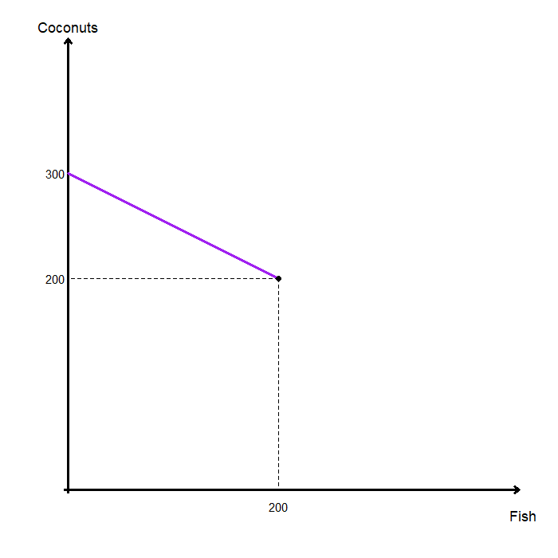
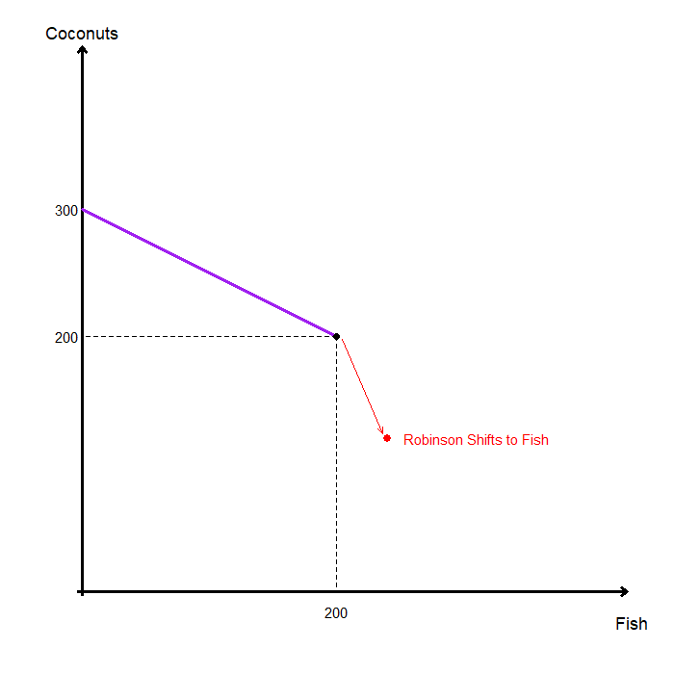
Joint Production Possibilities: Specialization
The joint PPF initially follows Friday’s production possibilities.
This continues until full specialization is reached:
Friday fully specializes in fish production.
Robinson fully specializes in coconut production.
At this point, if more fish is to be produced, Robinson must also shift to fish production.
The initial segment has slope -0.5, and the slope becomes steeper at -2 as Robinson starts producing fish.
The joint PPF is “kinked” at the full specialization point.

Slide 19
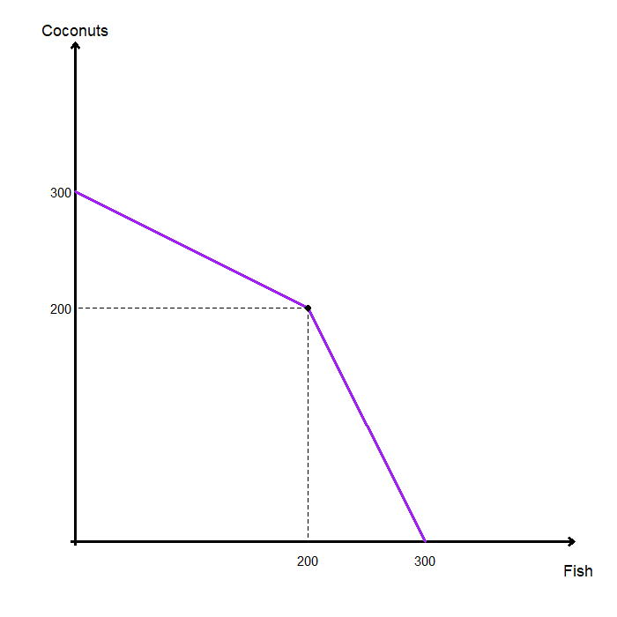
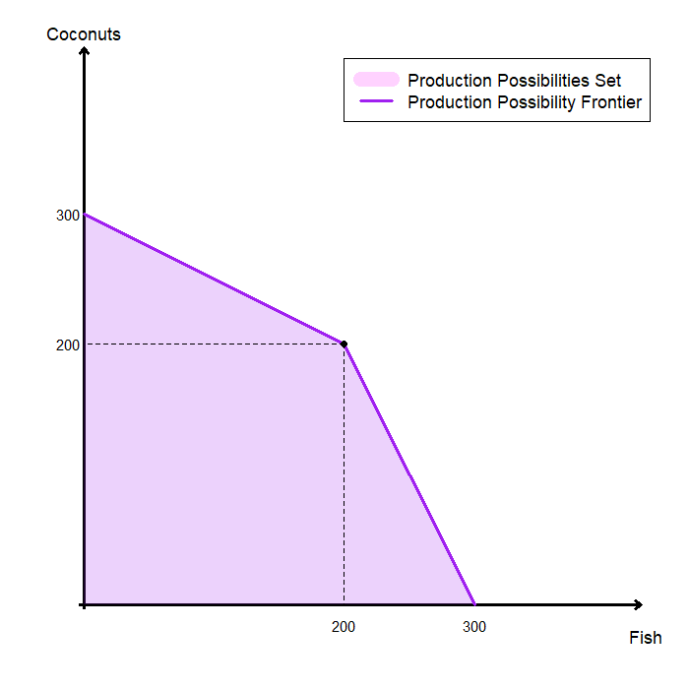
Joint Production Possibilities: Kinked PPF
When both Robinson and Friday exclusively produce fish, they can produce 300 units.
The joint production possibilities set is “kinked” at the full specialization point.
The kink arises due to differences in opportunity costs across the two production technologies.
When many different production technologies are available, the PPF becomes smooth and bowed outward.

Slide 20
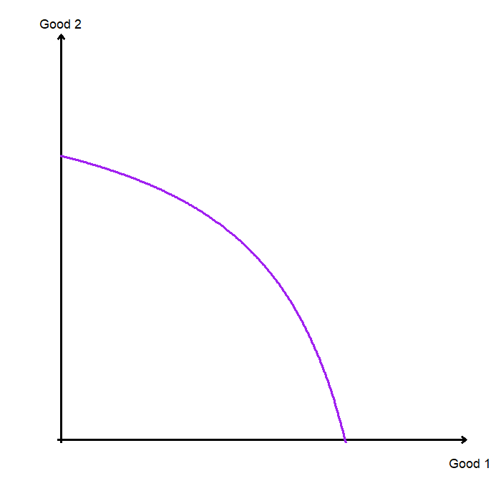
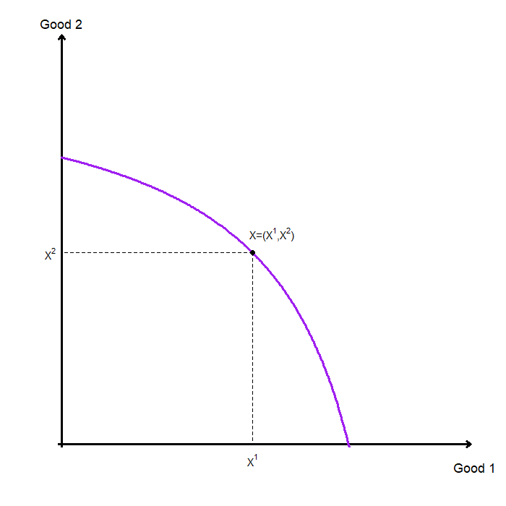
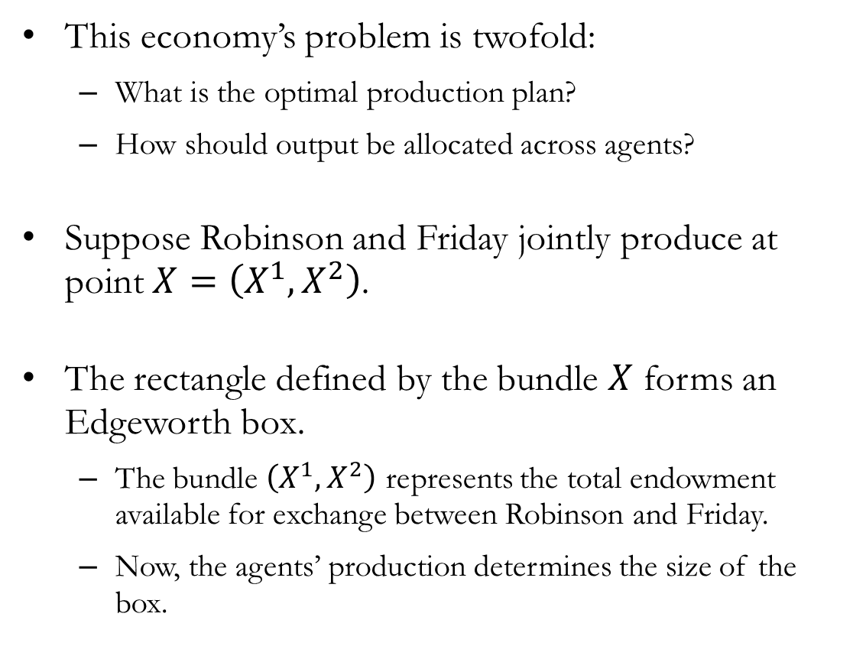
Joint Production
This economy’s problem is twofold:
What is the optimal production plan?
How should output be allocated across agents?
Suppose Robinson and Friday jointly produce at point $X=\left(X^{1},X^{2}\right)$.
The rectangle defined by the bundle $X$ forms an Edgeworth box.
The bundle $\left(X^{1},X^{2}\right)$ represents the total endowment available for exchange between Robinson and Friday.
Now, the agents’ production determines the size of the box.

Slide 21
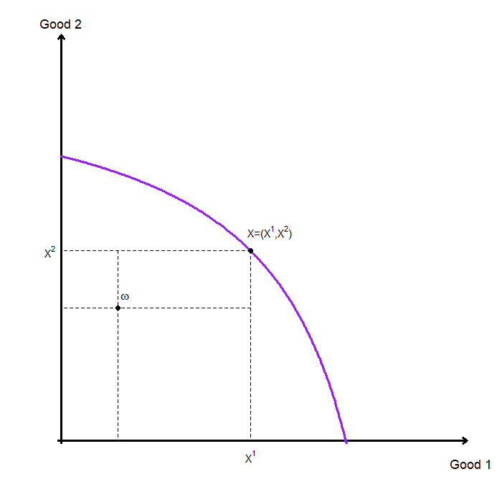
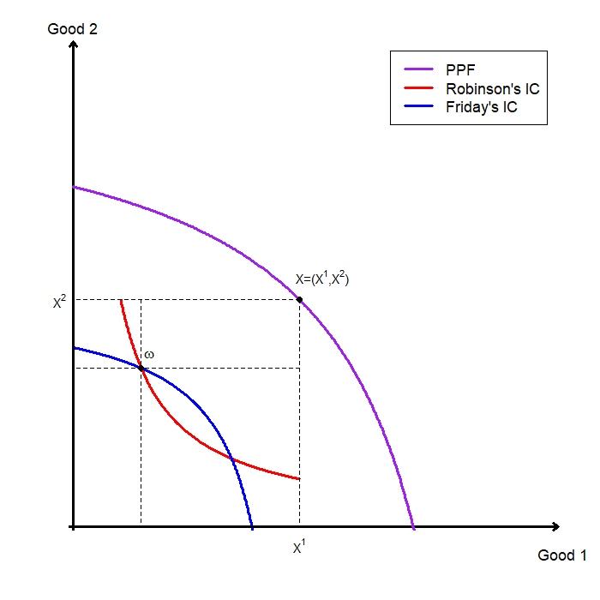
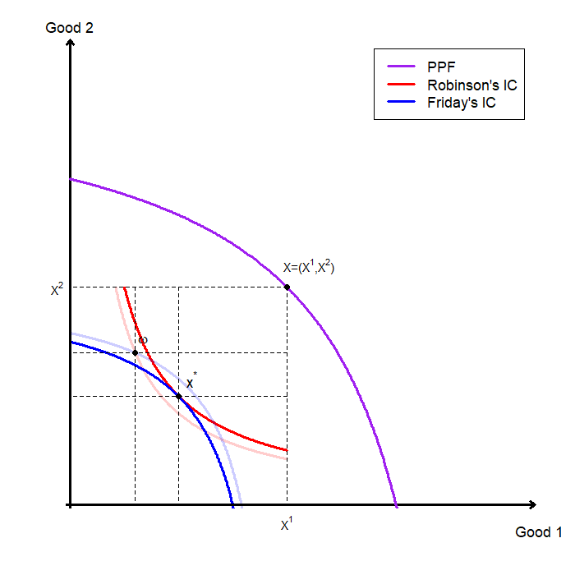
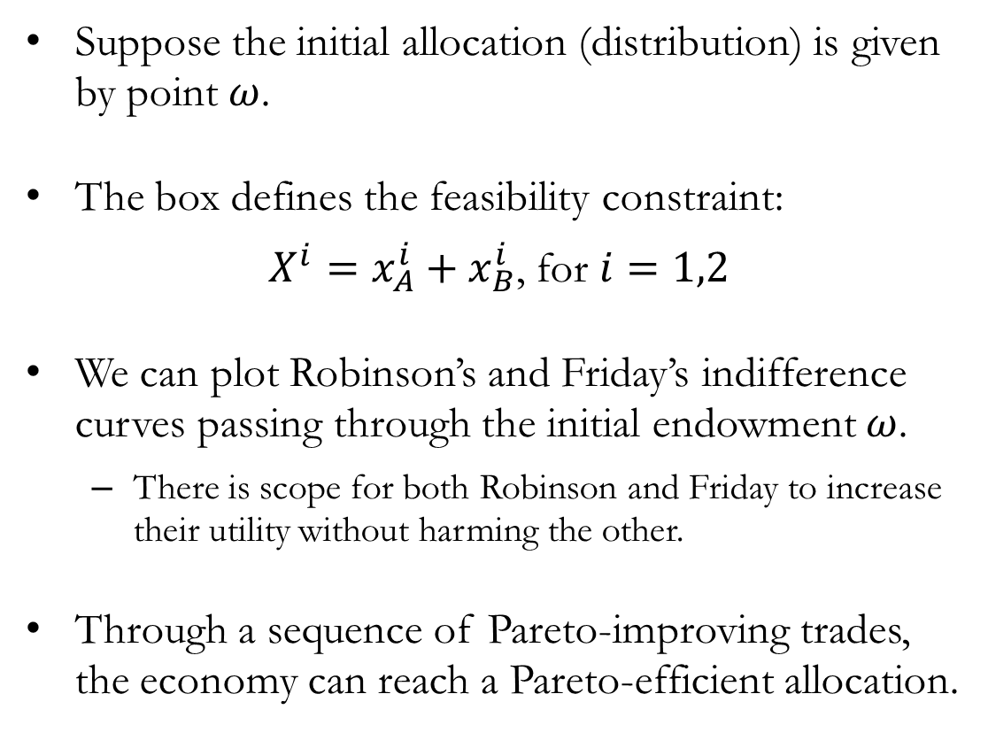
Endowments and Trade
Suppose the initial allocation (distribution) is given by point $ω$.
The box defines the feasibility constraint:
$X^{i}=x_{A}^{i}+x_{B}^{i}$, for $i=1,2$
We can plot Robinson’s and Friday’s indifference curves passing through the initial endowment $ω$.
There is scope for both Robinson and Friday to increase their utility without harming the other.
Through a sequence of Pareto-improving trades, the economy can reach a Pareto-efficient allocation.

Slide 22
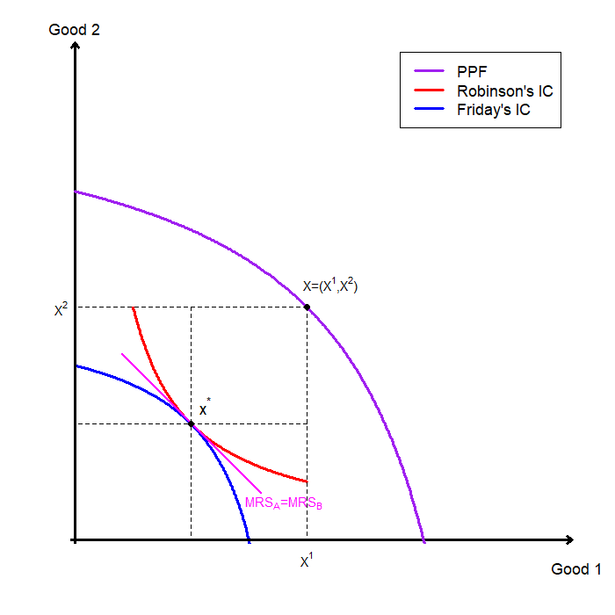
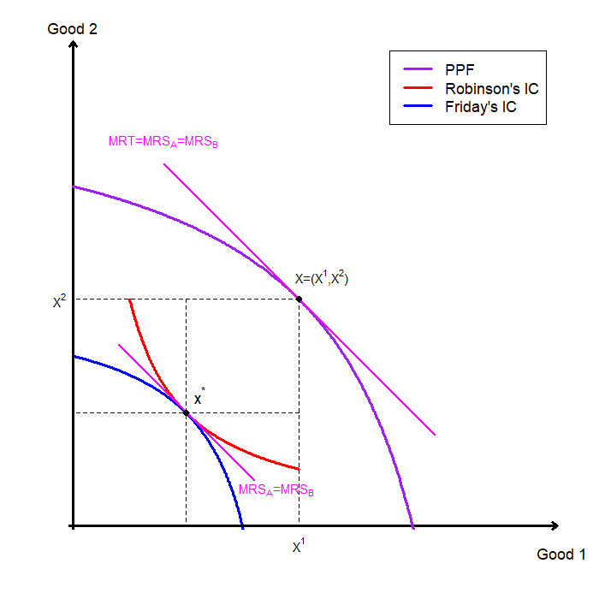
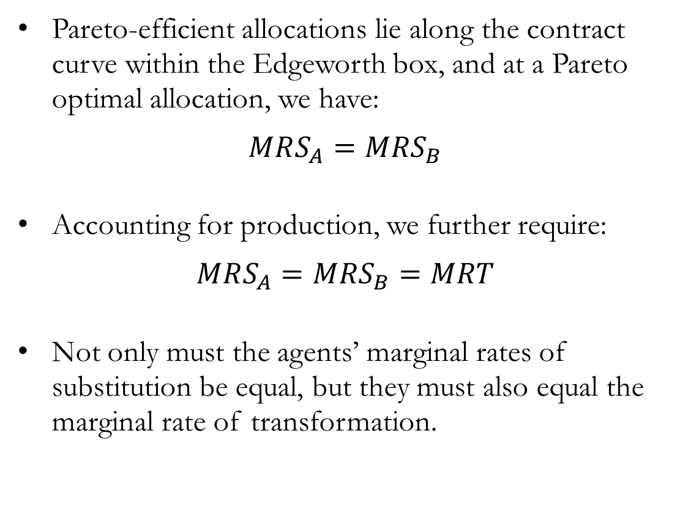
Joint Production and Trade
Pareto-efficient allocations lie along the contract curve within the Edgeworth box, and at a Pareto optimal allocation, we have:
$$MRS_{A}=MRS_{B}$$
Accounting for production, we further require:
$$MRS_{A}=MRS_{B}=MRT$$
Not only must the agents’ marginal rates of substitution be equal, but they must also equal the marginal rate of transformation.

Slide 23
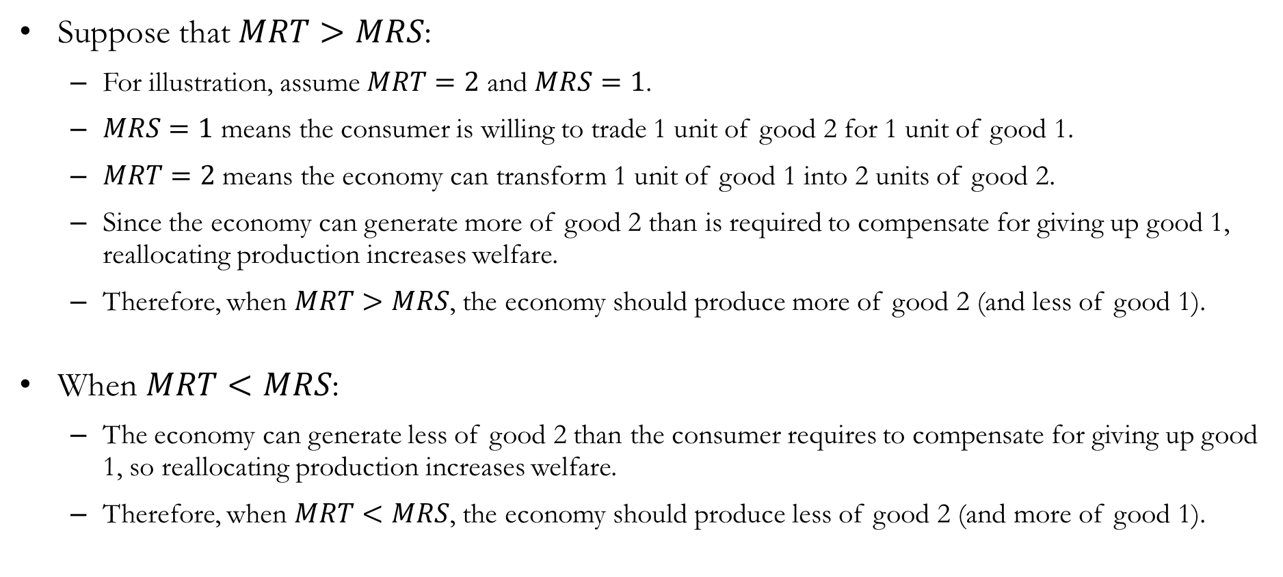
Joint Production and Trade: Why MRT=MRS
Suppose that $MRT>MRS$:
For illustration, assume $MRT=2$ and $MRS=1$.
$MRS=1$ means the consumer is willing to trade 1 unit of good 2 for 1 unit of good 1.
$MRT=2$ means the economy can transform 1 unit of good 1 into 2 units of good 2.
Since the economy can generate more of good 2 than is required to compensate for giving up good 1, reallocating production increases welfare.
Therefore, when $MRT>MRS$, the economy should produce more of good 2 (and less of good 1).
When $MRT<MRS$:
The economy can generate less of good 2 than the consumer requires to compensate for giving up good 1, so reallocating production increases welfare.
Therefore, when $MRT<MRS$, the economy should produce less of good 2 (and more of good 1).

Slide 24
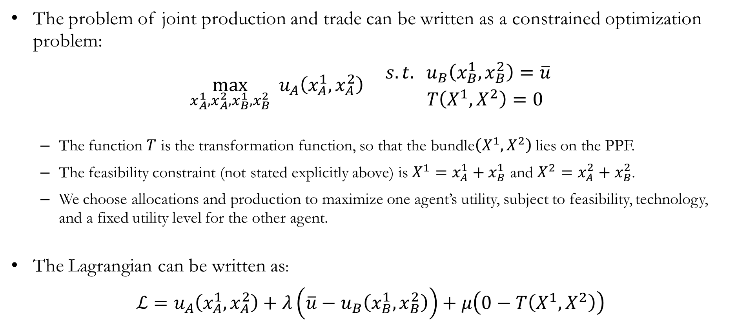
Production and Trade: The Mathematics
The problem of joint production and trade can be written as a constrained optimization problem:
$$\max_{x_{A}^{1},x_{A}^{2},x_{B}^{1},x_{B}^{2}} u_{A}\left(x_{A}^{1},x_{A}^{2}\right) \begin{matrix}s.t. u_{B}\left(x_{B}^{1},x_{B}^{2}\right)=\overline{u} \\ T\left(X^{1},X^{2}\right)=0 \end{matrix}$$
The function $T$ is the transformation function, so that the bundle$\left(X^{1},X^{2}\right)$ lies on the PPF.
The feasibility constraint (not stated explicitly above) is $X^{1}=x_{A}^{1}+x_{B}^{1}$ and $X^{2}=x_{A}^{2}+x_{B}^{2}$.
We choose allocations and production to maximize one agent’s utility, subject to feasibility, technology, and a fixed utility level for the other agent.
The Lagrangian can be written as:
$$ℒ=u_{A}\left(x_{A}^{1},x_{A}^{2}\right)+λ\left(\overline{u}−u_{B}\left(x_{B}^{1},x_{B}^{2}\right)\right)+μ\left(0−T\left(X^{1},X^{2}\right)\right)$$

Slide 25
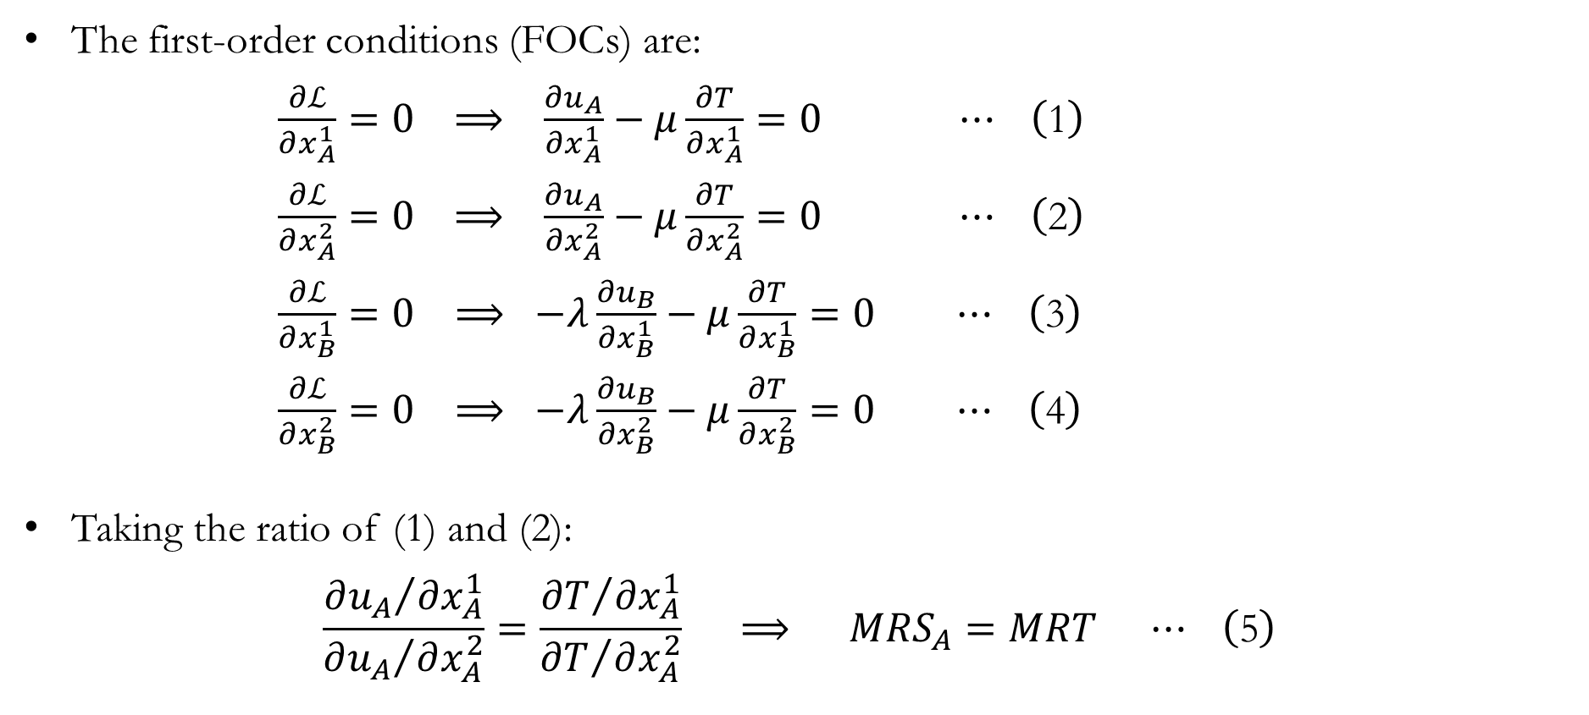
Production and Trade: The Mathematics
The first-order conditions (FOCs) are:
$\frac{∂ℒ}{∂x_{A}^{1}}=0 ⟹ \frac{∂u_{A}}{∂x_{A}^{1}}−μ\frac{∂T}{∂x_{A}^{1}}=0 ⋯ \left(\text{1}\right)$
$\frac{∂ℒ}{∂x_{A}^{2}}=0 ⟹ \frac{∂u_{A}}{∂x_{A}^{2}}−μ\frac{∂T}{∂x_{A}^{2}}=0 ⋯ \left(\text{2}\right)$
$\frac{∂ℒ}{∂x_{B}^{1}}=0 ⟹ −λ\frac{∂u_{B}}{∂x_{B}^{1}}−μ\frac{∂T}{∂x_{B}^{1}}=0 ⋯ \left(\text{3}\right)$
$\frac{∂ℒ}{∂x_{B}^{2}}=0 ⟹ −λ\frac{∂u_{B}}{∂x_{B}^{2}}−μ\frac{∂T}{∂x_{B}^{2}}=0 ⋯ \left(\text{4}\right)$
Taking the ratio of (1) and (2):
$$\frac{{∂u_{A}}/{∂x_{A}^{1}}}{{∂u_{A}}/{∂x_{A}^{2}}}=\frac{{∂T}/{∂x_{A}^{1}}}{{∂T}/{∂x_{A}^{2}}} ⟹ MRS_{A}=MRT ⋯ \left(\text{5}\right)$$

Slide 26
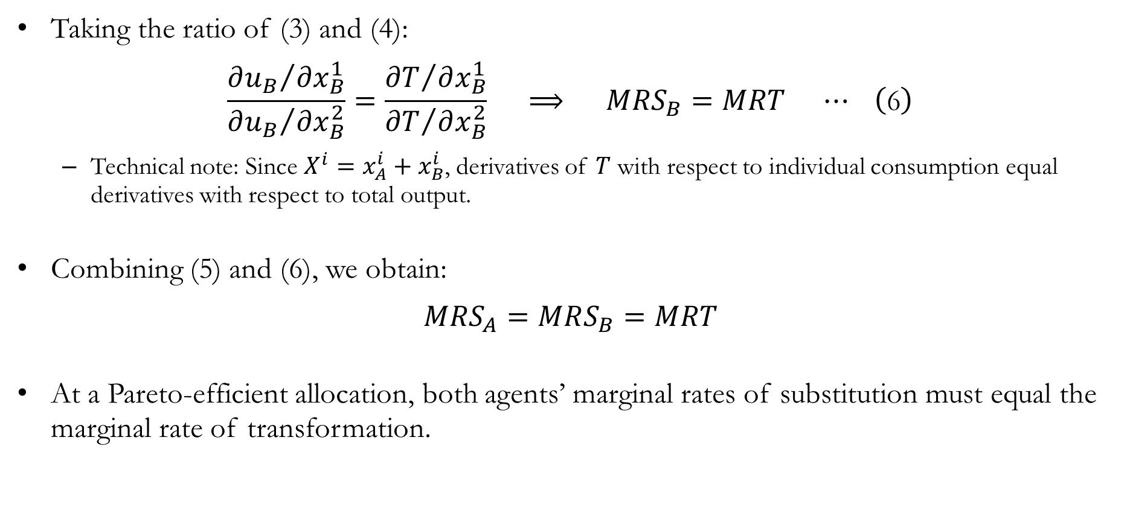
Production and Trade: The Mathematics
Taking the ratio of (3) and (4):
$$\frac{{∂u_{B}}/{∂x_{B}^{1}}}{{∂u_{B}}/{∂x_{B}^{2}}}=\frac{{∂T}/{∂x_{B}^{1}}}{{∂T}/{∂x_{B}^{2}}} ⟹ MRS_{B}=MRT ⋯ \left(\text{6}\right)$$
Technical note: Since $X^{i}=x_{A}^{i}+x_{B}^{i}$​, derivatives of $T$ with respect to individual consumption equal derivatives with respect to total output.
Combining (5) and (6), we obtain:
$$MRS_{A}=MRS_{B}=MRT$$
At a Pareto-efficient allocation, both agents’ marginal rates of substitution must equal the marginal rate of transformation.

Slide 27
Recap & Preview

Slide 28
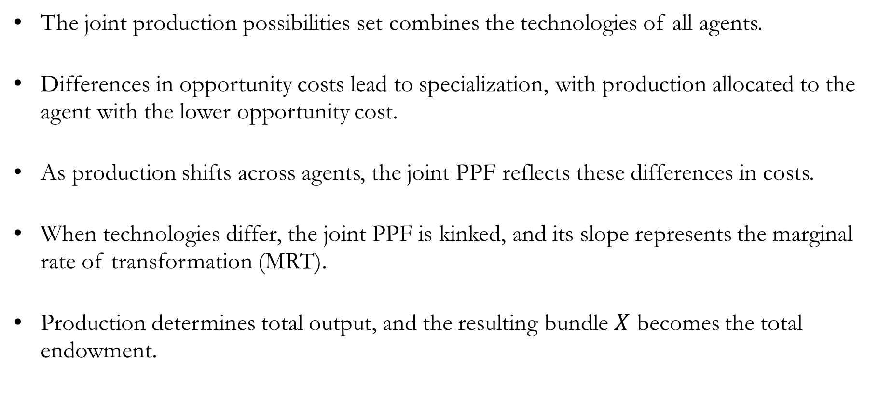
Recap: Production
The joint production possibilities set combines the technologies of all agents.
Differences in opportunity costs lead to specialization, with production allocated to the agent with the lower opportunity cost.
As production shifts across agents, the joint PPF reflects these differences in costs.
When technologies differ, the joint PPF is kinked, and its slope represents the marginal rate of transformation (MRT).
Production determines total output, and the resulting bundle $X$ becomes the total endowment.

Slide 29
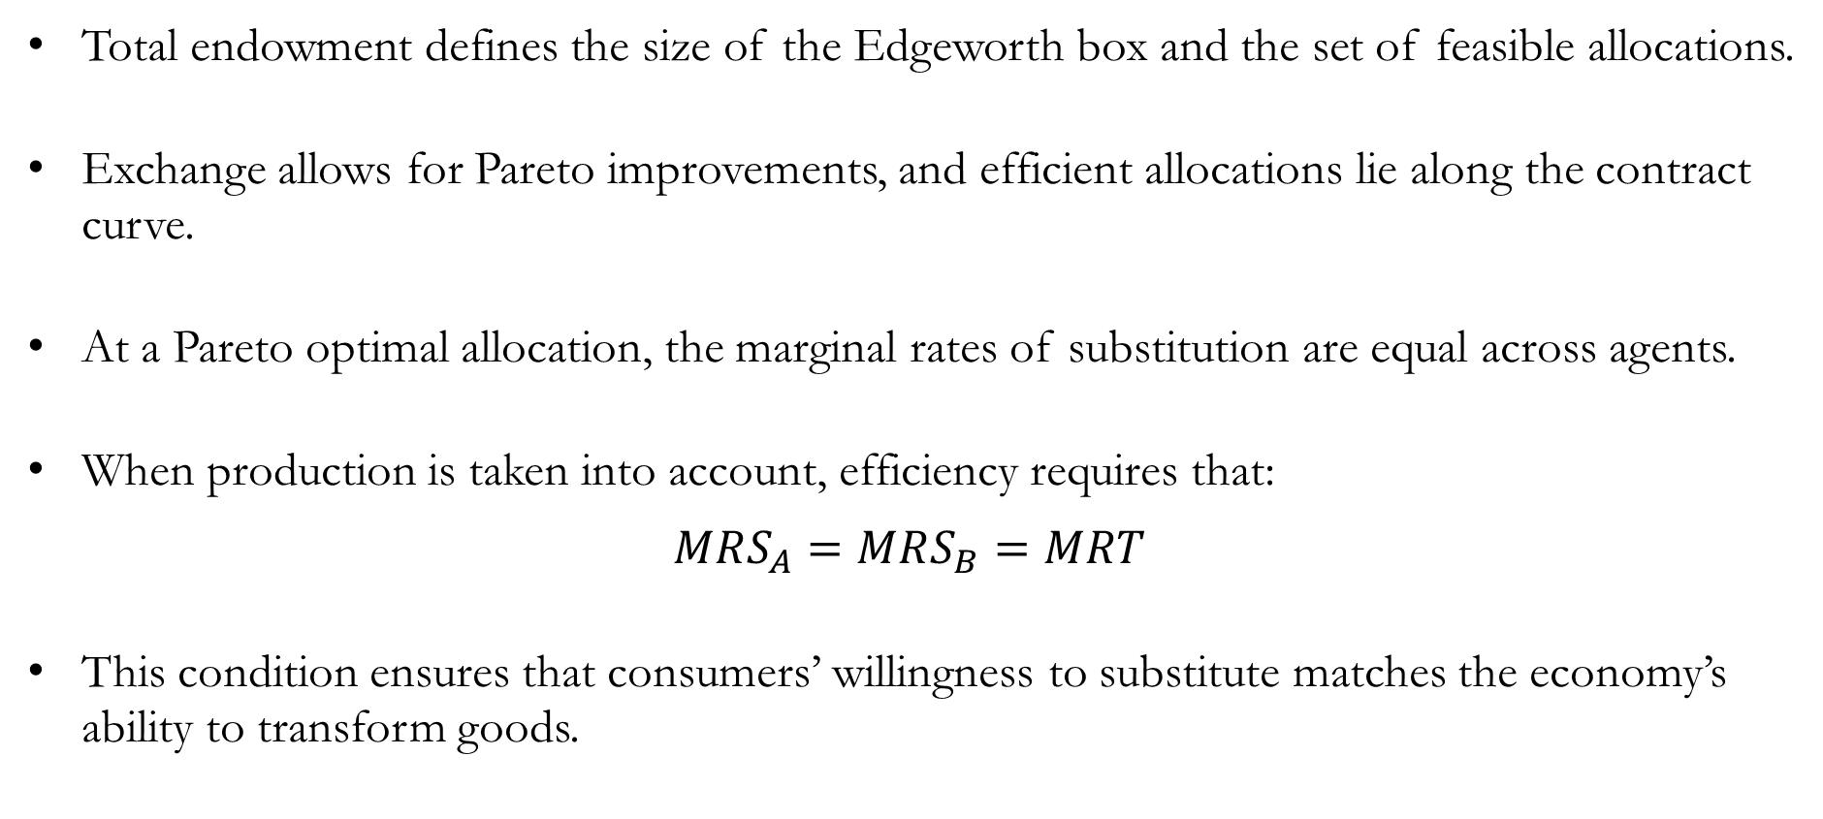
Recap: Production
Total endowment defines the size of the Edgeworth box and the set of feasible allocations.
Exchange allows for Pareto improvements, and efficient allocations lie along the contract curve.
At a Pareto optimal allocation, the marginal rates of substitution are equal across agents.
When production is taken into account, efficiency requires that:
$$MRS_{A}=MRS_{B}=MRT$$
This condition ensures that consumers’ willingness to substitute matches the economy’s ability to transform goods.

Slide 30
Preview: Welfare
So far, we have characterized efficient allocations in various settings.
However, efficiency alone does not determine which allocation is better for society:
An allocation can be efficient, yet not socially optimal.
Recall that the “corners” of Edgeworth boxes are Pareto optimal.
How do we compare different Pareto optimal allocations?
We will introduce:
Social welfare functions
Equity vs. efficiency trade-offs
The role of policy and redistribution

