Slide 1
MANAGEMENT INFORMATION SYSTEMS
Chapter 9: Enterprise Applications

Slide 2
Recap of Chapter 8
Understand why information systems are vulnerable.
Describe the most prevalent and dangerous types of malware.
Understand the dangers posed by threat actors.
Describe the security issues raised by software vulnerabilities.
Describe the security issues raised by artificial intelligence.
Describe the business value of security and control.
Describe an organizational framework for security and control.
Discuss technologies for safeguarding information resources.

Slide 3
Enterprise Resource Planning

Slide 4
Why ERP?
Why Firms Need ERP:
Firms operate across multiple locations, functions, and supply chains.
Managers must respond quickly to orders, delays, and disruptions.
Firms require real-time visibility into sales, inventory, production, financial performance, etc.
Without ERP:
Separate legacy systems do not communicate effectively.
Managers rely on manual or outdated reports.
Sales may not know current inventory levels.
Production planning is disconnected from demand data.
Decision-makers lack a complete picture of firm performance.
Without integration, data becomes fragmented, inconsistent, and unreliable for decision making.

Slide 5
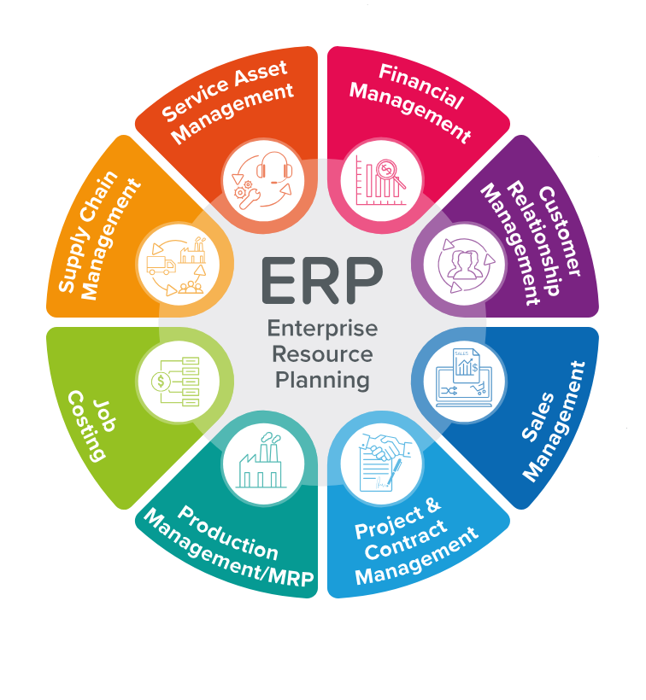
Enterprise Resource Planning Systems
ERP systems create a single, unified view of the entire organization.
Built around a centralized database shared across departments.
Data is entered once and automatically updated across all functions.
Integrates key business processes such as sales, production, finance, supply chain, and HR.
Enables real-time coordination and enterprise-wide decision making.

Slide 6
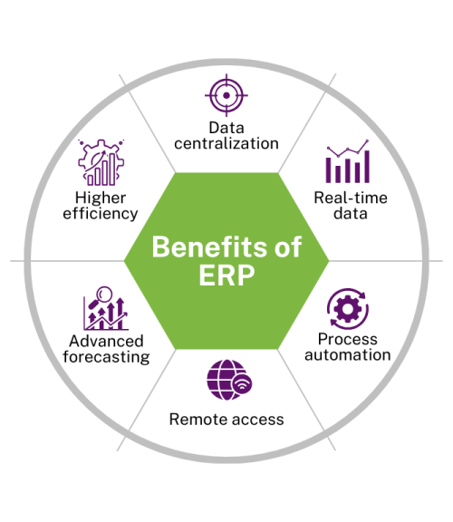
Business Value of ERP Systems
Integration → Value creation:
Standardized processes improve efficiency and reduce errors.
Centralized, consistent data improves accuracy and decision quality.
Real-time information enables faster response to customers and disruptions.
Shared data improves coordination across manufacturing, procurement, and sales.
Improves planning, forecasting, and resource allocation.
Strategic Benefits
Enhances reporting accuracy and global visibility.
Supports better long-term planning and competitive advantage.

Slide 7
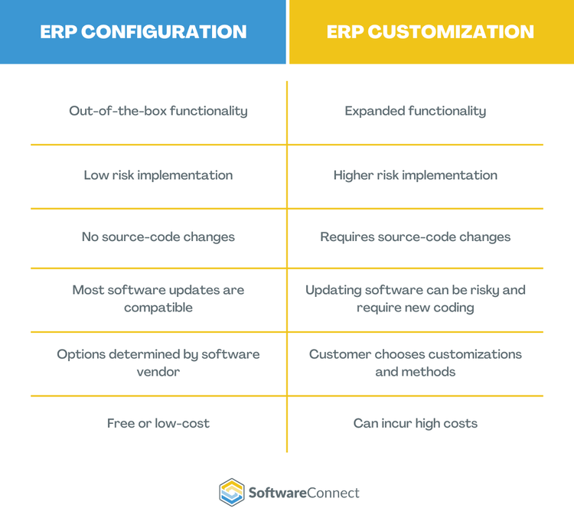
ERP Software Configuration
Standardized Processes
ERP software includes predefined processes based on industry best practices.
Firms must adapt or map their processes to fit the ERP system.
Configuration vs Customization
Configuration: Adjust settings without changing code. Lower risk and easier to update.
Customization: Modify code to fit unique needs. Higher risk, more costly, and harder to maintain.
Configuration preserves integration and system stability, but excessive customization can increase costs, reduce performance, and undermine integration benefits.

Slide 8
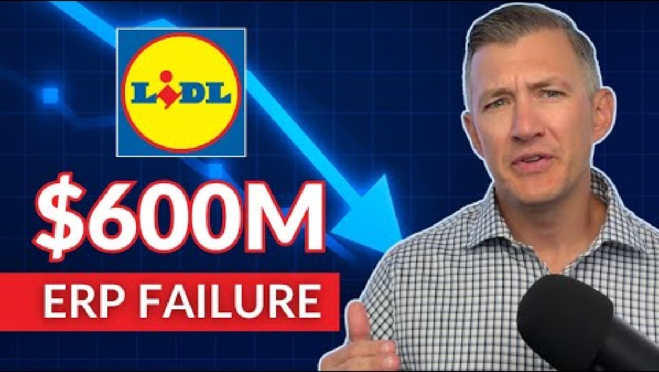
Software Connect (2025, July 16). Hidden Costs of ERP Customization: Lessons from a $600M Failure [Video]. YouTube. https://youtu.be/-QK7cgDFIaU?si=JDMbhddz_eegkSnc

Slide 9

AI and ERP
ERP vendors increasingly integrate AI and natural language processing.
Systems can understand user queries and provide conversational responses.
AI improves performance across accounting, finance, HR, manufacturing, and product development.
AI identifies patterns in large structured and unstructured datasets.
Provides predictive insights for workflow optimization and cost reduction.

Slide 10
AI Applications in ERP
Digital Assistants: Chatbots respond to employee and customer inquiries.
Predictive Analytics: Predicts equipment failures and recommends preventative maintenance.
Anomaly Detection: Flags irregular financial data and unusual transactions.
Product Development and Innovation: Suggests product improvements and new ideas.
Financial Forecasting: Models financial outcomes under different economic scenarios.
Workflow Optimization: Supports supply chain planning, inventory management, transaction processing, and transportation.

Slide 11
Supply Chain Management

Slide 12
Supply Chains
Supply Chains
A network of organizations and processes that procure raw materials, transform them into intermediate and finished goods, and distribute them to customers.
Includes suppliers, manufacturers, distribution centers, retailers, and customers.
Materials, information, and payments flow both upstream and downstream.
Returned items also flow upstream from customers back to sellers.
Why Supply Chain Management Matters
Small firms with simple products can manage suppliers using phone and email.
Large firms producing complex goods work with hundreds or thousands of suppliers.
Each supplier has its own suppliers, creating a vast global network.
SCM systems address challenges of scale, coordination, and information flow.

Slide 13
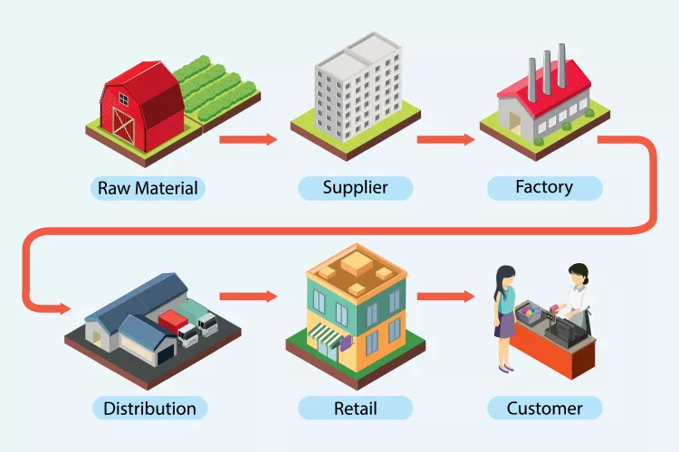
Supply Chain Transformation Process
Goods begin as raw materials.
Move into intermediate components.
Become finished products.
Shipped to distribution centers.
Distributed to retailers and customers.

Slide 14
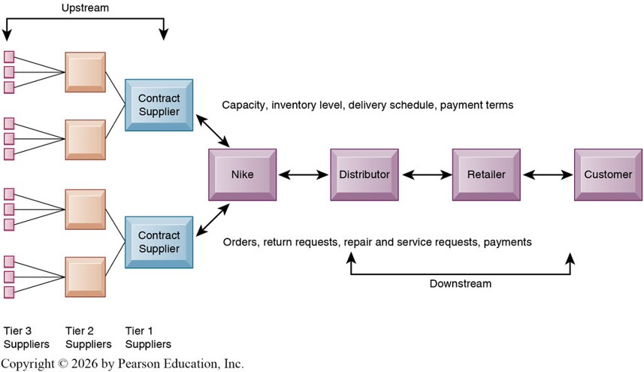
Supply Chain Transformation Process

Slide 15
Supply Chain Inefficiencies
Inefficiencies are often caused by inaccurate or delayed information and can account for up to 25% of operating costs.
Common Problems:
Parts shortages
Excess inventory
Underused production capacity
An ideal supply chain would operate under a just-in-time (JIT) strategy, where components arrive as needed and finished goods are shipped as they are produced.
Due to uncertainty, firms maintain safety stock, which acts as a buffer but also contributes to inefficiency.

Slide 16
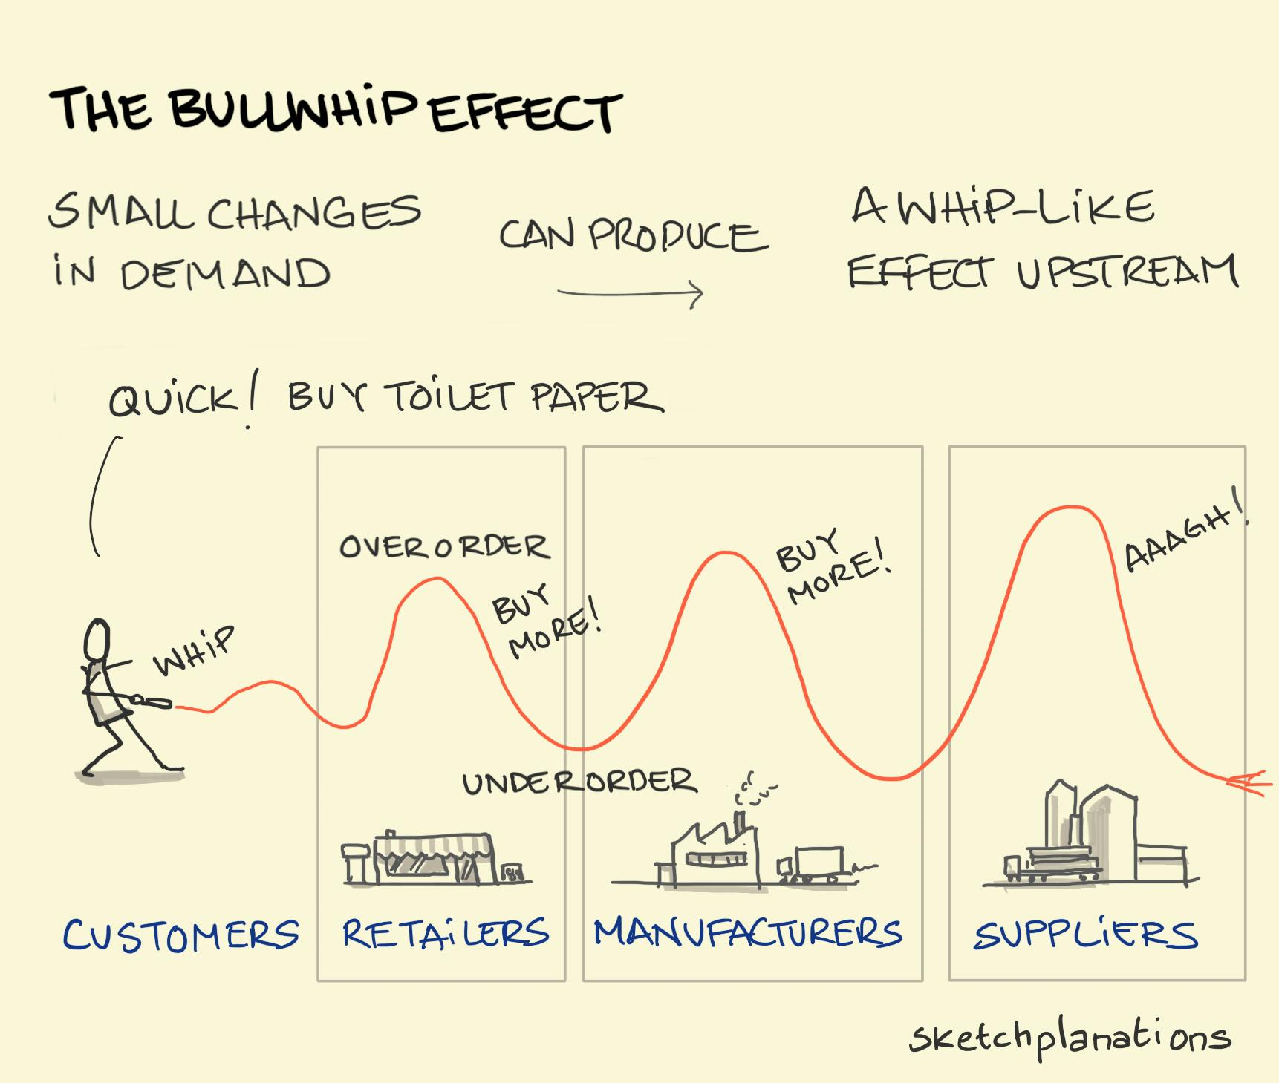
The Bullwhip Effect
Another major source of inefficiency in supply chains is the bullwhip effect.
Small fluctuations in retail demand become amplified as information moves upstream.
Each supply chain participant (retailer, distributor, manufacturer, supplier) tends to overreact to demand changes.
This leads to excess inventory, overproduction, and increased warehousing and transportation costs.

Slide 17
Solution to Supply Chain Inefficiencies
These inefficiencies are largely caused by a lack of visibility into real demand and supply conditions.
They can be reduced by sharing accurate, real-time information across all members of the supply chain.
SCM systems provide shared data on:
Inventory levels
Production schedules
Forecasts
Shipments
This enables coordinated adjustments across the entire network.

Slide 18
Supply Chain Management Software
There are two major categories of SCM software:
Planning systems decide what should happen, while execution systems manage what is happening.
Supply Chain Execution Systems
Manage the physical movement of goods through warehouses and distribution centers
Track inventory, shipments, and logistics operations.
Coordinate warehouse activities such as picking, packing, and loading.
Supply Chain Planning Systems
Model the supply chain
Forecast demand
Develop sourcing and production plans
Determine inventory levels and storage locations
Identify transportation methods
Adjust production schedules in response to demand changes

Slide 19
Push-Based vs Pull-Based Supply Chains
SCMs can enhance efficiency by enabling more demand-driven systems.
Push-Based Model (Build-to-Stock)
Production based on forecasts.
Inventory levels determined by predicted demand.
Goods are pushed downstream based on planned sales.
Pull-Based Model (Demand-Driven / Build-to-Order)
Actual customer orders trigger production and replenishment.
Information flows upstream immediately from retailers.
Only products needed to satisfy real customer orders move downstream.
Push predicts demand, Pull reacts to demand.

Slide 20
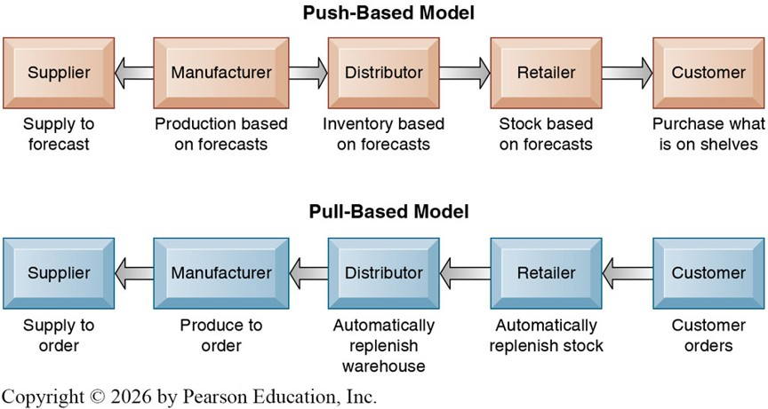
Push-Based vs Pull-Based Supply Chains

Slide 21
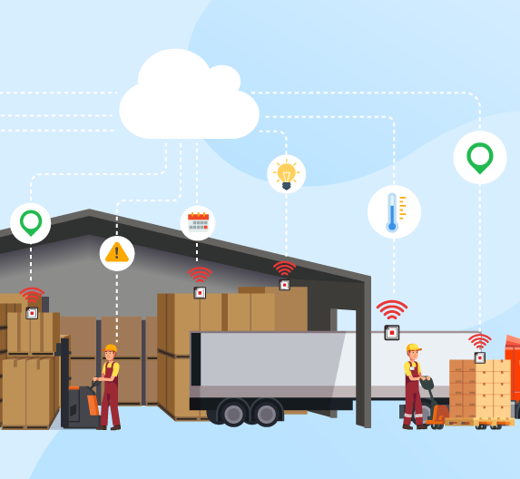
SCM and the Internet
Supply Chain Integration Before the Internet
Internal systems for purchasing, manufacturing, and distribution often could not communicate.
Difficult to share real-time inventory, schedules, and demand information.
Limited visibility led to delays, miscommunication, and higher operating costs.
Internet-Enabled Supply Chain Integration
ERP and SCM systems use Internet technology to share information across partners.
Employees and partners access systems through online platforms to collaborate in real time.
Integration reduces delays and improves coordination across all stages.

Slide 22
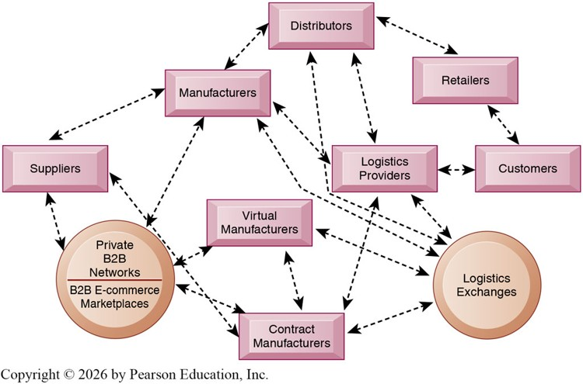
Internet-Driven Supply Chains
The internet enables multidirectional information flows among suppliers, manufacturers, logistics providers, retailers, and customers.
Supply chains become concurrent rather than sequential.
Sequential: step-by-step, one firm at a time.
Concurrent: multiple firms coordinate simultaneously in real time.
Partners can immediately adjust inventories, orders, capacity, and transportation plans.

Slide 23
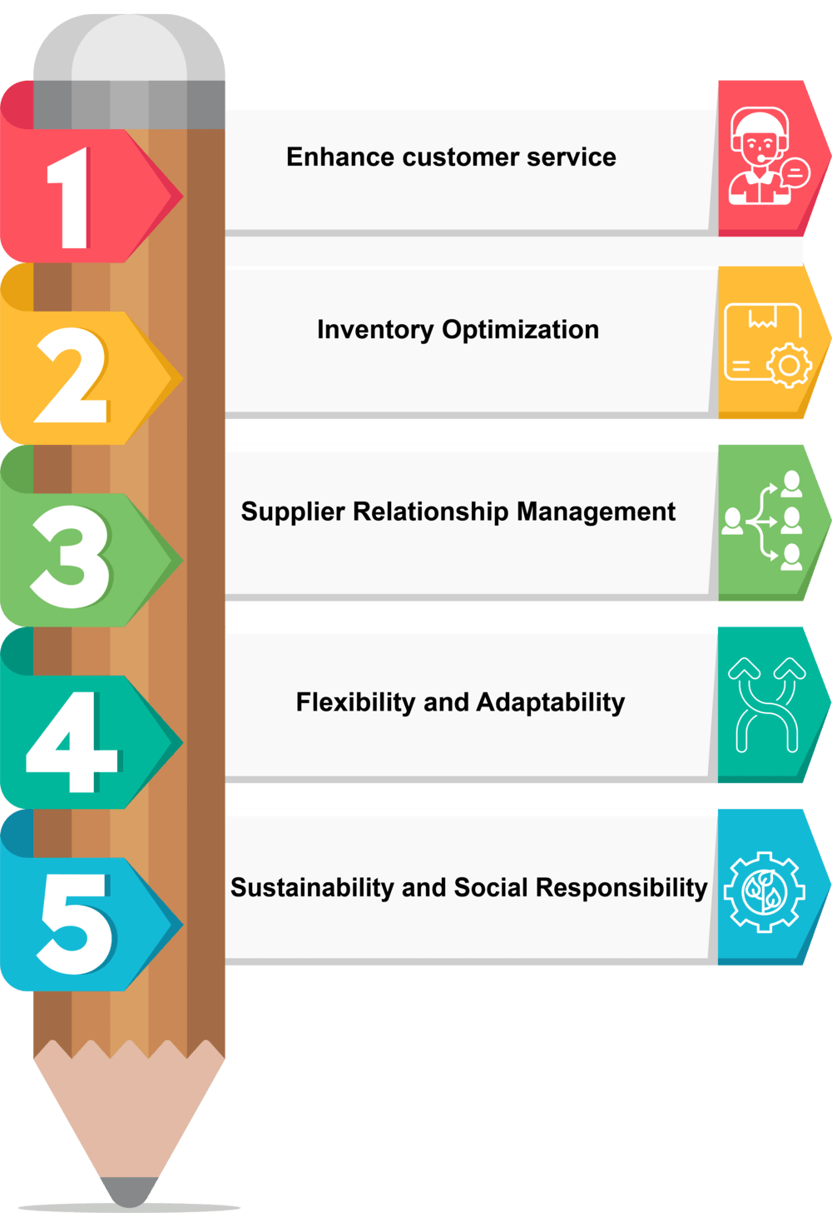
Business Value of SCM Systems
Match supply with actual demand more accurately.
Reduce excess inventory and storage costs.
Improve product availability and delivery speed.
Speed time to market for new products.
Improve utilization of assets and production capacity.
Reduce supply chain costs, which can be up to 75% of total operating expenses.
Increase sales by ensuring products are available when customers want them.

Slide 24
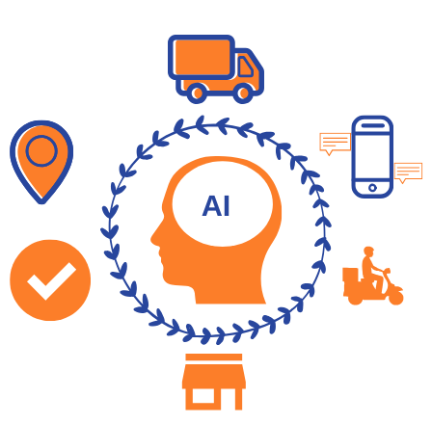
AI and SCM
AI enables real-time, data-driven supply chain decisions
Accurate Inventory Management
AI manages inventory levels with greater precision.
Forecasting adjusts stock levels to match real demand.
Computer vision tracks inventory in warehouses and distribution centers.
Timely Deliveries
Machine learning optimizes delivery routes and schedules.
Models incorporate order volume, deadlines, customer priority, and product availability.
AI improves estimated delivery times across networks.

Slide 25
AI and SCM
Improved Supply Chain Sustainability
AI identifies waste and inefficiencies in fuel use and material consumption.
Helps organizations reduce environmental impact.
Improves forecasts and production planning to avoid overproduction.
Precise Demand Planning
Uses internal signals such as sales trends and marketing data.
Incorporates external signals such as weather, economic conditions, and disruptions.
Produces more accurate forecasts for global markets.
Simulations for Supply Chain Optimization
AI-powered simulations analyze complex logistics networks.
Identify bottlenecks and test alternative routes or facility locations.
Help evaluate impacts of product redesigns, distribution changes, and demand shifts.

Slide 26
Customer Relationship Management

Slide 27
Customer Relationship Management
What Is Customer Relationship Management
CRM systems capture, consolidate, analyze, and distribute customer data across the organization.
Provide a unified view of each customer by integrating data from all interactions.
Support sales, service, and marketing processes.
Enable firms to personalize communication and tailor offerings.
Why CRM Matters
Product-based advantages are often short-lived.
Firms increasingly compete on customer relationships.
Strong relationships increase retention, loyalty, and lifetime value.
Requires accurate, integrated data across all customer touch points.

Slide 28
Customer Relationship Management
Why CRM?
Large firms cannot personally know every customer.
Customers interact through many channels: web, phone, email, social media, mobile, retail.
Data are often fragmented across departments and systems.
CRM integrates this data into a complete customer profile.
What CRM Systems Help Firms Answer
Who are our most loyal and profitable customers.
What is each customer’s lifetime value.
What products specific customers prefer.
Which customers should receive targeted offers or service.
How to acquire new profitable customers and retain existing ones.

Slide 29
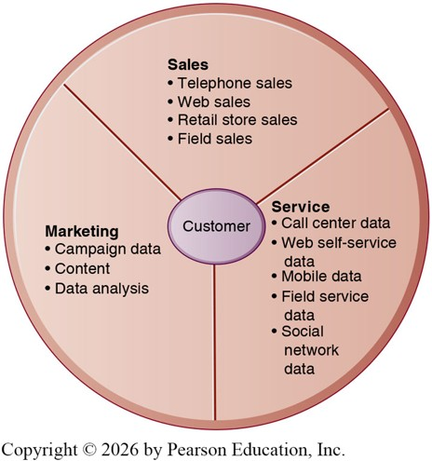
Customer Touch Points
CRM systems collect data from multiple customer touch points.
Sales Data: Telephone, web, retail store, and field sales.
Service Data: Call centers, web self-service, mobile interactions, field service, social media.
Marketing Data: Campaign data, content interactions, and marketing analytics.

Slide 30
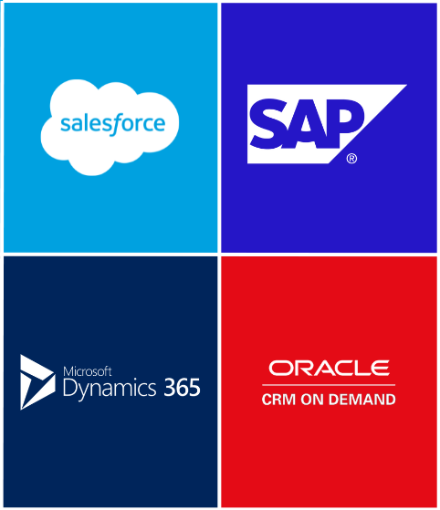
CRM Software
Ranges from specialized tools (e.g., website personalization) to enterprise-wide CRM suites.
Major vendors: Oracle, SAP, Salesforce, Microsoft Dynamics.
Often integrated with SCM and ERP systems.
Core CRM functions include:
Sales
Customer Service
Marketing

Slide 31
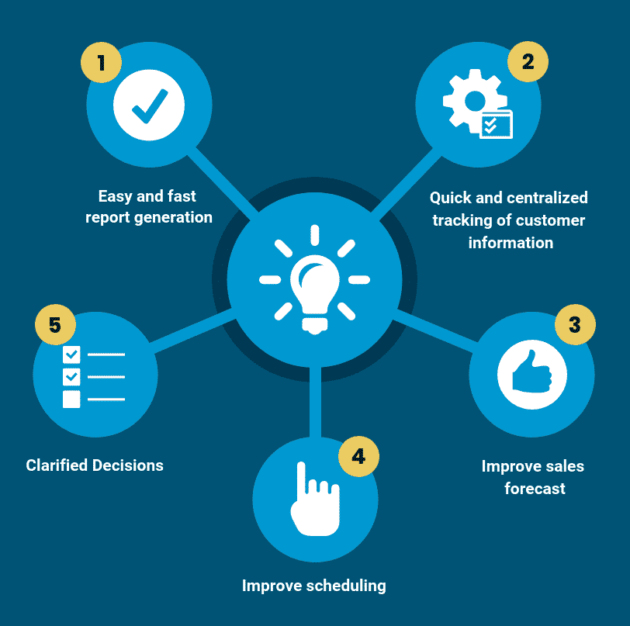
CRM Software: Sales Force Automation (SFA)
SFA modules increase salesperson productivity by identifying profitable customers.
Provide customer data, product information, configuration tools, and quote generation.
Enable personalized recommendations based on purchase history.
Support sales forecasting, territory management, and team selling.
Reduce cost per sale and customer acquisition costs.

Slide 32
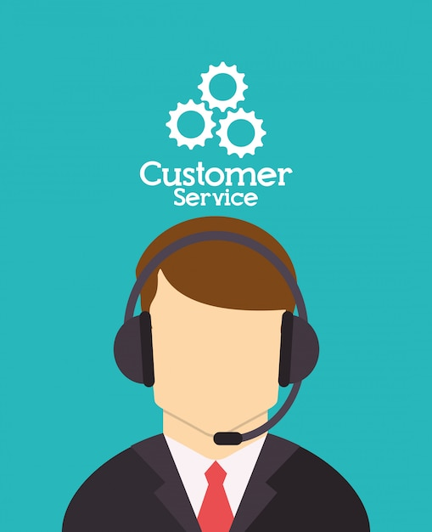
CRM Software: Customer Service
Supports call centers, help desks, and service teams.
Captures and shares customer information across support staff.
Routes requests to the appropriate service representative.
Reduces response time and increases cases handled per day.
Enables online self-service through portals and chat.
Improves service quality while reducing costs.

Slide 33
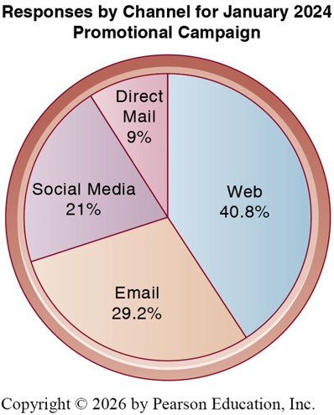
CRM Software: Marketing
Supports targeted marketing campaigns and lead qualification.
Captures customer and prospect data.
Tracks and evaluates campaign performance across channels.
Enables segmentation, cross-selling, and product personalization.
Compares channel effectiveness (web, email, social media, direct mail).

Slide 34
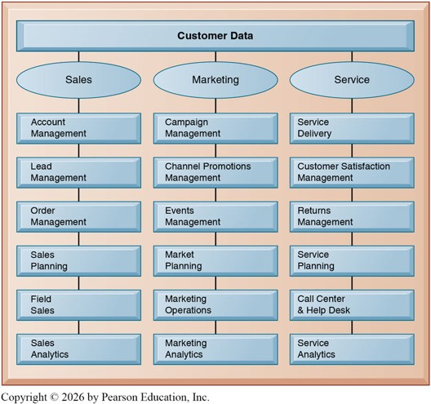
CRM System Capabilities
CRM supports key business processes across functions.
Sales: Account management, lead management, order management, sales planning, field sales, analytics.
Marketing: Campaign management, channel promotions, events, market planning, operations, analytics.
Service: Service delivery, customer satisfaction management, returns management, service planning, call center operations, analytics.

Slide 35
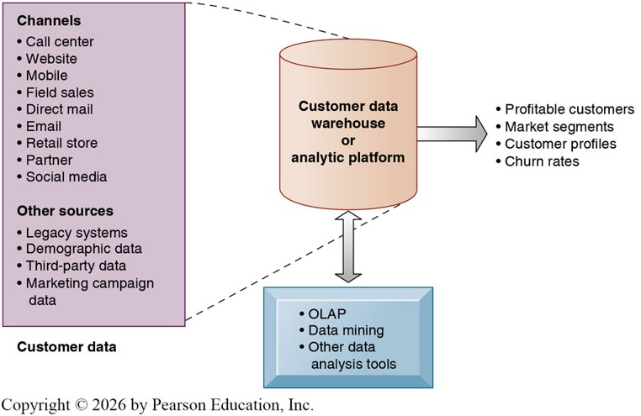
Operational CRM vs Analytical CRM
Operational CRM
Customer-facing tools.
Includes SFA, customer service, and marketing automation.
Analytical CRM
Analyzes customer data to improve decision-making.
Identifies profitable customers, segments, and buying patterns.
Supports customer profiling and behavior prediction.

Slide 36
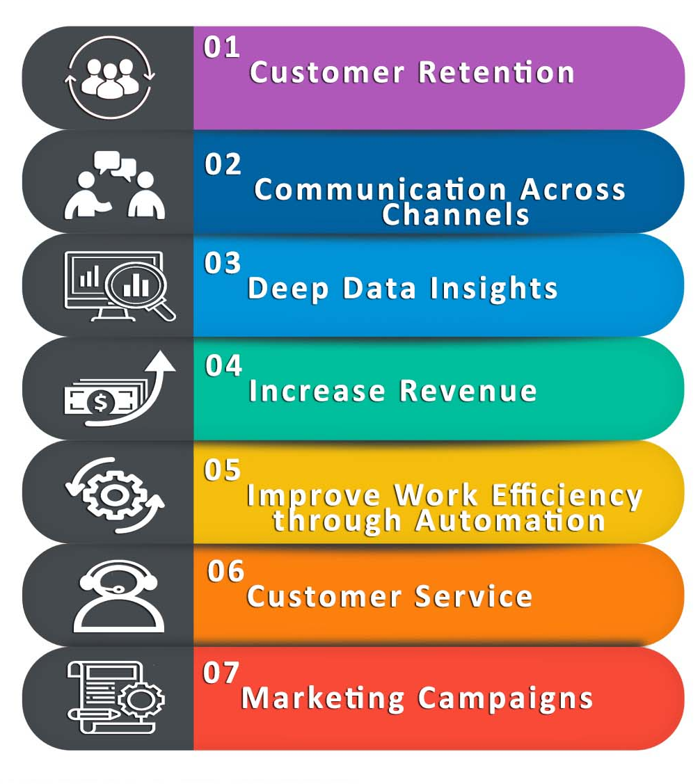
Business Value of CRM Systems
Increase customer satisfaction and loyalty.
Reduce marketing costs through better targeting.
Lower customer acquisition and retention costs.
Increase revenue through cross-selling and upselling.
Reduce customer churn.
Improve efficiency in sales, service, and marketing operations.

Slide 37
AI and CRM
Digital Assistants: Chatbots handle inquiries and capture customer data automatically.
Field Service Optimization: Predictive AI improves scheduling and resource allocation.
Lead Scoring and Conversion: Identifies high-probability prospects and prioritizes opportunities.
Pricing Optimization: Recommends prices and discounts to maximize revenue.
Predictive Scoring: Identifies customers most likely to engage or purchase.

Slide 38
Challenges to Enterprise Applications

Slide 39
Challenge: Implementation Costs
ERP, SCM, and CRM systems promise benefits such as lower inventory, faster order-to-delivery times, improved customer response, and higher profitability.
These benefits require firms to redesign business processes to fit the system, and enterprise applications are costly to purchase and implement.
Survey (Panorama Consulting Group, 2024):
27.5% of projects experienced cost overruns.
5.3% had significant overruns.
Almost one-third were completed late.
Causes of Overrun: organizational issues, scope creep, excessive customization, underestimating training and change management needs, etc.

Slide 40
Why Firms Still Adopt Enterprise Systems
Despite high costs and risks, firms adopt enterprise systems.
Short-run pain vs long-run efficiency:
High upfront costs, but lower operating costs over time.
Automation reduces duplication and manual errors.
Standardization vs flexibility tradeoff:
Standard processes improve coordination and data consistency.
But reduce ability to customize to specific needs.
Improved information and decision-making:
Real-time data across departments.
Enables faster and more informed decisions
Coordination:
Integrates suppliers, production, and customers.
Reduces delays, bottlenecks, and miscommunication.
Competitive pressure:
Firms adopt systems because competitors do.
Falling behind can be costly.

Slide 41

Third Stage Consulting Group (2020, September 9). ERP Failure Case Study - Hershey’s [Video]. YouTube. https://youtu.be/41Q9RokhKAM?si=hmUa06kZxn1mc_No

Slide 42

Challenge: Need for Major Organizational Change
ERP and CRM require process reengineering:
Employees must learn new workflows and responsibilities.
Data entered by one user affects multiple functions, requiring coordination and training.
Implementation involves significant organizational learning costs.
Additional challenges for SCM:
Requires multiple independent organizations to share data and processes.
Partners must align workflows for effective integration.
Difficult to coordinate changes across firms with different systems and priorities.

Slide 43
Challenge: Other Issues
Switching Costs:
Moving from one vendor (e.g., SAP, Oracle) to another is costly and disruptive.
Firms become dependent on vendors for updates, maintenance, and extensions.
Increases long-term costs and strategic dependence.
Data Standardization and Cleansing:
Enterprise systems require company-wide data definitions.
Firms must align definitions of customers, products, accounts, and processes.
Poor data quality reduces system value and can cause disruptions.
Customization:
Customizing ERP or CRM systems makes upgrades more difficult and costly.
Heavy customization can create fragile systems and delay implementation.

Slide 44
Trends in Enterprise Applications
More Flexible Enterprise Applications
Stand-alone ERP, SCM, and CRM systems are being replaced by integrated suites.
Vendors offer more web-enabled, mobile, and user-friendly interfaces.
Cloud-based solutions reduce installation costs and improve scalability.
Composable ERP
Growing use of hybrid systems combining best-of-breed components.
e.g., Use SAP S/4HANA for core ERP, SAP SuccessFactors for HR, and SAP Ariba plus a third-party CRM tool such as Salesforce for procurement and customer management.
Provides flexibility, scalability, and customization without heavy vendor lock-in.
AI in Enterprise Applications
Vendors increasingly embed AI into ERP, SCM, and CRM systems.
Supports forecasting, anomaly detection, content generation, and decision support.

Slide 45
Recap of Chapter 9

Slide 46
Recap of Chapter 9
Understand ERP systems.
Understand SCM systems.
Understand CRM systems.
Discuss enterprise application challenges.
Describe how enterprise applications are using AI.

