Slide 1
The Short Run:
Goods and Financial Markets
ECON 301

Slide 2

https://pollev.com/brianpark046

Slide 3
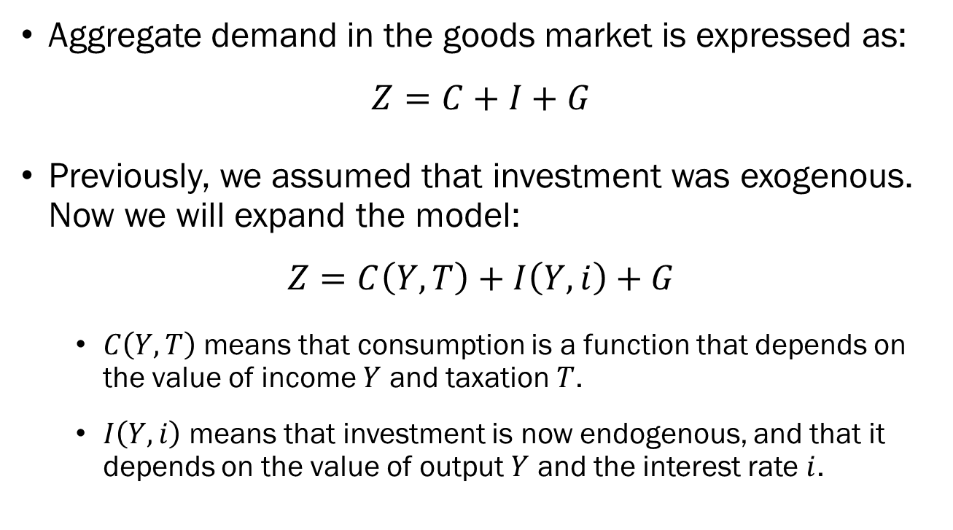
Expanding the Goods Market
Aggregate demand in the goods market is expressed as:
$$Z=C+I+G$$
Previously, we assumed that investment was exogenous. Now we will expand the model:
$$Z=C\left(Y,T\right)+I\left(Y,i\right)+G$$
  $C\left(Y,T\right)$ means that consumption is a function that depends on the value of income $Y$ and taxation $T$.
  $I\left(Y,i\right)$ means that investment is now endogenous, and that it depends on the value of output $Y$ and the interest rate $i$.

Slide 4
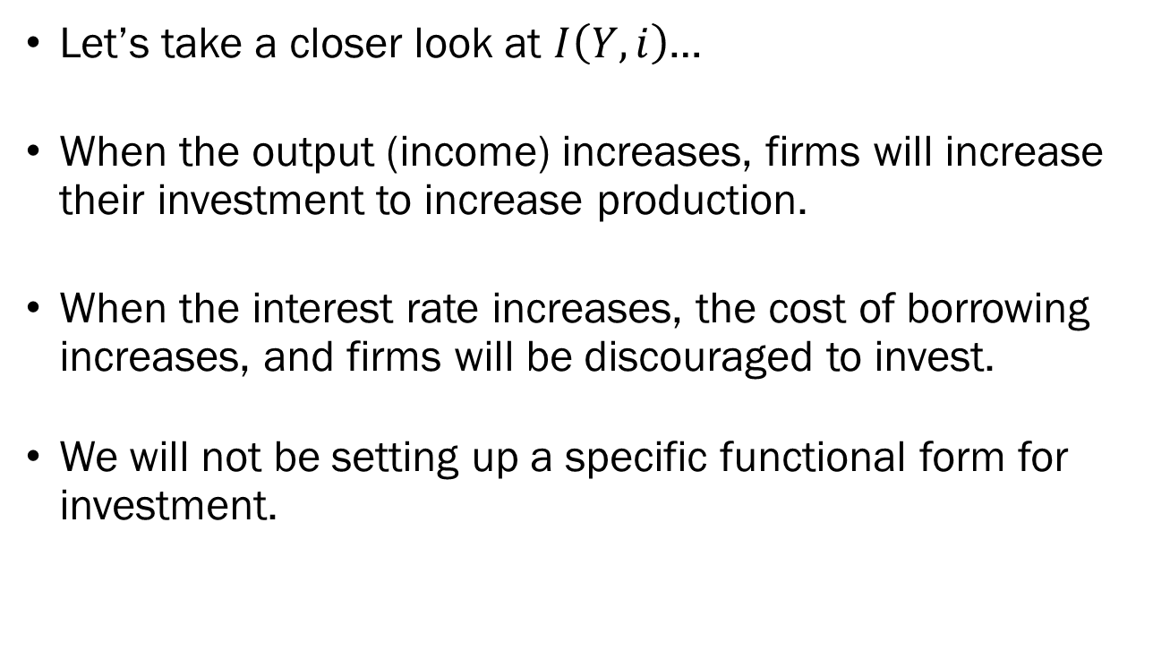
Expanding the Goods Market
Let’s take a closer look at $I\left(Y,i\right)$…
When the output (income) increases, firms will increase their investment to increase production.
When the interest rate increases, the cost of borrowing increases, and firms will be discouraged to invest.
We will not be setting up a specific functional form for investment.

Slide 5
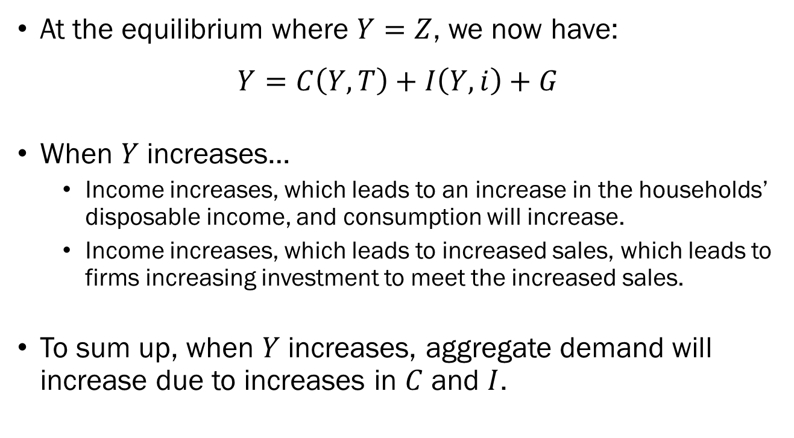
Expanding the Goods Market
At the equilibrium where $Y=Z$, we now have:
$$Y=C\left(Y,T\right)+I\left(Y,i\right)+G$$
When $Y$ increases…
  Income increases, which leads to an increase in the households’ disposable income, and consumption will increase.
  Income increases, which leads to increased sales, which leads to firms increasing investment to meet the increased sales.
To sum up, when $Y$ increases, aggregate demand will increase due to increases in $C$ and $I$.

Slide 6


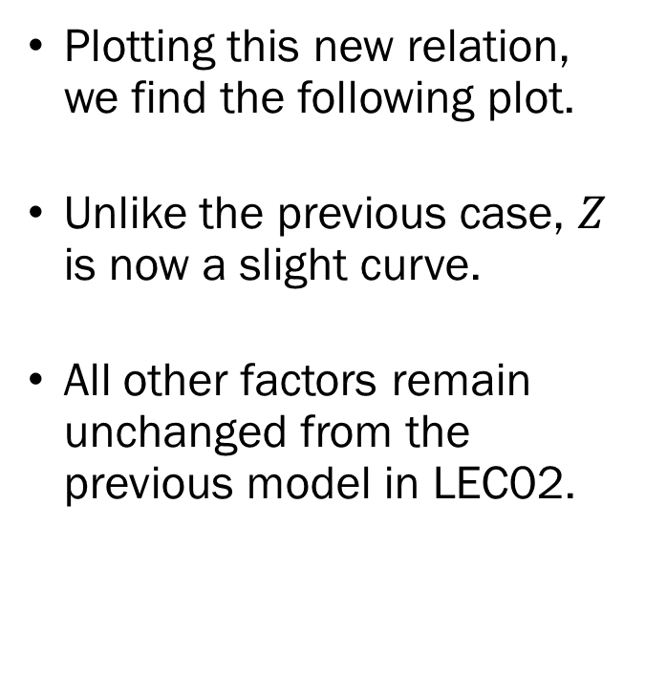



Expanding the Goods Market
$$Y=Z$$
Plotting this new relation, we find the following plot.
Unlike the previous case, $Z$ is now a slight curve.
All other factors remain unchanged from the previous model in LEC02.
Demand
$$Z$$
$$A$$
$${45}^{°}$$
$$Y^{∗}$$
Output

Slide 7
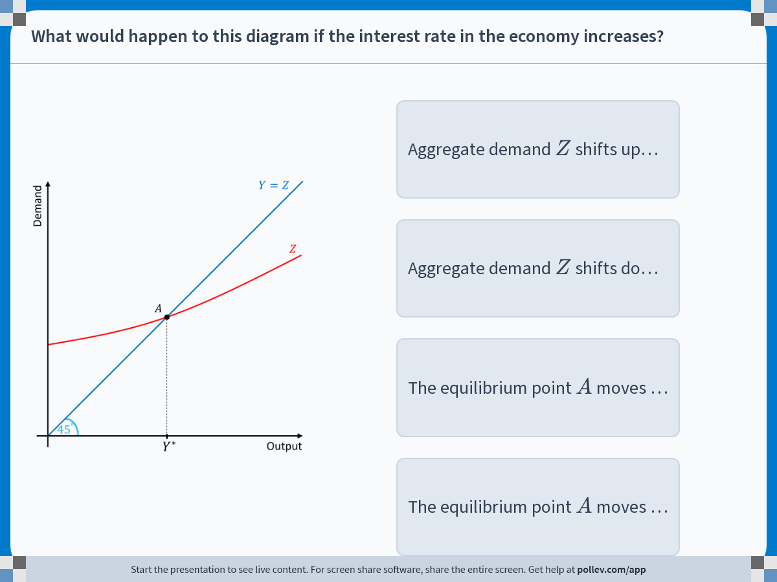
Notes:
Poll Title: Do not modify the notes in this section to avoid tampering with the Poll Everywhere activity.
More info at polleverywhere.com/support
What would happen to this diagram if the interest rate in the economy increases?
https://www.polleverywhere.com/multiple_choice_polls/Kpt0IkH9WXKx4dJimwEDl?display_state=instructions&activity_state=opened&state=opened&flow=Engagement&onscreen=persist

Slide 8
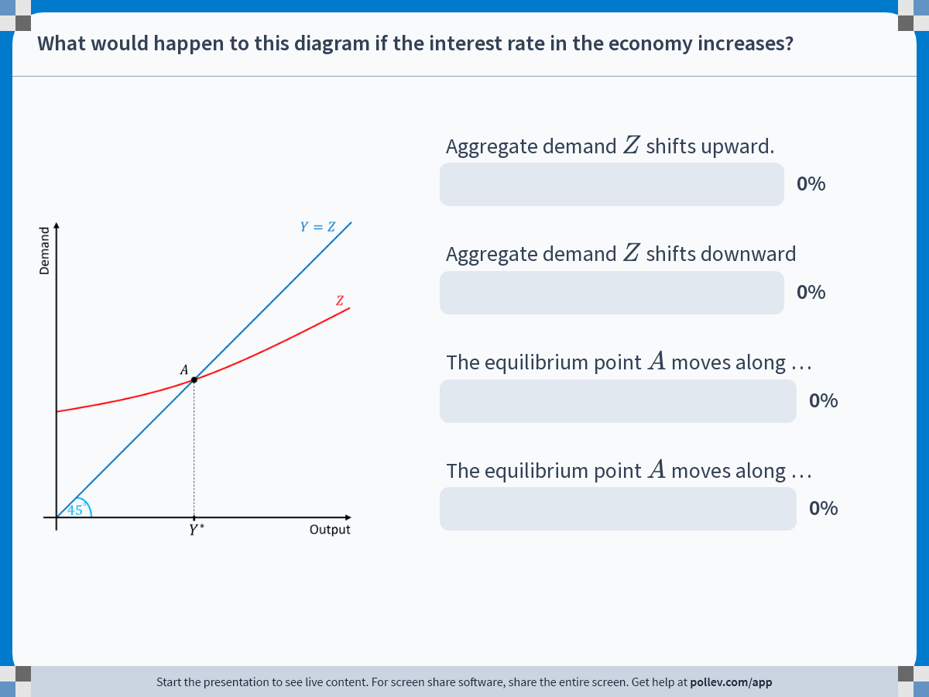
Notes:
Poll Title: Do not modify the notes in this section to avoid tampering with the Poll Everywhere activity.
More info at polleverywhere.com/support
What would happen to this diagram if the interest rate in the economy increases?
https://www.polleverywhere.com/multiple_choice_polls/Kpt0IkH9WXKx4dJimwEDl?display_state=chart&activity_state=closed&state=closed&flow=Engagement&onscreen=persist

Slide 9

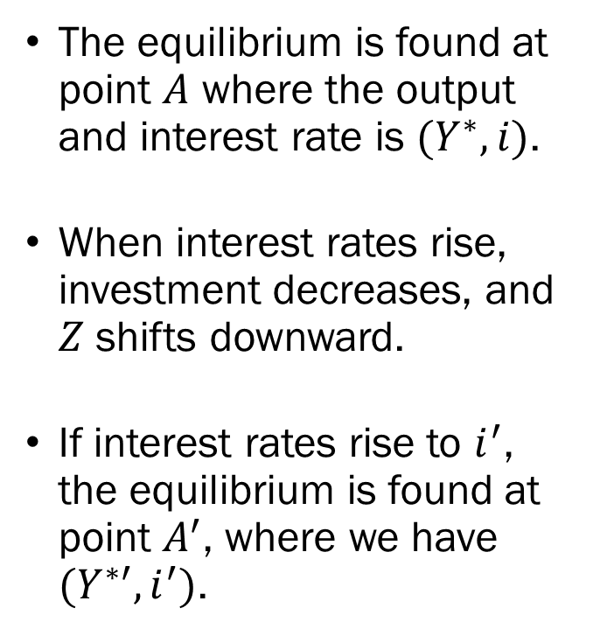



Expanding the Goods Market
$$Y=Z$$
The equilibrium is found at point $A$ where the output and interest rate is $(Y^{∗},i)$.
When interest rates rise, investment decreases, and $Z$ shifts downward.
If interest rates rise to $i^{′}$, the equilibrium is found at point $A^{′}$, where we have $(Y^{∗′},i^{′})$.
Demand
$Z$ with $i$
$$A$$
$Z$ with $i^{′}$
$$A^{′}$$
$${45}^{°}$$
$$Y^{∗′}$$
$$Y^{∗}$$
Output

Slide 10
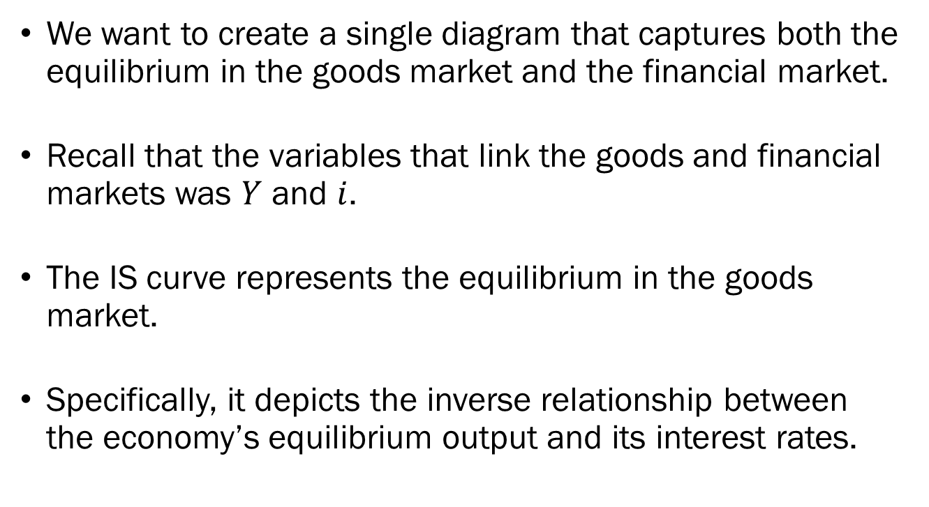
Deriving the IS Curve
We want to create a single diagram that captures both the equilibrium in the goods market and the financial market.
Recall that the variables that link the goods and financial markets was $Y$ and $i$.
The IS curve represents the equilibrium in the goods market.
Specifically, it depicts the inverse relationship between the economy’s equilibrium output and its interest rates.

Slide 11







Deriving the IS Curve
$$Y=Z$$
Demand
Interest Rate
$Z$ with $i$
$$i^{′}$$
$$A$$
$Z$ with $i^{′}$
$$i$$
$$A^{′}$$
$$IS$$
$$Y^{∗′}$$
$$Y^{∗}$$
Output
$$Y^{∗′}$$
$$Y^{∗}$$
Output

Slide 12

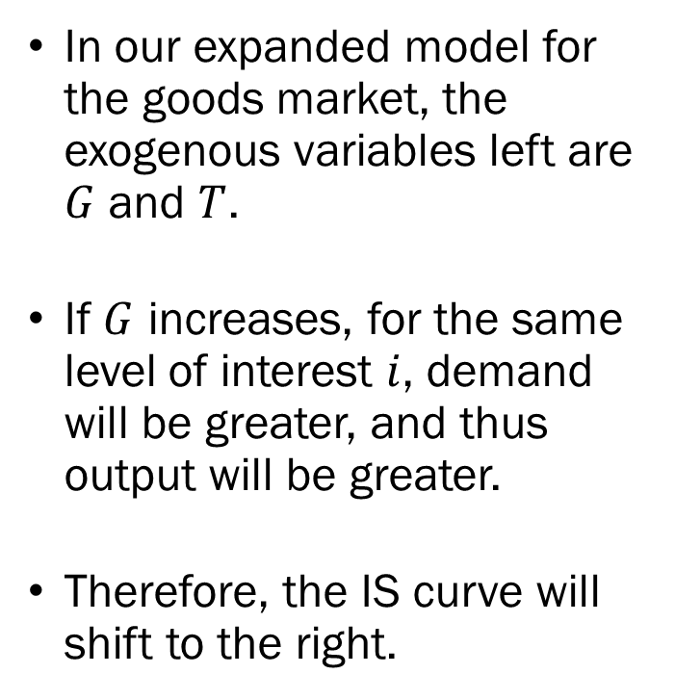



Shifts of the IS Curve
In our expanded model for the goods market, the exogenous variables left are $G$ and $T$.
If $G$ increases, for the same level of interest $i$, demand will be greater, and thus output will be greater.
Therefore, the IS curve will shift to the right.
Interest Rate
$$i$$
$$IS^{′}$$
$$IS$$
$$Y^{∗}$$
$$Y^{∗′}$$
Output

Slide 13
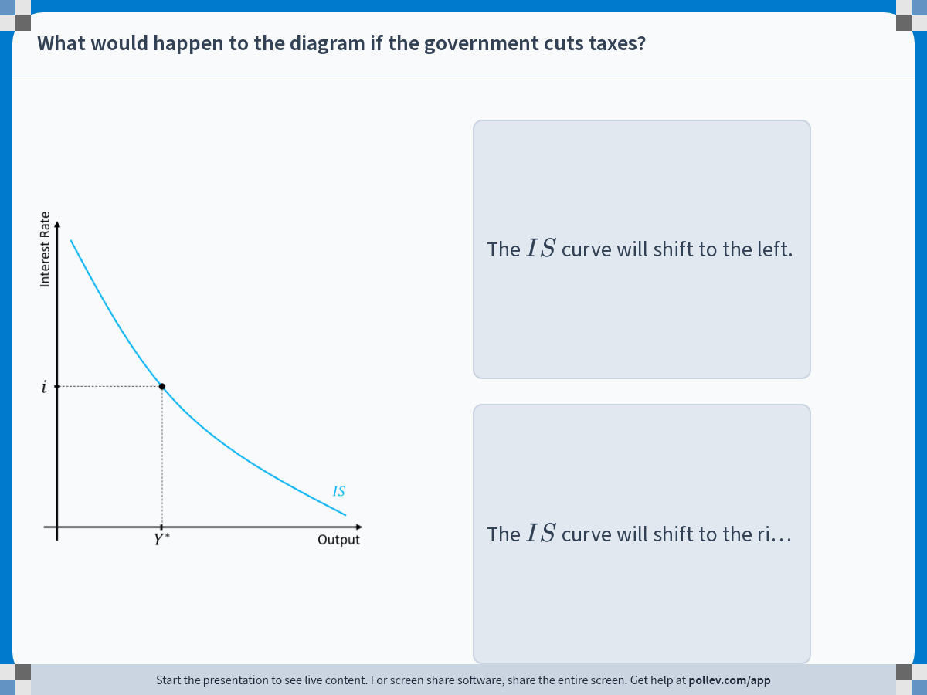
Notes:
Poll Title: Do not modify the notes in this section to avoid tampering with the Poll Everywhere activity.
More info at polleverywhere.com/support
What would happen to the diagram if the government cuts taxes?
https://www.polleverywhere.com/multiple_choice_polls/CzM89CphMLMSqCxoolyMP?display_state=instructions&activity_state=opened&state=opened&flow=Engagement&onscreen=persist

Slide 14
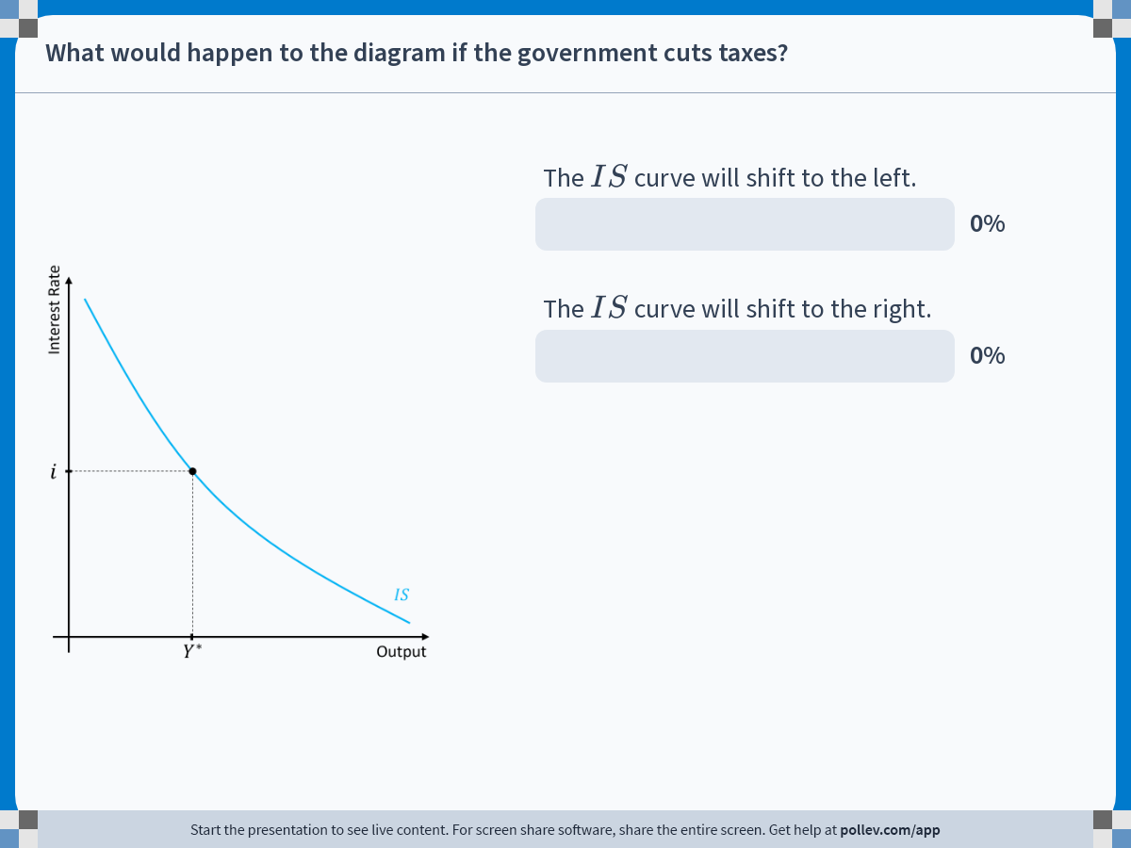
Notes:
Poll Title: Do not modify the notes in this section to avoid tampering with the Poll Everywhere activity.
More info at polleverywhere.com/support
What would happen to the diagram if the government cuts taxes?
https://www.polleverywhere.com/multiple_choice_polls/CzM89CphMLMSqCxoolyMP?display_state=chart&activity_state=closed&state=closed&flow=Engagement&onscreen=persist

Slide 15
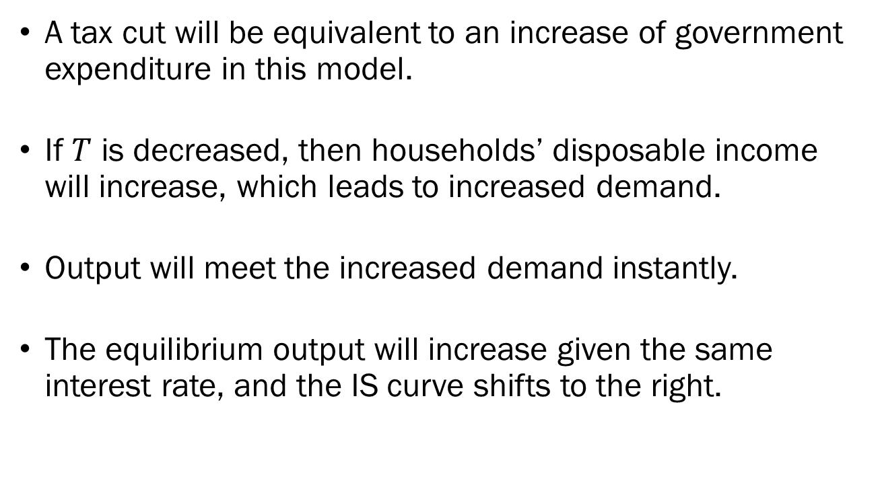
Solution to In-Class Poll
A tax cut will be equivalent to an increase of government expenditure in this model.
If $T$ is decreased, then households’ disposable income will increase, which leads to increased demand.
Output will meet the increased demand instantly.
The equilibrium output will increase given the same interest rate, and the IS curve shifts to the right.

Slide 16
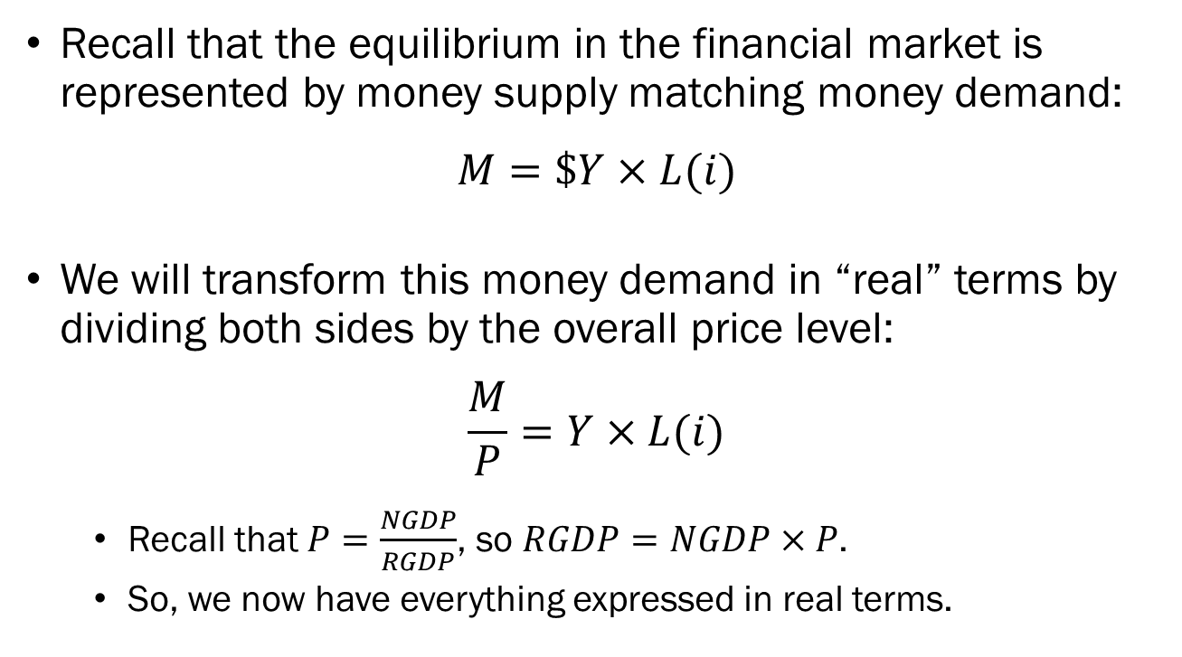
Deriving the LM Curve
Recall that the equilibrium in the financial market is represented by money supply matching money demand:
$$M=\$Y×L(i)$$
We will transform this money demand in “real” terms by dividing both sides by the overall price level:
$$\frac{M}{P}=Y×L(i)$$
  Recall that $P=\frac{NGDP}{RGDP}$, so $RGDP=NGDP×P$.
  So, we now have everything expressed in real terms.

Slide 17
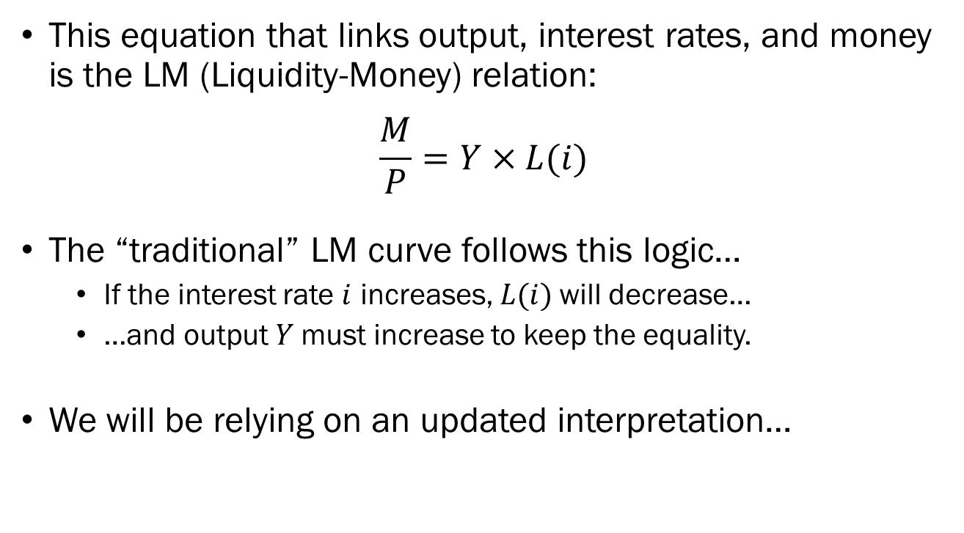
Deriving the LM Curve
This equation that links output, interest rates, and money is the LM (Liquidity-Money) relation:
$$\frac{M}{P}=Y×L(i)$$
The “traditional” LM curve follows this logic…
  If the interest rate $i$ increases, $L(i)$will decrease…
  …and output $Y$must increase to keep the equality.
We will be relying on an updated interpretation…

Slide 18

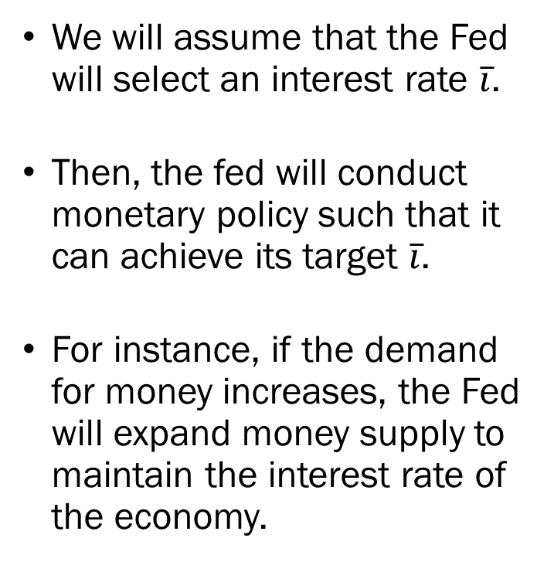

Deriving the LM Curve
We will assume that the Fed will select an interest rate $\overline{i}$.
Then, the fed will conduct monetary policy such that it can achieve its target $\overline{i}$.
For instance, if the demand for money increases, the Fed will expand money supply to maintain the interest rate of the economy.
Interest Rate
$$\overline{i}$$
$$LM$$
Output

Slide 19


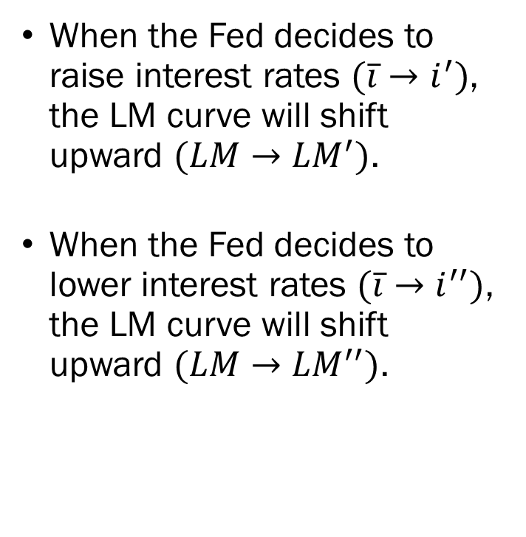


Shifts of the LM Curve
When the Fed decides to raise interest rates $(\overline{i}→i^{′})$, the LM curve will shift upward $(LM→{LM}^{′})$.
When the Fed decides to lower interest rates $(\overline{i}→i^{′′})$, the LM curve will shift upward $(LM→{LM}^{′′})$.
Interest Rate
$$LM^{′}$$
$$i′$$
$$\overline{i}$$
$$LM$$
$$i^{′′}$$
$$LM^{′′}$$
Output

Slide 20
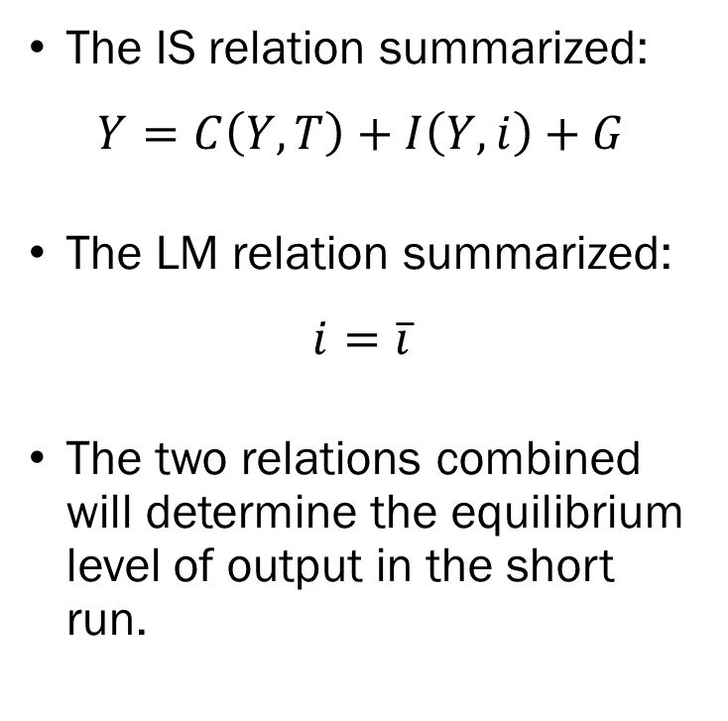

The IS-LM Framework
The IS relation summarized:
$$Y=C\left(Y,T\right)+I\left(Y,i\right)+G$$
The LM relation summarized:
$$i=\overline{i}$$
The two relations combined will determine the equilibrium level of output in the short run.
Interest Rate
$$i$$
$$LM$$
$$IS$$
$$Y^{∗}$$
Output

Slide 21

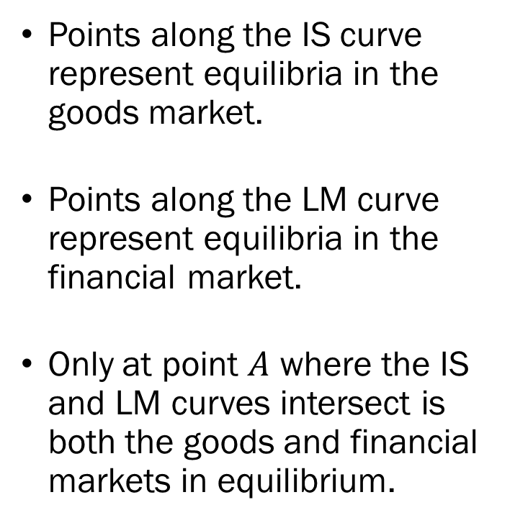
The IS-LM Framework
Points along the IS curve represent equilibria in the goods market.
Points along the LM curve represent equilibria in the financial market.
Only at point $A$ where the IS and LM curves intersect is both the goods and financial markets in equilibrium.
Interest Rate
$$A$$
$$LM$$
$$i$$
$$IS$$
$$Y^{∗}$$
Output

Slide 22
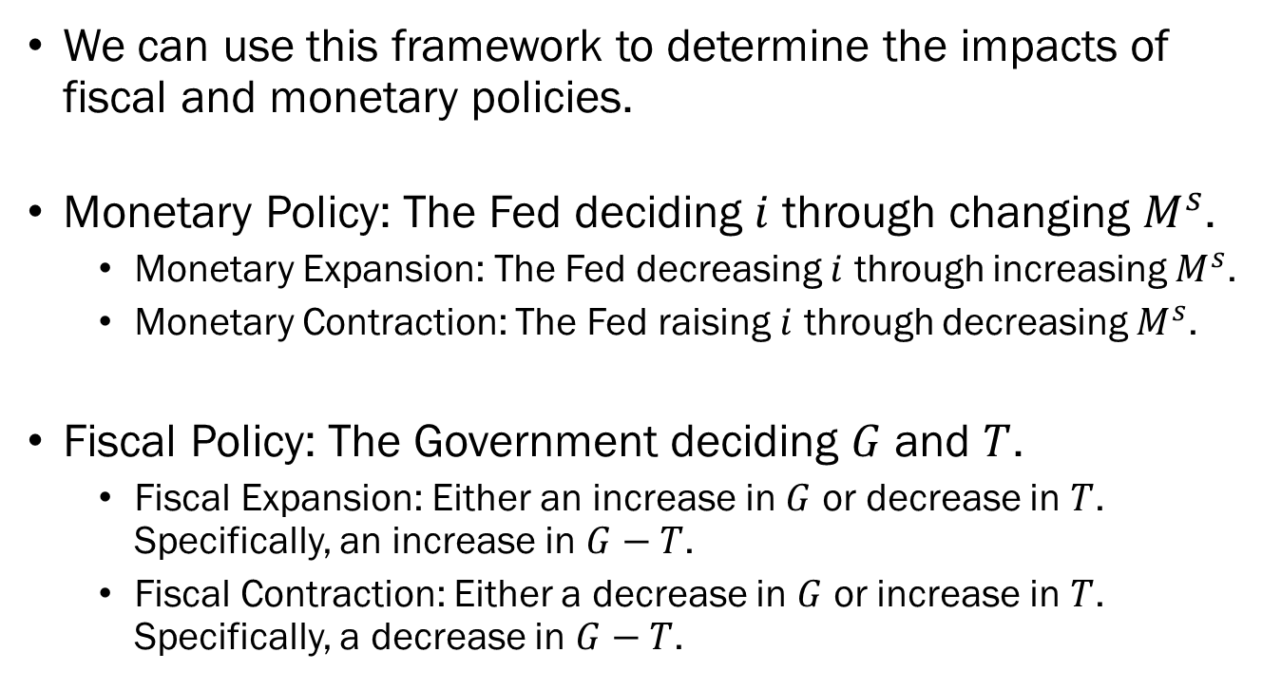
Why does this Matter?
We can use this framework to determine the impacts of fiscal and monetary policies.
Monetary Policy: The Fed deciding $i$ through changing $M^{s}$.
  Monetary Expansion: The Fed decreasing $i$ through increasing $M^{s}$.
  Monetary Contraction: The Fed raising $i$ through decreasing $M^{s}$.
Fiscal Policy: The Government deciding $G$ and $T$.
  Fiscal Expansion: Either an increase in $G$ or decrease in $T$. Specifically, an increase in $G−T$.
  Fiscal Contraction: Either a decrease in $G$ or increase in $T$. Specifically, a decrease in $G−T$.

Slide 23
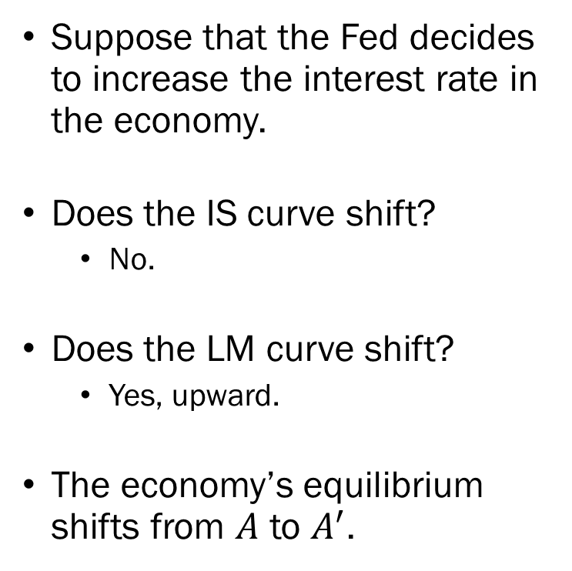


The Impact of
Contractionary Monetary Policy
Suppose that the Fed decides to increase the interest rate in the economy.
Does the IS curve shift?
  No.
Does the LM curve shift?
  Yes, upward.
The economy’s equilibrium shifts from $A$ to $A^{′}$.
Interest Rate
$$A^{′}$$
$$LM^{′}$$
$$i′$$
$$A$$
$$LM$$
$$i$$
$$IS$$
$$Y^{∗′}$$
$$Y^{∗}$$
Output

Slide 24
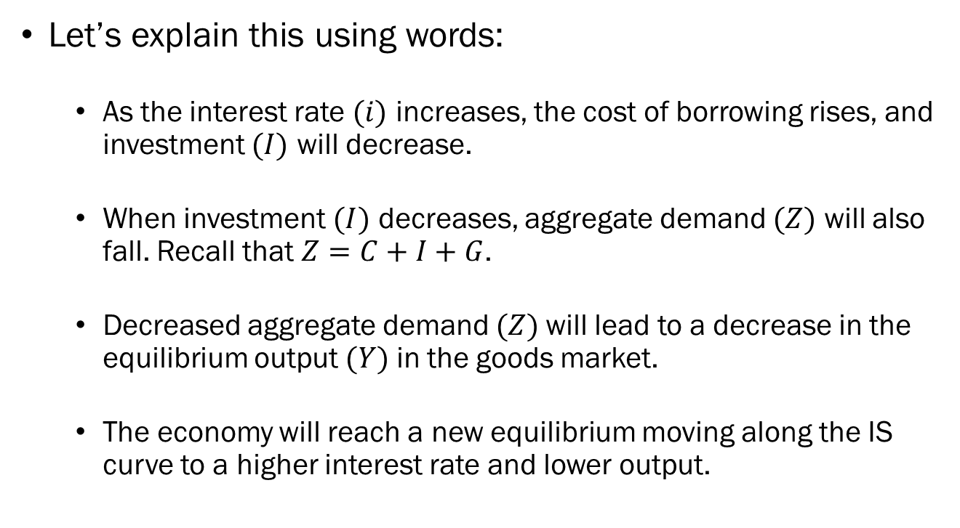
The Impact of
Contractionary Monetary Policy
Let’s explain this using words:
  As the interest rate $(i)$ increases, the cost of borrowing rises, and investment $(I)$ will decrease.
  When investment $(I)$ decreases, aggregate demand $(Z)$ will also fall. Recall that $Z=C+I+G$.
  Decreased aggregate demand $(Z)$will lead to a decrease in the equilibrium output $(Y)$ in the goods market.
  The economy will reach a new equilibrium moving along the IS curve to a higher interest rate and lower output.

Slide 25

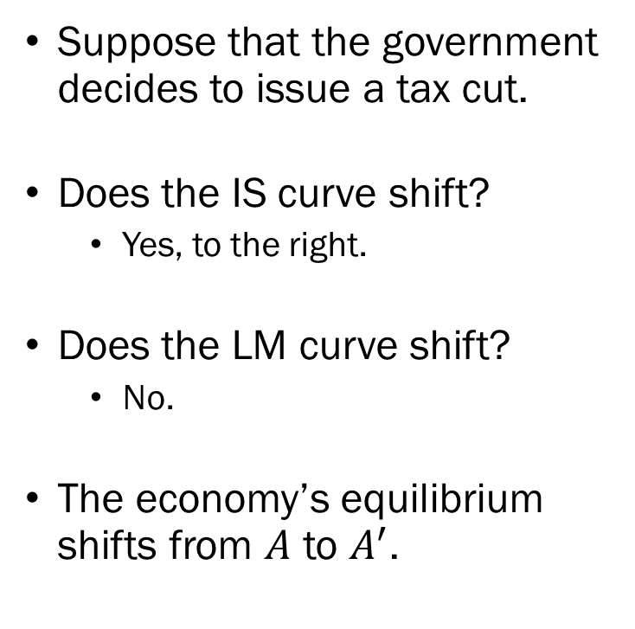

The Impact of
Expansionary Fiscal Policy
Suppose that the government decides to issue a tax cut.
Does the IS curve shift?
  Yes, to the right.
Does the LM curve shift?
  No.
The economy’s equilibrium shifts from $A$ to $A^{′}$.
Interest Rate
$$A$$
$$A^{′}$$
$$LM$$
$$i$$
$$IS^{′}$$
$$IS$$
$$Y^{∗}$$
$$Y^{∗′}$$
Output

Slide 26
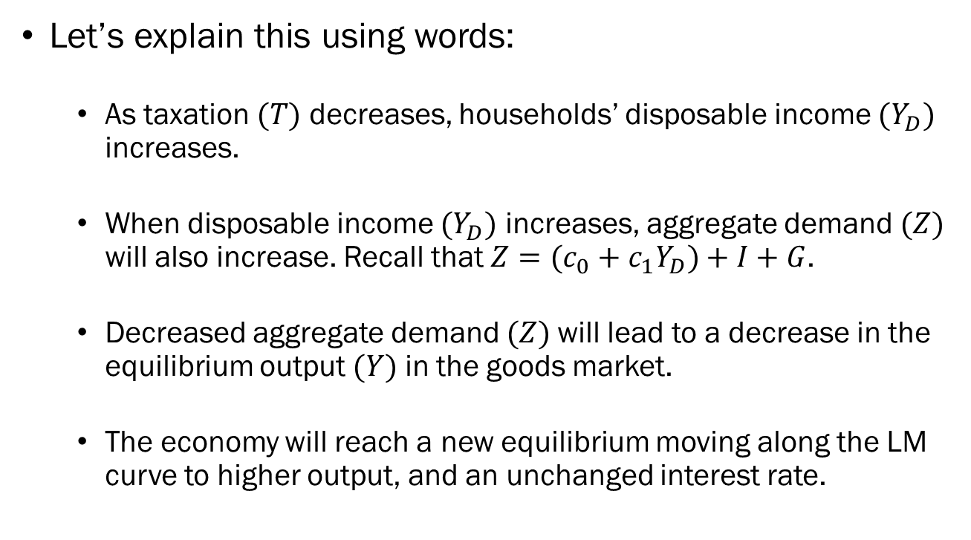
The Impact of
Expansionary Fiscal Policy
Let’s explain this using words:
  As taxation $(T)$ decreases, households’ disposable income $(Y_{D})$ increases.
  When disposable income $(Y_{D})$ increases, aggregate demand $(Z)$ will also increase. Recall that $Z=(c_{0}+c_{1}Y_{D})+I+G$.
  Decreased aggregate demand $(Z)$will lead to a decrease in the equilibrium output $(Y)$ in the goods market.
  The economy will reach a new equilibrium moving along the LM curve to higher output, and an unchanged interest rate.

Slide 27
Fiscal and Monetary Policy Mix
In the real world, most economies will see a mix of fiscal and monetary policies occurring in conjunction.
If the government is already running a large deficit, it may be better to get some help from monetary policy.
If the interest rate is already incredibly low, there is not a lot of room for monetary policy, and it may be beneficial to get some help from fiscal policy.
Long story short, using both fiscal and monetary policy allows us to “share the burden.”

Slide 28



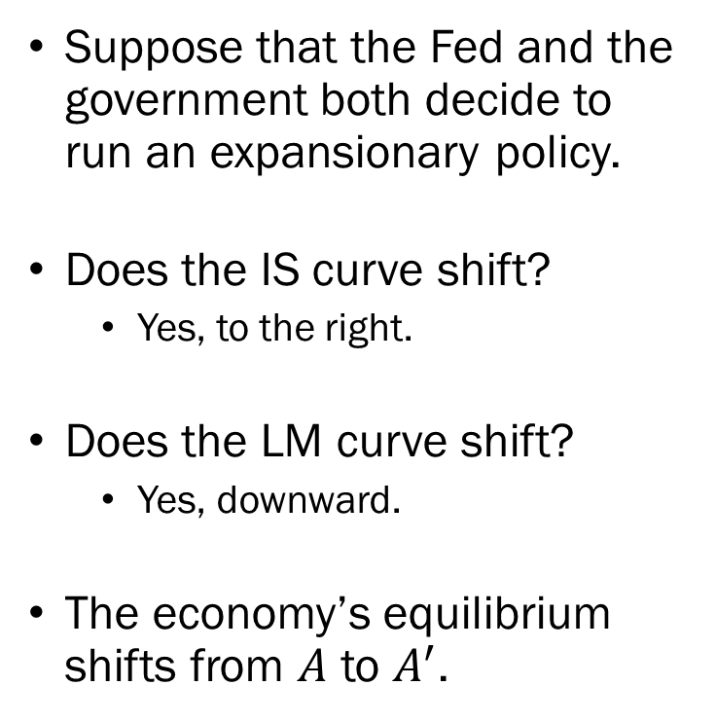



The Impact of Expansionary Fiscal and Expansionary Monetary Policy
Suppose that the Fed and the government both decide to run an expansionary policy.
Does the IS curve shift?
  Yes, to the right.
Does the LM curve shift?
  Yes, downward.
The economy’s equilibrium shifts from $A$ to $A^{′}$.
Interest Rate
$$A$$
$$LM$$
$$i$$
$$A^{′}$$
$$LM^{′}$$
$$i^{′}$$
$$IS^{′}$$
$$IS$$
$$Y^{∗}$$
$$Y^{∗′}$$
Output

Slide 29
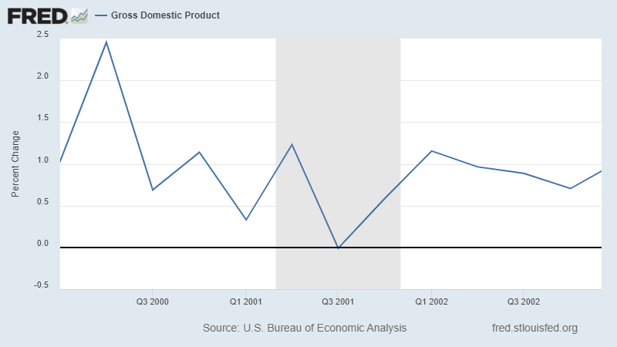
Combating Recessions: 2001

Slide 30
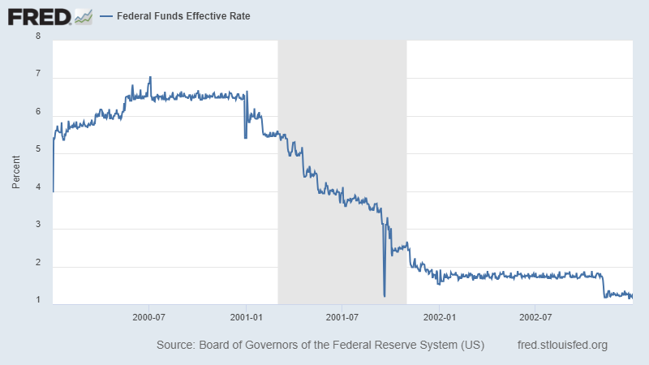
Combating Recessions: 2001

Slide 31
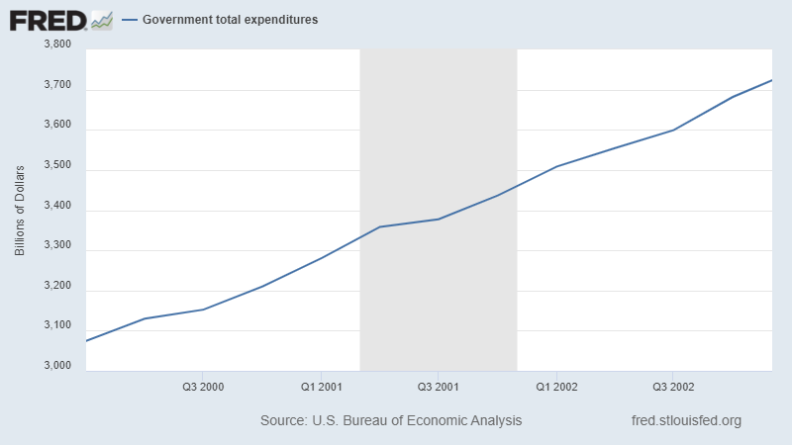
Combating Recessions: 2001

Slide 32
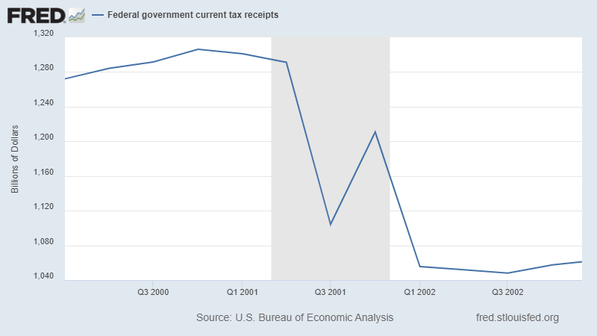
Combating Recessions: 2001

