Slide 1
Practice Final Review
ECON 300

Slide 2
Administrative Details for the Finals
https://calendly.com/brianhwpark
Venue: Rm. 248 Center for Science and Business
Dates: Nov. 13th ~ Nov. 21st , 2023
Length: 30 Minutes per Session
Use the Whiteboard / Paper to correct your answers.
Recovery Rate: 70%

Slide 3
Definitions: Problem 1.
Technical Progress
  Changes to the production function that results in an increase in output without the increase of inputs.
Marginal Revenue
  The incremental amount of revenue that the producer can earn if they produce (sell) an additional unit.
Duopoly
  A subcategory of oligopolies. A market structure in which there exist only two firms that produce a certain product.

Slide 4
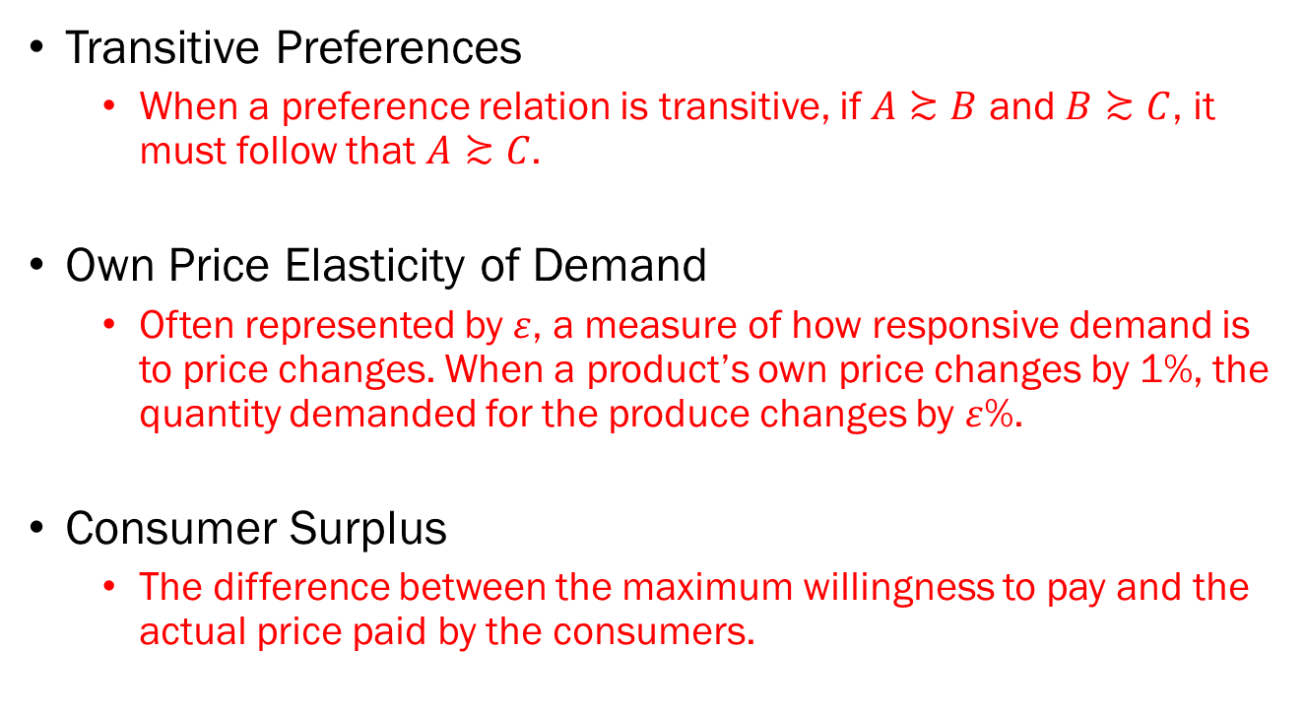
Definitions: Problem 1. (Cont’d)
Transitive Preferences
  When a preference relation is transitive, if $A≿B$ and $B≿C$, it must follow that $A≿C$.
Own Price Elasticity of Demand
  Often represented by $ε$, a measure of how responsive demand is to price changes. When a product’s own price changes by 1%, the quantity demanded for the produce changes by $ε$%.
Consumer Surplus
  The difference between the maximum willingness to pay and the actual price paid by the consumers.

Slide 5
T/F: Problem 2.A.
The long run supply curve is “steeper” compared to the short run supply curve.
  FALSE
  The long run supply curve will be less steep than the short run supply curve.
  When the conditions in a certain market is less advantageous for the existing producers, they will have the opportunity to repurpose factors of production to either producing other goods or to exit the market in the long run.
  Meanwhile, when the conditions of a certain market becomes favorable to producers, there may be new producers entering the market in the long run.
  Therefore, the long run supply curve will be “more responsive” to changes in the market prices.

Slide 6

T/F: Problem 2.B.
When two goods $x$ and $y$ are perfect substitutes, the consumer’s preferences will be represented by a linear utility function.
  TRUE
  If the goods x and y are perfect complements, we should be using a Leontief utility function to represent their preferences.

Slide 7
T/F: Problem 2.C.
When the consumers’ demand is more elastic compared to the producers’ supply, if the government levies a tax, the consumer will bear a larger burden..
  FALSE
  The side that is less elastic will bear a greater burden.
  If the demand is more elastic, it means that the producers cannot afford to increase the price by a large margin, as they will lose a larger amount of quantity demanded.
  This means that the suppliers must bear a greater share of the burden from taxation.

Slide 8
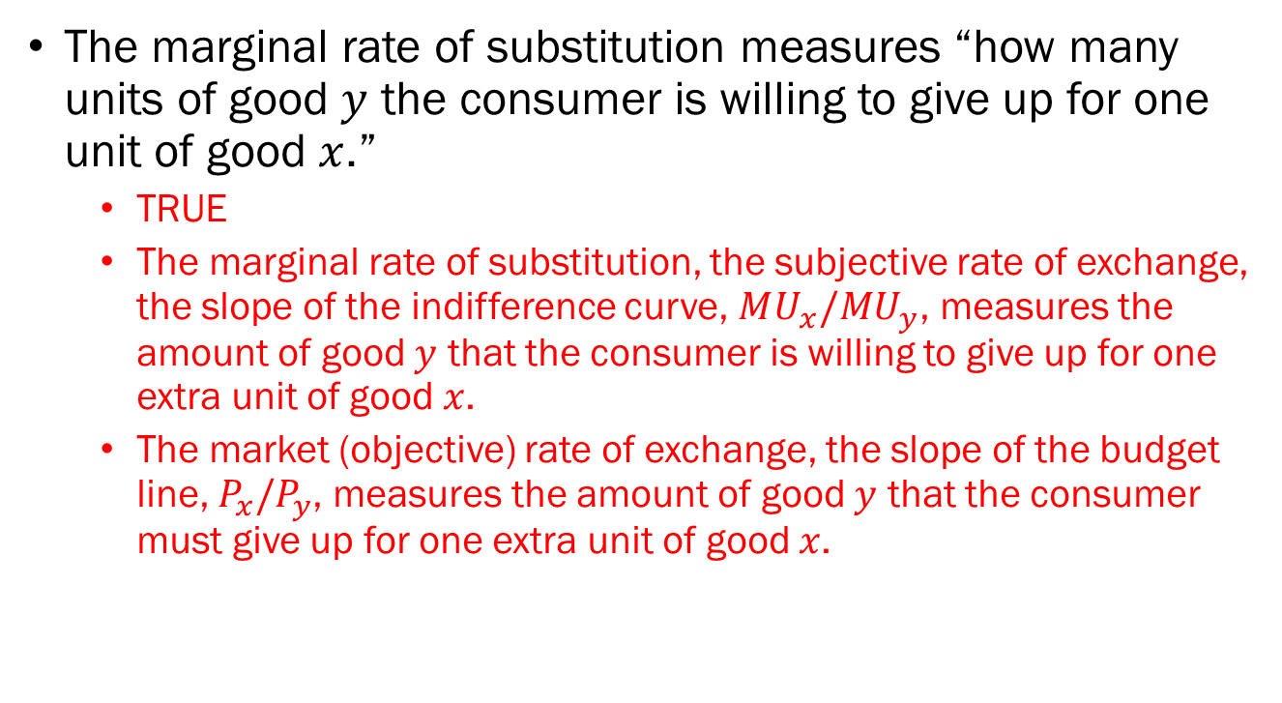
T/F: Problem 2.D.
The marginal rate of substitution measures “how many units of good $y$ the consumer is willing to give up for one unit of good $x$.”
  TRUE
  The marginal rate of substitution, the subjective rate of exchange, the slope of the indifference curve, $MU_{x}/MU_{y}$, measures the amount of good $y$ that the consumer is willing to give up for one extra unit of good $x$.
  The market (objective) rate of exchange, the slope of the budget line, $P_{x}/P_{y}$, measures the amount of good $y$ that the consumer must give up for one extra unit of good $x$.

Slide 9
Multiple Choice: Problem 3.A.
Which of the following statements is true?
  Any bundle of goods that is “above” the budget line is affordable for the consumer.
  Any bundle of goods that is “below” an indifference curve is more preferred to any bundle on the indifference curve.
  All preferences can be represented by continuous utility functions.
  The marginal rate of substitution is the slope of the indifference curve.

Slide 10
Multiple Choice: Problem 3.B.
Select ALL properties that are required for a preference relation to be rational.
  Completeness
  Convexity
  Transitivity
  Continuity

Slide 11
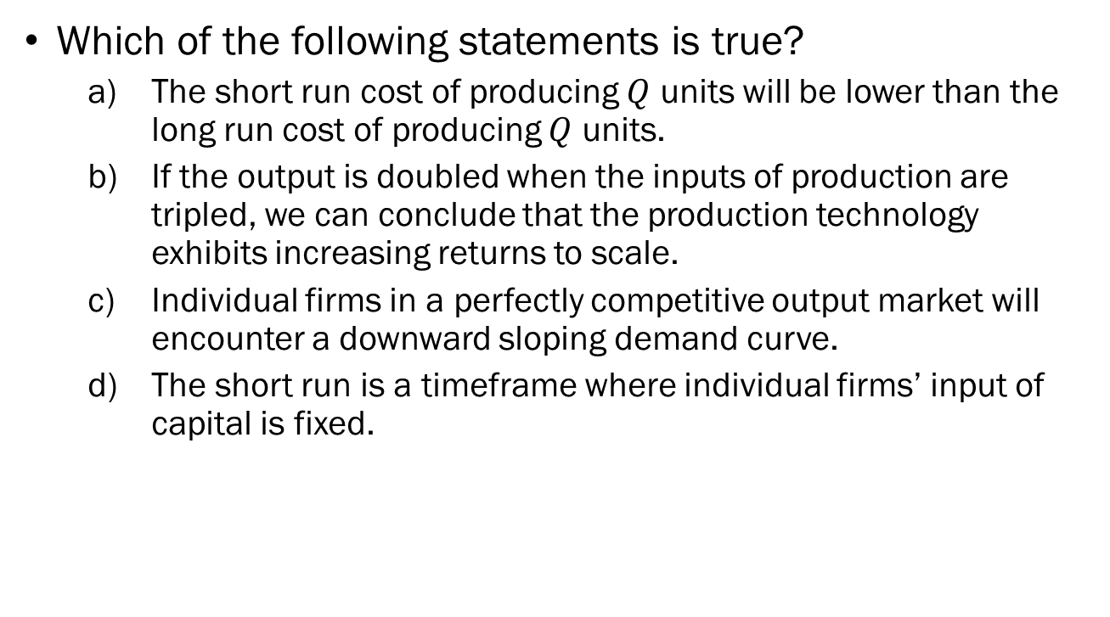
Multiple Choice: Problem 3.C.
Which of the following statements is true?
  The short run cost of producing $Q$ units will be lower than the long run cost of producing $Q$ units.
  If the output is doubled when the inputs of production are tripled, we can conclude that the production technology exhibits increasing returns to scale.
  Individual firms in a perfectly competitive output market will encounter a downward sloping demand curve.
  The short run is a timeframe where individual firms’ input of capital is fixed.

Slide 12
Multiple Choice: Problem 3.D.
Which of the following statements is NOT true?
  When games are played indefinitely, players will always cooperate.
  Complete information in games imply that all players know each other’s payoff structures.
  Some dynamic games can be represented in the normal form.
  Some static games can be represented in its normal form.

Slide 13
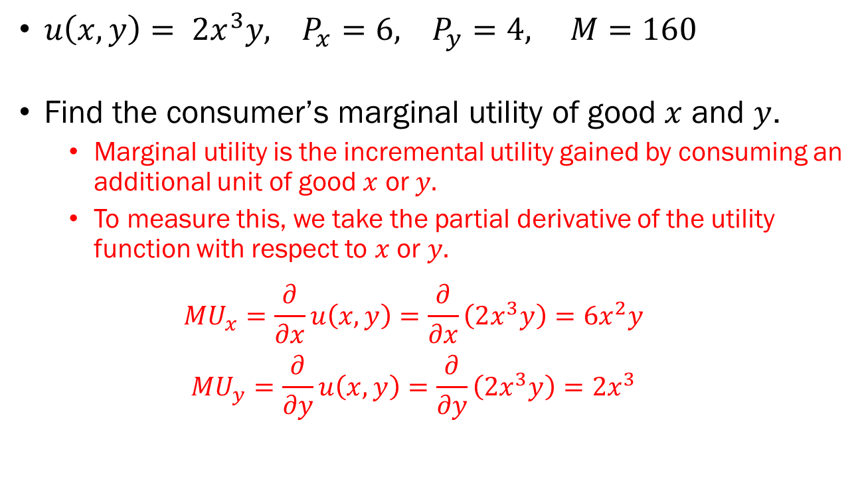
Problem 4.A.
$u\left(x, y\right)= 2x^{3}y, P_{x}=6, P_{y}=4, M=160$
Find the consumer’s marginal utility of good $x$ and $y$.
  Marginal utility is the incremental utility gained by consuming an additional unit of good $x$ or $y.$
  To measure this, we take the partial derivative of the utility function with respect to $x$ or $y.$
  $$MU_{x}=\frac{∂}{∂x}u\left(x,y\right)=\frac{∂}{∂x}\left(2x^{3}y\right)=6x^{2}y$$
  $$MU_{y}=\frac{∂}{∂y}u\left(x,y\right)=\frac{∂}{∂y}\left(2x^{3}y\right)=2x^{3}$$

Slide 14
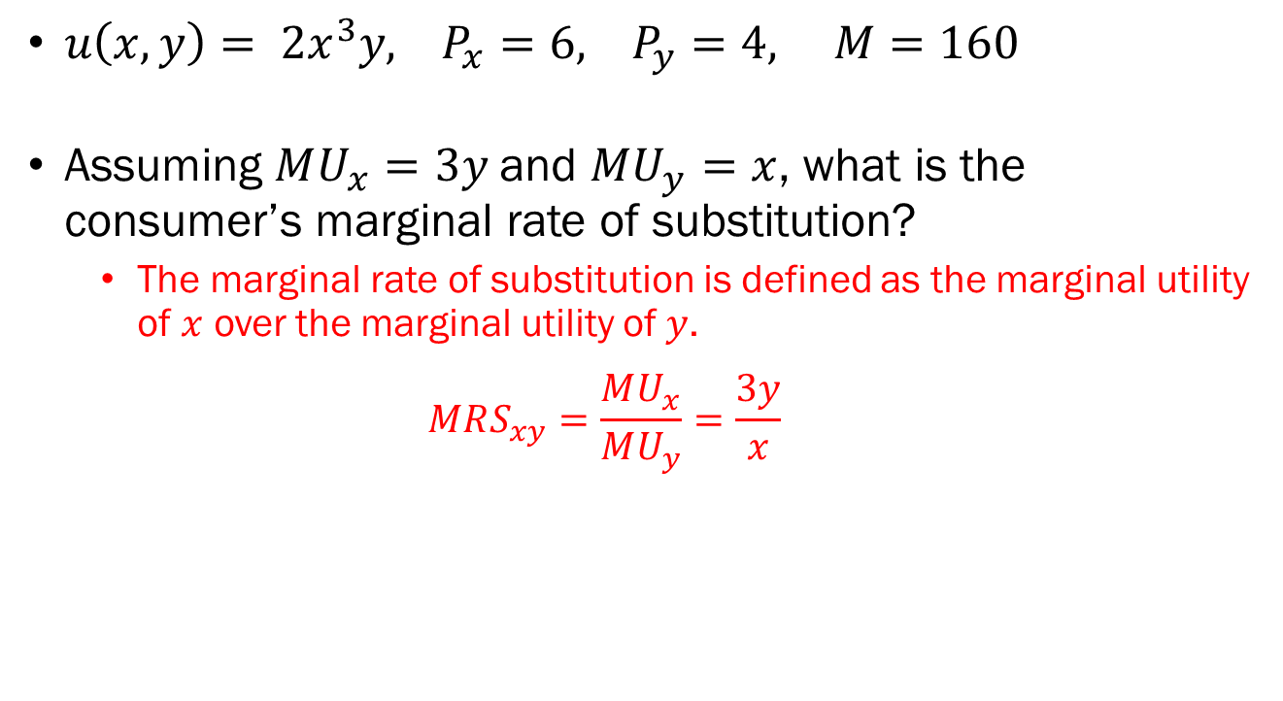
Problem 4.B.
$u\left(x, y\right)= 2x^{3}y, P_{x}=6, P_{y}=4, M=160$
Assuming $MU_{x}=3y$and $MU_{y}=x$, what is the consumer’s marginal rate of substitution?
  The marginal rate of substitution is defined as the marginal utility of $x$ over the marginal utility of $y$.
  $$MRS_{xy}=\frac{MU_{x}}{MU_{y}}=\frac{3y}{x}$$

Slide 15
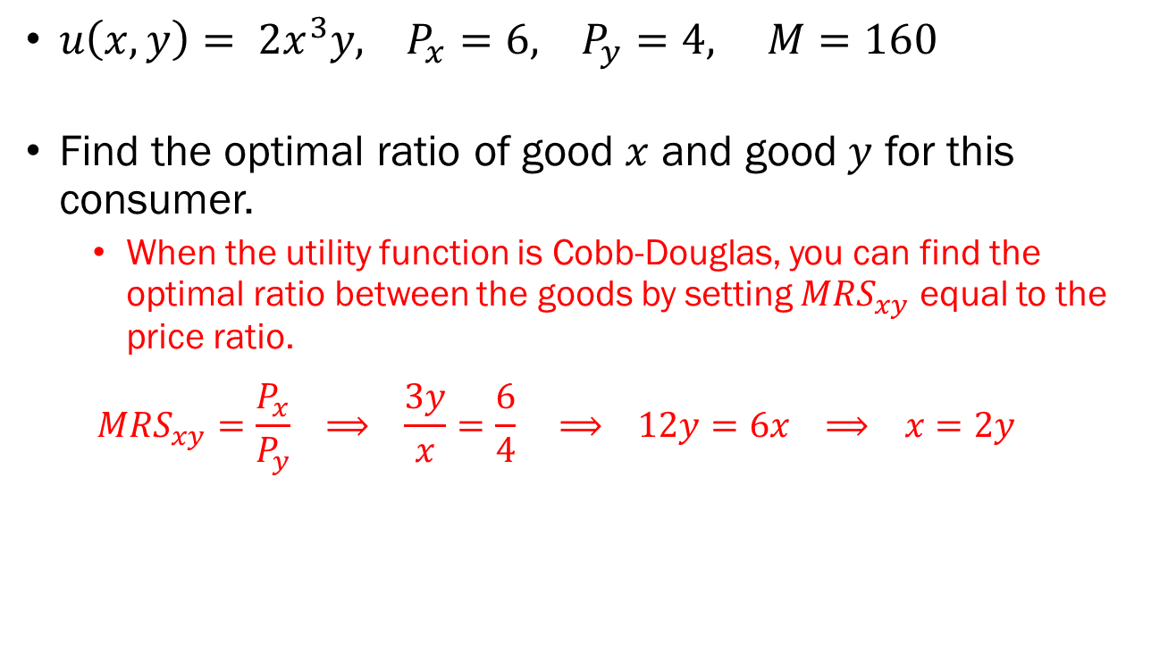
Problem 4.C.
$u\left(x, y\right)= 2x^{3}y, P_{x}=6, P_{y}=4, M=160$
Find the optimal ratio of good $x$ and good $y$ for this consumer.
  When the utility function is Cobb-Douglas, you can find the optimal ratio between the goods by setting $MRS_{xy}$ equal to the price ratio.
  $$MRS_{xy}=\frac{P_{x}}{P_{y}} ⟹ \frac{3y}{x}=\frac{6}{4} ⟹ 12y=6x ⟹ x=2y$$

Slide 16
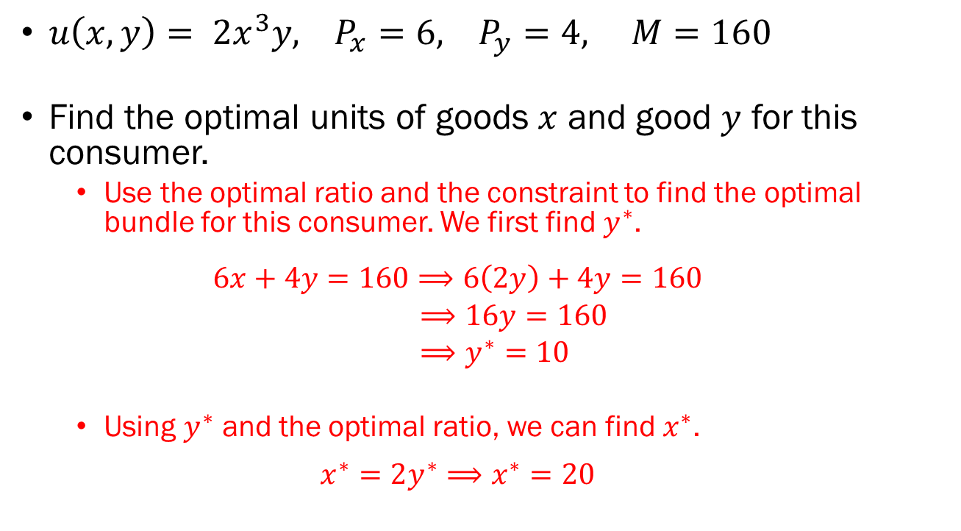
Problem 4.D.
$u\left(x, y\right)= 2x^{3}y, P_{x}=6, P_{y}=4, M=160$
Find the optimal units of goods $x$ and good $y$ for this consumer.
  Use the optimal ratio and the constraint to find the optimal bundle for this consumer. We first find $y^{∗}$.
  $$6x+4y=160⟹6\left(2y\right)+4y=160$$
  $⟹16y=160$
  $⟹y^{∗}=10$
  Using $y^{∗}$ and the optimal ratio, we can find $x^{∗}$.
  $$x^{∗}=2y^{∗}⟹x^{∗}=20$$

Slide 17
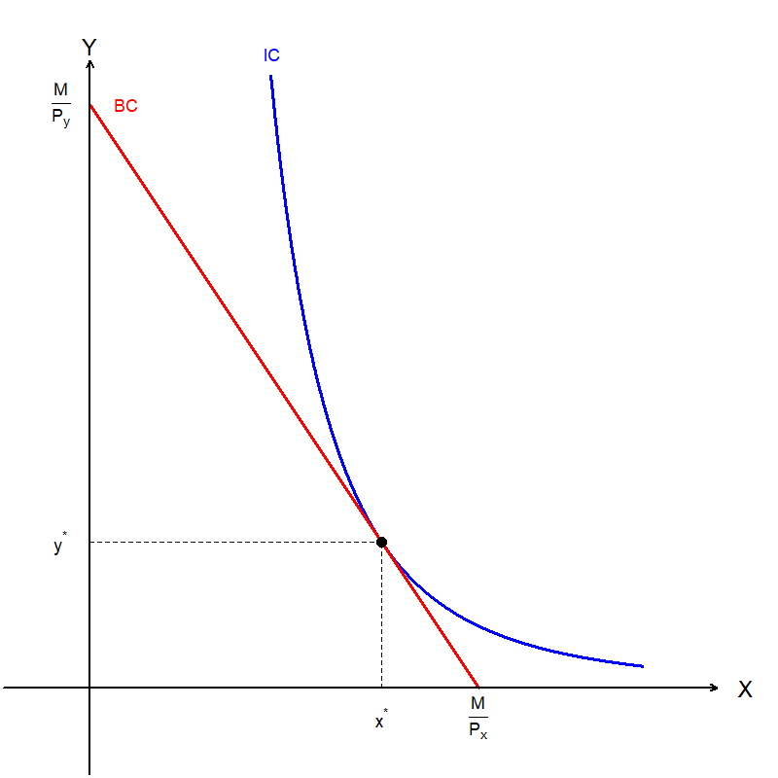

Problem 4.E.
$u\left(x, y\right)= 2x^{3}y, P_{x}=6, P_{y}=4, M=160$
Complete a diagram illustrating the consumer’s utility maximization.

Slide 18
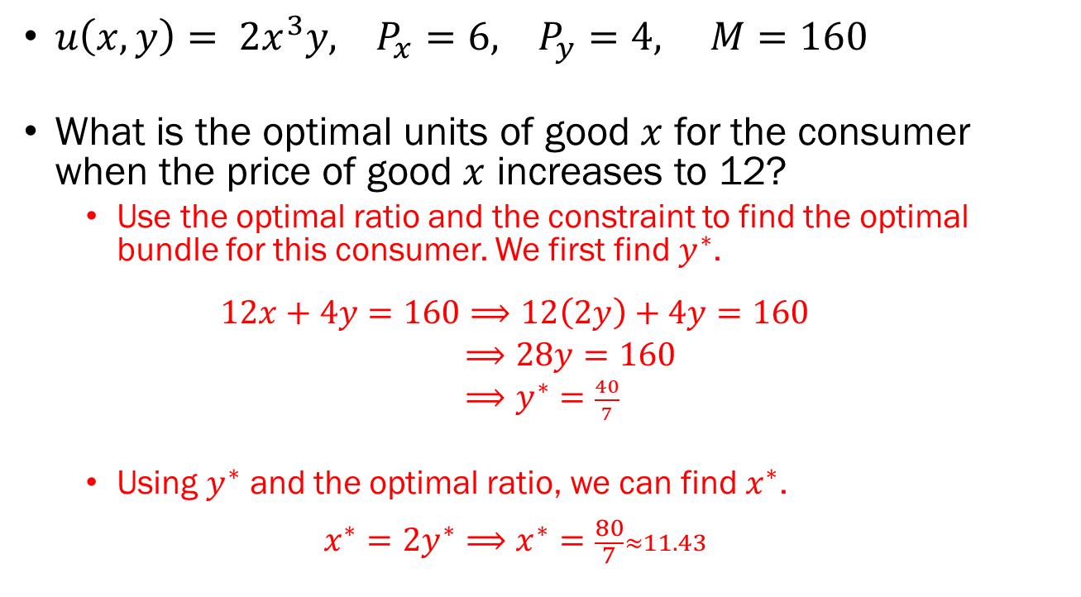
Problem 4.F.
$u\left(x, y\right)= 2x^{3}y, P_{x}=6, P_{y}=4, M=160$
What is the optimal units of good $x$ for the consumer when the price of good $x$ increases to 12?
  Use the optimal ratio and the constraint to find the optimal bundle for this consumer. We first find $y^{∗}$.
  $$12x+4y=160⟹12\left(2y\right)+4y=160$$
  $⟹28y=160$
  $⟹y^{∗}=\frac{40}{7}$
  Using $y^{∗}$ and the optimal ratio, we can find $x^{∗}$.
  $$x^{∗}=2y^{∗}⟹x^{∗}=\frac{80}{7}≈11.43$$

Slide 19
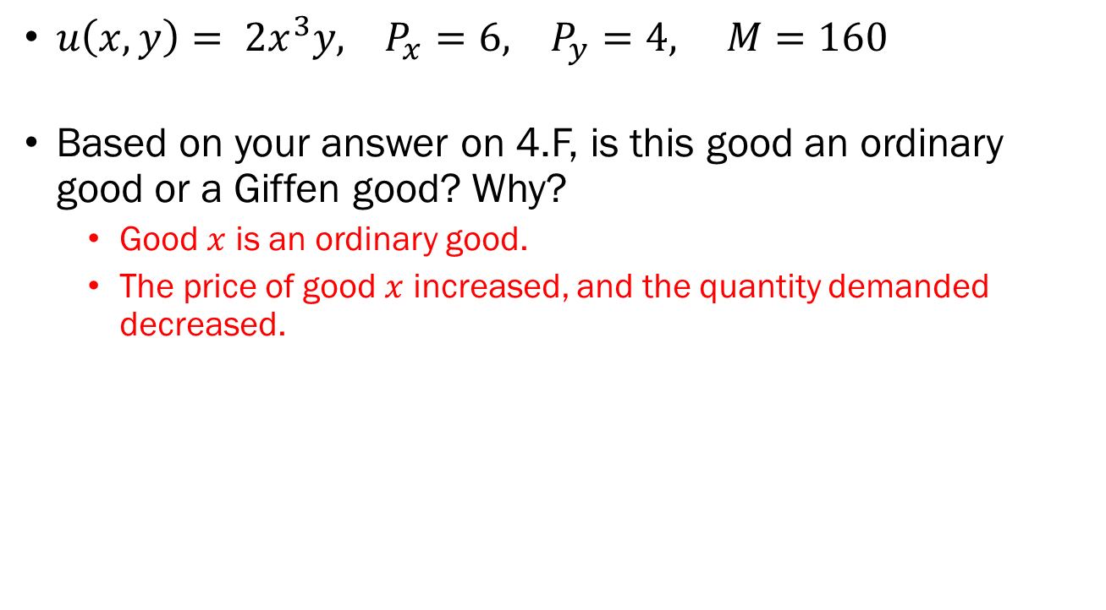
Problem 4.G.
$u\left(x, y\right)= 2x^{3}y, P_{x}=6, P_{y}=4, M=160$
Based on your answer on 4.F, is this good an ordinary good or a Giffen good? Why?
  Good $x$ is an ordinary good.
  The price of good $x$ increased, and the quantity demanded decreased.

Slide 20
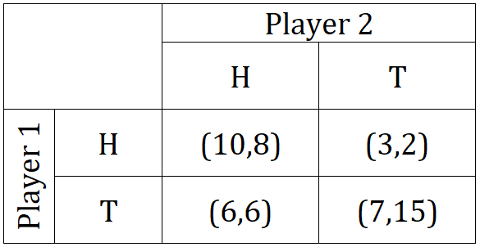
Problem 5.A.
Represent this game in its normal form…

Slide 21
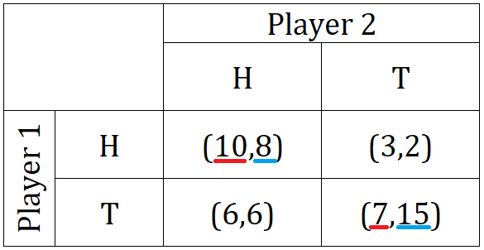
Problem 5.A.
…and find all Nash equilibria.

