Slide 1
Quiz #3 Review
ECON 301

Slide 2
Quiz #3 “Recovery” Office Hours
https://calendly.com/brianhwpark
Venue: Rm. 248 Center for Science and Business
Dates: Mar. 18th ~ Mar. 27th, 2024 (10 Days)
Length: 30 Minutes per Session
Use the Whiteboard / Paper to correct your answers.
Recovery Rate: 50%

Slide 3
Problem 1. Definitions
Natural Rate of Unemployment
  The medium-run equilibrium level of the unemployment rate, determined at the point where realized inflation matches expected inflation.
Potential Output
  The output level of the economy in the medium run equilibrium, which is determined by the natural rate of unemployment.
Reservation Wage
  The wage in which workers are indifferent between the options of employment and unemployment. (i.e., If a worker is offered even 1 cent below their reservation wage, they choose unemployment)

Slide 4
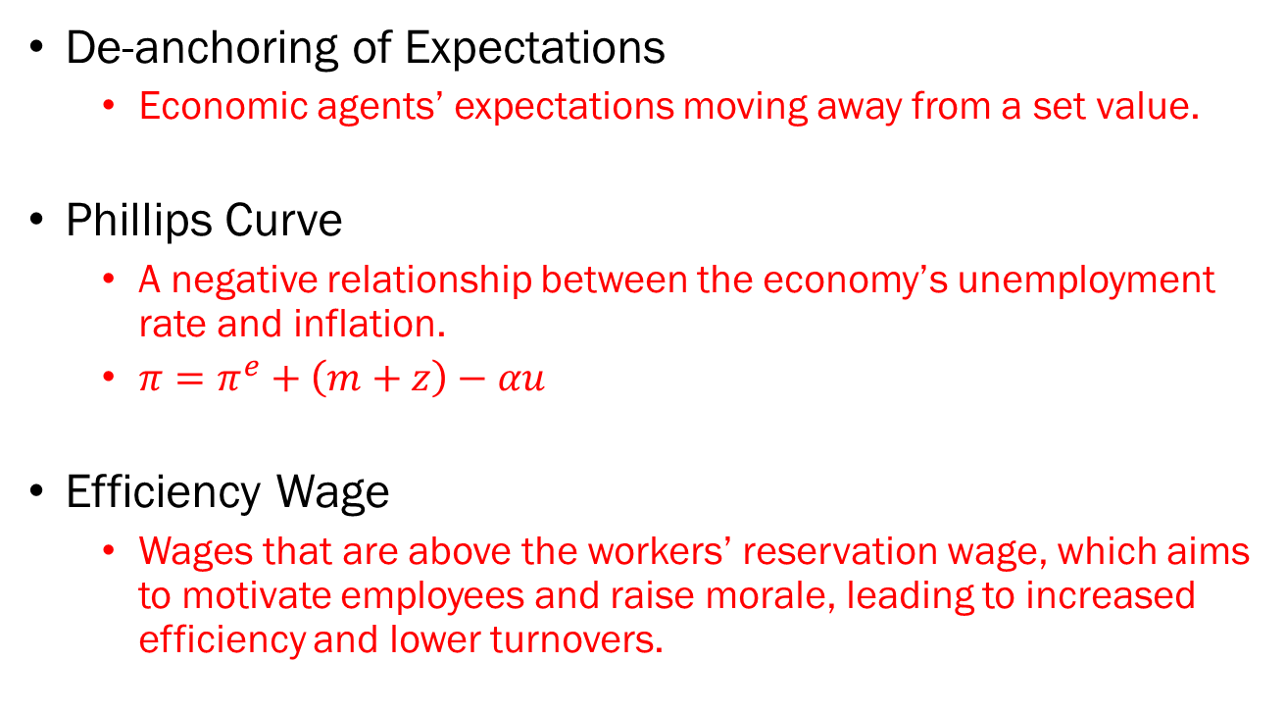
Problem 1. Definitions
De-anchoring of Expectations
  Economic agents’ expectations moving away from a set value.
Phillips Curve
  A negative relationship between the economy’s unemployment rate and inflation.
  $π=π^{e}+\left(m+z\right)−αu$
Efficiency Wage
  Wages that are above the workers’ reservation wage, which aims to motivate employees and raise morale, leading to increased efficiency and lower turnovers.

Slide 5
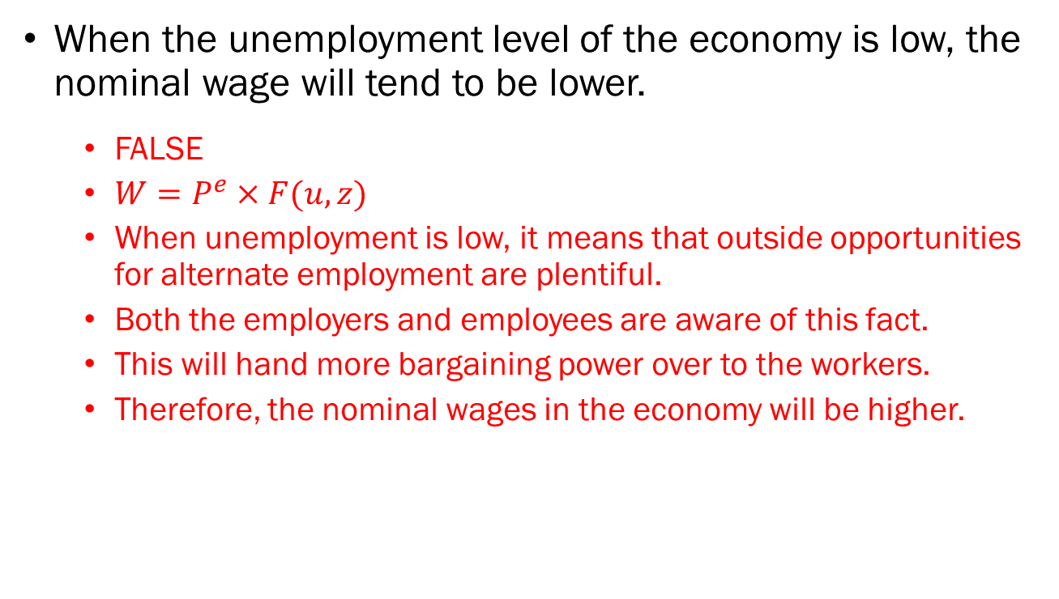
Problem 2.A.
When the unemployment level of the economy is low, the nominal wage will tend to be lower.
  FALSE
  $W=P^{e}×F(u,z)$
  When unemployment is low, it means that outside opportunities for alternate employment are plentiful.
  Both the employers and employees are aware of this fact.
  This will hand more bargaining power over to the workers.
  Therefore, the nominal wages in the economy will be higher.

Slide 6
Problem 2.B.
If the level of competition in the goods market decreases, the markup that firms can charge above the marginal cost of production will increase.
  TRUE

Slide 7
Problem 2.C.
Stagflation refers to a situation in which the economy is facing both stagnation and deflation.
  FALSE
  Stagflation describes an economy facing low growth (stagnation) and high inflation.

Slide 8
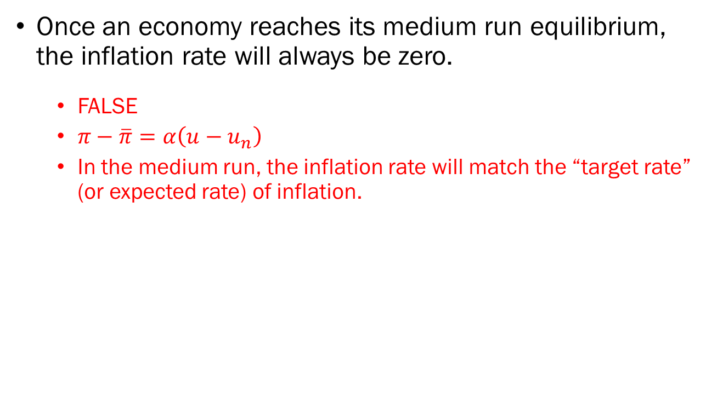
Problem 2.D.
Once an economy reaches its medium run equilibrium, the inflation rate will always be zero.
  FALSE
  $π−\overline{π}=α\left(u−u_{n}\right)$
  In the medium run, the inflation rate will match the “target rate” (or expected rate) of inflation.

Slide 9
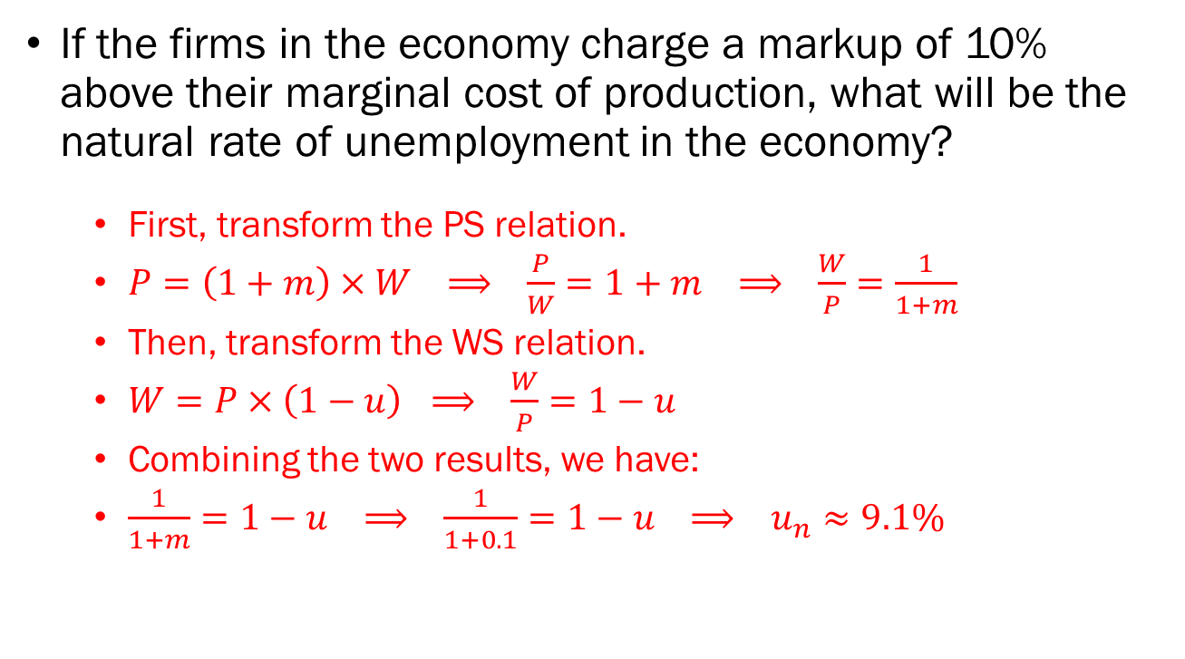
Problem 3.A.
If the firms in the economy charge a markup of 10% above their marginal cost of production, what will be the natural rate of unemployment in the economy?
  First, transform the PS relation.
  $P=\left(1+m\right)×W ⟹ \frac{P}{W}=1+m ⟹ \frac{W}{P}=\frac{1}{1+m}$
  Then, transform the WS relation.
  $W=P×\left(1−u\right)$ $⟹ \frac{W}{P}=1−u$
  Combining the two results, we have:
  $\frac{1}{1+m}=1−u ⟹ \frac{1}{1+0.1}=1−u ⟹ u_{n}≈9.1\%$

Slide 10
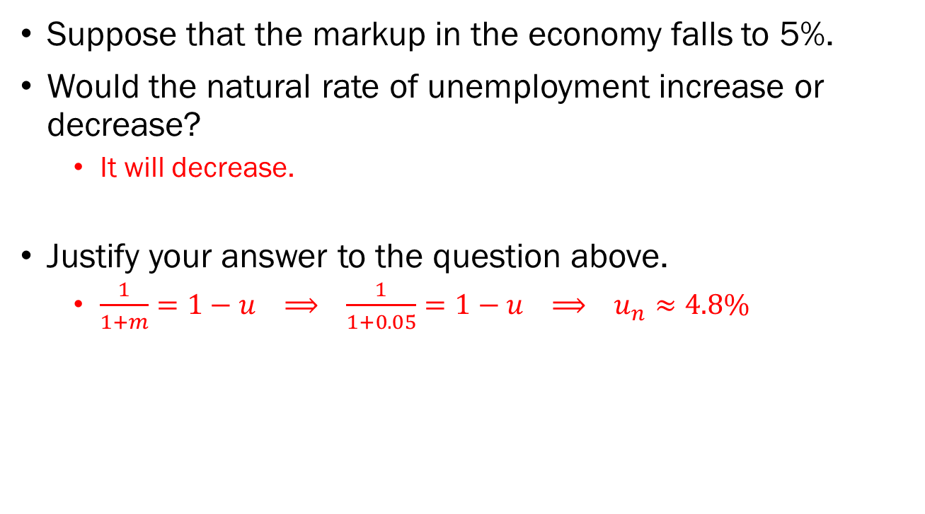
Problem 3.B.
Suppose that the markup in the economy falls to 5%.
Would the natural rate of unemployment increase or decrease?
  It will decrease.
Justify your answer to the question above.
  $\frac{1}{1+m}=1−u ⟹ \frac{1}{1+0.05}=1−u ⟹ u_{n}≈4.8\%$

Slide 11





Problem 4.A.
Plot the PC in the empty chart below and calculate the inflation rate if the current level of output is 50, potential output is 45, and the target rate of inflation is 0%.
$$PC$$
  $π−\overline{π}=\frac{1}{100}\left(Y−Y_{n}\right)$
  $π−0=\frac{1}{100}\left(50−45\right)$
  $π=0.05$
$$π−\overline{π}$$
$$Y_{n}=45$$
Output
$$0$$

Slide 12



Problem 4.B.
Suppose that the natural rate of unemployment increases in this economy. Plot both the original PC and the updated PC’ in the empty chart below.
$$PC^{′}$$
$$PC$$
  The natural rate of unemployment increases.
  The potential output of the economy decreases.
  The Phillips curve shifts to the left.
$$π−\overline{π}$$
$$Y_{n}^{′}$$
Output
$$0$$
$$Y_{n}$$

Slide 13
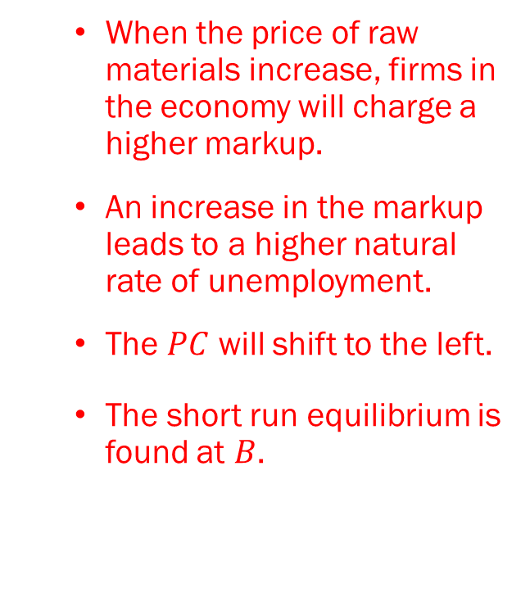


















Problem 5.A.
$$r$$
  When the price of raw materials increase, firms in the economy will charge a higher markup.
  An increase in the markup leads to a higher natural rate of unemployment.
  The $PC$ will shift to the left.
  The short run equilibrium is found at $B$.
$$=B$$
$$A$$
$$r_{n}$$
$$LM$$
$$0$$
$$Y$$
$$Y_{n}$$
$$IS$$
$$PC^{′}$$
$$π−\overline{π}$$
$$PC$$
$$π−\overline{π}$$
$$B$$
$$Y_{n}^{′}$$
$$A$$
$$0$$
$$Y$$
$$Y_{n}$$

Slide 14
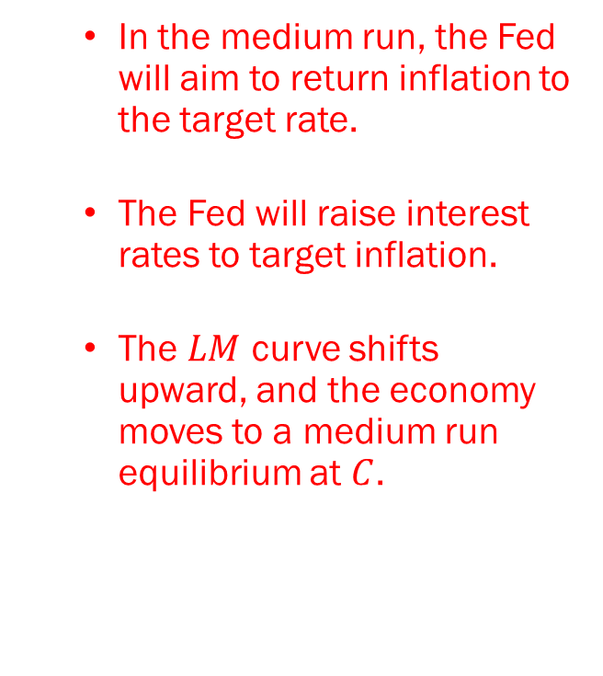





Problem 5.B.
$$r$$
$$C$$
$$LM^{′}$$
  In the medium run, the Fed will aim to return inflation to the target rate.
  The Fed will raise interest rates to target inflation.
  The $LM$ curve shifts upward, and the economy moves to a medium run equilibrium at $C$.
$$=B$$
$$A$$
$$r_{n}$$
$$LM$$
$$0$$
$$Y$$
$$Y_{n}^{′}$$
$$Y_{n}$$
$$IS^{′}$$
$$IS$$
$$PC^{′}$$
$$π−\overline{π}$$
$$PC$$
$$π−\overline{π}$$
$$B$$
$$Y_{n}^{′}$$
$$A$$
$$0$$
$$Y$$
$$C$$
$$Y_{n}$$

