Slide 1
Team MorphCore
Status Update – 11/2/2015

Slide 2
Outline
Core status
Peripheral status
Schedule

Slide 3
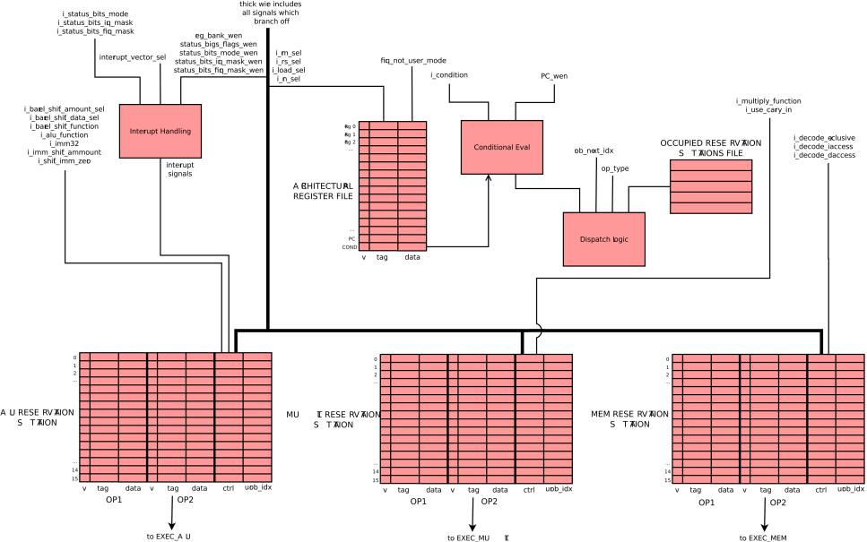
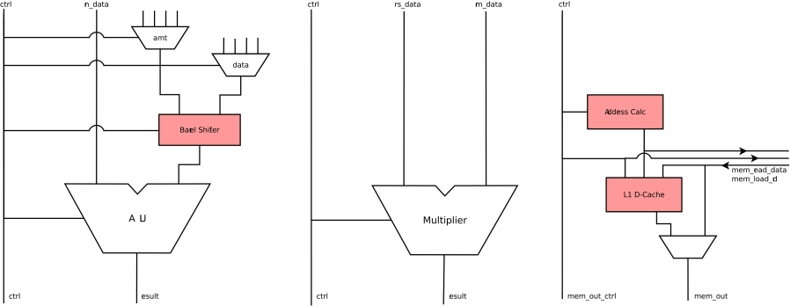
Core
Out-of-order core ~85% complete
Reorder stage structure/logic done, working on interrupts and interfaces with other stages
Execution stages mostly done
Reorder → Writeback for initial testing
Memory functionality pending in-order core debugging
Expect completion and superscalar start this week

Slide 4
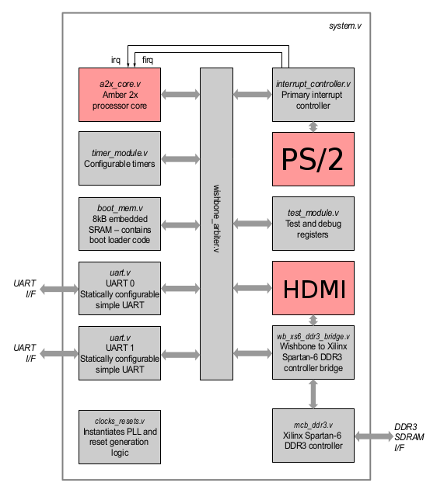
Peripherals
PS/2 works
Successfully receiving scan codes, easy conversion to ASCII
UART in progress
Basic display controller design done, implementation paused

Slide 5
Schedule
Core modifications progressing as expected
Peripherals (esp. UART) slightly behind, but manageable
This week
Finish/verify OOO
Start superscalar
Integrate PS/2
Fix lingering memory problems, UART
Next
Superscalar → full MorphCore
Verification
Demo programs

