Slide 1
Calculating Pi (poorly)
Using a Monte Carlo Simulation to calculate Pi inefficiently for a demo.

Slide 2
Imagine a patio that is 2 meters by 2 meters
2
2

Slide 3
We inscribe a circle on the patio…
2
1
2

Slide 4
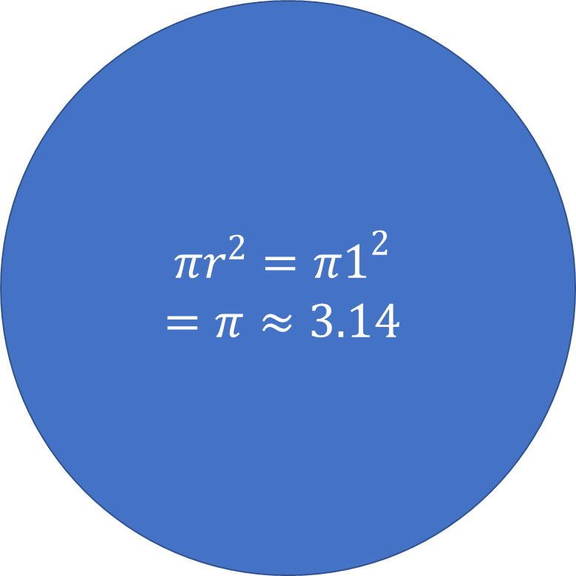
… and calculate the area of both
L X W = 2 X 2 = 4.00
$$πr^{2}=π1^{2}$$
$$=π≈3.14$$

Slide 5
When it rains, we count the raindrops

Slide 6
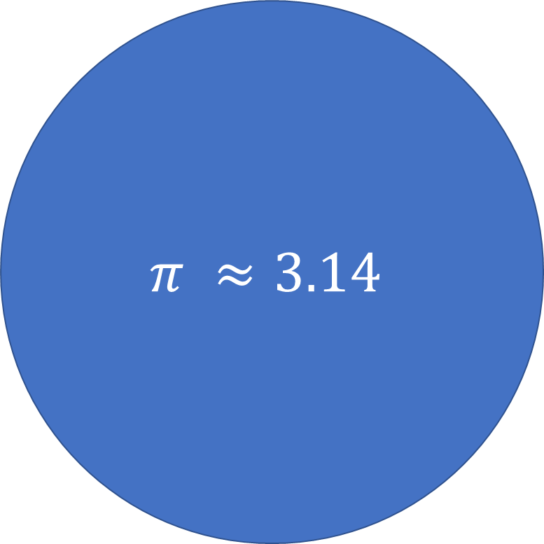

If the raindrops are randomly distributed…
4.00
$$\frac{π}{4}=\frac{Raindrops in Circle}{Total Raindrops}$$
$$π ≈3.14$$

Slide 7
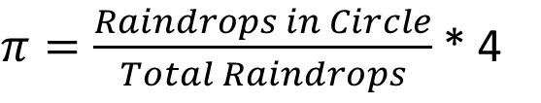

… we can use raindrops to solve for pi
4.00
$$\frac{π}{4}=\frac{Raindrops in Circle}{Total Raindrops}$$
$$π ≈3.14$$
$π=\frac{Raindrops in Circle}{Total Raindrops}$ * 4

Slide 8
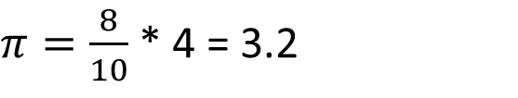
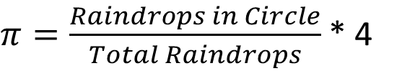
After the first 10 raindrops, we estimate pi
$π=\frac{Raindrops in Circle}{Total Raindrops}$ * 4
$π=\frac{8}{10}$ * 4 = 3.2

Slide 9
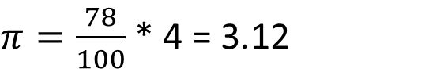
As more rain falls, our estimate improves
$π=\frac{Raindrops in Circle}{Total Raindrops}$ * 4
$π=\frac{78}{100}$ * 4 = 3.12

Slide 10
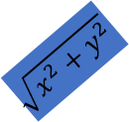
We can simulate this with Python
from random import uniform
from math import sqrt, pow
#iterations is the number of raindrops to simulate
def estimate_pi(iterations):
samples_in_circle = 0
for i in range(1, iterations):
#generate a random point in the patio
x = uniform(-1, 1)
y = uniform(-1, 1)
#use Pythagorean theorem to find distance from origin
distance_from_origin = sqrt(pow(x,2) + pow(y,2))
#count points that fall within the circle
if(distance_from_origin <= 1): samples_in_circle += 1
#estimate pi from the ratio
print (4.0 * samples_in_circle / iterations)
y
$$\sqrt{x^{2}+y^{2}}$$
x

Slide 11
Our estimate improves with interations
Iterations | Estimate | Error
10 | 3.2 | 0.0584
100 | 3.12 | 0.0216
1,000 | 3.124 | 0.0176
10,000 | 3.134 | 0.0076
100,000 | 3.14028 | 0.0013
1,000,000 | 3.14178 | 0.0002
10,000,000 | NA | NA
1MM iterations took 2.5 seconds to simulate
10MM iterations failed with a MemoryError
(yes I could have used numpi to go much bigger)

Slide 12
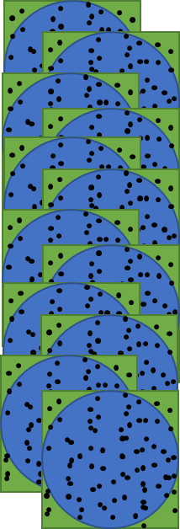
Monte Carlo is easily parallelized
We run many simulations of 1MM iterations and summarize the results.
NOTE: If all the simulations have the same iteration count, we can simply find the mean of the individual simulations.

Slide 13
DEMO

Slide 14
A Note on the Method of Calculating Pi
While slightly better than actually counting raindrops, this Monte Carlo simulation is a terrible way to estimate Pi. It is intended to demo a sufficiently long running job in an HPC cluster. There are much better and more efficient ways of calculating Pi. There are many alternatives discussed at https://en.wikipedia.org/wiki/Pi.

