Slide 1
Coding Challenge Brian Burrows 11/26/2019

Slide 2
Agenda
Overview
Code Documentation
Results Summary

Slide 3
Overview
Catalog Convergence Study
View the effects of the number of catalog years on convergence at various spatial locations and spatial resolutions.
County Level
State Level
10K catalog
100K catalog
Metrics used for comparison
Average Annual Loss (AAL)
Standard Error of AAL (STD_ERR)
Coefficient of Variation (COV)
Detailed Instructions in ReadMe.txt

Slide 4
Code Documentation
Catalog Convergence Study
Catalog_constructor.py
CatalogProcessor
Used to process the 10K and 100K loss files.
Trims the dataset to only useful columns.
Computes loss tables on a county level.
process_by_state(), process_by_county()
Computes loss statistics on a county and state level.
Includes Average Annual Loss (AAL)
Standard Deviation of Loss (STD)
Standard Error of AAL (STD_ERR)
Coefficient of Variation (COV)
visualize_results.py
Produces the plots in the slides that follow.
Requires running Catalog_constructor.py to completion prior to visualization.

Slide 5
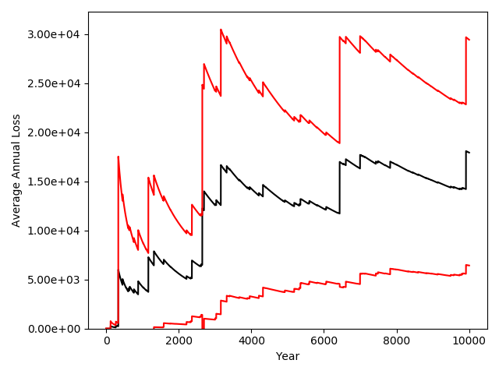
Results Summary: 10K Catalog
Cresta Code: 08061
Average Annual Loss
2nd Standard Error from the Mean
Notes:
- Analysis
- We are interested in the Average Annual Loss (AAL) per calendar year on various spatial resolutions.
- Here we are looking at the AAL for Cresta Code: 08061.
- The figure shows many large jumps, right up until the last years of the catalog.
- The downward sloping portions between large jumps are due to the year number increasing without an event.
- The large discontinuities in this plot indicate that the sample average changes quite dramatically whenever an event occurs, and
the fact that the time plot has not “settled” or shows no tendancy towards converging to a particular value indicates that this
simulation has not converged.
- In addition, we would expect that the error bars would begin to narrow as the plot approaches 10K years, which does not occur.

Slide 6
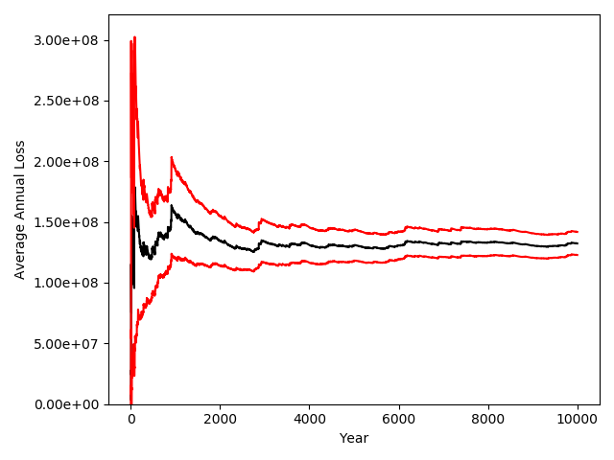
Results Summary: 10K Catalog
Cresta Code: 08*
Average Annual Loss
2nd Standard Error from the Mean
Notes:
Analysis
Looking at the same state (08) as the previous example, but considering losses aggregated across all counties, we see a more stable trend across the catalog.
Specifically, the plot tends toward a specific value, indicating that the mean value computation is beginning to converge, which is also supported by the narrowing of
error bars as we approach the final years in the catalog.
The county level analysis fails to converge due to the rarity of an event occurring within a particular county. Whereas the state level has a much higher occurance rate simply to the inclusion of
additional counties.
The distinction between the state level and county level analysis is an important consideration: the same set of simulations can produce converged results for both different spatial resolutions
and different physical locations, which we will see in the next slide.

Slide 7
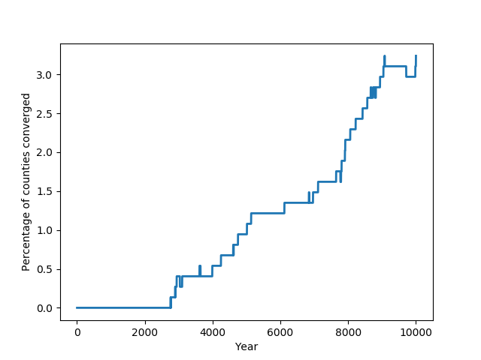
Results Summary: 10K Catalog
Convergence defined as a coefficient of variation (COV) < 0.05
Percentage of counties that Reached Convergence by a particular Year
Notes:
Analysis
Here we are looking at the percentage of counties whose simulations converged according to A.I.R.’s criterion on coefficient of variation (COV).
Each county has its own loss table from which a COV can be computed. Looking at this plot, we see that in the early years of the catalog, all of the
counties fail to reach convergence. As the number of years increase, some counties reach convergence while others do not. This depends on the particular
stochastic events simulated.
- This highlights the fact that spatial resolution is not the only factor to consider, but spatial location as well.

Slide 8
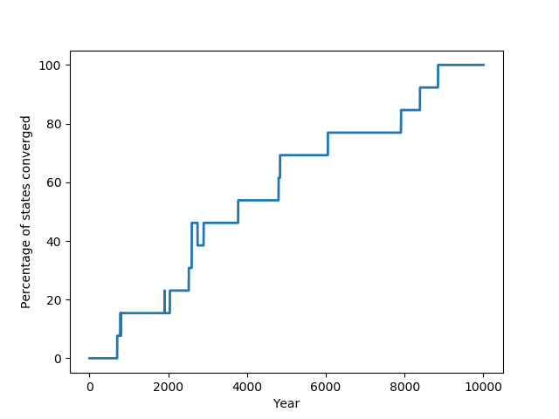
Results Summary: 10K Catalog
Convergence defined as a COV < 0.05
Percentage of states that Reached Convergence by a particular Year
Notes:
Analysis
Looking at the state level, we see a much faster convergence rate than on the county level. In fact, 100% of the state level loss tables converged after the 10K simulations.
The same reasons that we discussed for the AAL plots are valid here.
Notice, even though the convergence rate is faster, different states (locatations) converge at different rates depending on the particulars of the stochastic simulation.

Slide 9
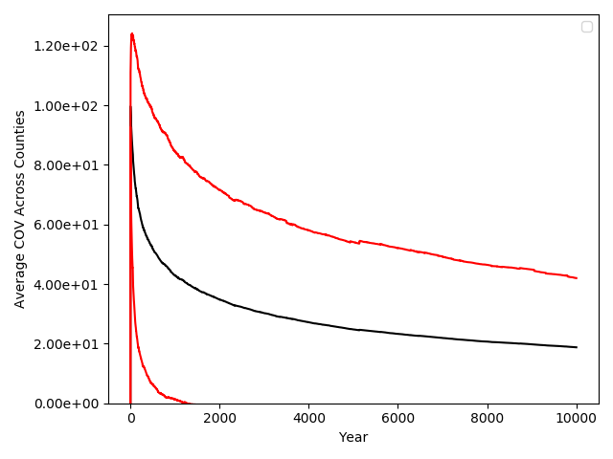
Results Summary: 10K Catalog
Only ~3% of counties analyzed reached convergence in the 10K catalog.
100% of states analyzed reached convergence in the 10K catalog.
Average Annual Loss
2nd Standard Deviation from the Mean
On average, the coefficient of variation is ~ 0.2 (20%) at 10K years,
Much higher than the convergence criterion that A.I.R. desires.
Notes:
Only ~3% of the counties studied reached convergence. However, that doesn’t give us any indication of whether they were close to converging or not.
Here we look at the average COV across all counties as a function of the catalog year. The coefficient of variation is high in the early years, and tends towards lower numbers
The central tendency is towards a COV of 0.2, which is much higher than our convergence criterion.
However, the error bars indicate that the COV can be much higher or lower depending on the particular county, which is consistent with what we have seen in previous slides.
Note: the error bars here are symmetric around the mean, and may be physically (or financially) unrealistic (i.e., negative COV values)

Slide 10
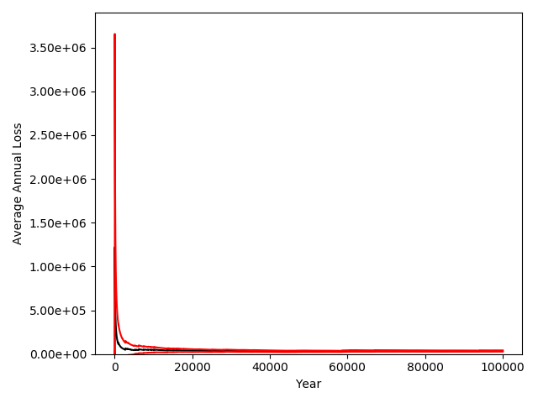
Results Summary: 100K Catalog
Cresta Code: 08061
Average Annual Loss
2nd Standard Error from the Mean
Notes:
Analysis
The same cresta code from the 10K year catalog, and we see that it appears to have reached convergence at a very low average annual loss

Slide 11
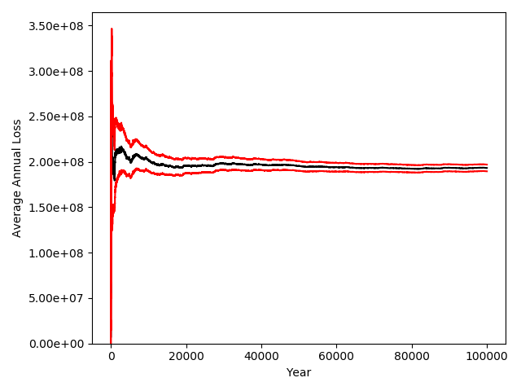
Results Summary: 100K Catalog
Cresta Code: 08*
Average Annual Loss
2nd Standard Error from the Mean
Notes:
- The same cresta state code from the previous analysis, appears to have converged, but to a much higher average annual loss than in the 10K catalog.
After making sure that I ran the same code on the two catalogs, this may be down to variability in the stochastic simulation itself., and the fact that I used 2 times
the standard error rather than 3 times the standard error (also there is some variability in the standard error estimate as well). However, it would appear that these
two calculations are a bit overconfident, or there is a bug in my code. This is an instance that I would ask for a second opinion before assuming my result is correct.

Slide 12
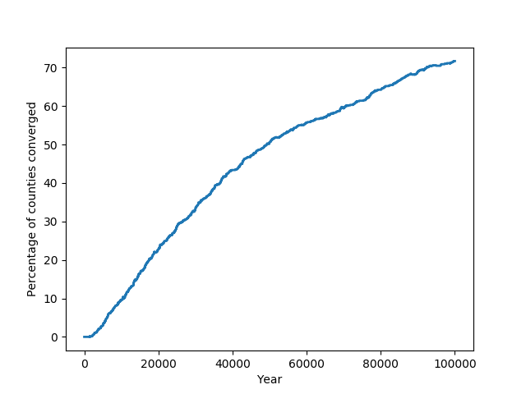
Results Summary: 100K Catalog
Convergence defined as a coefficient of variation (COV) < 0.05
Percentage of counties that Reached Convergence by a particular Year
Notes:
Looking at the frequency of counties which reach convergence, we see that we have achieved convergence in a significantly higher proportion of the counties than with the 10K catalog
However, not every county reached convergence according to A.I.R.’s catalog.

Slide 13
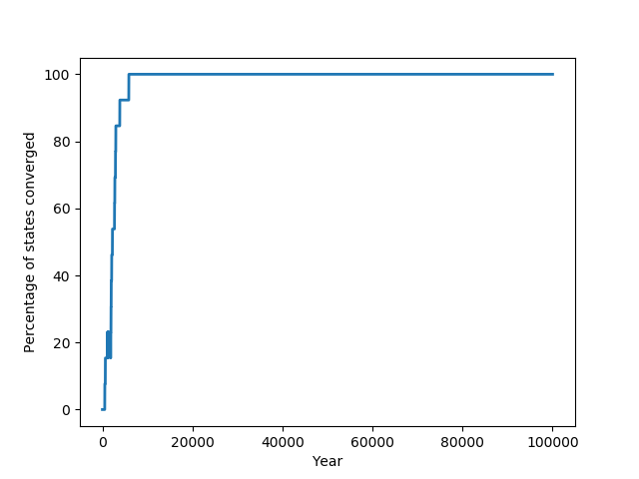
Results Summary: 100K Catalog
Convergence defined as a COV < 0.05
Percentage of states that Reached Convergence by a particular Year
Notes:
Meanwhile, the states continue to converge at a high rate, and the large catalog is not necessary for the state level due to aggregation of losses.

Slide 14
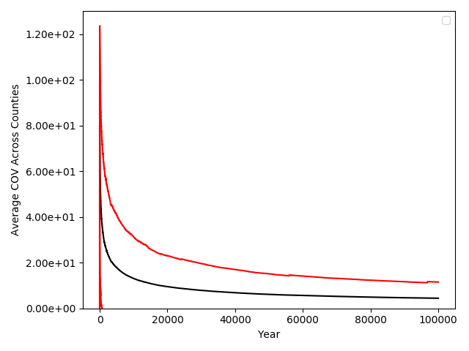
Results Summary: 100K Catalog
~70% of counties analyzed reached convergence in the 100K catalog.
100% of states analyzed reached convergence in the 100K catalog.
Average Annual Loss
2nd Standard Deviation from the Mean
On average, the coefficient of variation is ~ 0.1 (20%) at 100K years,
Better with the larger stochastic catalog
Notes:
Looking at the same plot from earlier with the 100K catalog instead of the 10K catalog, we see diminishing returns on the coefficient of variation with increasing the catalog years,
However the 2nd standard deviation’s COV is lower than the mean COV from the 10K catalog, which is a significant improvement.

