Slide 2

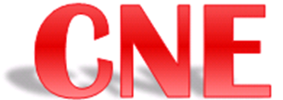


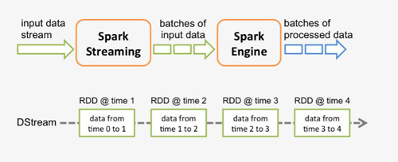

Real-Time Streaming Flow Diagram
(Basic) End–to–End Demo COMPLETED: May 3rd
‘Real-Time’ Kafka: Processes raw csv data from S3 on a time interval
Streaming
input
data
Real-Time ‘Chunks’ of Structured
data
Summary
data
Real Time
Processing
Messaging sys.,
pushing ‘Already
Processed’
Structured Data
Batch
Processing
‘Batch’: Processes data from S3 after entire job is completed
‘Real-Time’ Kafka: Processes structured data from S3 into DDB-Summary data on a time interval
DDB snapshot summary
One-click: PDF
Auto-generated
Time Stamped,

Slide 3
Overview
http://dastboxx01:8050/
pseudo-DEMO:
Real-Time Dashboard – allowing the Engr. Visibility to the qual data while the test is running
One (few) click standardized report generation

Slide 4
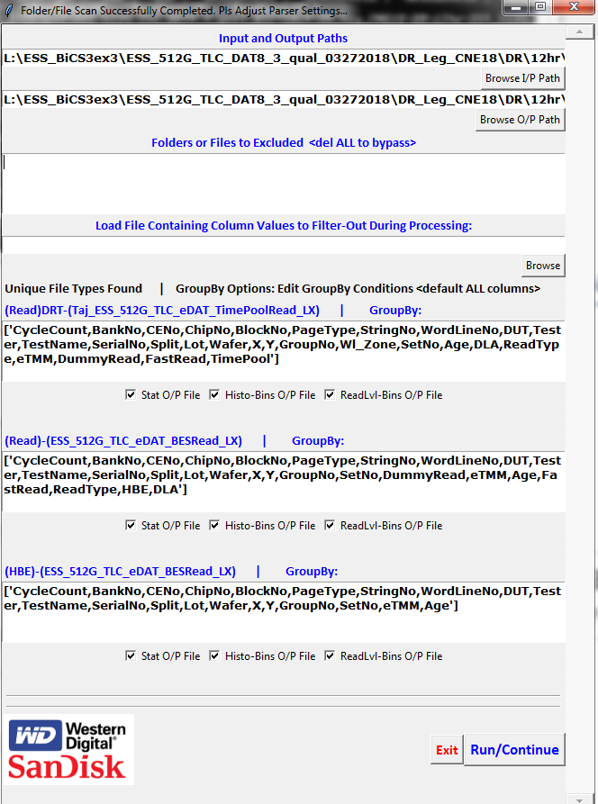
Overview
http://dastboxx01:8050/
pseudo-DEMO:
Real-Time Dashboard – allowing the Engr. Visibility to the qual data while the test is running
One (few) click standardized report generation GUI
In the meantime, can we tailor this GUI to output summary files for you?
This will depend on how close your
structured data format is to ours (% overlap?)
How are you parsing RAW to Struct
2) Provide Struct data to us – we will make
GUI to give you summaries
3) Tailor Report gen. GUI to fit your data

Slide 5
Overview
Goal: Define work load overlaps, what can be used by your group now while RT-Dash, and Std. Report Gen.
Here are the steps we need to review today:
Step 0.1) What types of data do we produce: does it align with your groups output?
Step 0.2) Define the gaps – development needs to add to our scripts – with the goal of having 1 single version of eDAT, Qual-CSS, Qual-ESS etc data parsing.
Step 1) Binary to RAW data conversion (Big Data?)
Step 2) RAW to Structured data conversion (how close is this step to our own method?)
Step 3) Structured to Summary file data conversion (we have a few different scripts, will show GUI version)
Step 4) Loading Summary files into one-(few)-click R GUI and outputting standardized PowerPoints and graphs
What is to come:
Real-Time Dashboard – allowing the Engr. Visibility to the qual data while the test is running
One (few) click standardized report generation

Slide 6
Summary Generation Flow Chart
Minimal Software Knowledge Required
Batch processing formatting
User Effort/ Knowledge for Platform Required
More or fewer columns
may be needed for aggregation setup depending on DOE
Internal Data Flow Chart
Auto filtering (Optional)
CNE Test Done
LF/Perf/VT Generation
Long Format/Perf/VT Data
Auto-Filtering + Default Aggregation Col/Sector Size Table Generation
Filtering Table/Aggregation Columns/Sector Size
Manual Update on Desired Filtering Table/Aggregation Columns/Sector Size
Preferred
(Close to Current Working Scheme in Local)
slow but flexible, requires user to have extensive knowledge on Hadoop/Linux
User-Requested Insights/Data Acquisition
Self-Started Aggregation Process
important and inevitable step for engineers’ feedback
Final Report
User-Defined Plots and Summary
User-initiated Report Generation
Summary Tables (Die/Page/Perf/ VT Stat, FBC/RL Histogram)
Engineering Judgement (e.g., DOE) +Additional Info(DS,KGD,etc.)
Fast with some flexibility, does not require user to have any knowledge on Hadoop/Linux
Information from Real-Time Dashboard

Slide 7
Near Real-Time Dashboard (Qual Data Analysis) v1.5.0

