Slide 1
Reinforcement learning algorithm
Brian Karlberg
Machine Learning 643
Dr. Xubo Song
Spring 2021

Slide 2
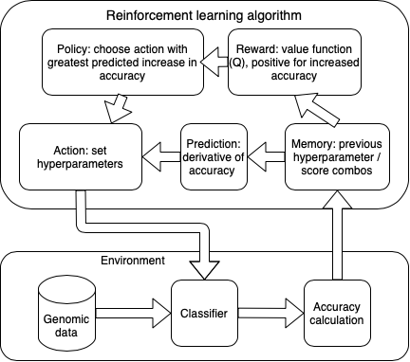
Schematic
Adaboost

Slide 3


Process
Generate Q-learning pseudocode
Use prediction accuracy to estimate value of next actions
Measure learning environment wall times and variance
Accurate characterization of state quality
Set reinforcement learning algorithm coefficients
Discount factor =0.2
Learning rate
Badia et al. 2020. “Agent57: Outperforming the Atari Human Benchmark.” In International Conference on Machine Learning, 507–17. PMLR.

Slide 4
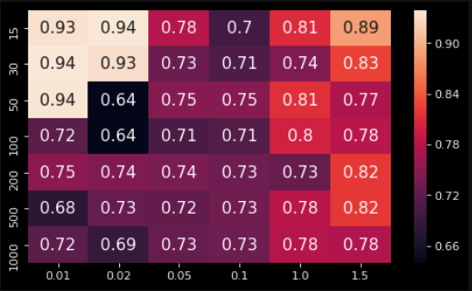
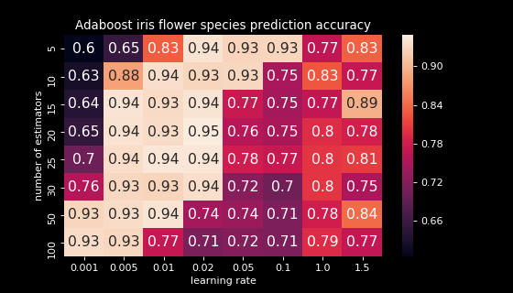
Environment
Adaboost classifier: accuracy
EDA – Need about 25 cross-folds

Slide 5
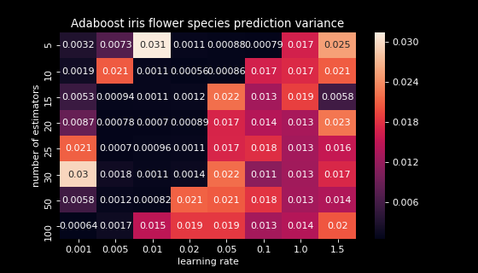
Environment
Adaboost classifier: variance

Slide 6
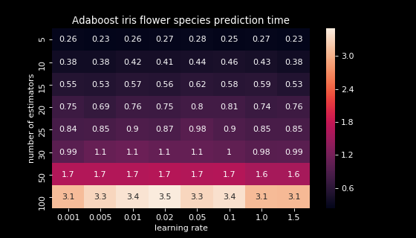
Environment
Adaboost classifier: time

Slide 7
Coding objectives
Use Q-table to avoid leaving hyperparameter search space
Balance exploration and exploitation
Don’t leave optimal area once located

Slide 8
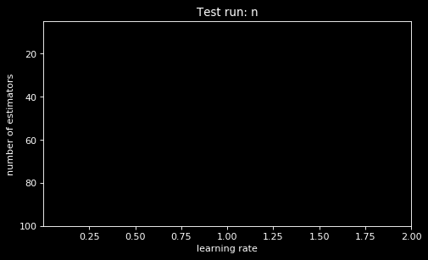




Algorithm summary

Slide 9
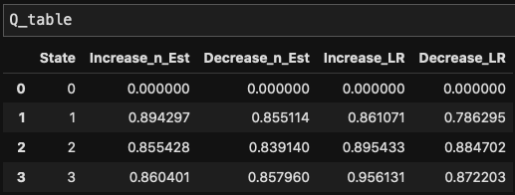
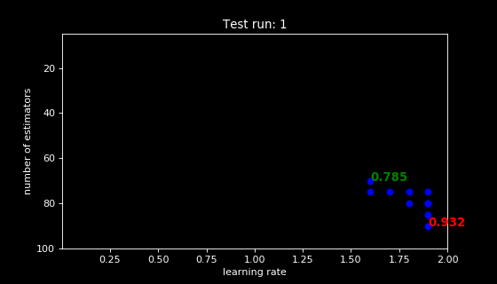
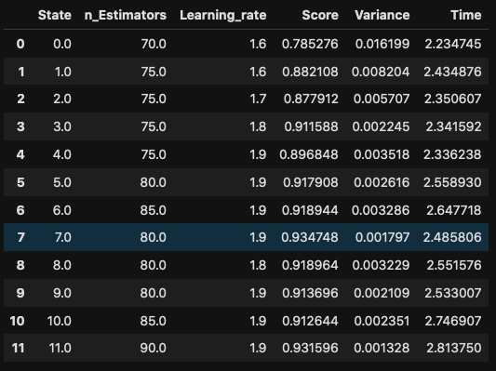
Results, test data

Slide 10
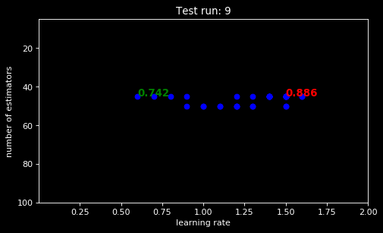
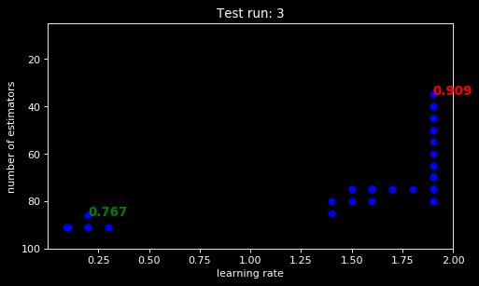
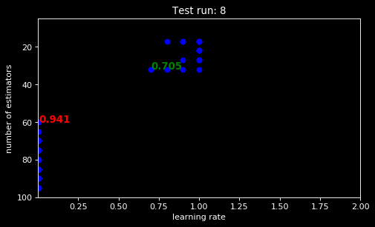
Results, test data

Slide 11
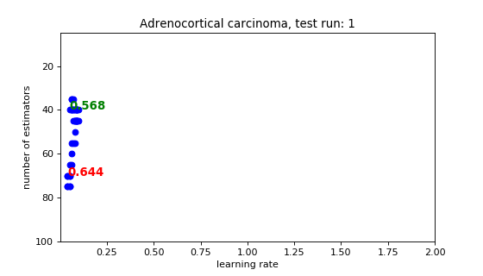
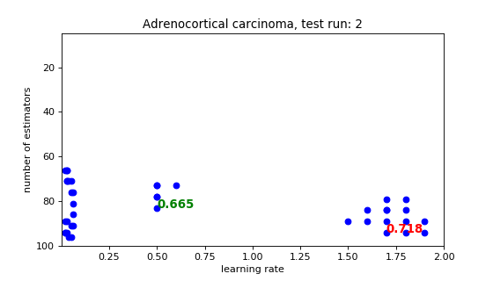
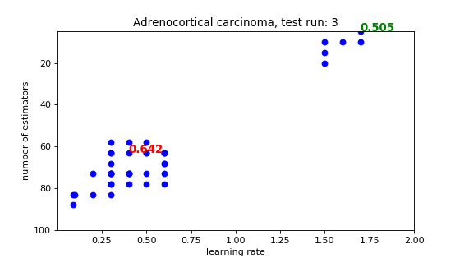
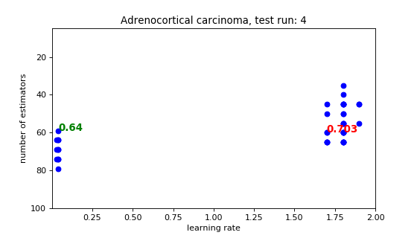
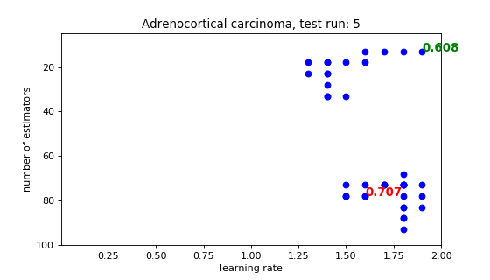
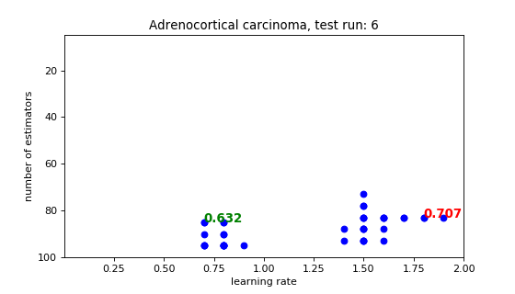
Results, genomic data

Slide 12
Summary
Environment setup to conceptually map to value (Q) function
Map actions back to environment
Balance of computational expense to precision of accuracy scores
Number of cross-folds
Design of RL algorithm controls for generalizability

