Slide 1
DAHYE · CLASS 21
The Seminar
Small talk — three you know, three new. Then a company books a seminar by phone. Then, on the day, the guests start calling.
Do English with Brian

Slide 2
SMALL TALK · 1 / 6
REVIEW I went to ~
What did you do yesterday?
AND THEN Who were you with?
went to ~
stayed home
went for a walk
with my mom
DAHYE SAYS
Just stayed home with my husband.
(Husband also stayed home?)
It was long weekend. My husband met his boss and played golf together on last Saturday.
(Who were you with?)
Mostly with my husband at home.

Slide 3
SMALL TALK · 2 / 6
REVIEW I had ~
What did you have for breakfast?
AND THEN Was it good?
had toast
had coffee
skipped breakfast
at home
DAHYE SAYS
Actually, I want to eat ramyeon from last night.
So, early this morning, I put half ramyeon into soybean paste soup from yesterday dinner.
(did you put the rameyon sauce into soybean paste soup?)
No. only noodles. It is my last dignity.
That’s why I put only half noodles. But, I had chocolate ice cream. Then I got high on my blood sugar.
(what time did you have your breakfast?)
8:30am maybe.
(Did you feel sleepy after that because of high blood sugar?)
Maybe / perhaps / probably

Slide 4
SMALL TALK · 3 / 6
REVIEW It was ~
How was your weekend?
AND THEN What was the best part?
was relaxing
was busy
was nothing special
the best part was ~
DAHYE SAYS
It was nothing special.
It was relaxing.
I did nothing special.
(what was the best part of your weekend?)
I played screen golf and it was fun. My weekend is always same. Nothing special.

Slide 5
SMALL TALK · 4 / 6
NEW I usually ~
What do you usually do on Monday mornings?
AND THEN Is today different?
usually wake up late
usually clean
usually go to ~
today is different
DAHYE SAYS
I usually do~
I usually wake up~
I usually drink~
I usually wake up at 7am. I usually feed my dog. And I usually go to café.
Last, I always wash his tumbler.

Slide 6
SMALL TALK · 5 / 6
NEW I'm thinking of ~ing
Any plans for the week?
AND THEN Have you decided?
thinking of going to ~
thinking of meeting ~
not decided yet
maybe Thursday
DAHYE SAYS
I’m thinking of ~~~~ing
Not decided yet.
But I’m thinking of studying English for myself.
What I’m thinking, you are good househusband.
What I’m thinking, my husband need to make more money.
What I’m thinking, you are a good person.
I’m thinking of planning to do for weekend.

Slide 7
SMALL TALK · 6 / 6
NEW It's been a while since ~
When did you last see a friend?
AND THEN How long has it been?
it's been a while
since last month
since summer
we should meet
DAHYE SAYS
It’s been a while since~
I saw my friend last Wednesday.
(How about a friend who hasn’t seen for a while?)
I usually meet 4 friends. One friend among 4, It’s been a while since 3 months.
(Other 3 friends, do you meet often?)
Yes. I usually meet those 3 friends once per month.

Slide 8
ON THE PHONE · BOOKING A SEMINAR · 1 / 5
Hi, I'm calling from a pharmaceutical company. We're planning a half-day seminar for about forty people. Is a weekday morning possible?
THEY ASK Which days are open?
weekday morning
forty people
which date?
let me check
DAHYE SAYS
Of course.
Do you have the date? / When is the date? / When is the event date? / Do you have any date in mind?
(How about 2nd week of November?)
Let me check the schedule. One moment please.
(Okay. Take your time)
I checked the available. From Monday to Thursday, you can choose.
(How about 9th of November Monday?)
It’s available. What time do you want to start?
(What time can we start? Is 9am okay?)
You can start from 8am. Our banquet manager will prepare from 7am.
(Okay. We can okay with 9am.)
For how long?
(How about 5 hours?)
Is it only event time? Or prepare time included?
(Event time only)

Slide 9
ON THE PHONE · BOOKING A SEMINAR · 2 / 5
We'll need a registration desk at the entrance and a place for a banner. Is that okay?
THEY ASK Can we set up the day before?
desk at the entrance
banner stand
day before
from ~ o'clock
DAHYE SAYS
That is okay.
We can prepare.
(You mean you can prepare the desk and a banner?)
We can request to us or you can bring your own.
(Can I request you for a desk? Then we will bring our own banner)
Desk is ready at the entrance. You can use that.
(Oh. Okay. So we will use that desk for a registration desk.)
(Can we set-up the day before?)
Is your event start at 9am? Right?
(That’s correct.)
One hour before the event, you can do the set-up. Our staffs will help you on the day. (How about one day before?)
It’s available. But there is an extra charge. (Then no worries. We will just set-up one hour before.) Good great. You can use the event at 7am on the day. If you need to bring the equipment early, you can bring them one day before from 7pm. Please let me know.

Slide 10
ON THE PHONE · BOOKING A SEMINAR · 3 / 5
Is there Wi-Fi for the guests? And enough power outlets for laptops?
THEY ASK Is the Wi-Fi free?
free Wi-Fi
password
outlets along the wall
extension cords
DAHYE SAYS
You can use wi-fi and enough power outlets.
Please let me know early.
(So everyone will bring their own laptops.)
Let me check early. / Let me check in advance.
(For wi-fi, is there any password?)
There is a password for wi-fi. At the entrance, we will put the password on the pillar.
(So can you help confirm that you can prepare the extension cords?)
We can prepare 10 extension cords. If you need more extension cords, you can bring your own.

Slide 11
ON THE PHONE · BOOKING A SEMINAR · 4 / 5
We'd like two coffee breaks instead of lunch. Can you do that?
THEY ASK What's included in a coffee break?
two coffee breaks
coffee and tea
cookies / sandwiches
per person
DAHYE SAYS
Do you want coffee break at the beginning of event and 1 more in between?
(Yes. We want one coffee break at the beginning of event. And another one in the middle.)
Lunch is not mandatory. You can request two coffee breaks. It’s 22,000 per person for 40 people on each coffee break.
(Ah. Okay. Can I ask you what is included in a coffee break?)
I will e-mail you with a quote and coffee break menu. Coffee break includes coffee and 3 cookies.
(Okay. Thank you. Here is my email address.)
Can I get your name, phone number and e-mail address?
May I have your name, phone number and e-mail address?

Slide 12
ON THE PHONE · BOOKING A SEMINAR · 5 / 5
Can you issue a tax invoice to the company?
THEY ASK What information do you need from us?
tax invoice
business registration number
email it to ~
after payment
DAHYE SAYS
Of course. I can issue a tax invoice to the company.
Before or after the event. Whenever you want.
(What information do you need from us?)
I need a business registration paper. And bank copy. And e-mail address for a tax invoice.
(Simple. I will send it over to you. Please give me your e-mail address.)
I will text you my e-mail address.
(perfect. Thank you)

Slide 13
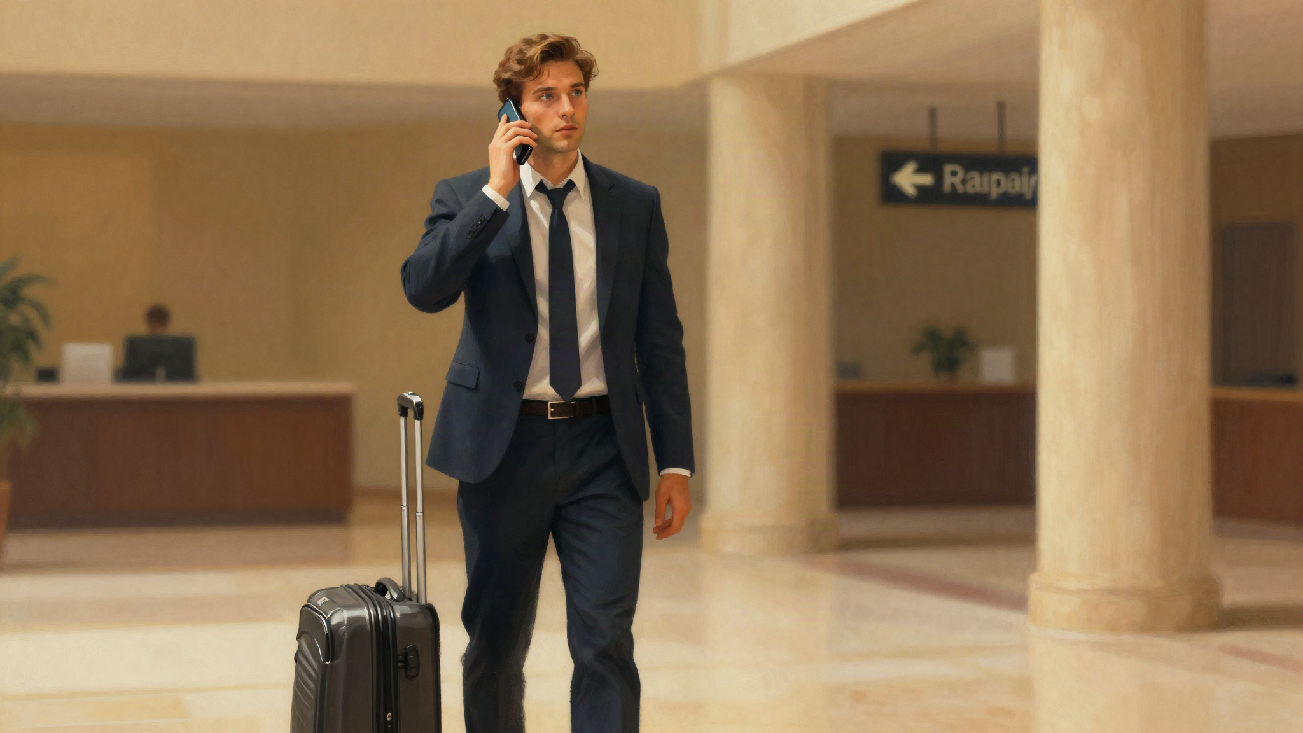
ON THE PHONE · SEMINAR DAY · A GUEST · 1 / 5
Hi, I'm here for the seminar — where exactly is the hall?
THE GUEST ASKS Which floor?
second floor
take the elevator
turn left
I'll come down
DAHYE SAYS

Slide 14
ON THE PHONE · SEMINAR DAY · A GUEST · 2 / 5
I'm coming from the station. What's the easiest way to get there?
THE GUEST ASKS How long does it take on foot?
exit 3
straight for five minutes
on your right
about ten minutes on foot
DAHYE SAYS

Slide 15
ON THE PHONE · SEMINAR DAY · A GUEST · 3 / 5
Is lunch provided, or should I eat before I come?
THE GUEST ASKS What time is the break?
no lunch today
two coffee breaks
sandwiches at 10:30
restaurants nearby
DAHYE SAYS

Slide 16
ON THE PHONE · SEMINAR DAY · A GUEST · 4 / 5
I have a suitcase with me. Can I leave it somewhere?
THE GUEST ASKS Is it safe? Can I pick it up at five?
of course
at the front desk
we'll keep it safe
until ~ o'clock
DAHYE SAYS

Slide 17
ON THE PHONE · SEMINAR DAY · A GUEST · 5 / 5
I'm running about twenty minutes late. Can I still get in?
THE GUEST ASKS Who do I ask for at the door?
no problem
back door
ask for Dahye
I'll wait for you
DAHYE SAYS

Slide 18
BY EMAIL · THE DAY BEFORE
From: Soyeon Kim, HK Pharma
Subject: Tomorrow's seminar – three small things
greet
thank
46: yes
parking: yes + where
invoice: received
Dear Dahye,
Thank you for all your help so far.
Three small things before tomorrow:
1. We now have 46 people, not 40. Is that okay for the coffee breaks?
2. One of our speakers is driving. Could you keep one parking space for her?
3. I've attached our business registration for the tax invoice.
See you tomorrow at 8:30.
Best,
Soyeon
see you at 8:30
DAHYE WRITES BACK · the same five lines

