Slide 1
JANE · CLASS 12
The Night Before
Tomorrow is day one. Tonight we run the onboarding meeting once, start to finish — no notes.
Do English with Brian

Slide 2
PART 1
The Seven You Memorized
자료 없이. Brian은 강세와 쉬는 곳만 들어요.
1
First hello
Nice to finally meet you — I'm Jane. / Thank you for making time for this today.
2
How's your first day?
great so far → everyone welcoming → excited to get started
3
About yourself (1 min)
FedEx 2 yrs → customs holds & delays → coordinated customers/customs/teams → pharma & labs → time-sensitive → clinical trials new → SOPs first
4
The case (30 sec)
research lab → held at customs, dry ice → airport team: expedited clearance + replenishment → stayed within temperature → quick action, clear communication
5
Your questions
priorities in first weeks? · report directly to you, or someone in Korea? · how often check-ins?
6
When you don't catch it
Sorry, could you say that again? · Could you speak a little more slowly? · Just to confirm, you'd like me to ~, right?
7
Closing
Thank you for the detailed overview. I'll review my notes and follow up if I have any questions.

Slide 3

1 Hello
2 About you
3 The team
4 Your role
5 Training
6 Systems
PART 2 · 1 of 6
Hello
첫 3~5분. 짧고 밝게.
1 How's your first day going so far?
2 Did you get your laptop set up?
3 How are you feeling about starting a new role?
4 Can you hear me okay?
5 Is the office a pleasant place so far?
FROM YOUR WORDS · 지난주 단어 pleasant

Slide 4

1 Hello
2 About you
3 The team
4 Your role
5 Training
6 Systems
PART 2 · 2 of 6
About You
핵심 메시지 하나: FedEx에서 통관·운송 지연을 중간에서 조율해 해결했다.
1 Could you tell me a bit about yourself and your background?
2 What did you handle day by day at FedEx?
3 Can you give me an example of a difficult case you handled?
4 What kinds of customs issues did you deal with most often?
5 What was the hardest problem you had to overcome there?
FROM YOUR WORDS · 지난주 단어 overcome

Slide 5

1 Hello
2 About you
3 The team
4 Your role
5 Training
6 Systems
PART 2 · 3 of 6
The Team
면접이 아니라 온보딩. 가볍게, 솔직하게.
1 What made you decide to move to ICON?
2 What do you think your strengths are?
3 What areas do you think you'll need to develop?
4 Your manager is in Taipei — how do you feel about working remotely with me?
5 How do you react when several urgent requests come in at once?
6 How quickly do you adapt to new systems and processes?
FROM YOUR WORDS · 지난주 단어 react · adapt

Slide 6
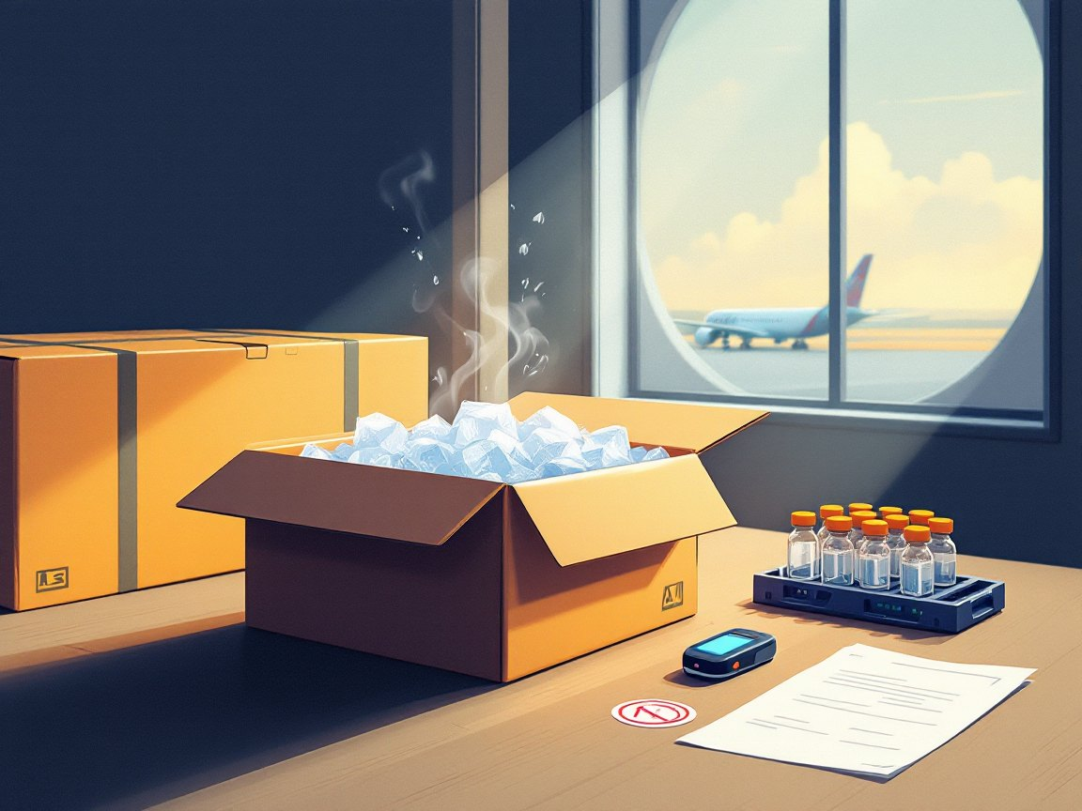
1 Hello
2 About you
3 The team
4 Your role
5 Training
6 Systems
PART 2 · 4 of 6
Your Role
아는 것 + 배우겠다. 모르면 모른다고.
1 Are you familiar with clinical trials, or how a CRO works?
2 Do you know what an investigational product is?
3 Why is temperature control so important in our shipments?
4 What would you do if a shipment had a temperature excursion?
5 Have you worked with specialty couriers like World Courier or Marken?
6 How confident are you with dry ice shipments?
FROM YOUR WORDS · 지난주 단어 confident

Slide 7

1 Hello
2 About you
3 The team
4 Your role
5 Training
6 Systems
PART 2 · 5 of 6
Training
“Is there anything you're curious about?” → Jane이 2~3개. Brian은 한두 문장으로만 답해요.
1 What are the main priorities for me in the first few weeks?
2 Do I report directly to you, or is there someone in Korea as well?
3 How often would you like to have check-ins?
4 Is there a deadline for completing the mandatory trainings?
5 What would success look like for me in the first 3 months?
FROM YOUR WORDS · 지난주 단어 curious

Slide 8

1 Hello
2 About you
3 The team
4 Your role
5 Training
6 Systems
PART 2 · 6 of 6
Systems & Closing
시스템 질문 하나, 그리고 마무리 인사까지 한 번에.
1 How and when should I request access to our trade compliance system?
2 Do you have any other questions for me?
3 Is there anything else you'd like to add before we wrap up?

Slide 9
PART 3
After the Meeting
Teams 메시지 한 줄과 팔로업 이메일. 말로 만들어요.
TEAMS · RIGHT AFTER
EMAIL · SAME DAY
Hi ~, thank you so much for the helpful onboarding session today!
I'll review the materials we discussed and let you know if I have any questions.
Jane이 바꿀 것: 오늘 실제로 들은 내용 한 가지를 넣기
Subject: Thank you – Onboarding meeting summary
Thank you for taking the time to meet with me today.
Here's a quick summary of what I noted:
· key responsibility · SOPs / trainings + deadline · next check-in
Please let me know if I missed anything.
Best regards, Jane
Jane이 바꿀 것: 세 줄 요약을 오늘 미팅 내용으로

Slide 10
PART 4
Tomorrow Morning
출근해서 매니저에게 보낼 첫 메시지. 2~3줄로 정해요. 이건 내일 진짜 보내는 거예요.
PICK TWO OR THREE
JANE'S MESSAGE
· Hi ~, I'm Jane. I started today on the GSO Global Logistics Import & Export team.
· I'll be taking over the Korea shipments, and I'm looking forward to working with you.
· What's the best way to reach you — chat, email, or a quick call?
· I'm one hour ahead of you, so what hours work best for you?
· Before our onboarding meeting, is there anything I should read?
· Just a quick update: I'm still waiting for IT to set up my laptop.

