Slide 1
JUNE · IAS 2026 · CLASS 14
Talking the Discussion
The Discussion is new this week. Tonight we don't edit it — we say it out loud until it sounds like you.
Do English with Brian

Slide 2
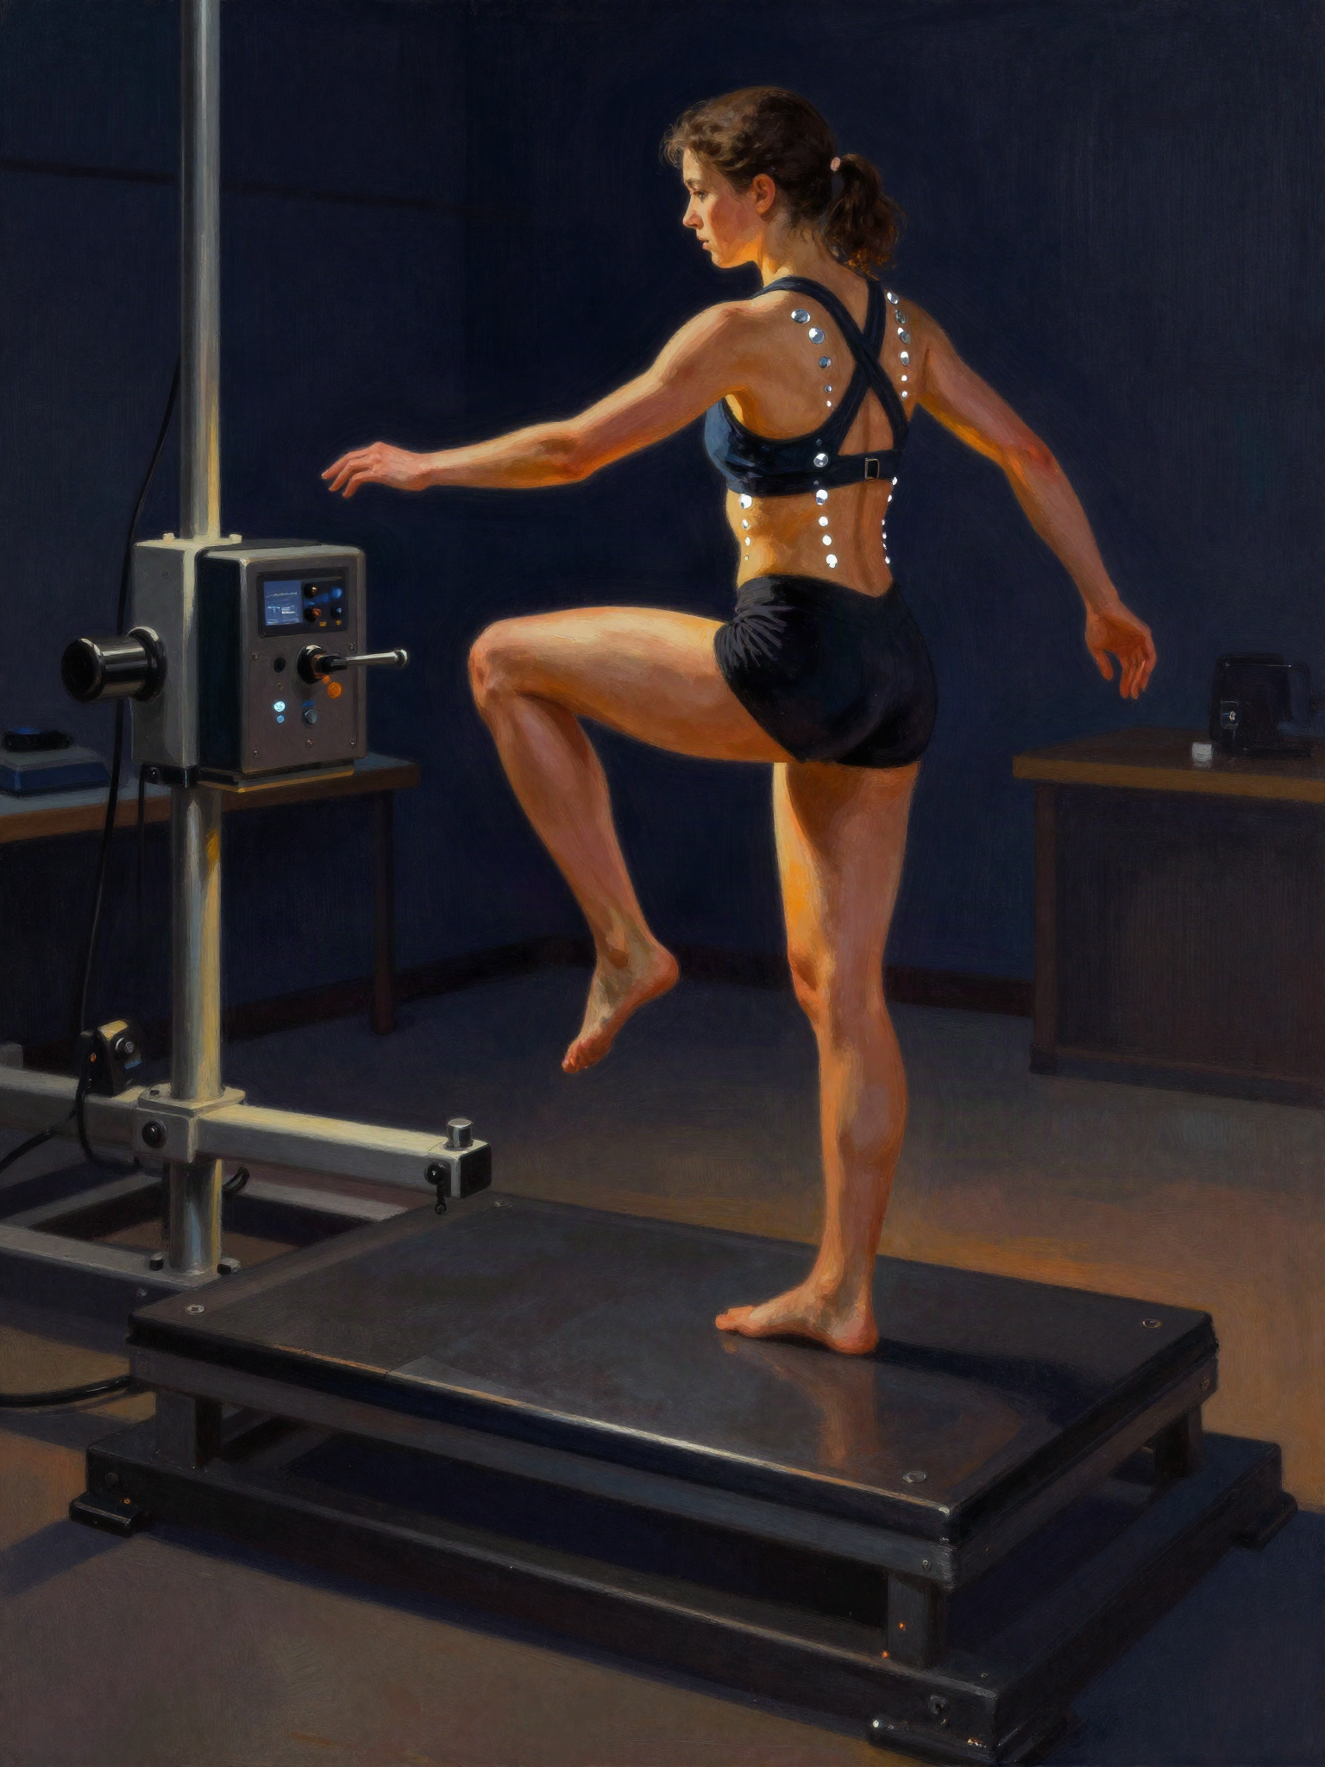
PART A · 20 MIN
The Skeleton
No numbers. Four sentences that carry the whole result.
BRIAN ASKS
· In one sentence — what happened to balance?
· And what did change?
· Which direction did the trunk move?
· Why does the direction matter?
· Say the whole thing again, no numbers, thirty seconds.
JUNE GETS COMFORTABLE WITH
Neither group improved balance more than the control.
What did change was trunk rotation — only in the foot core group.
Less rotation toward the standing leg.
Rotating toward the standing leg is how CAI patients compensate.
FROM THE PAPER
Balance no time-by-group interaction, static or dynamic
Trunk rotation FCG −2.6° at contact, −4.0° at peak
WE SAY
Direction (+) toward the standing leg = the compensation

Slide 3

PART B · 25 MIN
Defending the Nulls
Brian is a curious colleague, not an examiner. June explains why nothing else moved.
BRIAN ASKS
· Isn't four weeks just too short?
· So foot core training does nothing for balance?
· The stability score didn't move but the trunk did — what does that actually mean?
· Why test standing still if you expected it to be too easy?
· Would six weeks have changed the picture?
JUNE GETS COMFORTABLE WITH
That's fair — four weeks is short. What we can say is …
It's not that it didn't work; the static task may not be sensitive enough to show it.
The movement strategy changed before the stability score did.
Other studies with the same exercises found the same thing.
FROM THE PAPER
Static Drewes (4-wk SFE) and Lynn (4-wk SFE/towel curl) — no change either
Dynamic earlier studies used reach tests, not landing
WE SAY
Lower limb 4 weeks + exercises that don't look like landing
Although some papers suggested 8 weeks as minimum for the training however, my initial thought~ / To attempt as 4 weeks training which I thought it will at least show the positive data to see the differences /

Slide 4

PART C · 15 MIN
The Awkward One
The trunk core group rotated more after training. Nobody will let that go.
BRIAN ASKS
· Your trunk core group rotated more after training — did trunk training make it worse?
· If a reviewer asks that on stage, what do you say?
· Is it noise, or is it real?
· Could trunk training make people use the trunk more on purpose?
· How do you say "I don't know" and still sound like the expert?
JUNE GETS COMFORTABLE WITH
We don't have a clean explanation for that.
One possibility is … but with ten per group, I'd be careful reading too much into it.
The clear difference was between the two training groups.
That's something I'd want to test with a bigger sample.
FROM THE PAPER
TCG change +4.0° at contact, +4.6° at peak
CG change +1.4° / +2.0°
WE SAY
Paper offers no explanation for the TCG increase

Slide 5
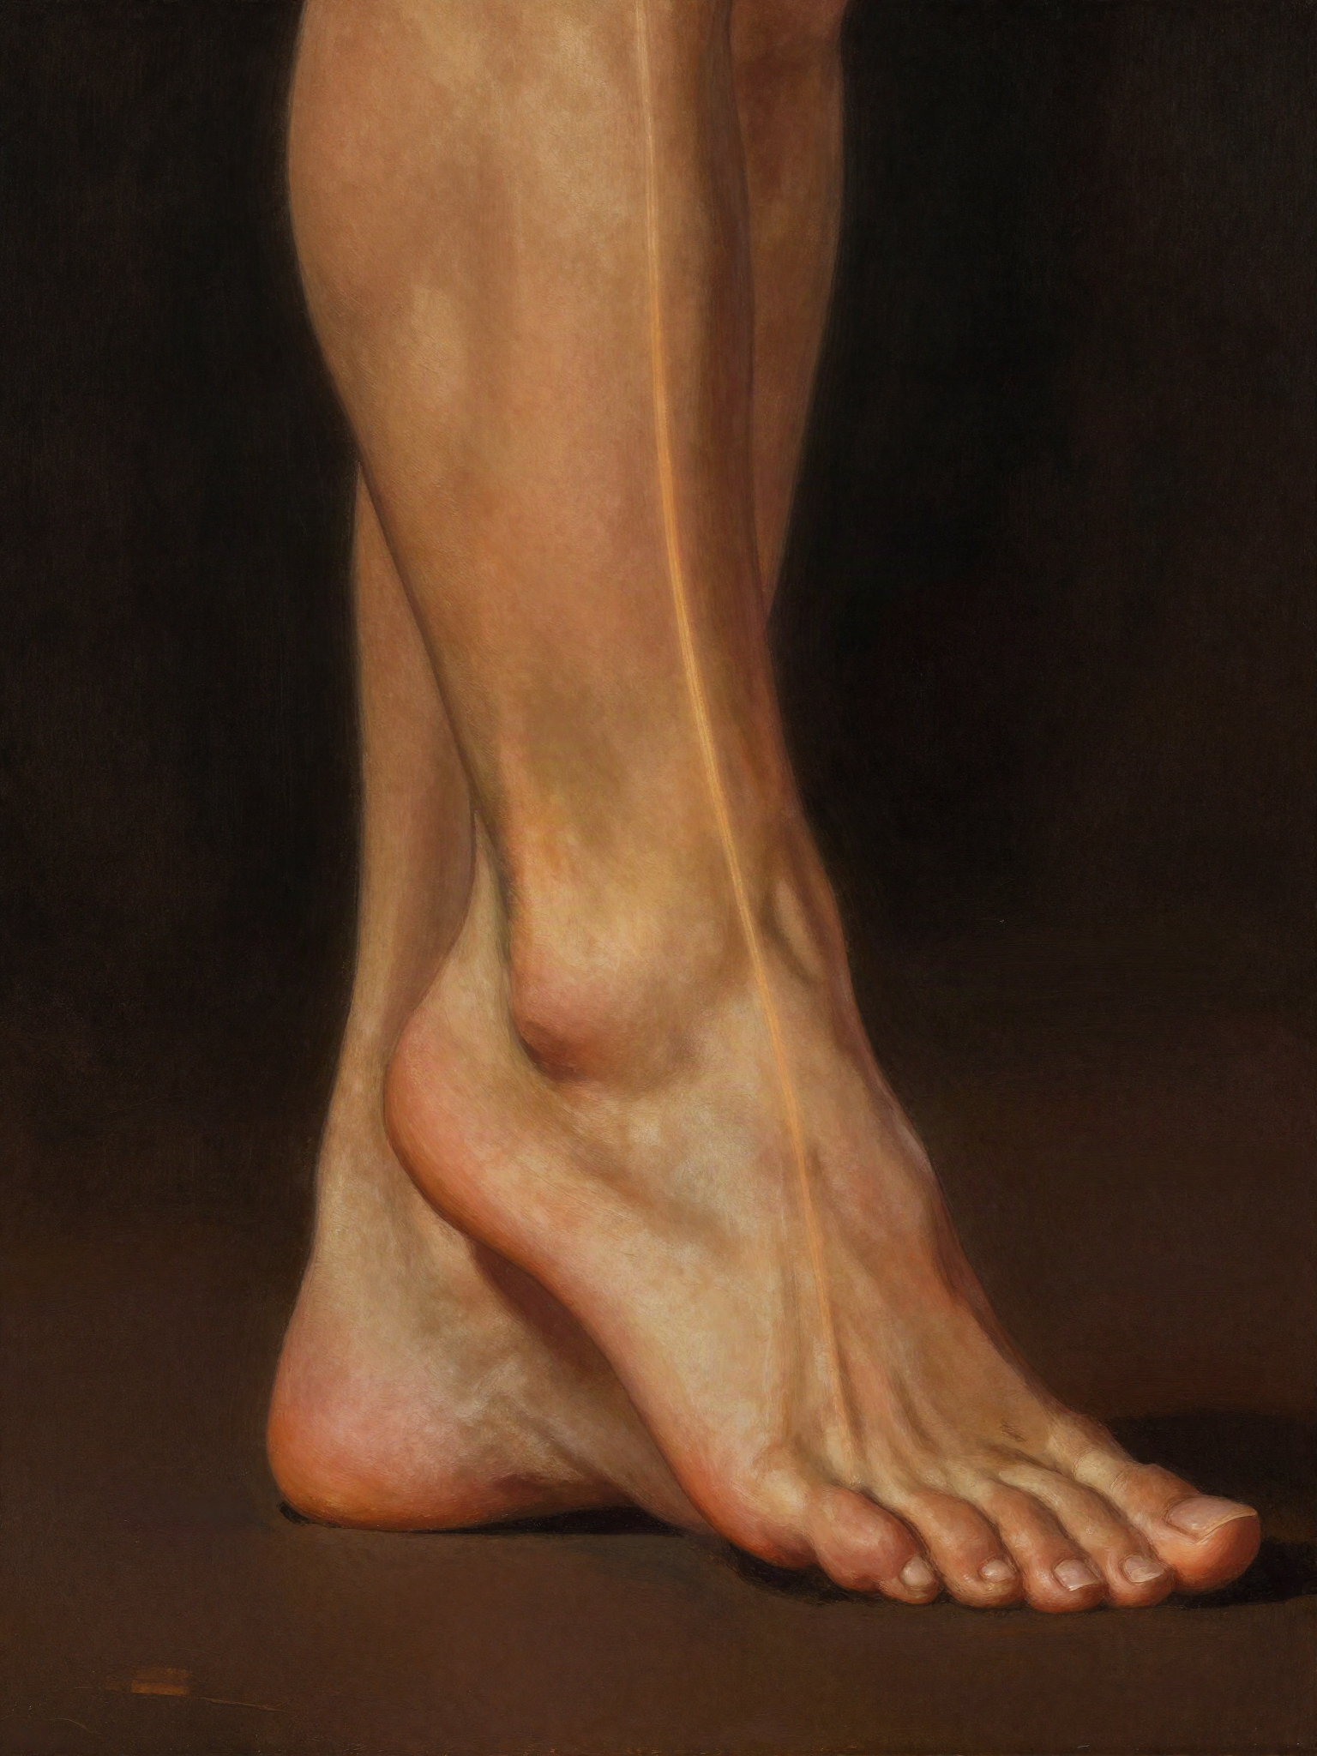
PART D · 10 MIN
One Line
If the room remembers one thing — which one?
BRIAN ASKS
· If the audience remembers one sentence, what is it?
· Option 1: Train the foot, and the trunk changes.
· Option 2: One component isn't enough for CAI.
· Which one does your data actually support?
· Finish this: "If you remember one thing from this talk …"
1st priority: intrinsic muscle exercise should be included in rehabilitation program for all CAI individual.
2nd priority: bottom up approach shall be consider before top down approach.
3rd part (biggest debate):
JUNE GETS COMFORTABLE WITH
We trained the foot, and the trunk changed.
People with CAI rotate the trunk to stay upright — foot core training seemed to reduce the need for that.
We think this is a bottom-up effect along the kinetic chain.
If you remember one thing from this talk, …
FROM THE PAPER
Conclusion foot core training may influence proximal movement control
Discussion ending single-component training may be insufficient
WE SAY
Both are in the paper only one fits in ten minutes

Slide 6

PART E · 15 MIN
Numbers Without Stumbling
Methods in forty seconds, said smoothly. Then once more, faster.
BRIAN ASKS
· How many people, how many groups?
· How long, how often?
· What did they do — foot group first, then trunk group.
· What did you measure, in three words each?
· Say all of it in forty seconds.
JUNE GETS COMFORTABLE WITH
Thirty people with CAI, ten per group, stratified by sex.
Twelve sessions — thirty minutes, three times a week, four weeks.
Five foot exercises, sitting to standing to single-leg. Five trunk exercises, longer holds each week.
Single-leg balance, a hurdle landing, and motion capture — 35 markers.
FROM THE PAPER
Hurdle 30 cm, start at 40% of height, land on the involved leg, hold 10 s
Window initial contact + first 200 ms
WE SAY
Stats mixed ANOVA + SPM across the curve

