Slide 1
Effects of Foot Core and Trunk Core Training on Postural Control Strategies in Individuals with Chronic Ankle Instability
Jiyoon Lee
Department of Physical Education, Yonsei University
Notes:
0:00–0:30. 원제 그대로. 세 줄 표시.

Slide 2
Introduction
01
Notes:
0:30

Slide 3
Chronic ankle instability and postural control
Up to 40% of first-time lateral ankle sprains progress to chronic ankle instability (CAI).
The hallmark deficit is postural control — most evident during dynamic tasks such as jump landing.
Deficits exist at both ends of the kinetic chain: the intrinsic foot muscles (distal) and the deep trunk stabilizers (proximal).
Individuals with CAI also show altered ankle, knee, hip and trunk kinematics during landing.
Notes:
0:30–1:30. 40% → CAI. 균형 결손, 착지에서 두드러짐. 원위·근위 결손 모두. 착지 운동학 변화.

Slide 4
Two approaches, one open question
Foot core training (bottom-up) and trunk core training (top-down) both improve postural control in CAI.
Whether either transfers to a dynamic landing task is unknown.
The two approaches have not been compared directly.
Purpose — to compare foot core training, trunk core training and a control condition on static and dynamic postural control, and on lower-limb and trunk kinematics, during single-leg landing in individuals with CAI.
Notes:
1:30–2:15. 두 접근 모두 균형 개선. 착지 전이 미확인. 직접 비교 없음. 목적.

Slide 5
Methods
02
Notes:
2:15

Slide 6
Study design
Foot core
n = 10
12 sessions
30 min · 3 × week · 4 weeks
30
with CAI
stratified
by sex
Trunk core
n = 10
Control
n = 10
no training
Randomized three-group pretest–posttest design · International Ankle Consortium criteria · IdFAI ≥ 11, FAAM-ADL < 90%, FAAM-Sport < 80%
Notes:
2:15–3:00. Randomized three-group pretest–posttest. 30 participants, IAC criteria, stratified by sex, 10 per group. 12 supervised sessions, 30 min, 3×/week, 4 weeks. Control: no training.

Slide 7
Training programs
Foot core training (FCG)
Trunk core training (TCG)
[Exercise 1]
[Exercise 2]
[Progression]
12 sessions · 30 min · 3 × week · 4 weeks · supervised
[Exercise 1]
[Exercise 2]
[Progression]
12 sessions · 30 min · 3 × week · 4 weeks · supervised
Notes:
3:00–3:30. 원고 Training Intervention 절이 비어 있음 — June이 채워야 함.

Slide 8
Procedures and measures
Static postural control
Dynamic postural control and kinematics
Single-leg stance, involved limb, 10 s
Eyes open and eyes closed, 3 trials each
COP mean velocity (total, ML, AP)
95% ellipse area
Single-leg jump landing over a 30-cm hurdle from 40% body height
Dynamic postural stability index (DPSI), first 3 s after contact
3D kinematics of ankle, knee, hip and trunk (35 markers, 200 Hz)
Angle at initial contact and peak within 200 ms
Notes:
3:30–4:15. 사전·사후 동일 절차.

Slide 9
Statistical analysis
Two-way mixed ANOVA — time (pre, post) × group (FCG, TCG, CG) — for discrete outcomes.
Significant interactions followed by one-way ANOVA on change scores with Bonferroni-adjusted pairwise comparisons.
Statistical parametric mapping (SPM) for continuous kinematics across the first 200 ms after initial contact; pairwise SPM t-tests at p < 0.0167.
Effect sizes as partial η²; α = 0.05.
Notes:
4:15–4:30. 짧게.

Slide 10
Results
03
Notes:
4:30

Slide 11
Postural control
No baseline differences among groups in sex, age, height, weight, IdFAI or FAAM scores.
No significant time-by-group interaction for any static or dynamic postural control outcome (all p > 0.05).
Main effect of time only for 95% ellipse area, eyes closed (p = 0.046).
Table 2. Postural control outcomes, pre and post (to be inserted).
Notes:
4:30–5:00. 균형 지표 무변화. 직접 인정.

Slide 12
Trunk transverse-plane angle: time-by-group interaction
◀ foot core reduced rotation more
Initial contact
p = 0.014
[-12.11, -1.13]
Peak ≤ 200 ms
p = 0.004
[-14.63, -2.49]
-15
-10
-5
0
5
10
15
FCG − TCG, change in trunk rotation (°)
interaction IC p = 0.016, ηp² = 0.26 · peak p = 0.004, ηp² = 0.34 · FCG vs CG at peak p = 0.053 · TCG vs CG n.s. · ankle, knee, hip: no interaction
Notes:
5:00–6:15. IC p = 0.016, ηp² = 0.26; peak p = 0.004, ηp² = 0.34. FCG > TCG reduction. FCG vs CG p = 0.053 at peak. TCG vs CG n.s. Ankle, knee, hip: no interaction.

Slide 13
Statistical parametric mapping
Significant time-by-group interaction across the entire 0–200 ms interval (p = 0.010).
Greater reduction in trunk rotation in FCG than TCG from 25% to 100% of the interval (p = 0.010).
Greater reduction in FCG than CG from 80% to 100% (p = 0.015).
No difference between TCG and CG.
Figures 1–2. SPM interaction and pairwise change waveforms (to be inserted).
Notes:
6:15–6:45. Figure 1·2 삽입.

Slide 14
Discussion
04
Notes:
6:45

Slide 15
Main finding
Four weeks of foot core training reduced transverse-plane trunk rotation during single-leg landing — more than trunk core training over the same period.
Neither program changed static or dynamic postural control scores.
The change appeared in the movement strategy, not in the summary balance measures.
Notes:
6:45–7:30.

Slide 16
Interpretation
Why the foot changed the trunk
Why balance scores did not change
The foot is the first segment to contact the ground; the trunk is the last to settle.
Improved control at initial contact may reduce the correction required upstream.
Trunk stabilization in isolation may not transfer to a fast, single-leg landing.
Four weeks may be sufficient to shift a movement pattern but not a summary measure such as COP velocity.
Individuals with CAI may compensate to maintain stance while the underlying strategy differs.
Notes:
7:30–8:30. 원고 Discussion 비어 있음 — June 해석과 대조.

Slide 17
Limitations
Sample size: 30 participants, 10 per group.
Intervention length: four weeks, no follow-up assessment.
Persistence of the kinematic change and its relation to giving-way episodes remain unknown.
Notes:
8:30–8:50.

Slide 18
Conclusion
05
Notes:
8:50

Slide 19
Conclusion and practical implications
Four weeks of foot core training reduced trunk rotation during landing in individuals with CAI; trunk core training did not.
Foot core training may be a useful component for modifying altered landing patterns in CAI rehabilitation.
It is low-load, brief and supervised — twelve sessions of thirty minutes — and can be added alongside existing balance and strength work.
Notes:
8:50–9:45. Thank you.

Slide 20

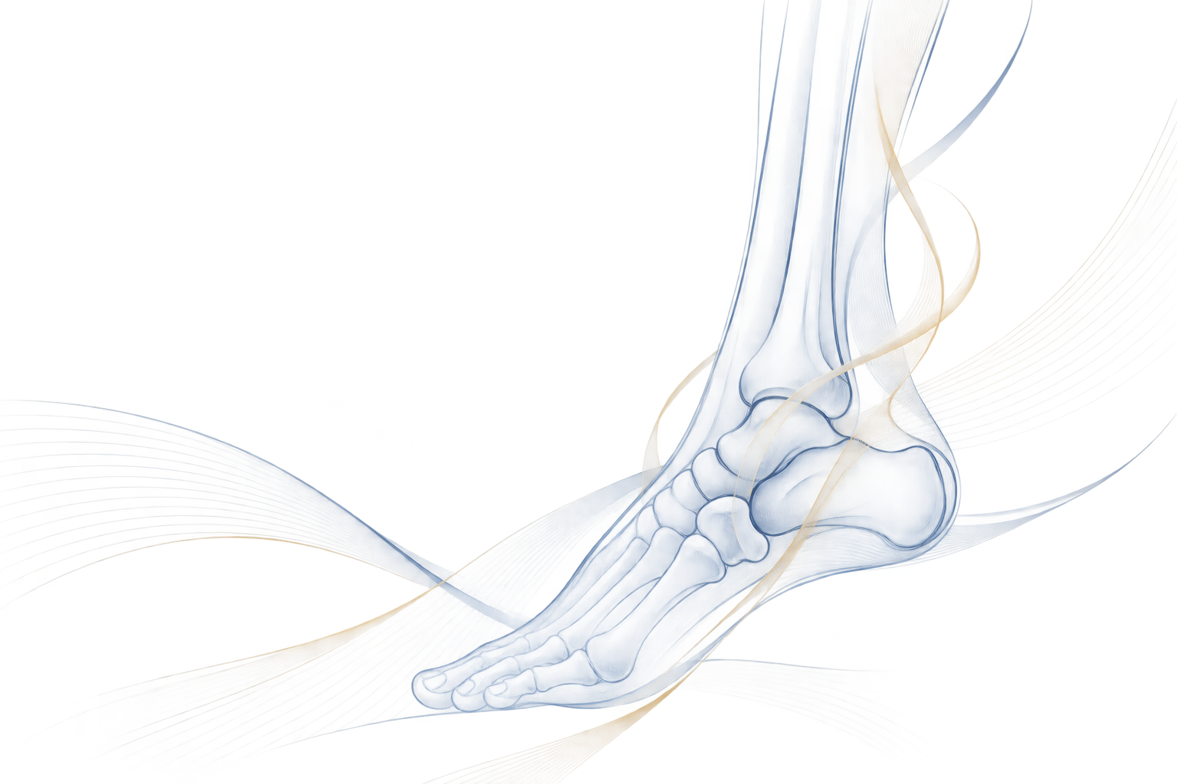

Thank You
Jiyoon Lee
[email]
Department of Physical Education, Yonsei University
Notes:
마지막장 — 연락처만 바꾸면 됩니다.

