Slide 1
Foot Core vs Trunk Core Training in CAI
Jiyoon Lee
Department of Physical Education, Yonsei University
Notes:
0:00–0:30. 짧은 제목은 제안. 초록 제출 제목과 같아야 하면 원제("Effects of Foot Core and Trunk Core Training on Postural Control Strategies in Individuals with Chronic Ankle Instability")로 교체. 공저자: Jihoon Gwark, Youngchang Lim, Kyeongtak Song.

Slide 2
One sprain. Then what?
40%
of first-time ankle sprains
become chronic instability
Not pain. Giving way — at landing.
Hertel & Corbett, J Athl Train 2019
Notes:
0:30–1:00. Up to 40% of first-time sprains become CAI. The complaint is giving way, especially at landing.

Slide 3
Foot, or trunk?
FOOT CORE
bottom-up
TRUNK CORE
top-down
Balance
✓
Landing
?
Notes:
1:00–2:15. Both improve balance in CAI. Nobody has compared them on landing.

Slide 4
Thirty people. Three groups. Four weeks.
Foot core
n = 10
12 sessions
30 min · 3 × week · 4 weeks
30
with CAI
stratified
by sex
Trunk core
n = 10
Control
n = 10
no training
pre-test → 4 weeks → post-test
Notes:
2:15–3:15. Randomized, IAC criteria, stratified by sex, 12 supervised sessions. [훈련 내용 한 줄 — June 확인 후 그룹 상자 아래에]

Slide 5
The task
jump · clear · land on one leg · hold 10 s
COP
static stance
DPSI
force plate
30 cm
start
3D kinematics
ankle · knee · hip · trunk
force plate
40% of body height
0–200 ms · SPM
Notes:
3:15–4:15. Two-leg take-off over a 30-cm hurdle, land on the involved limb, hold 10 s. From the landing: DPSI and 3D kinematics; IC and peak within 200 ms; SPM over the whole window. Static: 10-s single-leg stance, COP.

Slide 6
Balance: nothing moved
0
interactions
across every balance measure
COP velocity
95% ellipse
DPSI
Notes:
4:15–5:00. Here I'll be direct: nothing changed.

Slide 7
Trunk rotation: foot core beat trunk core
◀ foot core reduced rotation more
Initial contact
p = 0.014
[-12.11, -1.13]
Peak ≤ 200 ms
p = 0.004
[-14.63, -2.49]
-15
-10
-5
0
5
10
15
FCG − TCG, change in trunk rotation (°)
interaction IC p = 0.016 · peak p = 0.004 · FCG vs CG at peak p = 0.053 · ankle · knee · hip: none
Notes:
5:00–6:15. Significant interaction at IC and peak. FCG reduced trunk rotation more than TCG. FCG vs CG at peak p = 0.053; TCG vs CG n.s.; ankle, knee, hip: no interaction.

Slide 8
…and across the whole landing window
Figure 1 · SPM interaction
Figure 2 · pairwise change waveforms
(from manuscript)
0 ms
200 ms
■ foot core < trunk core 25–100% p = 0.010
■ foot core < control 80–100% p = 0.015
Interaction across the entire window, p = 0.010
Notes:
6:15–6:45. SPM: interaction across the entire 0–200 ms (p = 0.010). FCG < TCG from 25%; FCG < CG from 80%. → 이 자리에 원고 Figure 1·2.

Slide 9
Train the first link. The last link quiets.
FOOT
ANKLE
KNEE
HIP
TRUNK
trained
rotation ↓
Better initial contact → less to correct upstream
limits n = 10 per group · 4 weeks · no follow-up
Notes:
6:45–8:45. Foot hits first, trunk settles last. Better initial contact → less to correct upstream. Trunk training alone didn't transfer. Balance: four weeks shifts a strategy, not a summary score. Limits.

Slide 10
Take-home
Add foot core early.
Alongside balance and strength work — not instead of it.
4
12
30
weeks
sessions
minutes
Notes:
8:45–9:45. Add a foot core component early — alongside, not instead of. Thank you.

Slide 11

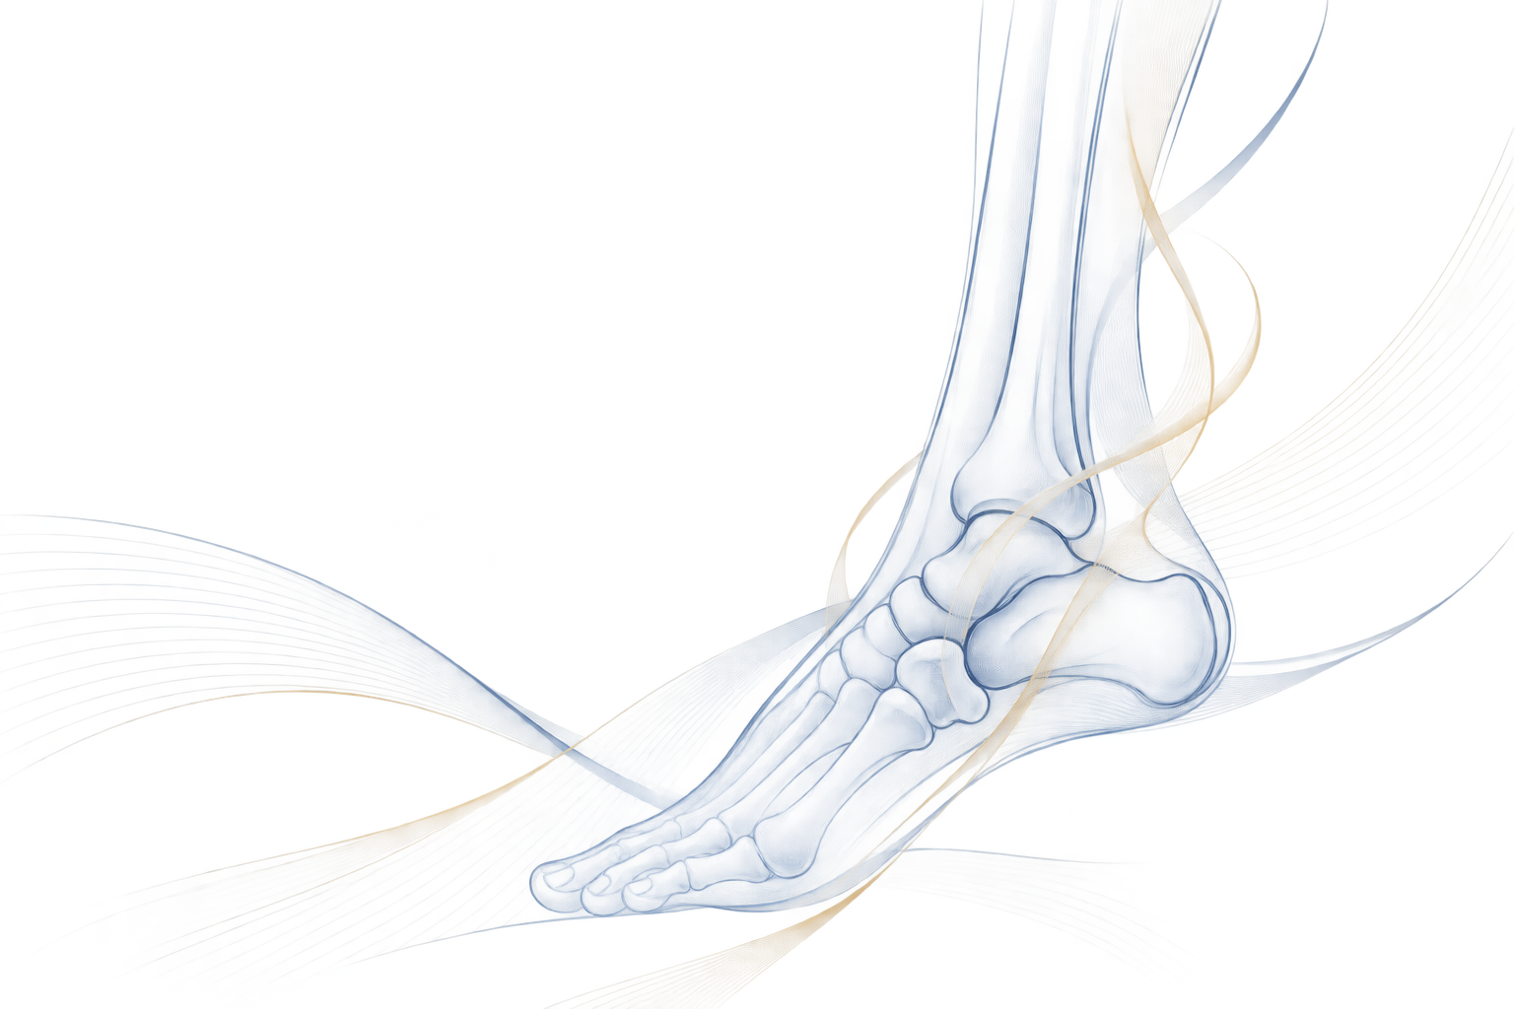

Thank You
Jiyoon Lee
[email]
Department of Physical Education, Yonsei University
Notes:
마지막장 — 연락처만 바꾸면 됩니다.

