Slide 1
JUNE · IAS 2026 · CLASS 13
Editing the Talk
Ten minutes. The whole paper. Twelve decisions nobody has made yet — we make them today.
Do English with Brian

Slide 2
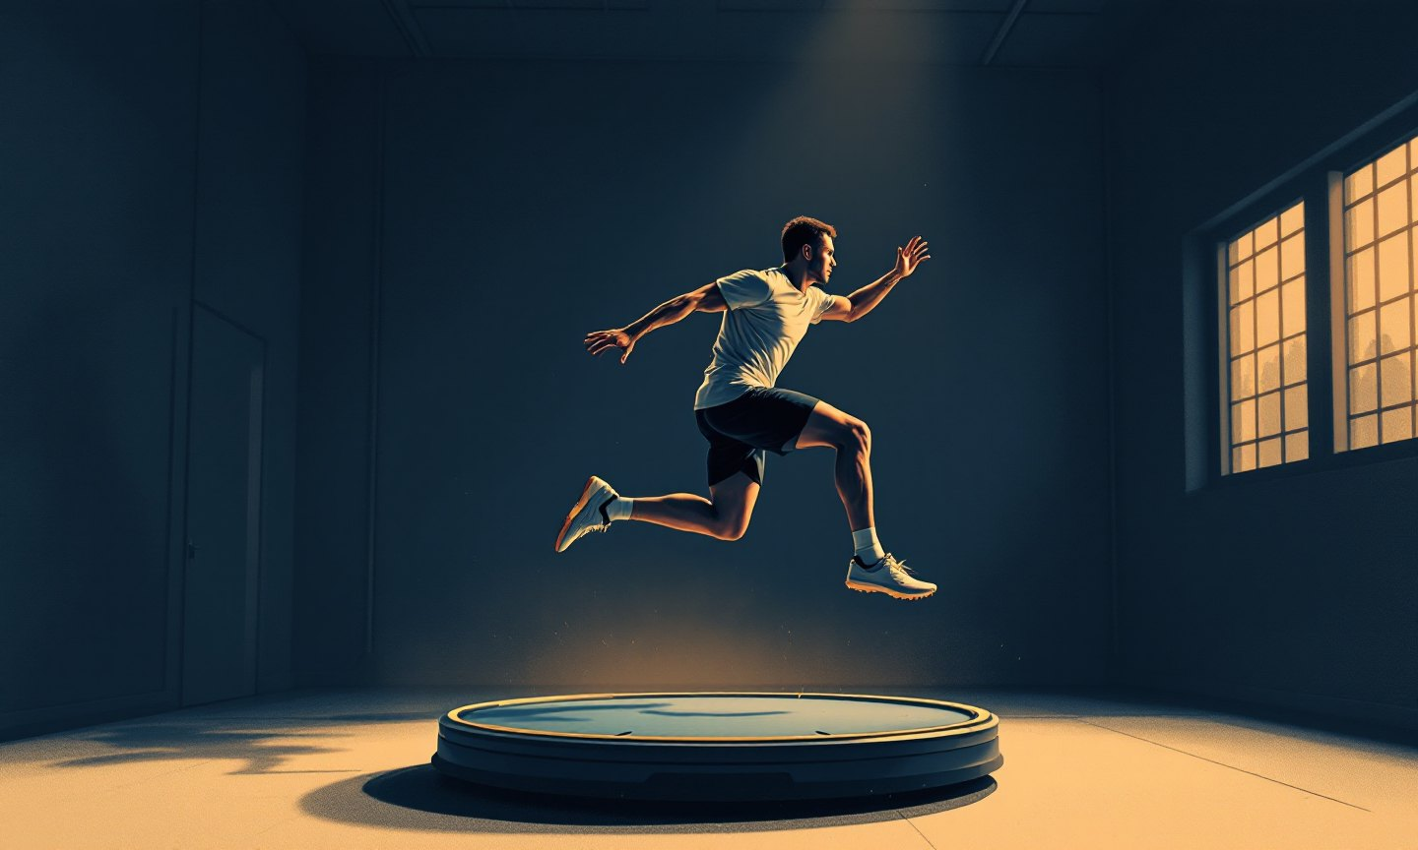
INTRODUCTION
Why should an ankle room care about the core?

Slide 3
1 / 12
INTRODUCTION
How does the talk open — the first sentence?
A
B
C
Start with the number — 40% of first sprains become chronic
Start with the moment — landing is where it goes wrong
Start with the puzzle — an ankle problem, but the answer may sit above the ankle
FROM THE PAPER
up to 40% → CAI
deficits most visible in landing
proximal stability for distal mobility
BRIAN, HONESTLY Which one would make you look up from your phone?
WE SAY
I prefers C as the core message. I focused on connection between ankle and something beyond the ankle. So the C shall be the key focus from this paper. From my perspective, I would say C is the most important message of my paper.

Slide 4
2 / 12
INTRODUCTION
The gap, in one sentence
A
B
C
Nobody has compared foot core and trunk core training directly
We don't know if balance gains show up when you actually land
Both — but which one comes first?
FROM THE PAPER
FCT and TCT each improve postural control
carry-over to landing: unknown
bottom-up vs top-down: rarely compared
BRIAN, HONESTLY If June says only one of these, which one do you remember?
WE SAY
What explains the best about the gap is A. There are a lot of studies based on B. As far as I am aware, I haven’t seen studies those figuring out how to improve the postural control and landing kinematics after these two trainings.

Slide 5

METHODS
Thirty people, three groups, four weeks, one landing.

Slide 6
3 / 12
METHODS
Which numbers survive the 60-second Methods slide?
A
B
C
Keep 30 / 3 groups / 4 weeks / 12 sessions — nothing else
The above + what the landing task looks like
The above + the 200-ms window, because the result lives there
FROM THE PAPER
30 participants · 10/group · stratified by sex
3×/week · 12 sessions · ~30 min
hurdle 30 cm · from 40% height · single-leg landing
Vicon 35 markers · IC > 20 N · first 200 ms
BRIAN, HONESTLY Which number did you forget first?
WE SAY
Should be showing C. B is very common dynamic task in our field. I don’t need to spend any time for B. I would just mention in one sentence. There are two periods which are IC and with 200-ms after IC.

Slide 7
4 / 12
METHODS
How do we show two training programs on one slide?
A
B
C
Two columns, five exercise names each
Two columns, two names each + one photo
One line: foot muscles vs deep trunk muscles — same dose
FROM THE PAPER
FCG: short-foot, towel curls…
TCG: drawing-in, planks…
both progressive · CG: nothing
BRIAN, HONESTLY Would a clinician want the exercise names, or the idea?
WE SAY
I prefer A. I want to include table 2 onto the slide. This is the most easiest way to explain the training programs to audiences.

Slide 8

RESULTS
Balance didn't change. The trunk did.

Slide 9
5 / 12
RESULTS
Order: lead with what didn't change, or with what did?
A
B
C
Null first — 'Balance didn't change… but something else did'
Trunk first — 'Foot core training changed the trunk', then the nulls
Side by side, one slide
FROM THE PAPER
no interaction: any balance outcome
no interaction: ankle · knee · hip
trunk interaction: IC p = .016 · peak p = .004
BRIAN, HONESTLY Which order keeps you listening?
WE SAY
Postural control index result first. That is the main outcome from the program. Even though I couldn’t see the significant differences on the result.

Slide 10
6 / 12
RESULTS
How do we say the null results without sounding like a failure?
A
B
C
'Balance measures were not sensitive to four weeks of training'
'All three groups changed similarly in balance — training didn't add to it'
'The ankle itself didn't move differently. The trunk did.'
FROM THE PAPER
time effect only: EC ellipse area p = .046
everyone changed: ankle & hip rotation at IC
nothing training-specific below the trunk
BRIAN, HONESTLY Does any of these sound like an excuse?
WE SAY
A would be the right way. Four weeks of training is insufficient to improve the postural control index.

Slide 11
7 / 12
RESULTS
The trunk finding — how precisely do we state it?
A
B
C
'Foot core training reduced trunk rotation' — simple, slightly over-claims
'…reduced trunk rotation compared with trunk core training' — exact
'Rotation went down with foot core and up with trunk core' — both directions
FROM THE PAPER
IC: FCG −2.59° · TCG +4.04° · CG +1.40°
FCG vs TCG p = .014 (IC) · p = .004 (peak)
FCG vs CG p = .224 (IC) · p = .053 (peak)
TCG vs CG: no difference
BRIAN, HONESTLY If a reviewer hears option A, what do they ask?
WE SAY
C is not correct. B is better one to choose. However, I would need to interpret and state that foot core training group reduced trunk rotation compare to TCG. TCG didn’t reduce trunk rotation compare to CG.
30 participants are quite limited.

Slide 12
8 / 12
RESULTS
Figures: one or both, and what do we point at?
A
B
C
Figure 1 only — the shape tells the story
Figure 2 only — it shows who differs from whom
Both, twenty seconds each
FROM THE PAPER
Fig 1: SPM interaction across 0–100%, p = .010
Fig 2: FCG vs TCG 25–100% · FCG vs CG 80–100%
audience: clinicians · projector · 10 min
BRIAN, HONESTLY Look at both. Which one did you understand without June explaining?
WE SAY
Need them both.

Slide 13
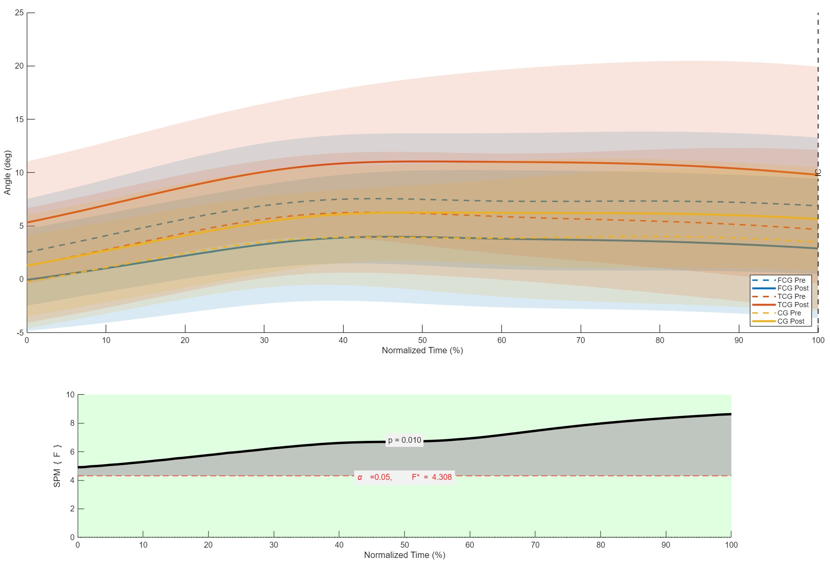
FIGURE 1
Mean trunk transverse-plane angle + SPM interaction (p = 0.010)
WHAT TO POINT AT
· Dashed = pre, solid = post
· FCG solid sits lower than dashed — rotation went down
· TCG moves the other way
· Shaded: significant across the whole 0–100%
· Say: 'the whole landing window, not one moment'

Slide 14
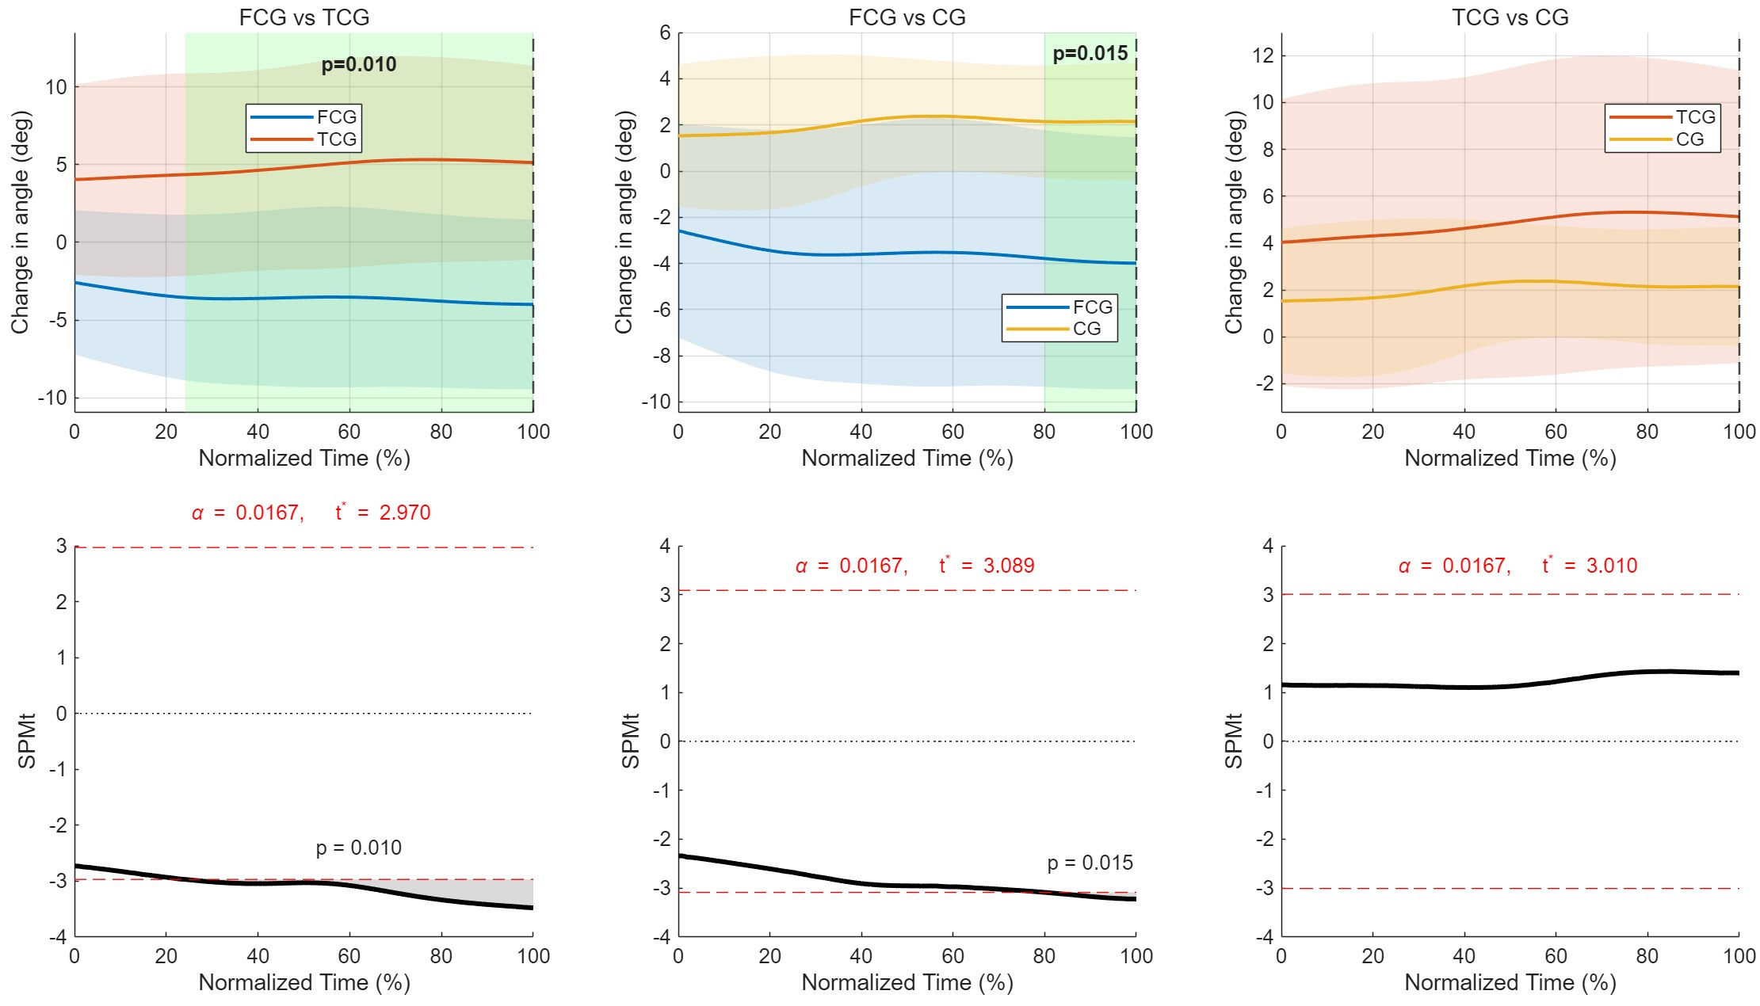
FIGURE 2
Post-hoc change waveforms (post minus pre)
WHAT TO POINT AT
· Negative = toward contralateral rotation
· FCG vs TCG: shaded 25% → 100%
· FCG vs CG: shaded only at the end, 80% → 100%
· TCG vs CG: nothing
· Say the two shaded panels, skip the third

Slide 15
9 / 12
RESULTS
SPM in twenty seconds
A
B
C
Don't explain it — just say 'across the whole landing window'
One sentence: 'ANOVA looks at two moments; SPM looks at the whole curve'
Skip the method — show the shaded region and let it speak
FROM THE PAPER
ANOVA: single points (IC, peak)
SPM: whole 200-ms curve
here they agree
BRIAN, HONESTLY After hearing it once, can you say what SPM does?
WE SAY
Little bit of B and C.

Slide 16

DISCUSSION
Not written yet. We decide the claim today.

Slide 17
10 / 12
DISCUSSION
Why would foot training change the trunk — and how hard do we claim it?
A
B
C
Strong — 'A stable foot gives the trunk less to correct'
Careful — 'One possibility is that…' mechanism as hypothesis
Honest-first — say what we didn't see (no ankle/knee/hip change), then the hypothesis
FROM THE PAPER
foot core = base of the chain (McKeon)
no change at ankle · knee · hip
effect vs TCG; vs CG p = .053
BRIAN, HONESTLY Which version would you believe from a stranger?
WE SAY

Slide 18
11 / 12
DISCUSSION
Limitations: one up front, the rest in your pocket
A
B
C
'Four weeks, ten per group — a signal, not a verdict'
'No sham control, so attention could play a role'
'We saw the trunk change but not the path to it'
FROM THE PAPER
4 weeks · no follow-up
n = 10 per group
control did nothing
lab landing · one height · one direction
BRIAN, HONESTLY Which limitation would you have raised yourself?
WE SAY

Slide 19

CONCLUSION
What can a clinician try on Monday?

Slide 20
12 / 12
CONCLUSION
The last line
A
B
C
'Add foot core work to CAI rehab — it may change how patients land'
'If you only have four weeks, start at the foot'
'Balance tests may miss what the trunk is doing — look at landing'
FROM THE PAPER
abstract: FCT reduced trunk rotation during landing
abstract: may modify altered landing patterns
practical implications: not written yet
BRIAN, HONESTLY Which one would you repeat to a colleague tomorrow?
WE SAY

Slide 21
THE SCRIPT · READ IT THROUGH, TIME IT
What we decided, in order
1 OPENING
2 GAP
3 METHODS
4 PROGRAMS
5 RESULTS ORDER
6 NULLS
7 TRUNK FINDING
8 FIGURE(S)
9 SPM
10 MECHANISM
11 LIMITATION
12 LAST LINE

