Slide 1
HOJUN · CLASS 15
A New Colleague Asks
Ten minutes on the weekend. Then a foreign colleague's first week in a Korean office — you explain how things really work. Then you ask me.
Do English with Brian

Slide 2

PART 1 · CASUAL · 10 MIN
Friday Already
주말 얘기로 가볍게. 길게 안 가요.
QUESTIONS
Q1 What are you up to this weekend?
Q2 Any plans to get out of the city?
Q3 What does a slow Saturday morning look like for you?
Q4 Is there anything you do regularly on weekends — or nothing at all?
Q5 Anything you've been meaning to do but keep putting off?
Q6 Has the weather changed your weekends yet?
TOOLBOX
I'm thinking of ~ ~할까 생각 중이에요
Nothing planned, probably just ~ 계획은 없고, 아마 그냥 ~
NOTES
I keep putting off ~ ~를 계속 미루고 있어요
If the weather holds, ~ 날씨만 괜찮으면 ~
It's been a pleasant change, actually 사실 기분 좋은 변화예요
FROM YOUR WORDS · 지난주 단어 regularly · pleasant

Slide 3
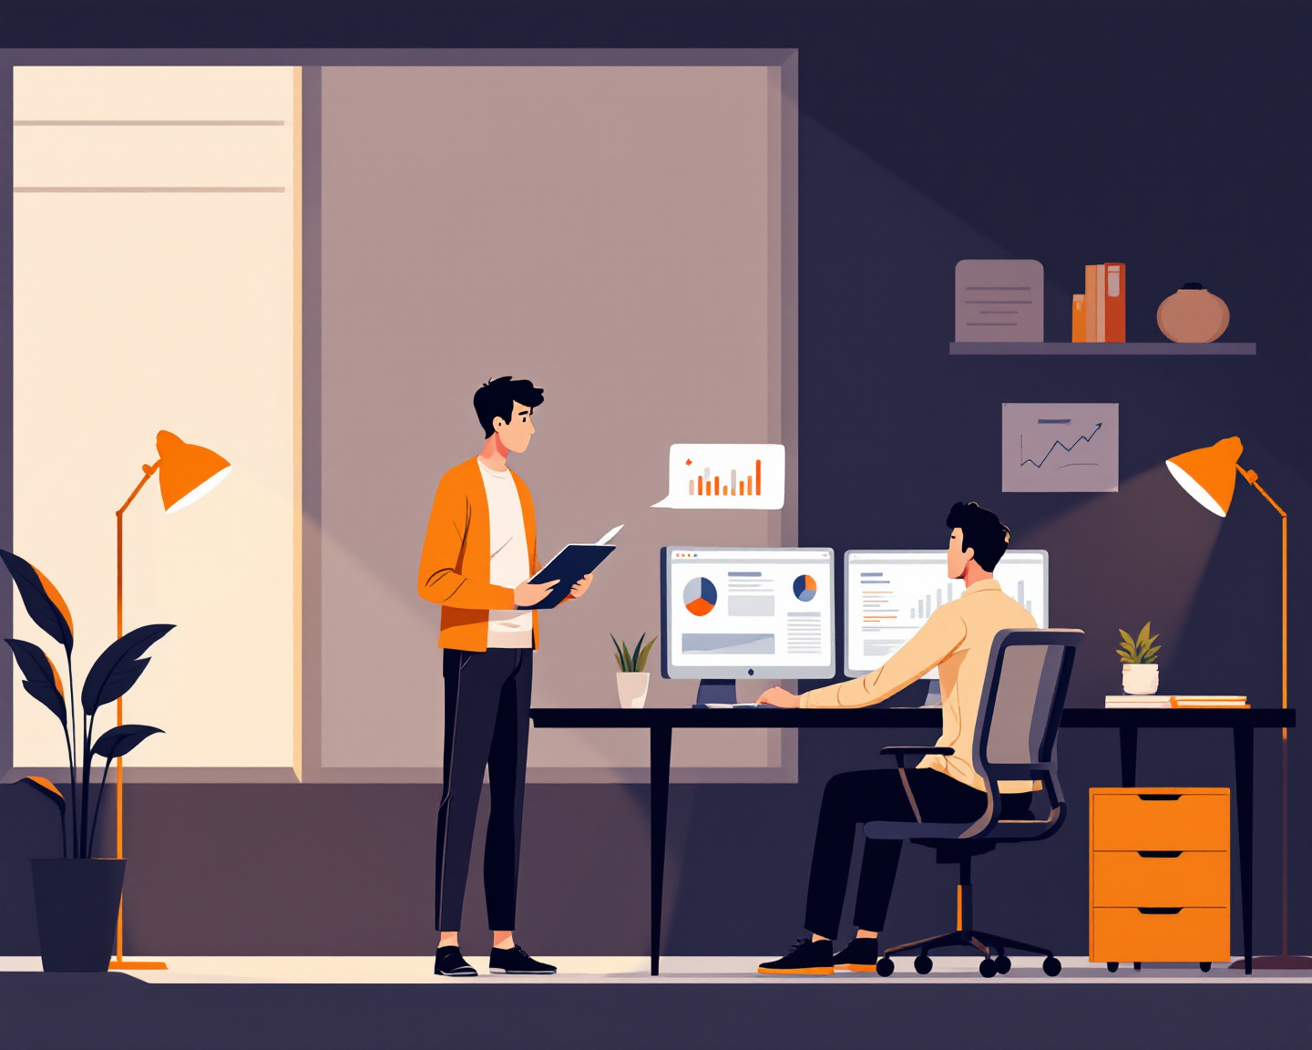
PART 2 · BUSINESS · 35 MIN
A New Colleague Asks
한국 회사에 막 온 외국인 동료. 첫 주에 진짜로 묻는 것들.
HE ASKS · pick the order
Q1 Do I really have to go to hoesik? What happens if I skip it?
Q2 How should I address people — by title, or by first name?
Q3 Is overtime still a thing here? When do people actually leave?
Q4 Can I disagree with my manager in a meeting, or is that a bad idea?
Q5 Does everyone eat lunch together? Is it strange to eat alone?
Q6 What do people do on Friday nights — and am I expected to join?
TOOLBOX
It's expected that ~ ~하는 게 당연하게 여겨져요
Not as much as it used to be 예전만큼은 아니에요
THREE LINES EACH What's typical → how it is in my team → what I actually do
일반적으로는 → 우리 팀은 → 나는. 규칙이 엄격한 쪽인지, 적응이 쉬운 쪽인지도 같이.
It depends on the team 팀마다 달라요
The unspoken rule is ~ 말은 안 해도 다들 아는 규칙은 ~
Nobody will say it, but ~ 아무도 대놓고 말은 안 하지만 ~
If I were you, I'd ~ 저라면 ~하겠어요
FROM YOUR WORDS · 지난주 단어 adapt · strict · disagree

Slide 4
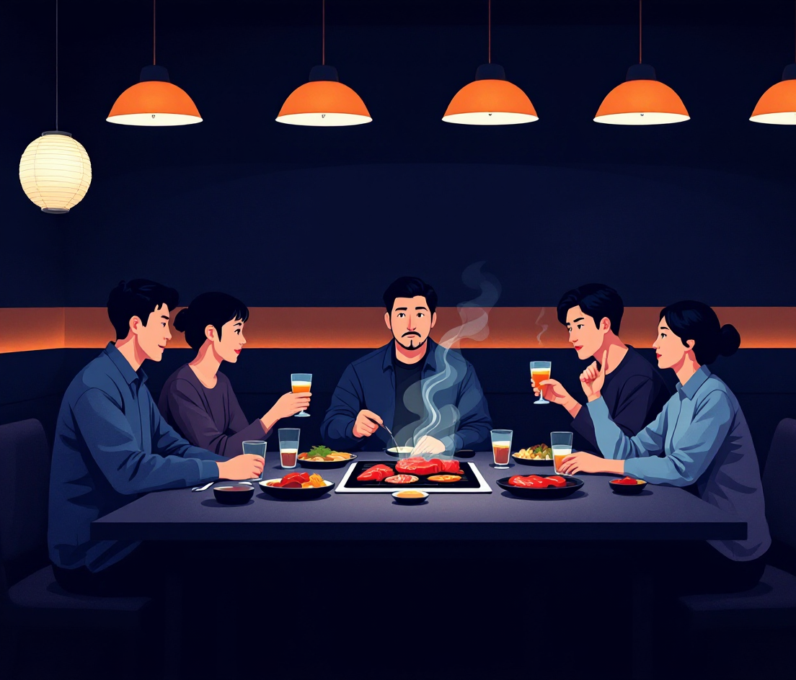
PART 2 · FOLLOW-UPS
When He Pushes Back
설명을 듣고 동료가 되묻는 것들. 여기서 진짜 대화가 돼요.
HE PUSHES BACK
Q1 "That sounds exhausting. Doesn't anyone push back?"
Q2 "What would happen if I just said no to drinking?"
Q3 "How did you behave in your first year? Same as now?"
Q4 "What's the most embarrassing mistake a foreigner could make here?"
Q5 "Is it changing with younger people, or is that a myth?"
Q6 "Be honest — would you change any of this if you could?"
TOOLBOX
Some people do, but ~ 그러는 사람도 있긴 한데 ~
KEEP IT REAL Your team, your examples, your first year. No textbook answers.
교과서 답 말고 실제 있었던 일로. 모르는 건 모른다고 해도 돼요.
Honestly, in my first year I ~ 솔직히 첫해엔 저도 ~
The one thing I'd never do is ~ 절대 안 할 것 하나는 ~
It's slowly changing — ~ 천천히 바뀌고 있어요 — ~
If it were up to me, ~ 제 마음대로 할 수 있다면 ~
FROM YOUR WORDS · 지난주 단어 behave · embarrass

Slide 5

PART 3 · 15 MIN
Now You Ask
역할 바꿈. Brian이 캐나다·미국계 회사에서 겪은 걸 Hojun이 물어요 — 진짜 궁금한 것으로.
TOPICS · pick any
bosses
meetings
saying no
after-work
vacation
getting promoted
being new
working late
WHAT STAYED WITH YOU · one insight, one sentence
QUESTION STARTERS
How did people ~ at your company? 그 회사에서 사람들은 ~를 어떻게 했어요?
Was it normal to ~? ~하는 게 보통이었어요?
What surprised you most about ~? ~에서 제일 놀란 건 뭐였어요?
Did you ever ~? ~해 본 적 있어요?
How is that different from ~? 그게 ~와는 어떻게 달라요?
FROM YOUR WORDS · 지난주 단어 curious · insight

