Slide 1
HONG · CLASS 16
A Friend in Luxembourg
You met her at the museum. Now she's asked you to come and stay. Let's talk it through — same shape as always.
Do English with Brian

Slide 2

TOPIC 1 · HOW WE MET
How did the two of you end up becoming friends?
①
She came in ___.
alone on a quiet weekday · with a group · just before closing
②
We started talking about ___.
the planes · where she was from · Korea · my English
③
Before she left, ___.
we swapped Instagram · she gave me her number · she said "come and visit"
EXAMPLE She came in alone on a quiet weekday. We started talking about where she was from. Before she left, we swapped Instagram — and we've been talking ever since.
HONG SAYS
TELL IT IN THE PAST · three moves
Set the scene When was it, what kind of day, where in the museum.
What happened What she asked, what you said, what made you both laugh.
How it ended that day Numbers, Instagram, a promise — the small thing that turned a visitor into a friend.
FROM YOUR WORDS scene

Slide 3

TOPIC 2 · WHAT I FOUND OUT
What surprised you, and what do you want to see?
①
The thing that surprised me was ___.
free public transport · three languages · how small it is
②
I'd want to see ___.
the old town · Vianden Castle · a spot she picks for me
③
I'm curious whether ___.
people really speak English · it's expensive · I can get around on my own
EXAMPLE The thing that surprised me was free public transport. I'd want to see the old town and one spot she picks for me. I'm curious whether I can get around on my own.
HONG SAYS
WHAT I FOUND · just for reference
The country Tiny and rich. Three official languages — Luxembourgish, French, German — and most people speak English too. About 680,000 people.
Getting there No direct flight from Korea — change in Frankfurt, Paris or Amsterdam. Paris to Luxembourg by TGV is about two hours. Korean passport: no visa for up to 90 days.
Getting around Every train, tram and bus in the country is free — since 2020. The old town and fortress are on the UNESCO list; Vianden Castle and the Mullerthal trails are the famous day trips.
FROM YOUR WORDS famous · spot

Slide 4
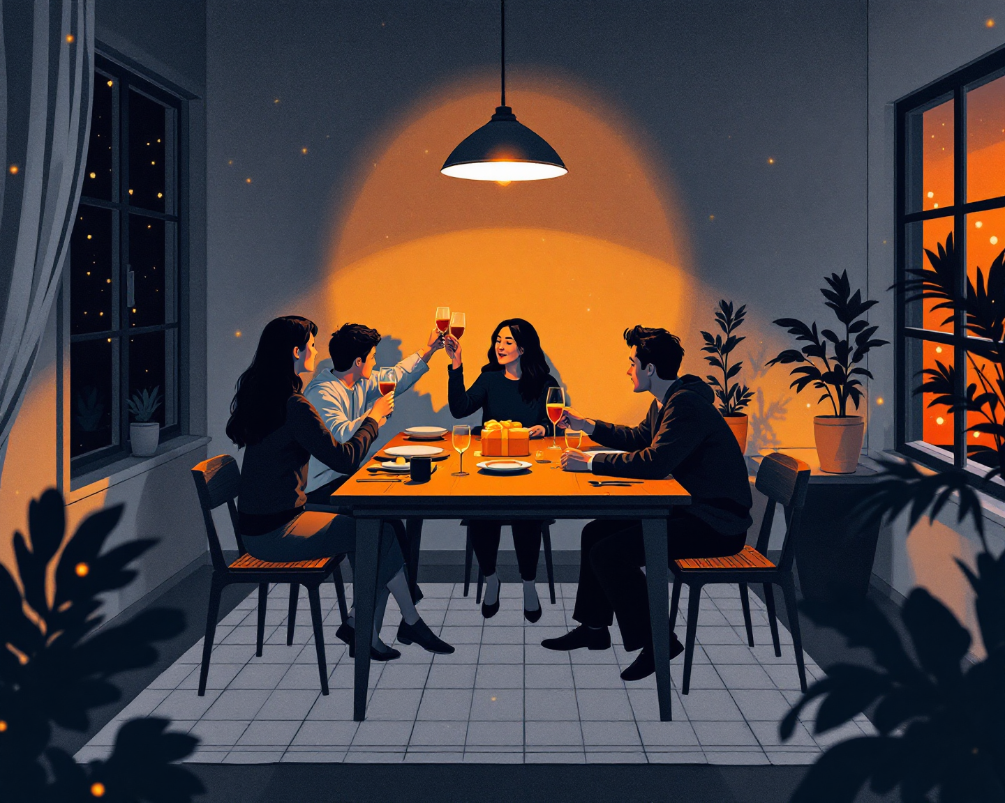
TOPIC 3 · STAYING AT HER HOME
What would you bring, and what would you ask before you go?
①
I'm thinking of bringing ___.
Korean tea · snacks from a convenience store · something from the museum shop
②
I'd ask her ___ before I go.
what time they usually have dinner · if I can cook one night · what the weather's like
③
The part I'm not sure about is ___.
how many nights to stay · what to do while she's at work · how much to help
EXAMPLE I'm thinking of bringing Korean tea. I'd ask her if I can cook one night before I go. The part I'm not sure about is what to do while she's at work.
HONG SAYS
BEING A GOOD GUEST · what people say
The gift Something small and Korean — tea, snacks, pretty stationery. Thoughtful beats expensive.
The house Shoes, shower times, breakfast, keys — ask once, early, and you're fine for the whole stay.
Helping out Set the table, do the dishes once, cook one Korean dinner. Guests who help get invited back.
FROM YOUR WORDS dinner

Slide 5

TOPIC 4 · THE MESSAGE
Write her the message — but say it out loud first.
①
I've booked ___.
my flight for the ~th · the train from Paris on ~
②
Would it be okay if ___?
I stayed ~ nights · I arrived in the evening · I cooked for your family one night
③
Can't wait to ___.
see where you live · try real Luxembourg food · finally meet your family
EXAMPLE I've booked my flight for the 12th, so I'd get to you in the evening. Would it be okay if I stayed four nights? Can't wait to see where you live.
HONG SAYS
THE MESSAGE · three lines are enough
Line 1 — when Your dates. Flight or train, and what time you'd arrive.
Line 2 — what One or two things you'd love to do with her. Let her plan the rest.
Line 3 — ask One question, not five. Friends ask; hotels confirm.

Slide 6
LAST ONE
So, how are you feeling about it?
①
What excites me most is ___.
②
What I'm a little nervous about is ___.
③
By the time I go, I want to be able to ___.
HONG SAYS
FROM YOUR WORDS excite

