Slide 1
INYOUNG · CLASS 3
After the Journal Club — and the Music You Love
First hour: how it went, and how you'd do it again. Second hour: your songs, your show.
Do English with Brian

Slide 2
PART 1 · 1 of 3
Looking Back
Journal club, in your own words.
QUESTIONS
TOOLBOX
· How did it go overall?
· Which figure was the hardest to explain — and which part, specifically?
· What questions did you get?
· What was the most meaningful question someone asked?
· Which answer would you redo?
· What did your professor say afterwards?
· How would you evaluate your own talk, out of ten?
It went better than I expected, except ~
The part I struggled with was ~
Someone asked me ~, and I said ~
If I did it again, I'd ~
It went significantly better once ~
FROM YOUR WORDS · 지난주 단어 specifically · meaningful · evaluate · significantly

Slide 3
PART 1 · 2 of 3
Do It Again
제일 어려웠던 그림 하나를, 네 칸 틀로 다시.
1 ASKED
2 DID
3 FOUND
4 SO WHAT
The question here is whether ___.
To test this, they ___.
What they found was ___.
This tells us ___.
INYOUNG SAYS
In figure 4, analysis with HMM method was the most difficult one to explain.
Because chatgpt explained this to me so I understood from the big picture but I didn’t understand the details.
It is important to understand the method in details as we discussed about the methods during the open discussion.
First most important thing is that I read the paper earlier. And understand earlier in details.
And then I make myself familiar with the script. Or speaking about the subjects.

Slide 4
PART 1 · 3 of 3
When the Question Comes
질문을 받았을 때의 첫마디. Brian이 journal club처럼 물어요.
FIRST MOVES
BRIAN ASKS
That's a great question.
I'm not sure, but my guess is ~
Let me go back to Figure ~
I'd have to check, but ~
The short answer is ~, and the longer answer is ~
· How big was the effect, really?
· Why that method and not another?
· What's the main limitation?
· Would this work in humans?
· What would you do next?
INYOUNG SAYS

Slide 5
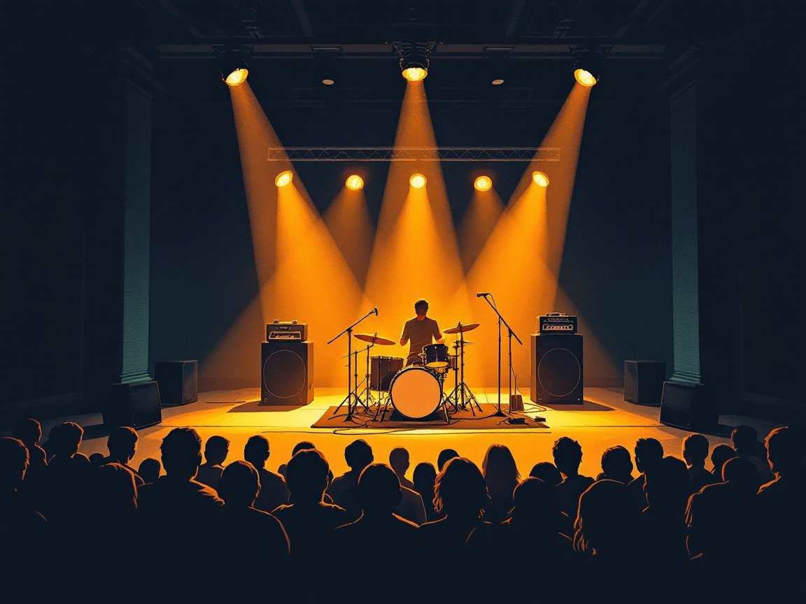
PART 2 · 1 of 4
This or That
하나 고르고, 이유 한 문장.
1 Live or studio?
2 Lyrics or sound?
3 Headphones or speakers?
4 Vinyl or streaming?
5 The '90s or now?
6 Front row or back of the room?
INYOUNG SAYS
100% live Because I can feel their expression and more excitement. Always find live version of the songs that I love / I like sounds when I hear the song for the first time. Then I check out the lyrics if I like the sounds of it. / I usually use my headphones. Although I have a turntable and speakers. /
I like vinyl but I usually use streaming service. / I like both of them but my favorite songs are from the 90s. / Absolutely front row.

Slide 6
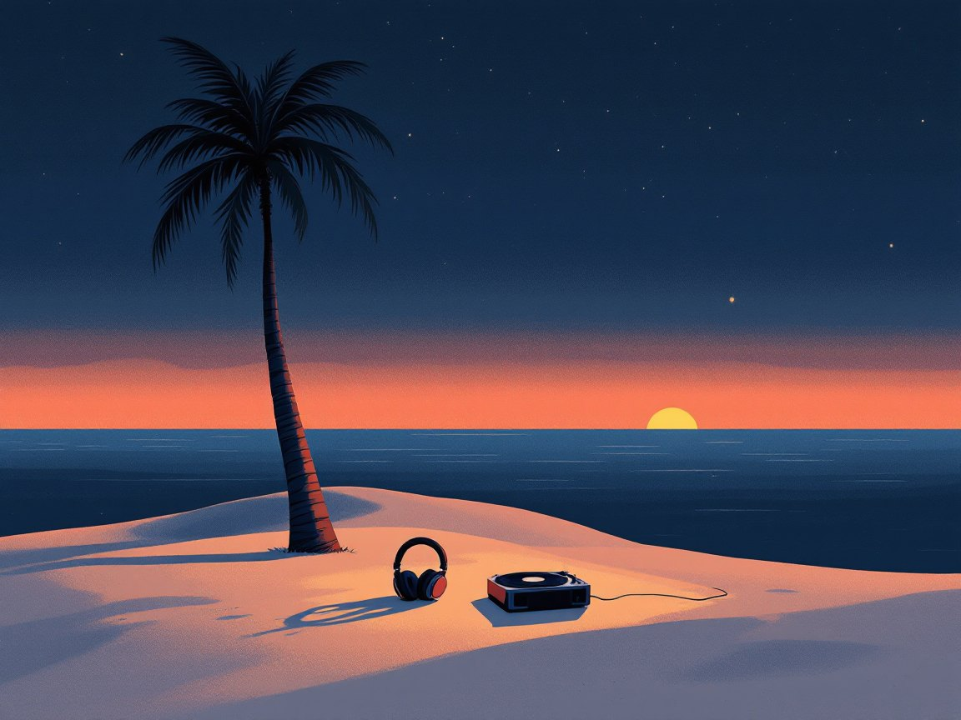
PART 2 · 2 of 4
Desert Island Tracks
무인도에 다섯 곡만 가져간다면? 한 곡씩, 그 곡에 얽힌 이야기.
1
song · first heard · where you were · why it stayed
Basket case by Green day / 3 years ago / At the café. / The song is about their difficult time. So if I am in a desert island, maybe I would feel the difficulty. This would cheer me up.
2
song · first heard · where you were · why it stayed
These days by Bon Jovi / about 3 years ago / I can’t remember where I heard this for the first time / I saw the youtube live video of these days. First, the song is so good. The song is about being a hopeful and the main singer of the band is so handsome.
3
song · first heard · where you were · why it stayed
Whatever by Oasis / about 2~3 years ago / I can’t remember. But I first experienced through a youtube / This song tells us you can do anything you want. Whatever you want.
TOOLBOX
The first time I heard it, I was ~
It reminds me of ~
I'd keep this one because ~
It's the one I play when ~
4
song · first heard · where you were · why it stayed
21 guns by Green day / 3 years ago / From youtube / I heard this song a lot. When I went to Green day concert in Japan, it was my first performance experience of this song. It was wonderful.
5
song · first heard · where you were · why it stayed
Bad by Ateez (guilty pleasure) / recent / From youtube shorts / The main dancer is not my type but I am keep watching him with no pair reasons.

Slide 7
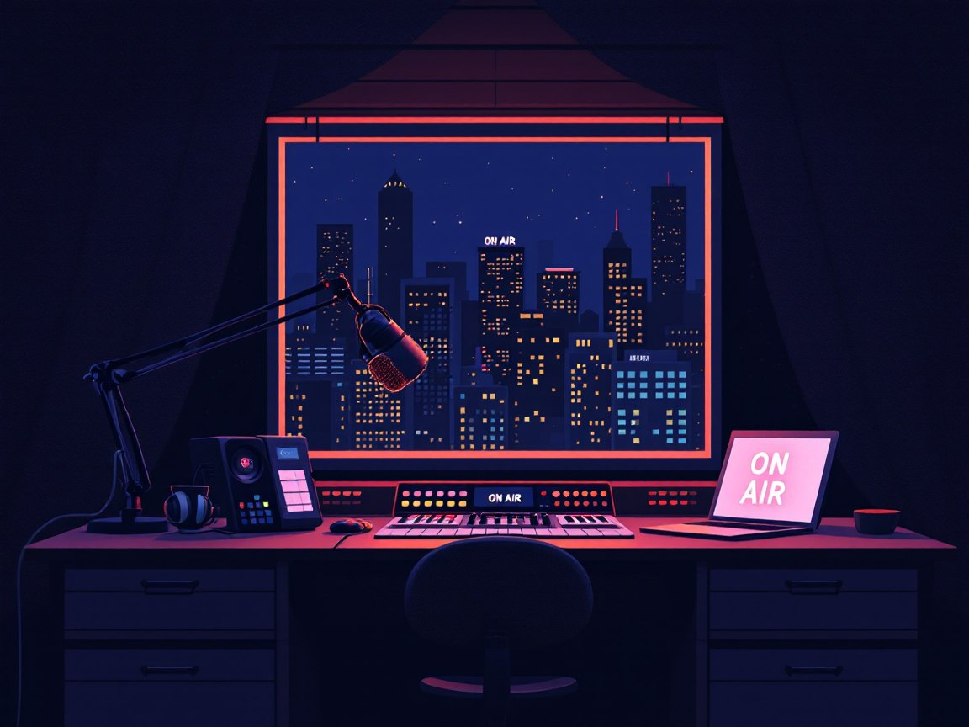
PART 2 · 3 of 4
On Air: 45-Second DJ
다섯 곡 중 하나를 라디오 DJ처럼 45초 안에. 두 번 해요.
THE FRAME
· Whose song is it?
· When did it come out?
· What should we listen for?
· Why this song, right now?
TOOLBOX
Coming up next is ~
Listen for the subtle ~ around the one-minute mark
If you only know their later stuff, ~
This one goes out to ~
INYOUNG SAYS
FROM YOUR WORDS · 지난주 단어 subtle

Slide 8
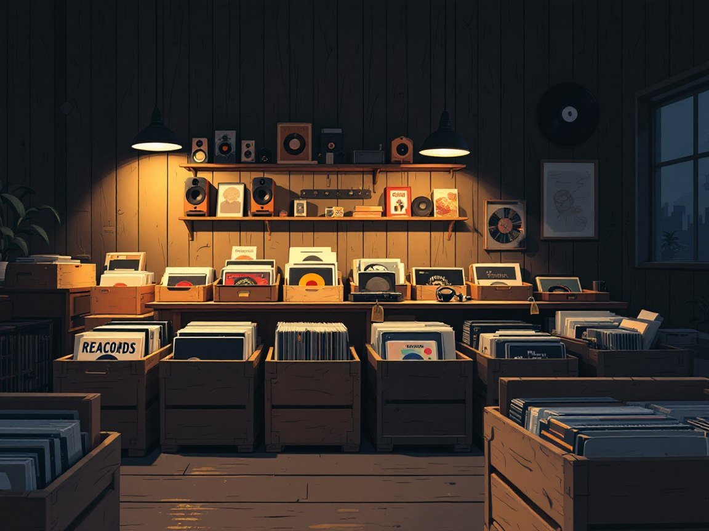
PART 2 · 4 of 4
The Lab Playlist
실험실에서 틀 음악. 상황마다 한 곡, 이유까지. Brian은 반대해요.
When you need to focus
I usually listen calming song. Like rock ballad.
During long, repetitive experiments
Excited songs especially when I am doing my data analysis work which is very repetitive. I like Imagine dragons with surrounded sounds which it gives me more excitement and cheering me up.
When you're writing a paper
Actually I haven’t yet wrote a paper. But if I write a paper, I think I won’t listen any songs.
When the experiment just failed
Anything is fine.
TOOLBOX
For ~, I need something ~ · Anything with lyrics is out when ~ · Is instrumental music sufficient for that?
FROM YOUR WORDS · 지난주 단어 sufficient

