Slide 1
INYOUNG · CLASS 4
Teach Brian — and Grad School, Off the Record
First hour: you're the expert and I know nothing. Second hour: your actual life as a grad student.
Do English with Brian

Slide 2
PART 1 · 1 of 3
Pick Three
아는 것만 골라요. Brian은 열 개 중 하나도 몰라요 — 그게 오늘의 재료예요.
I focus on mitochondria in neurons.
1
H.M.
The man who couldn't make a new memory after 1953 — and taught us where memory lives.
2
Split-brain
Cut the bridge between the hemispheres: one body, two minds, and a hand with its own opinion.
3
Grid cells
The brain's own GPS — neurons that fire in a perfect hexagonal pattern. Nobel Prize, 2014.
4
The "Jennifer Aniston" neuron
One human neuron that fires for one famous face — front, side, even the name in letters.
5
The civil servant with almost no brain
A French office worker, married with two kids, whose scans showed mostly fluid (Lancet, 2007).
6
The rubber hand illusion
Two paintbrushes, one fake hand — and your brain decides the fake one is yours.
7
Mirror neurons
Cells that fire when you act and when you watch someone act. Big claims, big debate.
8
Optogenetics
Switching single neurons on and off with light. How a lot of modern neuroscience is done.
9
The fruit fly connectome
Every neuron and connection in a fly's brain, mapped (2024). Why that's a big deal.
10
Placebo
Nothing in the pill — real change in the brain. What is belief doing in there?
Rule: pick what you already know. Three topics, about fifteen minutes each.

Slide 3
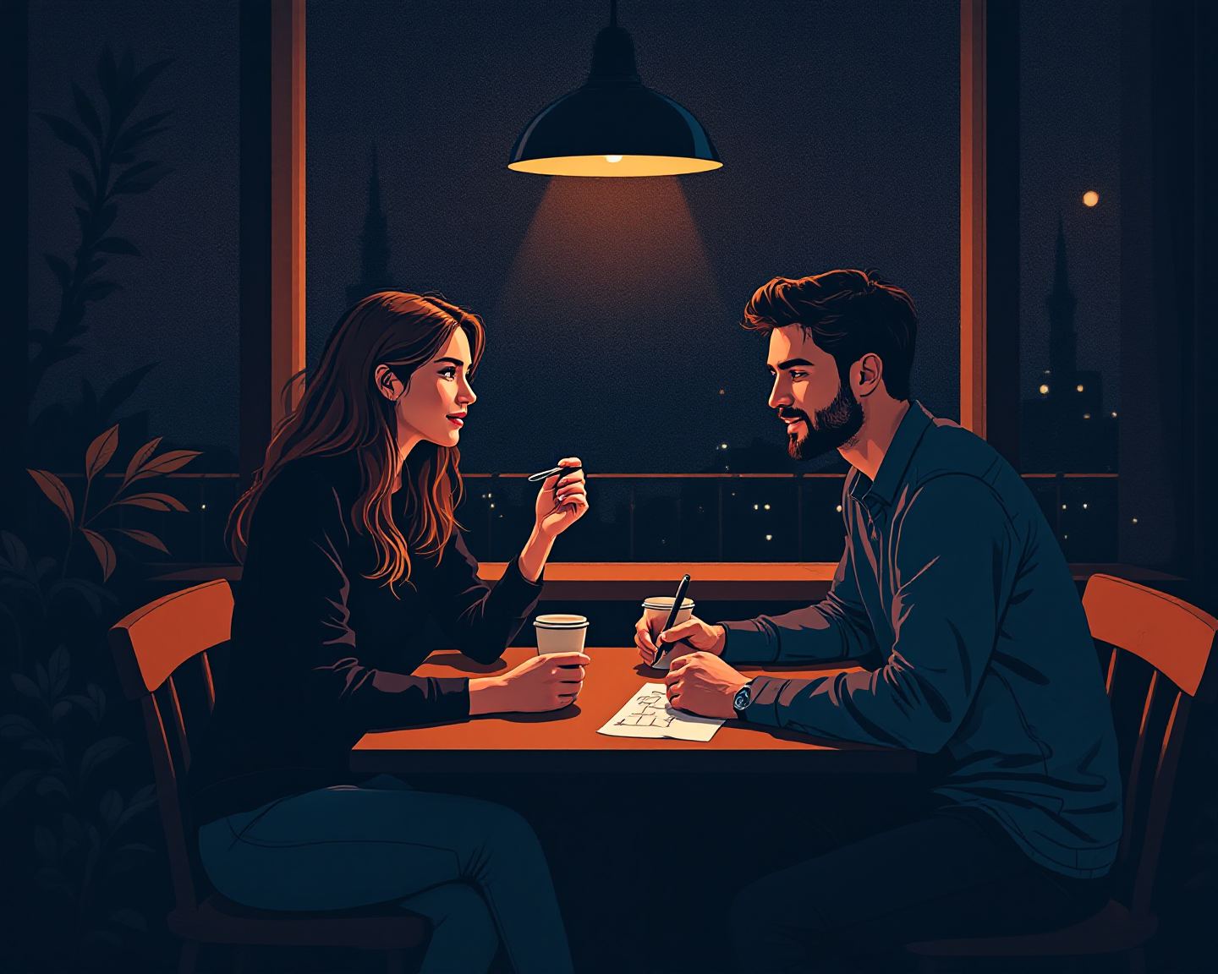
PART 1 · 2 of 3
How to Teach It
주제마다 같은 순서로. 랩 발표의 네 칸과 같은 뼈대 — 청중만 비전공자로 바뀐 것.
TOOLBOX
Imagine ~ 상상해 보세요, ~
The surprising part is ~ 놀라운 건 ~예요
Think of it like ~ ~라고 생각하면 돼요
What this tells us is ~ 이게 말해 주는 건 ~
The catch is ~ 문제는 ~예요
We still don't know ~ ~는 아직 몰라요
BRIAN ASKS · the non-scientist's questions
· So what? Why does that matter to me?
· How do we know that's actually true?
· Could that happen to me?
· Why did nobody know this before?
· Is this in textbooks now, or still argued about?
FIVE MOVES · 3 minutes
1 HOOK Why should a non-scientist care? One sentence.
2 WHAT THEY DID The experiment, in plain words. No jargon yet.
3 WHAT IT SHOWED The result — and what surprised everyone.
4 WHY IT MATTERS What changed in the field, or in the clinic.
5 WHAT'S STILL OPEN The part nobody has figured out.
FROM YOUR WORDS · 지난주 단어 insight · convert

Slide 4
PART 1 · 3 of 3
Round Two — Thirty Seconds
세 주제 다 끝나면, 하나씩 30초로 다시. 이번엔 노트 없이. Brian이 다른 사람한테 설명할 수 있으면 통과.
TOPIC 1
TOPIC 2
TOPIC 3
Did Brian get it? 1 2 3 4 5
Hardest question:
Word Inyoung was missing:
Did Brian get it? 1 2 3 4 5
Hardest question:
Word Inyoung was missing:
Did Brian get it? 1 2 3 4 5
Hardest question:
Word Inyoung was missing:
INYOUNG SAYS · Brian writes the good sentences here

Slide 5
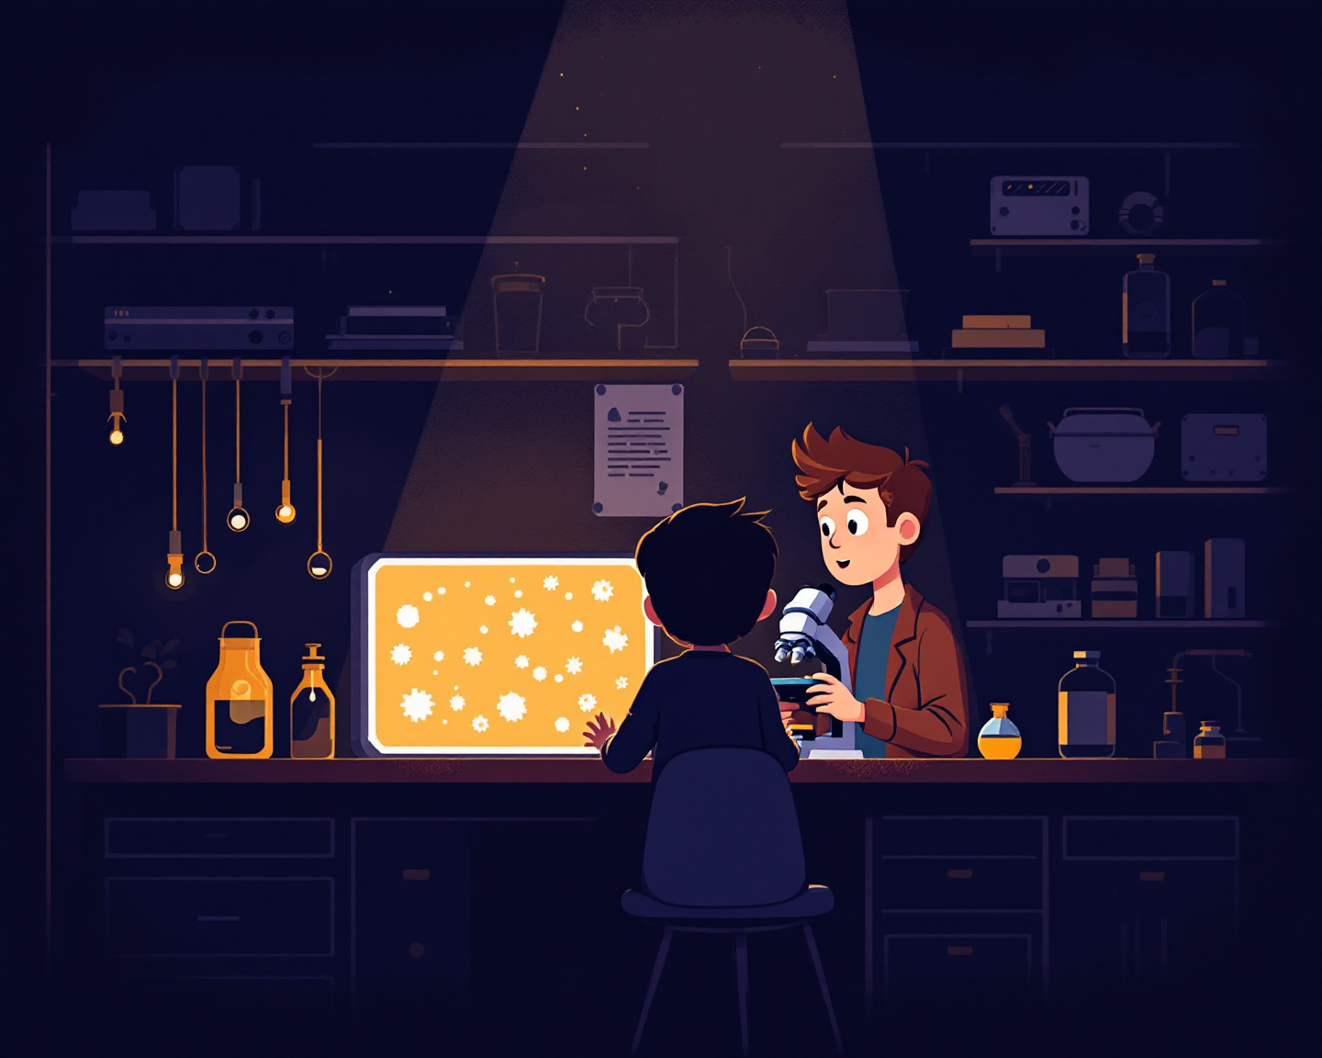
PART 2 · 1 of 4
Why Neuroscience
왜 이 길이었는지. 아직 한 번도 안 물어본 것.
QUESTIONS
Q1 When did you first decide on neuroscience — was there a moment, or did it creep up on you?
Q2 Was there a person you admired who pushed you this way?
Q3 How did you end up in this lab, of all labs?
Q4 What did your family say?
Q5 If not neuroscience, what would you be doing right now?
TOOLBOX
What drew me to ~ was ~ ~에 끌린 건 ~ 때문이었어요
I didn't plan it — ~ 계획한 건 아니었어요 — ~
INYOUNG SAYS
Genetic disorder / to make a drug to cure them
Neurodegenerative disease (during undergrad)
I admired the way ~ ~하는 방식이 멋져 보였어요
Looking back, the turning point was ~ 돌아보면 전환점은 ~였어요
If it weren't this, I'd probably ~ 이게 아니었으면 아마 ~
FROM YOUR WORDS · 지난주 단어 admire

Slide 6
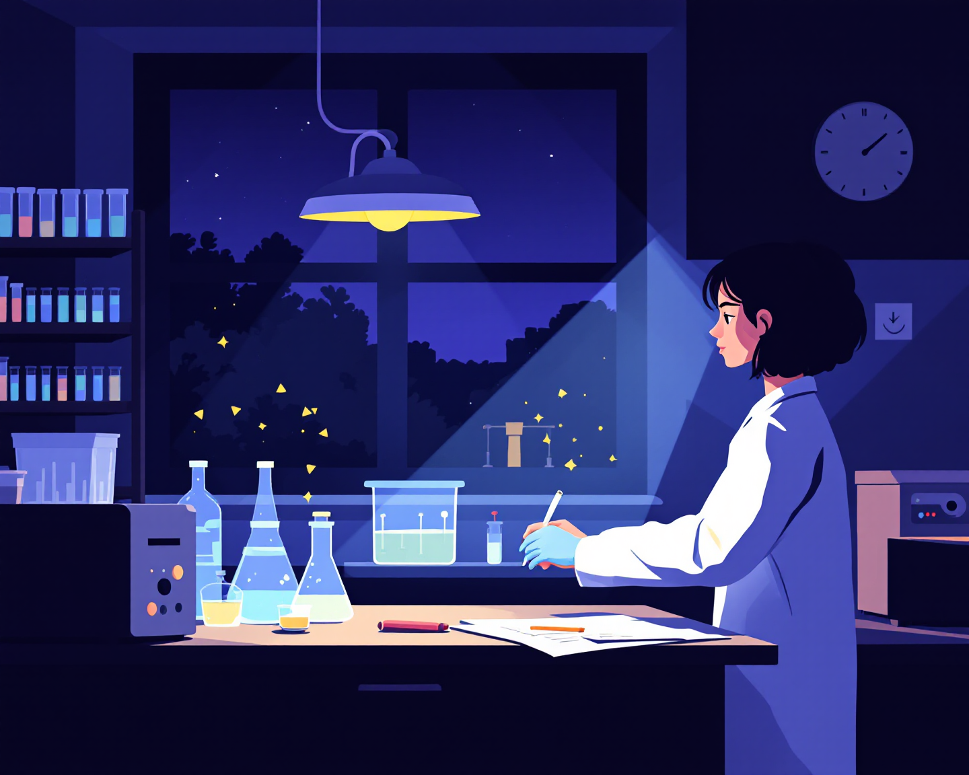
PART 2 · 2 of 4
A Day at KIST
실험실의 하루. 몇 시부터 몇 시까지, 뭐가 제일 싫고 뭐가 제일 좋은지.
QUESTIONS
Q1 Walk me through a normal day — from the moment you arrive to the moment you leave.
Q2 What do you do regularly that nobody outside a lab would guess?
Q3 What's the most boring part? And the part you secretly enjoy?
Q4 When was the last time an experiment just failed? What did you do that evening?
Q5 How much of the day is actual science, and how much is everything else?
TOOLBOX
A typical day runs from ~ to ~ 보통 하루는 ~부터 ~까지예요
Most of the morning goes to ~ 오전은 대부분 ~에 써요
INYOUNG SAYS
The part nobody sees is ~ 아무도 모르는 부분은 ~예요
Honestly, half of it is ~ 솔직히 절반은 ~예요
When it fails, I usually ~ 실패하면 보통 ~해요
FROM YOUR WORDS · 지난주 단어 regularly

Slide 7
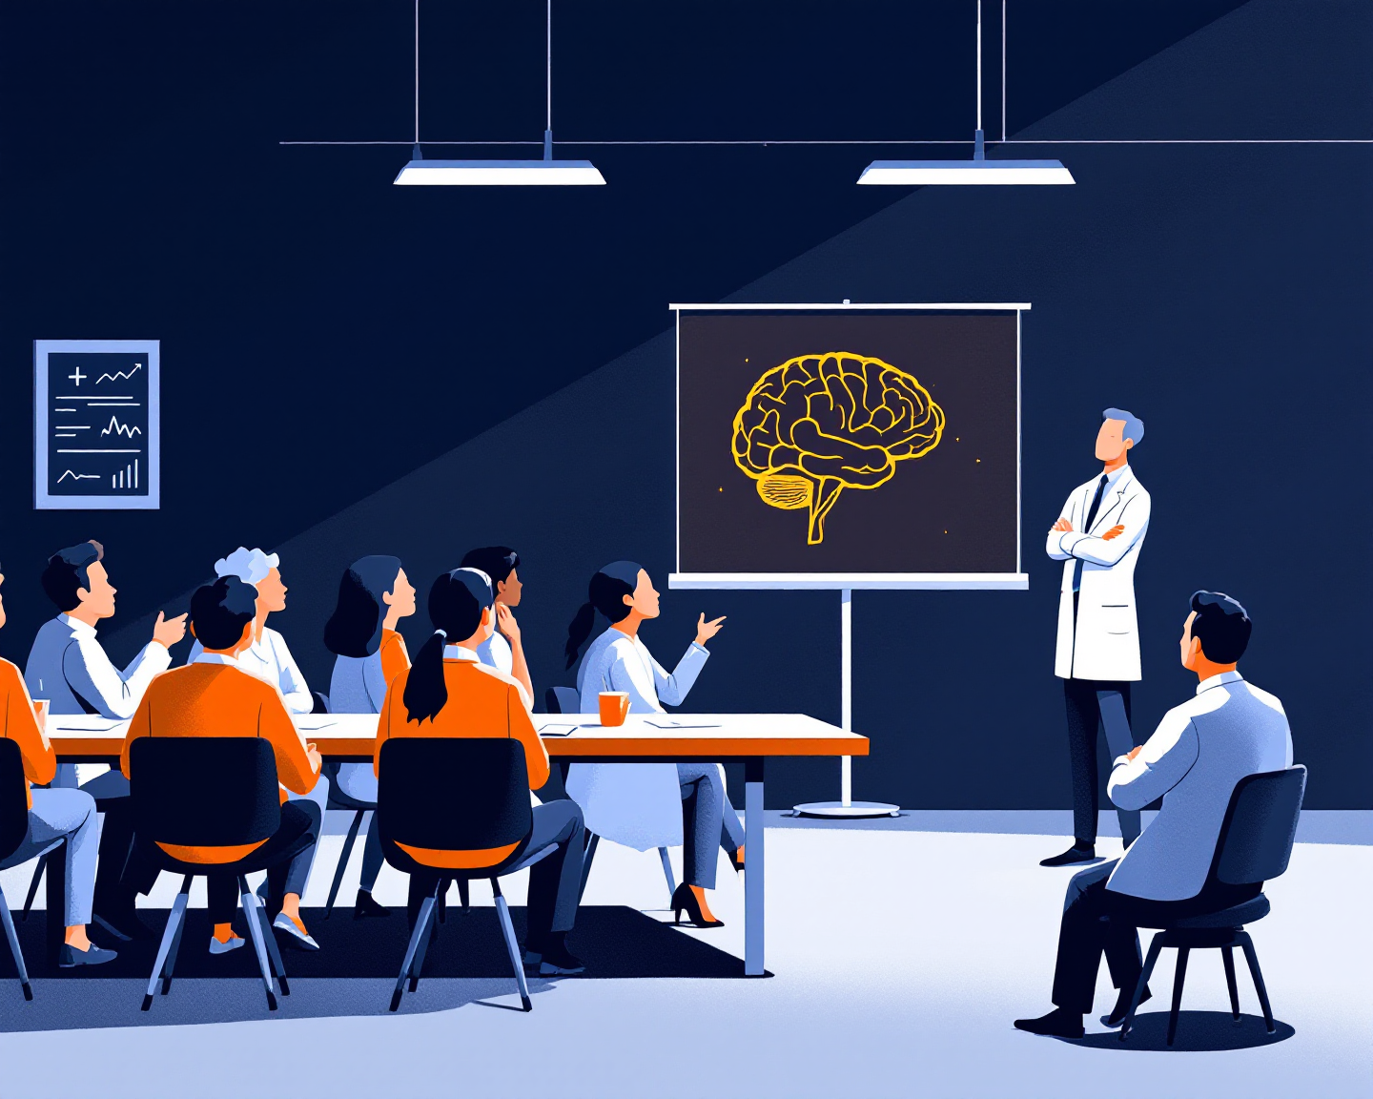
PART 2 · 3 of 4
The Lab, Off the Record
사람들, 랩 미팅 때 공기, 교수님. 솔직하게.
QUESTIONS
Q1 Who's in the lab, and who do you actually talk to?
Q2 What's the air like in lab meeting — relaxed, tense, sleepy?
Q3 Have you ever pretended to understand something in a meeting? What happened?
Q4 What's the most embarrassing thing that's happened to you in the lab so far?
Q5 What's one thing about your professor that surprised you?
TOOLBOX
There are ~ of us, and ~ 저희는 ~명이고, ~
In lab meeting, the mood is usually ~ 랩 미팅 분위기는 보통 ~
INYOUNG SAYS
I'll admit I once pretended to ~ 솔직히 한 번은 ~하는 척했어요
The part I didn't expect was ~ 예상 못 했던 건 ~였어요
What I've learned about ~ is ~ ~에 대해 알게 된 건 ~예요
FROM YOUR WORDS · 지난주 단어 pretend · embarrass

Slide 8
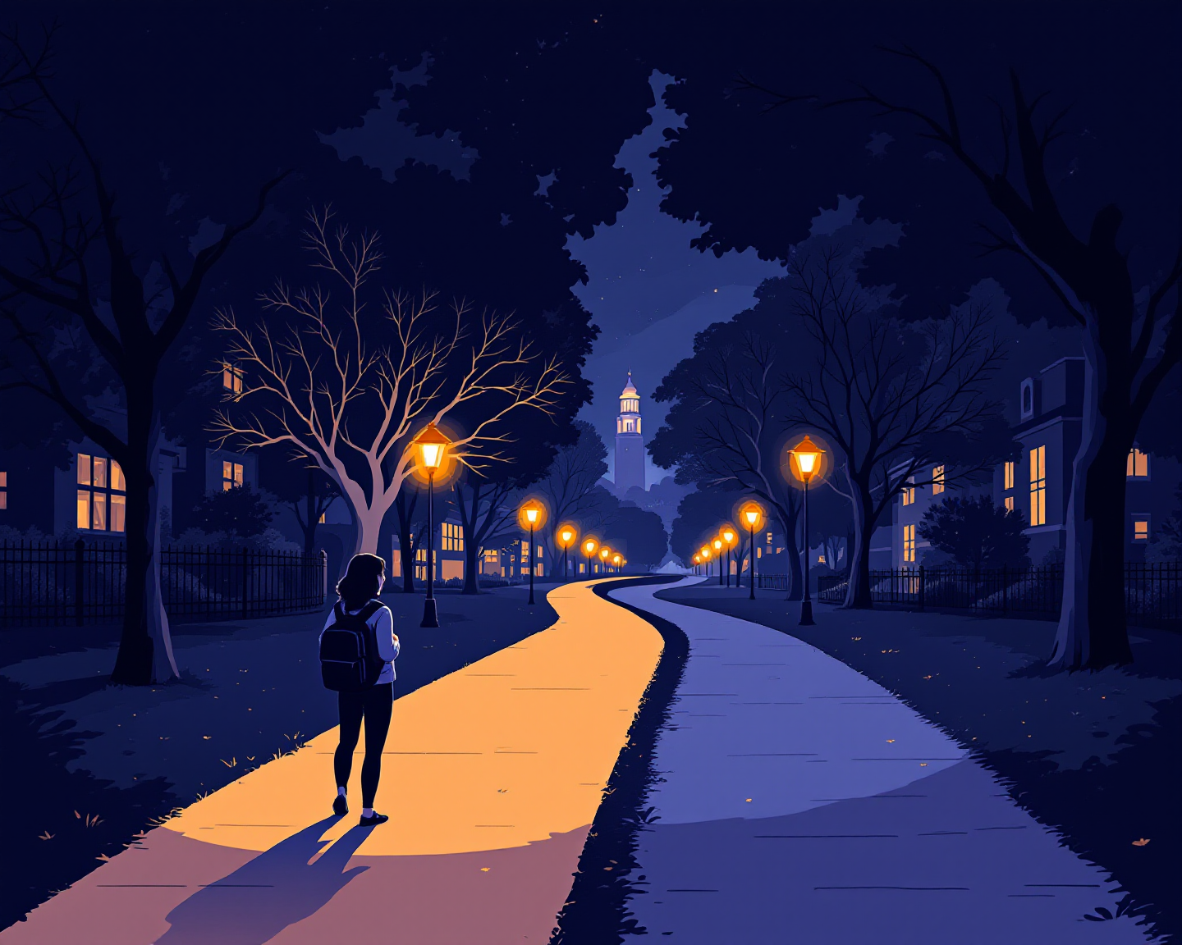
PART 2 · 4 of 4
After the Master's
석사 끝나면. 그리고 1년 전의 나한테 한마디.
QUESTIONS
Q1 When the master's is done — PhD, a job, abroad? Where are you leaning right now?
Q2 What makes you anxious about that choice, and what makes you confident?
Q3 Who do you talk to when you're not sure?
Q4 Where would you like to be at thirty?
Q5 One line to yourself a year ago — what would you say?
TOOLBOX
I'm leaning toward ~, but ~ ~ 쪽으로 기울고 있는데, ~
What makes me anxious is ~ 불안한 건 ~예요
INYOUNG SAYS
I feel confident about ~ because ~ ~는 자신 있어요, ~라서요
By thirty, I'd like to ~ 서른까지는 ~하고 싶어요
If I could tell her one thing, it'd be ~ 한마디만 할 수 있다면 ~
FROM YOUR WORDS · 지난주 단어 anxious · confident

