Slide 1
INYOUNG · CLASS 8
The Paper You'll Present
Four figures, four boxes. Then the whole talk, twice. Then the questions.
DO ENGLISH WITH BRIAN

Slide 2
HOW TODAY WORKS
Four Boxes, Every Figure
St. Laurent et al., Biological Psychiatry 97:707 (2025) — ITC dysfunction and avoidance extinction in Sapap3 mice
1 ASKED
2 DID
3 FOUND
4 SO WHAT
The question here is whether ___.
To test this, they ___.
What they found was ___.
This tells us ___.
EXTINCTION 소거
TENSE
Not forgetting. Learning something new: “the warning doesn't mean danger any more.”
잊는 게 아니라, "이제 그 신호가 위험을 뜻하지 않는다"를 새로 배우는 것.
What they did, what they found → past. They took the food away for six hours.
What it means → present. This tells us that hunger changes…
VOICE · out loud, active is easier to follow
✓ They switched the neurons off during the tone. △ The neurons were switched off during the tone. fine in a paper, harder to follow in a room
60분 조립 · 35분 통으로 두 번 · 25분 질문 받기

Slide 3
PIECE 1 · THE BACKGROUND · 10 MIN
Why Ask This at All?
Why does a mouse keep climbing the platform when nothing bad happens any more?
SET IT UP IN THREE LINES
1
People with OCD keep doing something even when ___.
WHO
Sapap3-null mice — ___.
2
That looks like a failure of ___.
THE TASK
3
So the question here is whether ___.
Sugar on one side, a safe platform on the other — ___.
YOUR LINE · 제일 잘 나온 문장, 고친 버전
WHAT GOES WRONG
In extinction, the tone comes without the shock, but ___.
THE TARGET
ITCd — a small group of cells that ___.
SAY IT RIGHT aMYGdala · obSESsive-comPULsive · exTINCtion · interCAlated
ITCd — 편도체 안의 작은 세포 묶음. 주변을 끄는 역할을 해요.

Slide 4
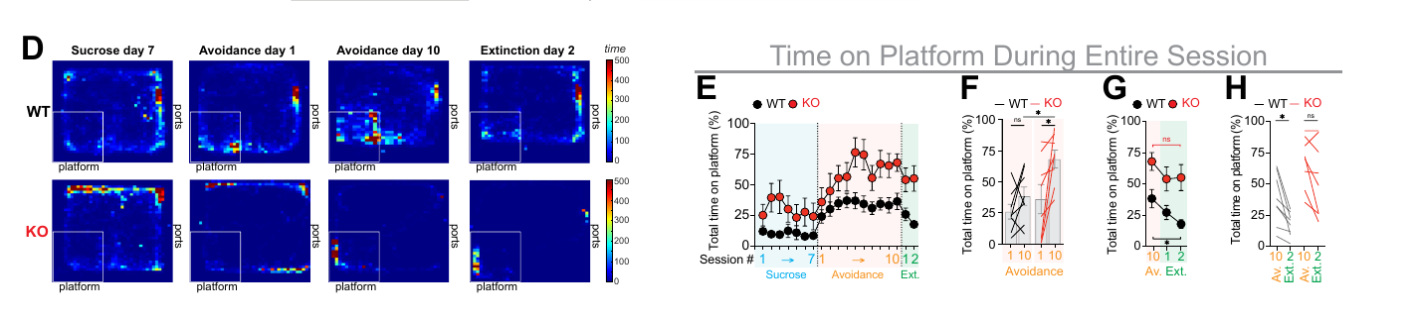
PIECE 2 · FIGURE 1 · 12 MIN
What the Mice Did
How do you show that a mouse failed to extinguish — and not that it was simply more afraid?
St. Laurent et al., Biol Psychiatry 97:707 (2025) · Fig. 1D–H
1 ASKED The question here is whether ___.
2 DID To test this, they ___.
3 FOUND What they found was ___.
4 SO WHAT This tells us ___.
METHOD IN ONE LINE · heatmaps + time on platform
SAY IT TO UNDERGRADS 학부생한테 말하듯
platform-mediated avoidance → a choice between food and safety
extinction → the tone comes, the shock doesn't
platform-mediated avoidance
10 training days
2 extinction days
KO stayed on the platform
HINT WORDS
SAY IT RIGHT aVOIDance · PLATform · deprivAtion · GENotype

Slide 5
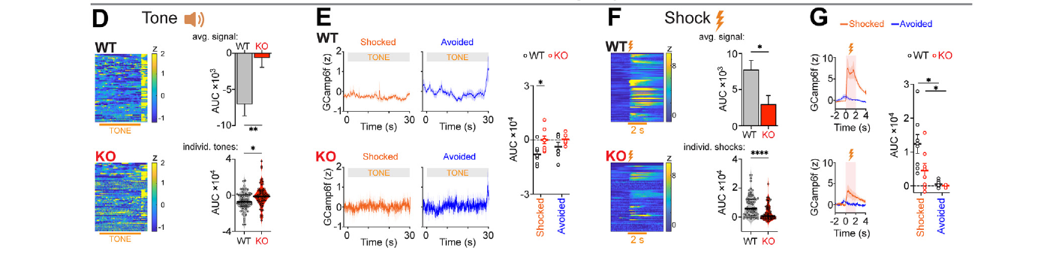
PIECE 3 · FIGURE 2 · 15 MIN
What the Cells Did
If the behaviour is different, what does the ITCd signal look like while it happens?
St. Laurent et al., Biol Psychiatry 97:707 (2025) · Fig. 2D–G
1 ASKED The question here is whether ___.
2 DID To test this, they ___.
3 FOUND What they found was ___.
4 SO WHAT This tells us ___.
METHOD IN ONE LINE · how photometry works, in one sentence
SAY IT TO UNDERGRADS 학부생한테 말하듯
fiber photometry → watching a group of neurons light up while the animal moves
AUC → how much signal there was in total
fiber photometry
GCaMP6f
tone vs. shock
AUC
weaker shock response
HINT WORDS
SAY IT RIGHT phoTOMetry · CALcium · TRANsient · AMplitude

Slide 6
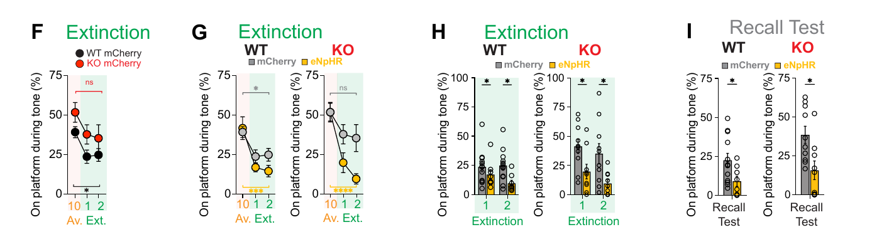
PIECE 4 · FIGURE 3 · 15 MIN
Switch It Off
Is the ITCd signal just along for the ride, or is it causing the deficit?
St. Laurent et al., Biol Psychiatry 97:707 (2025) · Fig. 3F–I
1 ASKED The question here is whether ___.
2 DID To test this, they ___.
3 FOUND What they found was ___.
4 SO WHAT This tells us ___.
METHOD IN ONE LINE · when exactly the light was on
SAY IT TO UNDERGRADS 학부생한테 말하듯
optogenetic inhibition → switching the cells off with light
recall test → testing again a day later, with no light
eNpHR3.0
light during the 30-second tone
extinction rescued
recall test 24 h later
HINT WORDS
SAY IT RIGHT optoGEnetic · inhiBItion · haloRHOdopsin · reCALL

Slide 7
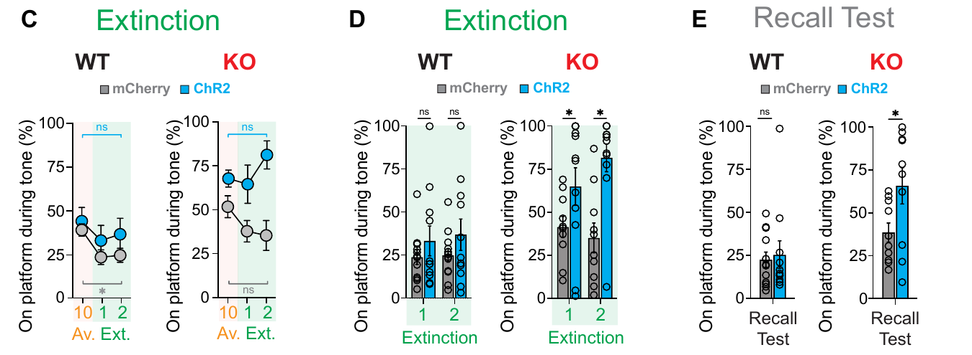
PIECE 5 · FIGURE 4 · 12 MIN
Switch It On
And the other direction — what happens if you drive the same cells harder?
St. Laurent et al., Biol Psychiatry 97:707 (2025) · Fig. 4C–E
1 ASKED The question here is whether ___.
2 DID To test this, they ___.
3 FOUND What they found was ___.
4 SO WHAT This tells us ___.
METHOD IN ONE LINE · what the control group got
SAY IT TO UNDERGRADS 학부생한테 말하듯
ChR2 activation → switching the cells on with light
mCherry control → the light, but no switch
ChR2
KO got worse
WT: no effect
persisted to the recall test
HINT WORDS
SAY IT RIGHT actiVAtion · channelrhoDOPsin · exACerbate · perSISted

Slide 8
PIECE 6 · THE WHOLE STORY · 35 MIN
Start from the Top
두 번 해요. 두 번째는 멈추지 않고, 그림을 가리키면서.
FIG 1
What the mice did — ___.
CLOSE IT · 하나 고르기
Mechanism
FIG 2
What the cells did — ___.
So the ITCd has to quiet down for the animal to let go of the habit — and in these mice, it doesn't.
FIG 3
Switch it off — ___.
Big picture
This is one of the first times a single ITC cluster has been switched off, and the behaviour followed.
FIG 4
Switch it on — ___.
For the room
TAKE 2 · 두 번째에 더 좋아진 한 줄
It points at a circuit you could actually aim a treatment at.
1분 배경 → Fig 1 → 2 → 3 → 4 → 마무리 한 줄.

Slide 9
PIECE 7 · WHEN THEY ASK · 25 MIN
The Questions You'll Get
Brian이 journal club처럼 물어요. 첫마디부터.
How did you know the mouse was avoiding, and not just sitting there?
Why only the dorsal cluster? What about the ventral one?
1
2
Two days of extinction — is that long enough?
Why did the activation do nothing in the wild-type mice?
3
4
How long does one photometry session take?
If you ran the next experiment, what would it be?
5
6
FIRST MOVES 첫마디
THE ONE YOU'LL REDO · 다시 답하고 싶은 것
· That's a good question — let me go back to Figure ~.
· I'm not sure, but my guess is ~.
· The short answer is ~, and the longer answer is ~.
· We didn't test that, but ~.
· I'd have to check the methods, but ~.
speculate
improvise
reiterate
FROM YOUR WORDS · 이번 주

Slide 10
WRAP
Before the Lab Meeting
오늘 나온 문장이 L&S 03으로 가요.
1
2
3
Record it
Find out
Listen
The three-minute version — about 40 seconds per figure. Send it to Brian.
How long the talk is · the date · whether the slides are yours or your professor's.
L&S 03 is built from today's YOUR LINE sentences — your own words, corrected.
3분 버전을 녹음해서 보내기
발표 길이·날짜·슬라이드 확인
오늘 나온 문장으로 만든 복습 자료
Do English with Brian

