Slide 1
LISA · CLASS 12
The Wine List
Twenty bottles from your own portfolio. Three very different rooms. Six bottles each — and the reasons you left the rest out.
Do English with Brian

Slide 2
THE CARDS
Twenty bottles, all yours
전부 금양 포트폴리오. 가격은 Lisa가 알아요 — 카드엔 가격대만.
1
Pol Roger Brut Réserve
Champagne ₩₩₩₩
2
Pierre Gimonnet Blanc de Blancs 1er Cru
Champagne ₩₩₩
3
Carta Nevada Brut
Cava · Spain ₩
4
Brown Brothers Moscato
Australia · sweet, light fizz ₩
5
Ramey Russian River Chardonnay
USA · Sonoma ₩₩₩
6
Craggy Range Te Muna Sauvignon Blanc
New Zealand ₩₩
7
Matua Marlborough Sauvignon Blanc
New Zealand ₩
8
Rapaura Springs Reserve Pinot Gris
New Zealand ₩₩
9
Château La Nerthe Châteauneuf-du-Pape Blanc
Rhône ₩₩₩
10
Penfolds Koonunga Hill Autumn Riesling
Australia ₩
11
1865 Selected Vineyards Cabernet Sauvignon
Chile ₩₩
12
Marques de Casa Concha Etiqueta Negra
Chile ₩₩₩
13
Penfolds Koonunga Hill Shiraz
Australia ₩
14
d'Arenberg The Dead Arm Shiraz
Australia · McLaren Vale ₩₩₩
15
Trapiche Reserva Malbec
Argentina ₩
16
Cafaggio Chianti Classico DOCG
Tuscany ₩₩
17
Tommasi Ca' Florian Amarone
Veneto ₩₩₩₩
18
Casisano Brunello di Montalcino
Tuscany ₩₩₩
19
Château La Nerthe Châteauneuf-du-Pape Rouge
Rhône ₩₩₩
20
Anseillan
Bordeaux · the Lafite team ₩₩₩
1–4 sparkling · 5–10 white · 11–20 red

Slide 3
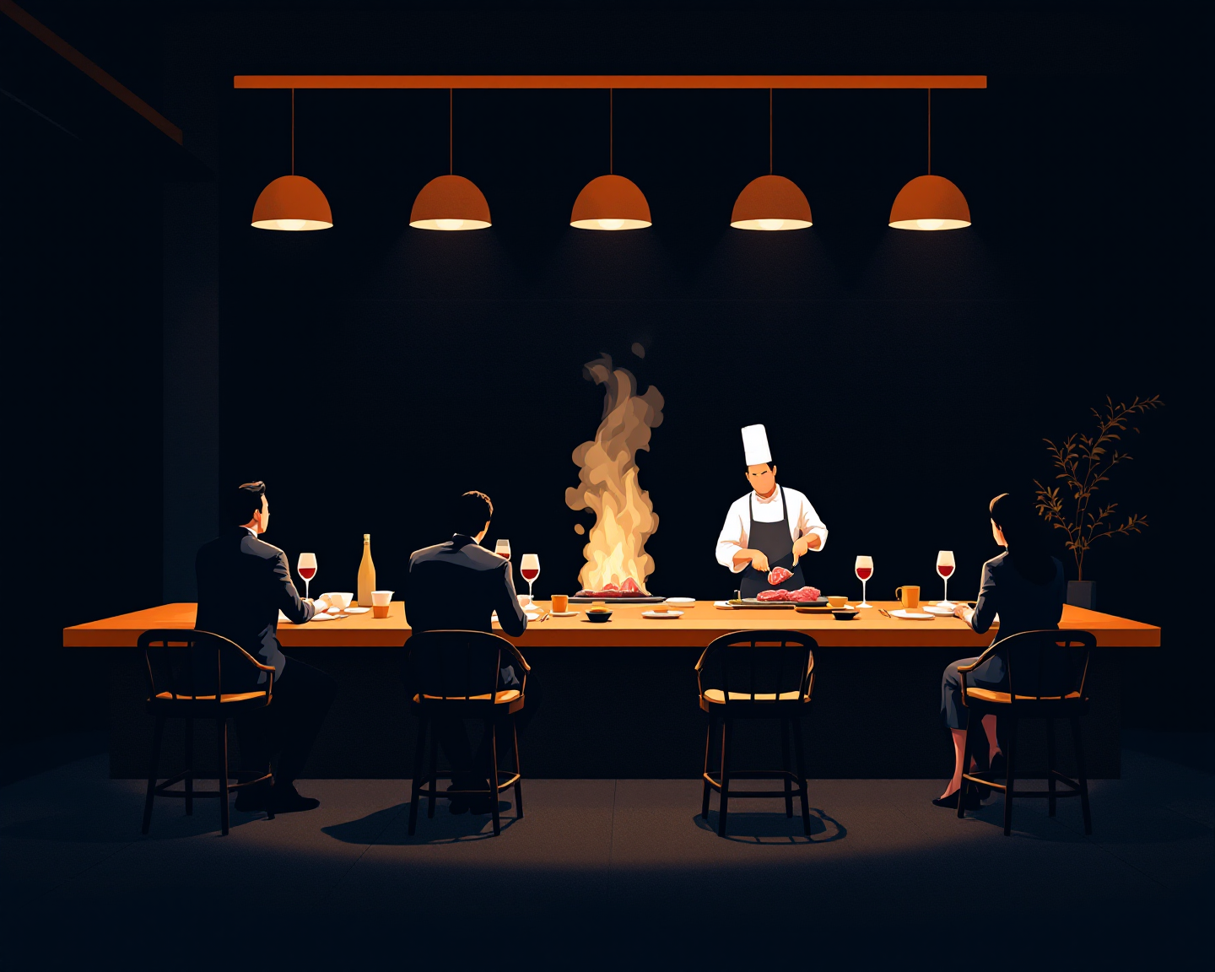
ROOM 1 OF 3
The Hanwoo Omakase
1인 15만 원대 한우 오마카세. 손님은 와인에 돈을 쓸 준비가 돼 있어요.
YOUR SIX · number + why
LEFT OUT · why
1
２
2
５
3
９
4
11
5
18
THE ROOM
6
19
Seats Twelve at the counter, one seating a night, about 150,000 won a head before wine.
Guests Already spending — the question is what they'll trust.
THE OWNER PUSHES BACK
“Five of these are red. My first three courses are raw.”
“Why would I pay for a name nobody at the counter knows?”
How it sells Mostly bottles; a glass pairing on request.
The chef Strict about one thing: nothing that fights the meat.
The menu Ten courses, raw to grilled to rice — the list has to move with them.
FROM YOUR WORDS · 지난주 단어 strict

Slide 4
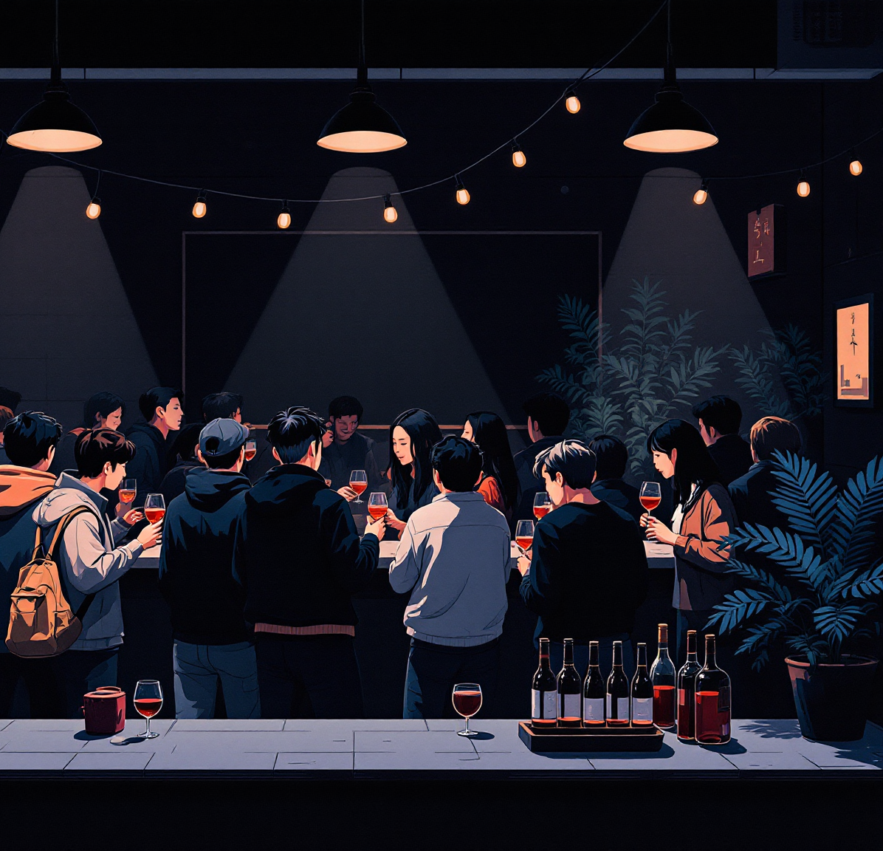
ROOM 2 OF 3
The Seongsu Bar
성수 캐주얼 와인바. 잔 판매 위주, 2030, 한 병 5만 원 아래가 잘 나가요.
YOUR SIX · number + why
LEFT OUT · why
1
4
2
6
3
8
4
15
5
13
THE ROOM
6
20
Room Forty seats, loud, standing room on weekends.
How it sells Eighty percent by the glass — a bottle has to survive two days open.
THE OWNER PUSHES BACK
“That one's too expensive to pour by the glass.”
“My regulars will say they've seen it everywhere.”
Guests Regulars come twice a week and want something new each time.
Price Under 50,000 won a bottle on the list is where it sells.
Marketing Instagram does it — the label matters.
FROM YOUR WORDS · 지난주 단어 regularly

Slide 5

ROOM 3 OF 3
The Hotel Lounge
호텔 라운지. 외국인 투숙객, 잔·병 반반, 아는 이름이 팔려요.
YOUR SIX · number + why
LEFT OUT · why
1
1
2
5
3
6
4
14
5
2
THE ROOM
6
20
Guests Business travelers, mostly foreign, often alone.
How it sells Half by the glass, half bottles for the table.
THE OWNER PUSHES BACK
“Nobody here knows Korean importers. Why this and not what they drink at home?”
“Which of these can you tell a story about in thirty seconds?”
Names A famous name converts a browser into a buyer.
Must-have Champagne by the glass is non-negotiable.
The twist One Korean-market story on the list would surprise them — if you can tell it.
FROM YOUR WORDS · 지난주 단어 convert · hint

Slide 6
LAST ONE
Beyond Myself, Now
트랙 이름을 정할 때와 지금. 그 사이에 뭐가 달라졌는지.
①
When you picked “beyond myself” for this track, what did you mean by it then?
②
What does it mean today — after the Ramey work, the trends, these lists?
③
Who do you admire that's a few steps ahead of you, and what are you still resisting?
LISA SAYS
FROM YOUR WORDS · 지난주 단어
admire
resist

