Slide 1
LISA · CLASS 13
Lisa's Calls
Eight arguments the wine world keeps having. You pick a side and tell me why — I just listen.
Do English with Brian

Slide 2
PICK YOUR ORDER
Eight calls
Lisa가 할 말 많은 것부터 골라요. 순서도, 건너뛰는 것도 Lisa 마음.
1
2
3
4
Natural Wine
100-Point Scores
Corkage in Korea
Young Koreans and Wine
Is natural wine here to stay?
Do scores still sell wine?
What's fair for corkage?
Who's winning the twenty-somethings?
5
6
7
8
The ₩300,000 Bottle
Wine with Korean Food
Screw Cap vs Cork
Wine on YouTube
Is a very expensive bottle worth it?
Does wine really work with Korean food?
Does the closure matter?
Do wine influencers help the market?
Every card: pick one side → three reasons → one real example.

Slide 3
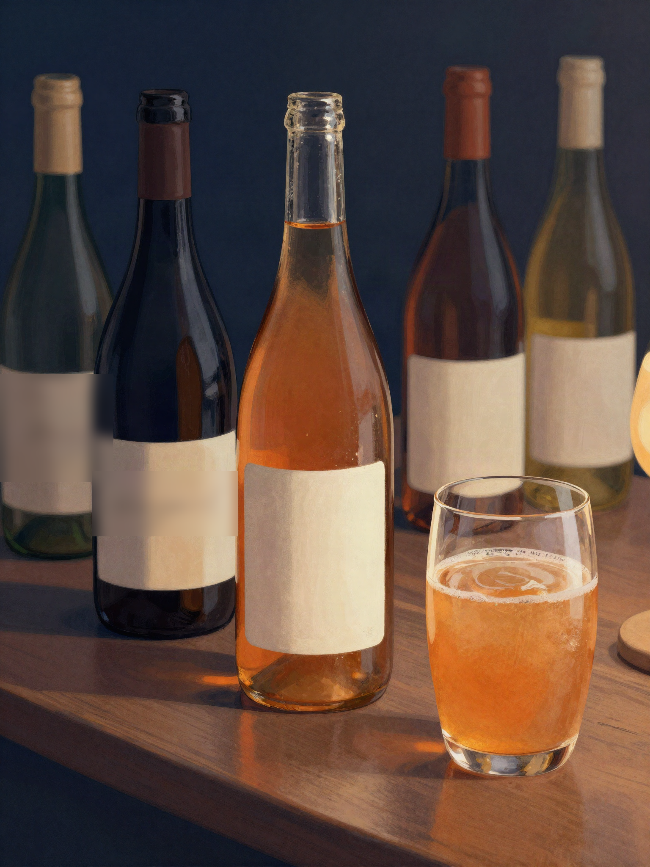
CALL 1 OF 8 · NATURAL WINE
Is natural wine here to stay?
A
A real shift in how people drink
B
A trend that'll fade in five years
C
Depends entirely on who's making it
THEN Would you put one on a restaurant list you were building? · What's the most acceptable flaw in a natural wine — and the one you can't forgive?
TOOLBOX
LISA SAYS
I'd go with ~, mainly because ~ ~ 쪽이에요, 주로 ~ 때문에
It depends on ~ ~에 따라 달라요
What people get wrong is ~ 사람들이 잘못 아는 건 ~
I used to think ~, but now ~ 예전엔 ~라고 생각했는데, 지금은 ~
FROM YOUR WORDS acceptable

Slide 4
CALL 2 OF 8 · 100-POINT SCORES
Do scores still sell wine?
A
Still useful — people need a shortcut
TOOLBOX
I'd go with ~, mainly because ~
~ 쪽이에요, 주로 ~ 때문에
It depends on ~
~에 따라 달라요
What people get wrong is ~
사람들이 잘못 아는 건 ~
I used to think ~, but now ~
예전엔 ~라고 생각했는데, 지금은 ~
B
Only useful for buyers, not drinkers
C
Nobody under 35 reads them anymore
THEN When did a score last change your mind about a bottle? · What would you replace scores with?
LISA SAYS

Slide 5
CALL 3 OF 8 · CORKAGE IN KOREA
What's fair for corkage?
A
It should be free
TOOLBOX
I'd go with ~, mainly because ~
~ 쪽이에요, 주로 ~ 때문에
It depends on ~
~에 따라 달라요
What people get wrong is ~
사람들이 잘못 아는 건 ~
I used to think ~, but now ~
예전엔 ~라고 생각했는데, 지금은 ~
B
Fair if it's reasonable
C
Restaurants are right to charge what they want
THEN What's the most aggressive corkage fee you've seen? · If you owned the restaurant, what would you charge?
LISA SAYS
FROM YOUR WORDS aggressive

Slide 6
CALL 4 OF 8 · YOUNG KOREANS AND WINE
Who's winning the twenty-somethings?
A
Wine is winning
TOOLBOX
I'd go with ~, mainly because ~
~ 쪽이에요, 주로 ~ 때문에
It depends on ~
~에 따라 달라요
What people get wrong is ~
사람들이 잘못 아는 건 ~
I used to think ~, but now ~
예전엔 ~라고 생각했는데, 지금은 ~
B
Highballs already won
C
Both — just on different nights
THEN What do your youngest frequent customers actually order? · What would bring them to wine, if anything?
LISA SAYS
FROM YOUR WORDS frequent

Slide 7
CALL 5 OF 8 · THE ₩300,000 BOTTLE
Is a very expensive bottle worth it?
A
Worth it, sometimes
TOOLBOX
I'd go with ~, mainly because ~
~ 쪽이에요, 주로 ~ 때문에
It depends on ~
~에 따라 달라요
What people get wrong is ~
사람들이 잘못 아는 건 ~
I used to think ~, but now ~
예전엔 ~라고 생각했는데, 지금은 ~
B
Only for the story behind it
C
Almost never
THEN What's the most you've paid for one bottle — and was it worth it? · Where does 'expensive' start for you?
LISA SAYS

Slide 8
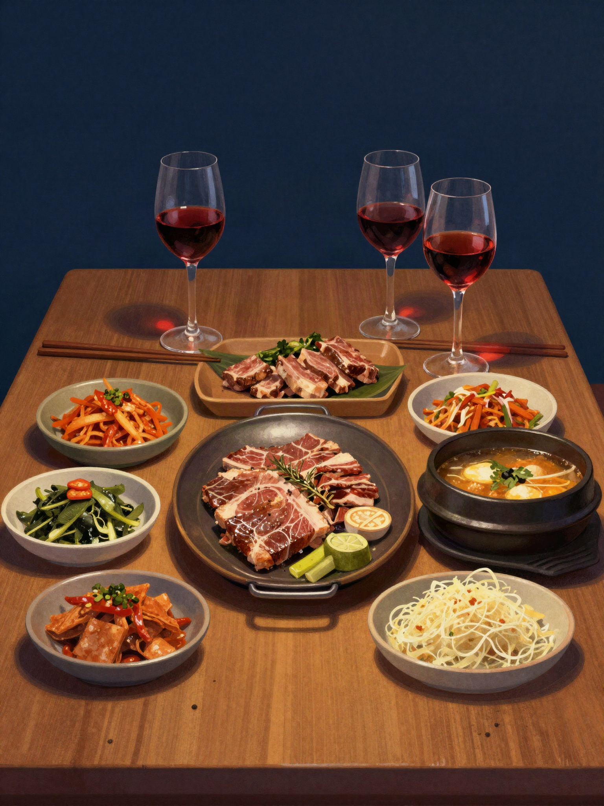
CALL 6 OF 8 · WINE WITH KOREAN FOOD
Does wine really work with Korean food?
A
Underrated — it works more often than people think
B
Overrated — soju and beer do it better
C
Only with certain dishes
THEN Name one Korean dish and the wine you'd put next to it. · Which dish is impossible?
TOOLBOX
LISA SAYS
I'd go with ~, mainly because ~ ~ 쪽이에요, 주로 ~ 때문에
It depends on ~ ~에 따라 달라요
What people get wrong is ~ 사람들이 잘못 아는 건 ~
I used to think ~, but now ~ 예전엔 ~라고 생각했는데, 지금은 ~

Slide 9
CALL 7 OF 8 · SCREW CAP VS CORK
Does the closure matter?
A
Screw cap is simply better
TOOLBOX
I'd go with ~, mainly because ~
~ 쪽이에요, 주로 ~ 때문에
It depends on ~
~에 따라 달라요
What people get wrong is ~
사람들이 잘못 아는 건 ~
I used to think ~, but now ~
예전엔 ~라고 생각했는데, 지금은 ~
B
Cork still matters for ageing
C
Customers decide, not the wine
THEN Do Korean customers still judge a screw cap? · Would you open a screw-cap bottle at a client dinner?
LISA SAYS

Slide 10
CALL 8 OF 8 · WINE ON YOUTUBE
Do wine influencers help the market?
A
They help — more people try wine
TOOLBOX
I'd go with ~, mainly because ~
~ 쪽이에요, 주로 ~ 때문에
It depends on ~
~에 따라 달라요
What people get wrong is ~
사람들이 잘못 아는 건 ~
I used to think ~, but now ~
예전엔 ~라고 생각했는데, 지금은 ~
B
They make everyone an expert overnight
C
They don't move sales at all
THEN Have you seen one video actually move a wine? · Do people consume more wine because of them — or just watch?
LISA SAYS
FROM YOUR WORDS consume

Slide 11
LAST ONE · JUST FOR FUN
The wine you secretly don't like
다들 좋아하는데 Lisa는 별로인 와인. 가볍게.
①
Which wine does everyone love that you just don't get?
②
Have you ever had to sell it anyway? How did that go?
③
And the opposite — a wine you love that nobody else orders?
LISA SAYS

