Slide 1
LUCY · CLASS 3B
What You Wanted to Be
No work talk today. The kid you were, the days that fly by, and the thing you'd do if nothing was in the way.
Do English with Brian

Slide 2
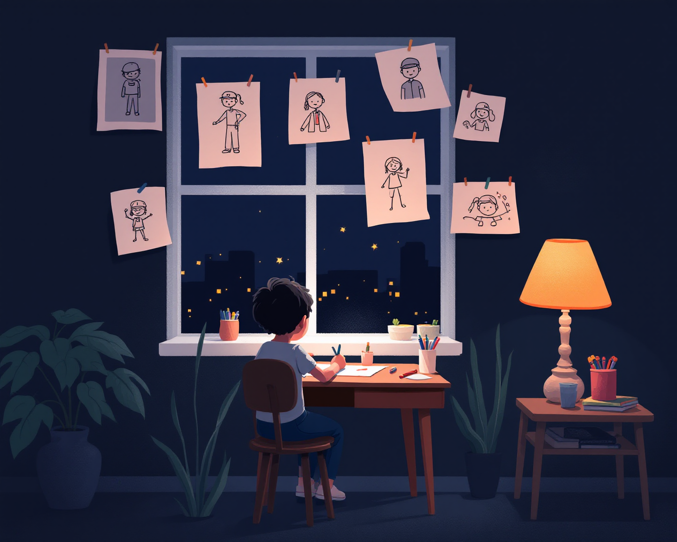
PART 1
The Kid
열 살 때, 스무 살 때. 되고 싶었던 것.
QUESTIONS
Q1 What did you want to be when you were ten?
Q2 And at twenty — had it changed?
Q3 Who did you look up to back then, and why?
Q4 Was that the norm for kids around you, or were you the odd one?
Q5 Is there anything from that kid still in you?
TOOLBOX
When I was ~, I wanted to be ~ ~살 때는 ~가 되고 싶었어요
LUCY SAYS
I used to ~ 예전엔 ~하곤 했어요
I looked up to ~ because ~ ~를 동경했어요, ~라서요
Somewhere along the way, ~ 어느 순간부턴가 ~
Part of me still ~ 마음 한구석은 아직 ~
FROM YOUR WORDS · 지난주 단어 norm

Slide 3

PART 2
The Good Days
시간 가는 줄 모르는 일. 돈 안 받아도 할 일.
QUESTIONS
Q1 When do you lose track of time — at work, or outside it?
Q2 Which campaign made you a little jealous, just as a viewer?
Q3 What would you do even if nobody paid you?
Q4 What do people come to you for?
Q5 When did you last feel proud of something you made?
TOOLBOX
I lose track of time when ~ ~할 때는 시간 가는 줄 몰라요
LUCY SAYS
What I love about ~ is ~ ~에서 제일 좋은 건 ~예요
I'd do ~ even if nobody paid me 돈을 안 줘도 ~는 할 거예요
People come to me when ~ 사람들이 ~할 때 저를 찾아요
The last time I felt that was ~ 마지막으로 그렇게 느낀 건 ~였어요
FROM YOUR WORDS · 지난주 단어 viewer

Slide 4
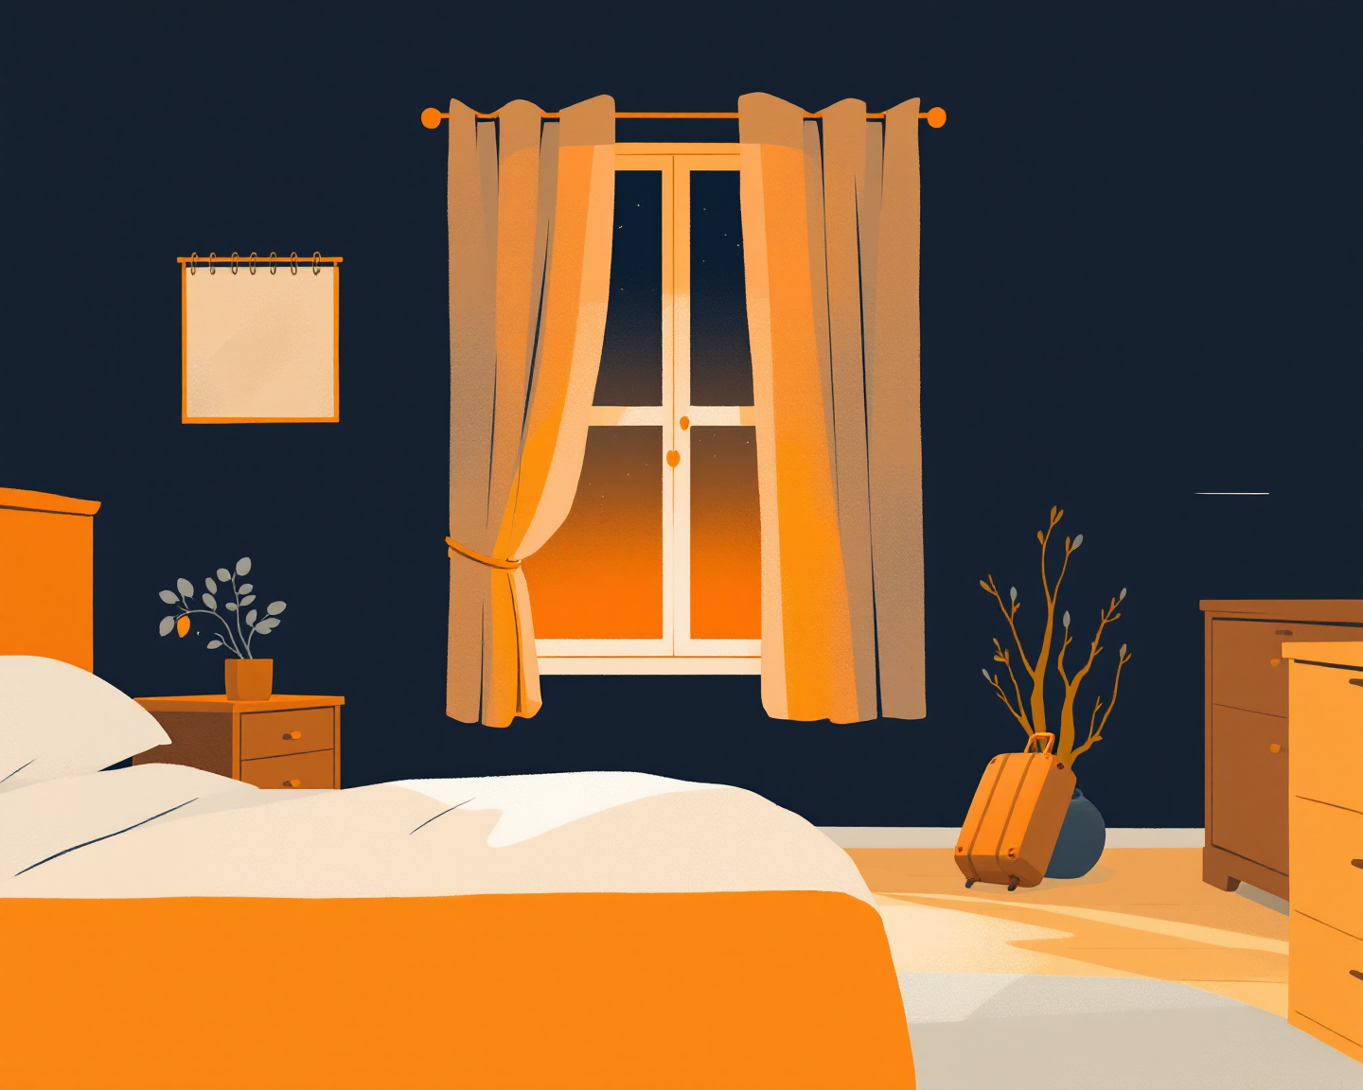
PART 3
If
1년이 통째로 자유라면. 그리고 '충분하다'는 어떤 모습인지.
QUESTIONS
Q1 Given a free year and no money worries — what would you do with it?
Q2 Through the lens of your ten-year-old self, what would she say about your job now?
Q3 What does "enough" look like for you?
Q4 Is there a version of your job you'd actually love?
Q5 What do you want that feels a bit embarrassing to say out loud?
TOOLBOX
Given a free year, I'd ~ 1년이 주어지면 ~할 거예요
LUCY SAYS
If I didn't have to worry about ~, I'd ~ ~ 걱정만 없으면 ~할 텐데요
Enough, for me, would be ~ 저한테 '충분하다'는 ~예요
I'd love a version of ~ where ~ ~가 ~하기만 하면 정말 좋을 것 같아요
It feels a bit silly to say, but ~ 말하기 좀 쑥스럽지만 ~
FROM YOUR WORDS · 지난주 단어 given · lens

Slide 5
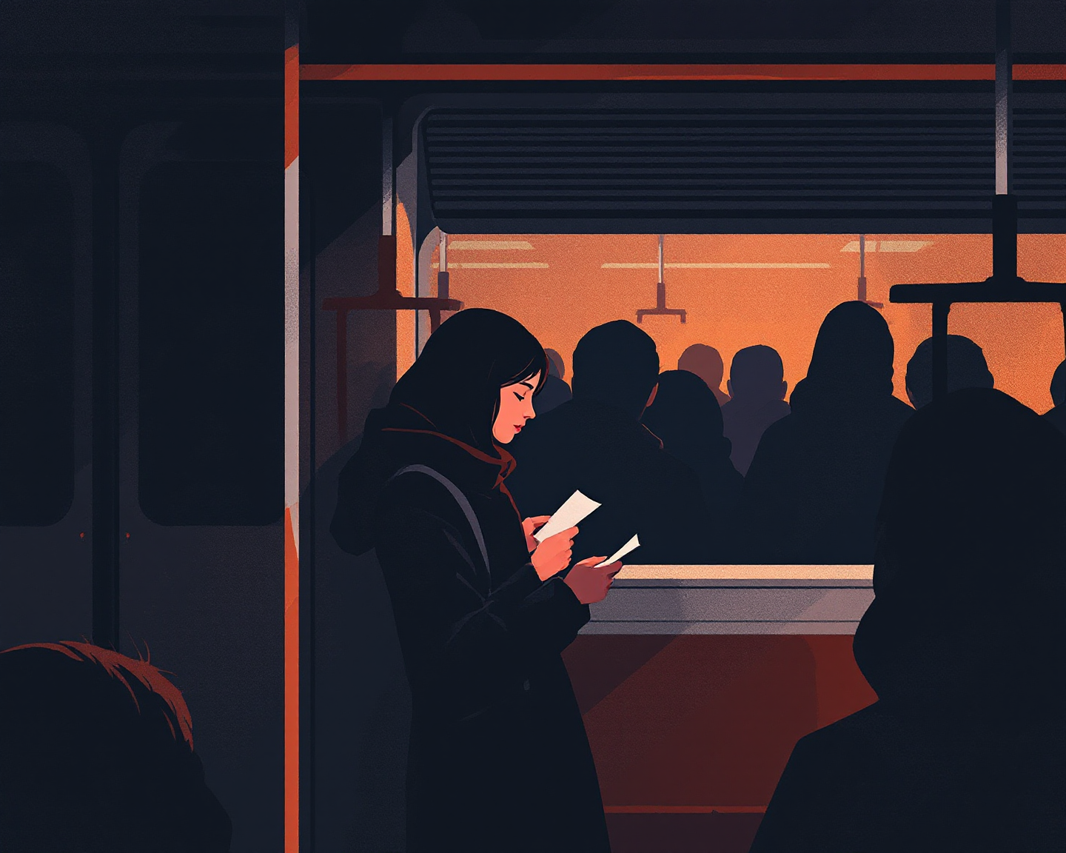
PART 4
Monday
그쪽으로 가는 아주 작은 한 걸음.
QUESTIONS
Q1 What's one small thing you could do this month toward it?
Q2 Who could you talk to about it?
Q3 What would you stop doing to make room?
Q4 How close have you come to it before?
Q5 If it doesn't work out, how would you let it go with grace?
TOOLBOX
One small thing I could do is ~ 작게라도 할 수 있는 건 ~예요
LUCY SAYS
I could start by talking to ~ ~한테 얘기하는 것부터 시작할 수 있어요
I'd stop ~ to make room 자리를 만들려고 ~를 그만둘 거예요
The closest I've come is ~ 제일 가까이 갔던 건 ~였어요
If it doesn't work out, ~ 안 되더라도 ~
FROM YOUR WORDS · 지난주 단어 grace

