Slide 1
LEE · CLASS 28
48 Hours in Seoul
Your Singapore partner lands Friday night and flies out Sunday. You planned it all. Walk me through it — and handle whatever goes wrong.
Do English with Brian

Slide 2
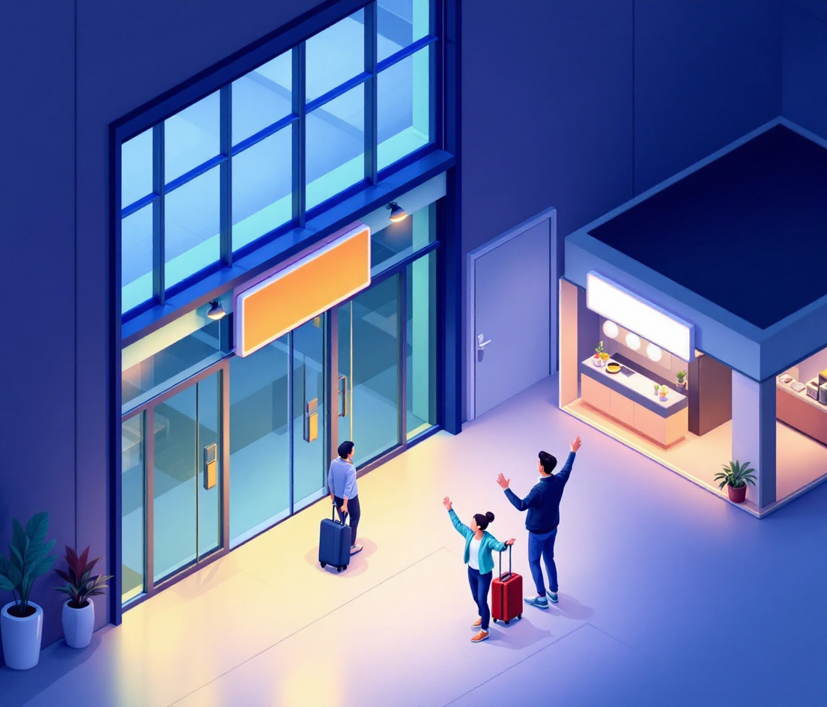
FRIDAY · 9 PM · 1 / 7
Arrivals, Incheon
LEE SAYS
Welcome to Korea! How was ~?
e.g. Welcome to Korea! How was the flight?
Let me take ~.
e.g. Let me take your bag.
It takes about ~ to get to ~.
e.g. It takes about an hour and a half to get to the hotel on a Friday.
HE ASKS Is the hotel far from here?
SURPRISE · click
↳ His suitcase didn't come out. What do you say, and what do you do first?
NOTES
How was the flight?
Let me take your bag.
It takes about 3 mins to get to hotel.
(Is the hotel nearby here?)
FROM YOUR WORDS half

Slide 3
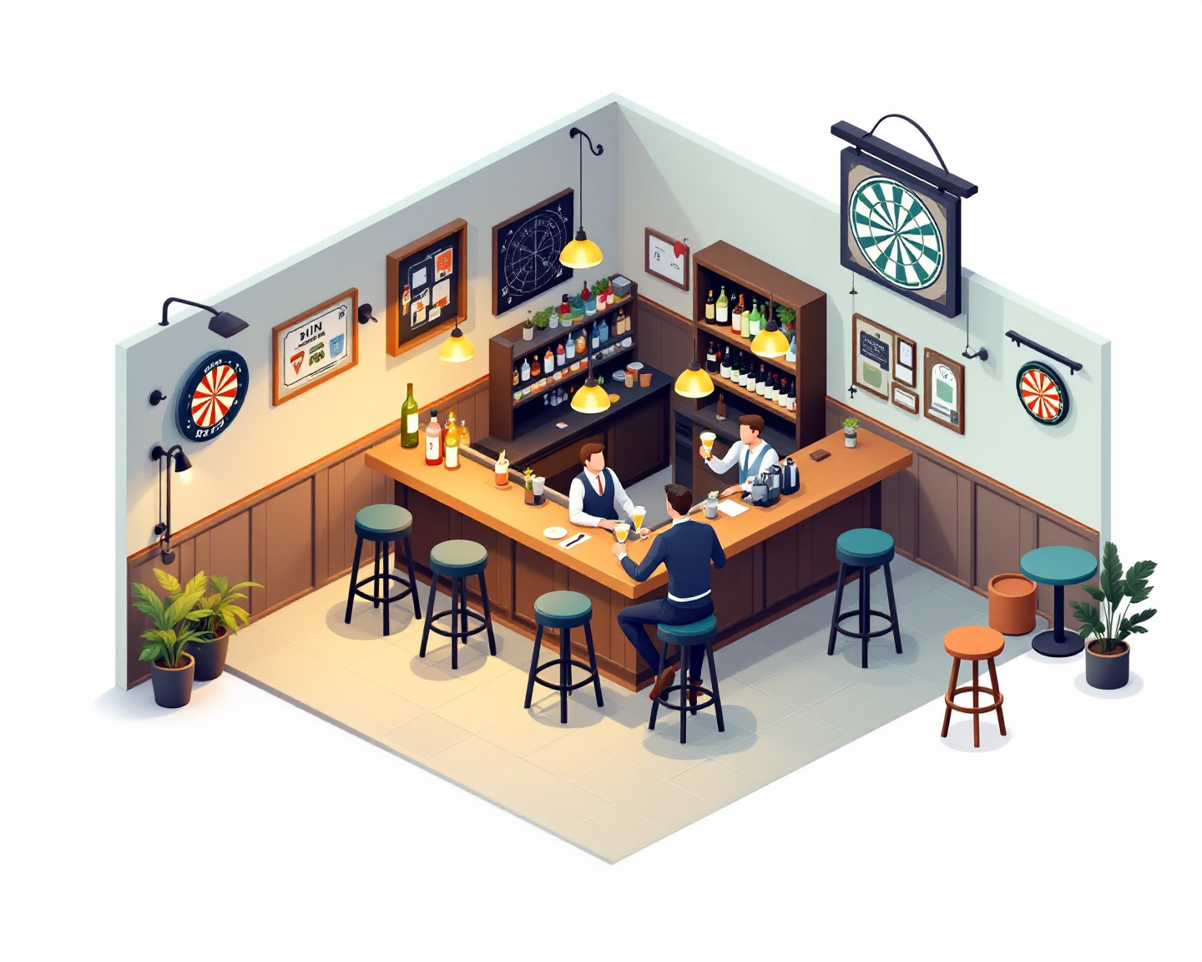
FRIDAY · 11 PM · 2 / 7
The Pub in Itaewon
LEE SAYS
This is where I ~.
e.g. This is where I come after work.
I always get ~ here.
e.g. I always get the gin and tonic here.
Do you follow ~?
e.g. Do you follow football?
HE ASKS What do people usually drink in Korea?
SURPRISE · click
↳ He doesn't drink alcohol at all. Change the plan — right now, out loud.
NOTES
This is where I come in the morning.
I always get the sparkling water here.
Do you follow your hobby?
Many people drink champagne and vodka set in Itaewon.
Because it gets drunk fast.

Slide 4
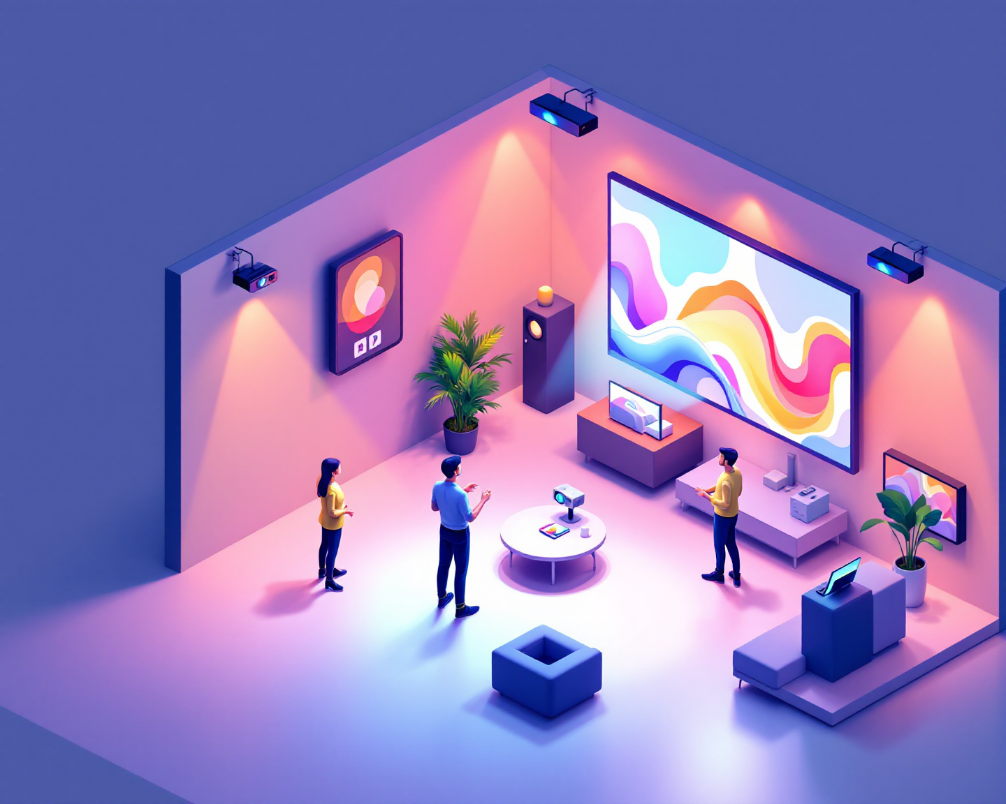
SATURDAY · 10 AM · 3 / 7
The Showroom
LEE SAYS
We make ~ for ~.
e.g. We make LED displays for shops and events.
This one is ~ than ~.
e.g. This one is brighter than last year's model — look at the light.
Can I show you ~?
e.g. Can I show you how it works?
HE ASKS Who buys these?
SURPRISE · click
↳ The projector won't turn on. Keep talking while you fix it.
NOTES
We make LED displays for shops and interior.
This one is more efficient than interior.
Can I show you before and after?
First, hotel and resort companies. And construction companies.
And bar, restaurant and café. And hospital.
FROM YOUR WORDS light

Slide 5
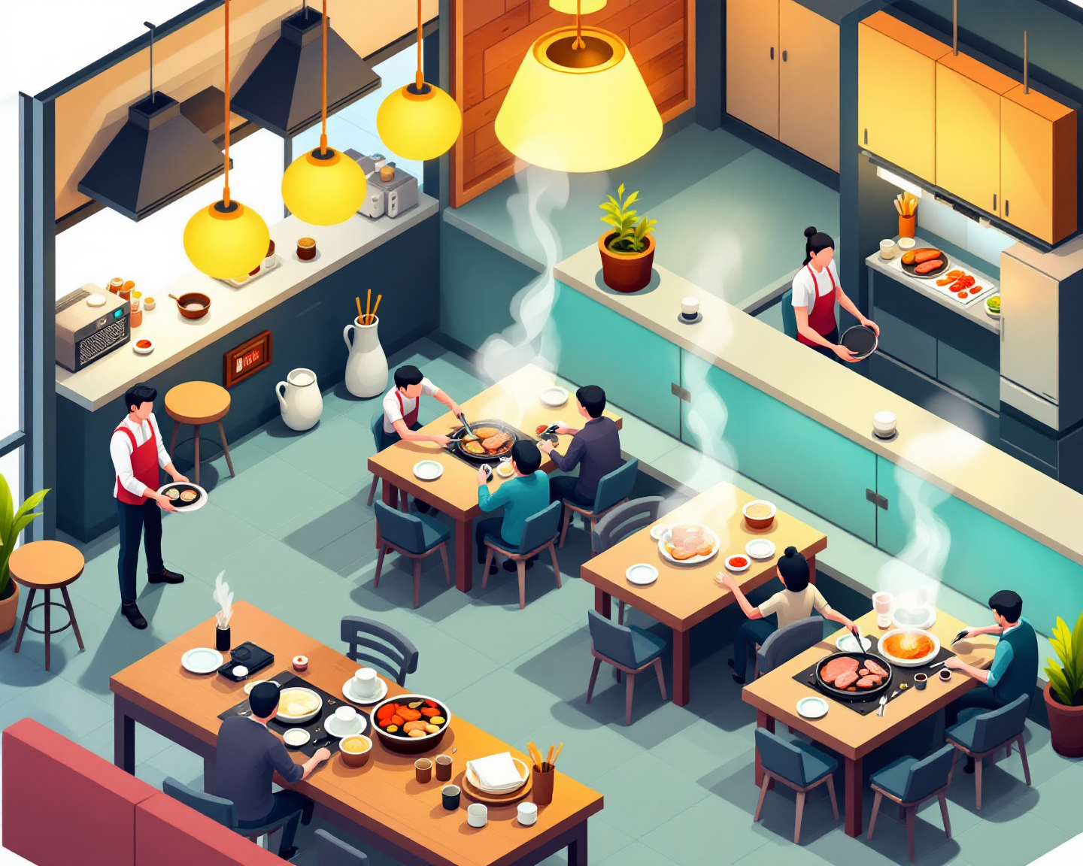
SATURDAY · 12:30 PM · 4 / 7
Lunch — Your Pick
LEE SAYS
Are you okay with ~?
e.g. Are you okay with Korean barbecue?
Can you handle ~?
e.g. Can you handle spicy food?
Let me order for ~.
e.g. Let me order for both of us.
HE ASKS What's this one? (he points at a side dish)
SURPRISE · click
↳ He can't eat spicy food at all. Pick another place — fast.
NOTES
Are you okay with 평양냉면?
Can you handle chopstick?
Let me order for you.
나물 is like Korean salad.

Slide 6

SATURDAY · 3 PM · 5 / 7
The Han River
LEE SAYS
Do you want to ~ or ~?
e.g. Do you want to walk or rent bikes?
On weekends, people ~.
e.g. On weekends, people come here with chicken and beer.
From here you can see ~.
e.g. From here you can see the bridge.
HE ASKS Do you come here often?
SURPRISE · click
↳ It starts raining. Plan B — where do you take him?
NOTES
Do you want to run or walk?
On weekends, couple come here with chicken with beer.
On weekends, family come here with camping gears.
From here you can see the drone show. Fireworks during autumn.
FROM YOUR WORDS walk

Slide 7
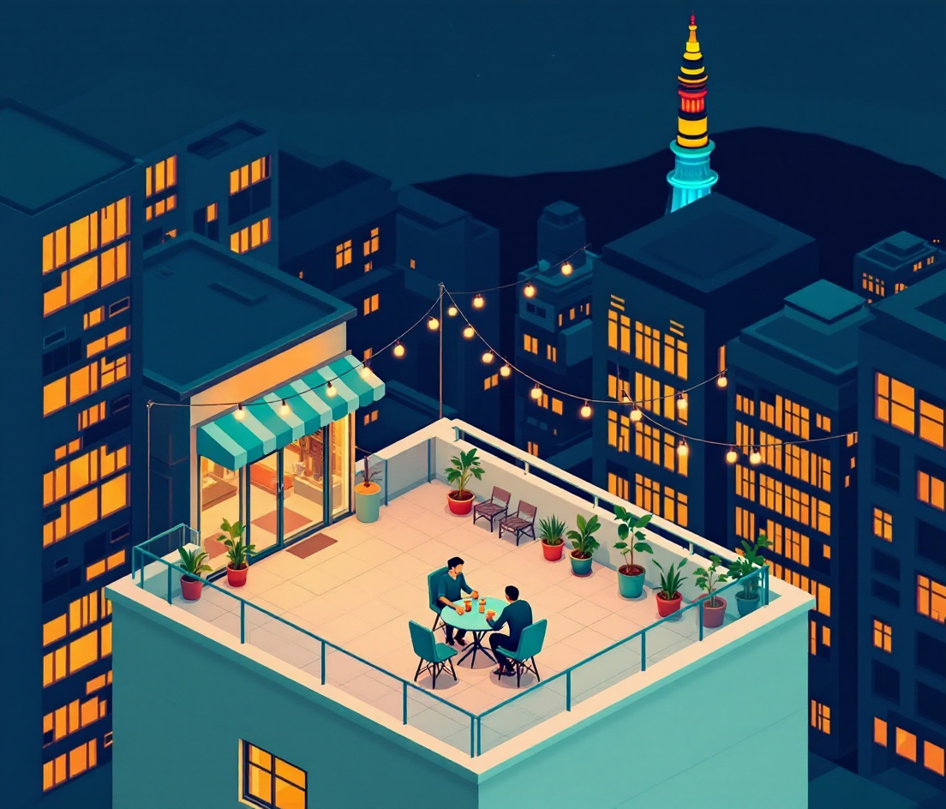
SATURDAY · 8 PM · 6 / 7
The Rooftop
LEE SAYS
Let's grab ~ before ~.
e.g. Let's grab dinner before the bar.
That's ~ over there.
e.g. That's Namsan Tower over there — at the top of the hill.
How do you like ~ so far?
e.g. How do you like Seoul so far?
HE ASKS What's your favorite part of Seoul?
SURPRISE · click
↳ He wants one more place, but you're exhausted. Say no — nicely.
NOTES
Let’s grab a massage before the dinner.
That’s Lotte tower over there – at the Jamsil area.
How do you like me so far?
Food and the beautiful city
FROM YOUR WORDS top

Slide 8
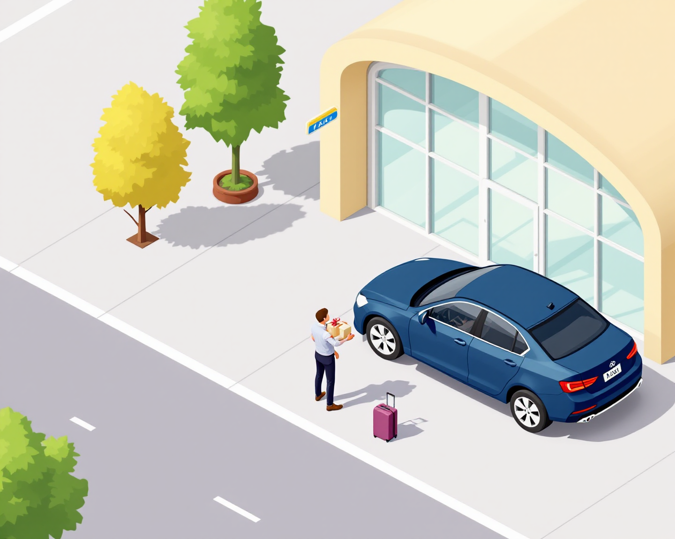
SUNDAY · 11 AM · 7 / 7
Back to the Airport
LEE SAYS
Did you sleep ~?
e.g. Did you sleep okay?
This is for ~.
e.g. This is for your team — Korean snacks.
Next time, I'll ~.
e.g. Next time, I'll come to Singapore for the whole week.
HE ASKS When can you come?
SURPRISE · click
↳ His flight is delayed three hours. What do you do with him?
NOTES
Did you sleep good? Well? Okay? Alright? Right?
This is for your wife and children.
Next time, I’ll go to Singapore for the whole month.
About next month.
FROM YOUR WORDS whole

Slide 9
ONE MORE TIME
Tell me the whole weekend in two minutes.
Friday night → Saturday → Sunday. No slides. Brian is the partner, back in Singapore, asking "So how was it?"
1
2
3
4
5
6
7
Arrivals
The pub
Showroom
Lunch
Han River
Rooftop
Airport
NOTES

