Slide 1
INYOUNG · CLASS 2
Explaining the Paper, Start to Finish
Cao et al., Nature 2025 — Integration of hunger and hormonal state gates infant-directed aggression
Do English with Brian

Slide 2
HOW TODAY WORKS
Four Boxes, Every Figure
1 ASKED
2 DID
TENSE
The question here is whether ___.
To test this, they ___.
What they did, what they found → past
They took food away for six hours.
What it means → present
This tells us that hunger changes…
3 FOUND
4 SO WHAT
What they found was ___.
This tells us ___.
VOICE · out loud, active is easier to follow
✓ They knocked out the receptor in the MPOA. △ The receptor was knocked out in the MPOA. fine in a paper, harder to follow in a room
Figure + question
Each piece starts from one real panel. Point at it while you talk.
Say it to undergrads
Paper term on top, classroom words below. Use the bottom line.
Say it right
Stress the gold syllable. We say these out loud first.
Your line
Your best sentence, corrected, goes here. It becomes your L&S.
Build it up
After each figure, start again from the top.
Last round
The whole paper, once, no stopping.

Slide 3
PIECE 1 · THE BACKGROUND
Why Ask This at All?
Why would a hungry mouse attack a pup it would normally look after?
SET IT UP IN THREE LINES
1 WHO
2 WHAT THEY USUALLY DO
Virgin female mice — ___.
They usually ___ or ___ pups.
1
Normally, ___.
3 WHAT CHANGES
4 WHY IT MATTERS
2
But animals feel many things at once — ___.
When they're hungry, ___.
It shows how two states ___.
3
SAY IT RIGHT VIRgin · beHAviour · PUP · orTHOgonal
So the big question here is ___.
YOUR LINE · best sentence, corrected
SAY IT TO UNDERGRADS paper term → classroom words
internal state
→ what's going on inside the body — hunger, hormones
social behaviour
→ how an animal treats another animal
virgin female mice
→ female mice that have never had pups
pup-directed care
→ looking after pups
pup-directed aggression
→ attacking pups
orthogonal states
→ two states that normally have nothing to do with each other
Notes:
답 방향 — Normally, virgin female mice either ignore pups or look after them. But animals feel many things at once — hunger, stress, hormones. So the big question is how the brain combines two of those states to change a social decision.

Slide 4
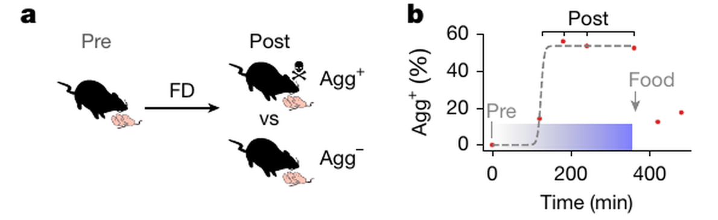
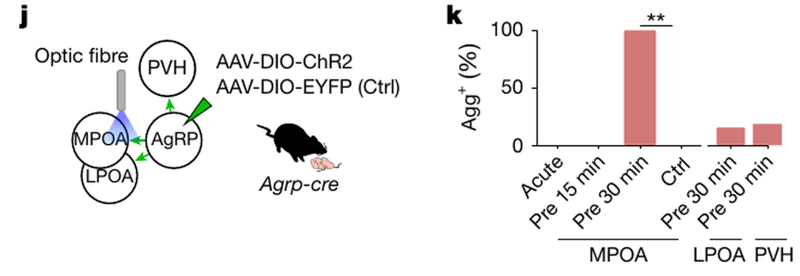
PIECE 2 · FIGURE 1
Hunger Flips the Switch
How do you prove hunger causes the attack — not stress, not something else?
1 ASKED
2 DID
The question here is whether ___.
To test this, they ___.
3 FOUND
4 SO WHAT
What they found was ___.
This tells us ___.
SAY IT RIGHT hypoTHAlamus · agGRESsion · depriVAtion · optoGEnetic
YOUR LINE · best sentence, corrected
Cao et al., Nature 648, 138 (2025) · CC BY 4.0 · Fig. 1a,b,k
SAY IT TO UNDERGRADS paper term → classroom words
food deprivation (FD)
→ taking their food away for six hours
Agg⁺ / Agg⁻
→ the mice that attacked / the ones that didn't
ArcAgRP neurons
→ the brain's hunger neurons
chemogenetic activation
→ switching those neurons on with a drug
optogenetic stimulation
→ switching one pathway on with light
MPOA
→ the part of the hypothalamus that runs parenting
Notes:
답 방향
ASKED: whether hunger itself causes pup attack.
DID: took food away for 6 h; switched AgRP hunger neurons on (drug) in fed mice and off in hungry mice; lit up the AgRP→MPOA pathway for 30 min.
FOUND: about 60% of hungry mice attacked (plateau ~3 h); AgRP on → fed mice attacked; AgRP off → far fewer attacks; MPOA pathway 30 min → all attacked, LPOA/PVH → no change. Not stress (maze, other stressors no effect).
SO WHAT: the switch runs from the hunger neurons into the parenting area.

Slide 5
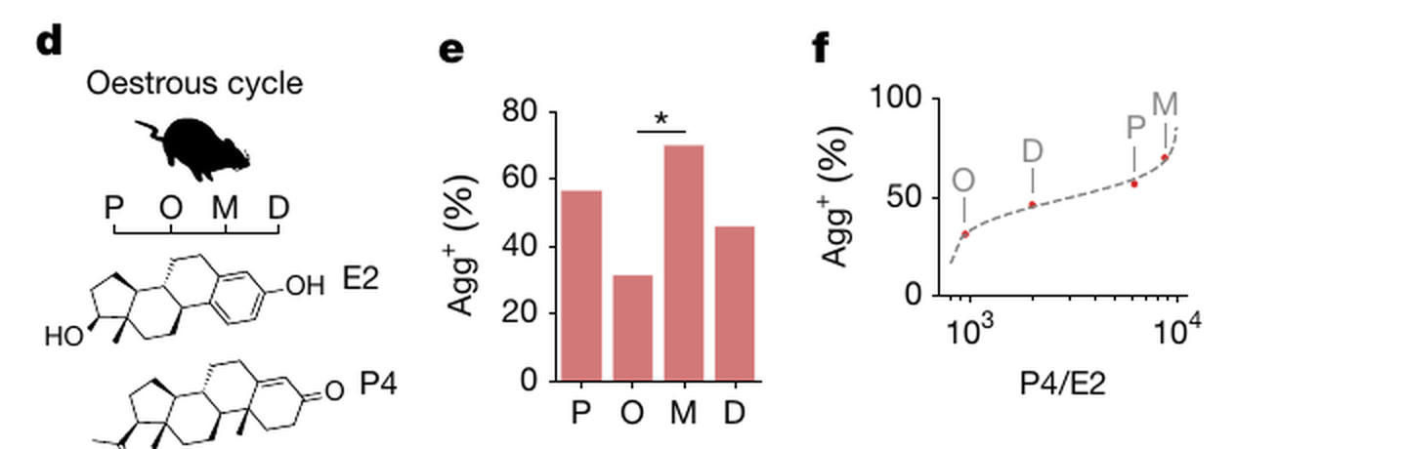
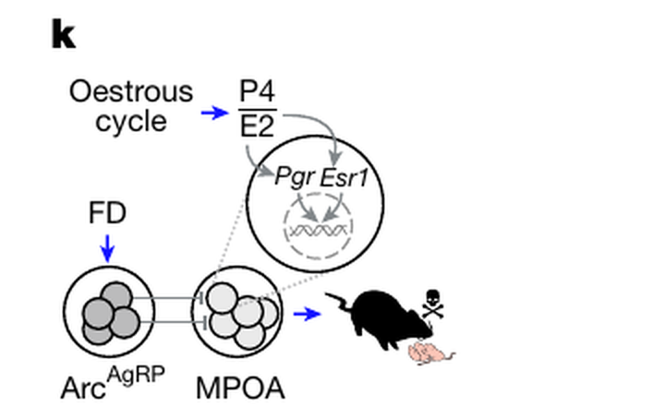
PIECE 3 · FIGURE 2
Hormones Set the Odds
If hunger causes it, why did only about 60% of the mice attack?
1 ASKED
2 DID
The question here is whether ___.
To test this, they ___.
3 FOUND
4 SO WHAT
What they found was ___.
This tells us ___.
SAY IT RIGHT OEStrous · oesTRAdiol · proGESterone · RAtio
YOUR LINE · best sentence, corrected
Cao et al., Nature 648, 138 (2025) · CC BY 4.0 · Fig. 2d–f,k
SAY IT TO UNDERGRADS paper term → classroom words
oestrous cycle
→ the mouse version of the menstrual cycle — four to five days
oestradiol (E2) · progesterone (P4)
→ the two main female sex hormones
P4/E2 ratio
→ not how much of each — the balance between them
receptor knockout
→ removing what the hormone binds to, in one brain area
switching rate
→ the share of mice that flip to attacking
metestrus · oestrus
→ the stages with the highest (70%) and lowest (32%) rate
Notes:
답 방향
ASKED: what decides which hungry mice switch.
DID: checked hunger (food intake, ghrelin — same); staged the oestrous cycle; measured E2, P4; knocked out Esr1 or Pgr in MPOA vs Arc; tested pregnant mice.
FOUND: rate tracks the P4/E2 ratio, not either hormone alone (highest metestrus 70%, lowest oestrus 32%); KO in MPOA not Arc changes it — Esr1 KO 100% (40% predicted), Pgr KO 23% (53% predicted); pregnant mice matched the ratio prediction; hormones alone never caused attack without hunger.
SO WHAT: hormones set the odds, hunger pulls the trigger — both read in MPOA.

Slide 6
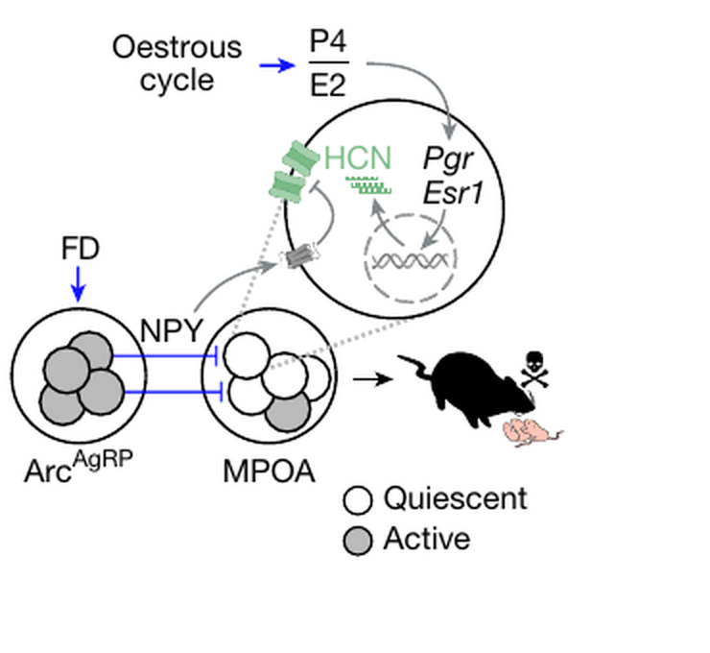
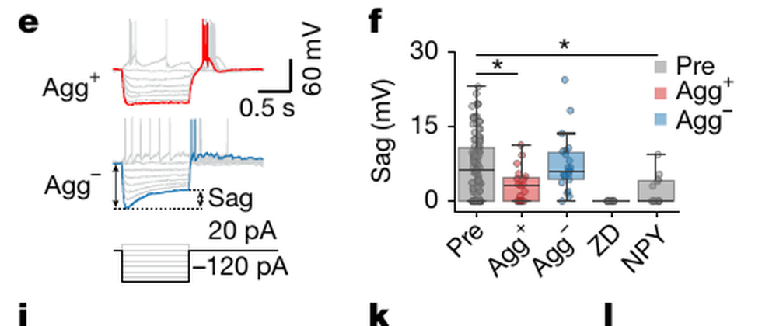
PIECE 4 · FIGURE 3
Where the Two Signals Meet
Two different signals, one behaviour. Where do they actually meet?
1 ASKED
2 DID
The question here is whether ___.
To test this, they ___.
3 FOUND
4 SO WHAT
What they found was ___.
This tells us ___.
SAY IT RIGHT exciTAbility · NEUropeptide Y · CHANnel · VOLtage
YOUR LINE · best sentence, corrected
Cao et al., Nature 648, 138 (2025) · CC BY 4.0 · Fig. 3e,f,w
SAY IT TO UNDERGRADS paper term → classroom words
patch-clamp recording
→ listening to one neuron's electrical activity
excitability
→ how easily a neuron fires
HCN channels
→ channels that keep a neuron ready to fire
voltage sag
→ the electrical sign that HCN channels are working
NPY (neuropeptide Y)
→ the chemical the hunger neurons release
knockdown
→ turning a gene down, not all the way off
Notes:
답 방향
ASKED: how one set of neurons reads both hunger and hormones.
DID: recorded MPOA neurons in brain slices before/after fasting; blocked HCN channels (ZD-7288); added NPY vs AgRP; knocked down NPY only in the AgRP→MPOA pathway; counted Hcn transcripts across the cycle; infused HCN blocker into MPOA of fed mice.
FOUND: MPOA neurons in attackers are quieter and less excitable; the HCN voltage sag is mostly gone; NPY (not AgRP) reproduces this; NPY knockdown brings it back and delays attack; Hcn1/Hcn2 peak in oestrus; blocking HCN alone makes fed mice attack.
SO WHAT: hormones set how many HCN channels there are; hunger (via NPY) shuts them. Together → quiet MPOA → attack.

Slide 7
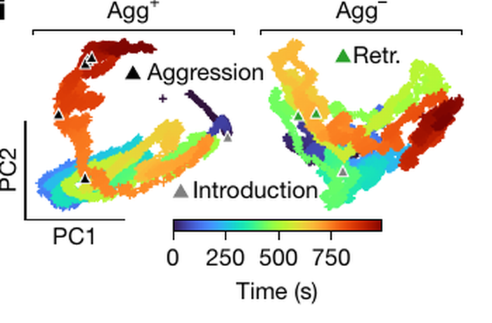
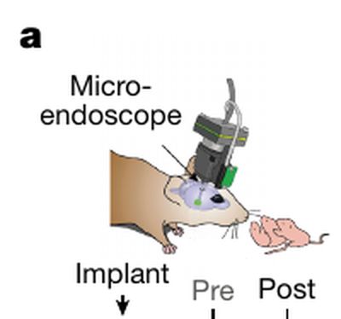
PIECE 5 · FIGURE 4
Watching It in a Living Brain
All of that was in brain slices. Does it hold in a living, behaving mouse?
1 ASKED
2 DID
The question here is whether ___.
To test this, they ___.
3 FOUND
4 SO WHAT
What they found was ___.
This tells us ___.
SAY IT RIGHT MIcroscope · enDOScopy · PRINcipal · CALcium
YOUR LINE · best sentence, corrected
Cao et al., Nature 648, 138 (2025) · CC BY 4.0 · Fig. 4a,i
SAY IT TO UNDERGRADS paper term → classroom words
calcium imaging
→ watching neurons light up when they fire
miniature microscope
→ a tiny microscope mounted on the mouse's head
baseline activity
→ how active the neurons are when nothing is happening
neural state
→ a pattern across many neurons that lasts, not a one-off response
PC1 · PC2
→ a way to squash hundreds of neurons into two lines
decode
→ read the behaviour off the brain activity
Notes:
답 방향
ASKED: whether MPOA shows an aggression state in a behaving animal.
DID: head-mounted microscope; tracked the same MPOA neurons before and after fasting, during pup interactions (6 females; the 2 in oestrus did not attack).
FOUND: attackers have lower baseline activity (already before fasting → hormones); weaker responses to pup sniffing/grooming; during attack, neurons go both up and down (average ~0) but the population enters a distinct, lasting state on PC2; an unsupervised HMM finds ~95% of aggression episodes; the state deepens with each attack.
SO WHAT: aggression is a persistent brain state, not a reflex — and MPOA encodes it.

Slide 8
PIECE 6
The Whole Story
Start from the top. No stopping. Point at each figure as you go.
CLOSE IT · pick one
Mechanism
So the same neurons read hunger and hormones, and the behaviour flips when both line up.
FIG 1 Hunger flips the switch — ___.
FIG 2 Hormones set the odds — ___.
Big picture
This is one of the first cases where we can see, cell by cell, how two internal states combine to change a social decision.
For undergrads
What an animal does to another animal depends not just on what it sees, but on what's going on inside it — and now we know one place in the brain where that calculation happens.
FIG 3 They meet at HCN channels — ___.
FIG 4 A living brain shows it — ___.
Notes:
처음부터 끝까지 한 번. Brian은 시간만 잰다. 발표 시간이 정해지면 목표 시간 조정.

Slide 9
TAKE IT TO YOUR LAB
Same Four Boxes, Your Own Research
One minute per box. This is your next lab meeting.
1 ASKED
2 DID
In my project, I'm asking whether ___.
To test this, I ___ / I'm going to ___.
3 FOUND
4 SO WHAT
So far, I've found that ___.
If it holds, it would mean ___.
TENSE, AGAIN · your own work
Done: I measured… Still going: I've been running… Next: I'm going to… Meaning: This suggests…
YOUR LINE · best sentence, corrected

Slide 10
WRAP
Before Next Class
1
2
3
Record it
Find out
Listen
The three-minute version — about 30 seconds per figure. Send it to Brian.
How long the talk is · the date · whether you make the slides or use your professor's.
L&S 02 is built from today's YOUR LINE sentences — your own words, corrected.

