Slide 1
Response Variable | Personal Identification Information
Personal Identification Information | Personal Identification Information |  | Covariates

Slide 2

Response Variable | Personal Identification Information
Personal Identification Information | Personal Identification Information |  | Covariates

Slide 3


Terry Smith
Durham
F
Taylor Smith
Durham
M
Taylor Smith
Durham
M
Tayler Smith
Raleigh
F

Slide 4
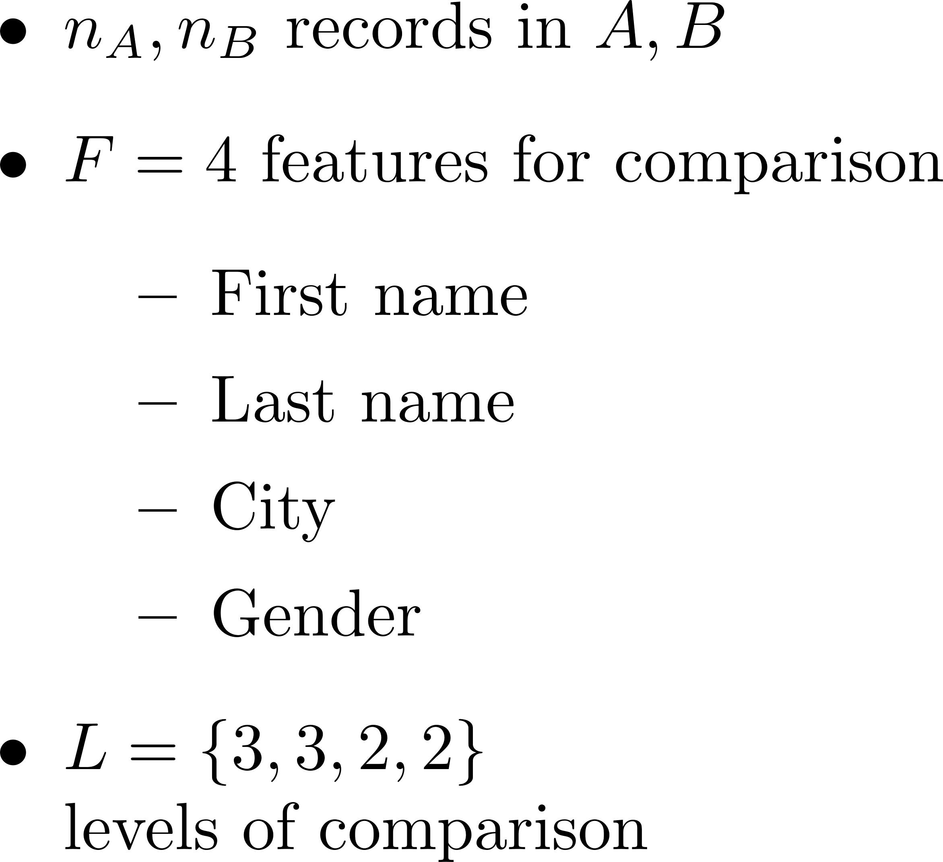
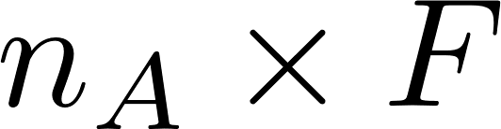
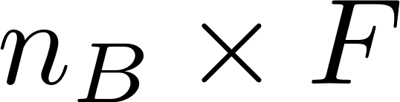
Terry Smith
Durham
F
Taylor Smith
Durham
M
Taylor Smith
Durham
M
Tayler Smith
Raleigh
F

Slide 5

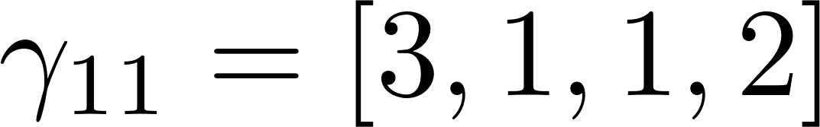
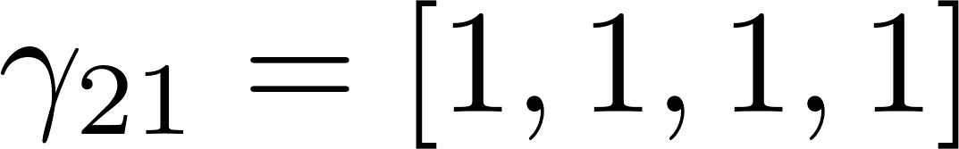
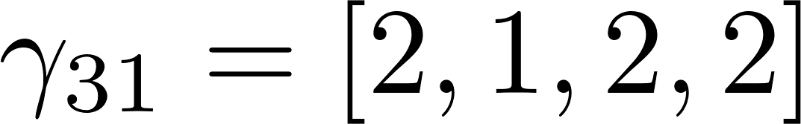
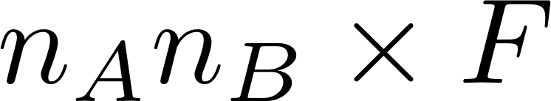
Terry Smith
Durham
F
Taylor Smith
Durham
M
Taylor Smith
Durham
M
Tayler Smith
Raleigh
F

Slide 6
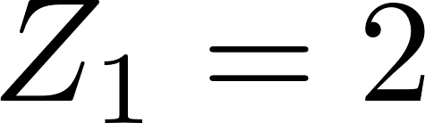
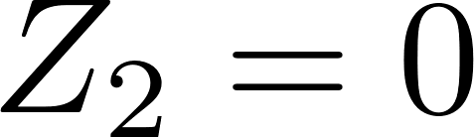
Terry Smith
Durham
F
Taylor Smith
Durham
M
Taylor Smith
Durham
M
Brandon Green
Asheville
M
Tayler Smith
Raleigh
F

Slide 14



Slide 16

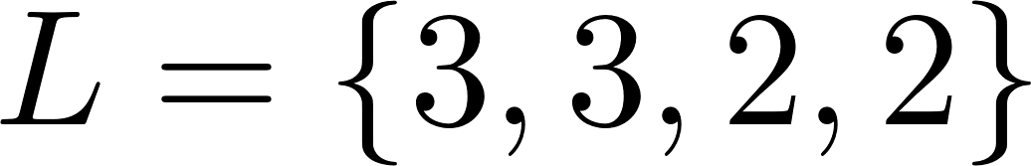

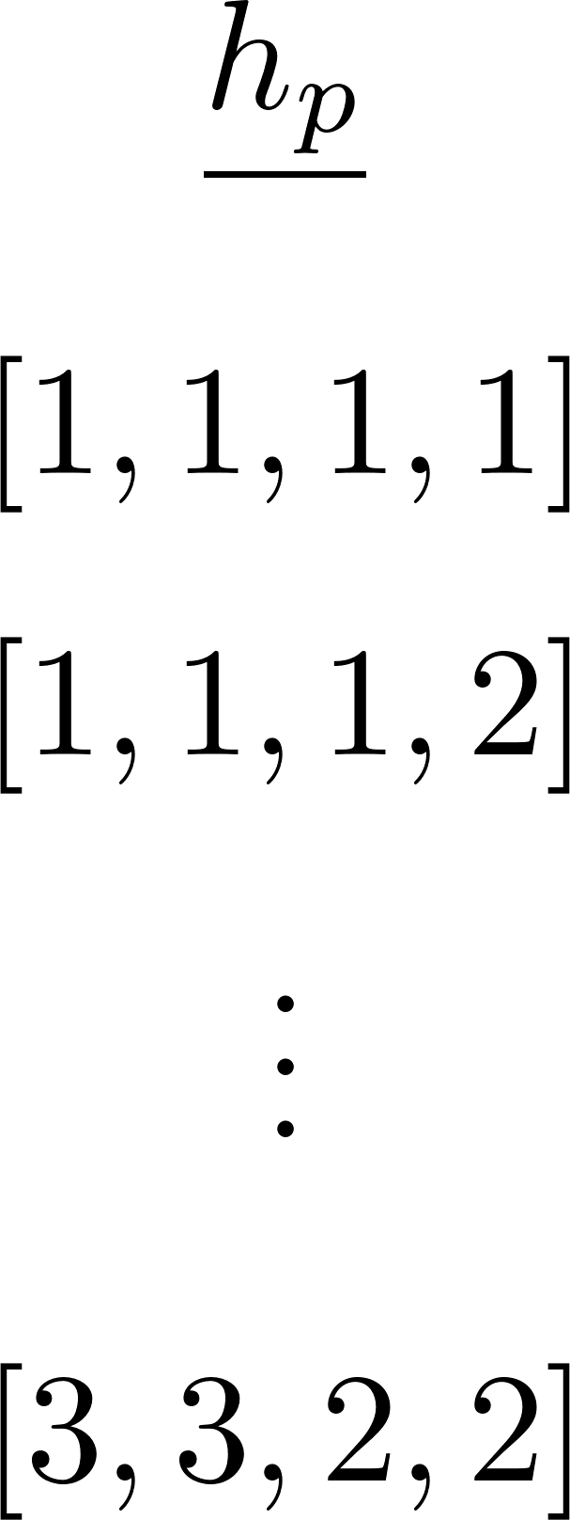

Slide 18


Slide 20
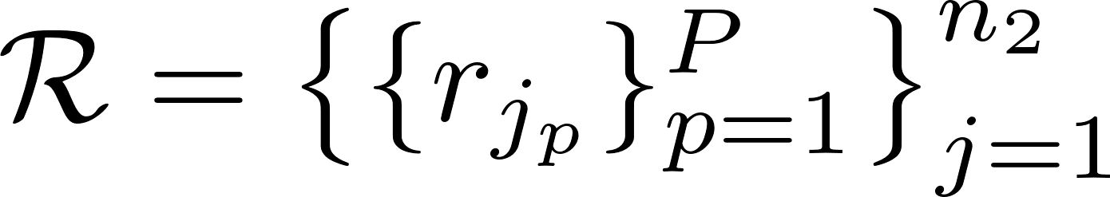
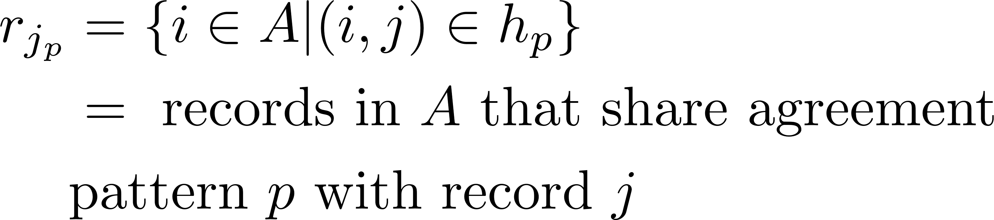

Slide 21
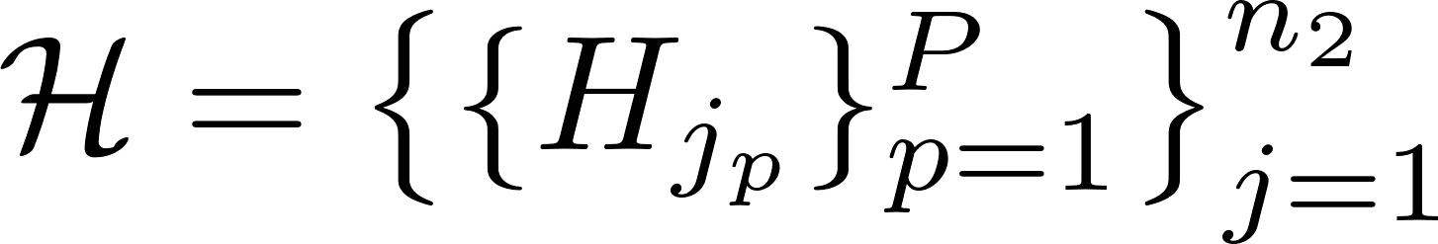
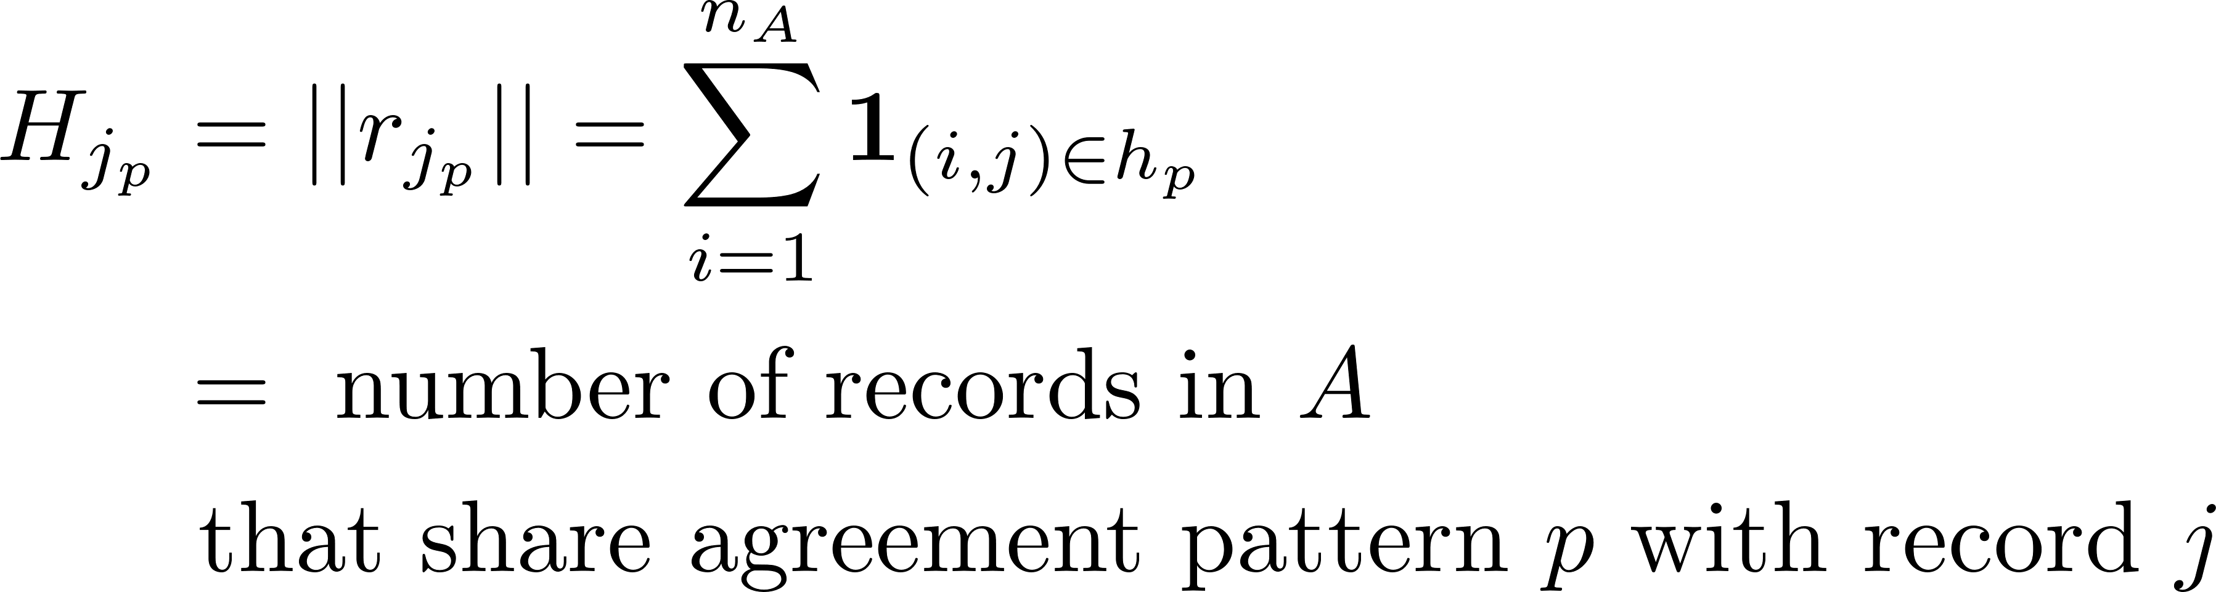

Slide 22
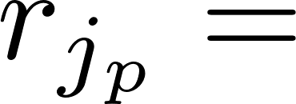
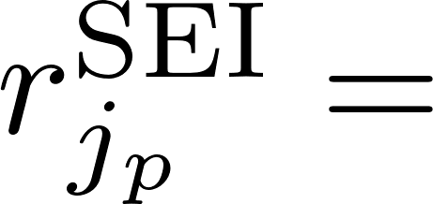

Slide 24
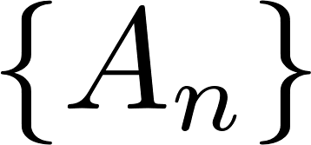


Slide 26


Slide 28
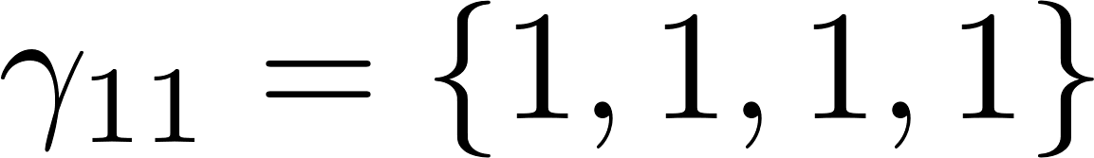
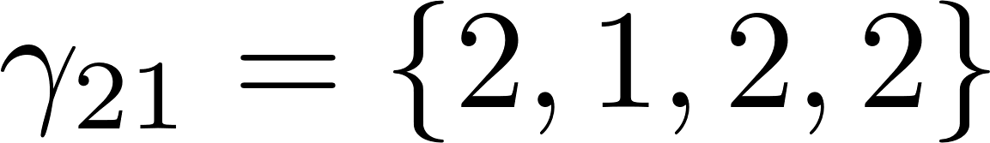
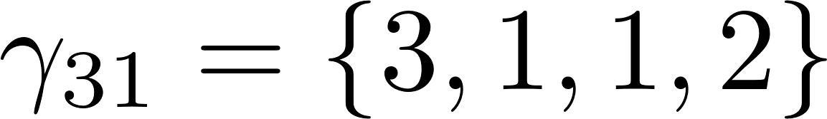
Taylor Smith
Durham
M
Tayler Smith
Raleigh
F
Taylor Smith
Durham
M
Terry Smith
Durham
F

Slide 29

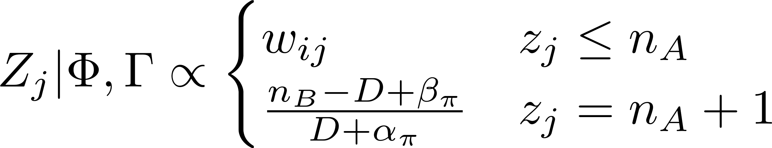
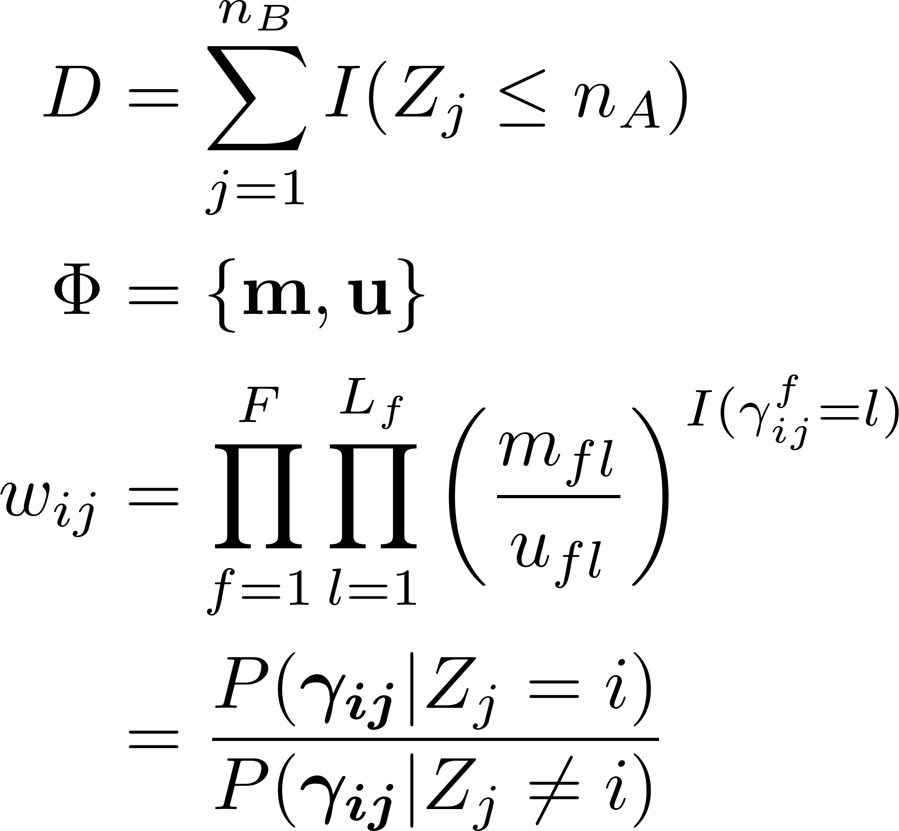

Slide 31
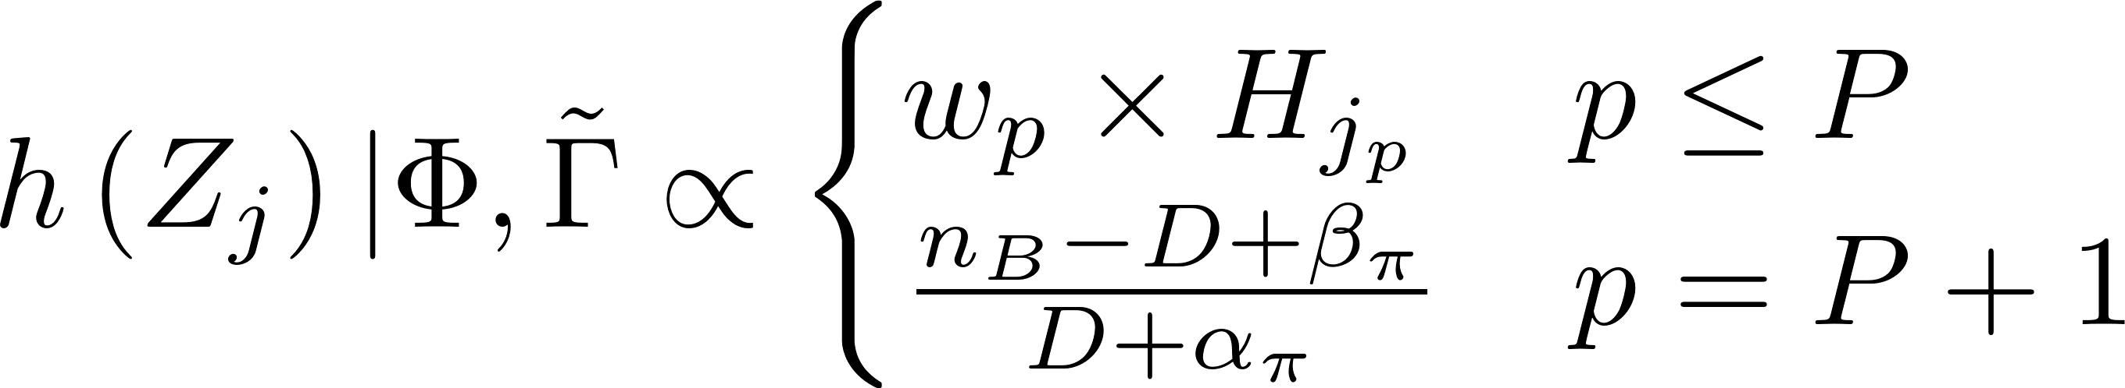

Slide 33
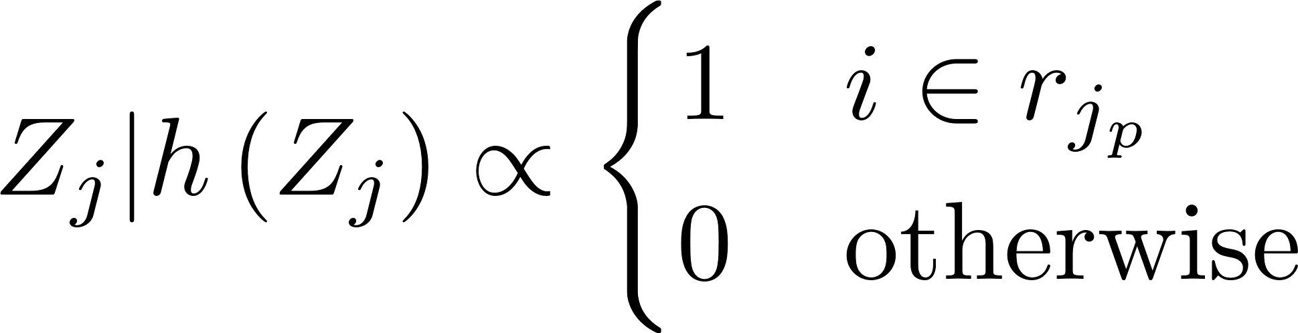

Slide 35
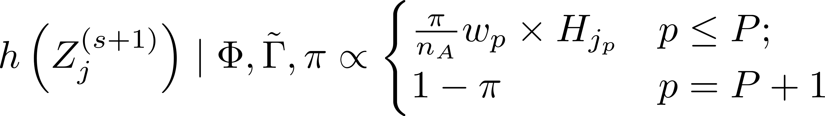
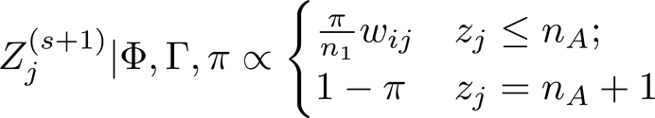
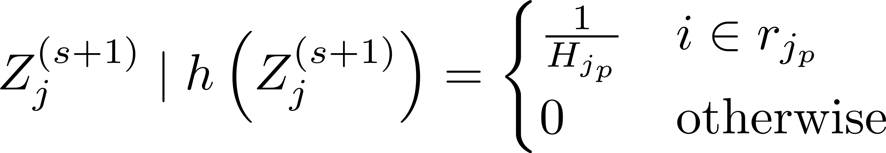
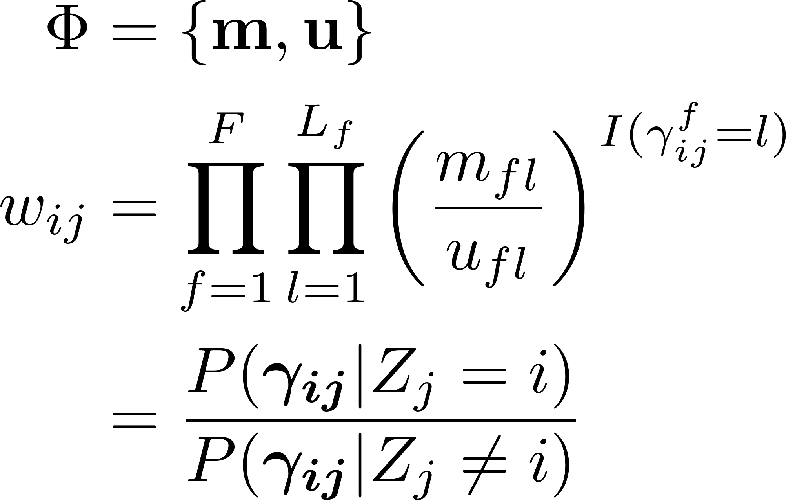

Slide 37
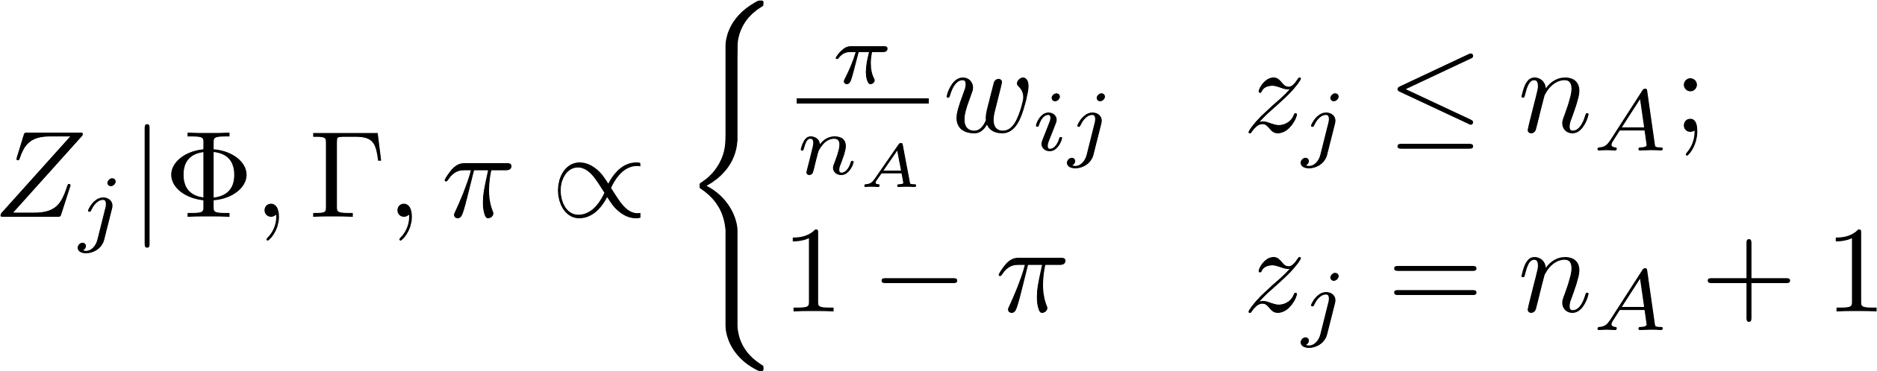

Slide 39
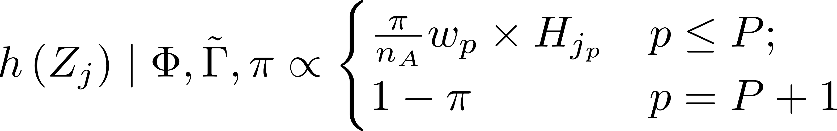

Slide 41
