Slide 1
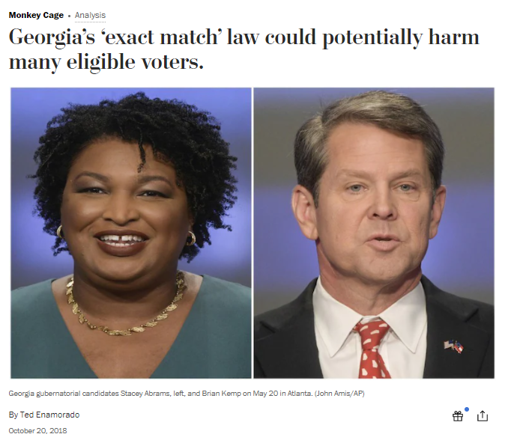
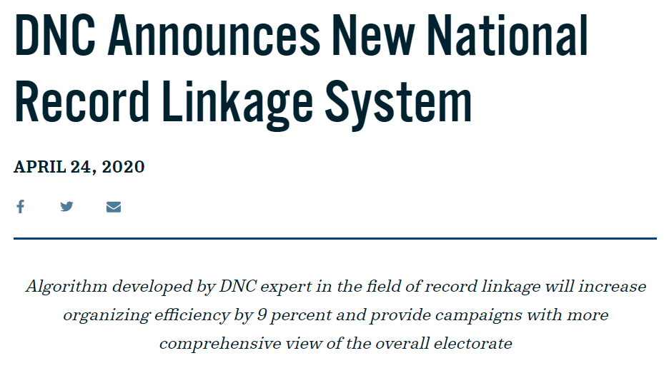

Slide 2
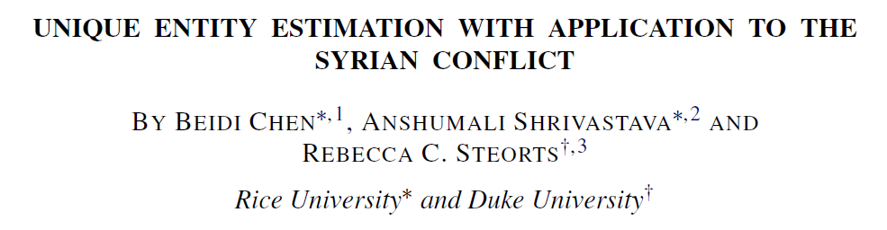

Slide 3
Response Variable | Personal Identification Information
Personal Identification Information | Personal Identification Information |  | Covariates

Slide 4

Response Variable | Personal Identification Information
Personal Identification Information | Personal Identification Information |  | Covariates

Slide 5



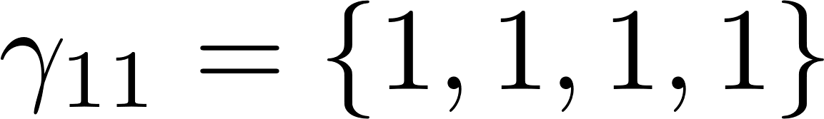
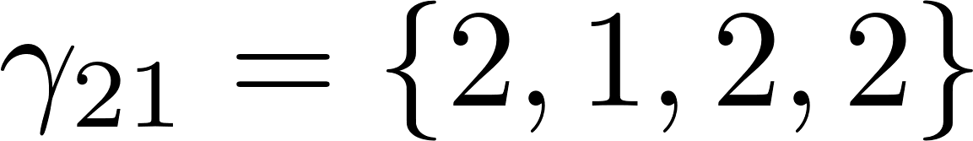
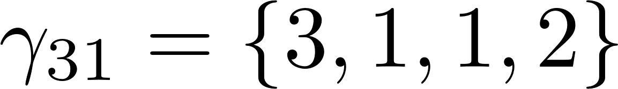
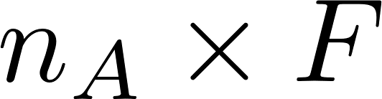
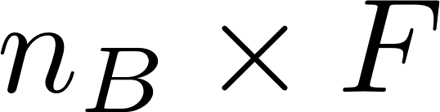
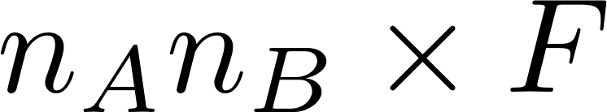
Taylor Smith
Durham
M
Tayler Smith
Raleigh
F
Taylor Smith
Durham
M
Terry Smith
Durham
F

