Slide 1
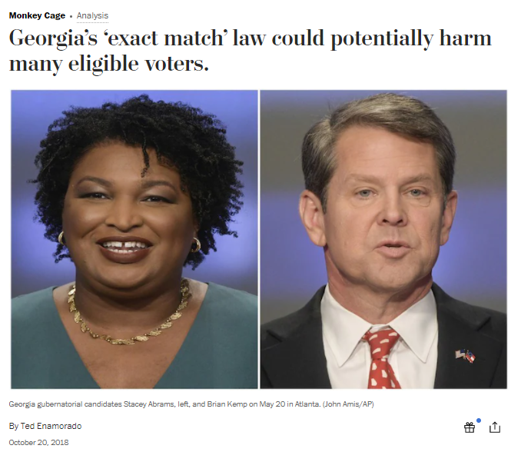
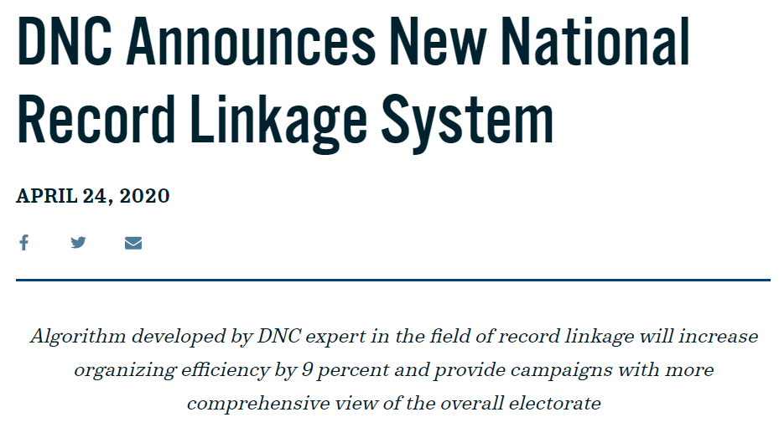
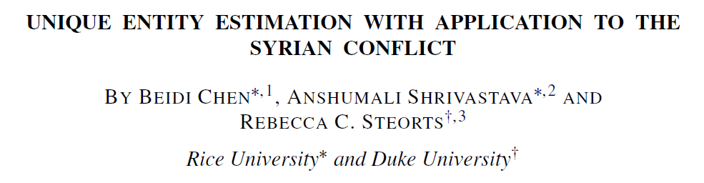

Slide 2
Response Variable | Personal Identification Information
Personal Identification Information | Personal Identification Information |  | Covariates

Slide 3

Response Variable | Personal Identification Information
Personal Identification Information | Personal Identification Information |  | Covariates

Slide 4



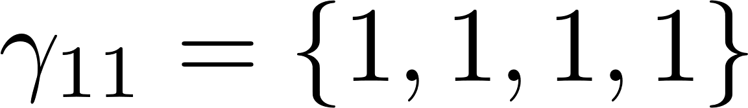
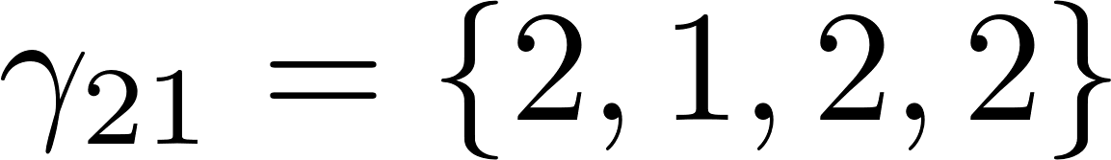
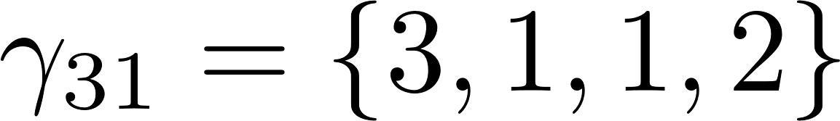
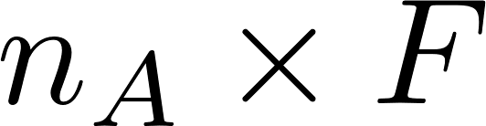
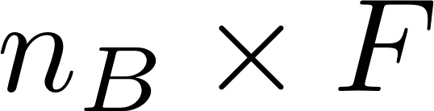
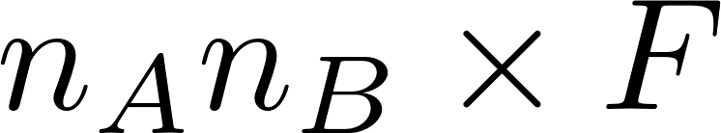
Taylor Smith
Durham
M
Tayler Smith
Raleigh
F
Taylor Smith
Durham
M
Terry Smith
Durham
F

