Slide 1
Efficient and Scalable Bipartite Matching Through Fast Beta Linkage (fabl)
Brian Kundinger
Department of Statistical Science
DATE

Slide 2
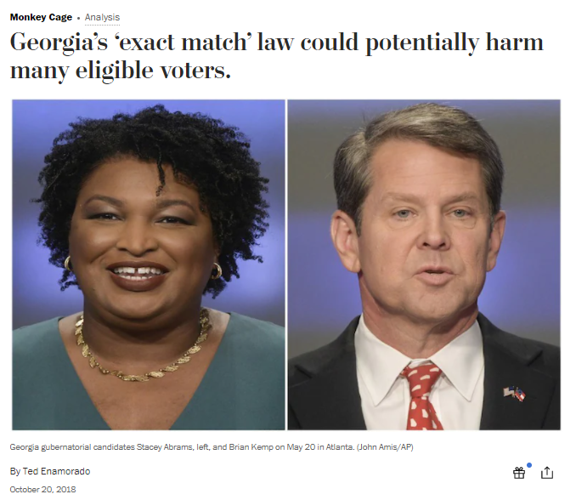
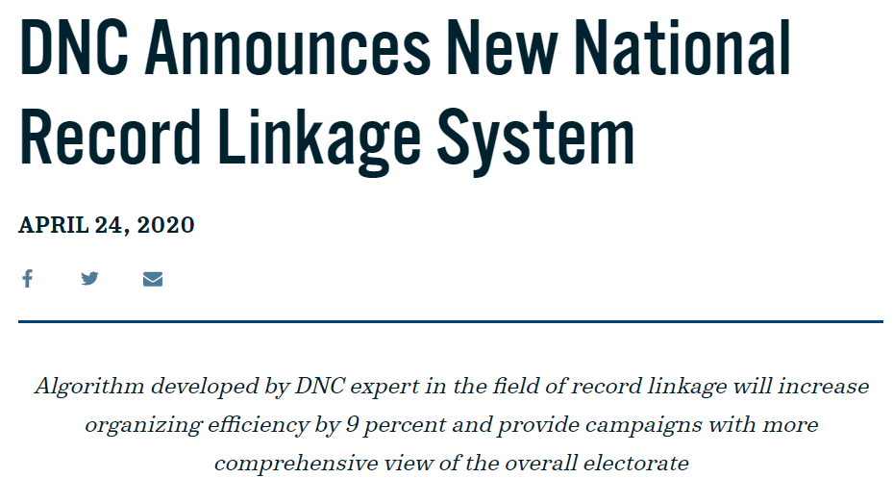
What is Record Linage?

Slide 3
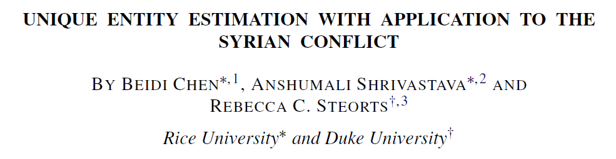
What is Record Linage?

Slide 4

What is Record Linage?
Response Variable | Personal Identification Information
Personal Identification Information | Personal Identification Information |  | Covariates

Slide 5



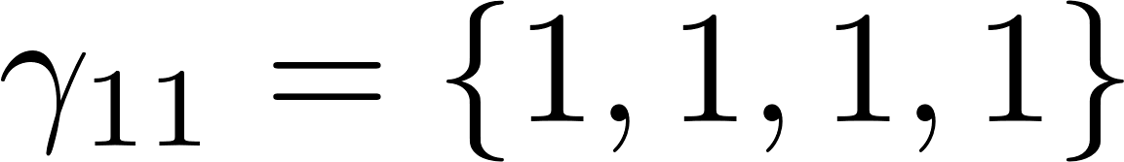
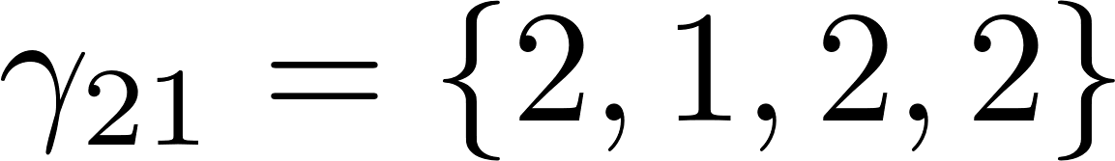
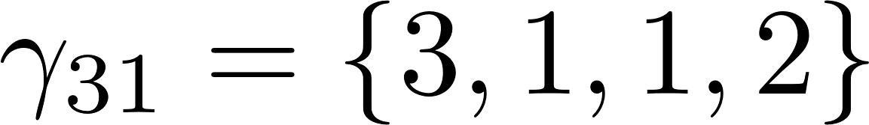
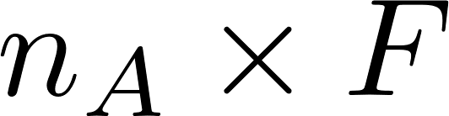
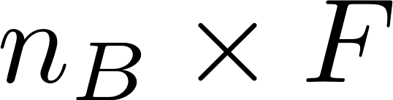
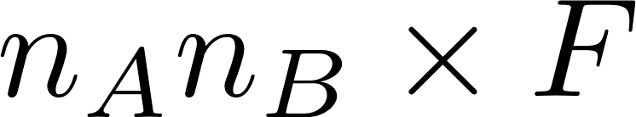
Fellegi and Sunter (1969)
Taylor Smith
Durham
M
Tayler Smith
Raleigh
F
Taylor Smith
Durham
M
Terry Smith
Durham
F

Slide 6
Previous Work

Slide 7
Previous Work

Slide 8
Previous Work

