Slide 1
Efficient and Scalable Bipartite Matching through “Fast Beta Linkage” (fabl)
Brian Kundinger
Statistical Science

Slide 2
Record Linkage

Slide 3
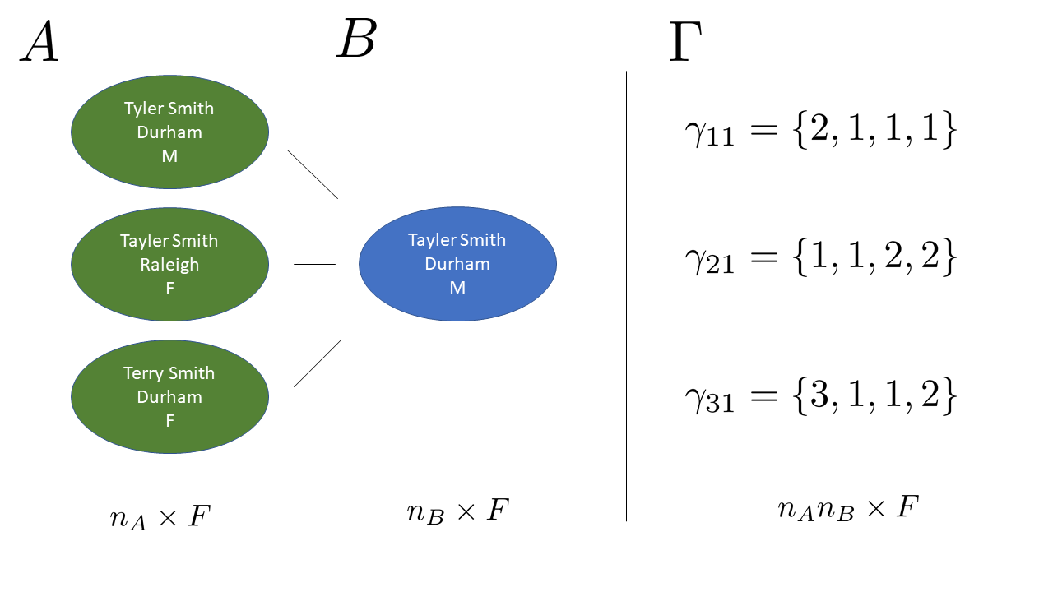
Fellegi Sunter (1969) Method

Slide 4
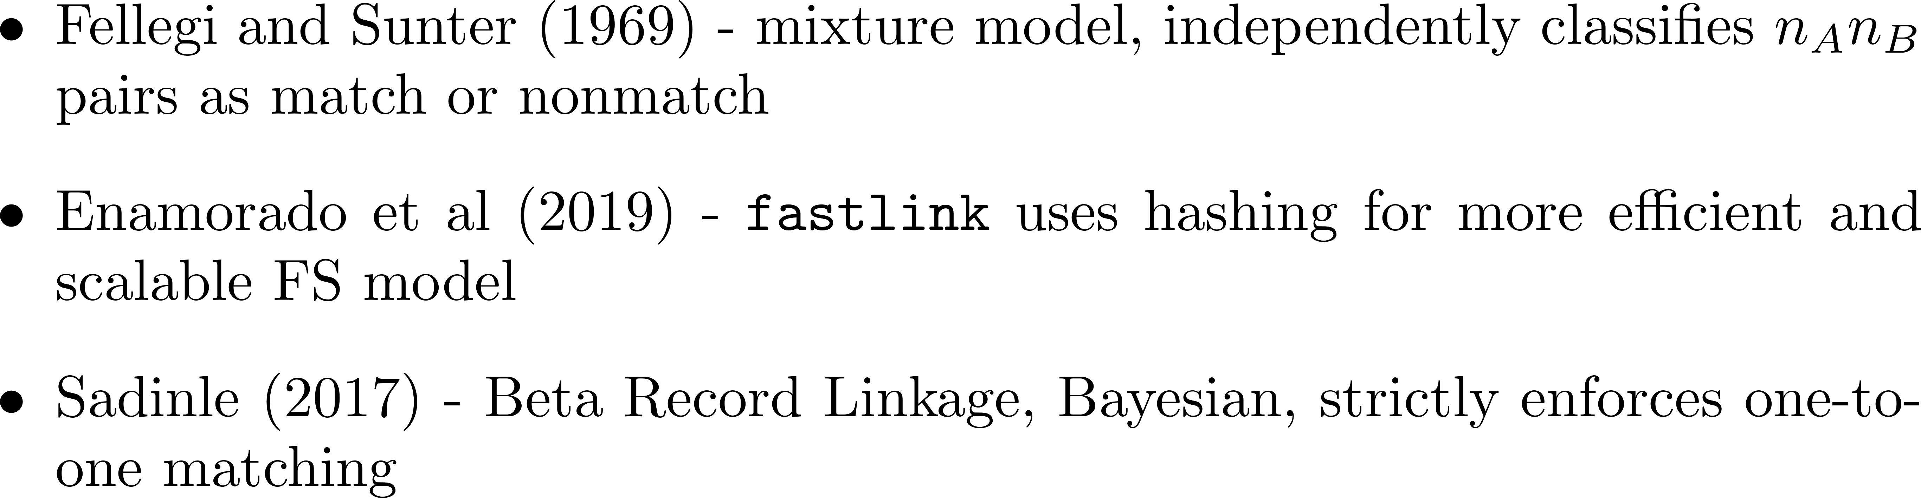
Related Work

Slide 5
Notation

