Slide 1


ROUGIR COSMETICS
INTERNATIONAL
A PRODUCTION OPTIMIZATION CASE
DATA OPTIMIZATION

Slide 2
TABLE OF CONTENT
About Rougir Cosmetics
Decision Variables & Objective Function
Constraints
Base Model – Initial Findings
Sensivity Report Analysis
Optimal Scenario Model
Key Takeaways for Data Optimization Modeling

Slide 3
ABOUT ROUGIR COSMETICS
COSMETIC OFFERINGS
COMPANY GROWTH
UPCOMING GOALS
CEO CONCERNS
Production and distribution through a subscription-based e-commerce model
Recent annual sales of over $150 million lead to a double-digit growth over the years
Face Cream:
12,000 cartons
Body Cream:
8,000 cases
Hand Cream:
18,000 cases
Too much outsourced production

Slide 4
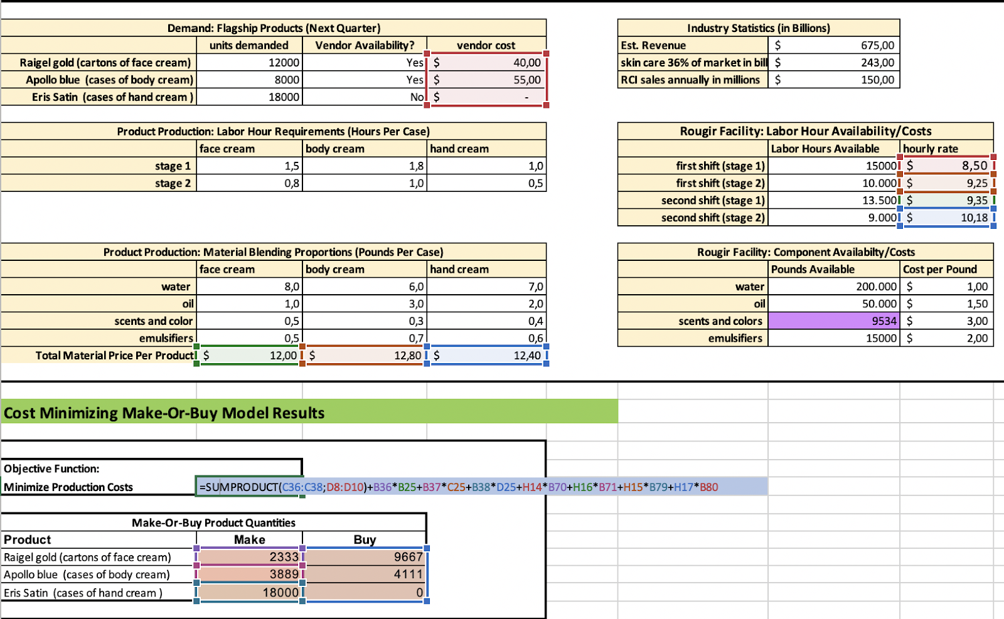
DECISION VARIABLES & OBJECTIVE FUNCTION
Decision Variables:
FC₁: Units of Face Cream to Make
BC₁: Units of Body Cream to Make
HC₁: Units of Hand Cream to Make
FC₂: Units of Face Cream to Buy
BC₂: Units of Body Cream to Buy
HC₂: Units of Hand Cream to Buy
SS₁₁: Number of Labor Hours to Utilize in Shift 1 of Stage 1
SS₁₂: Number of Labor Hours to Utilize in Shift 1 of Stage 2
SS₂₁: Number of Labor Hours to Utilize in Shift 2 of Stage 1
SS₂₂: Number of Labor Hours to Utilize in Shift 2 of Stage 2
FCW: Water Material Usage in Face Cream
BCW: Water Material Usage in BodyCream
HCW: Water Material Usage in Hand Cream
FCO: Oil Material Usage in Face Cream
BCO: Oil Material Usage in Body Cream
HCO: Oil Material Usage in Hand Cream
FCSC: Scent&Color Material Usage in Face Cream
BCSC: Scent&Color Material Usage in Body Cream
HCSC: Scent&Color Material Usage in Hand Cream
FCEM: Emulsifier Material Usage in Face Cream
BCEM: Emulsifier Material Usage in Body Cream
HCEM: Emulsifier Material Usage in Hand Cream
Objective Function: minimize production costs
= 40FC2 +55BC2 + 12FC1 + 12,8BC1 + 12,40HC1 + 8,50SS11 + 9,25SS12 + 9,35SS21 + 10,18SS22 + 0HC2
Notes:
FC₁: Units of Face Cream to Make
BC₁: Units of Body Cream to Make
HC₁: Units of Hand Cream to Make
FC₂: Units of Face Cream to Make
BC₂: Units of Body Cream to Make
SS₁₁: Number of Labor Hours to Utilize in Shift 1 of Stage 1
SS₁₂: Number of Labor Hours to Utilize in Shift 1 of Stage 2
SS₂₁: Number of Labor Hours to Utilize in Shift 2 of Stage 1
SS₂₂: Number of Labor Hours to Utilize in Shift 2 of Stage 2
FC1 (= Face Cream Make) BC1 (= Body Cream Make) HC1 (= Hand Cream Make) FC2 (= Face Cream Buy) BC2 (=Body Cream Buy) HC2 (= Hand Cream Buy) SS11 (= Schift 1; Stage1) SS12 (= Schift 1; Stage2) SS21 (= Schift 2; Stage 1) SS22 (= Schift 2; Stage 2)

Slide 5
CONSTRAINTS
HC1 = 18,000
FC1 + FC2 = 12,000
BC1 + BC2 = 8,000
HC1 + HC2 = 18,000
SS11 <= 1,.000
SS21 <= 13,500
SS12 <= 10,000
SS22 <= 9,000
SS11 + SS12 <= 28,500
SS22 + SS21 <= 19,000
FCW + BCW + HCW <= 200,000
FCO + BCO + HCO <= 50,000
FCSC + BCSC + HCSC <= 9,534
FCEM + BCEM + HCEM <= 15,000
FC1 + BC1 + HC1 + FC2 + BC2 + HC2 = int
FC1,BC1,HC1,FC2,BC2,HC2 >= 0

Slide 6
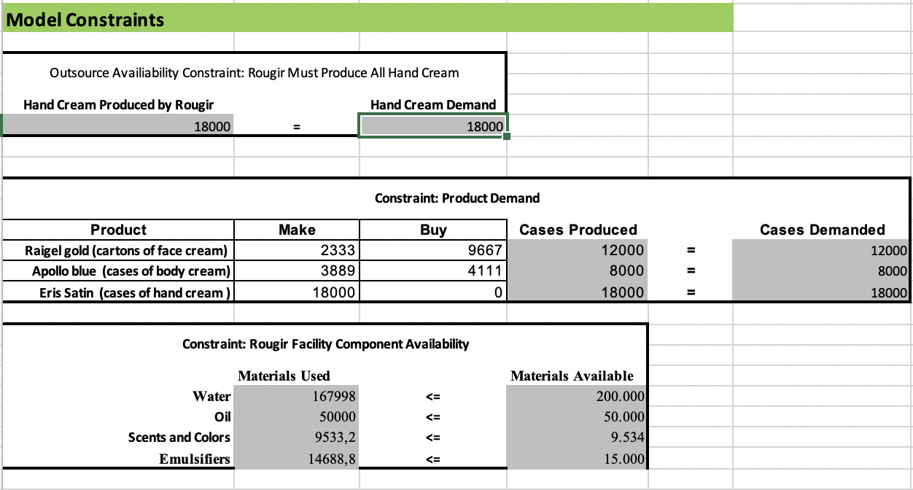
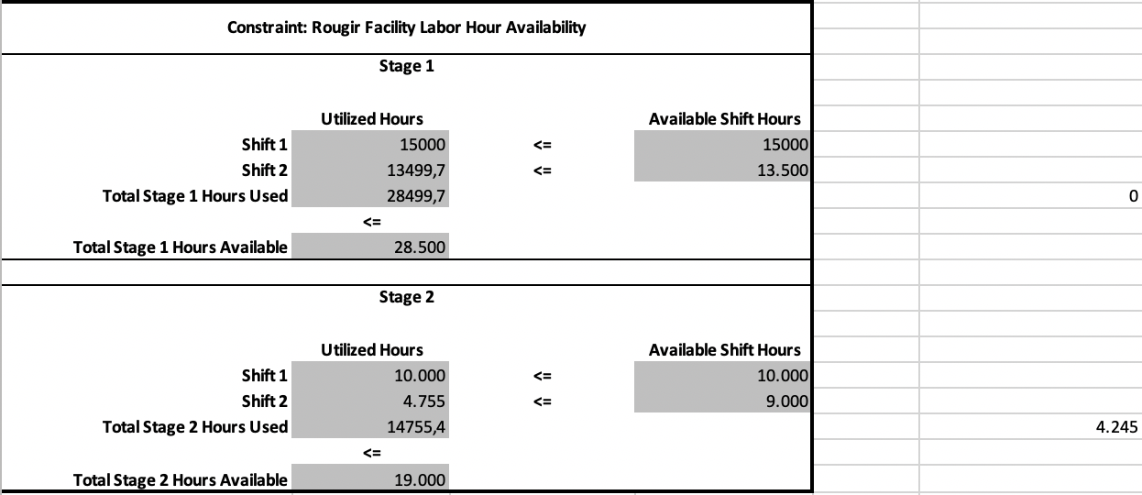
CONSTRAINTS

Slide 7
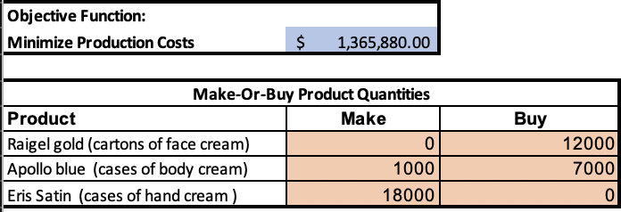
BASE MODEL
In order for Rougir Cosmetics to minimize production cost the company should choose the amount of product to make or to purchase(Make or Buy Model)
Rougir Cosmetics must produce 18,000 units of hand cream and 1,000 units of body cream. Due to the shortage of scents & color material, Rougir Cosmetics have to subcontract the manufacturing process of 12,000 units of face cream and 7,000 of body cream to ensure demand is fulfilled.
All production cost including raw material, labor, and subcontract cost with total of $1,365,880 in production cost.

Slide 8
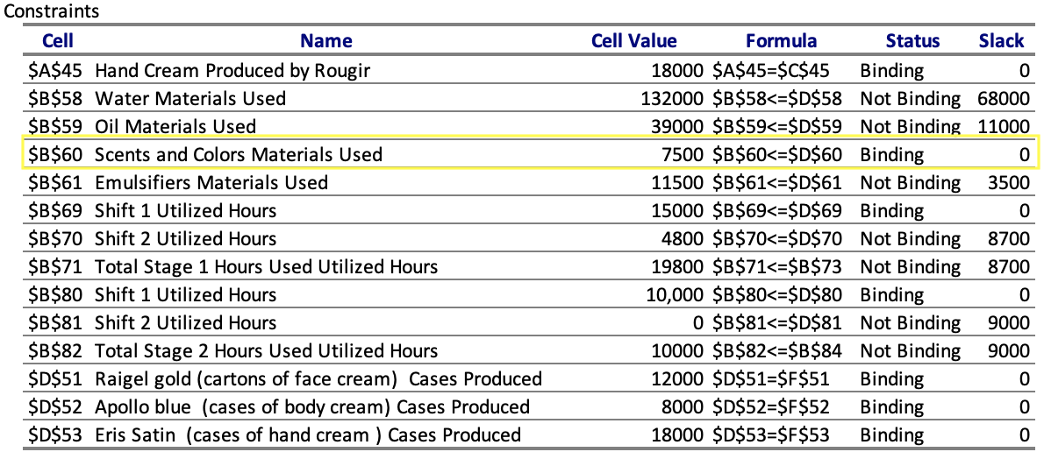
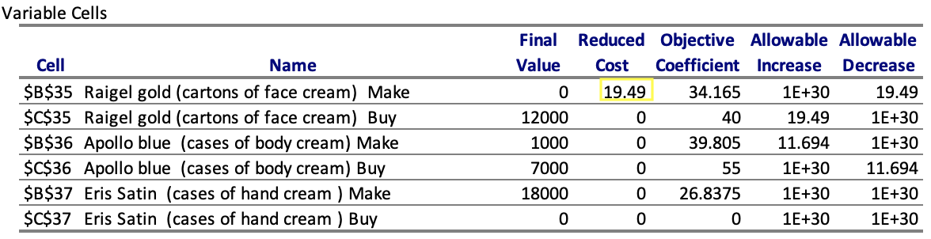
BASE MODEL: SENSITIVITY ANALYSIS
Key Sensitivity Report Findings:
Riegel Gold face cream” reduced cost of $19.49
Bind Constraint: “Scent and Colors” Raw Material
Underutilized labor hours
Due to the binding constraint of “Scents and Colors” availability, the Rougir facility is unable to use 27% of their labor hours. This forces the remainder of demand to be produced at the outsourced facility, increasing overall production costs.
Scenario Model Solution: Increase the “scents and colors” material availability.
Notes:
Key Sensitivity Report Findings:
“Riegel Gold face cream” reduced cost of $19.49
Bind Constraint: “Scent and Colors” Raw Material
Underutilized labor hours
Due to the binding constraint of “Scents and Colors” availability, the Rougir facility is unable to use 27% of their labor hours. This forces the remainder of demand to be produced at the outsourced facility, increasing overall production costs.
Therefore, our scenario model will increase the “scents and colors” availability to mitigate this.

Slide 9
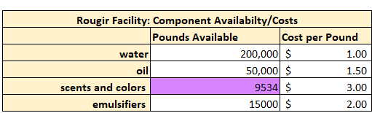
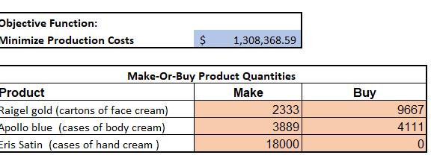
OPTIMAL SCENARIO MODEL
Business Recommendation: Increase the available supply of “scent and colors” material in order to increase labor hour usage and optimize the minimum production costs.
New Optimal “Scents and Colors” Availability: 9534 pounds (2034 pound increase)
Optimal Minimized Production Costs: $1,308,368.59
Scenario Model Improvements:
The Rougir Cosmetics Company will see a $57,512 decrease in minimized production cost.
The Rougir production facility will see a 28% increase in utilized labor hours.
Notes:
Business Recommendation: Increase the available supply of “scent and colors” material in order to increase labor hour usage and optimize the minimum production costs.
New Optimal “Scents and Colors” Availability: 9534 pounds (2034 pound increase)
Optimal Minimized Production Costs: $1,308,368.59
Scenario Model Improvements:
The Rougir Cosmetics Company will see a $57,512 decrease in minimized production cost.
The Rougir production facility will see a 28% increase in utilized labor hours.

Slide 10
KEY TAKEAWAYS FOR DATA OPTIMIZATION MODELING
Find out right at the beginning what your decision variables are to get a better overview and good start about the make-or-buy model.
Analyzing the sensitivity report in order to optimize the model and improve the objective function.
To be able to make conclusive decisions and to identify and separate out unnecessary information.
Always keep a clear and consistent pattern so that you do not lose track of what you are doing. This also helps others to understand the final model.

Slide 11
REFERENCES
M. Alkubaisi, M. (n.d.). Non-simplex based solution methods. Linear Programming and Its Applications, 261-294. doi:10.1007/978-3-540-73671-4_9
G., Y., R., M., & R. (2002). Subject disciplines and disciplining subjects. Postmodernism and Education, 88-106. doi:10.4324/9780203425206-5
Meghabber, F. Z. (june 2015). REDUCE COSTS IN THE MODERN MANUFACTURING ENVIRONMENT: CASE STUDY WITH IMPLEMENTATION OF TARGET COSTING AND ε -CONSTRAINT METHOD. AEuropean Scientific Journal. doi:University of Tlemcen - ALGERIA
Dellino, G. (2015). Uncertainty management in simulation-optimization of complex systems algorithms and applications. New York: Springer.

