Slide 1


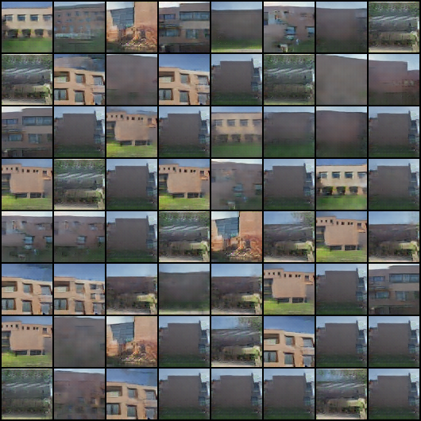


Generating New RIT Building Images using DCGANs Brian Landy, MS Computer Engineering, Rochester Institute of Technology
DCGANS:
Results:
This is where I discuss the baseline model parameters
This is where I discuss the best highly variational set results parameters
The Parameters and Results:
What model changes led to the best success?
What do these changes mean? Explain significance of parameter change to model design/training. Ex. (one sided soft labels etc)
Best Parameter/design choice:
This change made the discriminator less sensitive to change and it took longer for the model to get good at fake detection
The model:
Unique qualities
What are they used for
Training Process:
Goal equations for D and G:

