Slide 1


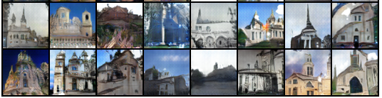
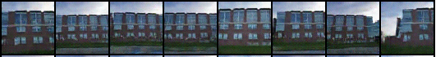
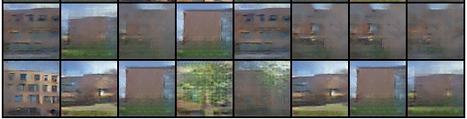
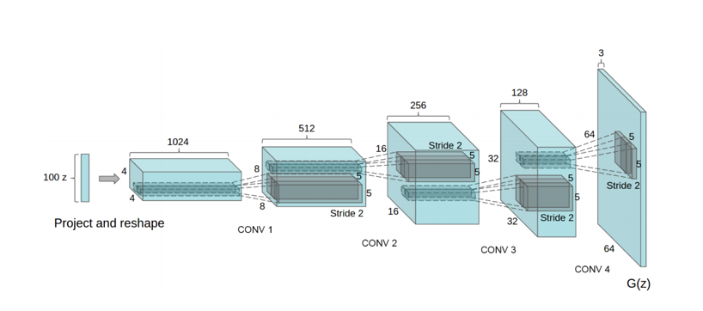











Generating New RIT Building Images using DCGANs Brian Landy, BS/MS Computer Engineering, Rochester Institute of Technology
Goal: Modify and tune Pytorch DCGAN to try and create many believable fakes
Outcome: Produced small amounts of images much better than baseline. Leap to more believable fakes is much larger
DCGANS/GANS:
Data Sets Evaluated with Baseline:
Lsun Churches: 75 Epochs →
← Low Variation: Bioscience Building
Large RIT Set: 330 Epochs →
(29,297 Images)
The Parameters and Results:
Best Parameter/design choice that worked here:
More filters in each layer of G
One sided label smoothing → Stops G from producing few tricks to fool D (Label 1 -> .8 to 1.1)
Discriminator Learning rate was 4 times lower than the generator
This change made the D take longer to get good at fake detection
Tried many things that didn’t work, tricky models
Best results still cherry picked
The model:
Generate images and “evaluate realness”
2 Networks competing and updating
Goal equations for D and G:
Even Match:
$$\frac{D\left(x\right)}{(D\left(G\left(z\right)\right)+D\left(x\right))}=D\left(G\right)$$
690

