Slide 1


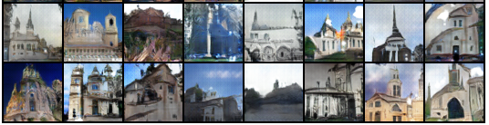
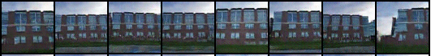
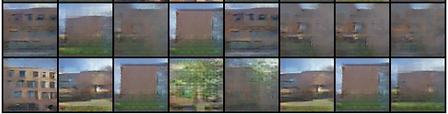
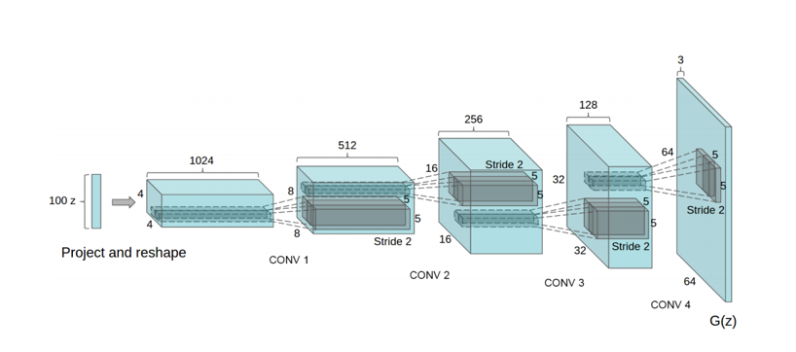











Generating New RIT Building Images using DCGANs Brian Landy, BS/MS Computer Engineering, Rochester Institute of Technology
Goal: Modify and tune Pytorch DCGAN to try and create many believable fakes
Outcome: Produced small amounts of images much better than baseline. Leap to more believable fakes is much larger
DCGANS/GANS:
Data Sets Evaluated with Baseline:
Lsun Churches: 75 Epochs →
← Low Variation: Bioscience Building
Large RIT Set: 330 Epochs →
(29,297 Images)
The Parameters and Results:
Best Parameter/design choice that worked here:
More filters in each layer of G
One sided label smoothing → Stops G from only producing one trick to fool D
Discriminator Learning rate was 4 times lower than the generator
This change made the discriminator less sensitive to change and it took longer for the model to get good at fake detection
Tried many things that didn’t help, tricky models
Best results still cherry picked
The model:
Generate images and “evaluate realness”
2 Networks competing and updating
Goal equations for D and G:
Even Match:
$$\frac{D\left(x\right)}{(D\left(G\left(z\right)\right)+D\left(x\right))}=D\left(G\right)$$

