Slide 1
Image Restoration by Brian Barnabas Langay

Slide 2
Covered
Introduction
Open Cv
Content
Visual Preview
Final & Advanced

Slide 3

Introduction to Computer Vision And Open Cv

Slide 4
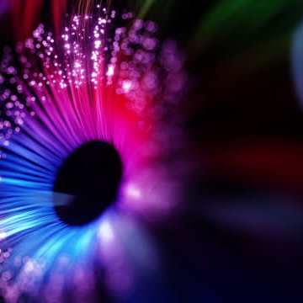
Image restoration
is a process of improving the quality of a digital image. It involves techniques to remove noise, correct distortions, and enhance overall visual appearance.

Slide 5
Red Eye Removal - Image Restoration
Image restoration aims to improve the quality of digital images by removing imperfections or artifacts.
Today's Focus: Red-eye removal as a specific example of image restoration.
Understanding Red Eye
What is Red Eye?
Explanation of the red-eye effect in photography.
Cause: Reflection of camera flash off the retina, resulting in a red-colored pupil.

Slide 6
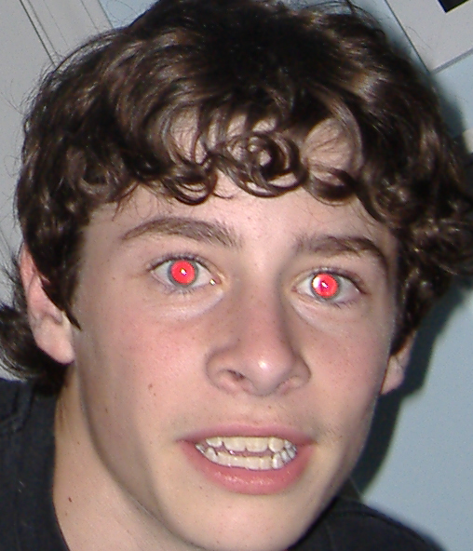
Red Eye Effect
  Given image shows example of the Red eye effect caused by camera flash when the photo was
  Pupil color to Red

Slide 7
Red-Eye Detection Algorithm
Introduction to OpenCV
OpenCV (Open-Source Computer Vision Library) is a popular open-source library for computer vision and image processing tasks.
  Widely used in various fields including robotics, augmented reality, and medical imaging.
  Provides a rich set of functions and algorithms for image manipulation, feature detection, object recognition, and more.
Algorithm Overview
  In our python code, OpenCV is utilized for implementing a red-eye detection and removal algorithm.
  The algorithm consists of several key steps to identify and correct red-eye regions within an image. Meaningful eye contact

Slide 8
Image Processing Techniques
Filling Holes and Dilation
After red-eye detection, the 'fill Holes' function is applied to clean and refine the red-eye mask.
Utilizes flood filling and bitwise operations to fill holes in the mask and ensure accurate detection.
Mean Channel Calculation
The mean channel is calculated by averaging the green and blue channels of the detected eye region.
This mean channel represents the corrected color for the red-eye affected pixels.
  Data Insights
  Example data from the code:
  Input image: "red_eyes2.jpg"
  Detection parameters: scale Factor=1.3, min Neighbors=4, min Size=(100, 100)
  Red-eye threshold: r > 150 & r > (b + g)
  Mask cleaning iterations: 3
  Visual Results
  Displayed images show the original image with red-eye artifacts and the resulting image after red-eye removal.
  Demonstrates the effectiveness of the algorithm in restoring natural eye appearance.

Slide 9
Visualization and Preview
Code preview

Slide 10
Conclusion
Image restoration techniques play a vital role in improving the quality and appearance of digital images. By using algorithms like face and eye detection, and red eye removal, we can enhance images for various applications.

Slide 11
Thank you
Brian Barnabas Langay
2322190027

