Slide 1
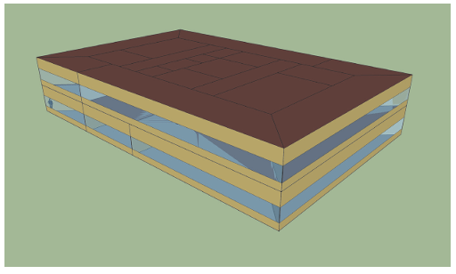
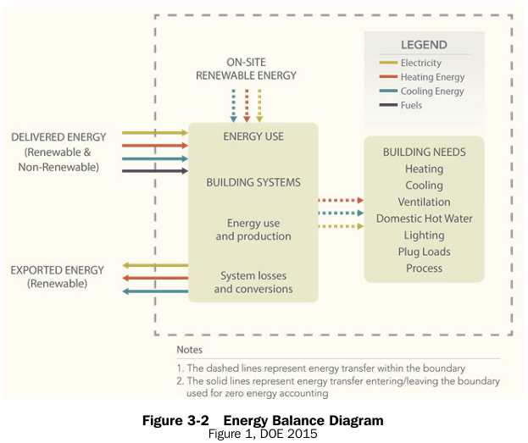
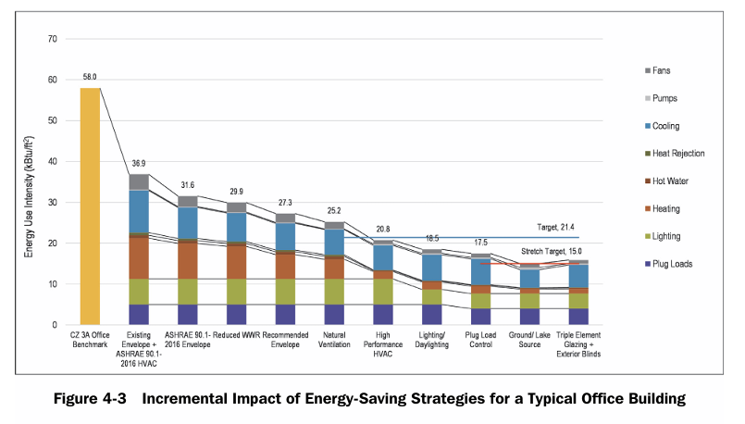
Prototypical Small Office 20,000 sqft

Slide 2
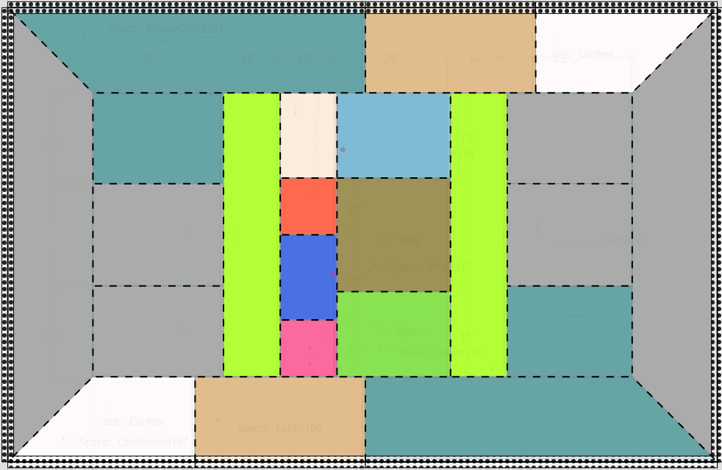
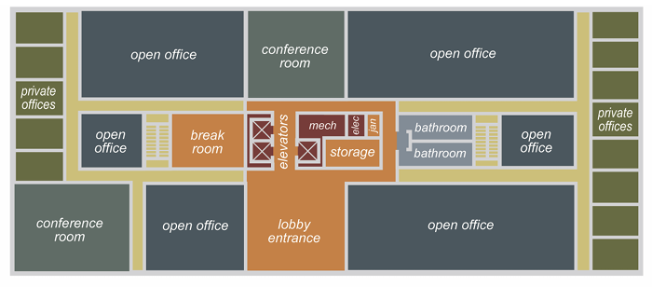
Baseline AEDG Small Office
Typical office layout
Lobby
Conference
Lobby – Welcoming area for visitors and staff; transition from exterior to office zones.
Conference Room – Enclosed meeting space for collaboration, equipped with AV systems.
Private Office – Individual workspace for focused tasks or confidential discussions.
Open Office – Shared workstation area promoting communication and flexibility.
Lounge – Informal break and social area to encourage occupant comfort and interaction.
Storage – Secured space for supplies, files, and building maintenance items.
Data Room – Climate-controlled area housing IT and network equipment.
Restroom – Accessible facilities for occupants’ hygiene and comfort.
Elevator – Vertical transportation connecting multiple building floors.
Corridor – Circulation path linking major zones; enables clear wayfinding and egress.
Mechanical & Electrical (Mech and Elec) – Houses HVAC, electrical panels, and utilities.
Stairway – Vertical circulation for daily use and emergency egress.
Lounge
Storage
Private Office
Open Office
Data
Corridor
Mech and Elec
Corridor
Restroom
Open Office
Private Office
Elevator
Stairway
Conference
Lobby

Slide 3
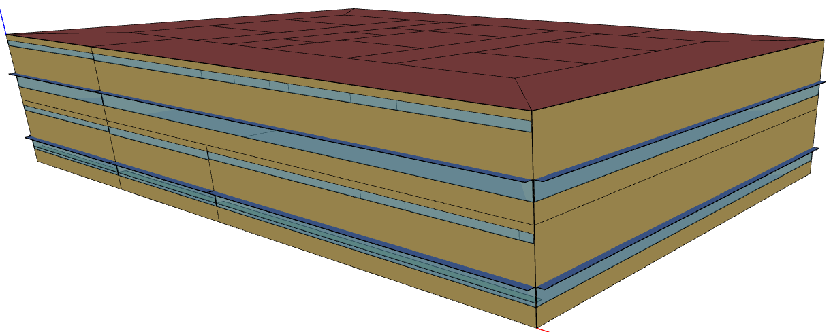
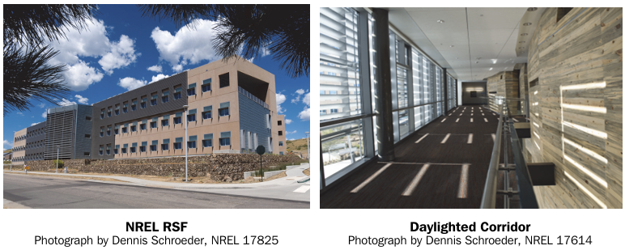
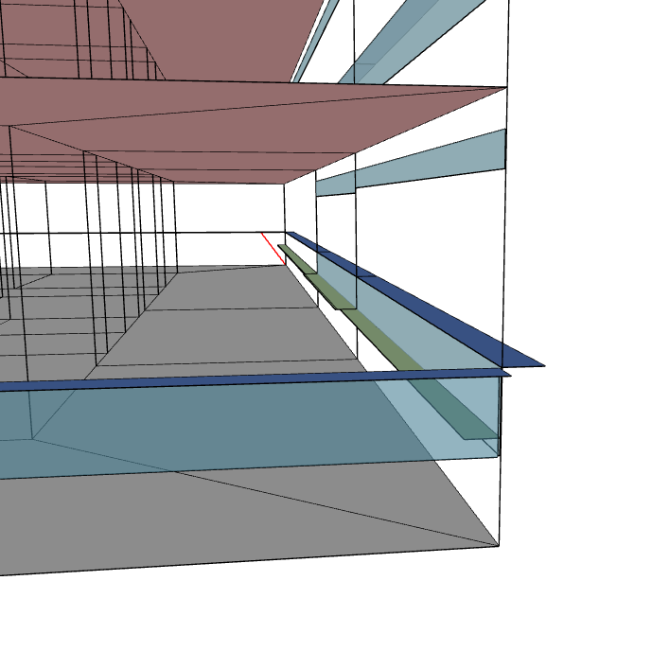
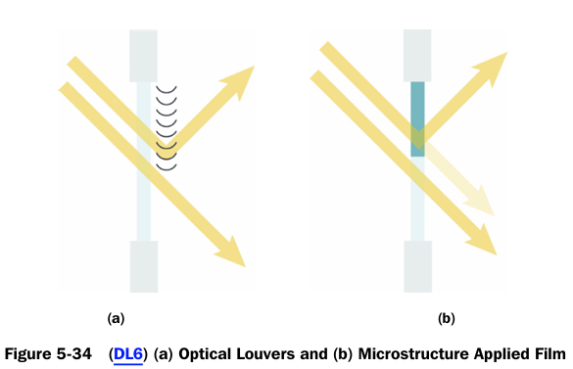
Baseline AEDG Small Office Fenestration
The window-to-wall ratio (WWR) is the ratio of window area to above-grade exterior wall
area (excluding parapets) for a building or a façade. Target is ~30%
It is good practice to reduce WWR on the east and west elevations compared to the north and south elevations. It is difficult to control solar gains and glare on the east and west façades, and northern latitudes have higher incident solar radiation striking these façades during the summer.
An effective daylighting system from an energy perspective is one in which the occupants do not want the lights on and do not want to cover over glazing to fix glare problems.
30% WWR N-S
20% WWR E-W
Daylight redirection
Exterior Shading Surface
Daylighting

Slide 4
Baseline AEDG Small Office Opaque Envelope
EN2 Insulation of Roofs
EN3 Insulation of Mass Walls—Concrete and Masonry
EN4 Insulation of Steel-Framed and Wood-Framed Walls
Insulated steel framed exterior wall
Cold-formed steel framing members are thermal bridges. Continuous insulation on the exterior of framed walls is the recommended method to minimize thermal bridges created by the framing. While wood studs are less conductive than steel, thermal bridging through the wood also decreases the effectiveness of stud cavity insulation; therefore, continuous exterior insulation is also recommended for wood-framed stud walls
Interior wall, no insulation.
Uninsulated interior walls permit heat transfer between core and perimeter zones.
This passive energy exchange helps moderate zone temperatures and lowers overall EUI.
Interior coupling reduces simultaneous heating and cooling loads in small office designs
Insulated concrete mass exterior wall
For mass walls, continuous exterior insulation is preferred over interior insulation as it can aid in the continuity of the air barrier and insulation and better accommodates the use of the thermal mass (when exposed to the interior) for energy efficiency.

Slide 5
Baseline AEDG Small Office Air Leakage
EN27 Air Leakage Control General Guidance
EN28 Air Leakage for Fenestration and Doors
EN29 Establish a Minimum Air Leakage Rate Target
When air moves through the envelope, energy transfer occurs and either heating or cooling from the interior is lost (exfiltration) or exterior air is admitted (infiltration). Air infiltration and exfiltration are caused by pressure differences from wind, stack effect, and building mechanical systems and are controlled by the air barrier system. The air barrier system must be continuous over all surfaces of the building envelope, including at the lowest floor, exterior walls, and the roof, separating controlled interior environments from exterior and semi-conditioned or unconditioned spaces.
Infiltration Target
The recommended target air leakage rate is 0.25 cfm/ft2 (or less) of total envelope surface area at 75 Pa for all climate zones except 7 and 8. The recommended target for climate zones 7 and 8 is 0.15 cfm/ft2 (or less) of total envelope surface area at 75 Pa. These targets are based on air leakage testing procedures per ASTM E779 (ASTM 2019).

Slide 6
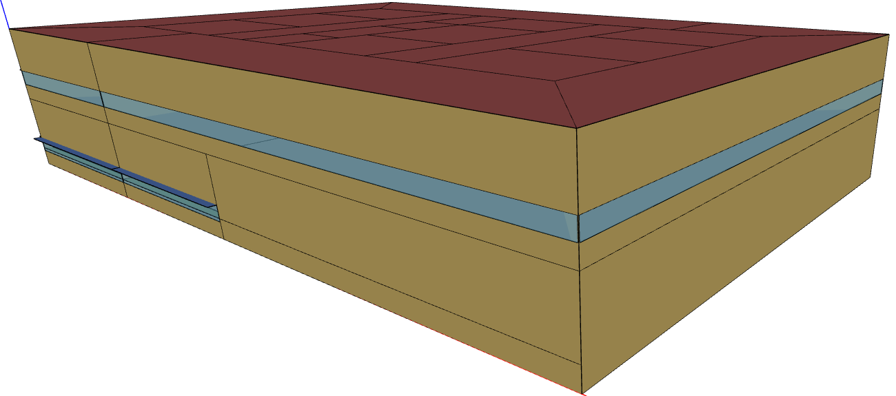
Secure Facility
Exterior Shading Surface
Secure Section
No windows first floor
windows low VLT
Lobby
Conference
Conference
No Daylighting
No Daylight redirection
Lounge
Storage
Private Office
Insulated concrete exterior wall
Open Office
Data
Corridor
Mech and Elec
Corridor
Interior wall, sound proofing
Restroom
Open Office
Open Office
Private Office
Private Office
Insulated concrete Roof
Elevator
Stairway
Very low infiltration
Conference
Lobby

Slide 7
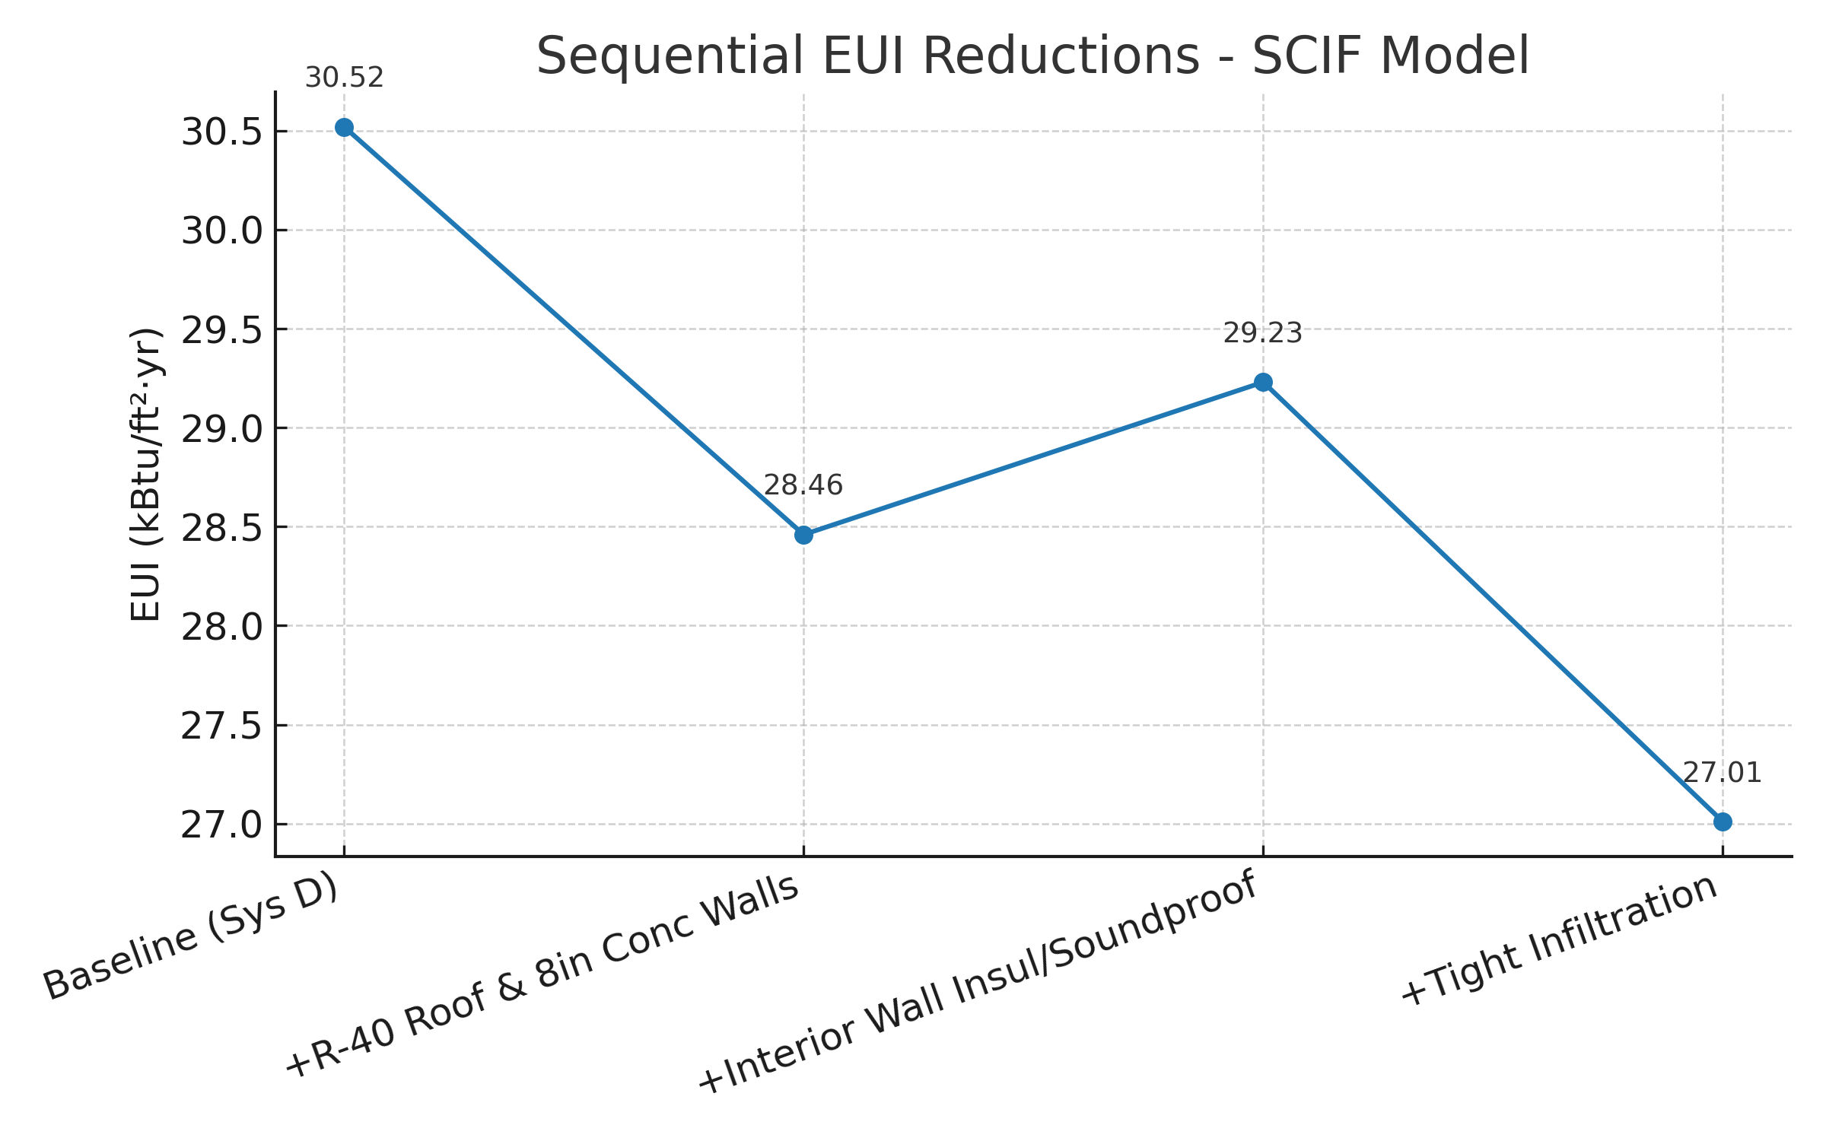
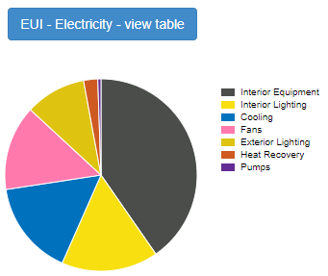
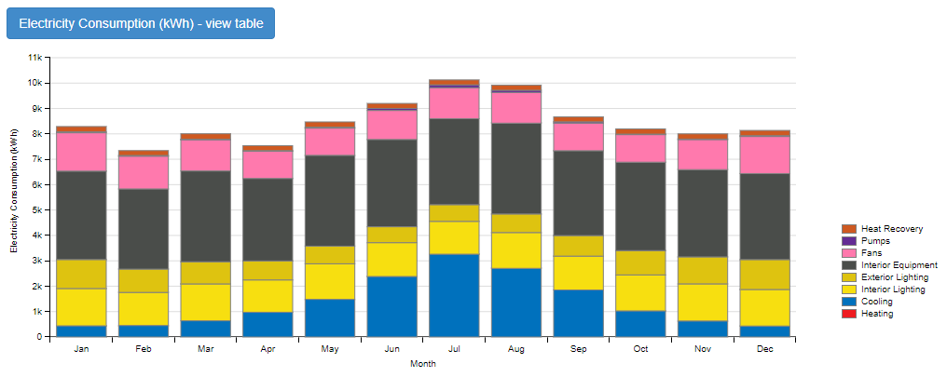
Envelope
System D R40 Roof and 8in Concrete ext walls
System D adding internal sound proofing
System D tighter infiltration
Windows
System D Window VLT 0.25
System D Remove Windows first floor SCIF
System D No Daylighting
System D Remove shading surfaces?
System D Remove light shelves?
HVAC
System D Fan static pressure increase

Slide 8
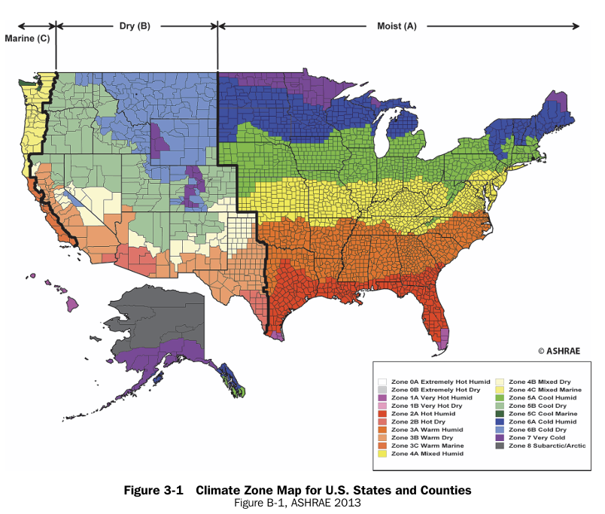
With more time scale to either climate zones or states

