Slide 1
Jeff Renz, Brian Liberatore

Slide 2
Top 10 states affected by COVID-19
State | Total Cases | Total Deaths
New York | 110465 | 7690
Illinois | 16323 | 577
Michigan | 12209 | 820
New Jersey | 10426 | 550
California | 10047 | 360
Florida | 7711 | 143
Pennsylvania | 7130 | 206
Massachusetts | 6254 | 188
Connecticut | 6213 | 287
Louisiana | 5718 | 276

Slide 3
Market Summary
## [1] "temp"

Slide 4
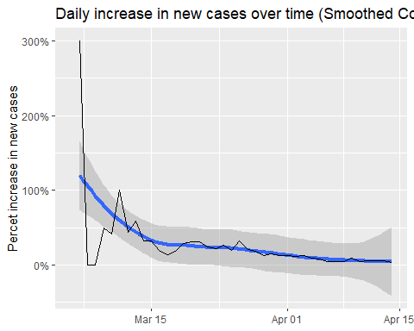
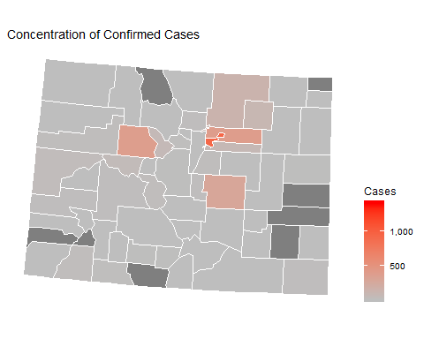
State Information

