Slide 1

Python Productivity for Zynq

Slide 2

Timeline
Session 1
First steps with PYNQ-Z2
Labs:
Getting started with Jupyter Notebooks
Getting started with Ipython
Exploring PYNQ-Z2
Programming on-board peripherals
Session 2
Overlay concept
Base Overlay
Labs:
Grove temperature sensor
Grove light sensor
Grove ledbar
OLED
Session 3
Overlay design methodology
Building customized overlay
Labs:
Developing a single IP
Creating a python-driver
Creating a custom overlay
Session 4
Why use Zynq for DL Inference
Binary neural network (BNN)
Labs:
MNIST + Char Recognition
Cifar 10
SVHN
Road Signs

Slide 3

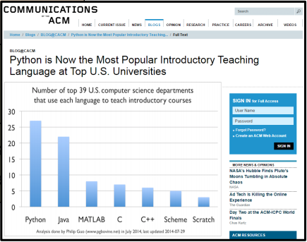
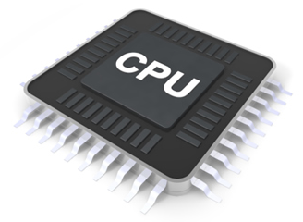
The rise of productivity languages
Applications,
Programming Frameworks
Productivity Languages,
Python, Scala, ..
Systems/Efficiency Languages
C, C++, OpenCL
Hardware Systems
OS, hypervisor, drivers
How can we program ZYNQ in a productivity language?
Notes:
1.生产力语言的崛起
向底层发展可以，有针对于系统级和提高效率的语言 C ,C++ OpenCL，再向下进入硬件系统、操作系统、管理系统以及驱动
向智能应用发展，基于生产力语言 Py't'hon Scala等，最后基于生产力语言进行应用于程序架构的搭建
Python已经成为美国高校最流行的语言之一
如何通过生产力语言进行ZYNQ编程

Slide 4
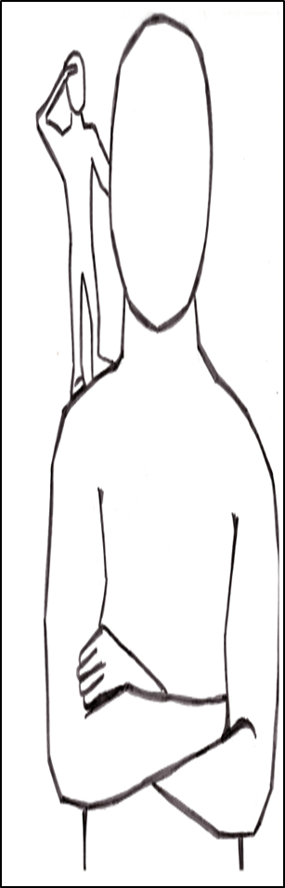
The rise of open source and knowledge re-use
GitHub: world’s leading software repository
https://github.com/
Stack Overflow: communities helping each other
http://stackoverflow.com/
Python Package Index (PyPI): 80,000+ packages
https://pypi.python.org
Jupyter Notebooks: literate, reproducible computing
http://jupyter.org/
Readthedocs: software documentation repository
https://readthedocs.org
And Linux, of course!
We see further when ‘we stand on the shoulders of giants’
Notes:
开源社区的兴起与共享
站在巨人的肩膀上,看得比较远——牛顿

Slide 5

Python Productivity on Zynq
Notes:
如何将python的生产力运用到zynq上

Slide 6
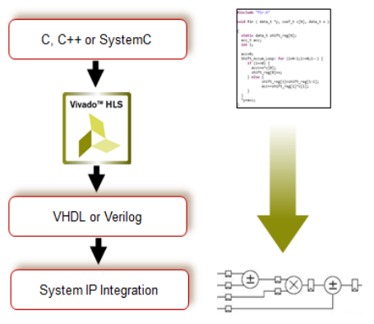
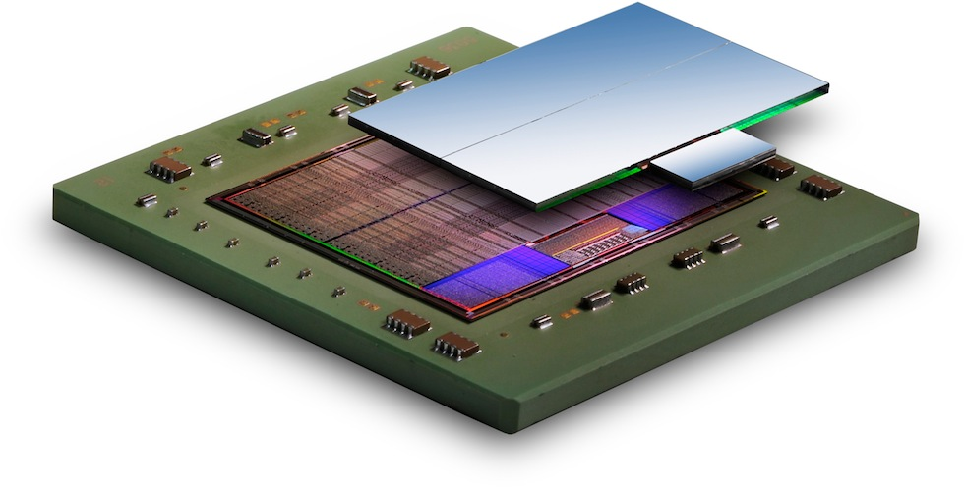
Today Zynq uses systems/efficiency languages
Could Zynq flows exploit
productivity languages?
Application
oriented
Productivity languages
Cross-compiled C/C++ code
Systems/
efficiency
languages
FreeRTOS/Linux
Bare metal IP drivers in C
Zynq PS & PL Hardware
H/W flow
S/W flow
Notes:
现在ZYNQ可以支持使用系统/效率语言进行开发
从硬件设计流程到软件设计流程，我们将C,C++或者SystemC语言通过HLS工具变成硬件语言再变成系统级IP,然后通过在硬件系统的运行的系统/效率语言为媒介进行生产力语言的应用

Slide 7
Productivity level tools for Zynq
Python scripts & programs
Interactive console
Python Libraries
CPython Virtual Machine
Python-C bindings
for IP drivers
Ubuntu core
IP drivers in C
Post-bitstream-programmable overlay

Slide 8
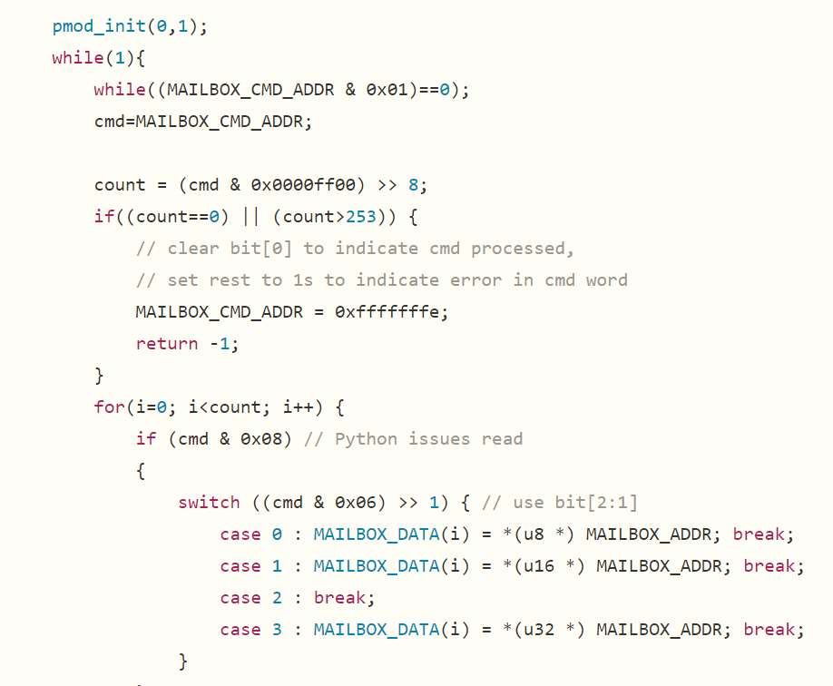
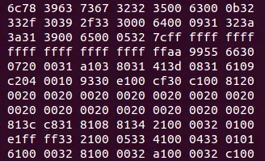
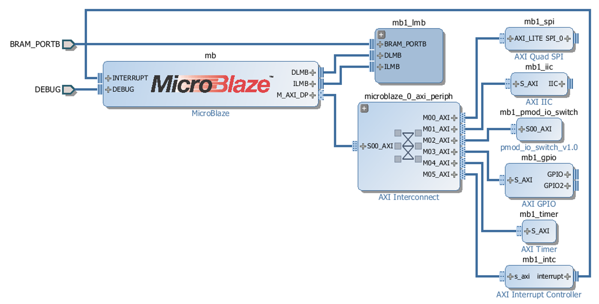
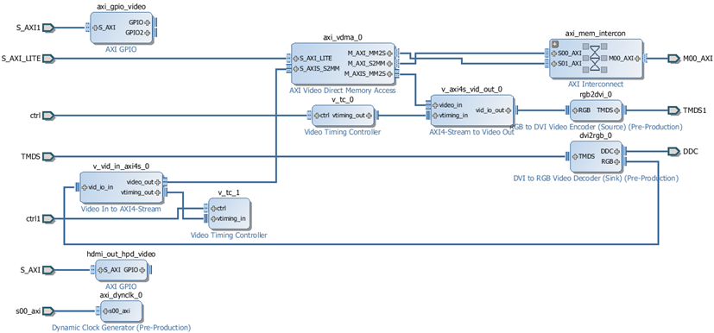
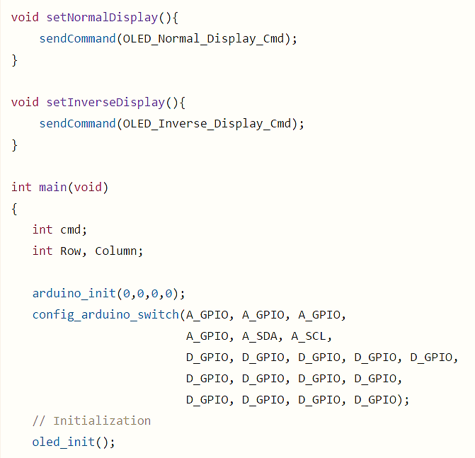
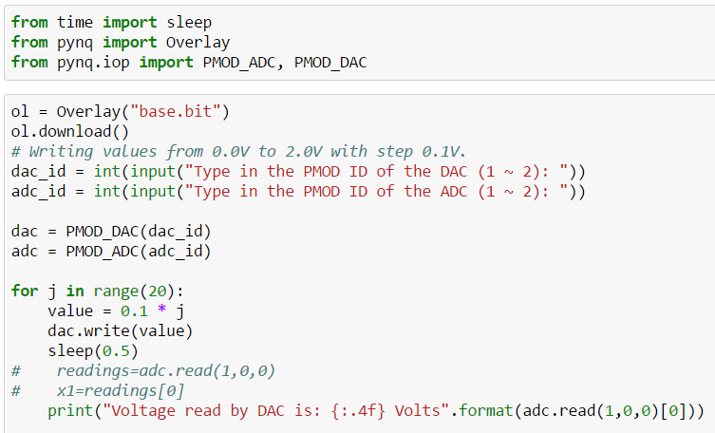
Overlays with IOP
Step 1:
Create an FPGA design for a class
of related applications
Step 2:
Export the bitstream and a C API
for programming the design
Step 3:
Wrap the C API to create a Python library
Step 4:
Import the bitstream and the library in your Python scripts and program
Notes:
步骤1：
为一类相关应用创建FPGA设计
步骤2：
导出比特流和用于设计的C API
步骤3：
包装C API创建Python库
步骤4：
在Python脚本和程序中导入比特流和库

Slide 9



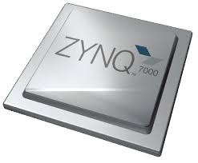
Jupyter on Zynq
Dashboard
Terminal
Editor
Notebooks
Jupyter
Browser tools:
JavaScript, HTML, CSS
Tornado Server
Server Tools:
Python
IPython Kernel
Pynq Libraries
Jupyter infrastructure consists of:
a suite of web browser tools
IPython kernel & Tornado web server
a fully-integrated, proven stack
additional tools for project sharing, dissemination and reuse
Ubuntu Server
Overlays
ARM A9s
FPGA
Notes:
Juyter基础设施包括：
一套Web浏览器工具
IPython内核和TrnADO Web服务器
一个完全集成的、经过验证的堆栈
项目共享、发布和重用的附加工具

Slide 10
FPGA overlays – hardware libraries (kernels)
Overlays are generic FPGA designs that target multiple users with new design abstractions and tools
Post-bitstream programmable via software APIs
Typically optimized for given domains
Encourages the use of open source tools & fast compilation
Enables productivity from re-using pre-optimized designs
Exposes benefits of FPGAs to new users
Active research area with many papers
Notes:
FPGA overlays – hardware libraries
overlays是通用的FPGA设计，针对多个用户，采用新的设计抽象和工具。
基于软件API的后置比特流可编程软件
通常对于给定域进行优化
鼓励使用开源工具和快速编译
利用重复优化设计实现生产率
暴露FPGA对新用户的好处
多论文活跃研究区

Slide 11

Web & Python-based, open source architecture
Develop on the target,
access via the browser
Web Server
Python VM
Pynq Libraries
Architecture emphasizes :
a software-centric approach
based on open, de facto standards
platform, OS and browser agnostic
minimal learning curve
no proprietary methodologies
Ubuntu Server
Overlays
ARM A9s
FPGA
Everything runs on Zynq
Notes:
建筑学强调：
以软件为中心的方法
基于开放的、事实上的标准
平台、OS和浏览器不可知论
最小学习曲线
没有专有的方法论

Slide 12
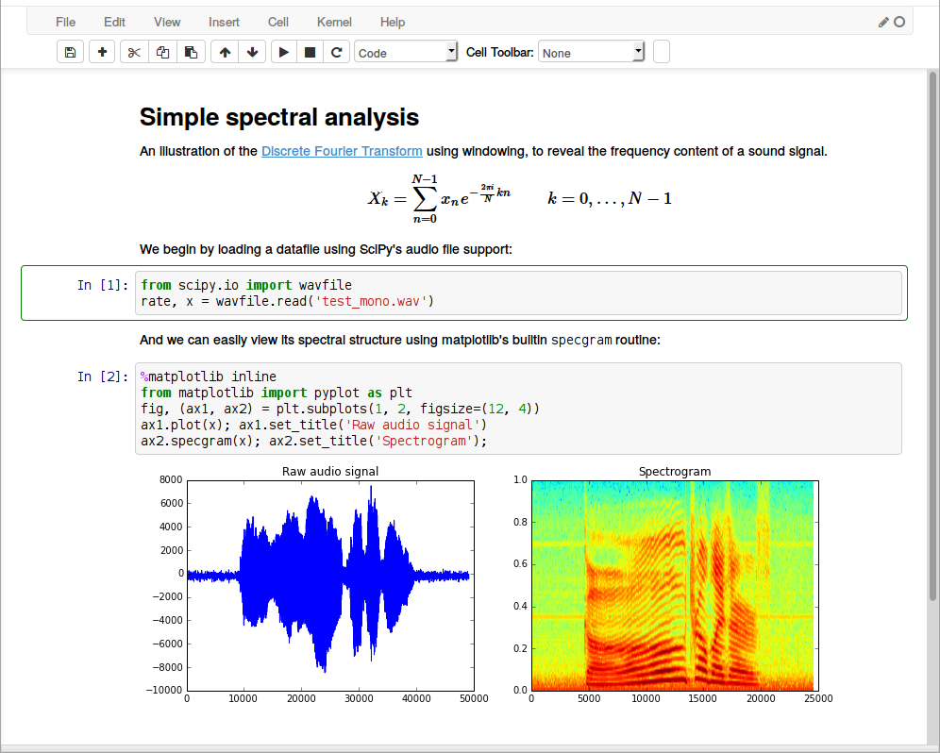
Jupyter on Zynq
Dashboard
Terminal
Editor
Notebooks
Tornado Server
IPython Kernel
Pynq Libraries
Jupyter Notebooks
Interactive design with Zynq:
highly productive, easy-to-use tools
extensive third-party libraries
integrated multi-media
open source JSON format
application-oriented perspective
Ubuntu Server
Overlays
ARM A9s
FPGA
Notes:
Jupyter笔记本
互动设计与Zynq：
高效、易用的工具
广泛的第三方图书馆
集成多媒体
开源JSON格式
面向应用的观点

Slide 13
With PYNQ embedded programmers get …
Productivity-level programming
Interactive console & scripting
Fast compile and debug times
Hardware performance in a software environment
Hardware parallelism
Function independence
Predictable performance
Hard, real-time latencies
Portable libraries & open source community
Notes:
生产力水平规划
交互式控制台和脚本
快速编译和调试时间
软件环境中的硬件性能
硬件并行性
函数独立性
可预测性能
硬实时潜伏期
便携式图书馆与开源社区

Slide 14
PYNQ_{TM}-Z2 Platform

Slide 15
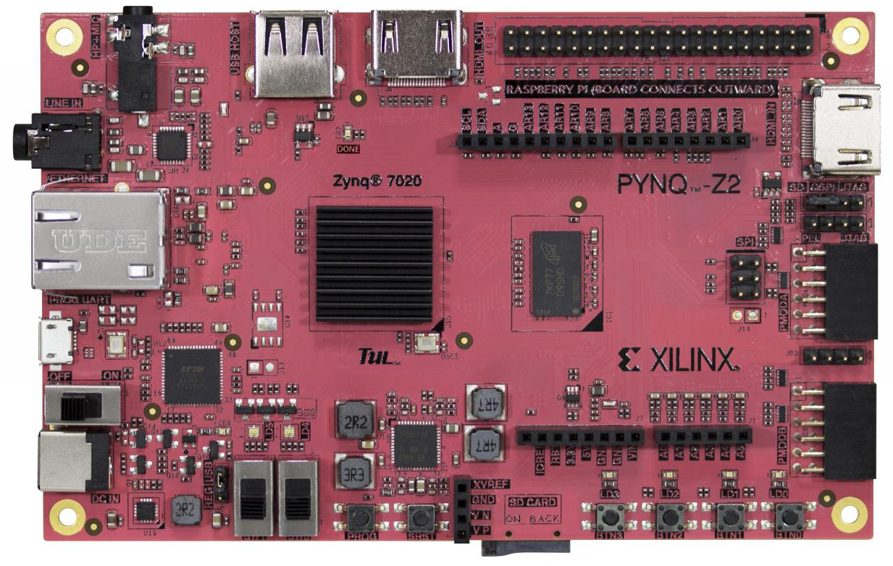
Low-cost PYNQ-Z2 Board
Zynq XC7Z020 CLG400
512 MB DRAM
HDMI input, HDMI out
Microphone input
Audio output
10/100/1G Ethernet
MicroSD slot
USB 2.0
4 LEDs, 4 buttons, 2 switches
Arduino connector
With additional IO
2 Pmod 8-pin GPIOs
Available from E-ELEMENTS for approved academic customers

Slide 16
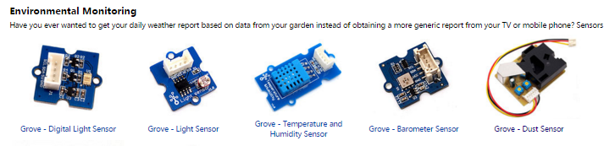
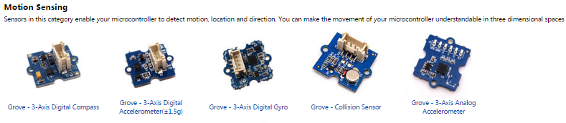
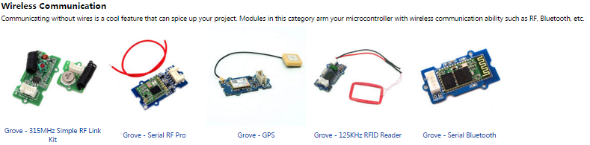
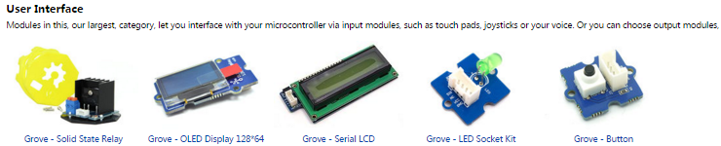
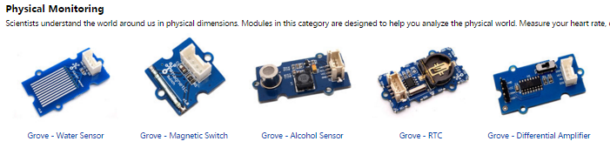
Wide range of low-cost sensors, actuators, etc
www.seeedstudio.com/wiki/Grove_System

Slide 17
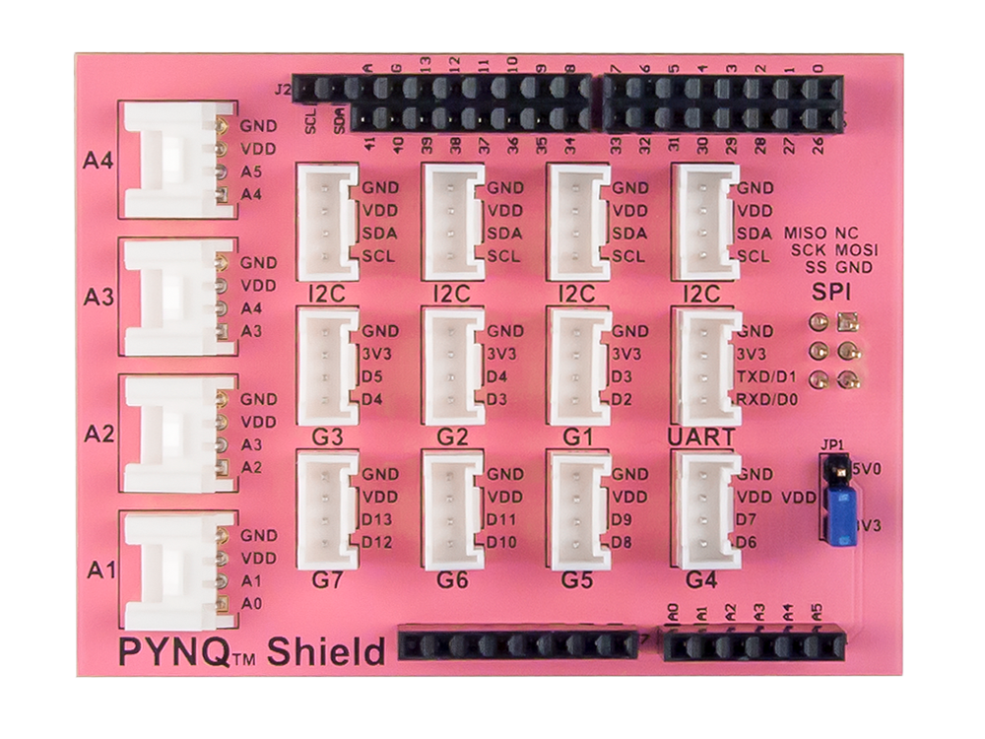
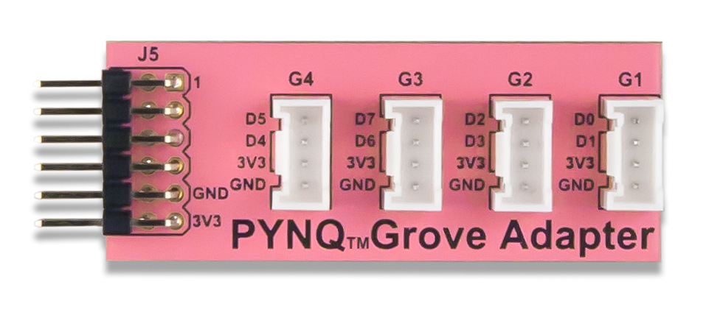
Low-cost Pynq Grove Shield & Pmod Adapter
Grove Shield:
4 x Analog ports
4 x I2C ports
3 x 3.3V GPIO ports
1 x UART
4 x 3.3/5V switchable GPIO ports
1 x SPI header
1 x 16-pin GPIO header
Pmod2Grove Adapter :
4 independent sockets for Grove modules
Pmod compatible
Solderless breadboard compatible
Open-source design

Slide 18
Jupyter Notebook

Slide 19
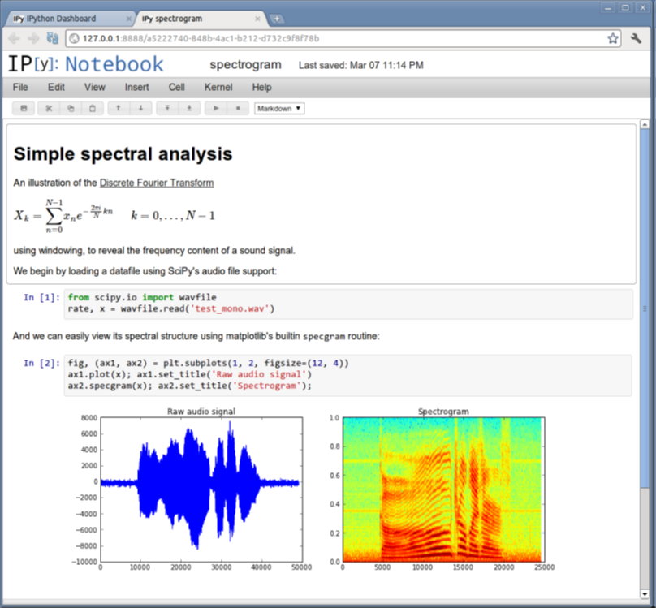
Jupyter Notebooks … a new paradigm for reproducible knowledge
Designed for
Interactive, exploratory computing
Reproducible results
Ideal for
Teaching and learning
Projects and research
Rapid adoption
Over 500,00 notebooks uploaded to Github in the last 3 years
github.com/ipython/ipython/wiki/A-gallery-of-interesting-IPython-Notebooks
Coming shortly for Zynq APSoCs as part of the PYNQ open source project
Notes:
计用于
交互式探索性计算
重现性结果
理想的
教与学
项目与研究
快速采用
过去3年500多万笔记本上传到GITHUB

Slide 20
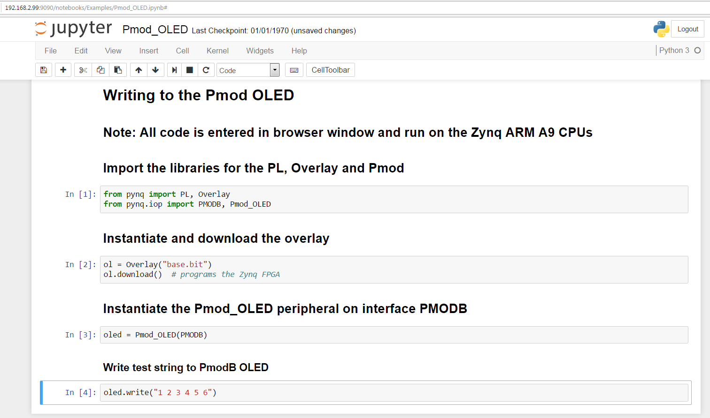
Jupyter Notebook

Slide 21
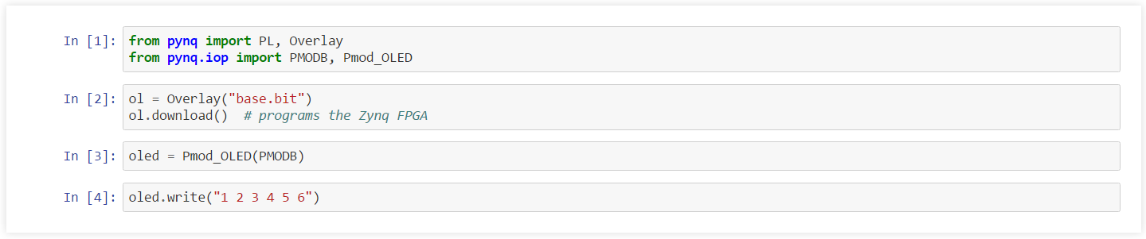
Jupyter Notebook Code Cells
6 lines of user code … thanks to Python, FPGA overlays, abstraction & re-use
Notes:
6行用户代码…感谢Python，FPGA overlays

