Slide 1

First steps with PYNQ-Z2

Slide 2
Agenda
Configure board, SD card
Connect to the board
Login in to portal
Jupyter Notebook
Labs
Getting started with Notebooks
Getting started with IPython
Exploring PYNQ-Z2
Programming on-board peripherals

Slide 3
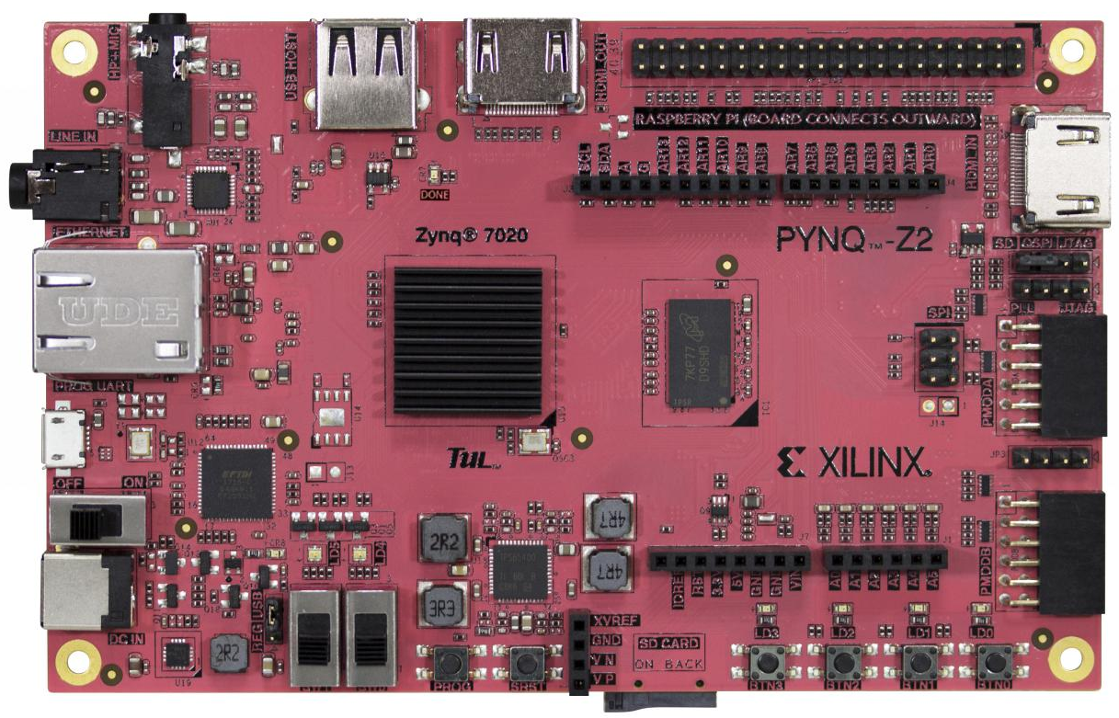
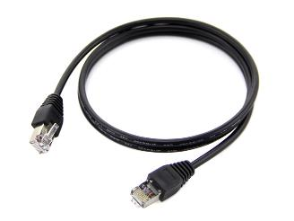
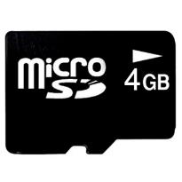
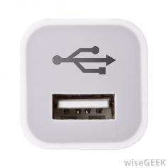
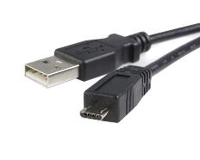
Prerequisites
PYNQ-Z2 board
SD Card with preloaded Image*
Ethernet Cable
USB cable and available USB port
*Instructions to download and prepare SD card:
http://www.tul.com.tw/download/pynq_z2_v2.2.img.zip

Slide 4

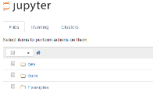


Pynq overview
USB
HDMI In/Out
Pmods
Programmable Logic
(Overlay)
Dual Cortex-A9
Raspberry Pi header
Ethernet
Jupyter
Linux, Jupyter, Pynq
(MicroSD card)
Pynq
Arduino header
Audio
LEDs, Buttons, Switches

Slide 5
Connecting to the board
Configure board to boot from SD Card
Insert SD Card
Connect USB cable
Connect Ethernet cable to PC or to a Switch/Router
Power On

Slide 6
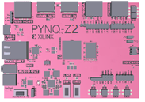
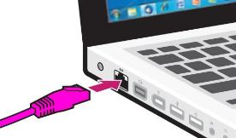

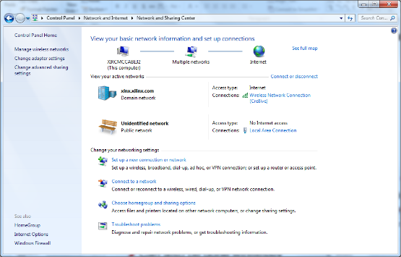
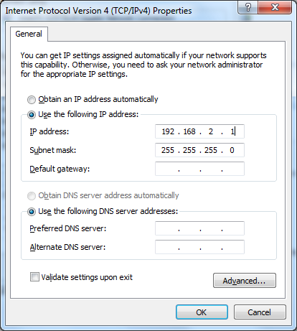
Connecting to the board – Direct connection
Connect board directly to Ethernet port on PC
USB to Ethernet adapter if no Ethernet port available
Board IP will default to 192.168.2.99
Manually specify static IP for PC
Must be in same range as board:
E.g. 192.168.2.1
No internet access unless you bridge network connections (packages can’t be updated)
Connect board directly to PC

Slide 7
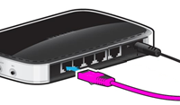
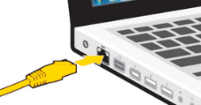
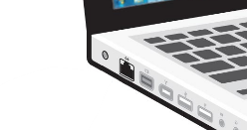

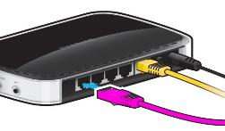
Connecting to the board – Via network switch
Board is connected to network (switch/router)
If DHCP server running on network board will get IP from DHCP server
Internet access via network allows Python packages to be installed/updated
PC can connect to same network
Wired
WiFi
1
Connect board to switch/router
2
PC connected to router via cable or wireless

Slide 8




Connecting to the board – Via WiFi
Connect USB WiFi dongle to board
Connect board and PC to wireless hotspot
Router, Mobile Phone
Need to configure board to connect to WiFi network
Notebook available to do configuration
usb_wifi.ipynb
Manually configure from terminal
Modify /etc/network/interfaces.d/
iwconfig in next release
1
Connect WiFi dongle to board
2
Connect board and PC to wireless hotspot

Slide 9
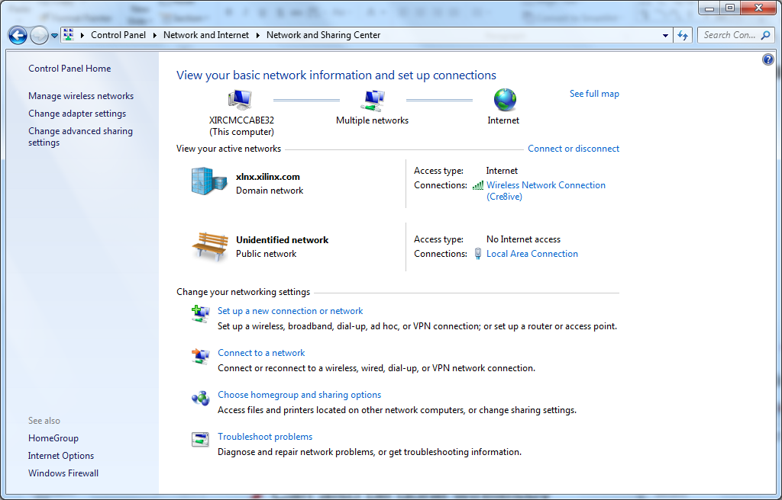
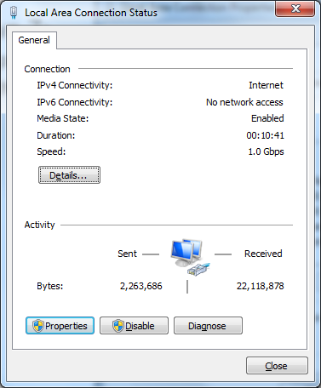
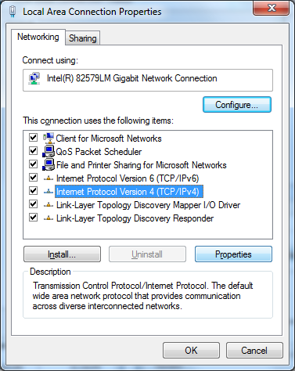
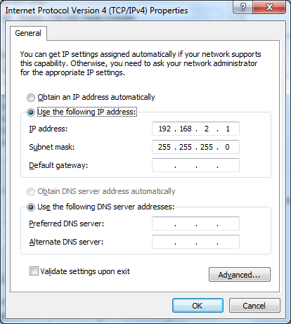
Configure Ethernet - Windows
Windows 7:
Control Panel\Network and Internet\Network and Sharing Center
Properties
TCP/IPv4→Properties
Set IP address

Slide 10
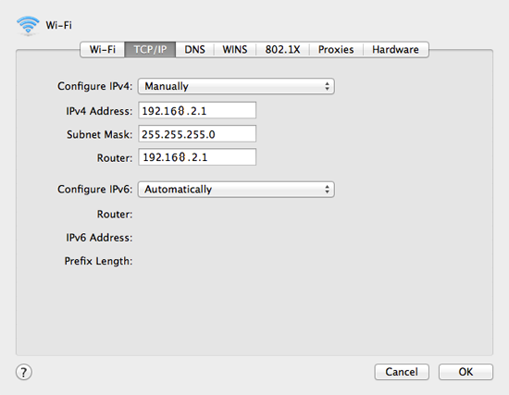
Configure Ethernet - Mac
Mac OS:
Apple menu > System Preferences > Network
Select interface > Advanced

Slide 11
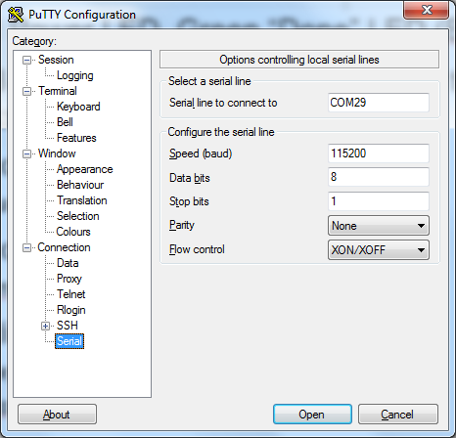
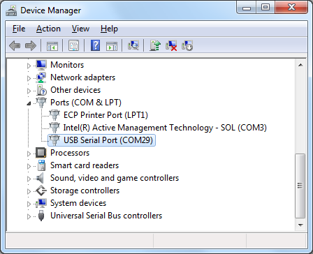
Troubleshooting: LEDs, serial connection
Status LEDs
Power On: Red LED
Bitstream Loaded (Pynq booting): Green “Done” LED
USB cable provides serial connection to the board
115200 baud (data:8 bit, stop bits:1)
Windows: Device manager to get COM port
Check board has booted
Is Linux shell available on terminal?
Check/Modify board IP
ifconfig to check network settings
Modify any other Linux settings
Proxy, Network settings
sudo password: xilinx

Slide 12
Hostname
Linux is running on the board
Change the hostname if multiple boards are on the same network
Default hostname is pynq
Linux username:password = xilinx:xilinx
sudo /home/xilinx/scripts/hostname.sh A_UNIQUE_HOSTNAME

Slide 13
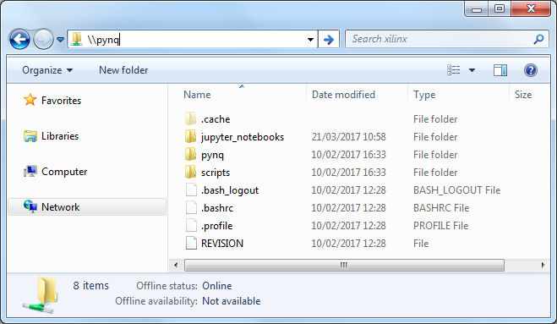
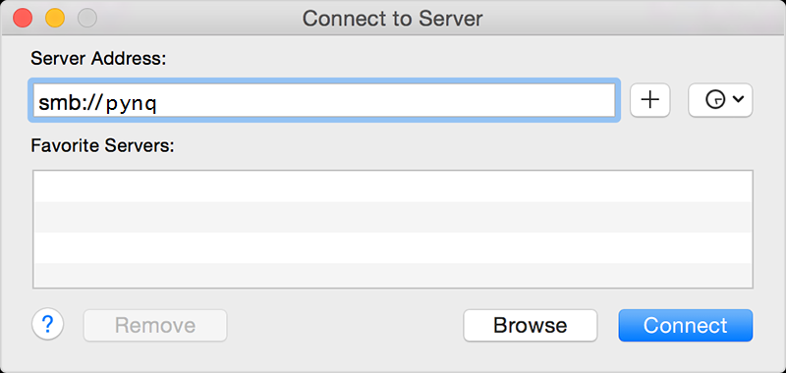
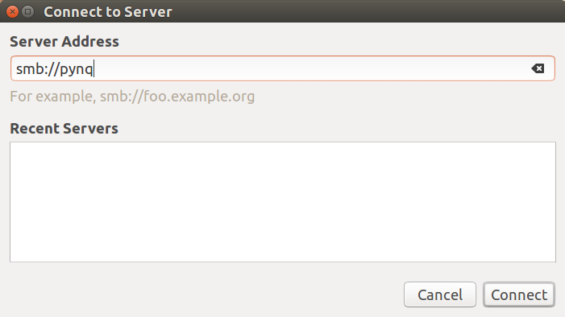
Samba share
Board can also be accessed as a shared drive
Windows: \\pynq\xilinx
Linux: smb://pynq/xilinx
username:password = xilinx:xilinx
Copy files between PC and board
Access documentation/ scripts/Notebooks

Slide 14
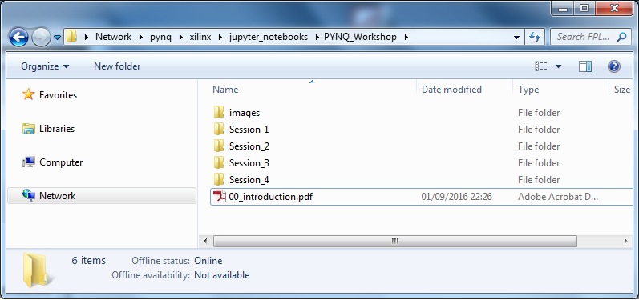
Introduction to Jupyter notebooks
Copy PYNQ_Workshop folder from USB to: \\pynq\xilinx\jupyter_notebooks

Slide 15
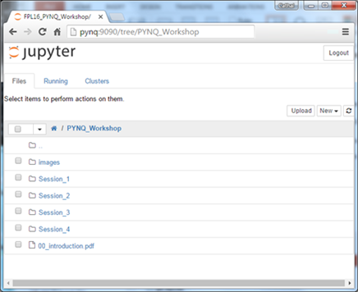
Log in to portal
Open a browser*
Chrome, Safari, Firefox
Browse to: http://pynq:9090 and log in
Where pynq is the hostname of the board
Use the IP address instead of the hostname
username:password = xilinx:xilinx
Browse to PYNQ_Workshop folder
* http://jupyter-notebook.readthedocs.io/en/latest/notebook.html#browser-compatibility

Slide 16
Lab exercises: Session 1
1 Getting started with Jupyter Notebooks
2 Getting started with IPython
3 Exploring PYNQ-Z2
4 Programming on-board peripherals
Notes:
1从Jupyter笔记本开始
2开始与IPython
3探索PYNQ-Z2
4车载外围设备编程

Slide 17
Lab Review
Jupyter Notebook
Web application/server
Create and share documents
Live code, equations, visualizations, explanatory text/comments, results
Make a copy of notebook before editing
Sharing Notebooks
Save the iPython Notebook .ipynb
Save as… HTML to share results

Slide 18
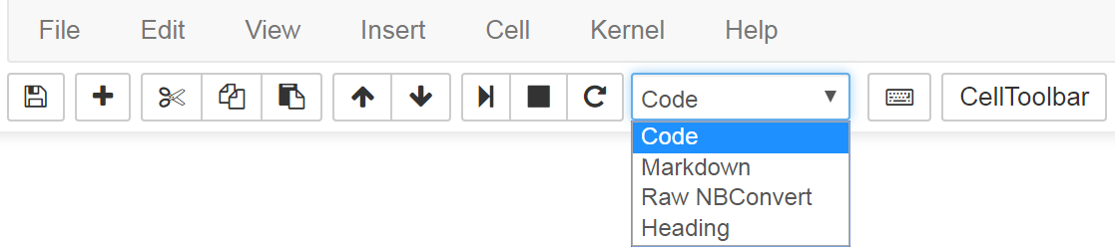
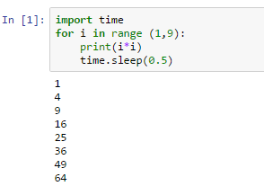
Notebook Cells
Code
Python
Markdown
Comments and notes
Execute cells to run code/render
Split and reorder cells
Output printed after cell

Slide 19
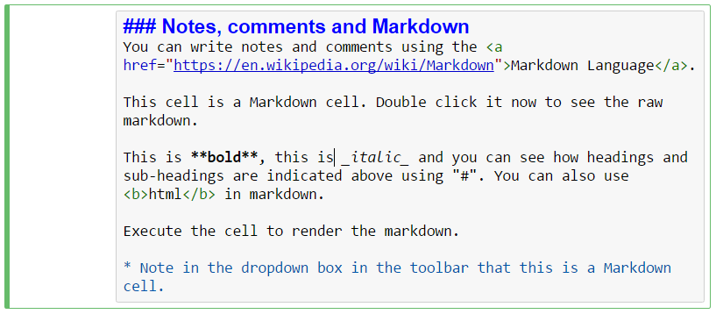
Markdown cells
# Headings
* Italics *
** bold **
* Bullet points
* Bullet points
<html></html>
Not just comments. Explanatory text, notes, documentation.

Slide 20
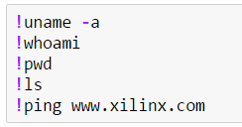
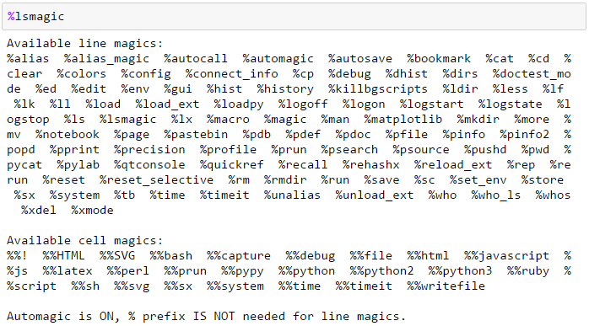
Shell commands, Cell magics
Execute shell commands directly from notebook
Prefix !
Built in Cell magics

Slide 21
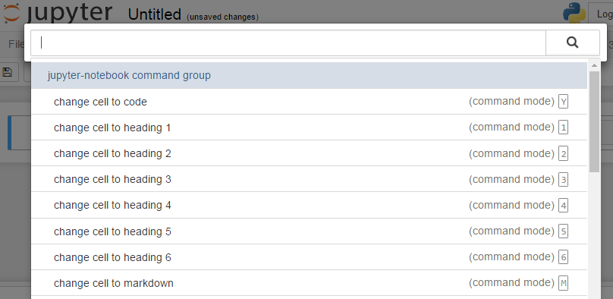
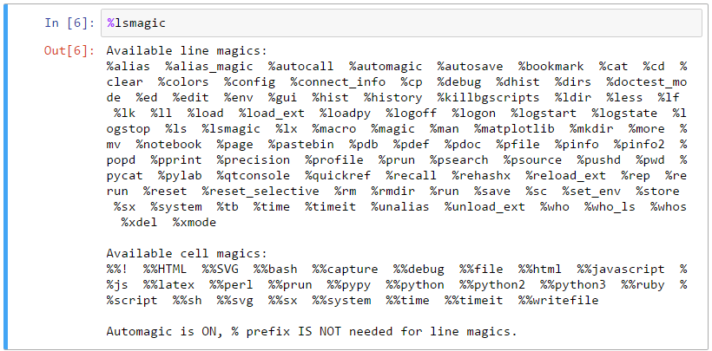
Help
Command palette: Ctrl + Shift + p keys
Python help:
Execute “?” In a cell
Help()
%magic – learn about Ipython magics
%lsmagic – get list of magics
%quickref

Slide 22
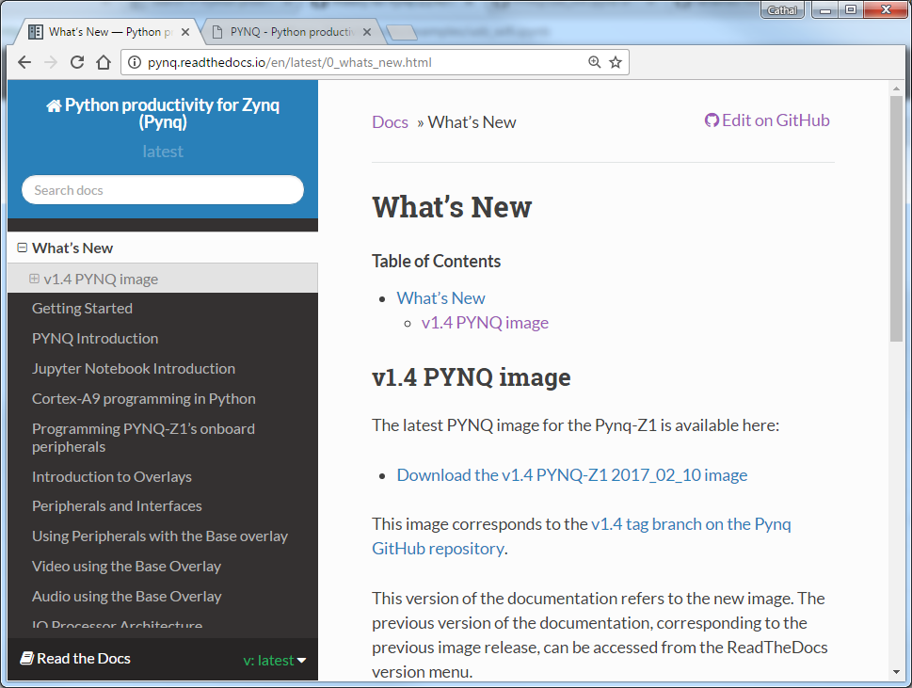
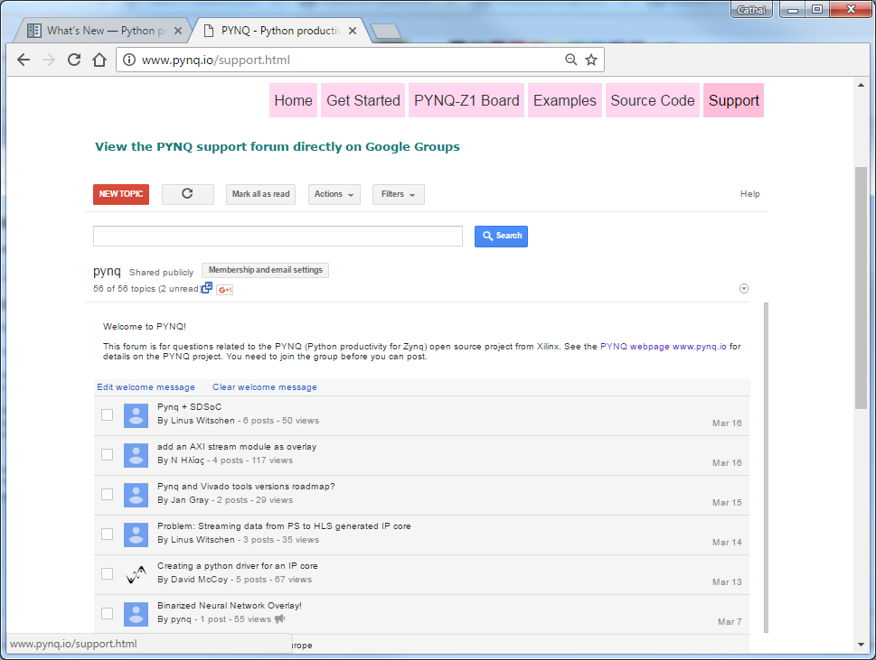
Documentation and Support
Documentation
http://pynq.readthedocs.io
Support
http://www.pynq.io/support
GitHub
Issue tracker

Slide 23
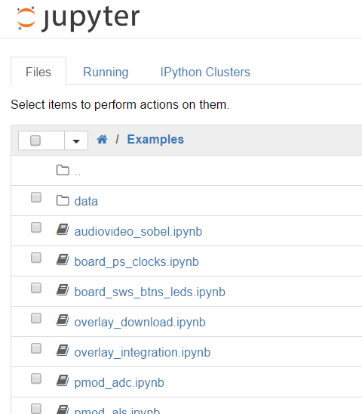
Next steps
examples/
Peripherals, Grove, Pmod
How to use overlays
Other peripherals, PS/PL

Slide 24
Summary
Configure board, SD Card
Connect to the board
Log In to portal
Jupyter Notebooks
Labs
Help

Slide 25
Questions?

