Slide 1

Introduction to Overlays

Slide 2
Agenda
Overlay Concept
Base Overlay
Labs:
Grove temperature sensor
Grove light sensor
Grove ledbar
OLED
Notes:
Overlay 概念与 Base Overlay 相关实验内容，主要为通过Python控制硬件，本次实验选择控制板上资源。

Slide 3
Overlay Concept

Slide 4
FPGA overlays – hardware libraries (kernels)
Overlays are generic FPGA designs that target multiple users with new design abstractions and tools
Post-bitstream programmable via software APIs
Typically optimized for given application domains
Encourages the use of open source tools & fast compilation
Enables productivity from re-using pre-optimized designs
Exposes benefits of FPGAs to new users
Notes:
覆盖是通用的FPGA设计，针对多个用户，采用新的设计抽象和工具。
基于软件API的后置比特流可编程软件
通常对于给定的应用域进行优化
鼓励使用开源工具和快速编译
利用重复优化设计实现生产率
暴露FPGA对新用户的好处

Slide 5
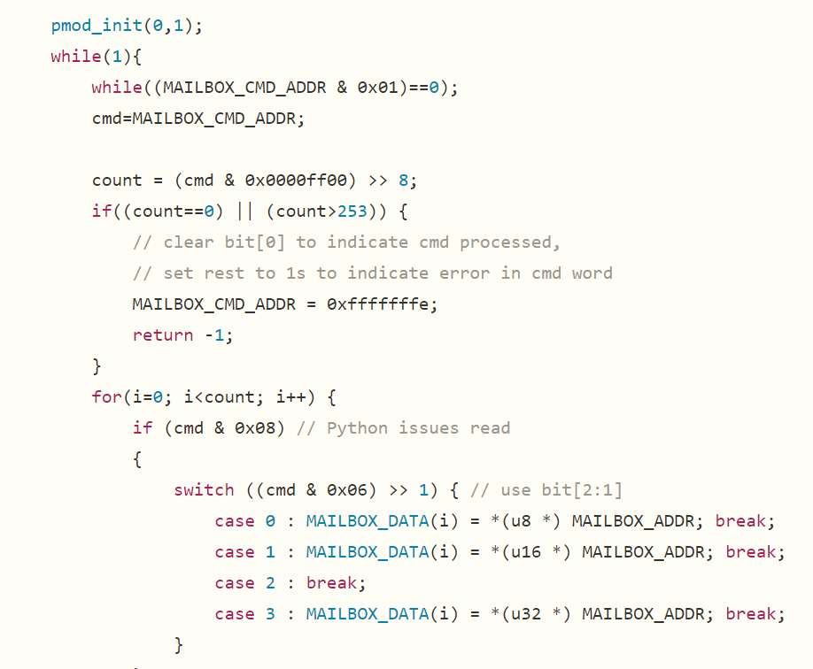
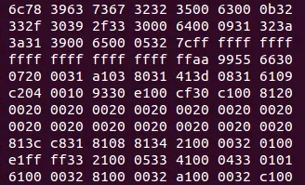
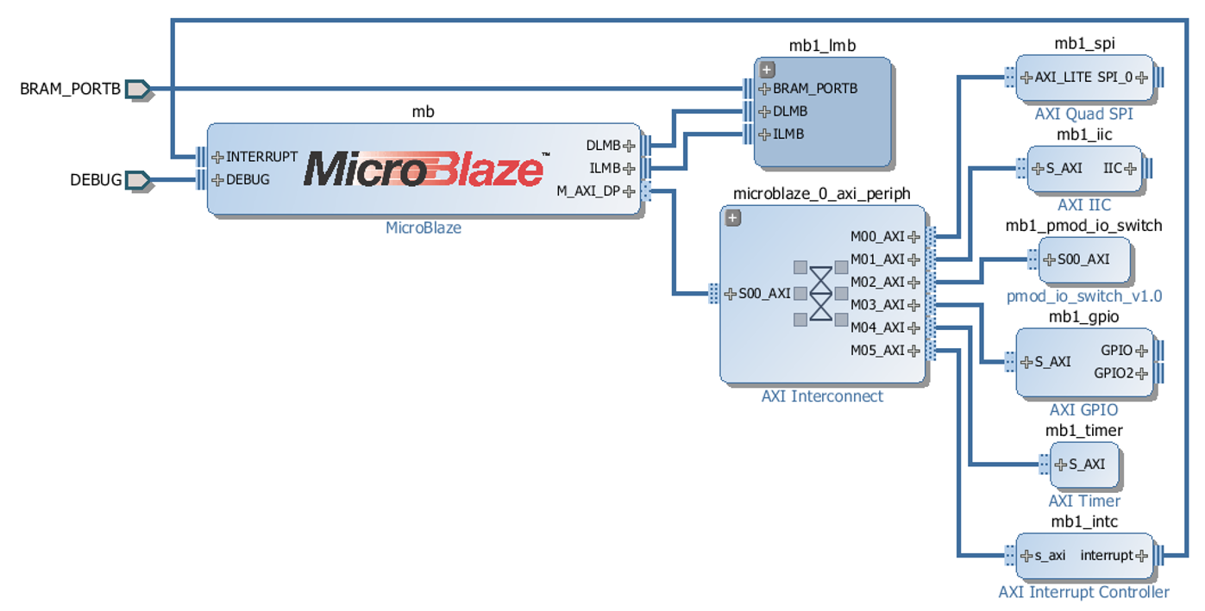
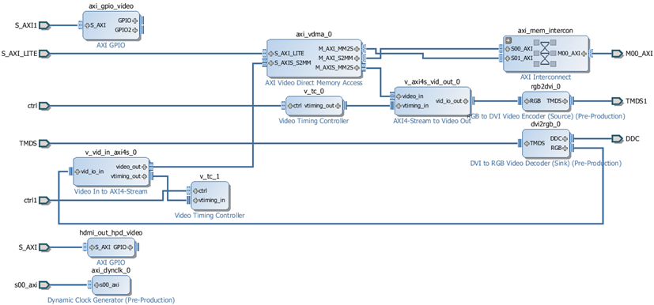
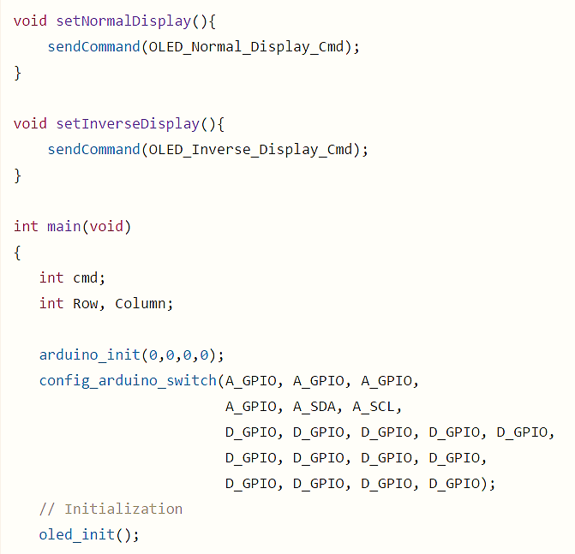
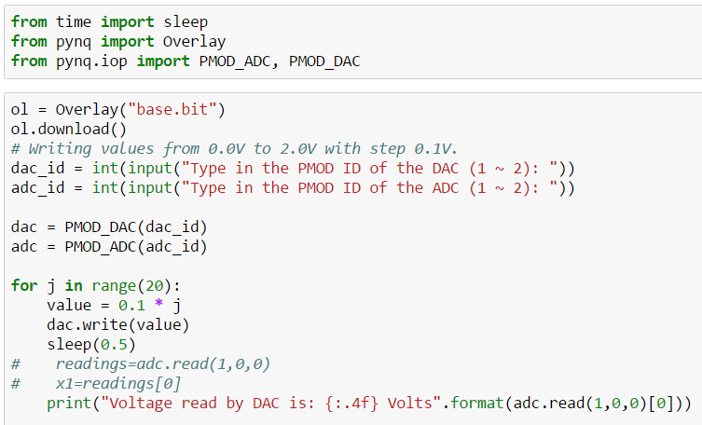
FPGA overlays – hardware libraries
Step 1:
Create an FPGA design for a class
of related applications
Step 2:
Export the bitstream and a C API
for programming the design
Step 3:
Wrap the C API to create a Python library
Step 4:
Import the bitstream and the library in your Python scripts and program
Notes:
步骤1：
为一类相关应用创建FPGA设计
步骤2：
导出比特流和用于设计的C API
步骤3：
包装C API创建Python库
步骤4：
在Python脚本和程序中导入比特流和库

Slide 6
Base Overlay

Slide 7

Base Overlay (base.bit)
DDR
HDMI In/Out
Pmods
DDR
HDMI Out
HDMI In
IOP
IOP
Dual Cortex-A9
Jupyter Server
Tracebuffer
Tracebuffer
Pynq API
Interrupt Controller
Arduino
IOP
Arduino header
MIC/Audio Out
Audio
GPIO Controller
LEDs, Buttons, Switches
Notes:
HDMI输入输出与DDR相连

Slide 8
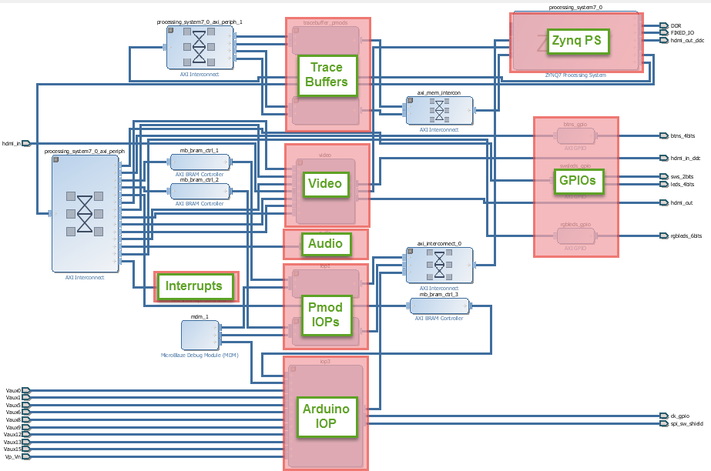

Base Overlay – Interface View
Base Overlay is PL design
Standard FPGA design flow
Vivado IPI
Interface to Python
Memory Map
Open source
Components are re-useable
Notes:
基础覆盖是PL设计
标准FPGA设计流程
Vivado IPI
Python接口
内存映射
开放源代码
组件是可重用的

Slide 9
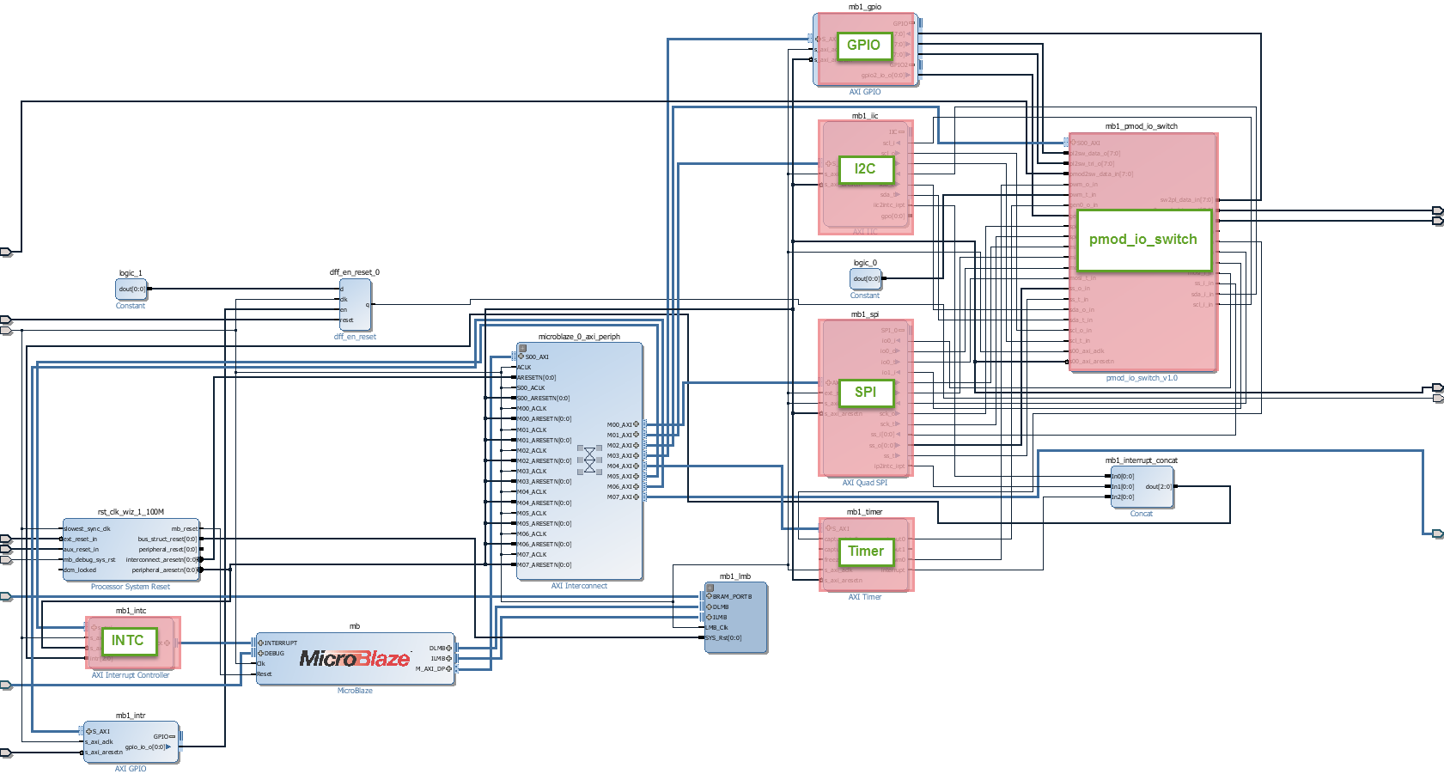
Pmod IOP
Flexible block allows different peripherals to be used without new hardware design
MicroBlaze processor sharing memory with PS
IIC, SPI, GPIO, Timer, Interrupt controller, Configurable Switch
Notes:
灵活的块允许在没有新硬件设计的情况下使用不同的外设。
MicroBlaze processor 与PS共享内存
IIC、SPI、GPIO、定时器、中断控制器、可配置交换机

Slide 10
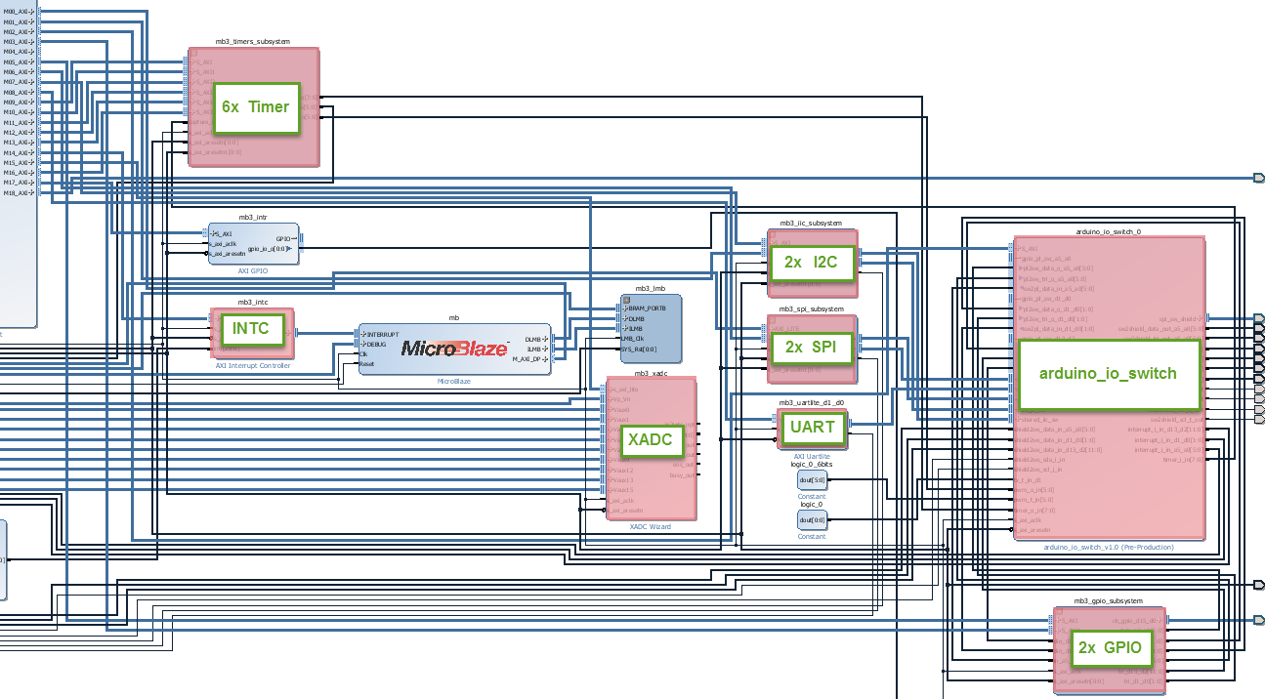
Arduino IOP
Shared
memory

Slide 11
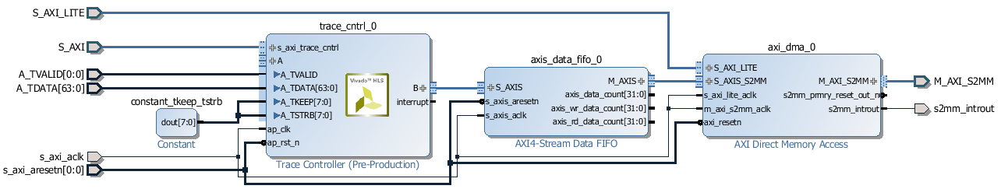
Tracebuffer IP
Tracebuffer running at 100 MHz connected to IOP outputs
Stream trace data into DDR memory
4MB blocks via DMA
64-bit data acquisition
Trigger Conditions
Python control
Start/stop, Acquisition rate, Number of samples
Notes:
Tracebuffer运行在100 MHz连接到IOP输出
流跟踪数据到DDR存储器中
通过DMA的4MB块
64位数据采集
触发条件
蟒蛇控制
开始/停止，获取率，样本数

Slide 12
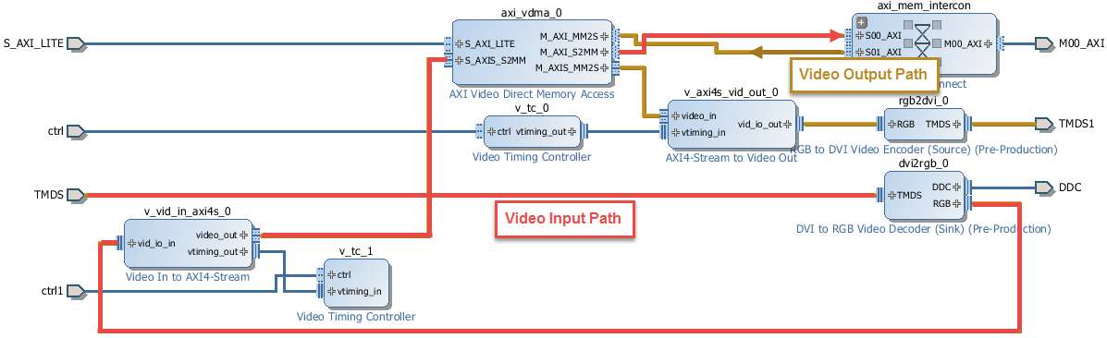
Video
HDMI In, HDMI Out
HDMI input controller writes to a framebuffer
PS DDR memory
3x framebuffers available
Data path
Stream from HDMI in to DDR, Stream from DDR to HDMI out
Image processing on PS
E.g. OpenCV
Notes:
HDMI，HDMI输出
HDMI输入控制器写入帧缓冲器
PS-DDR存储器
可用的3X帧缓冲器
数据路径
从HDMI到DDR的流，从DDR流到HDMI输出
基于PS的图像处理
例如OpenCV

Slide 13
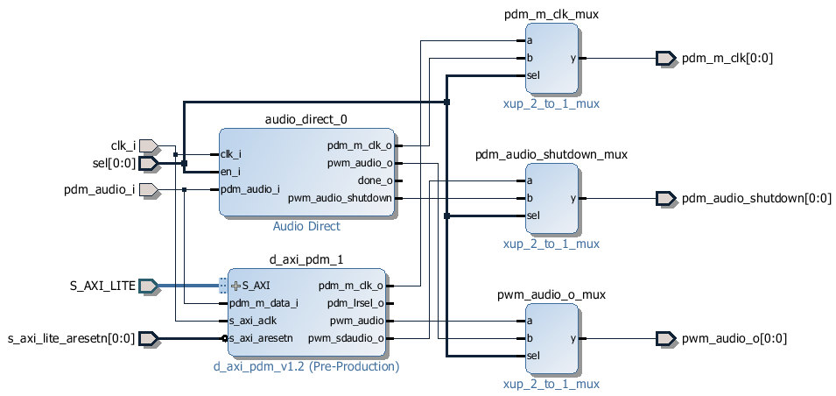
Audio
Audio controller
MIC in (PDM)
Line Out (PWM)
Connected to PS in Base Overlay
Notes:
音频控制器
MIN（PDM）
输出线（PWM）
在基础覆盖中连接到PS

Slide 14
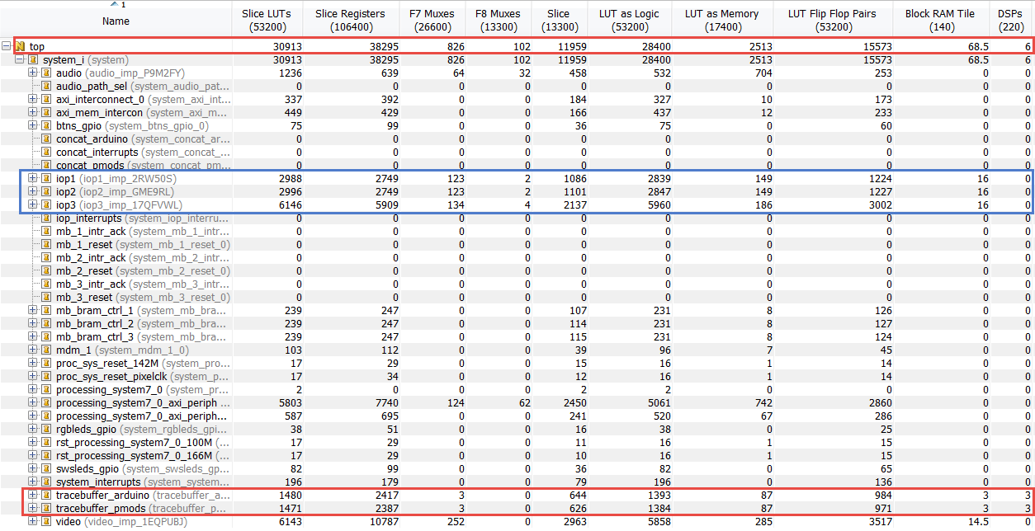
Base Overlay Resource Utilization
Z-7020, Total resource utilization ~50%
IOP (Pmod) ~ 5% IOP (Arduino) ~ 10%
Video ~ 10% Audio ~ 2%
Tracebuffer ~ 3%
Notes:
Z-7020，总资源利用率50%
IOP（PMOD）～5% IOP（ARDUINO）～10%
视频~ 10%音频~ 2%
Tracebuffer～3%

Slide 15
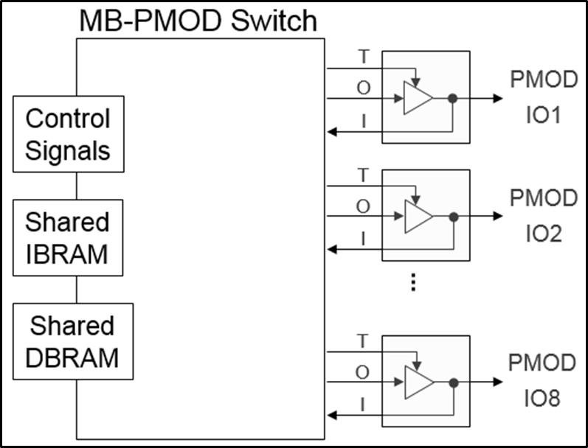
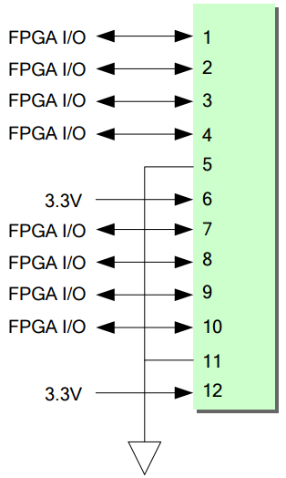

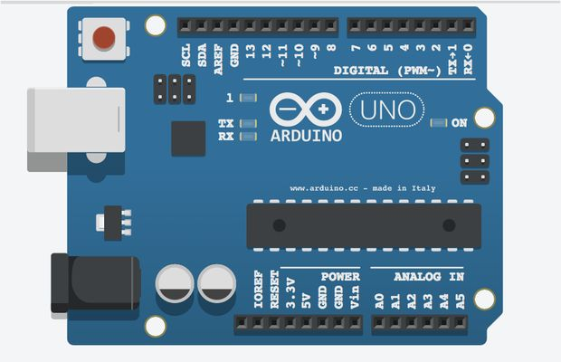
Base Overlay MicroBlaze IOP
PmodA
ARMA9
ARMA9
AXI-Lite
Switches
PmodB
Onboard (Fixed)
Peripherals
LEDs
Pushbuttons
The A9s control the MicroBlaze processors
They deliver the C code to be executed via dual-ported Instruction BRAMs
They exchange data and control (commands/status) with the MicroBlazes via dual-ported Data BRAMs
Arduino
Notes:
A9S控制微火焰处理器
它们通过双端口指令BrAMP来执行C代码。
它们通过双端口数据总线交换数据和控制（命令/状态）。

Slide 16
Pynq_tutorial Overlay

Slide 17
Pynq_tutorial Overlay (pynq_tutorial.bit)
DDR
Pmods
DDR
IOP
IOP
MM2S
Dual Cortex-A9
Jupyter Server
FIFO
S2MM
M_AXI_GP0
Pynq API
S_AXI_GP1
Interrupt Controller
S_AXI_HP0
EMIO
S_AXI_HP2
EMIO
GPIO Controller
Shared LEDs, Buttons, Switches

Slide 18
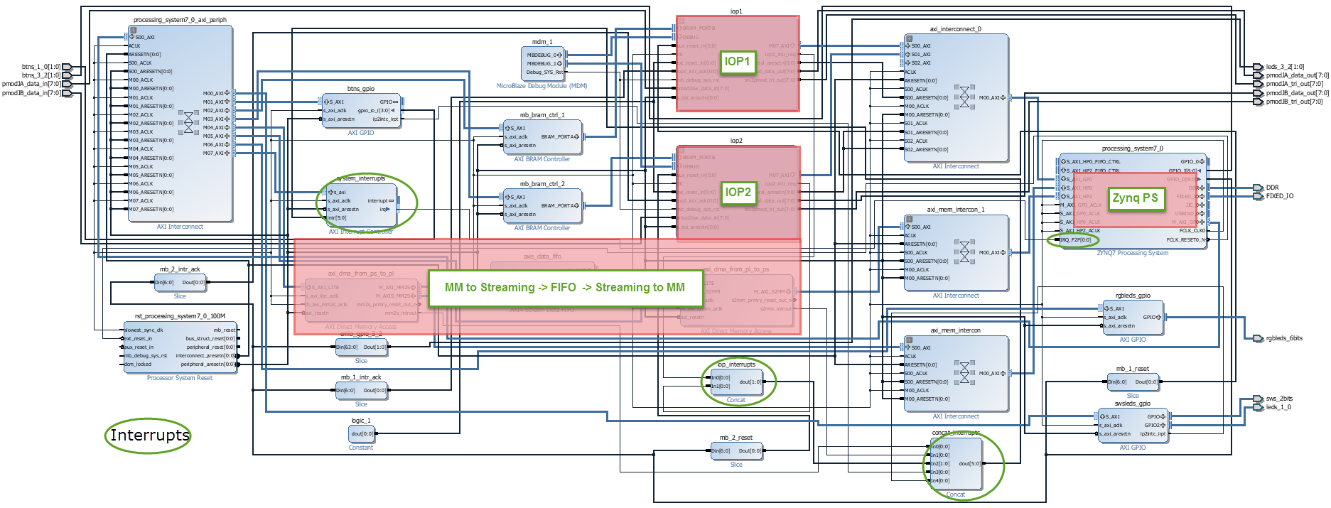
Pynq_tutorial Overlay
Pynq_tutorial Overlay is a light-weight “base” overlay
IOP1 and IOP2 included
No Video, Audio, Arduino IOP, Tracebuffer
MM to Streaming -> FIFO -> Streaming to MM added
Shared LEDs and buttons between EMIO and MIO ports of PS

Slide 19
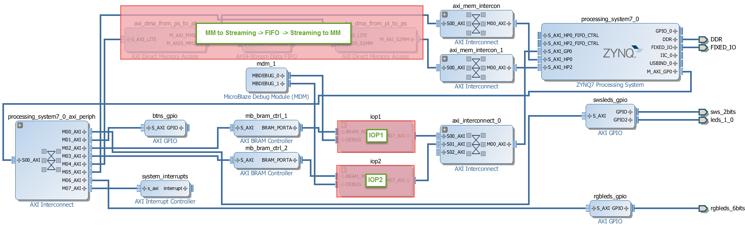
pynq_tutorial Overlay – Interface View
Allows testing of DMA interfaces to AXI streams
Send and Receive DMAs
Replace FIFO with custom stream IP
Use pynq_tutorial overlay to test DMA operation

Slide 20
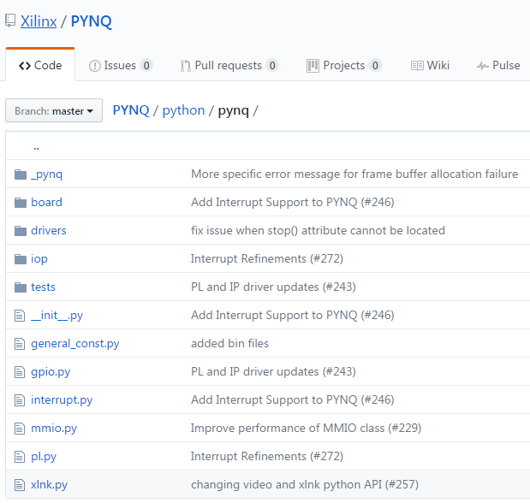
Pynq interface classes
MMIO
Memory Mapped Input Output
Register based memory mapped transactions
Xlnk
Memory allocation (used in DMA)
DMA (drivers)
Direct Memory Access
Offload memory transfers from main CPU
GPIO
Read/Write GPIO wires

Slide 21
MMIO
Import MMIO
Define memory mapped region
BASE_ADDRESS: starting location
ARRAY_SIZE: length of accessible memory
Read and Write 32-bit values
ADDRESS_OFFSET: Offset from BASE_ADDRESS
Need to ensure the memory can be read/written
from pynq import MMIO
BASE_ADDRESS = 0x40000000
ARRAY_SIZE = 1024
mmio = MMIO(BASE_ADDRESS, ARRAY_SIZE)
data = 0x12345678
ADDRESS_OFFSET = 0x10
mmio.write(ADDRESS_OFFSET, data)
result = mmio.read(ADDRESS_OFFSET)
print(result)
> 0x12345678

Slide 22
Xlnk
Memory managed by Linux
Virtual
Memory must be allocated before it can be accesses by PL
PL needs the physical address of a memory buffer
Xlnk can allocate (contiguous) memory buffers
Translates between virtual and physical
Contiguous memory is more efficient/allows simpler DMA logic
Once buffer is allocated a DMA can be used to transfer data to/from PS/PL
DMA class uses Xlnk for memory allocation

Slide 23
Xlnk example
Import Xlnk
Allocate contiguous buffer
cma_alloc()
Returns Linux virtual address
Get Physical Address
cma_get_phy_addr()
Can be used by PL to access DDR (Linux) memory
Write to buffer/Read from buffer
MEMORY_SIZE = 10
from pynq import Xlnk
mmu = Xlnk()
virt_ptr = mmu.cma_alloc(MEMORY_SIZE)
phy_addr = mmu.cma_get_phy_addr(virt_ptr)
buffer = mmu.cma_get_buffer(virt_ptr, MEMORY_SIZE)
buffer = [0,1,2,3,4,5,6,7,8,9]
for i in range(10):
print(buffer[i])

Slide 24
DMA
Direct memory access
Transfer data between memories directly
PS - PL
Bypasses CPU
Doesn’t waste CPU cycles on data transfer
Speed up memory transfers with burst transactions
Xilinx AXI Direct Memory Access IP block supported in PYNQ
Read and Write Paths from PL to DDR and DDR to PL
Memory Mapped to Stream
Stream to Memory Mapped
Needs to stream to/from an allocated memory buffer
PYNQ DMA class inherits from xlnk for memory allocation

Slide 25
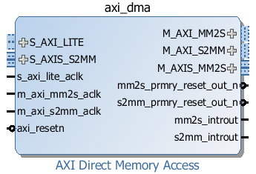
AXI Direct Memory Access IP
AXI Lite control interface (AXI GP port)
Memory mapped interface (AXI interface, HP/ACP ports)
AXI Stream interface (AXI stream accelerator)
Transfer between streams and memory mapped locations
Paths from PL to DDR and DDR to PL
Memory Mapped to Stream/Stream to Memory Mapped
(Read)
From MM to stream
Control interface
From Stream (write)
to MM
(Read)
From Stream to MM
From MM (write)
to Stream

Slide 26
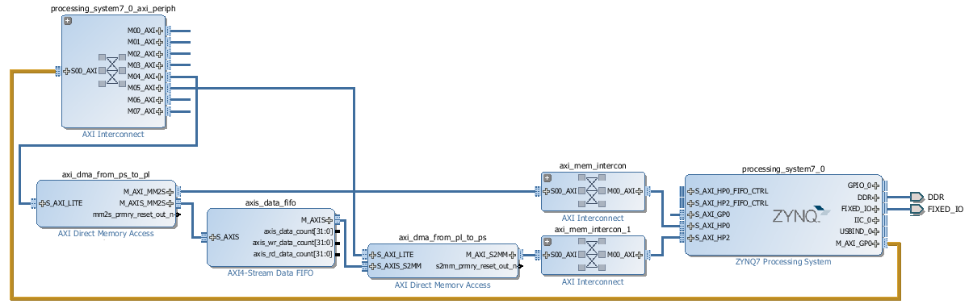
DMA example
from pynq.drivers import DMA
dma_send = DMA(dma_send_addr, 0) # DMA_TO_DEV
dma_recv = DMA(dma_recv_addr, 1) # DMA_FROM_DEV
dma_send.create_buf(1024)
send_buffer = dma_send.get_buf(32) # 32-bit
send_buffer[i] = …
dma_send.transfer(transfer_size*4, 0) # Bytes
dma_recv.create_buf(1024)
recv_buffer = dma_recv.get_buf(32)
dma_recv.transfer(transfer_size*4, 1)
print(recv_buffer[i])
Setup DMAs
Allocate memory buffers
Start DMA transactions

Slide 27
GPIO
Up to 64 GPIO wires from PS
Tri-state
Accessed from Linux
Setup GPIO instance
Map to GPIO pin
Translated pin numbers to Linux GPIO number
get_gpio_pin()
Read/Write
Most appropriate for simple control
Set, reset, start, done …
from pynq import GPIO
btn_gpio = GPIO.get_gpio_pin(0)
led_gpio = GPIO.get_gpio_pin(1)
ps_btn = GPIO(btn_gpio, 'in')
ps_led = GPIO(led_gpio, 'out')
ps_btn.read()
ps_led.write()

Slide 28
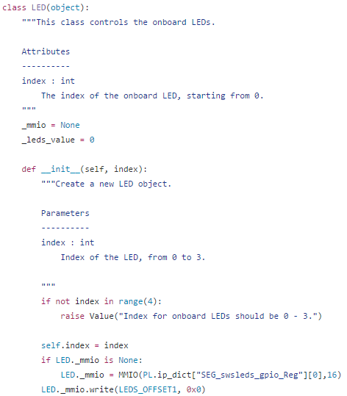
Python Wrapper
Standard Python code
Interface classes used
MMIO, Xlnk, DMA, GPIO
Check PYNQ repository for examples

Slide 29
Summary
Overlay Concept
Base Overlay
Pynq_tutorial Overlay
Labs
GPIO example
Xlnk example
DMA example

Slide 30
Using Sensors

Slide 31
Load ‘base’overlay on PL
PmodA
ARMA9
MicroBlaze
MicroController
Microprocessors
ARMA9
AXI-Lite
Switches
PmodB
Onboard (Fixed)
Peripherals
LEDs
MicroBlaze
MicroController
Pushbuttons
Python code on ARM A9:
Arduino
from pynq import Overlay
ol = Overlay("base.bit")
ol.download()
MicroBlaze
MicroController

Slide 32
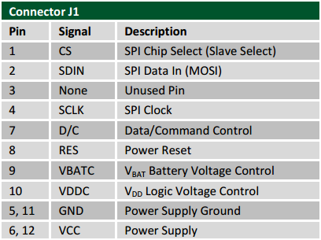
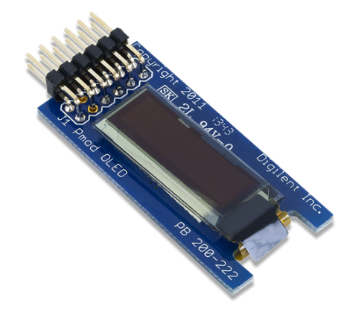
Configure IO processor
from pynq import Pmod_OLED, PMODB
oled = Pmod_OLED(PMODB)
AXI
CONFIG
T
MicroBlaze
O
PMOD
IO1
out(0,7)
I
GPIO
in(0,7)
RESET
LMB
T
O
PMOD
IO2
I
GPIO
CPU
Reset
IIC(0,2)
Switch
ARM
A9
IIC
AXI
IOP
Code
Shared
IBRAM
SPI(0,3)
SPI
T
Shared
DBRAM
O
PMOD
IO8
I
oled.write("1 2 3 4 5 6")

Slide 33
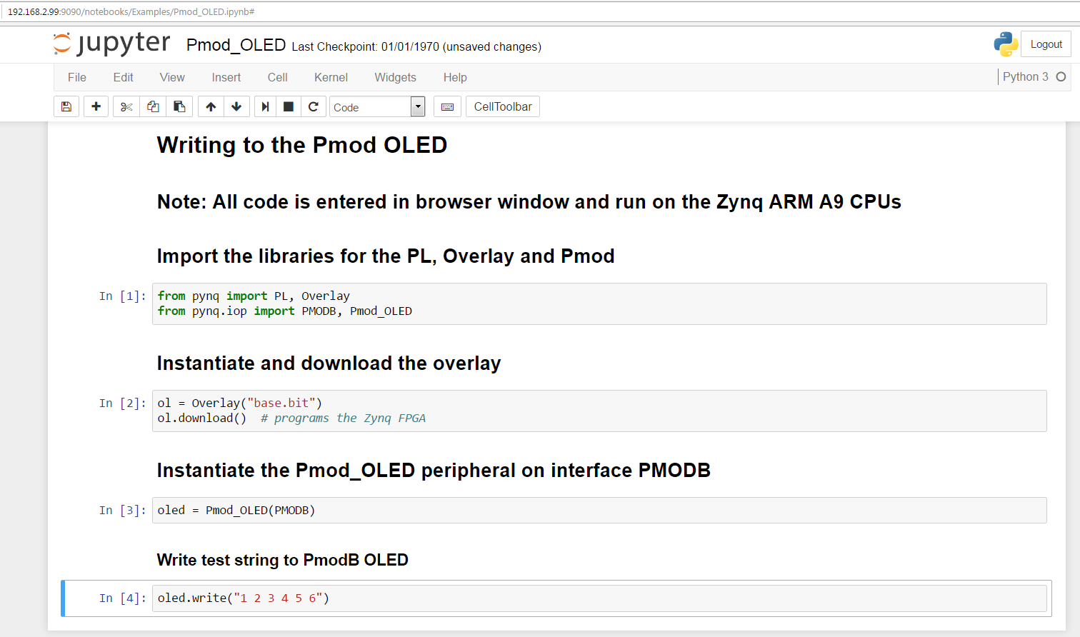
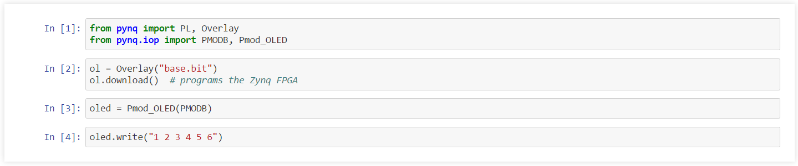
Jupyter Notebook
6 lines of user code … thanks to Python, FPGA overlays, abstraction & re-use

Slide 34
Summary
Overlay Concept
Base Overlay
Pynq_tutorial Overlay
IOPs
Using Sensors
Labs
Grove temperature sensor
Grove light sensor
Grove LEDBar
PMOD OLED

Slide 35
Questions?

