Slide 1

_{Building customized Overlay}

Slide 2
Agenda
Overlay design methodology
Building custom Overlay
Labs
Developing a single IP
Writing a python-driver
Creating a custom overlay
Notes:
覆盖设计方法学
建立自定义覆盖
实验室
开发单一IP
编写Python驱动程序
创 建自定义覆盖

Slide 3
Overlay design methodology
Notes:
Overlay design methodology
overlay设计方法学

Slide 4
Overlay design considerations
Programmable Logic design
Zynq PS configuration must match the settings defined for PYNQ
Zynq architecture & interfaces between PS-PL
PL design – reusable IP
Overlay programmability
New IOP peripheral
Software design of IOP driver for custom peripheral
Python interface
May be pure Python wrapper
CFFI to wrap C driver with thin Python layer
Notes:
可编程逻辑设计
ZYNQ PS配置必须匹配为PYNQ定义的设置
ZNYP体系结构与PS-PL接口
可重用IP
覆盖可编程性
新型眼压周边设备
定制外围设备IOP驱动程序的软件设计
Python接口
可能是纯Python包装器
用瘦Python层封装C驱动程序

Slide 5
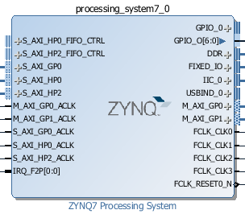
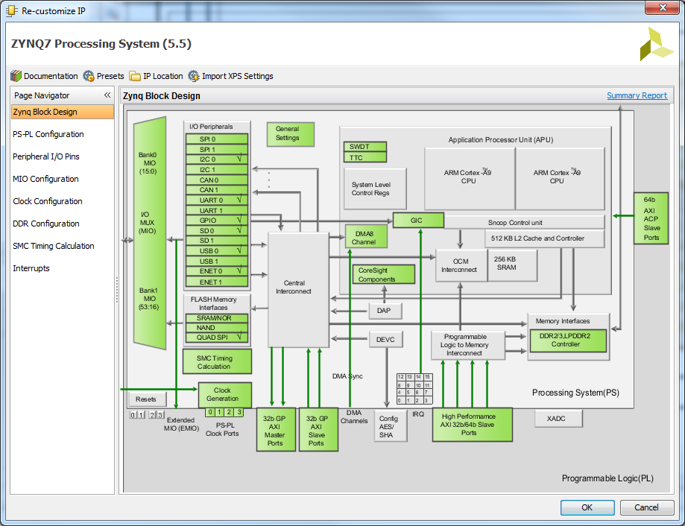
Pynq-Z2 base configuration
PYNQ image used to boot board
PS is configured during boot
Default overlay loaded
Downloading new overlays
Only the PL design from Vivado (bitstream) will be downloaded
Designing new overlays
PL depends on PS e.g. clocks from PS
Vivado PS settings must match PYNQ image
Zynq PS settings
Notes:
用于引导板的PYNQ图像
在启动期间配置PS
默认覆盖加载
下载新overlays
只有Vivado（比特流）的PL设计才会被下载。
新overlays的设计
PL依赖于PS，例如PS的时钟。
VIVADO PS设置必须匹配PYNQ图像

Slide 6
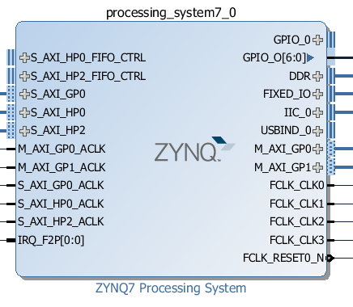
Pynq-Z2 PS Settings
GP0, GP1 enabled
IOPs, Video control, GPIO, Audio, Interrupts
Tracebuffer
HP0, HP2
Video
Tracebuffer
Peripherals
SD, Ethernet, GPIO, IIC (Video), USB, Uart
Clocks
100 MHz, 142 MHz, 200 MHz
Software Programmable

Slide 7
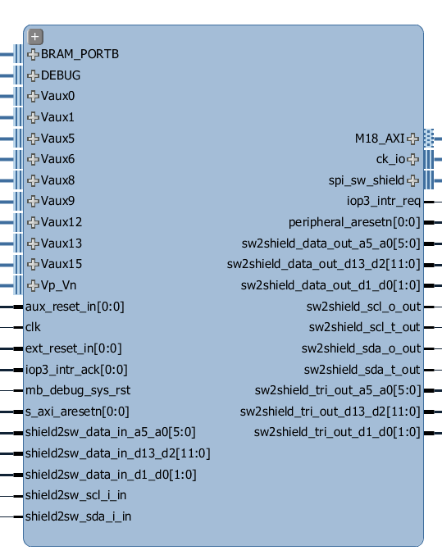
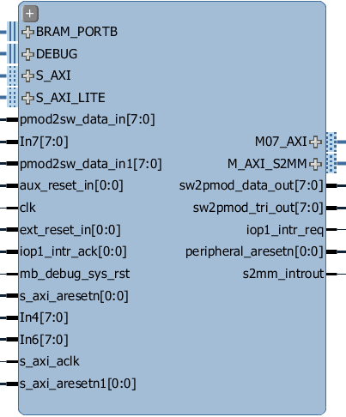
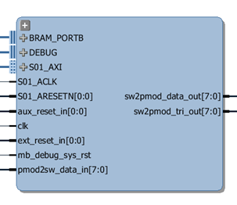
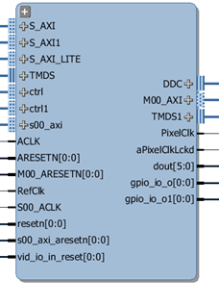
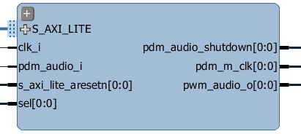
PL Design
Standard FPGA/Zynq design
IP version and driver depends on Vivado version
PYNQ drivers also depend on Vivado
Current version of Vivado: 2016.1
Other versions may work, but are unsupported (driver differences)
PYNQ reusable blocks
Audio, Video, Tracebuffer, IOPs
Audio
Video
Tracebuffer
Pmod IOP
Arduino IOP
Notes:
标准FPGA /ZYNQ设计
IP版本和驱动程序依赖VIVADO版本
PYNQ驱动程序也依赖VIVADO
ViVADO的当前版本：2016.1
其他版本可能工作，但不受支持（驱动程序差异）
可重用块
音频，视频，Tracebuffer，IOPs

Slide 8
Overlay Programmability
End-user programmability and flexibility valued over logic utilisation
Create Programmable IP and overlays that can be reused for many applications and domains
IOPs support many peripherals in the same design
E.g.
BNN Design
Weights can be “hard coded” into bitstream for slightly higher performance/resource utilisation
However, each network would need to be built with Xilinx tools
BNN Overlay
Weights can be programmed into BRAM at runtime for flexibility
Many networks can run on the same overlay
Notes:
overlay 可编程性
基于逻辑应用的终端用户可编程性和灵活性
创建可编程IP和覆盖，可重复使用的许多应用和领域
IOPS支持同一设计中的许多外围设备
例如。
BNN设计
权重可以“硬编码”到比特流中，以稍高的性能/资源利用率。
但是，每个网络都需要用Xilinx工具来构建。
神经网络覆盖
在运行时，可以将权重编程到BRAM中，以实现灵活性。
许多网络可以在同一覆盖上运行。

Slide 9
Overlay TCL
Bitstream + TCL must be provided to load an overlay
\\pynq\xilinx\pynq\bitstream
TCL from Vivado block diagram is used to provide information about the system
ip_dict: addresses of IP block
gpio_dict: used internally to connect IOP resets/interrupts
EMIO GPIO pins, interrupt pins
Used internally in PYNQ
E.g. Instantiating IOPs
Must generate TCL from Vivado IP Integrator Block Diagram
“Standardizes” TCL scripts
File > Export > Export Block Design
write_bd_tcl command
Notes:
必须提供比特流+TCL来加载overlay
\\pynq\xilinx\pynq\bitstream
VIVADO框图中的TCL用于提供有关系统的信息
ip_dict: IP块地址
gpio_dict:内部使用IOP重置/中断连接
EMIO GPIO pins,中断引脚
在PYNQ内部使用
例如实例化IOPS
必须从VIVADO IP积分器框图生成TCL
“标准化”TCL脚本
文件>导出>导出块设计
写入命令

Slide 10
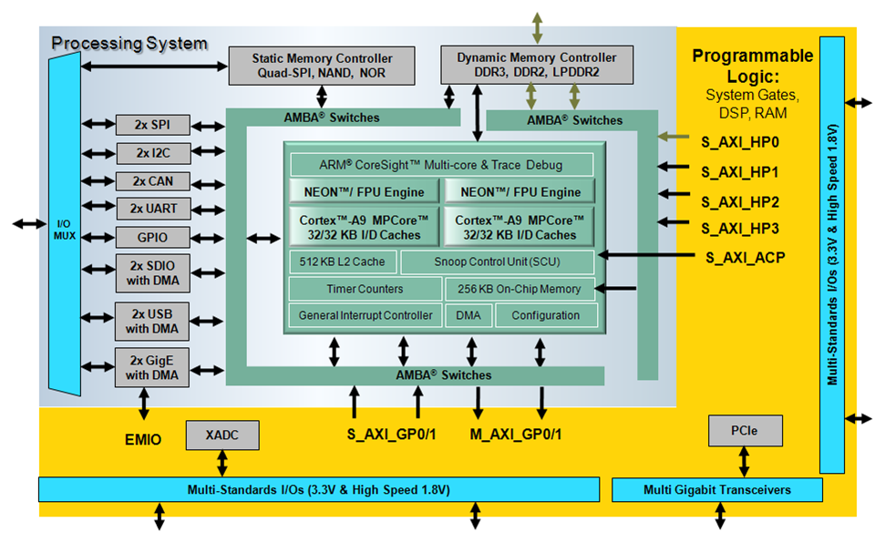
Zynq PS-PL interfaces

Slide 11
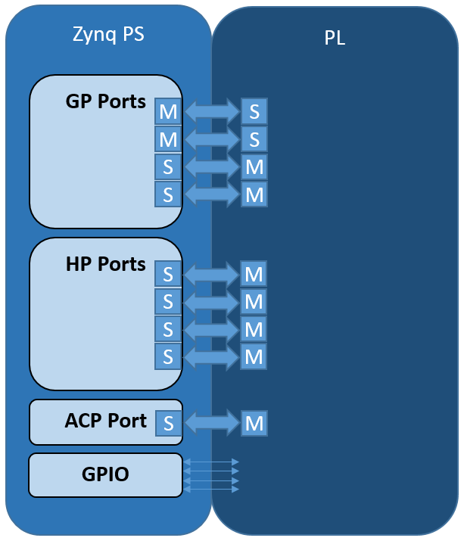
PS-PL interfaces types
AXI General Purpose ports
2x Master (32-bit)
2x Slave (32-bit)
AXI High Performance
4x Slave (64-bit)
1K FIFOs
ACP
1x Slave (64-bit)
Cache access
GPIO (EMIO)
Wires (64)

Slide 12
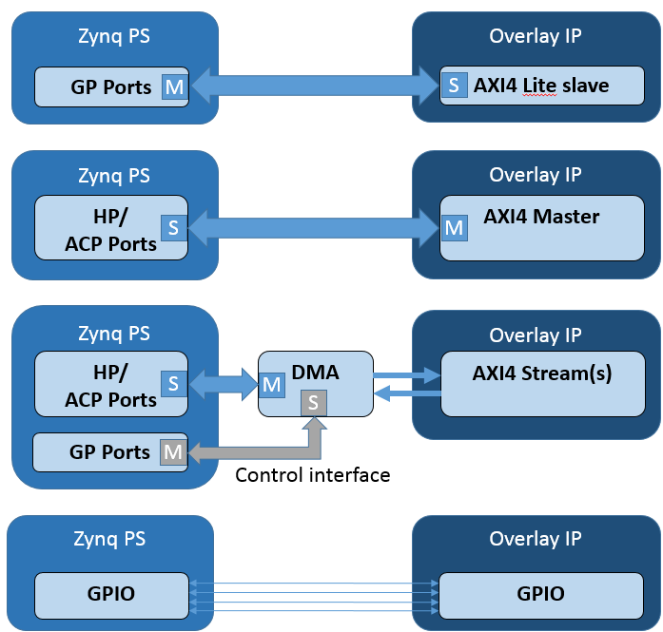
IP interfaces
AXI General Purpose
Typically AXI Lite slaves
Low performance
AXI HP/ACP
AXI4 Master
Higher performance
DMA
HP/ACP ports
AXI Stream
GPIO
Control type data

Slide 13
Building custom Overlay

Slide 14
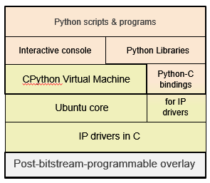
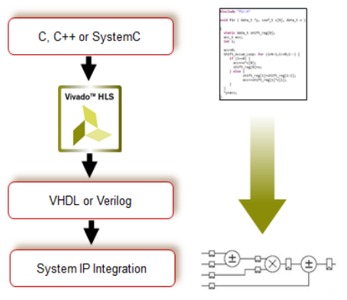
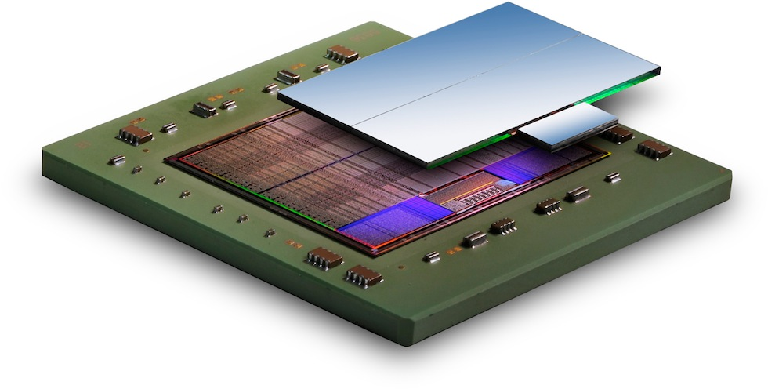
Overview
Design goals
Allow overlay users to find out what is inside an overlay in a consistent manner
Provide a simple way for developers of new hardware designs to test new IP
Facilitate reuse of IP between Overlays
How to
Walking through the process of interacting with a new IP
Developing a python driver
Finally building a more complex system from multiple IP blocks
Notes:
设计目标
允许覆盖用户以一致的方式找出覆盖中的内容。
为开发新硬件设计测试新IP提供一种简单的方法
促进重叠之间IP的重用
如何
行走在与新IP交互的过程中
开发Python驱动程序
最后从多个IP块构建更复杂的系统

Slide 15

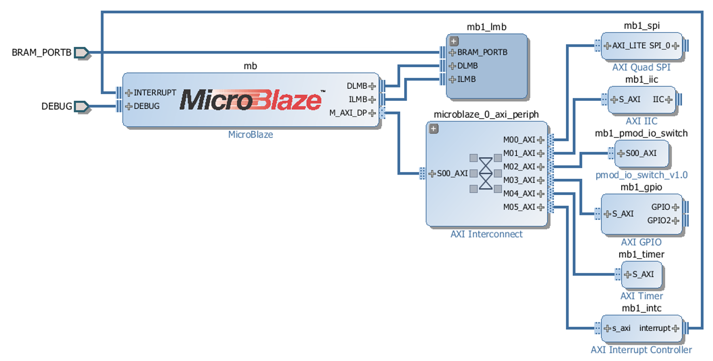
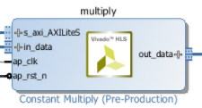
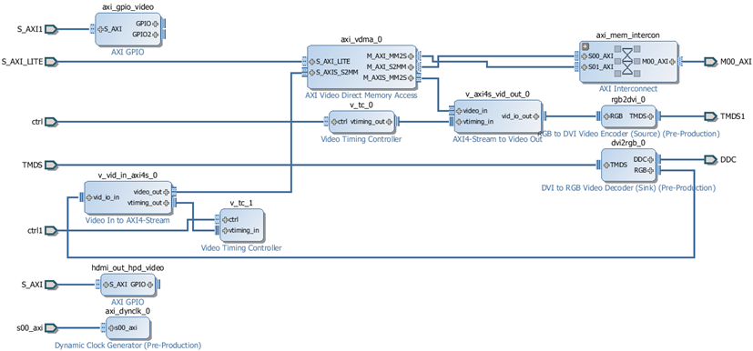
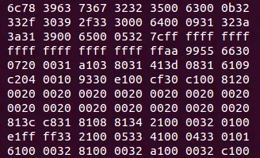
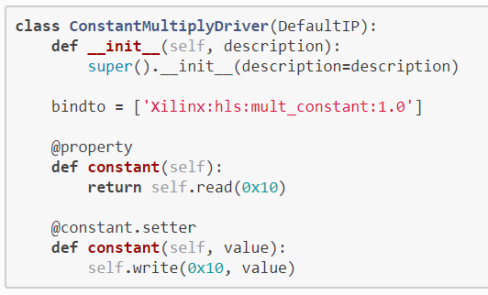
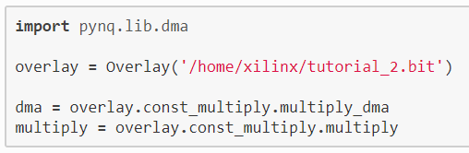
Steps of building custom Overlays
Step 1:
Developing a single IP with specific
function.
Step 2:
Create an FPGA design for a class
of related applications
Step 3:
Writing a Python-driver for the FPGA design
Step 4:
Import the bitstream and the library in your Python scripts and program
Notes:
步骤1：
为一类相关应用创建FPGA设计
步骤2：
导出比特流和用于设计的C API
步骤3：
包装C API创建Python库
步骤4：
在Python脚本和程序中导入比特流和库

Slide 16
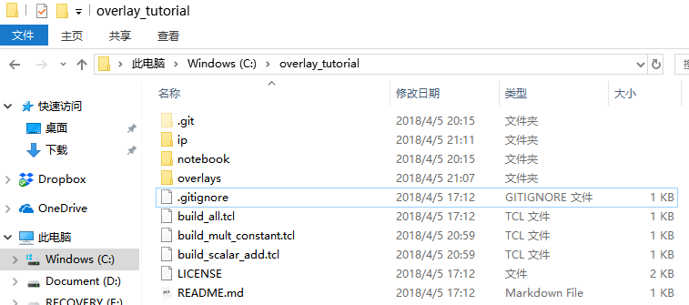
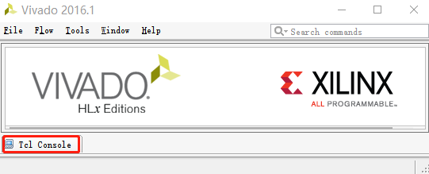
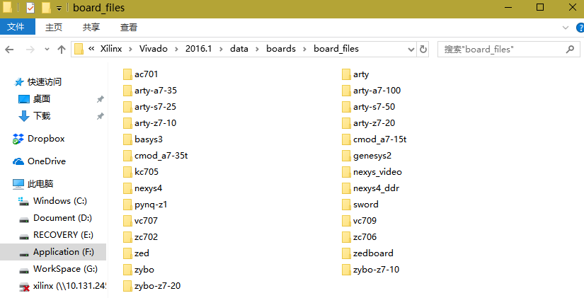
Step 0: Checking prerequisite
Find folder overlay_tutorial
You can also download from
https://github.com/sonnyhcl/overlay_tutorial/archive/master.zip
Vivado suite pre-installed
Version 2016.1
Open it and click into Tcl Console
Type cd path/to/overlay_tutorial
E.g. cd C:/overlay_tutorial
Make sure Digilent board files exists
You can download from
https://github.com/Digilent/vivado-boards/archive/master.zip
Notes:
查找文件夹覆盖层教程
你也可以从
HTTPS://GITHUBCOM/SONYHCL/OULLAGIOUTIORICAL/SARVEVE/MASTER ZIP
VIVADO套件预装
版本2016.1
打开它并点击到TCL控制台
CD路径/OT/OLALAL教程
例如CDC:/OrLayLub教程
确保数字板文件存在
你可以从
HTTPS://GITHUBCOM/DigILTEN/VIVADO-BOADS/Save/Mault.Zip

Slide 17
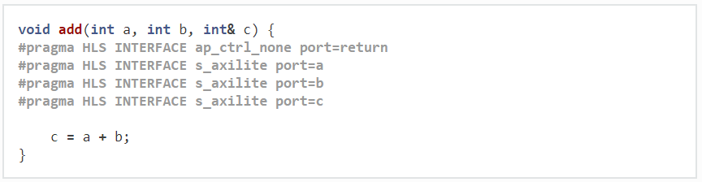
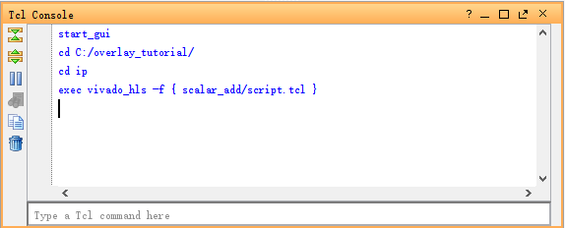
Step 1: Develop a single IP using HLS
Writing C/C++ code using HLS
You can find src code in C:\overlay_tutorial\ip\scalar_add\add.cpp
Generate IP using tcl script
Notes:
Step 1: Develop a single IP using HLS
步骤1：使用HLS开发单个IP
编写C++代码使用HLS
您可以在C:\OffLayTudio\Ip\CalrasyAddio\ADD.CPP中找到Src代码
使用TCL脚本生成IP

Slide 18
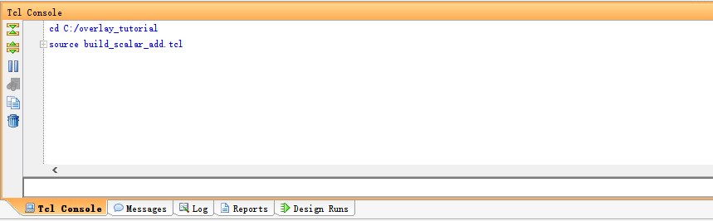
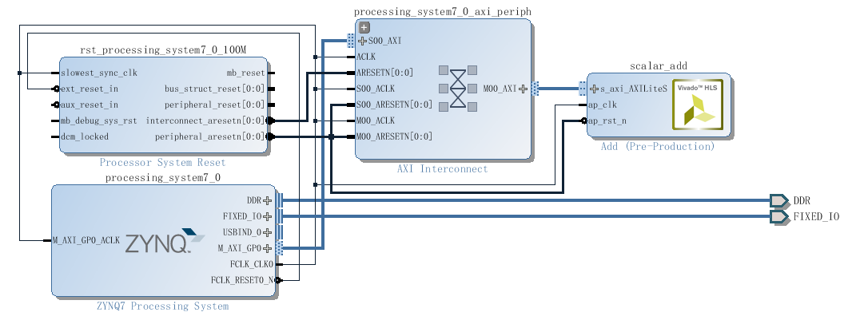
Step 2: Create FPGA design using Vivado
Creating an FPGA design
Generate project using tcl C:\overlay_tutorial\build_scalar_add.tcl
Open Block Design
Notes:
步骤2：使用ViVADO创建FPGA设计
创建FPGA设计
使用TCL C生成项目：
开放式设计

Slide 19
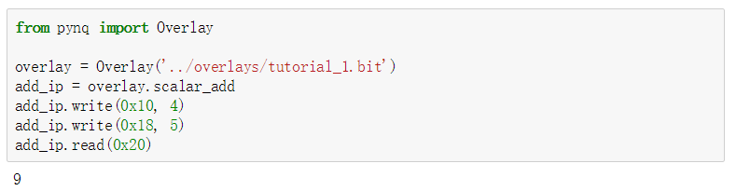
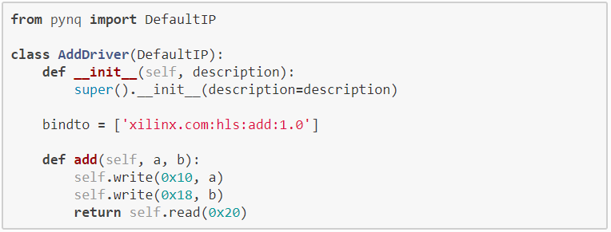
Step 3: Write Python driver
Test the functionality of FPGA design
Write the AddDriver for FPGA design
Notes:
步骤3：编写Python驱动程序
测试FPGA设计的功能性
编写FPGA设计的驱动程序

Slide 20
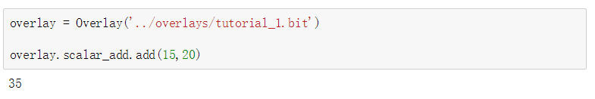
Step 3: Write Python driver
Load scalar_add
Reusing IP in next Project - mult_constant
Suppose we or someone else develops a new overlay and wants to reuse the existing IP.
As long as they import the python file containing the driver class, the drivers will be automatically created.
Audio
Video
Tracebuffer
Pmod IOP
Arduino IOP
Notes:
Step 3: Write Python driver
Load scalar_add
在下一个项目中重用IP——Multy常数
假设我们或其他人开发了一个新的覆盖，并希望重用现有的IP。
只要导入包含驱动程序类的Python文件，就会自动创建驱动程序。

Slide 21
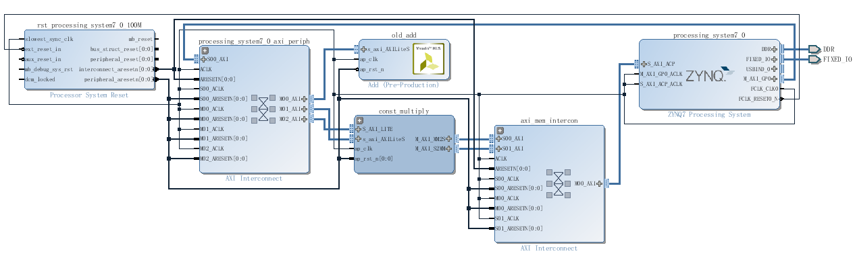
Make your hands dirty
Reusing IP in next Project - mult_constant
Same work flow as scala_add
Build mult_constant IP using HLS
Create FPGA design using Vivado
Write Python driver
Open your Jupyter Notebook and have a try !!!
http://192.168.2.99:9090
Username: xilinx
Password: xilinx

Slide 22
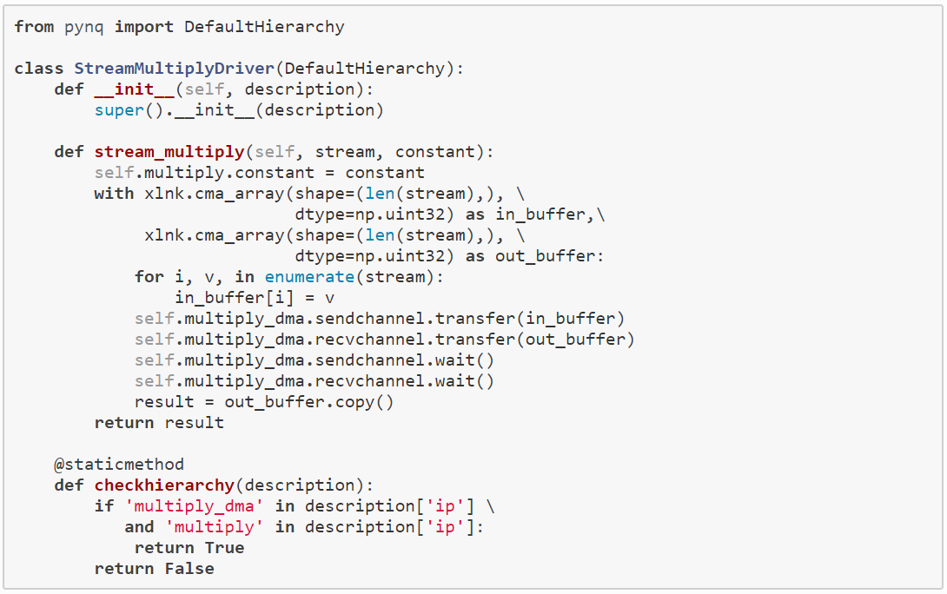
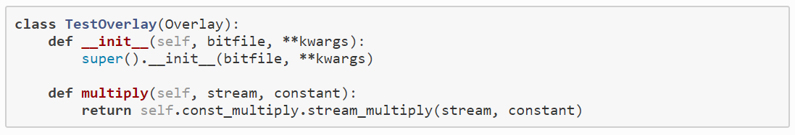
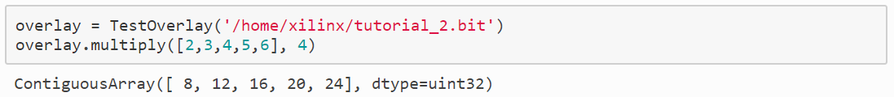
Step 4: Import as new Overlay
Create drivers for mult_constant
Creating a custom overlay
Call mult_constant Overlay
Notes:
步骤4：导入新的overlay
创建Multy常数的驱动程序
创建自定义overlap
调用mult_constant Overlay

Slide 23
Summary
Overlay design methodology
Build custom Overlay
Labs
Developing a single IP
Creating a python-driver
Creating a custom overlay

Slide 24
Questions?

