Slide 1

Binarized Neural Network

Slide 2
Agenda
Why use Zynq for DL Inference
Labs:
MNIST
Char Recognition
Cifar 10
Road Signs

Slide 3
Why use Zynq for DL Inference

Slide 4




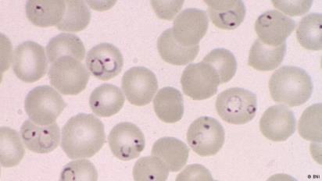









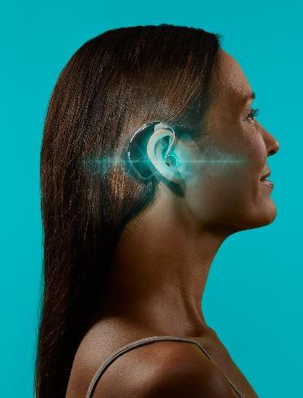








Diverse Applications with Diverse Design Targets
Translate & AlphaGo: Huge networks
Medical
Diagnosis:
Robotics: Real-time
Small networks
ADAS
High accuracy
Low latency
Hearing Aids: Small network Low latency

Slide 5





Zynq SoCs Offer Superior Throughput, Latency
6x
Images/sec/watt
1/5
Latency (ms)
GoogLeNet @ batch = 1 |  | Xilinx ZU9 | Xilinx ZU5 | eGPU*
 | Images/s | 370.0 | 155.0 | 70
 | Power (W) | 7.0 | 4.5 | 7.9
 | Images/s/watt | 53.0 | 34.5 | 8.9
Machine Learning Inference
Real Time Applications Latency
GoogLeNet @ batch = 1 |  | Xilinx ZU9 | Xilinx ZU5 | eGPU*
 | Images/s | 370.0 | 155.0 | 70
 | Latency (ms) | 2.7 | 6.4 | 14.2
GoogLeNet @ batch = 8 |  | Xilinx ZU9 | Xilinx ZU5 | eGPU*
 | Images/s | 370.0 | 155.0 | 163
 | Latency (ms) | 2.7 | 6.4 | 49.0
Xilinx Benchmark
Xilinx Benchmark
For large batch, CPU/GPU/DSPs latency increases significantly
eGPU = nVidia TX1: nVidia GoogLeNet performance: https://devblogs.nvidia.com/parallelforall/jetpack-doubles-jetson-tx1-deep-learning-inference/
Notes:
ZYNQ SoC提供优越的吞吐量、延迟时间

Slide 6
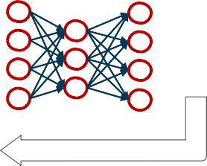

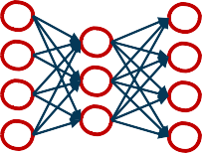

The Divergence of Training and Inference
Training: Process for machine to
“learn” and optimize model from data
Inference: Using trained models to predict/estimate outcomes from new observations in efficient deployments
Inference now 8 bit and below for maximum efficiency
TRAINING
Input
labels
”cat”
= ?
“dog”
Many
Error
Input
INFERENCE
“dog” ✓
Fewer
Top-5 Accuracy | FP-32 | FIXED-16 (INT16) | FIXED-8 (INT8) | Difference vs FP32
VGG-16 | 86.6% | 86.6% | 86.4% | (0.2%)
GoogLeNet | 88.6% | 88.5% | 85.7% | (2.9%)
SqueezeNet | 81.4% | 81.4% | 80.3% | (1.1%)
https://arxiv.org/pdf/1510.00149v5.pdf
Notes:
训练与推理的分歧
训：机器的过程
从数据中“学习”和优化模型
推理：使用训练模型来预测/估计有效部署中的新观测结果
现在推断8位以下为最大效率

Slide 7
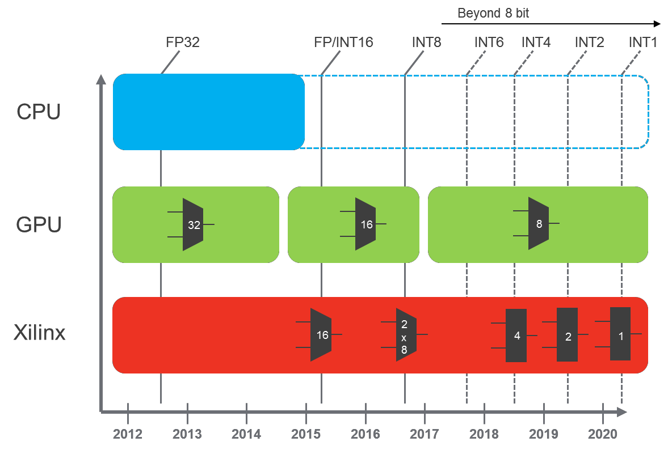
Future Proof Architecture for Any Precisions
Limited to 32 bit operations
SIMD operations at INT8/16
New devices required to
support change in precision efficiently
Reconfigurable to scale and optimize for different precisions
Notes:
未来证明体系结构
任何精度

Slide 8
BNN

Slide 9





































BNN: Unparalleled Performance
Reducing precision from 8b to 1b shrinks LUT cost by 40x
Potential to scale CNN performance to above 23TOPS (ZU9)
TOPS
8b
1b 1b 1b
1b 1b 1b
1b 1b
1b 1b
1b 1b
1b 1b
1b 1b
1b 1b
1b 1b
1b 1b
1b
1b 1b
1b 1b 1b
1b
1b 1b
1b 1b 1b
1b
1b 1b
1b 1b 1b
1b
1b 1b
1b
1b 1b
1b
1b 1b
1b 1b 1b
1b
1b 1b
1b 1b 1b
1b
1b 1b
1b 1b 1b
2.7
1b 1b 1b 1b 1b 1b 1b 1b
Assuming 300 MHz with 90%/70% DSP/LUT utilizations
Resource consumption assumption: 2.5 LUTs/op (INT1), 16 LUTs/op (INT4), 0.25 DSP/op (INT8)
1.5
0.3
TX2 Q3 ZU9
Notes:
降低精度从8B到1B减少LUT成本40X
将美国有线电视新闻网业绩提升到23以上的潜力（ZU9）

Slide 10






BNN: Unparalleled Performance
Reducing precision from 8b to 1b shrinks LUT cost by 40x
Potential to scale CNN performance to above 23TOPS (ZU9)
S
TOPS
8b
TOP
1b
1b 1b 1b
1b 1b 1b
1b 1b
1b 1b
1b 1b
1b 1b
1b 1b
1b 1b
1b 1b
1b 1b
1b
1b 1b
1b 1b 1b
1b
1b 1b
1b 1b 1b
1b
1b 1b
1b 1b 1b
1b
1b 1b
1b
1b 1b
1b
1b 1b
1b 1b 1b
1b
1b 1b
1b 1b 1b
1b
1b 1b
1b 1b 1b
2.7
1b 1b 1b 1b 1b 1b 1b 1b
Assuming 300 MHz with 90%/70% DSP/LUT utilizations
Resource consumption assumption: 2.5 LUTs/op (INT1), 16 LUTs/op (INT4), 0.25 DSP/op (INT8)
1.5
1.5
TX2
0.3
23
ZU9
0.3
Q3
TX2 Q3 ZU9

Slide 11







BNN: Unparalleled Performance
att
Reducing precision from 8b to 1b shrinks LUT cost by 40x
Potential to scale CNN performance to above 23TOPS (ZU9)
GOPS/W
S
1b 1b 1b
1b 1b 1b
1b 1b
1b 1b
1b 1b
1b 1b
1b 1b
1b 1b
1b 1b
1b 1b
1b
1b 1b
1b 1b 1b
1b
1b 1b
1b 1b 1b
1b
1b 1b
1b 1b 1b
1b
1b 1b
1b
1b 1b
1b
1b 1b
1b 1b 1b
1b
1b 1b
1b 1b 1b
1b
1b 1b
1b 1b 1b
2.7
102
(8b)
177 (8b)
2300 (1b)
1b 1b 1b 1b 1b 1b 1b 1b
Assuming 300 MHz with 90%/70% DSP/LUT utilizations
Resource consumption assumption: 2.5 LUTs/op (INT1), 16 LUTs/op (INT4), 0.25 DSP/op (INT8)
1.5
1.5
TX2
0.3
23
ZU9
Q3
0.3
Q3
ZU9
TX2
TX2 Q3 ZU9

Slide 12
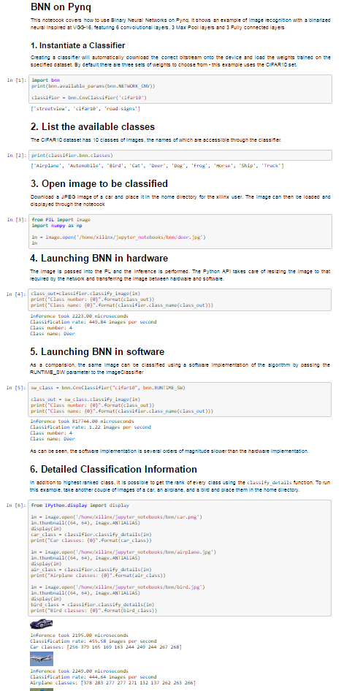
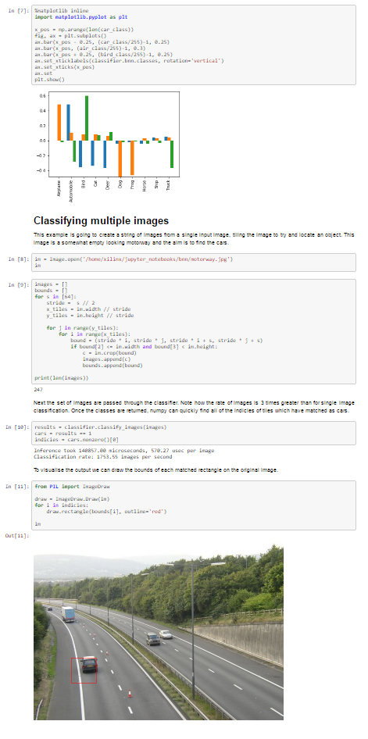
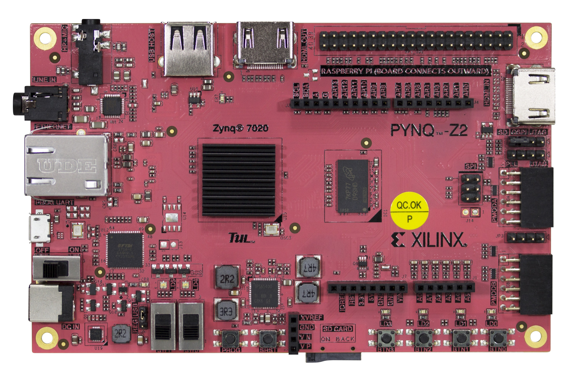
PYNQ BNN overlays
 | Z7020 ARM FPS (software only) | Raspberry Pi3 FPS
LFC | 17.3 | 44.3
CNV | 1.2 | 2.3
Unprecedented classification rates <2.5W
Z7020 | FPS (FPGA) | GOPS/s | BRAM | LUT | Latency [us]
LFC | 168k | 974 | 112 (80%) | 30.6K (57.6%) | 102
CNV | 1.7k | 190 | 116 (82.9%) | 30.0K (56.4%) | 2200
Ultra-low latency for robotics, AR, UAVs
FINN: A Framework for Fast, Scalable Binarized Neural Network Inference; Xilinx labs, NTNU, University Sidney, FPGA 2017
https://arxiv.org/pdf/1612.07119.pdf
Notes:
前所未有的分类率<2.5W
Ultra-low latency for robotics, AR, UAVs
机器人、AR、无人机的超低潜伏期

Slide 13
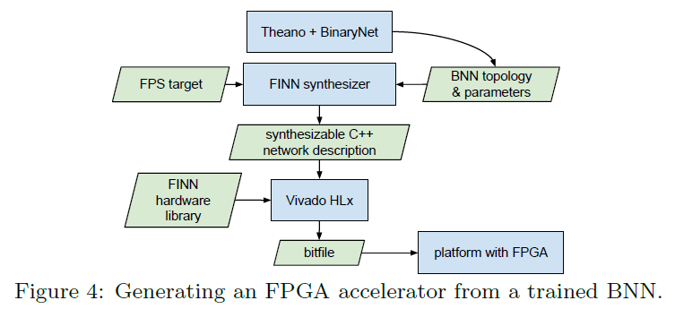
PYNQ BNN demo
LFC
three-layer fully connected network
MNIST(98.4%)
Char Recognition
CNV
inspired by BinaryNet and VGG-16
Cifar 10(80.1%)
SVHN(94.9%)
Road Signs

Slide 14
Summary
Why use Zynq for DL Inference
PYNQ-BNN
Labs：
MNIST
Char Recognition
Cifar 10
Road Signs

Slide 15
Questions?

