Slide 1
Working With Street Addresses
Brian Long
Twitter: @brianlong
GitHub: brianlong
Skype: brian.long.co
LinkedIn: http://www.linkedin.com/in/brianklong
Notes:
Hi, my name is Brian Long and the title of my talk today is “Working With Street Addresses” You can also find me at any of these popular hangouts.
My company crawls the web reading real estate advertisements. We process millions of street addresses each year.

Slide 2
Common Problems
123 Main St S, Schenectady, NY 12345
123 Main Street S, Schenectady, NY
123 Main St South, Schenectady, NY 12345
123 Main Street South, Schenectady, NY 12345
123 Main St S, Schenectady, NY 12345
123 Main St S, Skanecktidy, NY 12346
Notes:
When processing and analyzing datasets with street addresses, we often see messy data like this. All of these entries are referring to the same address. However, the data formatting is inconsistent or has typographical errors. This inconsistency leads to problems with sorting, grouping, and searching.
One way to deal with this problem is to write your own code to standardize the addresses and hope that your sorting, grouping, and searching works out OK. It rarely does. Groan if you have tried this before.
Don’t’ worry, there is another way to work with street addresses that makes sorting, grouping, and searching quite easy. That story starts with this guy…

Slide 3

Cliff Clavin
http://en.wikipedia.org/wiki/Cliff_Clavin
Notes:
Most of us know Cliff. He is a great mail man, but he is no computer scientist. He doesn’t know about depth-first searches, breadth-first searches, or shortest-path algorithms. Although he can always find the shortest path to his next beer.
Somehow, he delivers the mail reliably every day. Fortunately, Cliff does work with some computer scientists and they help Cliff with this…

Slide 4

Postal Barcode
ZIP Code
+4 Code
Delivery Point Code
http://en.wikipedia.org/wiki/ZIP_code, http://en.wikipedia.org/wiki/POSTNET
Notes:
A postal bar code appears on every piece of mail delivered in the US.
Mr. ZIP promoted the use of ZIP codes for the USPS during the 1960s and 1970s. The ZIP code was introduced in the US in 1963 and the ZIP +4 was introduced in the 1980s.
The POSTNET bar code shown here is an 11 digit barcode, containing the ZIP Code, ZIP+4 Code, and the delivery point code. Versions of this bar code have been used for decades. There is also a new Intelligent Mail Bar Code that contains additional information about the mailer and the mail piece.
It is the information contained in the bar code that helps Cliff deliver the mail. It is also key to understand the bar code to efficiently analyze and process street addresses.
Let’s look at how Zip Codes work…

Slide 5
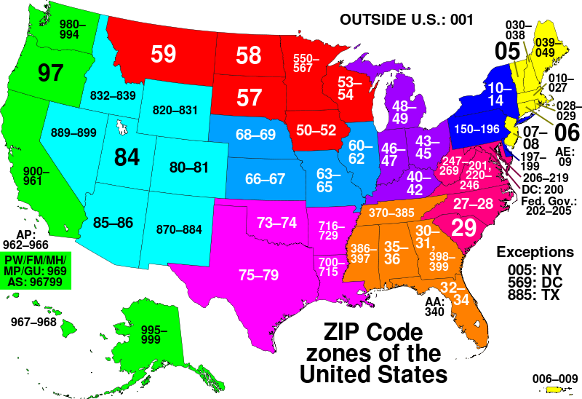
Zip Code Zones
Notes:
The US is split into zip code zones and these zones form the first 2 or 3 digits of a zip code. Here we can see that Colorado zip codes all start with 80 or 81.
The first 3 digits refer to a Sectional Control Facility (SCF) which will be contained within a zip code zone.

Slide 6
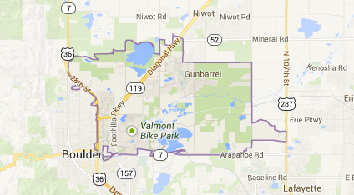
80301
Notes:
And here is a map showing an individual ZIP code in Boulder. You can see that CU has been excluded from 80301. CU has its own zip codes.

Slide 7
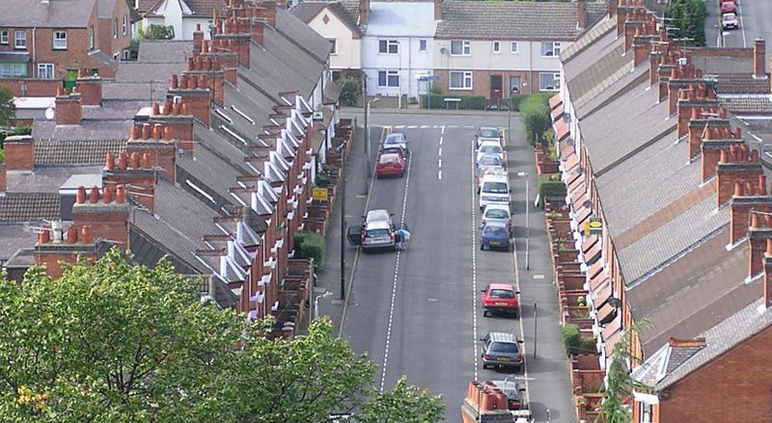
ZIP+4
http://en.wikipedia.org/wiki/Terraced_house
Notes:
Zip+4 codes were assigned in the 1980s. Within a ZIP code, the USPS has assign a ZIP+4 code to small sections within the ZIP code. Typically, a +4 code is assigned to each side of the street on a particular block. So, in this photo, the homes on the left would share a 9-digit zip and the homes on the right would share a different 9-digit zip. There can be thousands of +4 codes within a single zip code.

Slide 8
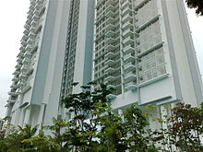
Highrise +4
http://en.wikipedia.org/wiki/Condominium
Notes:
In highrise buildings, the USPS may assign different +4 codes for each floor. So, the residents on a given floor will usually share the same 9-digit zip code.

Slide 9
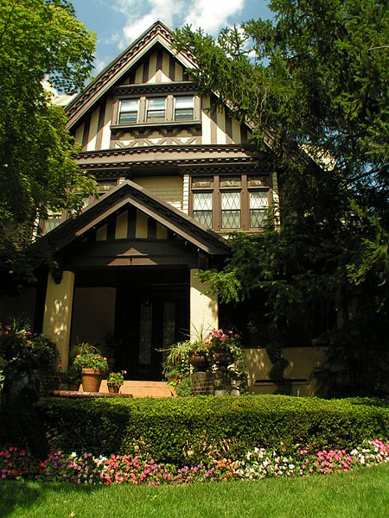
Delivery Point
http://en.wikipedia.org/wiki/Single_family_house
Notes:
Finally, to complete the bar code, the USPS will add the last two digits of the house number to the Zip+4 code for a total of eleven digits. If this is 123 Main Street, the delivery point code will be ‘23’.
In a highrise building, the two digit delivery point code will be the same for all delivery points in the building and unit number is required for final delivery.
The USPS also includes a check digit of the sum modulo 10 of the bar code digits. This check digit is not important for our story.

Slide 10
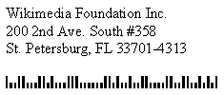
Final Delivery
33701-4313-00
UNIT-358
Notes:
Ignoring the check digit, here is the full delivery point bar code for Wikipedia. 33701 is the ZIP code, 4313 is the +4 code, and 00 is the delivery point code.
Since this is a highrise, we then add the unit information to complete the final walk sequence.
Thinking back to our friend Cliff Clavin, this is how he can deliver the mail so reliably. Every day, his mail is sorted into a walk sequence based on these codes. All he needs to do is follow the addresses in the order they are sorted in his stack of mail.
I previously mentioned that it was key to understand the bar code when working with street addresses. Well it turns out that this is a …

Slide 11
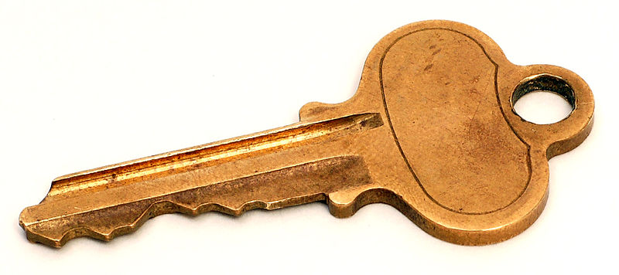
Unique Key
33701431300UNIT358
Notes:
Unique Key that we can use to create indexes for sorting, grouping, and search operations. Every deliverable address in the country has a unique code for sorting and delivering the mail.
Doesn’t it seem easier to work with this string sequence than the mish-mash of street addresses that we saw in the first slide?
In my systems, I create an indexed database column for this key and use it for all of our sorting, grouping, and matching operations. It is an extremely fast and accurate way to process street addresses.
The last thing to talk about is how we get the information required to create the key.

Slide 12

Data Hygiene
Use 3rd Party Software to cleanup addresses:
1 Microwsoft Weigh, Redmund, WA => 1 Microsoft Way, Redmond, WA 98052-8300
Coding Accuracy Support Software (CASS)
A list of CASS certified software vendors can be obtained from the USPS or by searching online.
http://ribbs.usps.gov/files/vendors/cassn01d.TXT
Notes:
Before processing data, use 3rd party data hygiene software to standardize the address.
For example, this incorrect address for Microsoft will be returned in the proper, standardized, format. The bar code data will be included too.
The USPS certifies software vendors who create software that can clean up your data and provide all the bar code elements. The software is referred to as CASS certified or just CASS for short. You can find a list of CASS software providers from the USPS or by searching online.
After this step, you then import the standardized data into your database and build your indexes.

Slide 13
Summary
Use third party CASS software for data hygiene.
Include standardized data & bar code elements in your dataset.
Create an indexed key using the bar code data.
Presentation & notes at https://github.com/brianlong/street_address
I will offer free CASS service for open data projects.
Notes:
Use third party CASS software for data hygiene.
Include the standardized address data & bar code elements in your dataset.
Create an indexed key using the bar code data.
See my GitHub account for this presentation and some miscellaneous Ruby code that may help you with your next project.
Also, I am willing to offer free CASS service for open data projects. I have licensed a CASS software package and can run your files for you if you are working on an open data project.

Slide 14
Questions?
What if a property doesn’t have a street address (e.g. vacant land)?
What if the address is incomplete?
Are there edge cases to be aware of?

